Slide 1
Introduction
By Elisabeth Rounis and Louise Whiteley

Slide 2
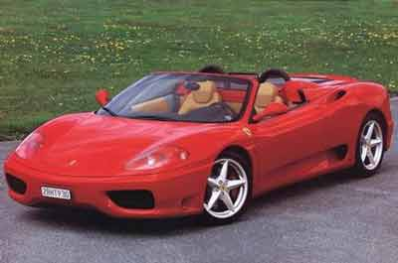
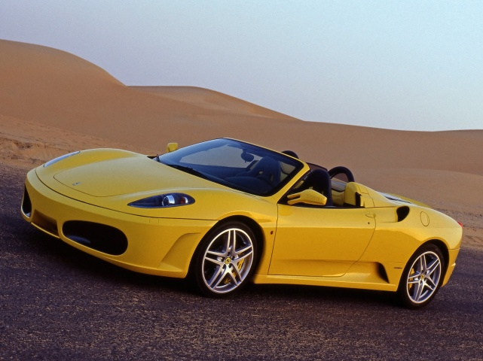
What affects a decision?
OR
?
Notes:
Cars – value
Cake v running – discounting
Nonlinear utility – have a basket of apples, do you want an apple or satsuma? (last example)
Probability of outcome – lottery v roulette wheel
Perceptual uncertainty – radiologist
Priors – radar screen
One slide each
2 eaxmples which make it concrete.
Interleave theory sldies and story slides…

Slide 3
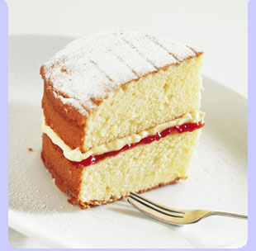
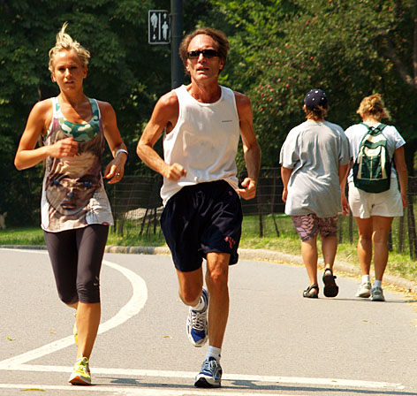
What affects a decision?
OR
?
Notes:
Cars – value
Cake v running – discounting
Nonlinear utility – have a basket of apples, do you want an apple or satsuma? (last example)
Probability of outcome – lottery v roulette wheel
Perceptual uncertainty – radiologist
Priors – radar screen
One slide each
2 eaxmples which make it concrete.
Interleave theory sldies and story slides…

Slide 4
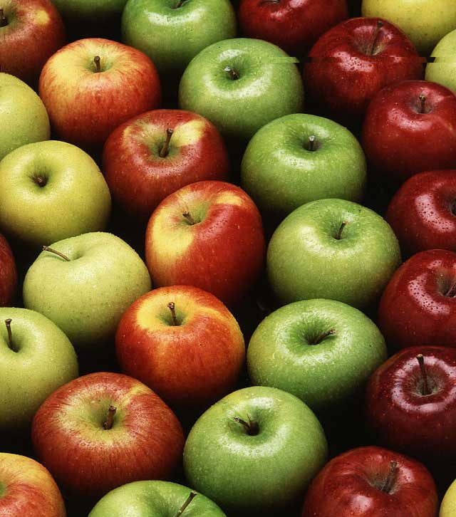
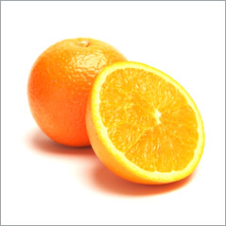
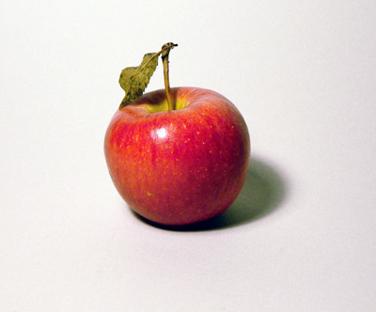
What affects a decision?
You have:
What would you rather…
OR
?
Notes:
Cars – value
Cake v running – discounting
Nonlinear utility – have a basket of apples, do you want an apple or satsuma? (last example)
Probability of outcome – lottery v roulette wheel
Perceptual uncertainty – radiologist
Priors – radar screen
One slide each
2 eaxmples which make it concrete.
Interleave theory sldies and story slides…

Slide 5

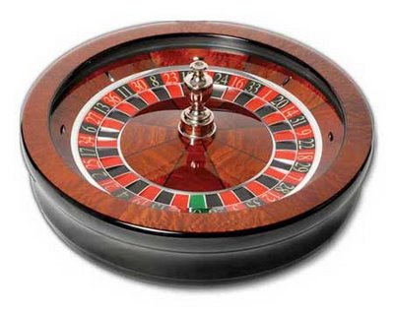
What affects a decision?
OR
Notes:
Cars – value
Cake v running – discounting
Nonlinear utility – have a basket of apples, do you want an apple or satsuma? (last example)
Probability of outcome – lottery v roulette wheel
Perceptual uncertainty – radiologist
Priors – radar screen
One slide each
2 eaxmples which make it concrete.
Interleave theory sldies and story slides…

Slide 6
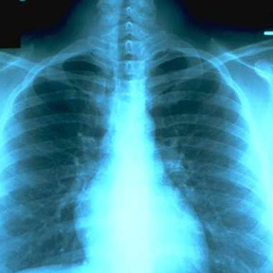
What affects a decision?
OR
Healthy? Or not?
Notes:
Cars – value
Cake v running – discounting
Nonlinear utility – have a basket of apples, do you want an apple or satsuma? (last example)
Probability of outcome – lottery v roulette wheel
Perceptual uncertainty – radiologist
Priors – radar screen
One slide each
2 eaxmples which make it concrete.
Interleave theory sldies and story slides…

Slide 7
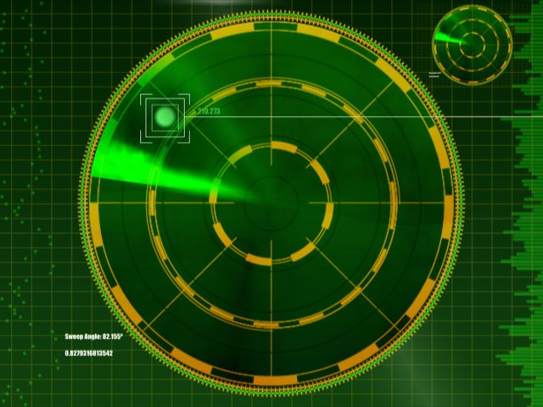
What affects a decision?
Vs.
Wartime
Peacetime
Notes:
Cars – value
Cake v running – discounting
Nonlinear utility – have a basket of apples, do you want an apple or satsuma? (last example)
Probability of outcome – lottery v roulette wheel
Perceptual uncertainty – radiologist
Priors – radar screen
One slide each
2 eaxmples which make it concrete.
Interleave theory sldies and story slides…

Slide 8

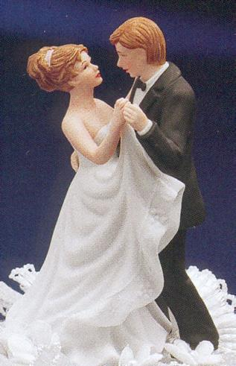
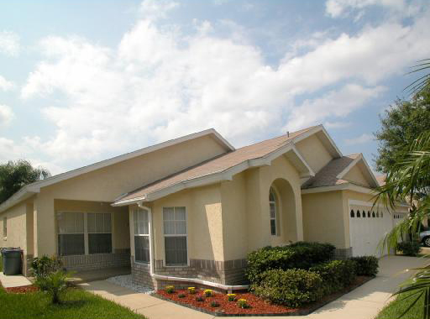
Big decisions…

Slide 9
Forming a decision
Decision
Information
Notes:
Put thumnail of decisions from intro, winning one from each pair – 6 components from the beginning
FINAL slide – shrink this spider diagram into one corner, one arrow to brain, one arrow to people

Slide 10
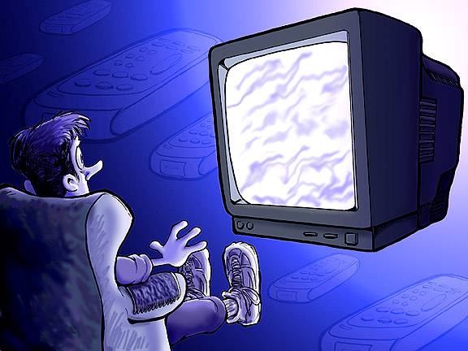
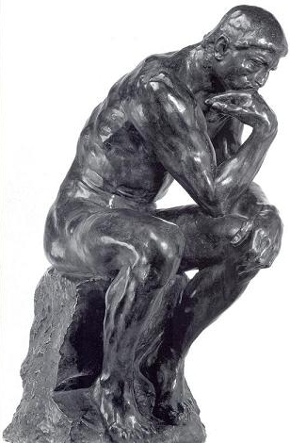

Behaviour

Slide 11
Decision

Slide 12
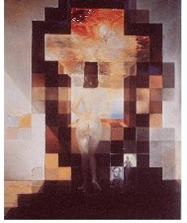
Decision

Slide 13
Behaviour

Slide 14
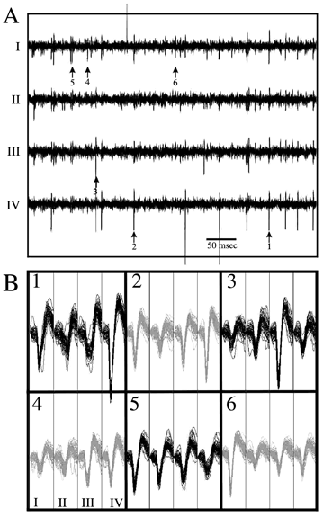
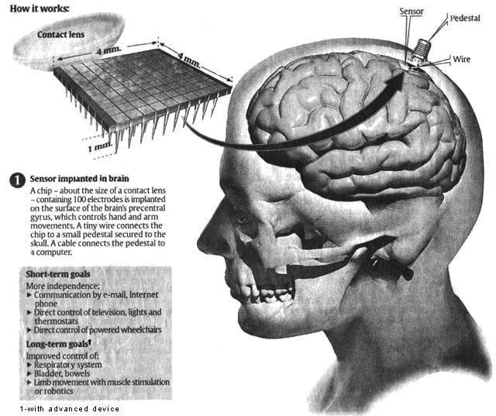
Neuronal recording

Slide 15
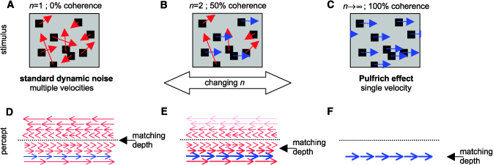
The Start: Building a perceptual decision
http://monkeybiz.stanford.edu/movies/0coh_circle.qt

Slide 16
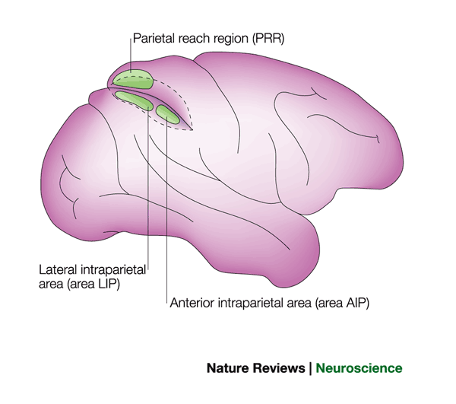

LIP
.
.
Are the dots moving left or right?

Slide 17
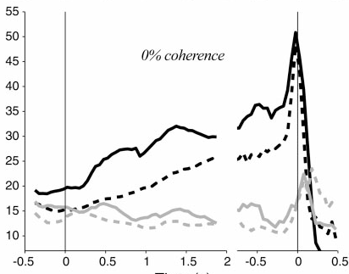
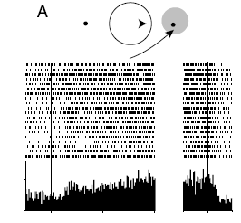
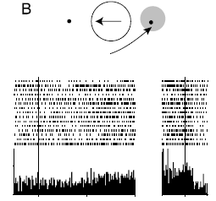

Slide 18
So what happens when we actually see something?

Slide 19
Representation of sensory evidence

Slide 20
Value
Compute V(A) and V(B)
A
Choose
B
Notes:
What kind of things involved? What affects choice? Present series of decisions, exemplars for each of the 6 key components. Ideas…
Alistair darling choosing?!

Slide 21
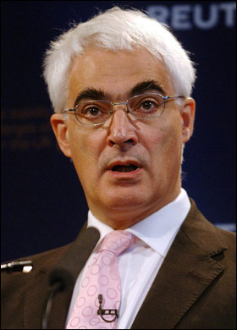
Value
V(A) > V(B), so choose A
A=£1000
B=£500
Notes:
What kind of things involved? What affects choice? Present series of decisions, exemplars for each of the 6 key components. Ideas…
Alistair darling choosing?!

Slide 22
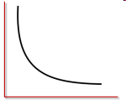
Discounting
Compute V(A) and V(B)
A
3 weeks…
Choose
Value
Now!
B
Time
Notes:
What kind of things involved? What affects choice? Present series of decisions, exemplars for each of the 6 key components. Ideas…
Alistair darling choosing?!

Slide 23
Discounting
V(B_{t=now}) > V(A_{t=3 weeks}) so choose B
A = £1000
3 weeks…
Now!
B = £500
Notes:
Put in discounting graph

Slide 24
Relative wealth
Compute V(A) and V(B) relative to your wealth now and in 3 weeks
A
3 weeks…
Utility
Choose
Value
Now!
B
Value
Time
Notes:
What kind of things involved? What affects choice? Present series of decisions, exemplars for each of the 6 key components. Ideas…
Alistair darling choosing?!

Slide 25
Relative wealth
Now, V(B_{t=now}, W_{t=now}) < V(A_{t=3 weeks}, W_{t=3 weeks}) so choose A
A = £1000
Plus pension of £1000 in 3 weeks!!
B = £500
Notes:
Put in utility graph

Slide 26
Probability
Weight V(A) and V(B) by the probability they will occur
A
x p(A)
Choose
U = p * V
B
x p(B)
Notes:
What kind of things involved? What affects choice? Present series of decisions, exemplars for each of the 6 key components. Ideas…
Alistair darling choosing?!

Slide 27
Probability
Now, V(B_{t=now}, W_{t=now})*0.9 > V(A_{t=3 weeks}, W_{t=3 weeks})*0.1 so choose B
A = £1000
Risky bet
p = 0.1
U = p * V
p = 0.9
B = £500
Safer bet
In other words… U(B_{t=now}, W_{t=now}) > U(A_{t=3 weeks}, W_{t=3 weeks}) so choose B

Slide 28
Deciding what we’re seeing
A
p = 0.1
Choose
B
p = 0.9
On balance, we think we saw B
Notes:
Replace x-ray with circle

Slide 29
Deciding what we’re seeing
Training a medical student…
Tumour
p = 0.3
Healthy
p = 0.7
p(healthy|x-ray) > p(tumour|x-ray), so thought to be healthy…
Notes:
Replace x-ray with circle

Slide 30
Priors
A
p = 0.3 x prior
Choose
B is only rarely seen, small prior belief
B
p = 0.7 x prior
Now we are not so sure…
Notes:
Replace x-ray with circle

Slide 31
Priors
Training a medical student…
Tumour
p = 0.3
Smokes 40 a day
p = 0.7
Healthy
Now, p(healthy|x-ray) * p(healthy) < p(tumour|x-ray) * p(tumour), so more likely a tumour

Slide 32
Value (again…)
A
p = 0.3 x prior x value
Choose
Detecting A is very important, detecting B is less so
B
p = 0.7 x prior x value
Better be safe than sorry – decide on “A”
Notes:
Replace x-ray with circle

Slide 33
Value (again…)
Treat
V = 100
Tumour
p = 0.3
All clear
V = -500
Smokes 40 a day
p = 0.7
Treat
V = -20
Healthy
In the real world…
All clear
V= 0
1) U(“tumour”|tumour) = p(tumour) * p(tumour|x-ray) * V(treat, tumour)
2) U(“healthy”|tumour) = p(healthy) * p(healthy|x-ray) * V(all clear, tumour)
3) U(“tumour”|healthy) = p(healthy) * p(healthy|x-ray) * V(treat, healthy)
4) U(“healthy”|healthy) = p(healthy) * p(healthy|x-ray) * V(all clear, healthy)
Then, U(“tumour”) = 1+3, U(“healthy”) = 2+4… choose which is bigger!

Slide 34
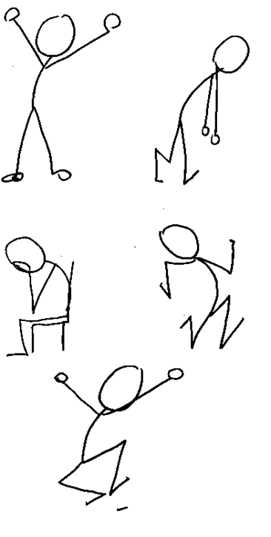
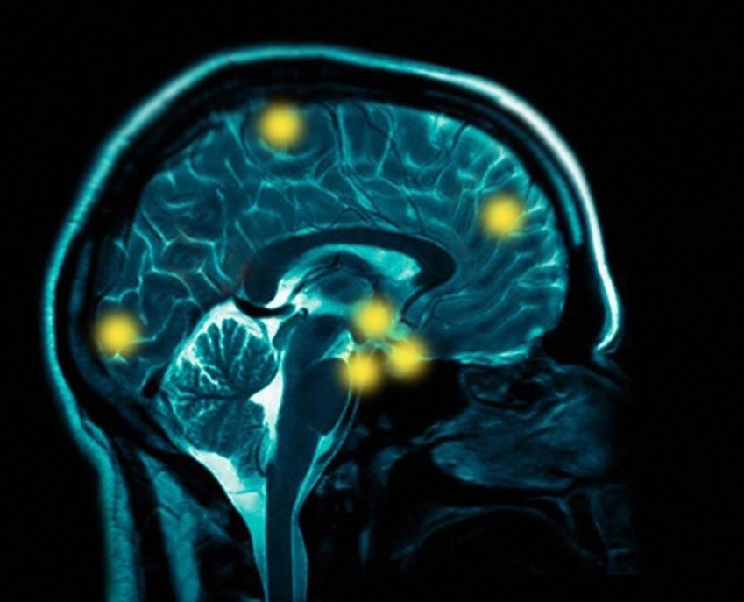
Putting it all together
Priors
Value
Decision
Perceptual
uncertainty
Discounting
Risk
Relative wealth
Notes:
Put thumnail of decisions from intro, winning one from each pair – 6 components from the beginning
FINAL slide – shrink this spider diagram into one corner, one arrow to brain, one arrow to people

Slide 35
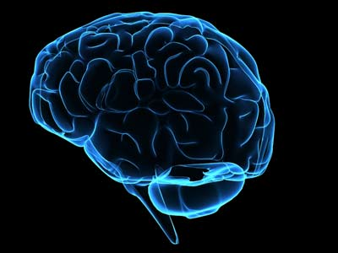
Priors
?
Value
Decision
Perceptual
uncertainty
Discounting
Risk
Relative wealth

Slide 36
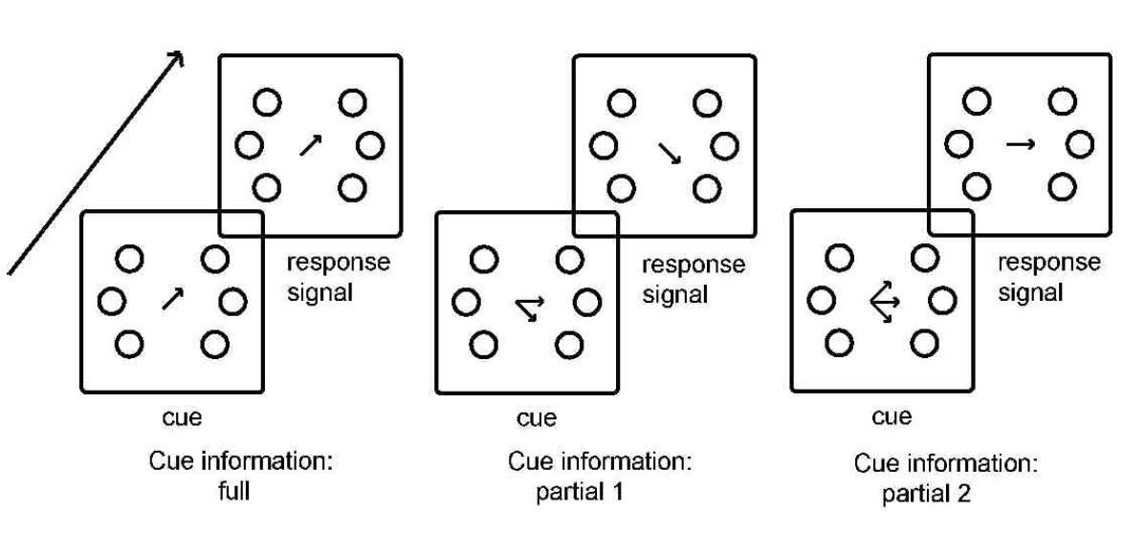
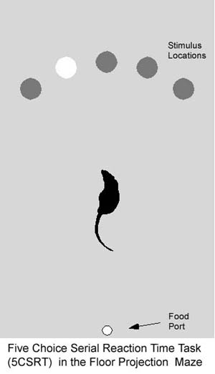
Behaviour

Slide 37
Neuronal recording

Slide 38
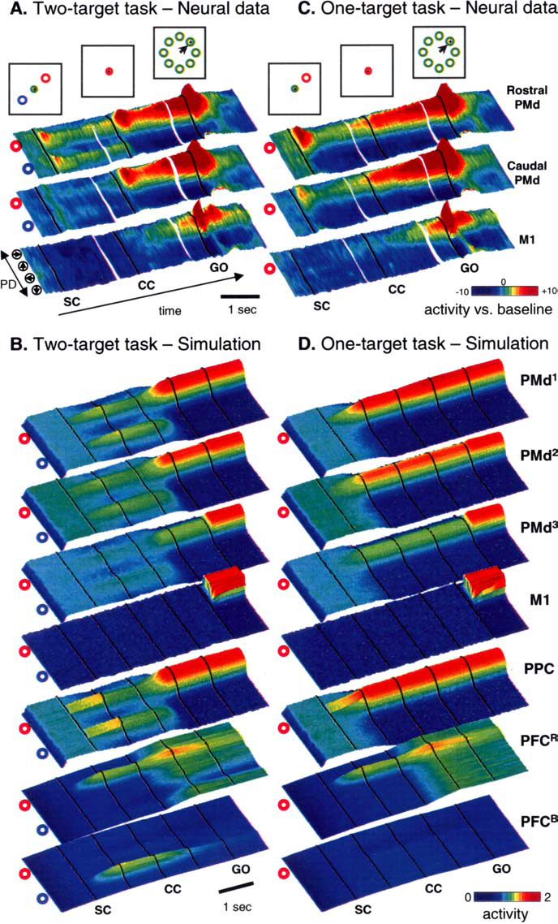

Slide 39
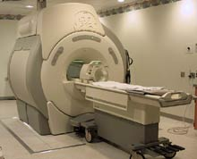
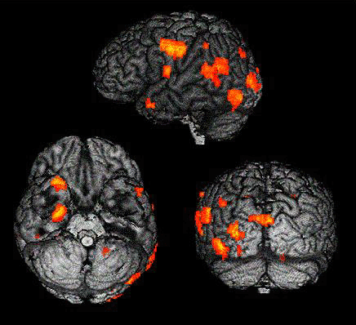
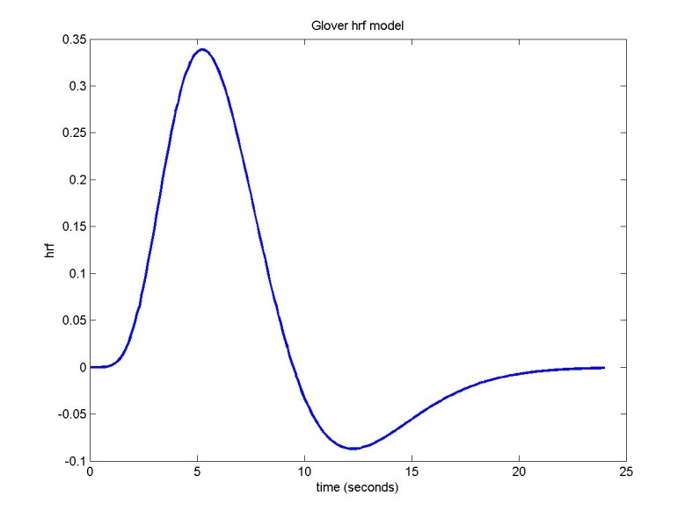
Functional Imaging

Slide 40
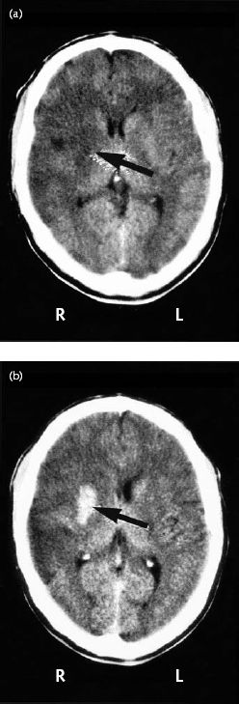
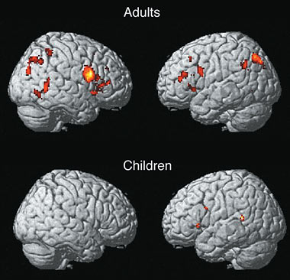
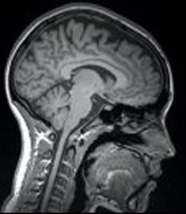
Functional vs Structural
Task-related activity
Structure ?Pathology

Slide 41
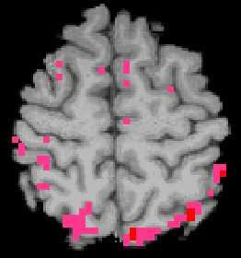
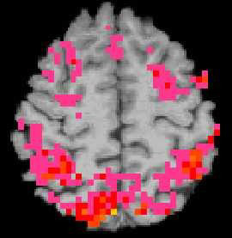
Need good hypotheses!

Slide 42
So… how is decision made in the brain???

Slide 43
An appropriate behavioural paradigm

