Slide 1
Our changing bodies:
The lessons of anthropometric history
Professor Sir Roderick Floud FBA
Provost, Gresham College

Slide 2
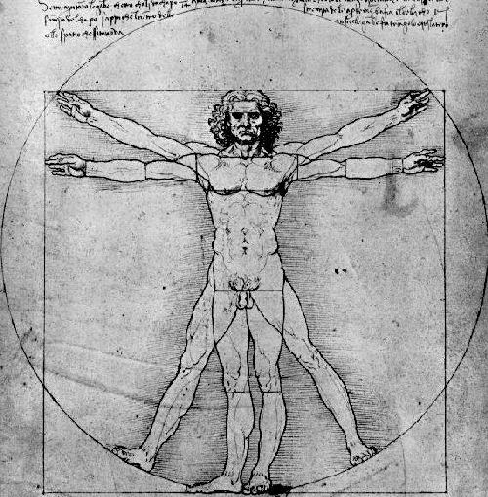
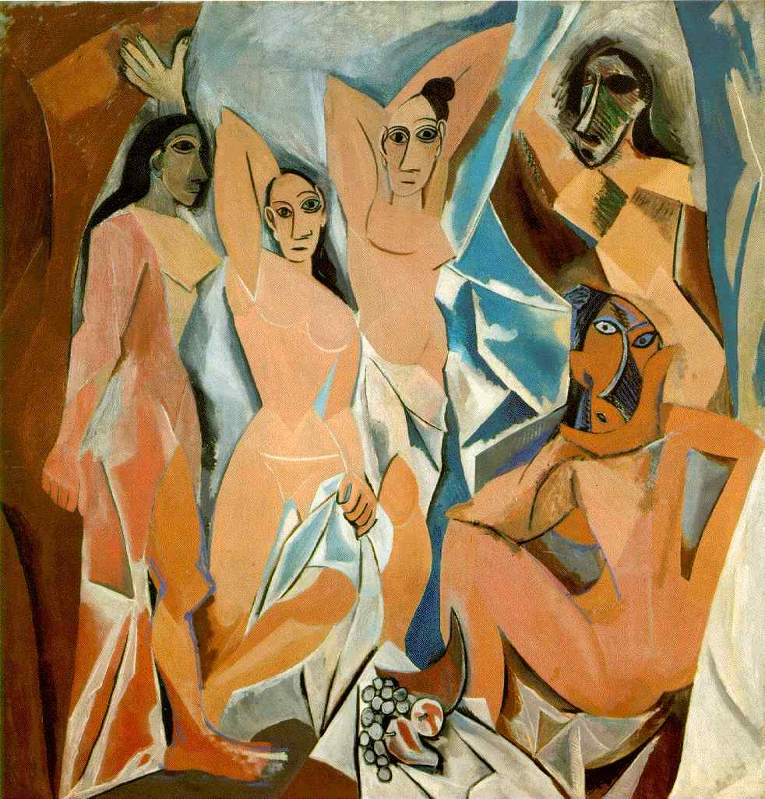
Representing our bodies – Leonardo and Picasso

Slide 3
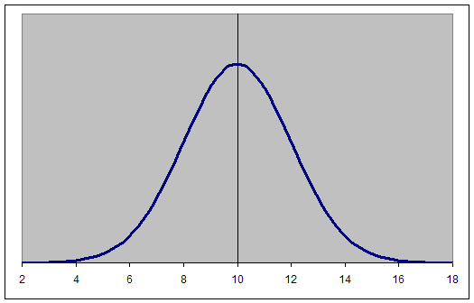
A normal distribution

Slide 4
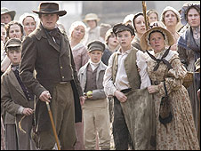
Workers in Cranford (BBC 2008)

Slide 5
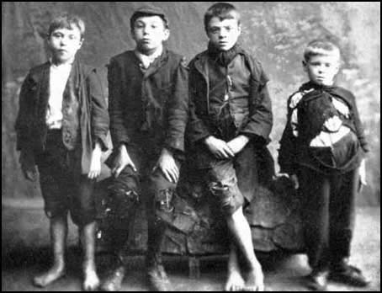
Factory children – mid 19th century

Slide 6
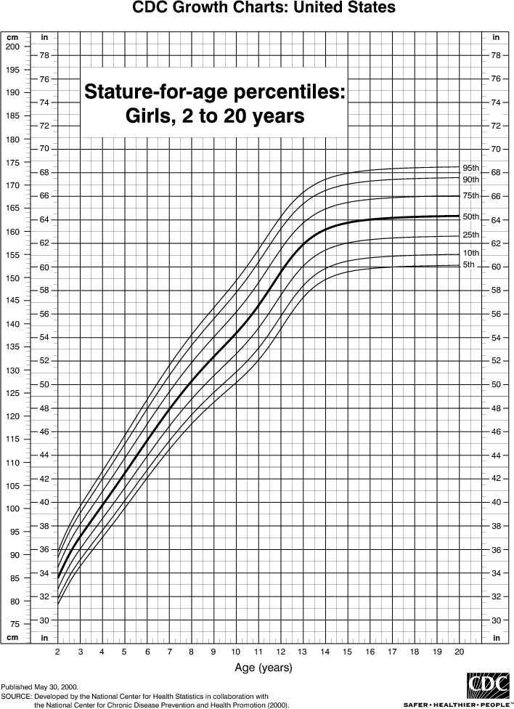
The pattern of human growth

Slide 7
Adult Male Height (cm.)
Date | UK | US | France | NL
1720-60 | 165.1 (5’5”)
1800 | 168.9 | 172.9 | 163.7 | 167.8
1850 | 165.3 | 171.1 | 164.7 | 167.4
1900 | 169.3 | 170.0 | 166.6 | 170.0
1950 | 174.1 (5’9”) | 177.1 | 172.3 | 178.1 (5’10”)
Source: Steckel and Floud 1997:424

Slide 8
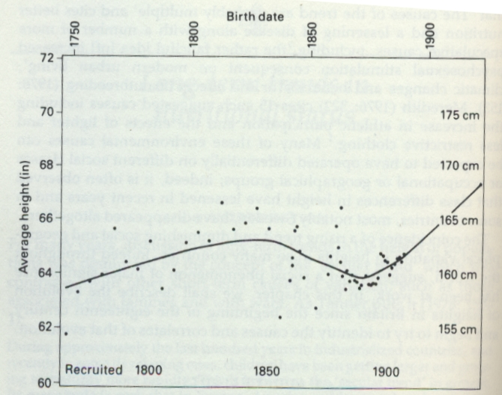
Height of British military recruits, 1750-1914

Slide 9
Body mass
Body mass index (BMI) is calculated as
Weight (in kg.) / (Height (in metres))²
A BMI of 18.5 to 25 may indicate optimal weight; a BMI lower than 18.5 suggests the person is underweight while a number above 25 may indicate the person is overweight.

Slide 10
Prevalence of chronic conditions among men aged 65 and over, USA (%)
Disorder: | 1910 Union Army veterans | 1985-1988 veterans
Musculoskeletal | 67.7 | 42.5
Digestive Hernia Diarrhoea | 84.0 34.5 31.9 | 18.0 6.6 1.4
Genitourinary | 27.3 | 8.9
Circulatory Heart Varicose veins Hemorrhoids | 90.1 76.0 38.5 44.4 | 40.0 26.6 5.3
Respiratory | 42.3 | 26.5
Source: Fogel 2004:31

Slide 11
Trends in healthy life expectancy
Life expectancy and healthy life expectancy for UK males
and females aged 65
 | Female | Female | Male | Male
Year | Life Expectancy (years) | Healthy Life Expectancy (years) | Life Expectancy (years) | Healthy Life Expectancy (years)
2000-2002 | 19.0 | 14.0 | 15.9 | 11.9
2004-2008 | 19.7 | 14.5* | 16.9 | 12.8*
Source: ONS
* = statistically significant

Slide 12
The pattern of human growth

Slide 13
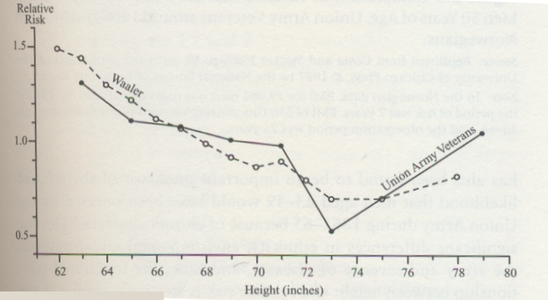
Height and mortality – modern Norway and 19th century America

Slide 14
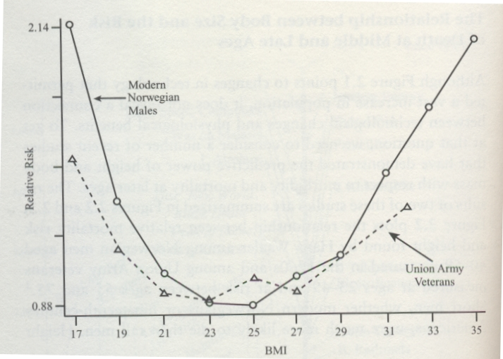
BMI and mortality – Modern Norway and 19th century America

Slide 15
Height and earnings
“For both men and women, the relationship is striking: a one-inch increase in height is associated with a 2 to 2.5 percent increase in income or earnings. An increase in US men’s heights from the 25th to the 75th percentile of the height distribution – an increase of four inches – is associated with an increase in earnings of 10% on average” (Case and Paxson: NBER WP 12466, 2006)

Slide 16
Birth-weight and cognitive ability
"Birth weight was significantly and positively associated with cognitive ability at age 8 ...
between the lowest and highest birthweight categories after sex, father's social class, mother's education and birth order was controlled for. This association was evident across the normal birthweight range (>2.5 kg) and so was not accounted for exclusively by low birth weight. The association was also observed at ages 11, 15, and 26, and weakly at age 43” (Richards et al 2001)

Slide 17
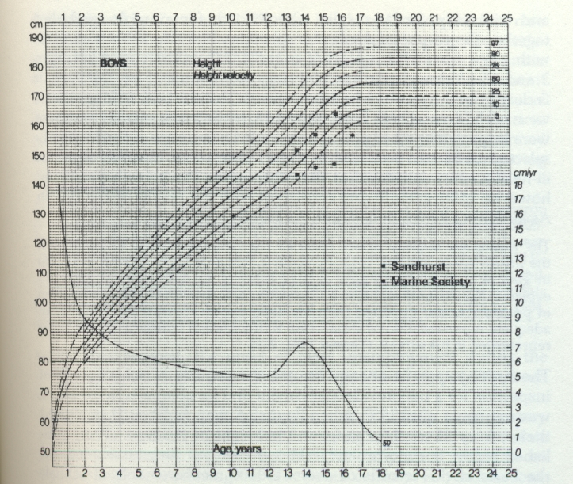
Early 19th century upper class boys and the modern standard

Slide 18
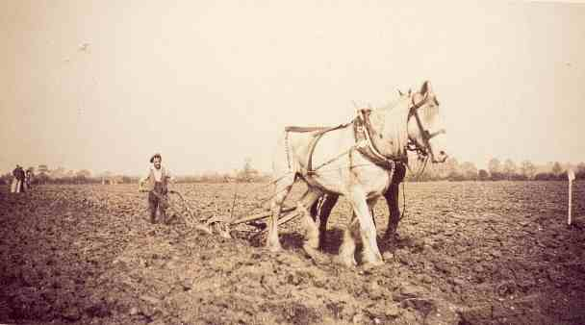
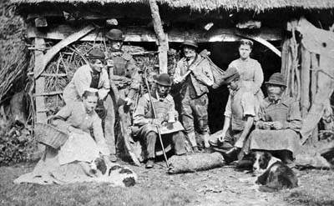
Agricultural labour in the 19th century

Slide 19

Hargreaves’ Spinning Jenny

Slide 21
UK real GDP per capita, 1801-1900
(year 2003 £)
£
Source: www.measuringworth.org

Slide 22
UK real GDP per capita, 1757-2007
(year 2003 £)
£
Source: www.measuringworth.org

Slide 23
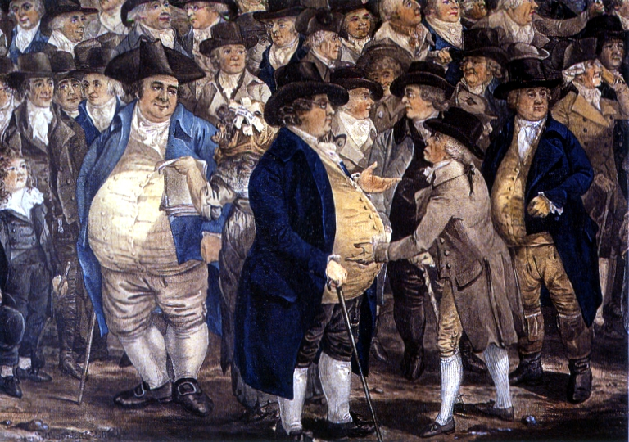
“Corpulent gentlemen” by Robert Dighton (1796)

Slide 24
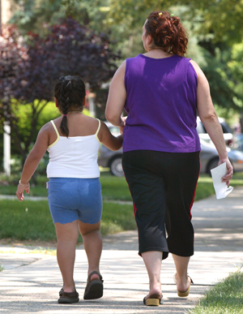
Child and adult obesity today

Slide 25
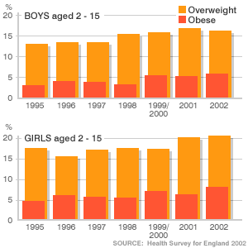
Childhood overweight and obesity in the UK

Slide 26
UK real GDP per capita, 1757-2007
(year 2003 £)
£
Source: www.measuringworth.org

