Slide 1

Standing up for fatigue – the role of autonomic function in the symptom of fatigue
Julia Newton
Dean of Clinical Medicine
Clinical Professor of Ageing and Medicine
Newcastle University
Newcastle UK

Slide 2
Outline of talk
Double act ….
What is fatigue ?
What is autonomic dysfunction ? How might it lead to fatigue ?
The role of sleep in fatigue & CFS
Recent and current work from Newcastle

Slide 3
What is CFS(ME)?
Classified by WHO in ICD-10 as a neurological disorder G93.3
Medical unexplained
  Physiologically distinct from depression
  Identifiable immunological, neurological, endocrine abnormalities that are consistent

Slide 4
What is CFS/ME?
Severe debilitating fatigue causing interference with normal functions.
Duration of at least 4 months
No evidence for other medical or psychiatric problems.
Typical history
No pointers on examination to alternative diagnoses.
Blood tests are normal

Slide 5
What is fatigue?
Fatigue is not the same as tiredness and is not relieved by sleep or rest.
It is common to a broad range of chronic medical illnesses.
Our understanding and recognition of the importance of fatigue in chronic illness is improving.

Slide 6
Newcastle Fatigue Research Centre
Liver
Neurology
Non-alcoholic
fatty
liver disease
Multiple
sclerosis
Primary Biliary
Cirrhosis
Parkinson’s
disease
Sjogrens
Mitochondrial
myopathy
Rheumatology
Assessment tools
Autonomic nervous system function
Cognitive testing
MRI modalities
Immunology
Cytokine regulation
Activity
Sleep
Transcranial doppler
Hypo-
thyroidism
Rheumatoid
arthritis
Endocrine
Measurement tools
generic
disease specific
Type 2
diabetes
SLE
Heart
failure
Pre-
dialysis
Treatment opportunities
B cell depleting
Exercise
Tilt training etc…..
Autonomic
dysfunction
Post-
dialysis
Bronchi-
ectasis
Cardiovascular
Renal
Chronic Fatigue
Syndrome
Ageing
COPD
Respiratory

Slide 7
Perceived fatigue is comparable across
chronic disease groups
Jones & Newton, QJM 2009
Notes:
7

Slide 8

Epidemiology of CFS
CFS - Prevalence of 0.2-0.4%
  Average primary care practice of 10,000 will have up to 40 patients
Estimated annual prevalence 4000 cases/million population

Slide 9
How common is Fatigue
25% of all primary care consultations are attributable to fatigue.
Main reason for attendance in 6.5% of consultations.
UK community surveys show that over 10% of adults had had substantial fatigue for over a month.

Slide 10
The cost of fatigue
In the US; fatigue occurs in 40% of workers resulting in lost productive time in 65% of these workers (26% in those without fatigue).
Workers with fatigue cost employers $136.4 billion annually, an excess of $101 billion compared with workers without fatigue.
When fatigue co-occurred with other conditions the condition specific lost productive time increased three-fold.

Slide 11
Is it a real illness?
Medically unexplained ≠ patient is mad or bad!
Almost all patients are devastated by their illness and suffer depression as a result.
Most will suffer severe hardship with loss of income, job, loss of hobbies, marital difficulties.
Difficult to conceive that the majority of patients would wish to continue in this state

Slide 12
Is it a real illness?
Scientific evidence now points to underlying physiological abnormalities.
Psychiatric symptoms are secondary.
  Anger
  Frustration
  Reactive depression and anxiety

Slide 13
Genetic predisposition
Psychosocial background
Triggering event (infection)
Dysfunctional immunological response
Chronic cytokine abnormalities
Endocrine disturbance (adrenocortical axis)
Autonomic dysfunction
POTS, postural hypotension,
abnormal muscle and skin blood flow
Mitochondrial abnormality?

Slide 14

What is autonomic dysfunction?

Slide 15
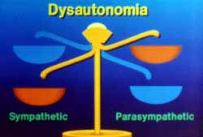

Slide 16
Symptoms of autonomic dysfunction

Slide 17

Orthostatic intolerance
CFS – 89%
NAFLD - 56% (Newton et al., CAR 2009)
PBC – 69% (Newton et al., Hepatology 2008)
In all cases fatigue severity associates with increased orthostatic intolerance.

Slide 18
CFS/ME
Chronic Disease
Dysautonomia-Associated
Fatigue (DAF)
Fatigued
Non-Fatigued
DAF Fatigue
Non-DAF Fatigue
Newton et al., QJM 2007

Slide 19
Objective autonomic abnormalities
Newton et al., Psychosom Med 2009
Newton et al., CAR 2009

Slide 20
Newton et al. Liver Int 2006
Newton et al. EJGH 2006
Newton et al. Hepatology 2006

Slide 21
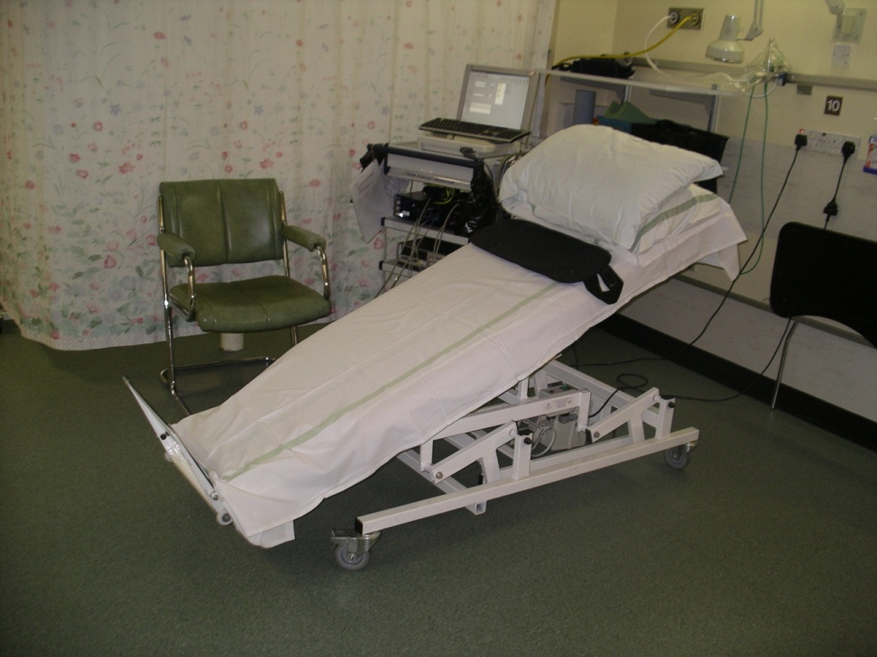
Consequences of autonomic dysfunction
Newton et al., CAR 2009

Slide 22
Those with LOC - HUT was positive in 15 (56%) which is comparable to previous studies of the predictive value of head up tilt in those with unexplained syncope.
Hollingsworth et al., EJCI 2010

Slide 23
Upstream

Slide 24
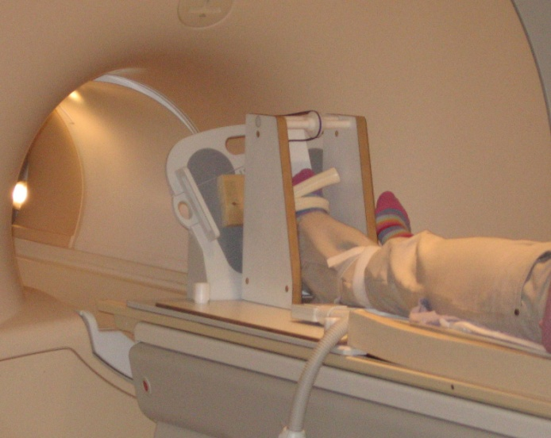
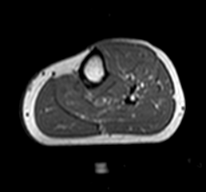

Muscle MR spectroscopy – 2 mins exercise
Jones & Newton JIM, 2009
Notes:
We recruited 15 patients who had been diagnosed with early stage PBC
8 CFS/ME patients satisfying the Fukuda clinical diagnostic criteria
8 healthy controls, age-matched to the PBC patients and CFS patients
A 3T Philips scanner was used in conjunction with a phosphorus surface coil allowing NOE and decoupling.
Baseline spectra were collected to quantify metabolite concentrations based on assumption of 8.2mM ATP
Two exercise runs were performed, one at 25% MVC

Slide 25
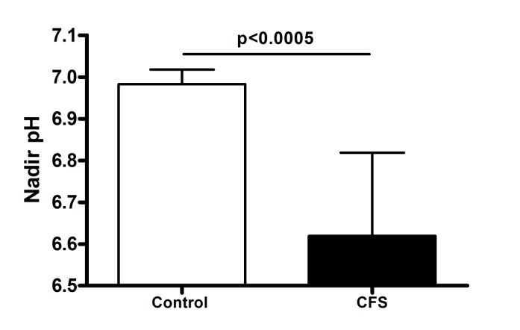
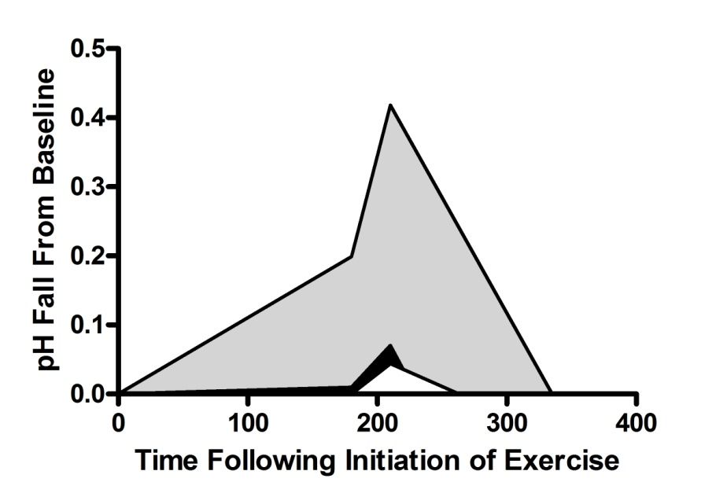
Downstream

Slide 26
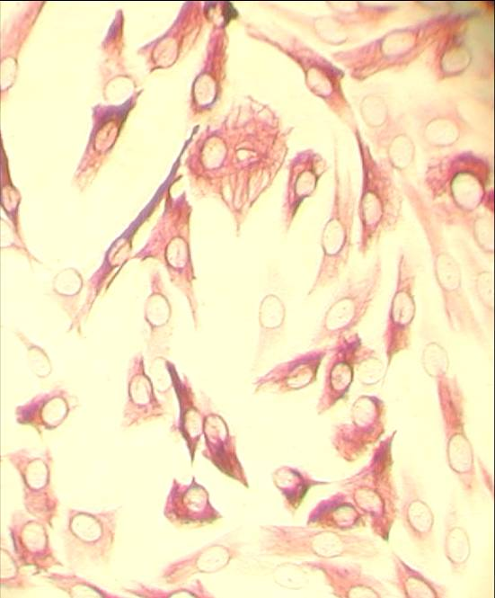
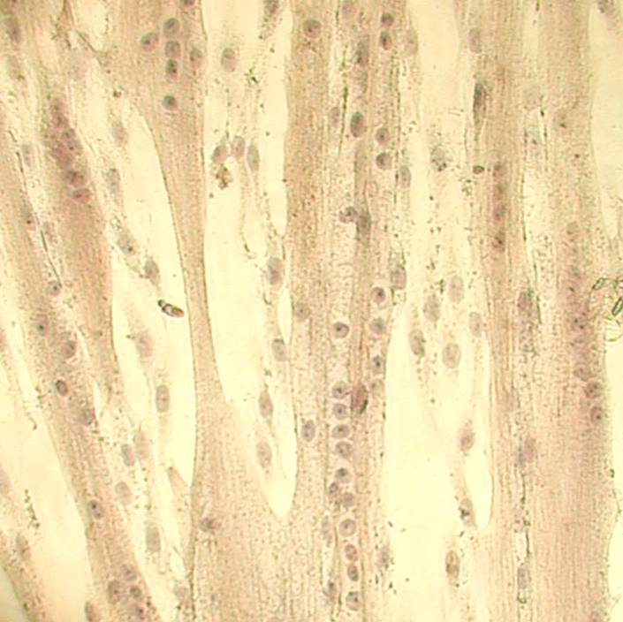
Human muscle cell cultures
Myoblast culture Day 7 myotube culture
10 biopsies obtained from chronic fatigue patients

Slide 27
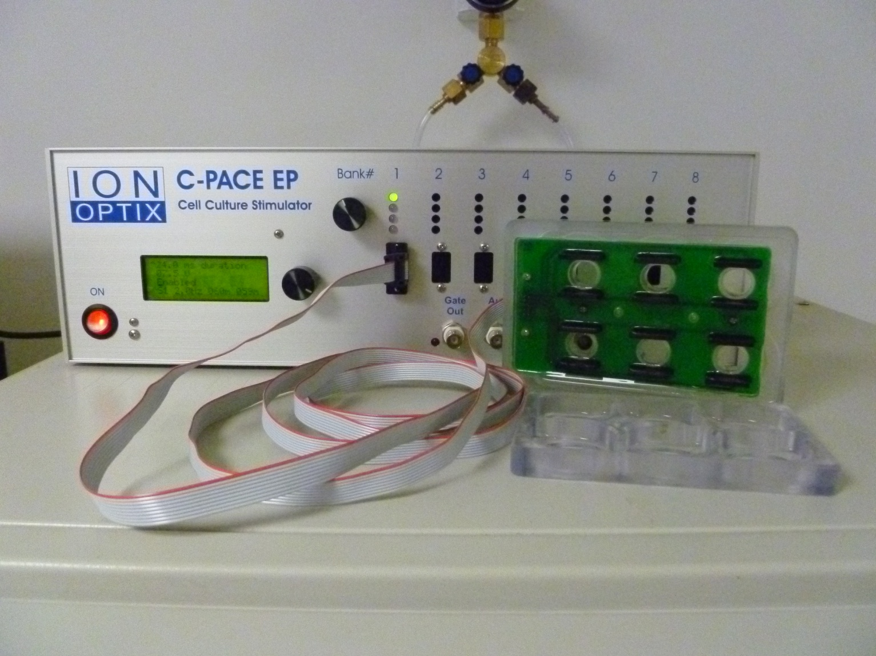
C-Pace EP

Slide 28
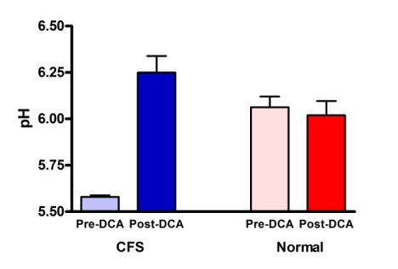
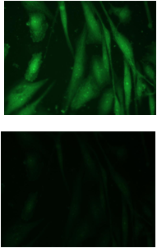
Drug development ?
Intra-cellular pH in cultured myoblasts from CFS and normal control subjects prior to and 120 minutes after treatment with dichloroacetate (DCA).

Slide 29
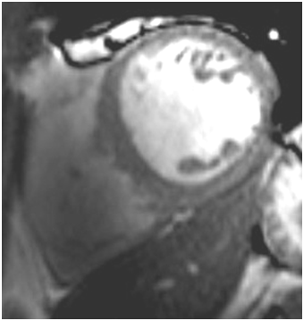
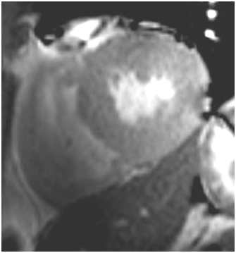
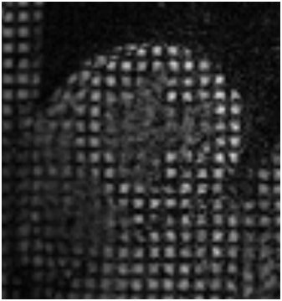
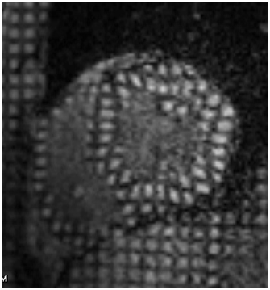
Cardiac MR
Hollingsworth et al., EJCI 2010 & JIM 2011

Slide 30
Studies from Newcastle
Confirmed autonomic abnormalities
Brain, cardiac and muscle abnormalities
Similar findings in fatigue associated chronic diseases

Slide 31
Conclusion
CFS/ME is a chronic disabling disease with a genetic background, triggered by infection and with a link to psychosocial stressors
Fatigue is a common problem that affects patients with a range of chronic diseases
There is increasing evidence of very specific physiological abnormalities
Symptoms suggestive of autonomic dysfunction are common.
Autonomic dysfunction is associated with fatigue severity and a range of other often considered to be insignificant symptoms.
There are still no curative treatments
Patients have major problems with disbelief within medical and benefits/insurance/pensions systems

Slide 32




Fatigue Work is
Supported by
Liver North
Northern CFS/ME Clinical Network
JRRG
ME Association

Slide 33



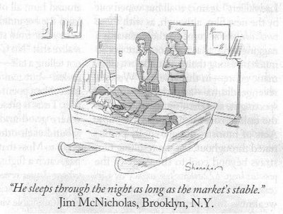
The Role of Sleep in M.E.
Professor Jason Ellis

Slide 34
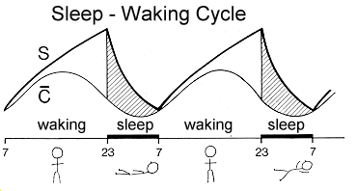
What is Sleep?

Slide 35
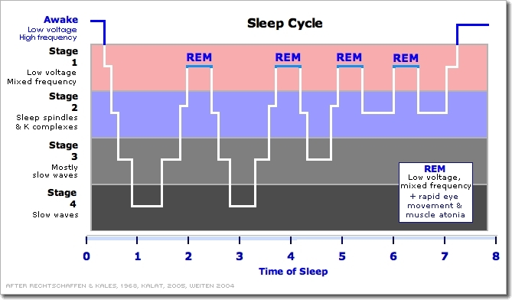
What is Normal Sleep?

Slide 36
Self-Reported Sleep
  Key Findings (n = 101):
  Huge variability in sleep characteristics across sample
  79.2 % patients napping during the day - 87.5% napping in the PM
  Daytime Napping (particularly in the afternoon) had a negative impact on patients’ daytime cognitive functioning and levels of sleepiness

Slide 37
To date there have been 32 studies which report objective sleep in patients with ME
No consistent pattern of sleep abnormality
 |  |  | Range
TST (Minutes) |  |  | 304-495
Sleep Efficiency % |  |  | 68-90
Sleep Latency |  |  | 6-69
WASO |  |  | 43-75
% Stage 1 |  |  | 4-36
% Stage 2 |  |  | 21-58
% Slow Wave |  |  | 13-42
% REM |  |  | 7-27
% Wake |  |  | 11-46
Nº Awakenings |  |  | 27-111
NoA per hour |  |  | 6
REM Latency |  |  | 63-149

Slide 38
To date there have been 32 studies which report objective sleep in patients with ME
No consistent pattern of sleep abnormality
 |  |  | Range
TST (Minutes) |  |  | 304-495
Sleep Efficiency % |  |  | 68-90
Sleep Latency |  |  | 6-69
WASO |  |  | 43-75
% Stage 1 |  |  | 4-36
% Stage 2 |  |  | 21-58
% Slow Wave |  |  | 13-42
% REM |  |  | 7-27
% Wake |  |  | 11-46
Nº Awakenings |  |  | 27-111
NoA per hour |  |  | 6
REM Latency |  |  | 63-149
All variables have ranges outside what is considered ‘normal’ sleep (in red)

Slide 39

343 First-night single PSGs performed on a sample of referrals to a fatigue service in Holland
Whole Sample (N = 343)
101 Suspected Apnoea (AHI>15)
239
Unexplained
17 Suspected PLMs (PLMI>5)
Age = 34.4 (SD 11.84)
Sex = 210 (87.9%) Female
BMI = 23.54 (SD 4.26)
AHI = 4.5 (SD 4.11)
PLM Index = 1.01 (SD 0.9)
TST = 435.22 (SD 242.65)
WAKE TIME = 85.78 (SD 64.44)
SL = 28.05 (SD 30.31)
WASO = 57.44 (SD 62.46)
SEI = 83.04 (SD 13.04)
Number of Awakenings = 11.82 (SD 8.48)
Number of Arousals per/hour = 6.64 (SD 16.01)
%N1 of TST = 15.10 (SD 11.81)
%N2 of TST = 37.74 (SD 12.60)
%N3 of TST = 32.11 (SD 13.44)
%REM of TST = 15.32 (SD 6.41)
REM Latency = 65.19 (87.35)

Slide 40
Sleep Phenotypes
Sleep Phenotype | Central Differential Features (statistical) | Associated Diagnostic Features (highest / lowest) | How this may present subjectively
1 | Long Sleep Onset Latency Long REM Latency High amounts of Slow Wave Sleep Low amounts of REM | Low amounts of Stage 2 Sleep | Problems in getting off to sleep but when asleep few awakenings. The Sleep that is obtained is of normal quality.
2 |  | High number of arousals per hour High amounts of Stage 2 Sleep | No difficulties in getting off to sleep and few awakenings but feelings or evidence of a 'restless' nights sleep
3 | High Total Sleep Time Low amounts of time awake during the night Low number of wake periods during the night | High amounts of REM Sleep Short Sleep Onset Latency Low number of Awakenings Short REM Latencies Low amounts of Stage 1 Sleep | No difficulties in getting off to sleep and few awakenings but feelings of being unrefreshed on waking despite a significant amount of time in bed asleep.
4 | Highest number of wake periods during the night Highest amounts of time awake during the night | Low Total Sleep Time Low number of arousals per hour during the night Low amounts of Slow Wave Sleep | Short sleep duration and although no difficulties getting off to sleep lots of awakenings for significant periods of time. Also increased feelings of daytime sleepiness.
REM Latency low (Groups 2 & 3)
Group 1 – Sleep Onset Insomnia?
Group 2 – Normal Sleep but Unrefreshing (pain / sensory gating)?
Group 3 – Hypersomnia?
Group 4 – Sleep Maintenance Insomnia?

Slide 41
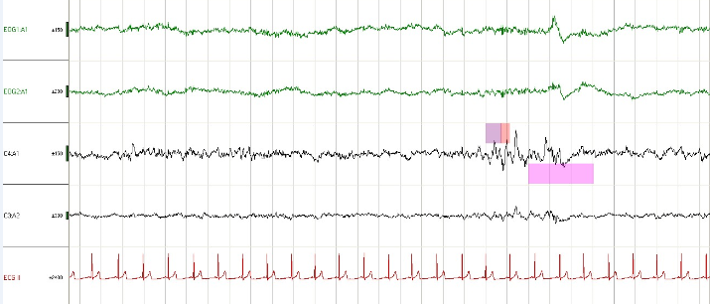
Cortical Protection in Healthy Adult

Slide 42

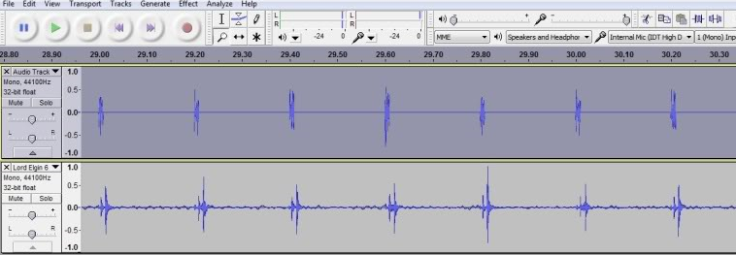
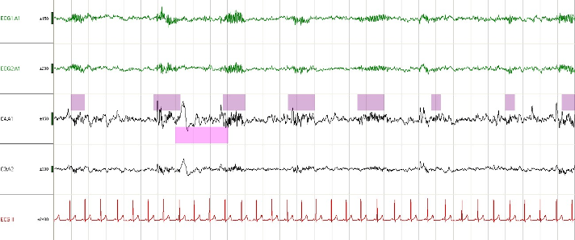

Slide 43
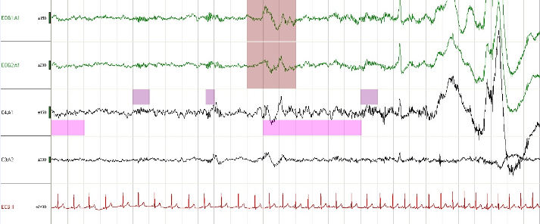
Failure and Resultant Sleep Instability

Slide 44
Theoretical Model
Onset of M.E.
Struggle to get M.E. Dx & Support
Fatigue
Cortical Arousal
Altered Immunocompetance
Autonomic Dysregulation HPA Dysfunction
Decreased SE%
Reduced SWS
Homeostatic Dysregulation
Circadian Dysregulation
Sleep Disorder

Slide 45

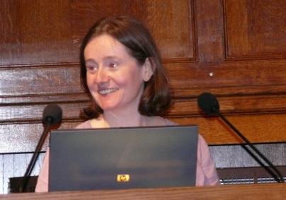












The Team
Dr. Vincent Deary
Zoe Gotts
Dr. Nicola Barclay
Dr. Mark Wetherell
Dr. Samantha Man
Dr. Naomi Hynde
Greg Elder
Rachel Sharman
Umair Akram
Collaborators
Professor Julia Newton (U Newcastle)
Dr. Michael Perlis (U Penn)
Professor Celyne Bastien (U Laval)
Dr. Phil Gehrman (U Penn)
Professor Dieter Riemann (U Freiberg)
Dr. Anne Germain (U Pitt)
Dr. Sean Drummond (UCSD)
Professor Colin Espie (U Glasgow)
Dr. Maria Gardani (U Glasgow)
Dr. Amy Thomson (U Glasgow)
Dr. Alice Gregory (U London)
Professor Annette Sterr (U Surrey)
Dr. Malcolm von Schantz (U Surrey)
Dr. Henriette Hogh (U Surrey)
And the people who fund this programme of work
Wall to Wall

