Slide 1
Launch of Cambridge Economic History

Slide 2
Percentage of UK population aged 85+,
1901-2011
Notes:
Data drawn from Annual Abstract of Statistics - Quarter 3, 2011, Chapter 15 (Population)
http://www.ons.gov.uk/ons/rel/ctu/annual-abstract-of-statistics/quarter-3-2011/art-quarter-3.html#tab-Chapter-15---Population

Slide 3
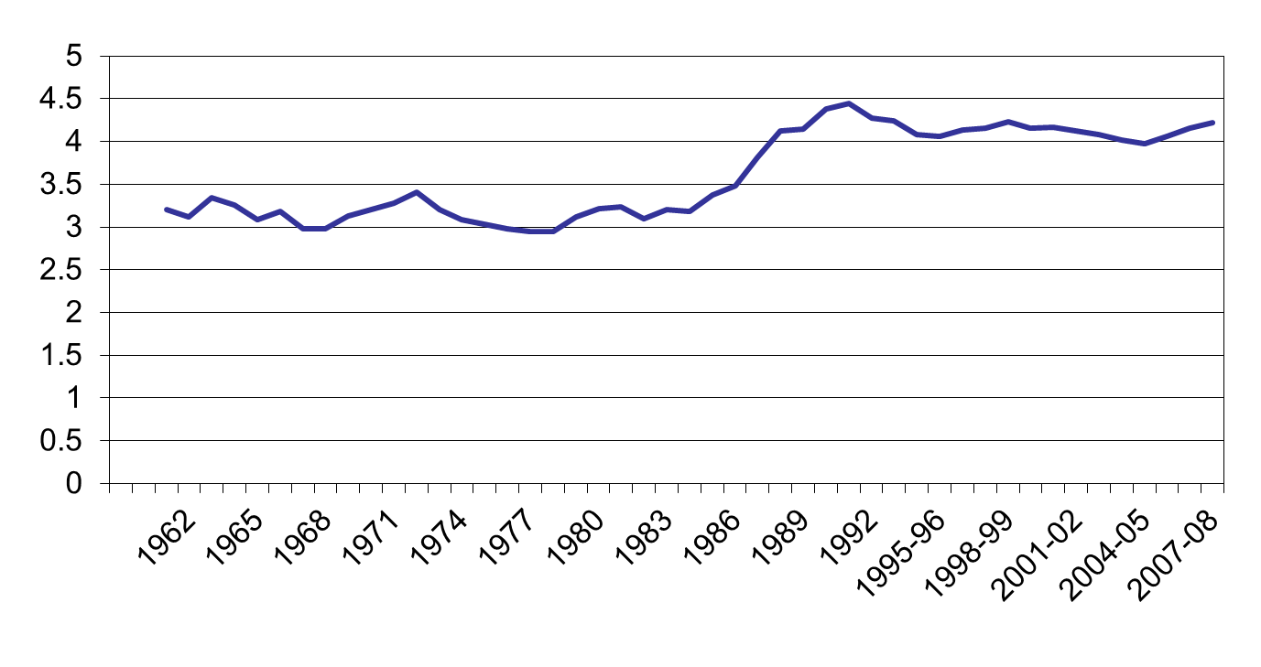
Inequality (90/10)

Slide 4
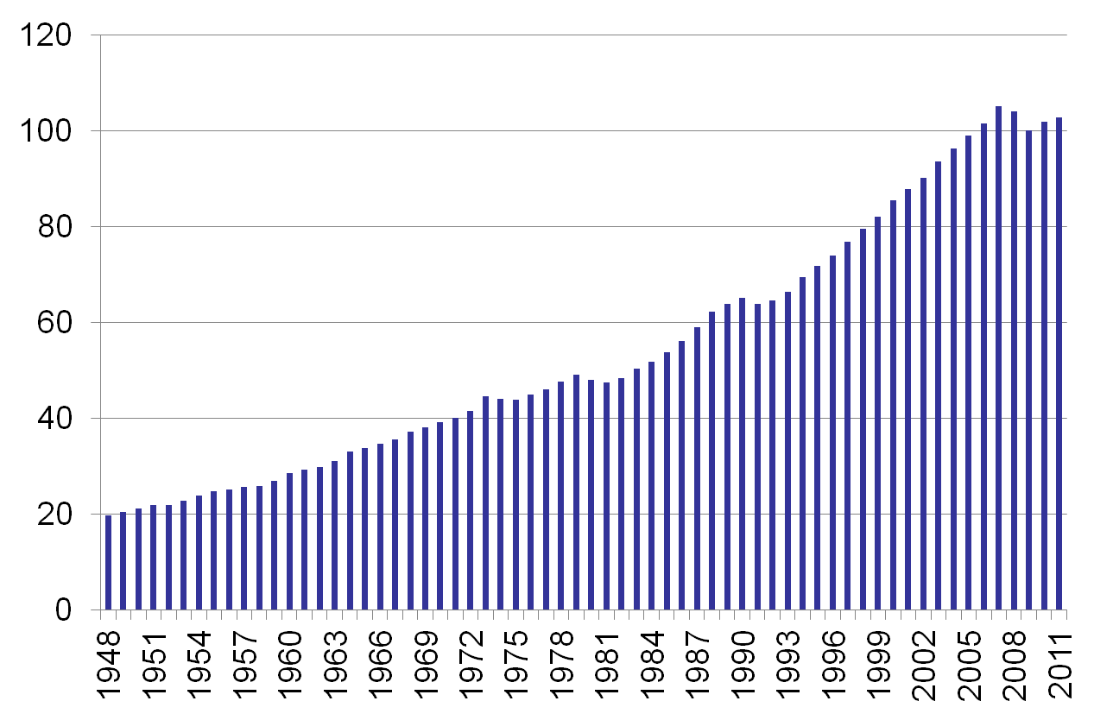
GDP 1948-2011

Slide 5
Changing spending patterns

