Slide 1
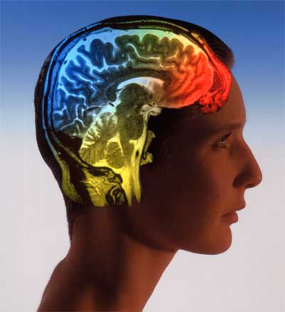
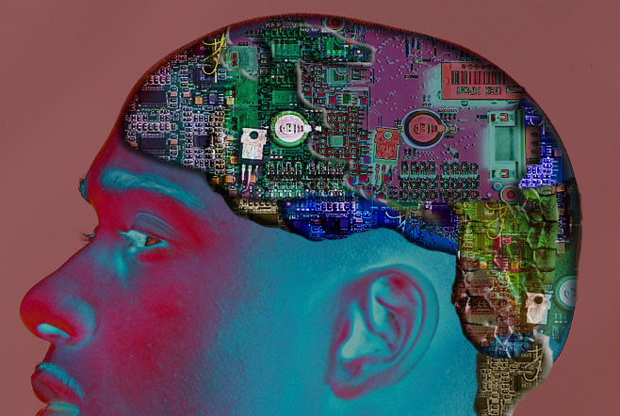

Future Brain
Professor Keith Kendrick

Slide 2

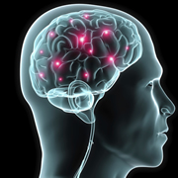
Future Brain

Slide 3
Some key areas for advance
Better understanding of how the brain functions in health and disease.
New ways to modify brain function for therapeutic purposes
Use the brain to control external devices
Produce mathematical models of brain function
Design brain-like computers

Slide 4
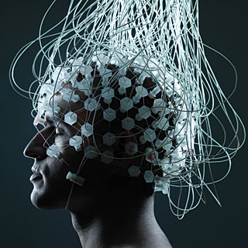
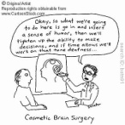
What kinds of advances may occur in the next 25 years?
Recording brain activity changes?

Slide 5
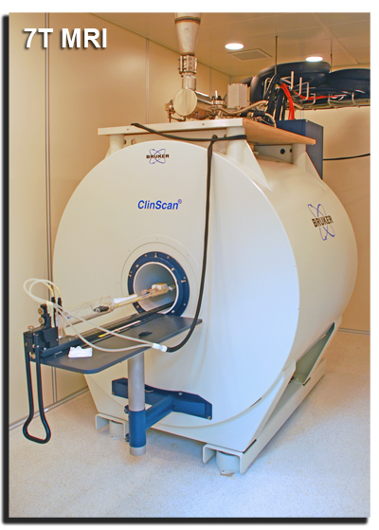
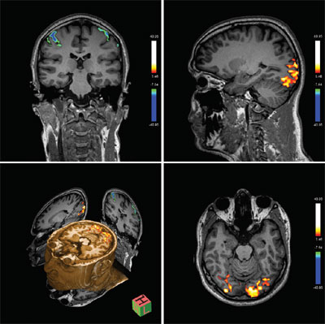
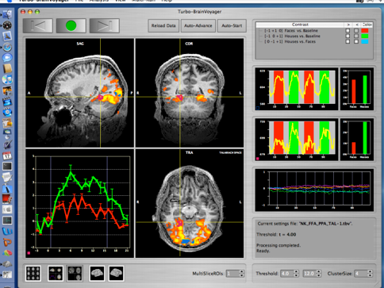
Brain imaging - fMRI
Real time fMRI

Slide 6
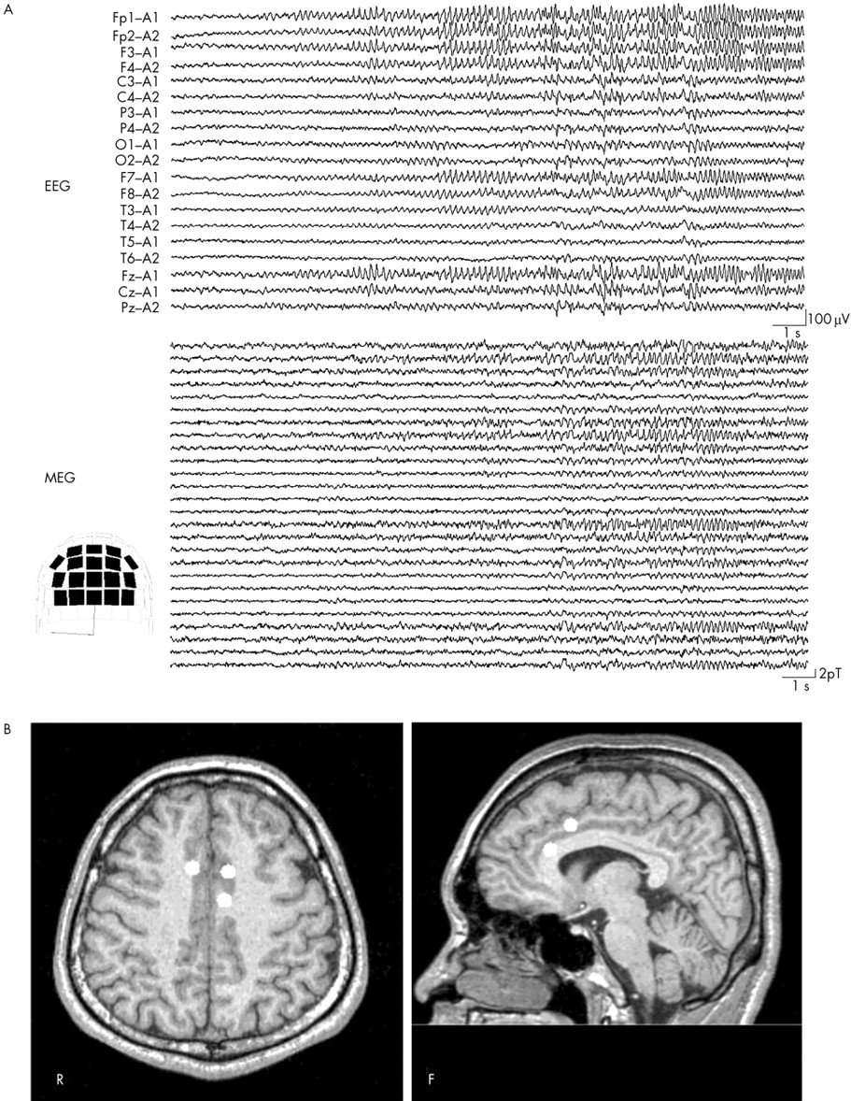
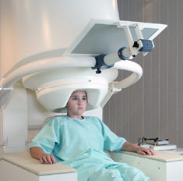
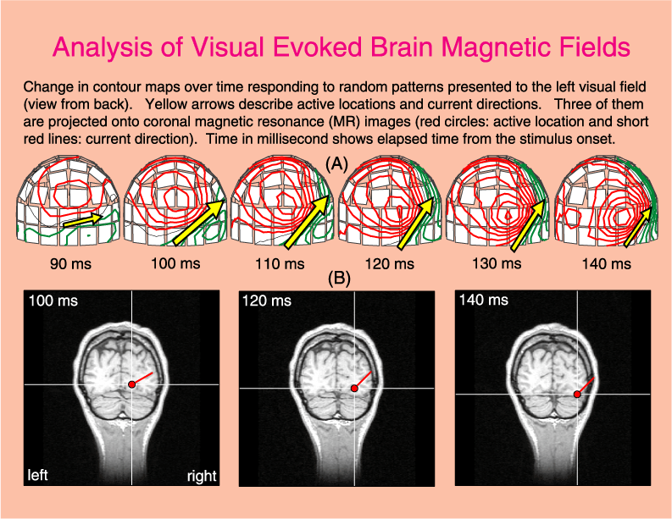
Magnetoencephalography (MEG)

Slide 7
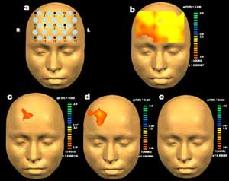
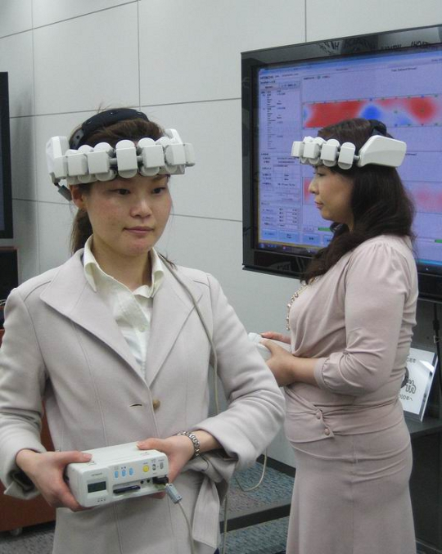
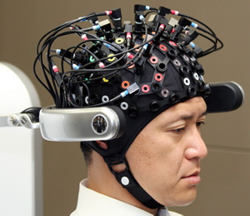
Shining light on the brain
Near infrared spectroscopy

Slide 8
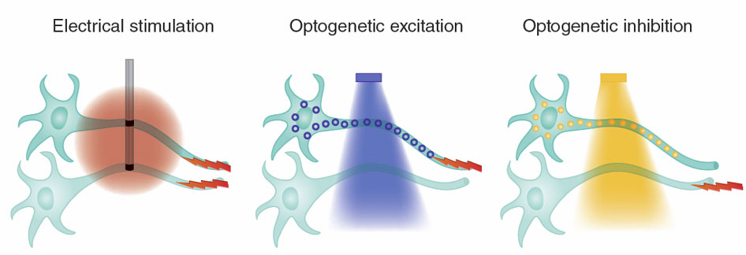
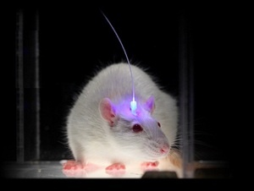
Optogenetics

Slide 9
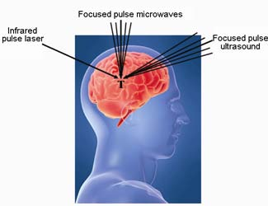
Brain stimulation using light or sound

Slide 10
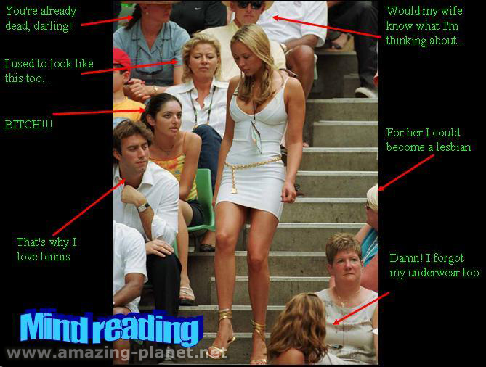
What kinds of advances may occur in the next 25 years?
Mind reading?

Slide 11
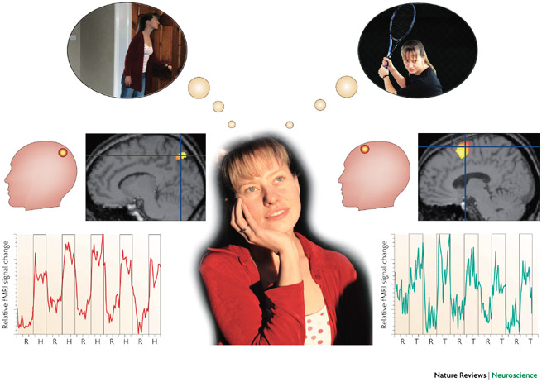
Allowing communication in “vegetative state” brain damaged patients
Spatial imagery
Motor imagery

Slide 12
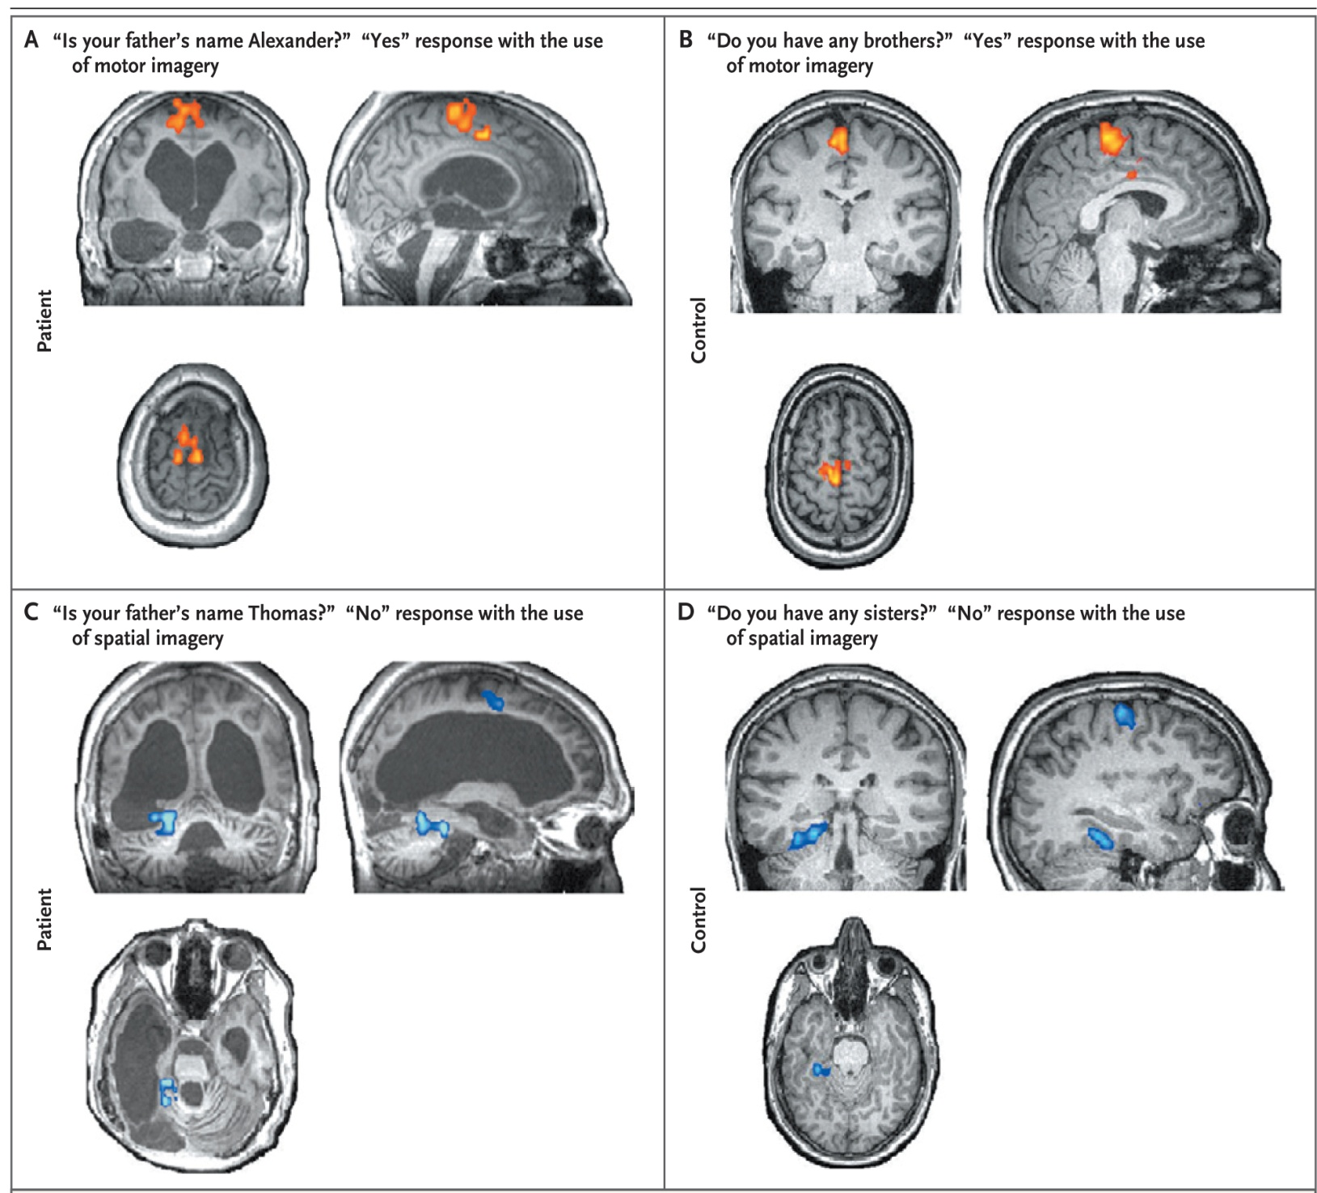
Using brain imaging to enable vegetative state patients to communicate
Monti et al
(2010)
New Eng J Med

Slide 13

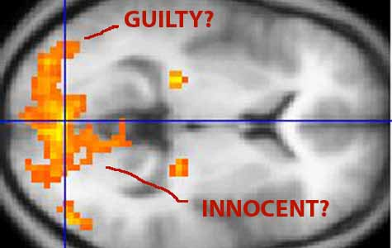
The brain as a lie detector?

Slide 14
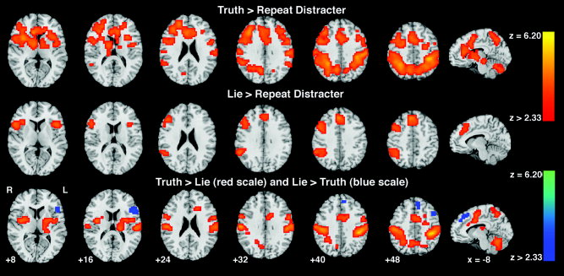
The difference between truth and lies
Langleben et al (2005) Human Brain Mapping

Slide 15
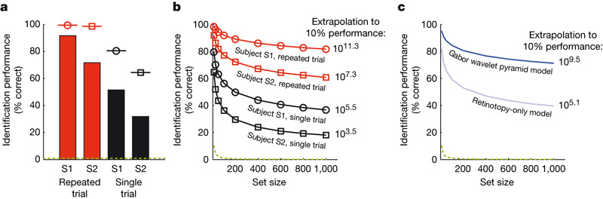
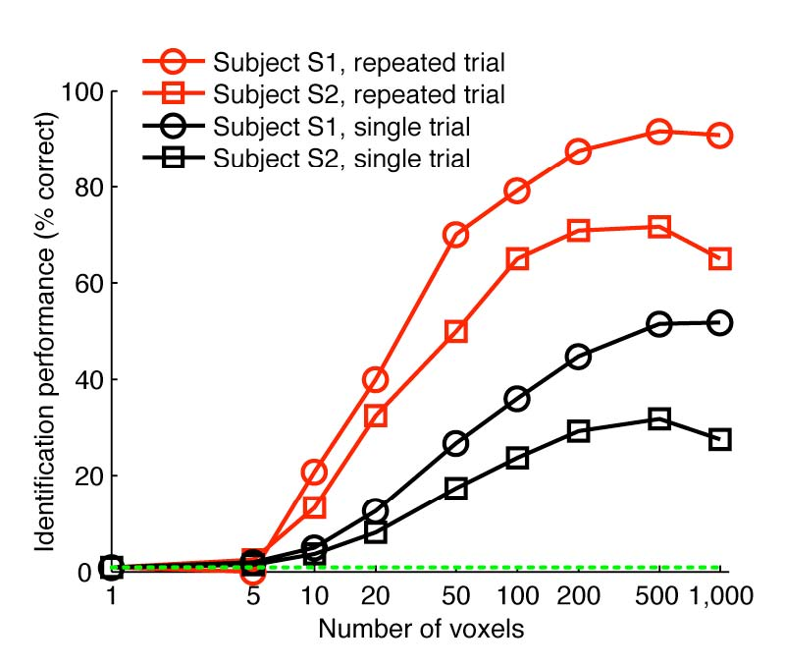
I know what you are looking at
Kay et al (2008) Nature

Slide 16
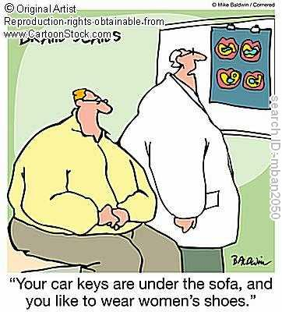


Slide 17
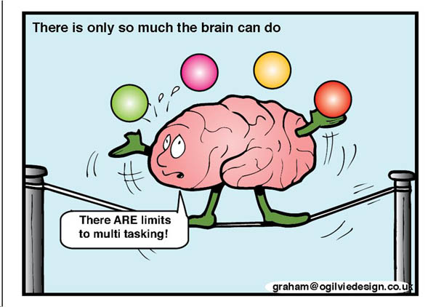
What kinds of advances may occur in the next 25 years?
Learning to control and heal our own brain?

Slide 18
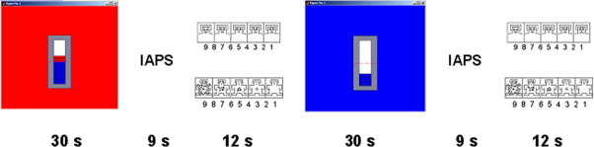
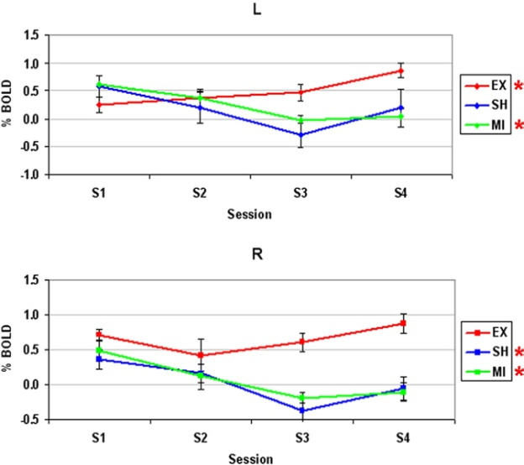
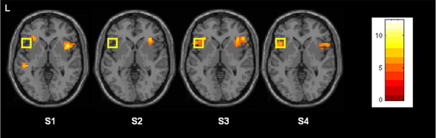
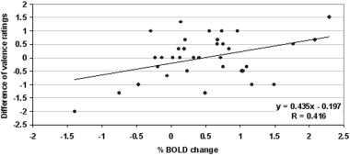
Using rtfMRI to show voluntary control over brain response to face expressions
Caria et al (2010) Biological Psychiatry

Slide 19
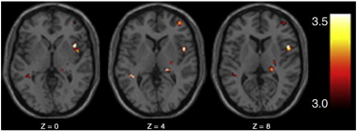
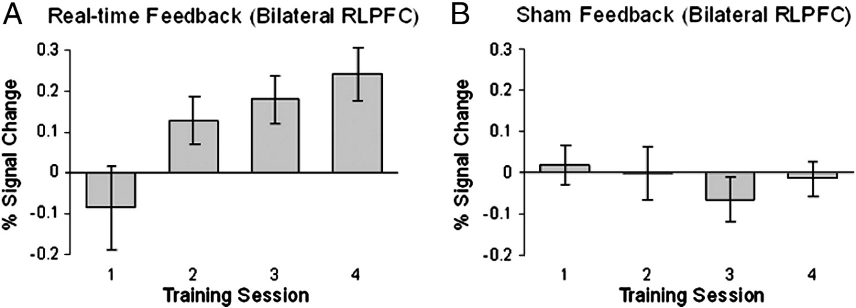
Meta-cognitive awareness
McCaig et al (2011) Neuroimage

Slide 20
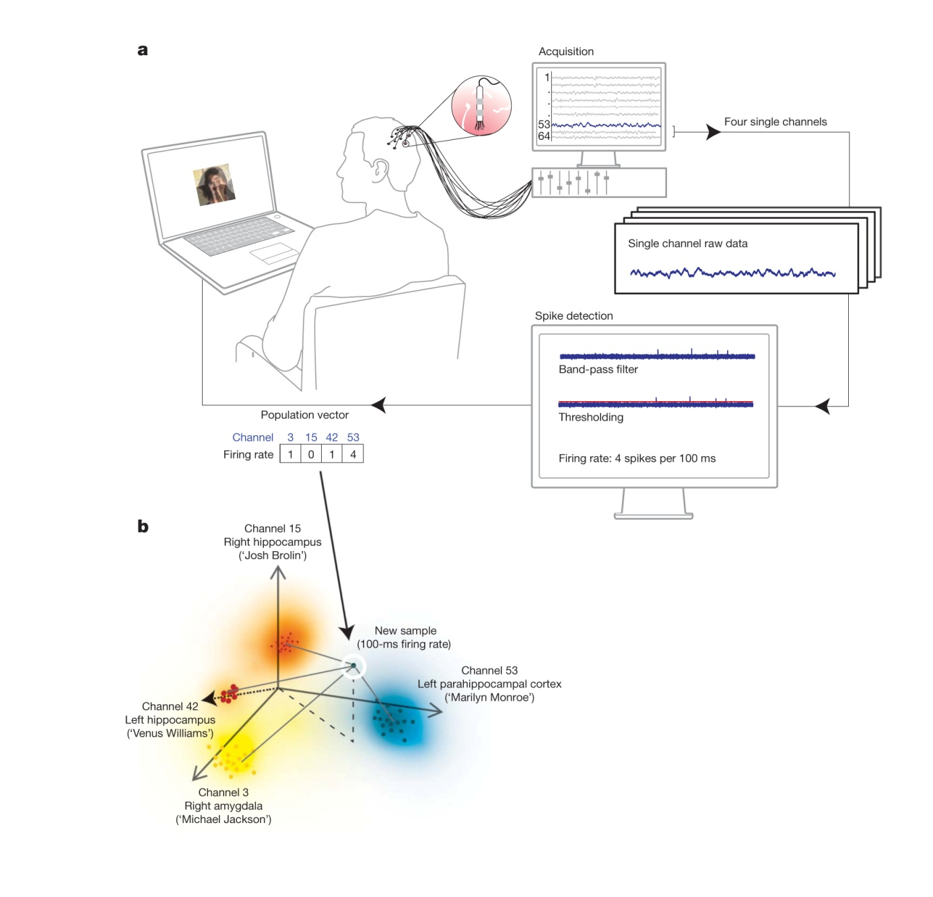
Voluntary control over activity of single neurones
Cerf et al (2010) Nature

Slide 21
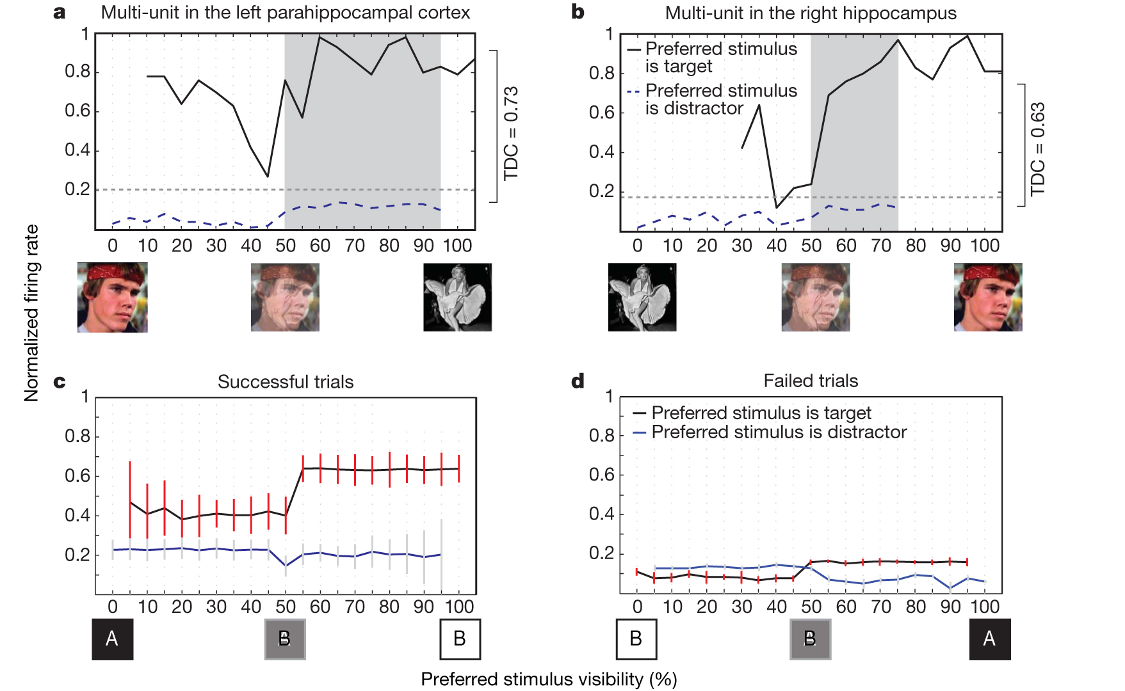

Slide 22
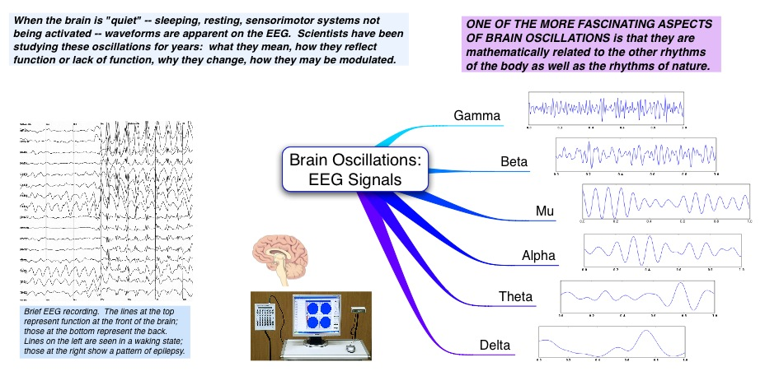
Altered brain rhythms in mental disorders

Slide 23
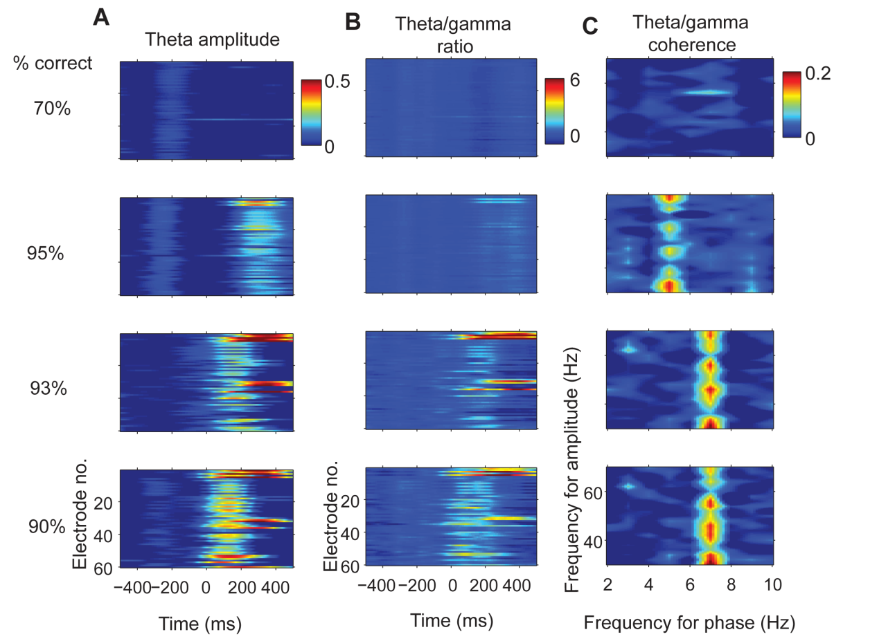
Correlations between discrimination performance and altered theta/gamma activity

Slide 24
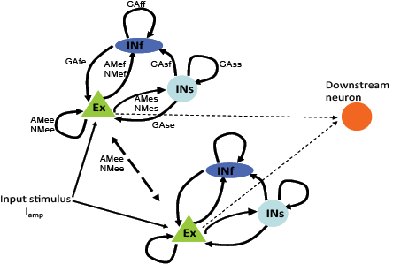
Neural network models of coupled brain rhythms
NL=0.0001
L= 0.00055
NL=0.002
L= 0.0035
Gamma ↑
Theta ↓
Theta ↑
Gamma ↓

Slide 25
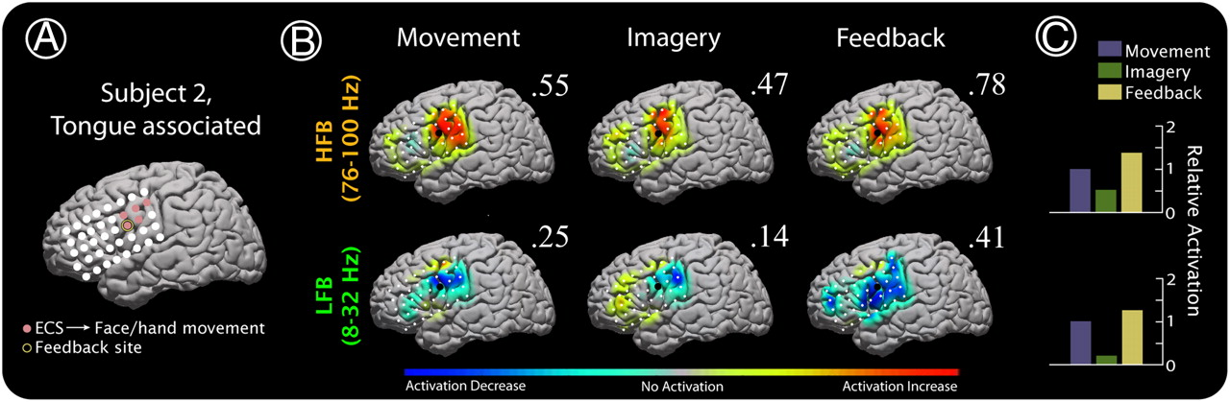
Augmentation of cortical activity during learning
Miller K J et al. PNAS 2010;107:4430-4435
©2010 by National Academy of Sciences
Notes:
Augmentation of cortical activity during learning in subject 2. (A) Electrocortical stimulation sites that produced face/hand movement (not further specified by neurologist) are shown. One of these (gold-circled) was selected from the motor/imagery tasks for feedback (using power from 37 to 43 Hz). (B) ECoG-based brain activation maps for tongue movement, imagined movement, and feedback-based BCI control of cursor, in the HFB and LFB ranges. Activation in each map is scaled to the maximum absolute activation (noted by flanking number). The feedback electrode is noted in each by an enlarged black dot. (C) Relative activation in the electrode-frequency combination for each of the conditions, computed by dividing the imagery- and feedback-related activation by the activation for actual movement, and normalizing the magnitude of activation for actual movement to 1 for all plots.

Slide 26
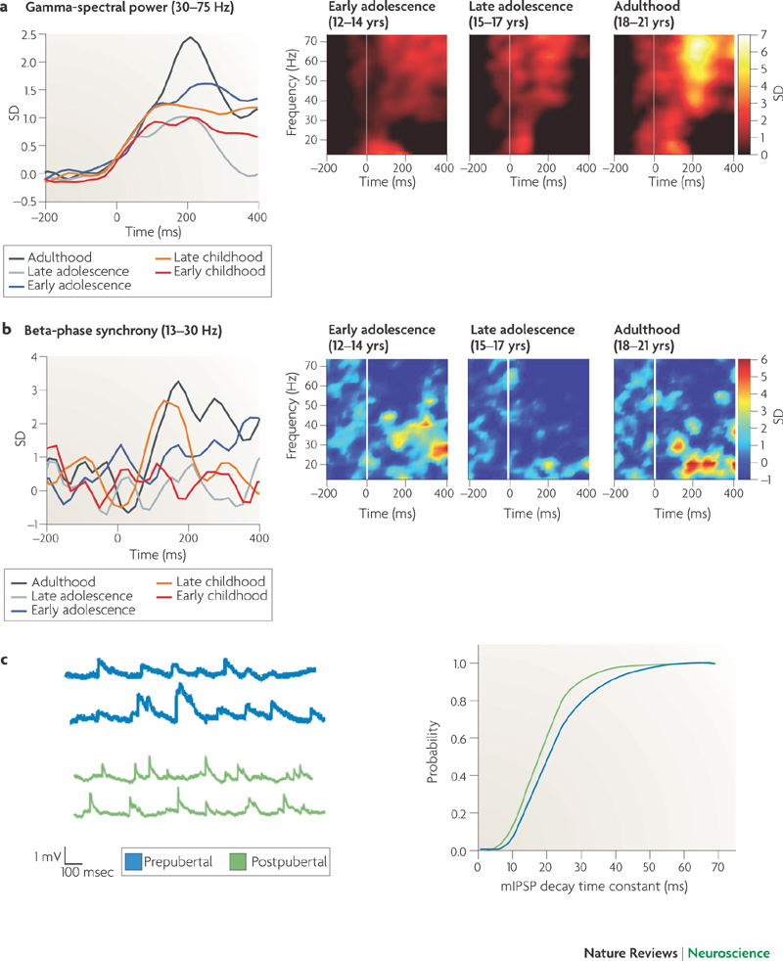
Changes in brain rhythms during development
Uhlhaas and Singer (2010)
Nature Neuroscience Rev

Slide 27
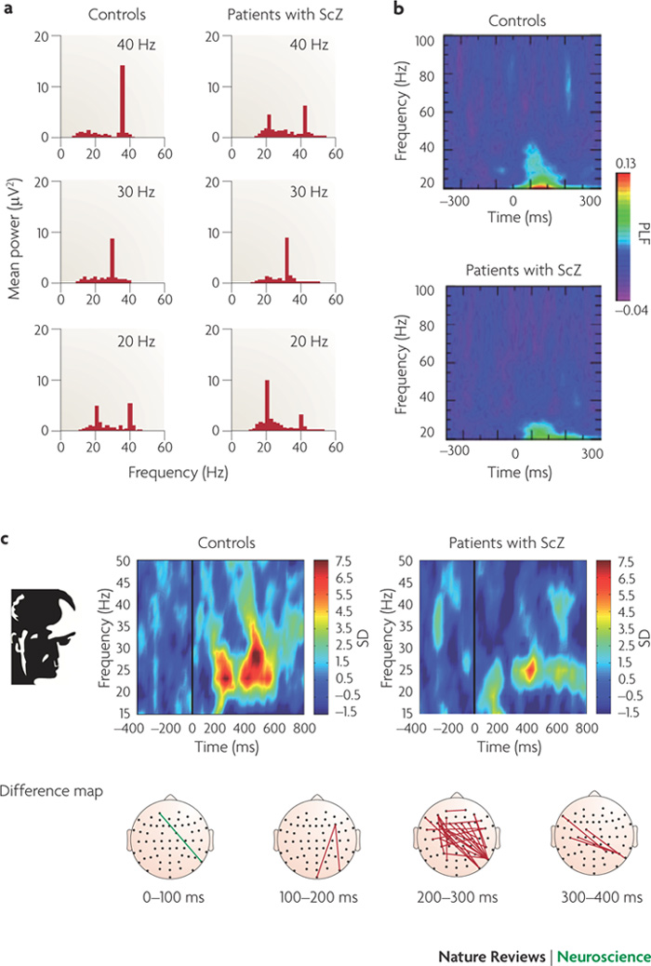
Altered brain rhythms in schizophrenia
Uhlhaas and Singer (2010)
Nature Reviews Neuroscience

Slide 28
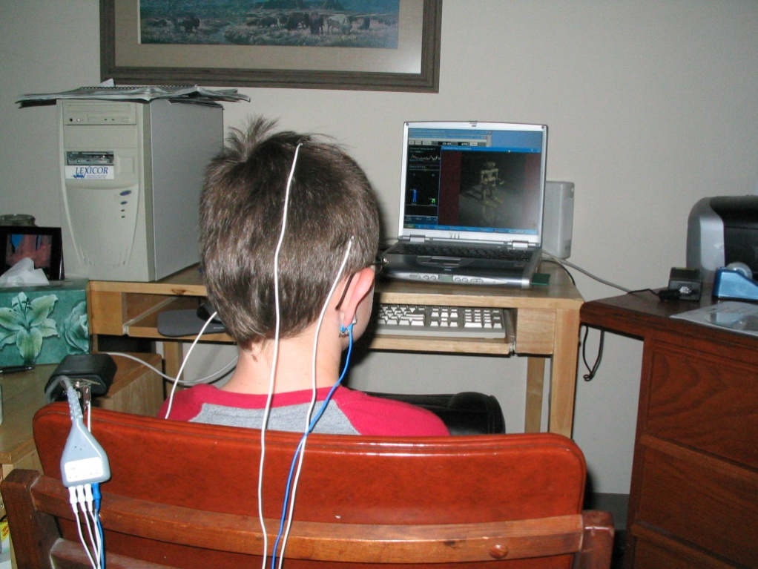
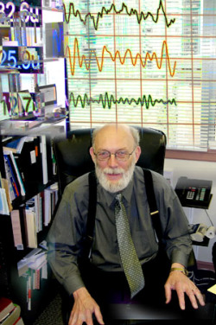
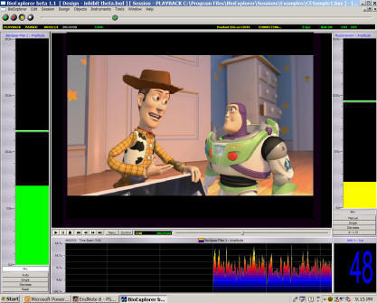
Neurotherapy
ADHD
Autism
Swingle (2008) Biofeedback for the Brain

Slide 29
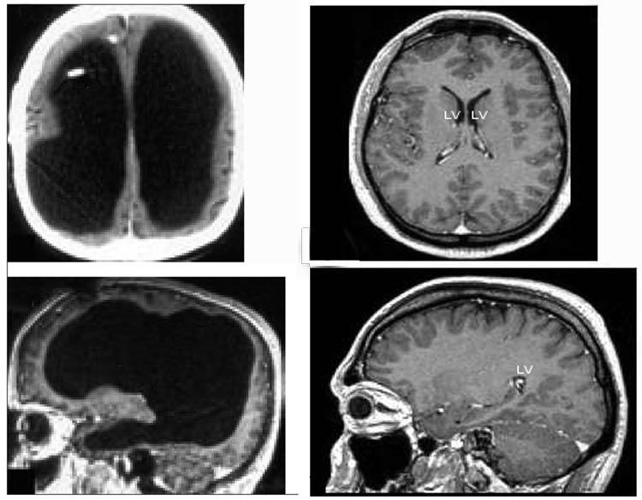
Brain adaptation and self-repair
The man with no brain!

Slide 30
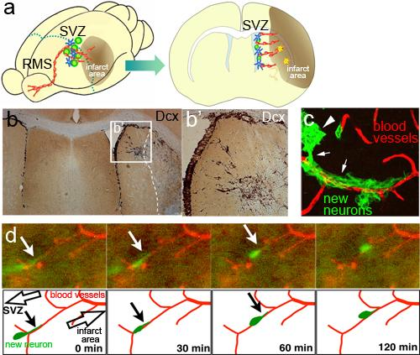
Self-repair with neuronal stem cells
Kaneko et al (2011) Genes

Slide 31
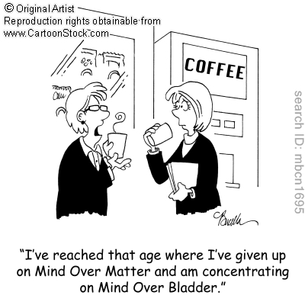
What kinds of advances may occur in the next 25 years?
Using the brain to control external devices?

Slide 32
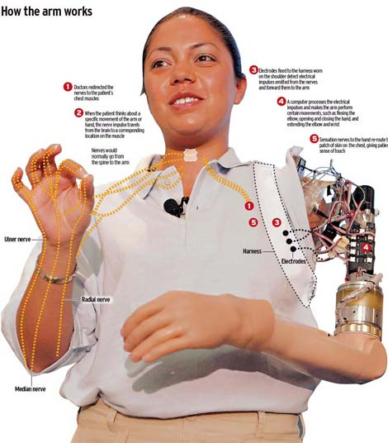
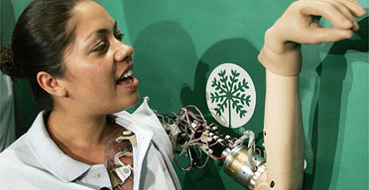
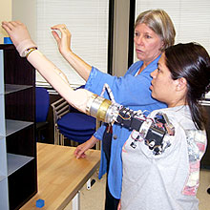
Neural prosthetic arm

Slide 33
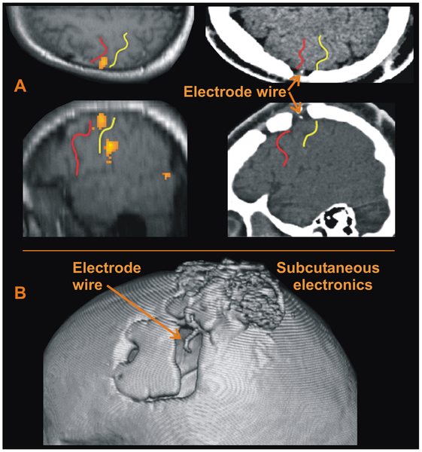

Brain controlling external speech synthesizer
Guenther et al (2009) PLoS ONE

Slide 34


Slide 35


Brain machine interfaces

Slide 36



Slide 37


And there’s an App for that too!

Slide 38

……may even improve interpersonal communication

Slide 39

What kinds of advances may occur in the next 25 years?
Can we construct new brain parts or even an artificial brain?

Slide 40



Neuromorphic approaches
Make existing computer technology simulate brains
Develop new technology using more brain like components
Create a hybrid system using neuronal and
in silico components
Make an organic brain either based on current biology or other novel approaches

Slide 41



Artificial brain within a decade?

Slide 42

Computers vs Brains
Computers process information first and then store it separately in registers
Neural networks both process and store information

Slide 43

Defence Advanced Research Projects Agency (DARPA)
Systems of Neuromorphic Adaptive Plastic Scalable Electronics,
or SyNAPSE.
"The program will develop a brain inspired electronic ‘chip’ that
mimics the function, size, and power consumption of a
biological cortex,"
Grants awarded to:
IBM
Hughes Research Labs (HRL)
Hewlett Packard (HP)

Slide 44


Computers that work like brains

Slide 45



Slide 46


Slide 47

Memristor chips behaving like synapses
Jo et al (2010) NanoLetters

Slide 48


Slide 49




Slide 50
Organic brains?

Slide 51

Advances in Molecular Physics and Polymer Chemistry

Slide 52

How a fabricated organic-based neural network might look

Slide 53


Slide 54



Neuroethics
Reading and controlling the thoughts of others
Improving on normal function

Slide 55

Neuroethics
Machines with consciousness?

Slide 56

Summary
Advances in brain recording technology and computational approaches will increasingly allow interpretation of mental activity

Slide 57


Summary
Our thoughts may be used against us!

Slide 58

Summary
Use of biofeedback and stem cell strategies will increasingly be used to treat damaged or dysfunctional brains

Slide 59



Summary
We will be able to control external devices using brain machine interfaces

Slide 60


Slide 61

Summary
Computers will become more like brains

Slide 62



Summary
Neuroprosthesis will become more routine
Google implant!

Slide 63


