Slide 1

Calisto: Scenic Conceptions in the Seventeenth Century and Today
Jonathan Glixon
University of Kentucky
Gresham College, London
September 22, 2008

Slide 2
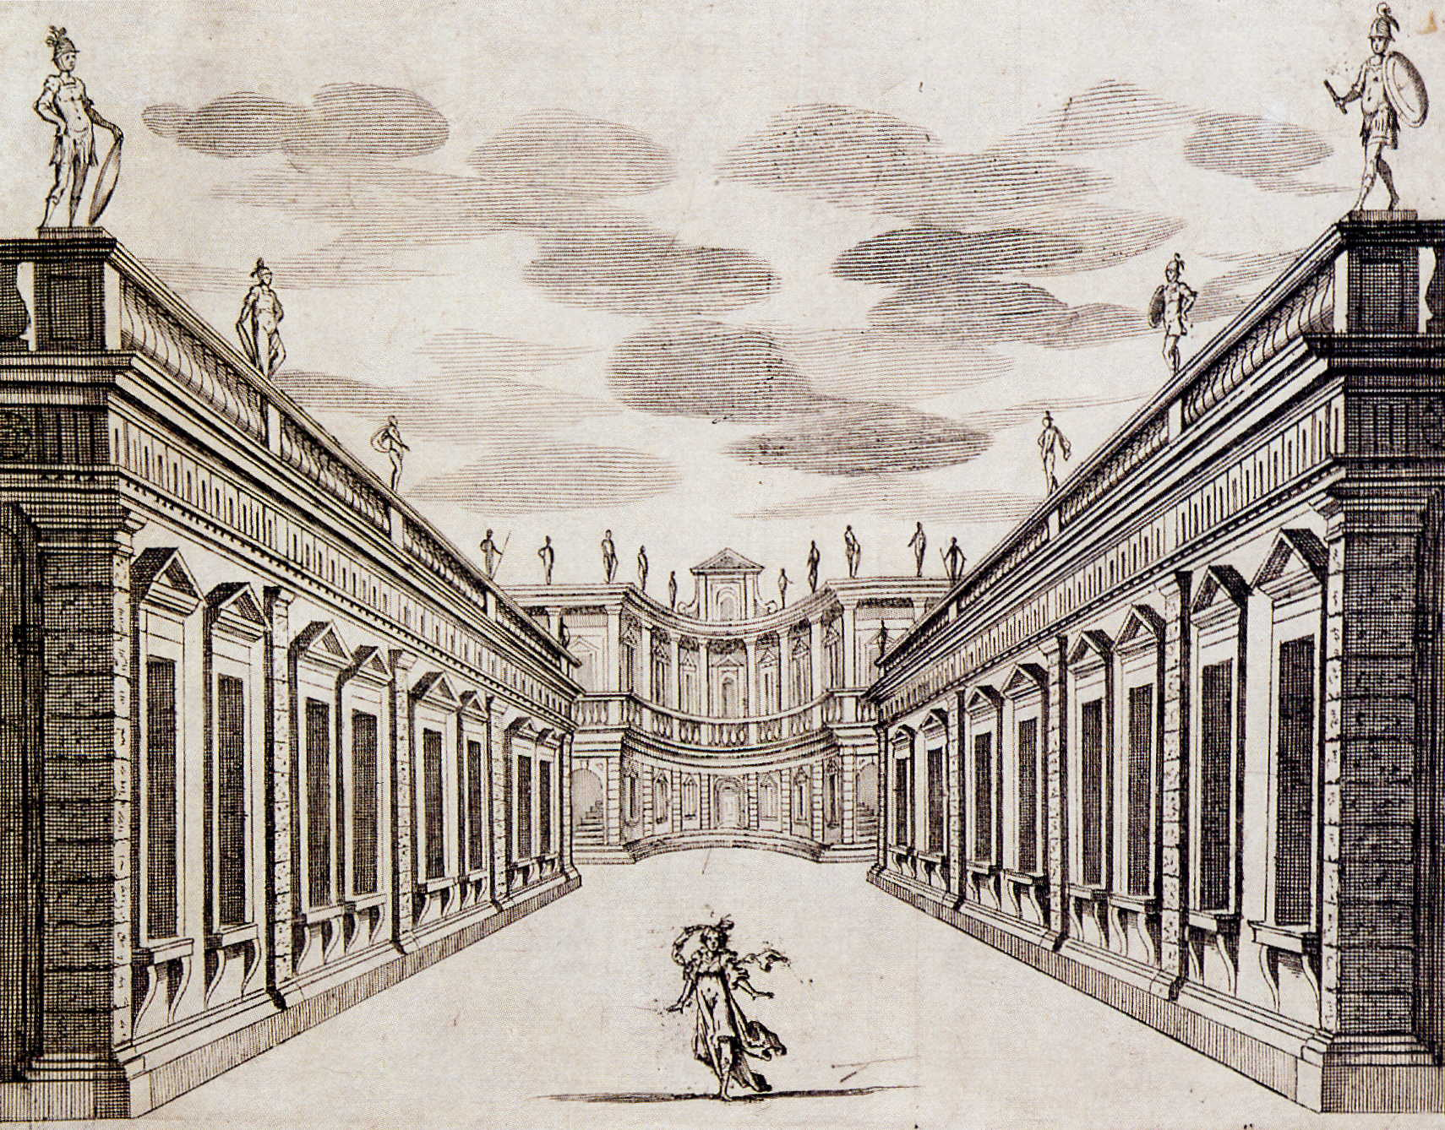
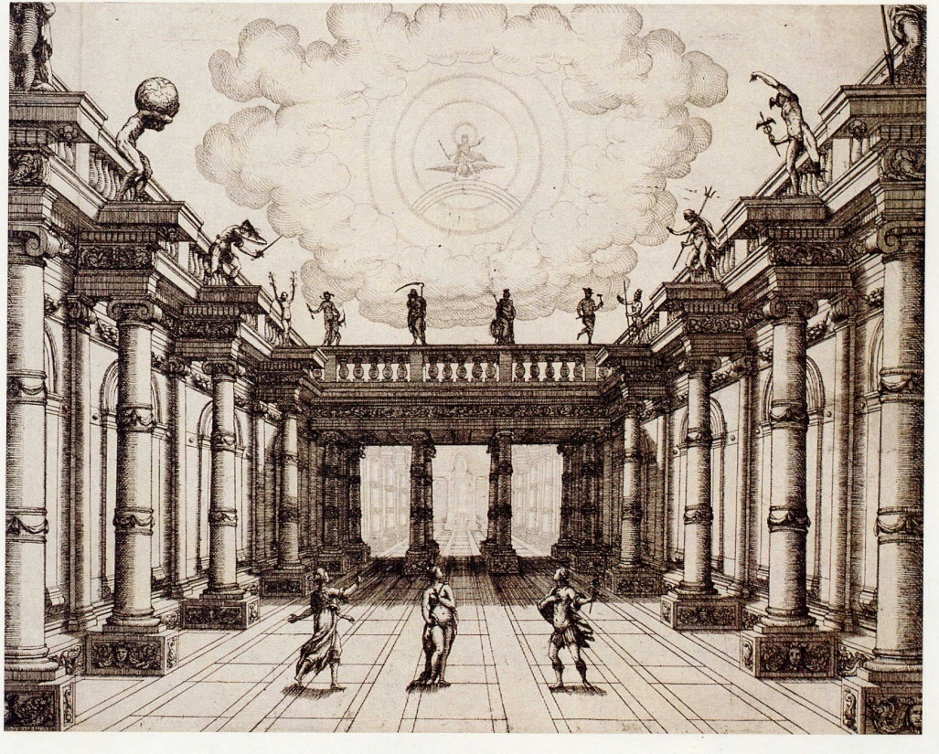
Torelli: Courtyard sets from Bellerofonte and Venere gelosa

Slide 3
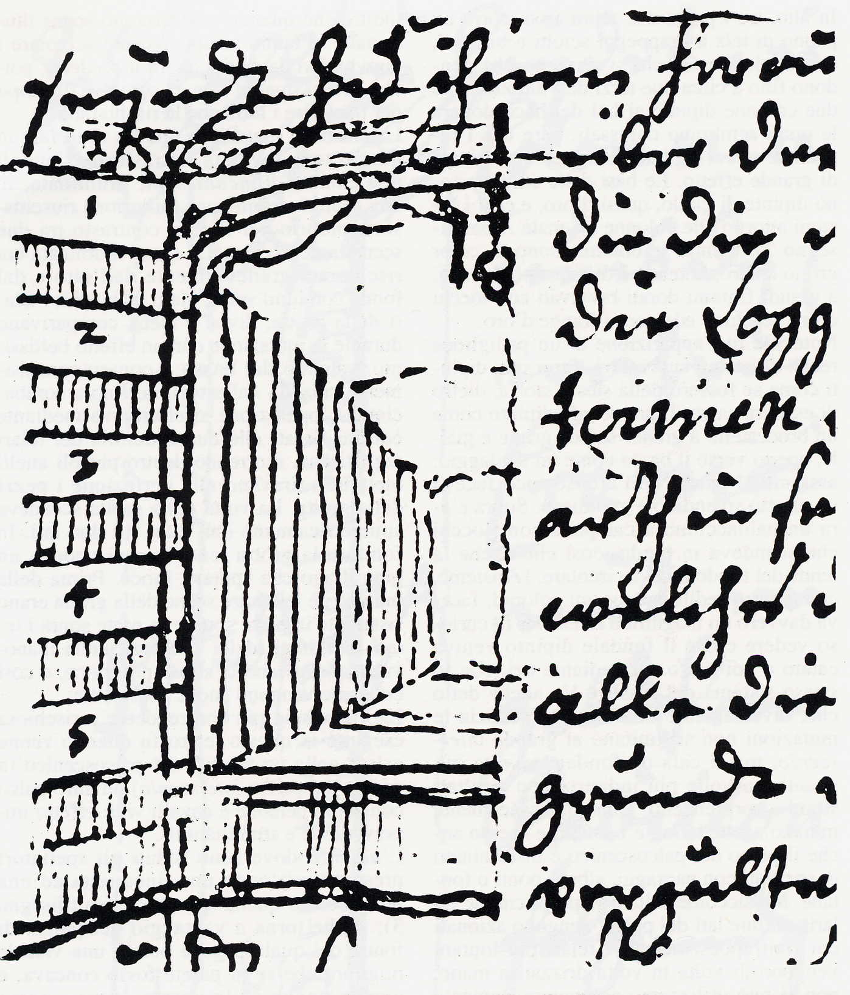
Tessin: drawing showing decreasing size of flats

Slide 4
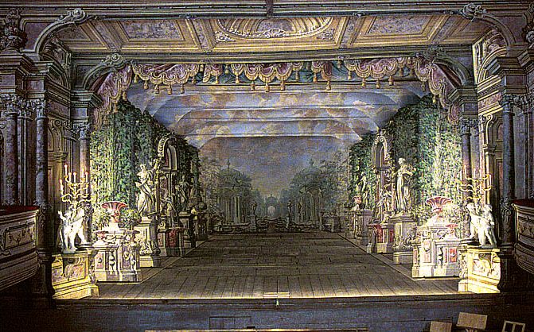
Krumlov Theatre (1766): Garden Scene

Slide 5
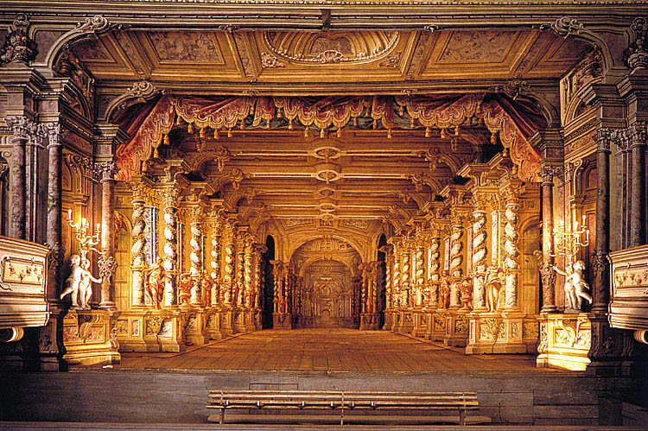
Krumlov Theatre (1766): Hall Scene

Slide 6
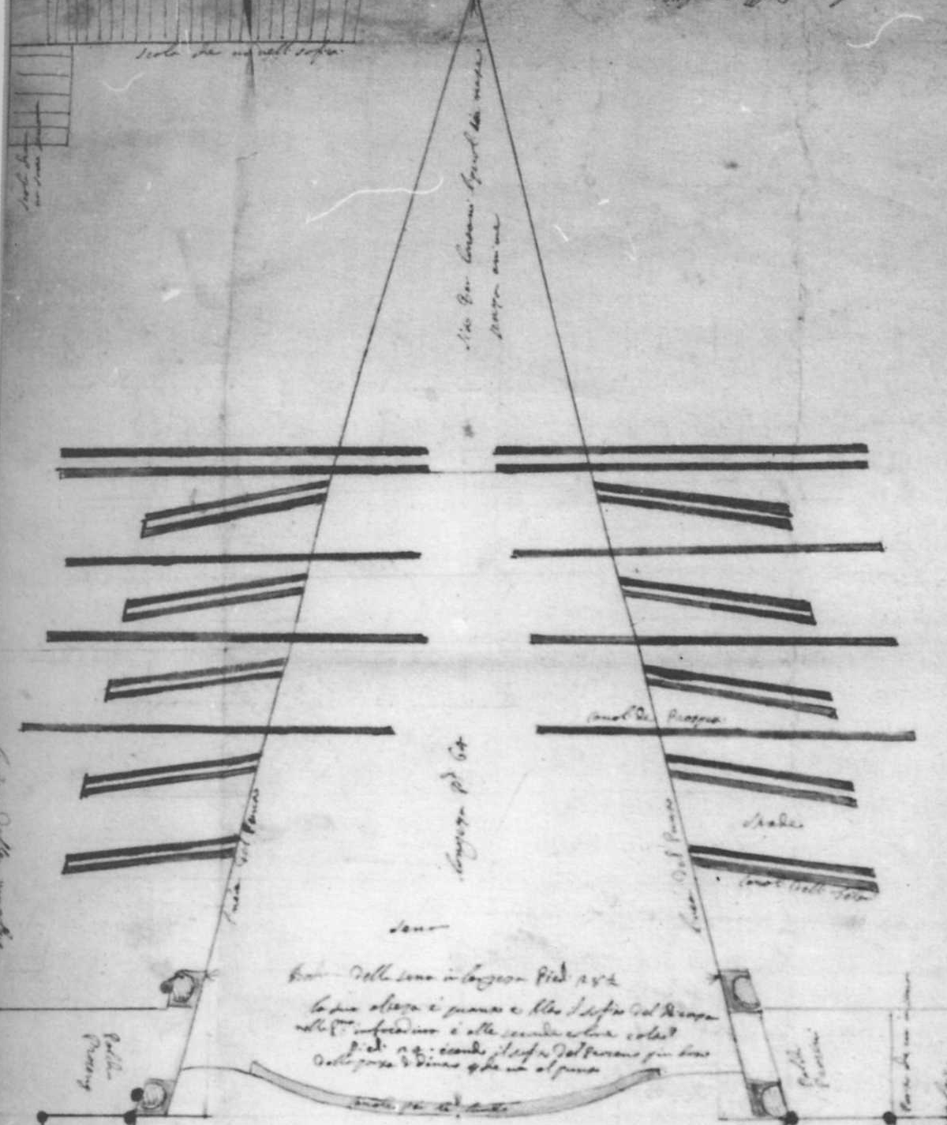
Teatro SS. Giovanni e Paolo, detail of plan
(1691-93)

Slide 7
Teatro SS. Giovanni e Paolo, detail of plan
(1691-93)

Slide 8
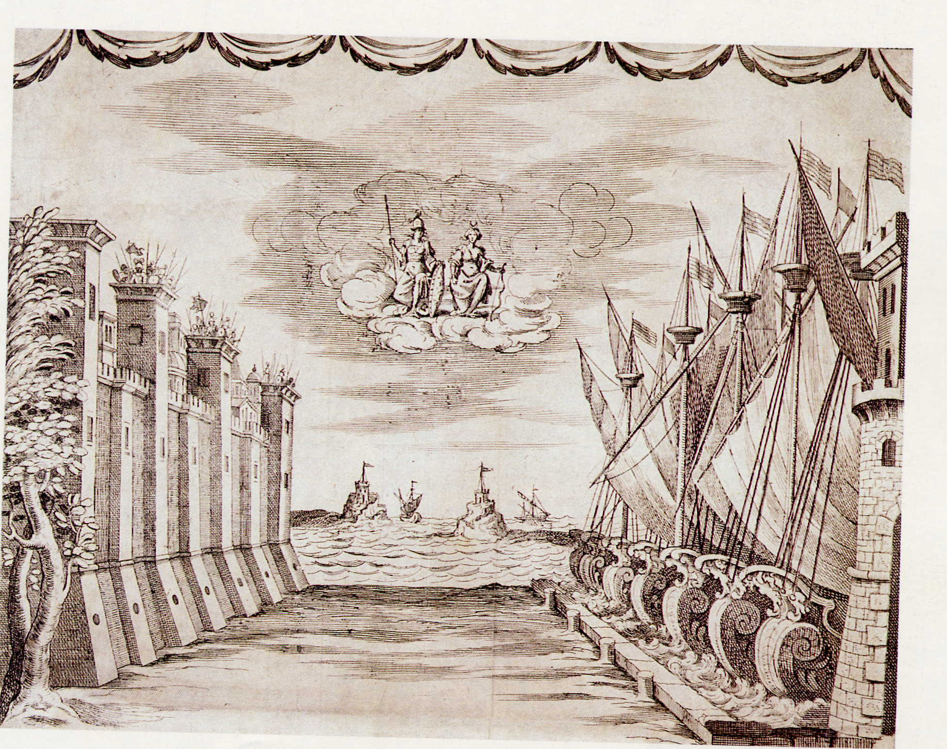
Torelli, Set for Bellerofonte, Act I, Scene 1

Slide 9
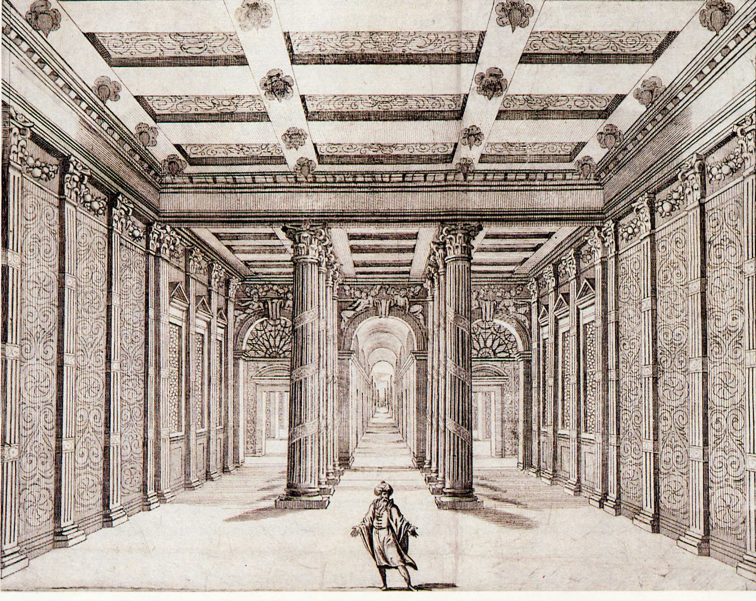
Torelli, Set for Bellerofonte, Act III, Scene 8

Slide 10
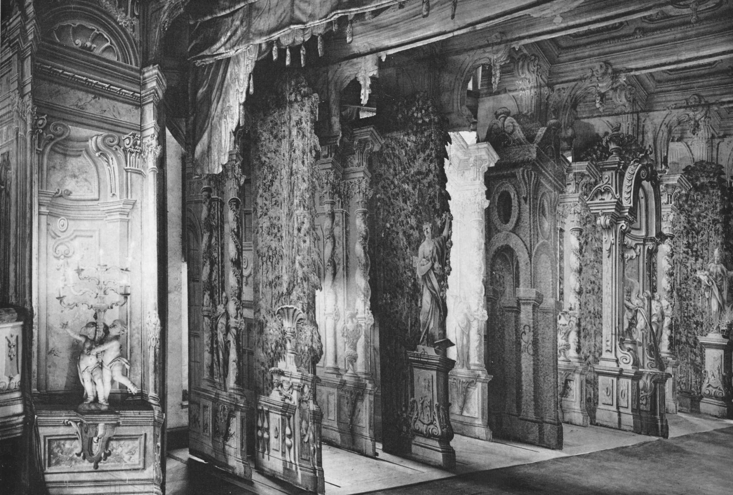
Krumlov Theatre (1766): Sets and slots in stage

Slide 11
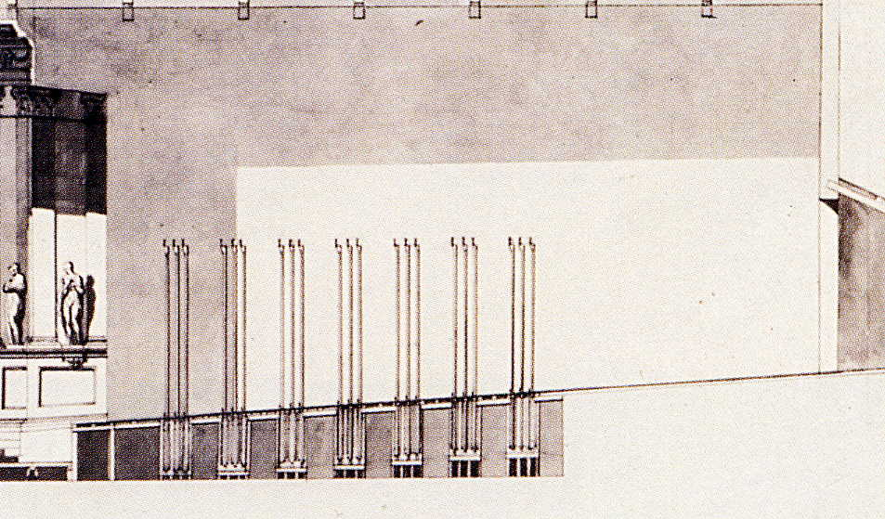
Fano Theatre (18th century): Cross-section with flats and trolleys

Slide 12
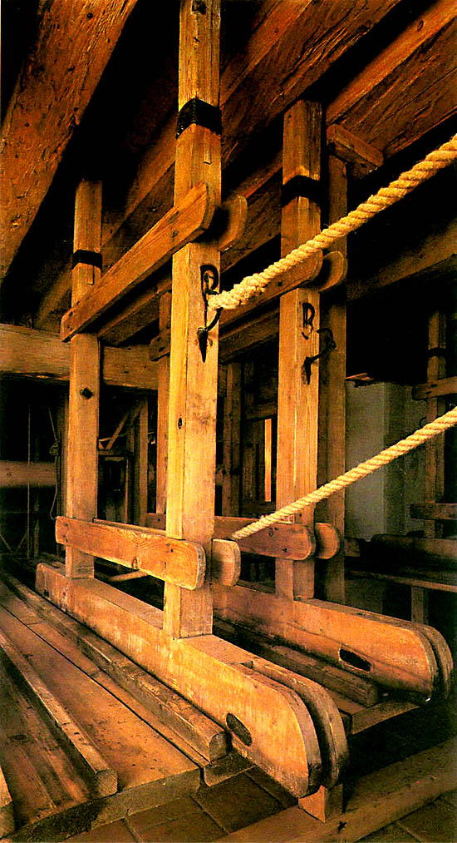
Krumlov Theatre: Trolleys on tracks

Slide 13
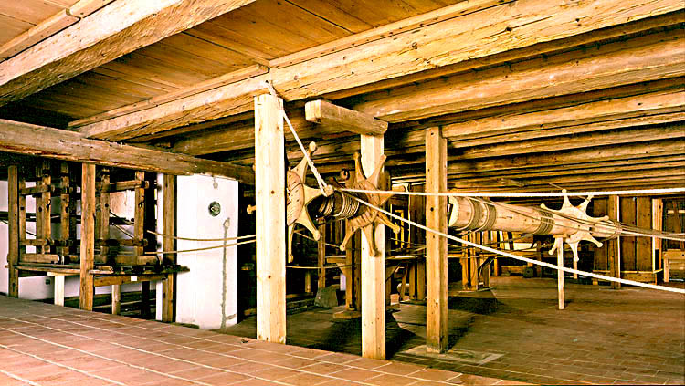
Krumlov Theatre: Scene-changing mechanism

Slide 15
Scenery for Calisto
LIBRETTO
The Grotto of Eternity
Arid Wilderness
Forest
The Peak of Mount Liceo
The Plain of Erimanto
The Fountains of Ladone
The Empyrean

Slide 16
Scenery for Calisto
LIBRETTO
The Grotto of Eternity
Arid Wilderness
Forest
The Peak of Mount Liceo
The Plain of Erimanto
The Fountains of Ladone
The Empyrean
ACCOUNT BOOK
the grotto of eternity
the arid wilderness with the fountain,
the peaks of Mt. Liceo,
the plain of Erimanto
the fountains of Ladone

Slide 17
Scenery for Calisto
LIBRETTO
The Grotto of Eternity
Arid Wilderness
Forest
The Peak of Mount Liceo
The Plain of Erimanto
The Fountains of Ladone
The Empyrean
ACCOUNT BOOK
the grotto of eternity, with a backdrop
the arid wilderness with the fountain, with backdrop
the peaks of Mt. Liceo, with backdrop
the plain of Erimanto
the fountains of Ladone with open backdrop

Slide 18
Scenery for Calisto
LIBRETTO
The Grotto of Eternity
Arid Wilderness
Forest
The Peak of Mount Liceo
The Plain of Erimanto
The Fountains of Ladone
The Empyrean
ACCOUNT BOOK
the grotto of eternity, with a backdrop
the arid wilderness with the fountain, with backdrop
the peaks of Mt. Liceo, with backdrop
the plain of Erimanto without backdrop
the fountains of Ladone with open backdrop

Slide 19
Scenery for Calisto
LIBRETTO
The Grotto of Eternity
Arid Wilderness
Forest
The Peak of Mount Liceo
The Plain of Erimanto
The Fountains of Ladone
The Empyrean
ACCOUNT BOOK
the grotto of eternity, with a backdrop
the arid wilderness with the fountain, with backdrop, and without backdrop
the peaks of Mt. Liceo, with backdrop and without backdrop
the plain of Erimanto without backdrop
the fountains of Ladone with open backdrop

Slide 20
Scenery for Calisto
LIBRETTO
The Grotto of Eternity
Arid Wilderness
Forest
The Peak of Mount Liceo
The Plain of Erimanto
The Fountains of Ladone
The Empyrean
ACCOUNT BOOK
the grotto of eternity, with a backdrop
the arid wilderness with the fountain, with backdrop, and without backdrop
the peaks of Mt. Liceo, with backdrop and without backdrop
the plain of Erimanto without backdrop
the fountains of Ladone with open backdrop
The Empyrean, of clouds above and below

Slide 21
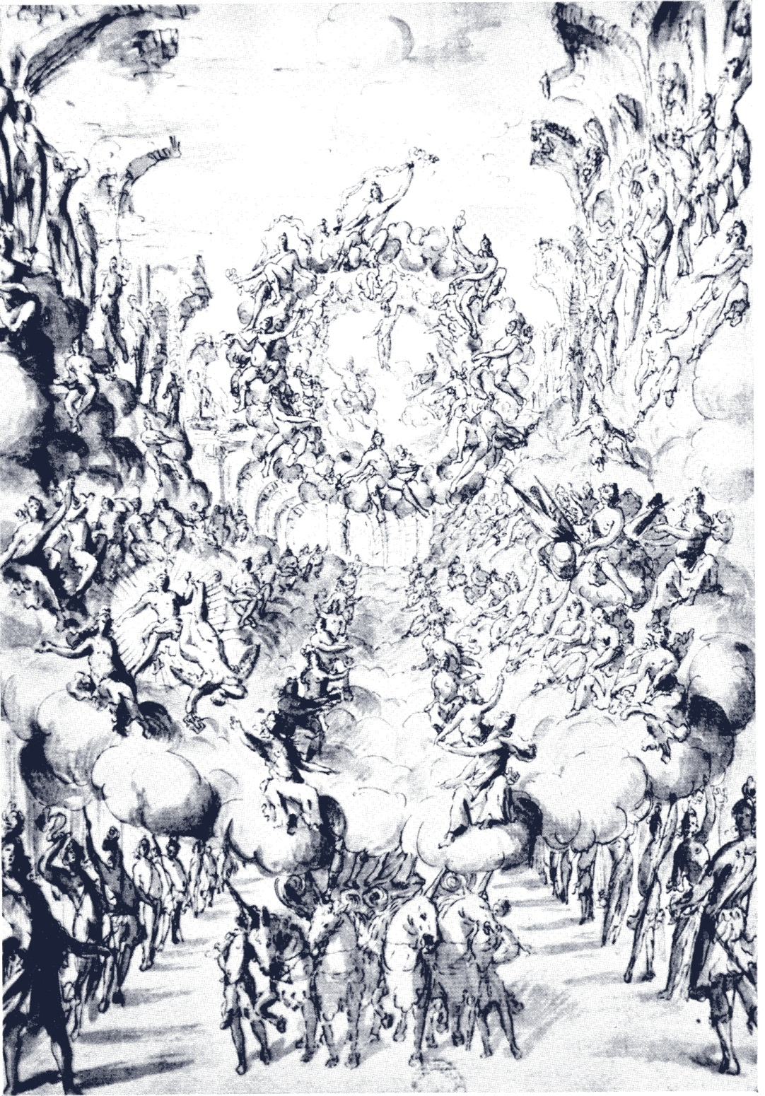
Apotheosis from Germanico sul Reno (1676)

Slide 22
