Slide 1

Can the Euro survive globalisation?
Year 2, Lecture 5
Douglas McWilliams
Mercers School Memorial Professor of Commerce
Gresham College

Slide 2
Objectives
To investigate how globalisation has affected the prospects for the euro

Slide 3
Outline
Europe’s competitiveness, particularly v the emerging economies
The slowing down of European economic growth
How the emerging markets affect the different countries in Europe asymmetrically
The role of Chinese reserves in bailing out the euro
Conclusions – can the euro survive?

Slide 4
The lectures so far
Compare the emergence of the Eastern economies with the ‘discovery of the Americas’ and the industrial revolution
Show that in their impact on the distribution of the world’s economic wealth they are amazingly disruptive
In particular their effects are pervasive and rapid
The speed means that the economic picture is changing far faster than attitudes
Comparing those Eastern economies who have already climbed up the mountain (Hong Kong and Singapore) shows how intense the competitive challenge is going to be

Slide 5
The misery cycle
Competitive
wage below welfare level
Collapsing employment and GDP
Escalating deficits
Financial collapse
Higher taxes and reduced public services

Slide 6
Western Europe’s share of world GDP more than halves in 30 years

Slide 7
Europe works the shortest hours
Country | Annual hours worked by full time employees (2012 in most cases)
Netherlands | 1381
Germany | 1397
France | 1479
UK | 1654
Spain | 1686
Italy | 1752
US | 1790
Chile | 2029
Mexico | 2226
Korea | 2193
Singapore | 2307
Hong Kong | 2579

Slide 8
Source: International comparison of hourly labour costs in the primary textile industry Winter 2011 Werner International Management Consultants

Slide 9
Source: International comparison of hourly labour costs in the primary textile industry Winter 2011 Werner International Management Consultants

Slide 10
All 23 of the 188 countries covered by the IMF with less than 20% growth 2000-13
Zimbabwe | -26.0%
San Marino | -8.0%
Italy | -0.2%
Portugal | 0.5%
Greece | 1.9%
Micronesia | 4.6%
Central African Republic | 6.3%
Denmark | 7.1%
Jamaica | 7.9%
Barbados | 9.4%
Japan | 11.5%
Netherlands | 12.4%
The Bahamas | 12.6%
Haiti | 13.3%
France | 14.2%
Libya | 14.6%
Antigua and Barbuda | 15.0%
Germany | 15.1%
Belgium | 16.8%
Tuvalu | 17.2%
Tonga | 18.2%
Cyprus | 18.3%
Spain | 19.0%

Slide 11
Eurozone returns to growth, but hold the champagne
Eurozone real GDP, annual growth
Source: IMF, Cebr forecast. Group includes Austria, Belgium, Cyprus, Estonia, Finland, France, Germany, Greece, Ireland, Italy, Latvia, Luxembourg, Malta, Netherlands, Portugal, Slovakia, Slovenia, and Spain.

Slide 12
Whereas in 2000 China only competed with the EU in 15% of products, the latest data shows this has increased to 35%
Source: Complementary Index for European and Chinese Exports

Slide 13
….and by 2028 based on our WELT forecasts, this will be up to 75%
Source: Complementary Index for European and Chinese Exports

Slide 14
World Bank data for extent of trade

Slide 15
World Bank Merchandise Trade Complementarity Index with China for selected EU member States, 2012
Germany | 45
France | 43
Italy | 39
Spain | 38
Portugal | 36
Greece | 29
Ireland | 22

Slide 16
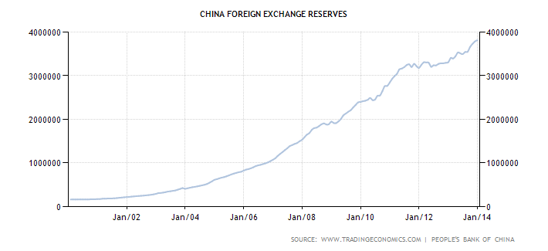
Chinese forex reserves were $3.8 trillion in January 2014

Slide 17
China’s composition of foreign currency reserves to 2011
Source: BICCS Asia Briefing Asia Paper  Volume 7  Issue 2  29 March 2013  ISSN 2034 5364 by Wang YongZhong and Duncan Freeman

Slide 18
Commentators certainly think that China has been buying euros
‘Since 2011, Beijing has disinvested away from dollar-denominated assets, increasing its holdings in euro which now account for around 30 percent of China’s foreign reserves. Support for the Eurozone has been accompanied by growing Chinese Foreign Direct Investment (FDI) in Europe’s industrial sectors and infrastructure projects’
Source: European Union Institute for Security Studies, Brussels Beijing Changing the Game Report 14 edited by Nicola Casarini

Slide 19
Implications
Europe’s economic problems are much greater than can be solved by dealing with the currency problem
Although the Euro has made things worse, it is not the cause of the currency problems
Although breaking up the Euro would probably make Europe better off in the longer term, it would have heavy short run costs
China’s investment has insulated the Euro from market pressures for the time being
But ultimately the future of the Euro is likely to depend on Europe’s voters willingness to accept the integration necessary to make it function
Whether EU membership is in the UK’s interest is finely balanced, though if we were to withdraw the costs will be short term while the benefits would be longer term
The position of the UK in the EU will be affected by how the EU itself adjusts to the economic problems and the willingness of the EU partners to negotiate with the UK

Slide 20
If you want more contact:
Douglas McWilliams
dmcwilliams@cebr.com
+44 207 324 2860

