Slide 1

Was Karl Marx always wrong?
Year 2, Lecture 3
Douglas McWilliams
Mercers School Memorial Professor of Commerce
Gresham College

Slide 2
Objectives
To assess whether globalisation means that profitability will increase
To discuss the extent to which ‘exploited workers’ whose wages are initially low benefit from faster real wage growth and so are ultimately better off

Slide 3
Outline
Karl Marx and his relevant theories
What has happened to profit shares and profitability
What is likely to happen over the next 20 years
When is ‘exploitation’ good for you

Slide 4
Background
‘Supercompetitive’ emerging economies
Lack of competitiveness of Western economies and difficulty in correcting this through devaluation
Boost to inflation from upward pressure on commodity prices and devaluing currencies
So growth shortfall and upward pressure on inflation likely
Meanwhile, skills and capacity are partly a function of past growth and so past slow growth will have eroded capacity

Slide 5
In the past 30 years the world’s total labour force has increased by 68%
McKinsey Global Insttitute

Slide 6
In addition there has been a sharp drop in the number of employees in agriculture
McKinsey Global Insttitute

Slide 7
So that in the past 30 years the world’s non farm labour force has increased by 115%
McKinsey Global Insttitute

Slide 8
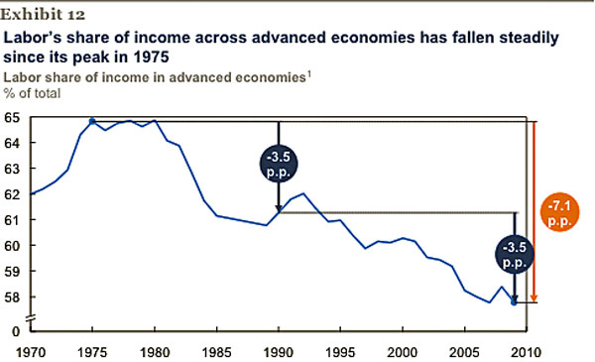
The fall in the workers’ share of advanced economies’ incomes
Source: McKinsey Global Institute

Slide 9
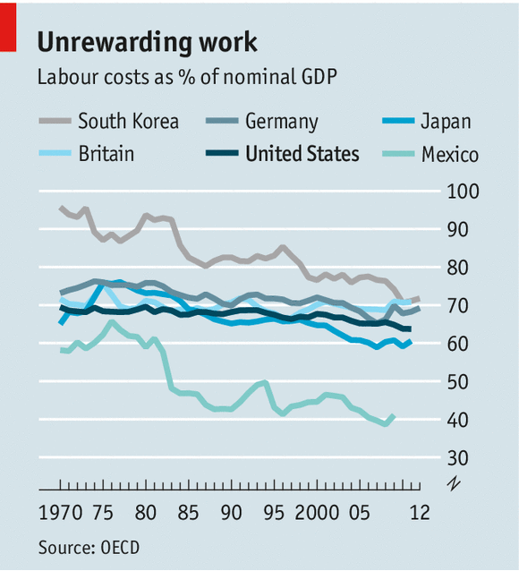
Labour costs as a share of GDP have fallen around the world

Slide 10
The share of labour in each of the 4 major economies has declined recently
Labour share of GDP % in the four largest economies
NBER paper see text for citation

Slide 11
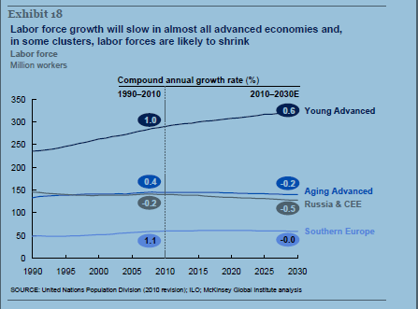
Slowing labour force growth in the advanced economies
Source: McKinsey Global Institute

Slide 12
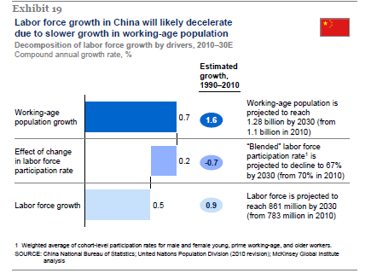
And also in China as the impact of the demographic policy bites
Source: McKinsey Global Institute

Slide 13
In the next 20 years the world’s total labour force is expected to increase by only 24%
McKinsey Global Insttitute

Slide 14
..and the speed with which people come out of agriculture will slow…
McKinsey Global Insttitute

Slide 15
So the increase in the non agricultural labour force is likely to be only just over 40%
McKinsey Global Insttitute and Cebr calculations

Slide 16
Labour does best when its share is between 30% and 60%

Slide 17
Implications
We are now in the middle phase of globalisation
The augmentation of the world’s labour supply continues but it is starting to slow
Labour’s share of the economy has got smaller
But the higher profits that this allows helps investment
Karl Marx’s predictions may yet be proved right but are unlikely to be proved right in the near future

Slide 18
If you want more contact:
Douglas McWilliams
dmcwilliams@cebr.com
+44 207 324 2860

