Slide 1



The shape of things to come: changing demographic structure, future society and health.
Gresham College 2015
Christopher Whitty

Slide 2

William Petty
One of the earliest proponents of demography with John Graunt.
Gresham Professor of Music 1651/2.
Physician, astronomer, linguist, economist, naval architect, MP and FRS.

Slide 3
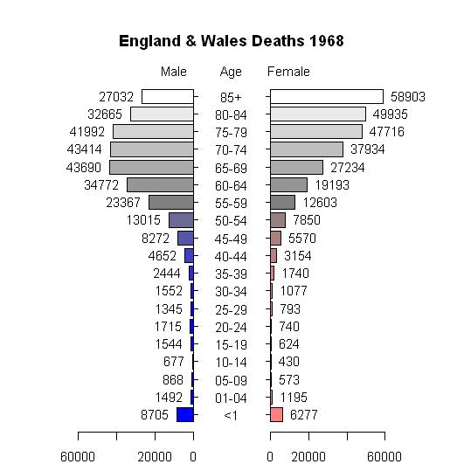
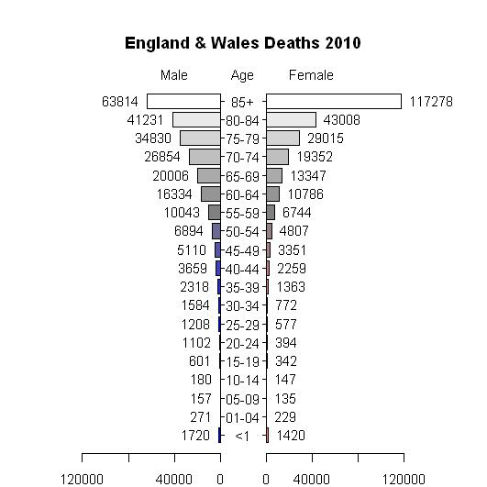
Mortality by age, England and Wales 1968-10
The life expectancy of UK babies 2015 94 (g) and 91 (b)

Slide 4
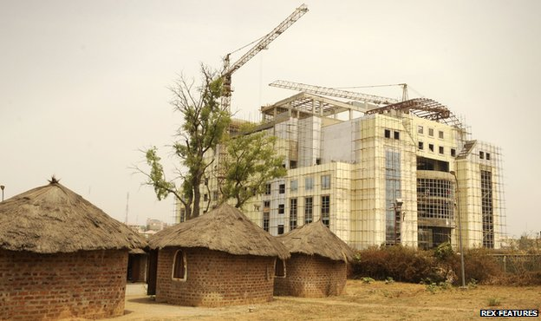
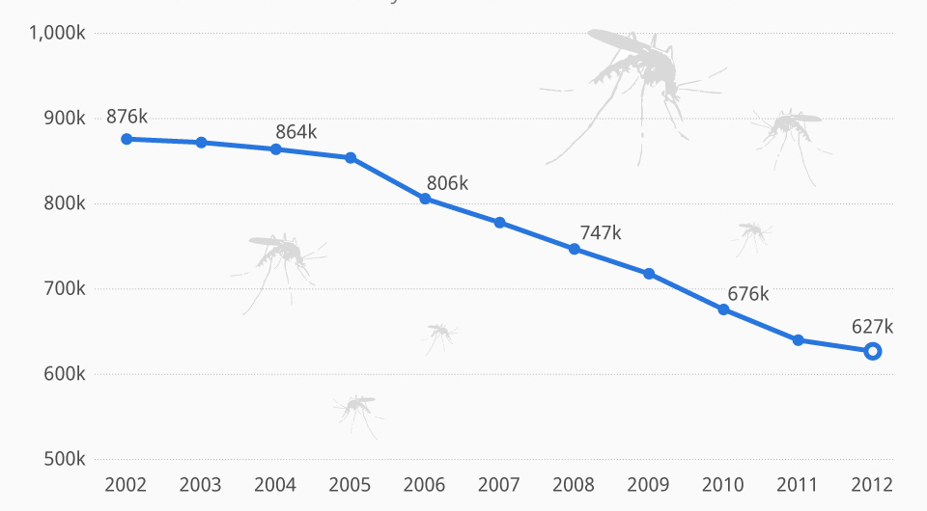
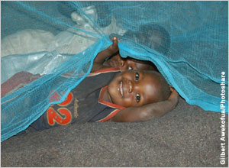
“Africa is experiencing some of the biggest falls in child mortality ever seen, anywhere.” And the same is true in Asia and Latin America.
(Economist 2012)

Slide 5
Drivers of demographic change
Rapidly falling child mortality, especially in poorer countries.
Rising average age of mortality in adults.
Fertility- number of children per woman.
-Socioeconomic development and female education.
-Availability of contraception.
66 countries remain with high fertility levels (>3.2 children/woman).
Low-fertility countries (<2.0 children/woman) increased from 51 in 1994 to 70 in 2014.
Migration.

Slide 6
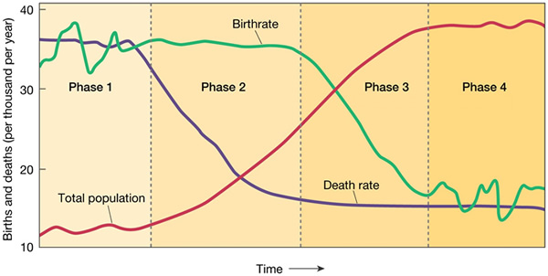
Demographic transition (stylised)

Slide 7
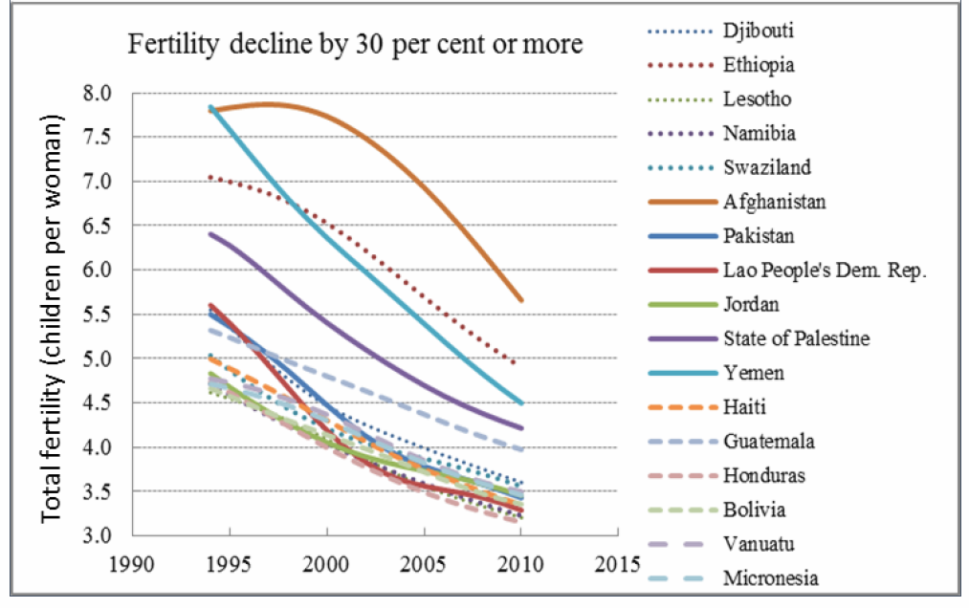
Fertility declines have often been rapid. (UN 2014)

Slide 8
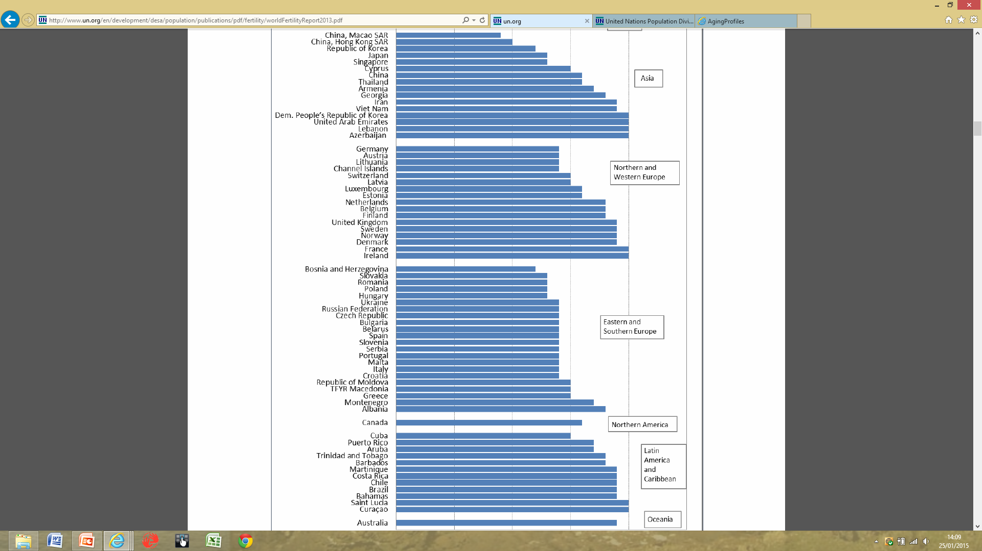
Large parts of Asia, Europe and Latin America now below replacement fertility (UN 2014)
1.5
2

Slide 9
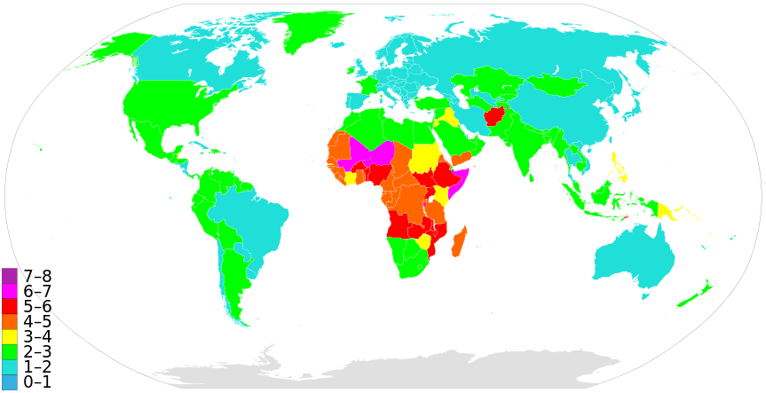
Fertility
("Countriesbyfertilityrate" by Supaman89 updated per The World FactBook (CIA) )

Slide 10
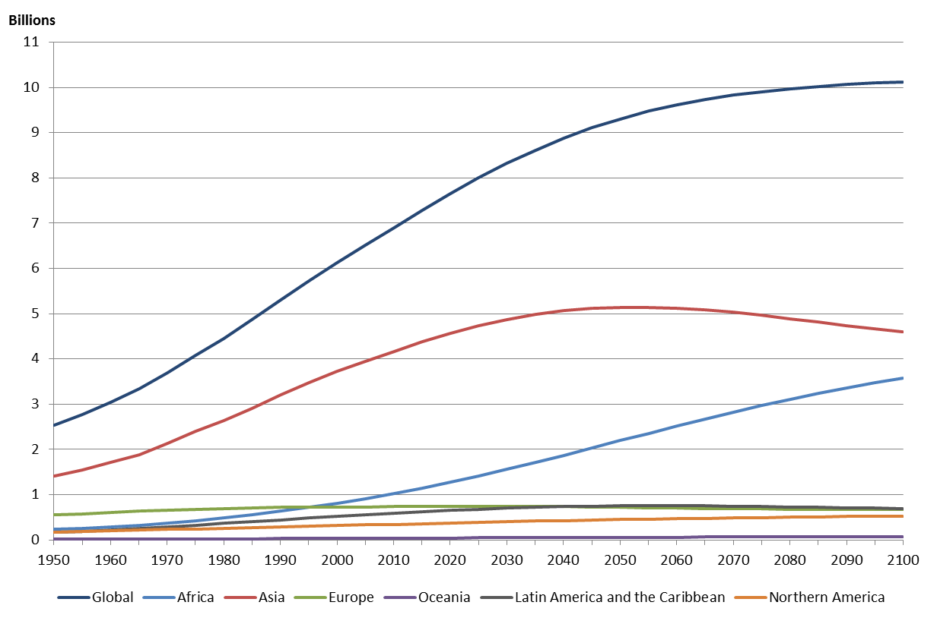
Population projections

Slide 11
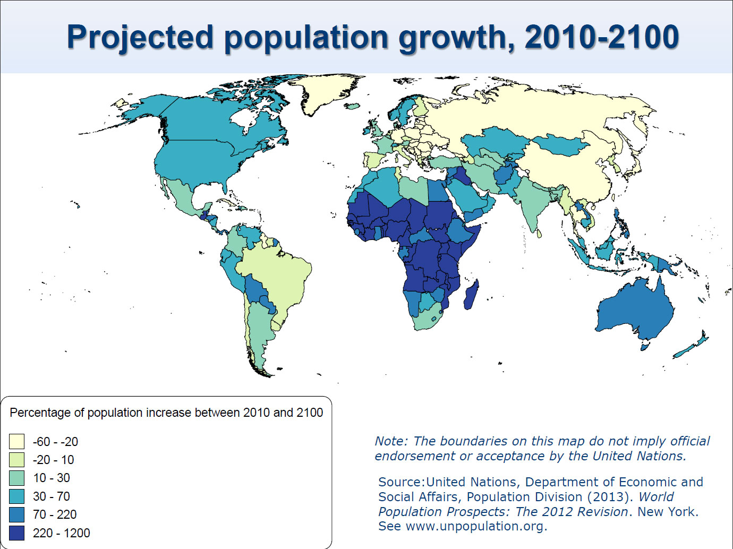

Slide 12
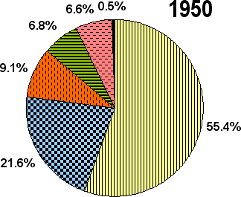
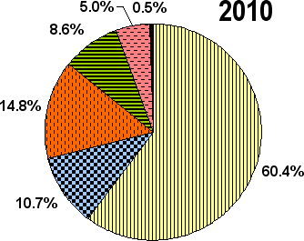

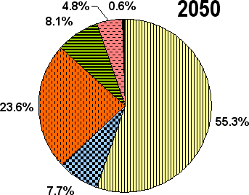
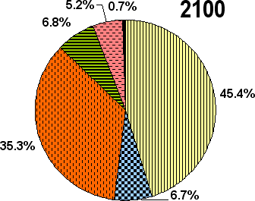
UN population division projections

Slide 13
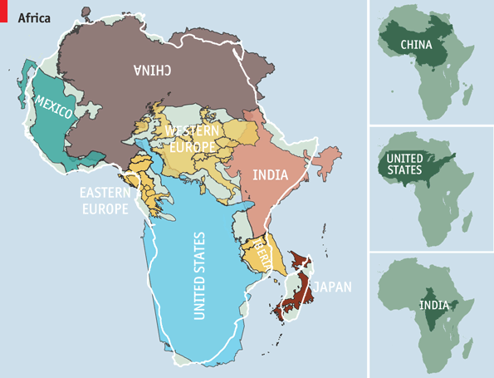
Africa is bigger than often imagined (Economist)
Population Africa 1.1 bn
China 1.4bn
India 1.27bn
EU 507m
USA 323m
Japan 127 m
Mexico 124m

Slide 14
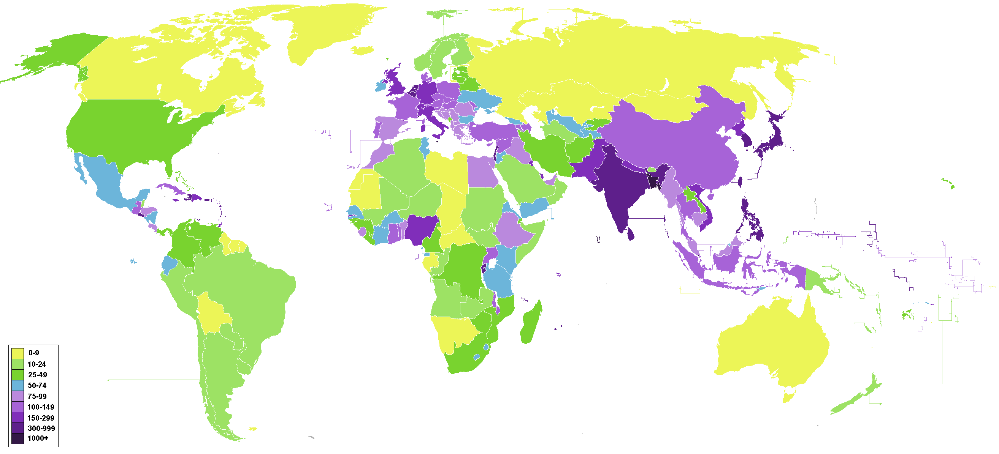
World population density per km (Wiki 2015)

Slide 15
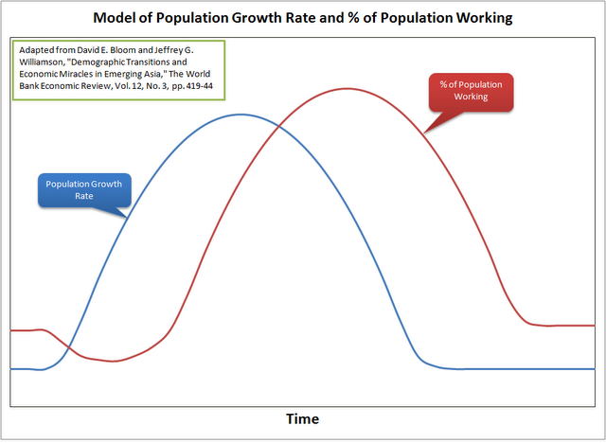
The demographic dividend and second demographic dividend?

Slide 16
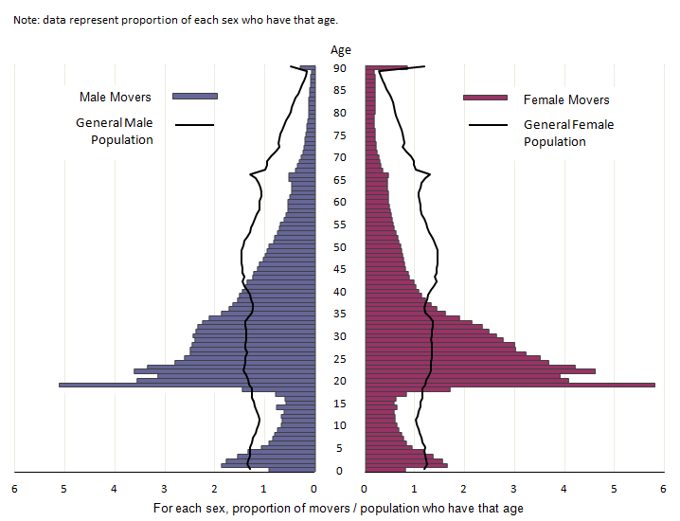
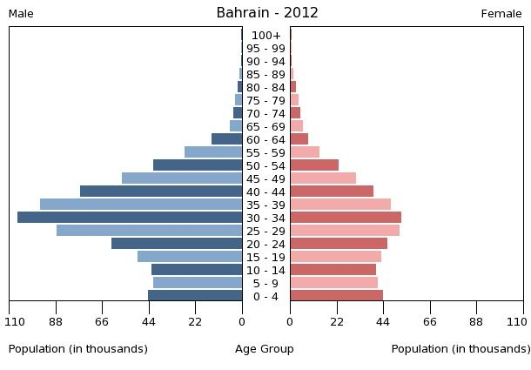
External (L, Bahrain) and internal (UK) migration

Slide 17
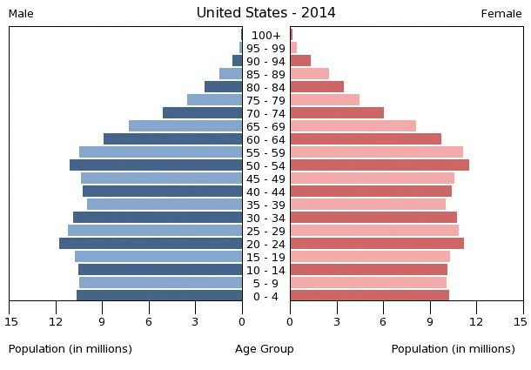
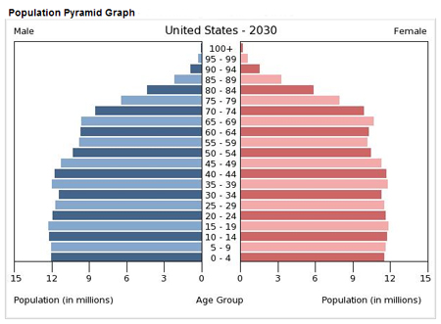
USA- relatively stable structure, whilst aging

Slide 18
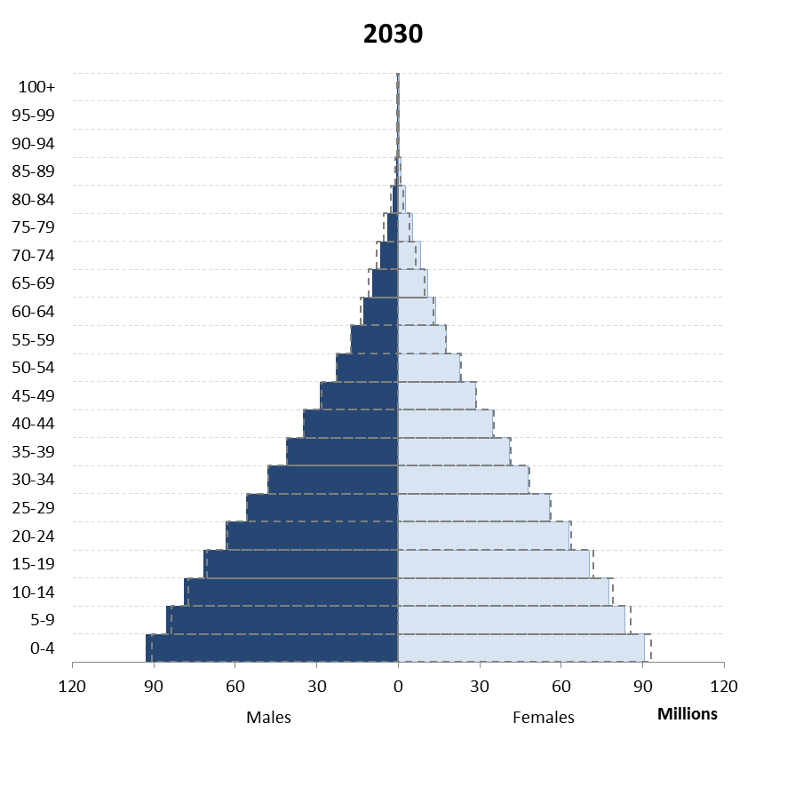
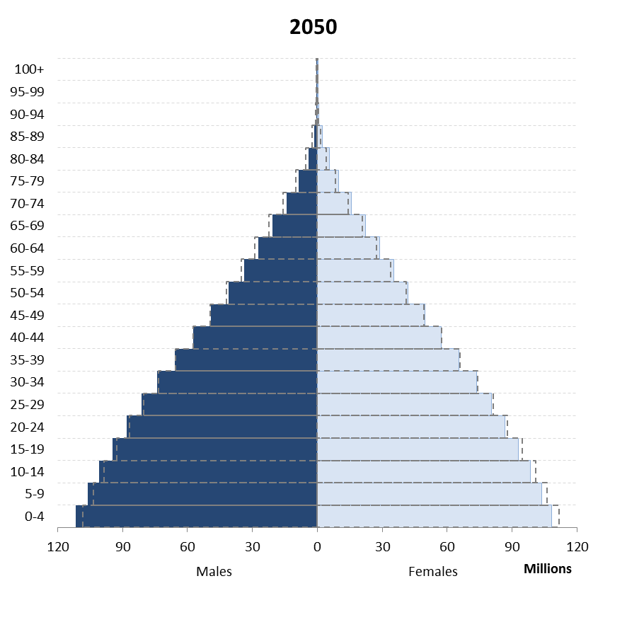
Sub-Saharan Africa

Slide 19
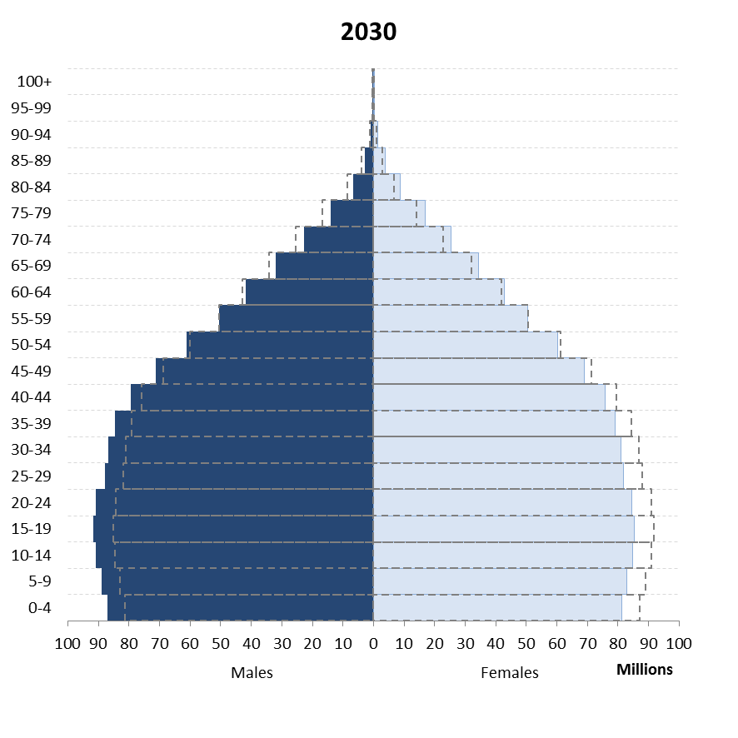
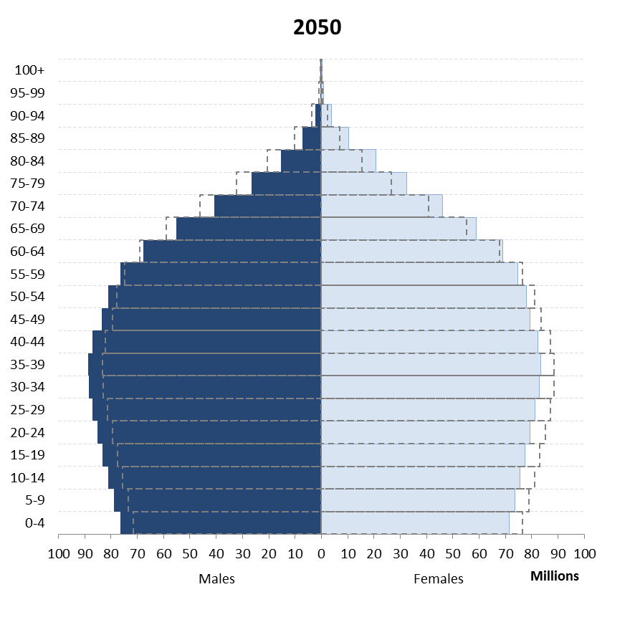
South Asia

Slide 20
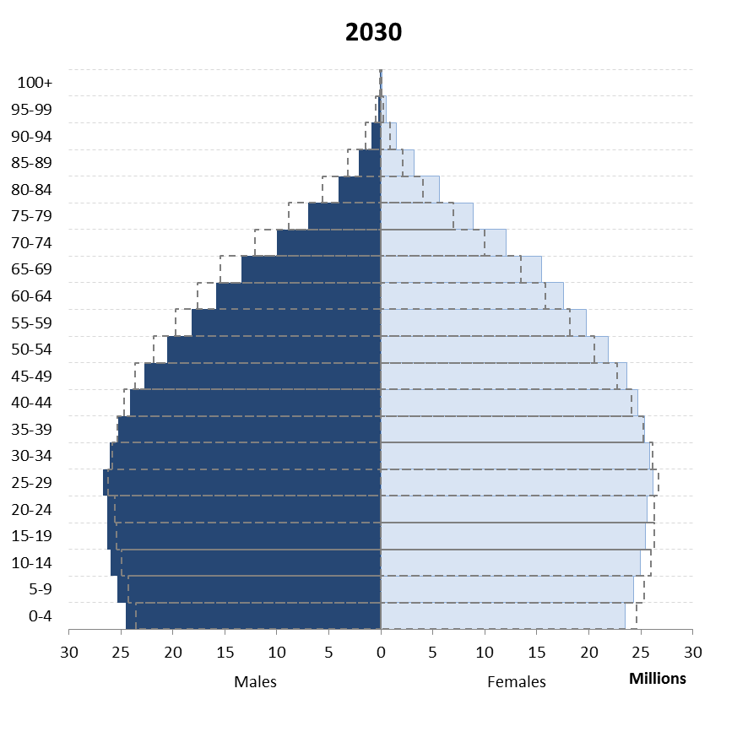
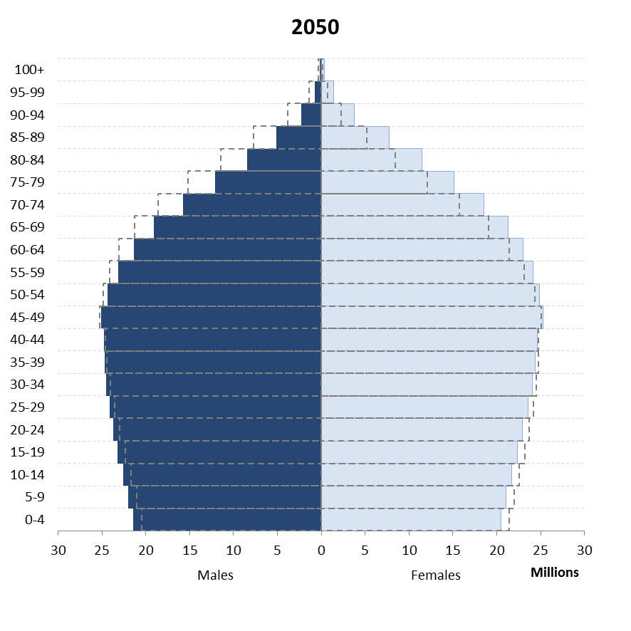
Latin America and Caribbean

Slide 21
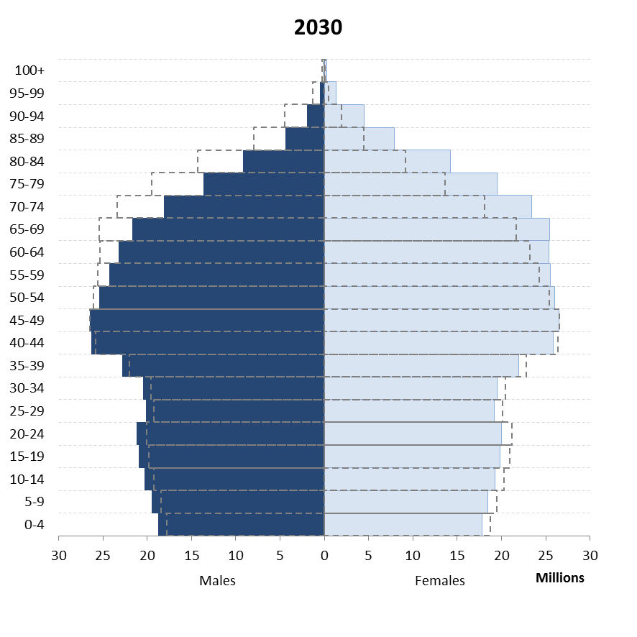
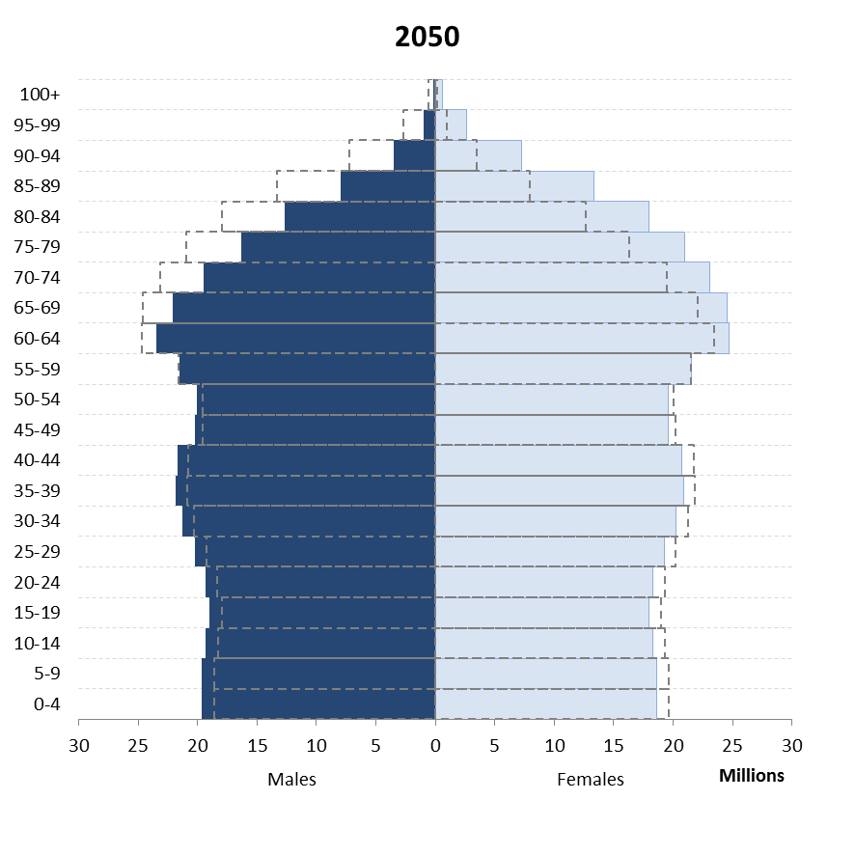
Europe

Slide 22
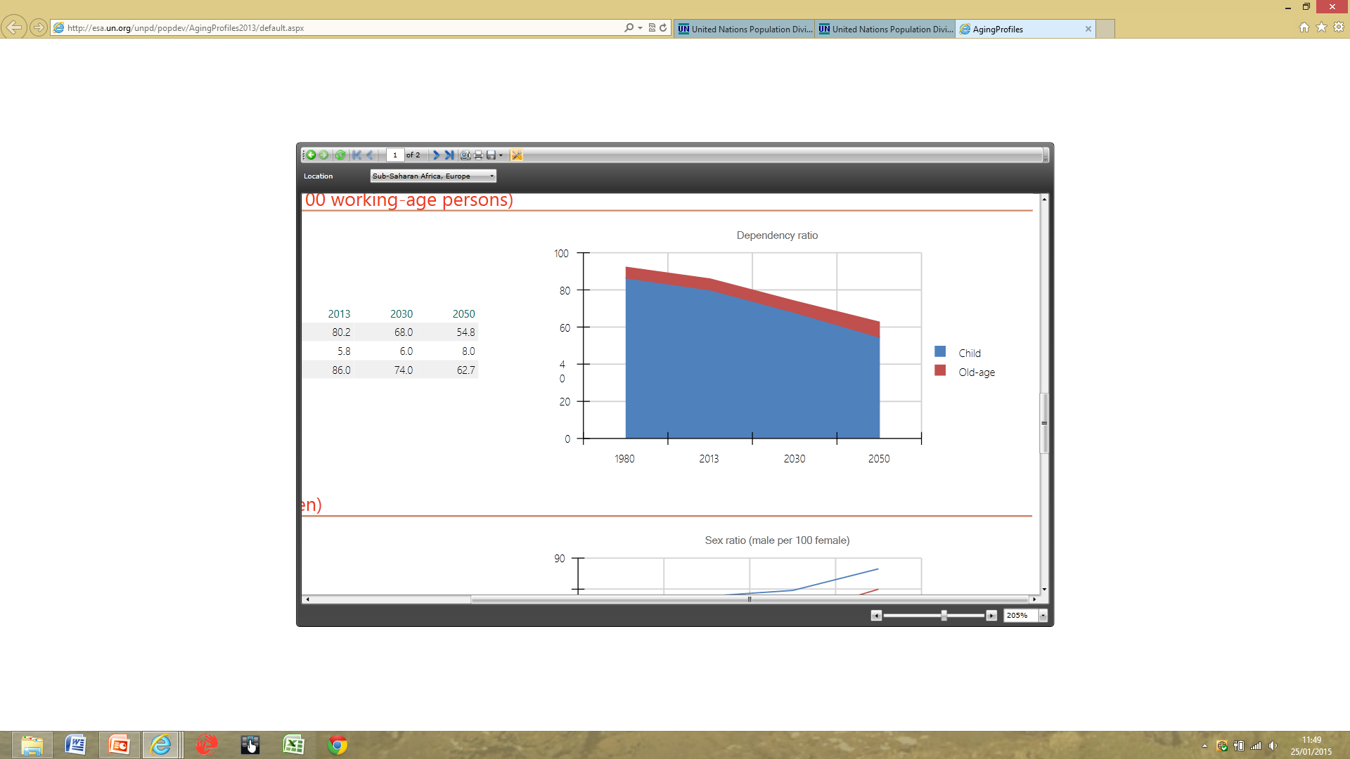
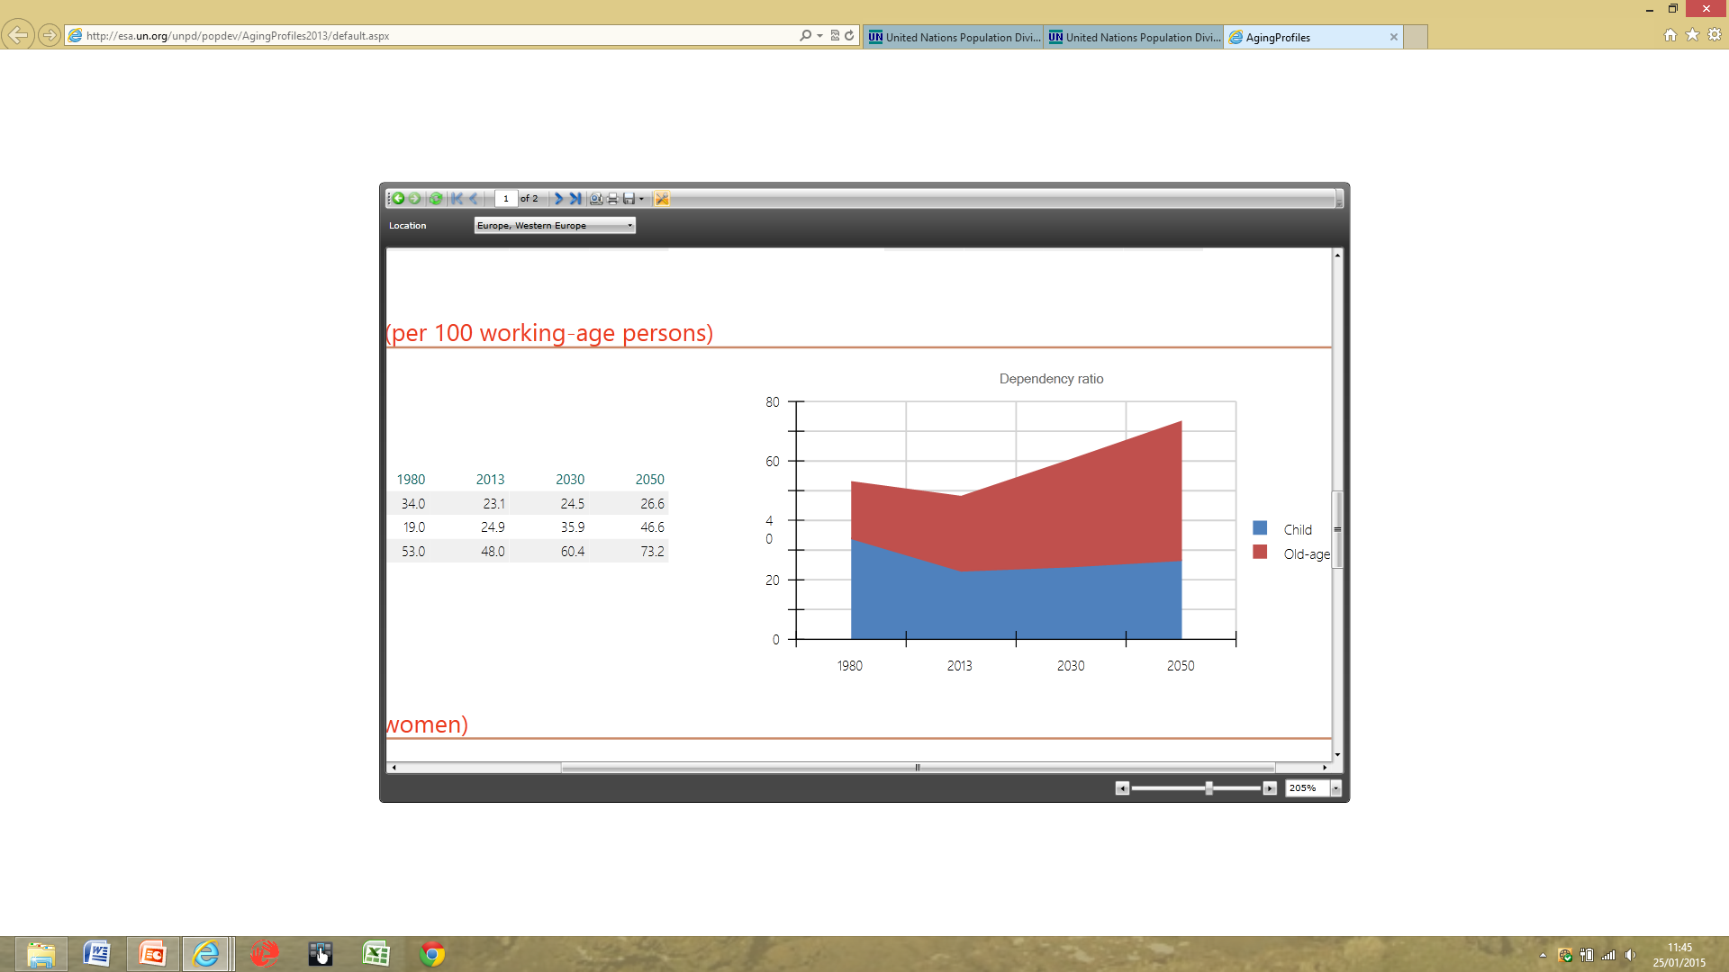
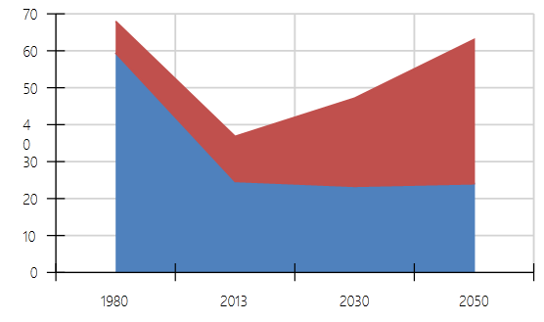
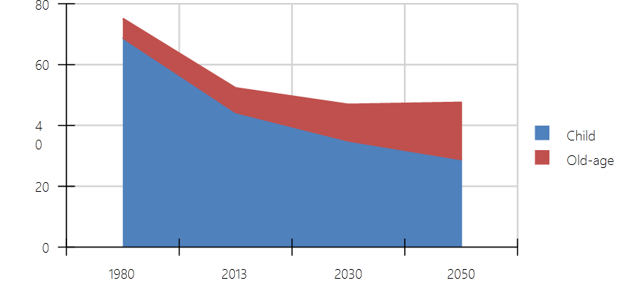
Dependency ratios: Clockwise from top L Western Europe, Sub-Saharan Africa, India, China. (UNPop)

Slide 23
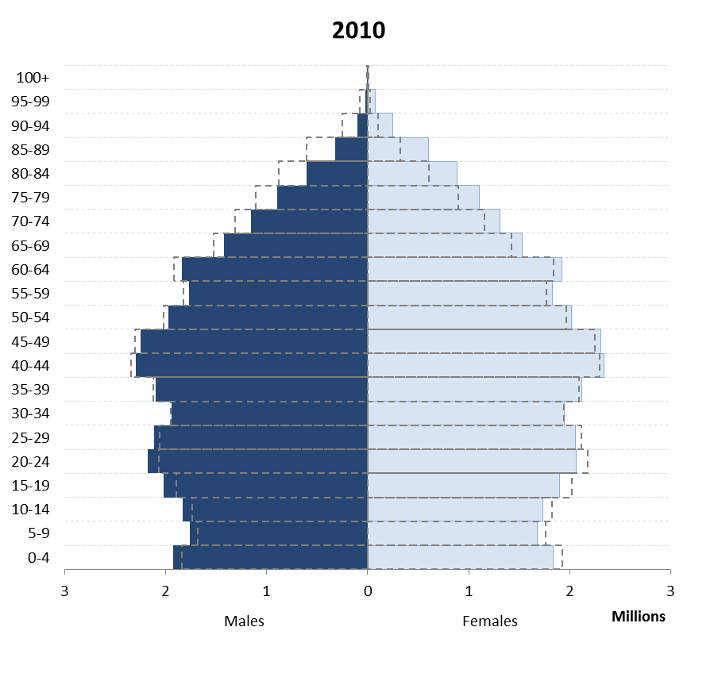
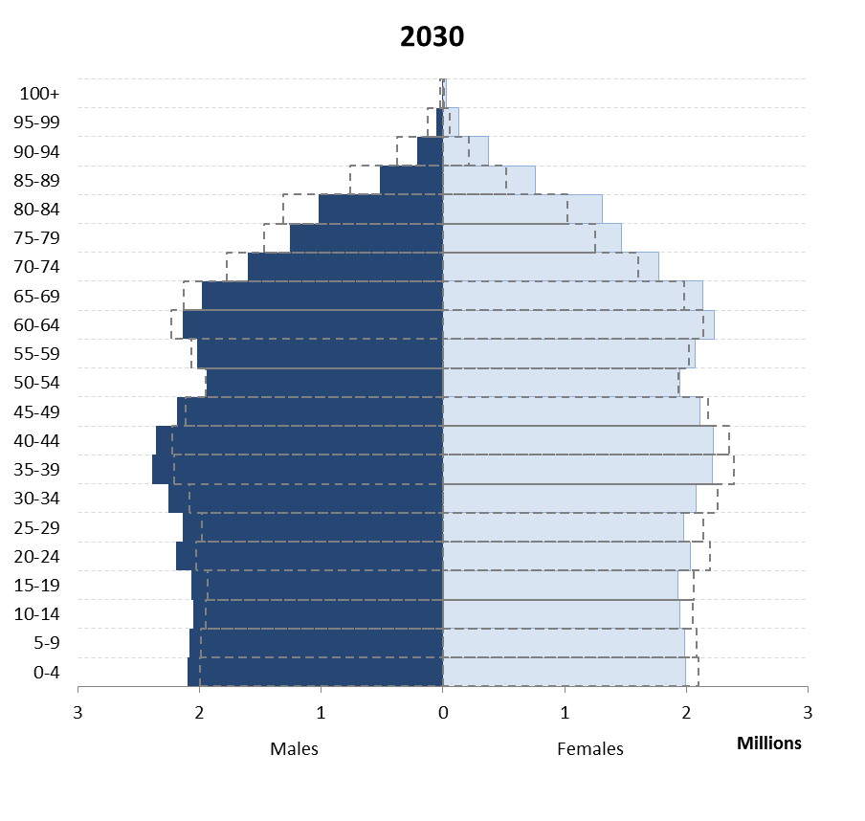
UK

Slide 24
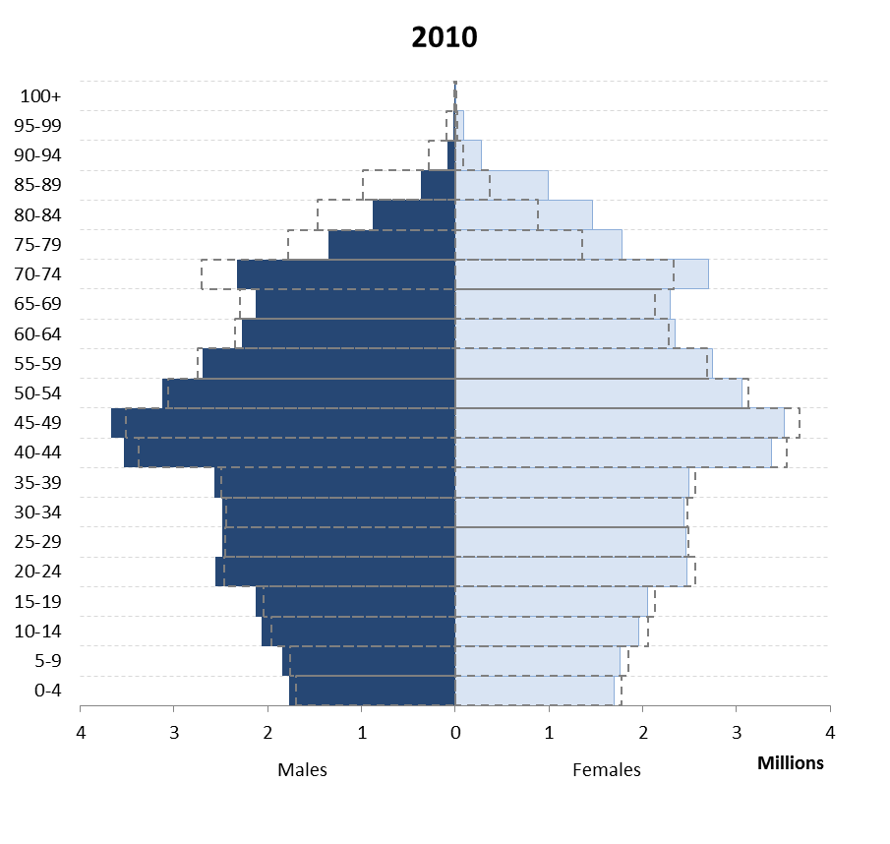
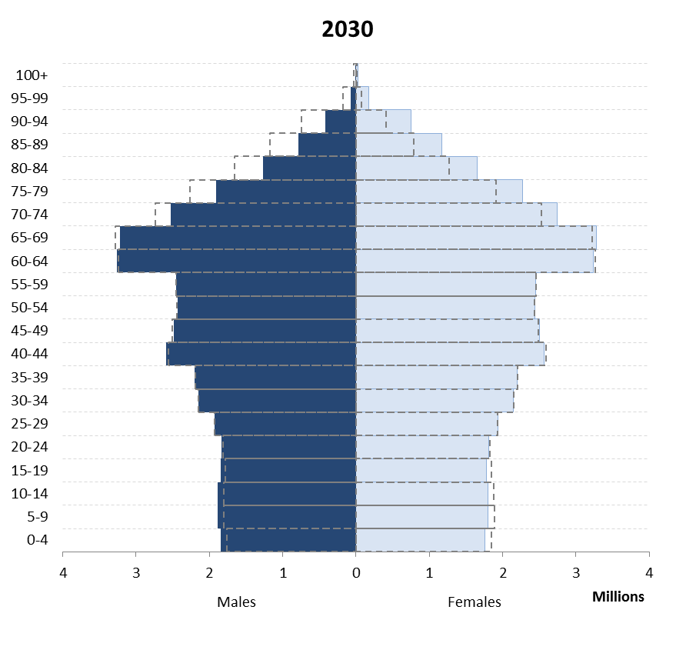
Germany

Slide 25
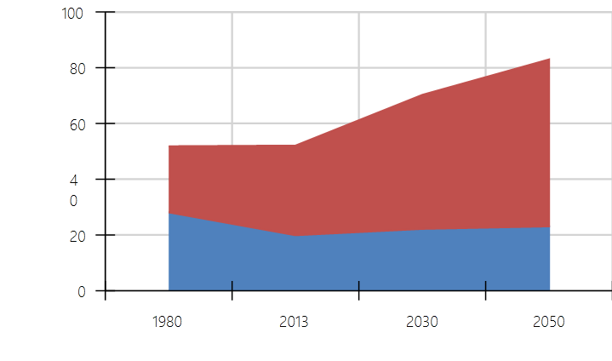
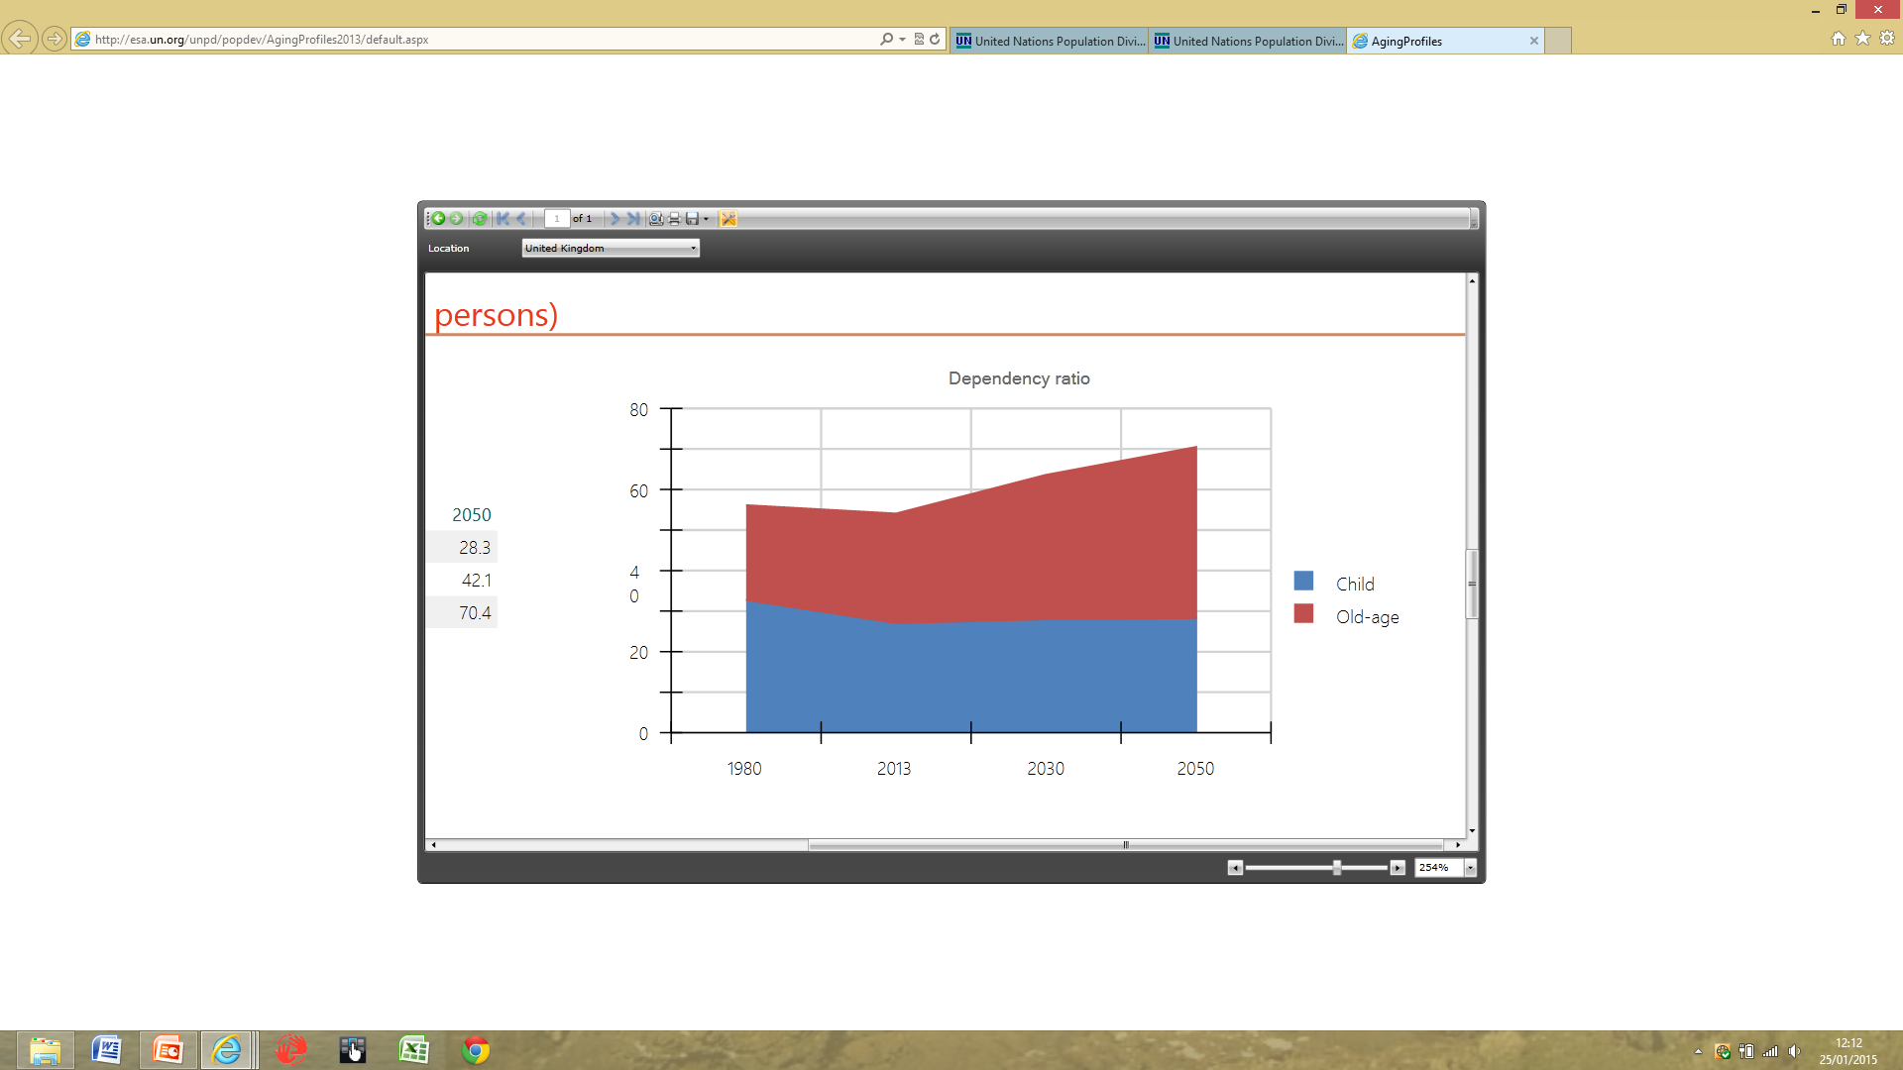
Germany (L) and UK

Slide 26
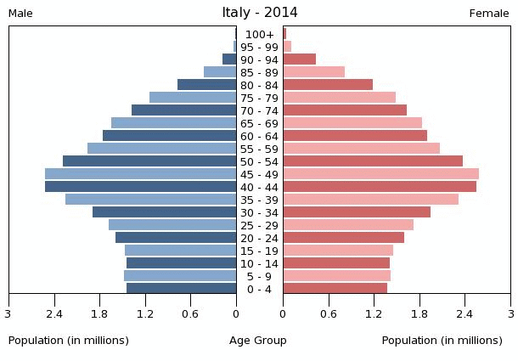
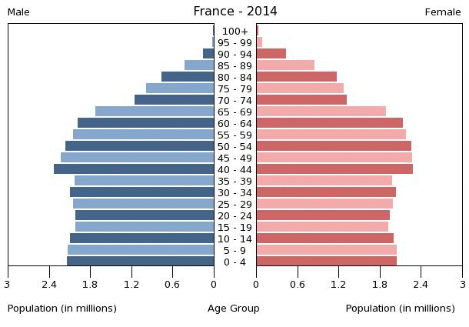
Italy (L), France

Slide 27
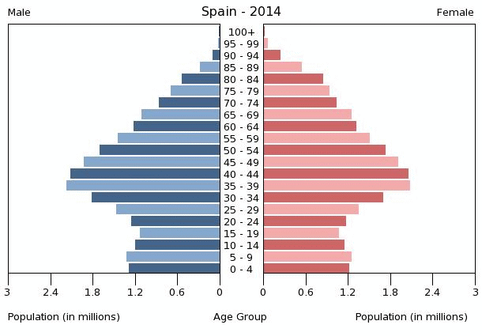
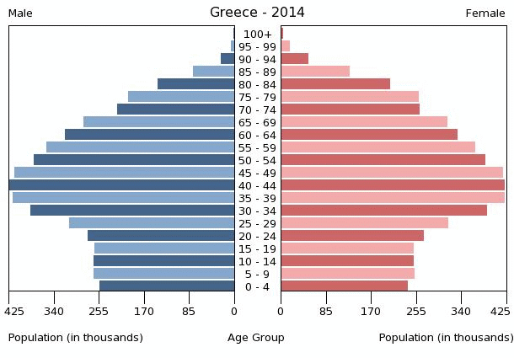
Spain (L), Greece

Slide 28
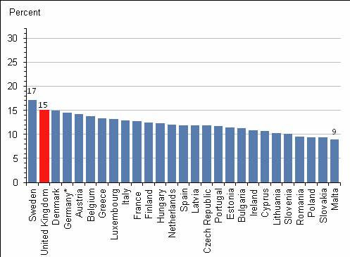
Percent of population 65 and over 1985 in EU
(ONS and Eurostat)

Slide 29
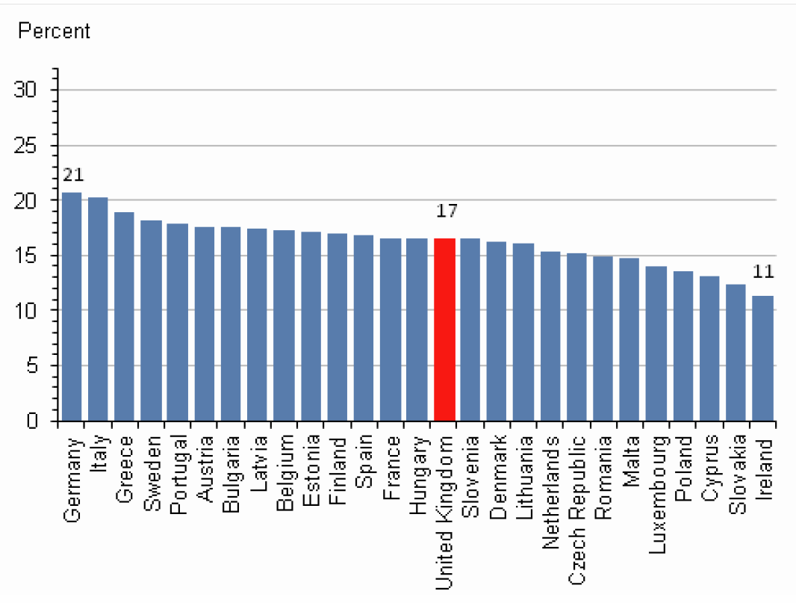
Percentage of population 65 and over 2010

Slide 30
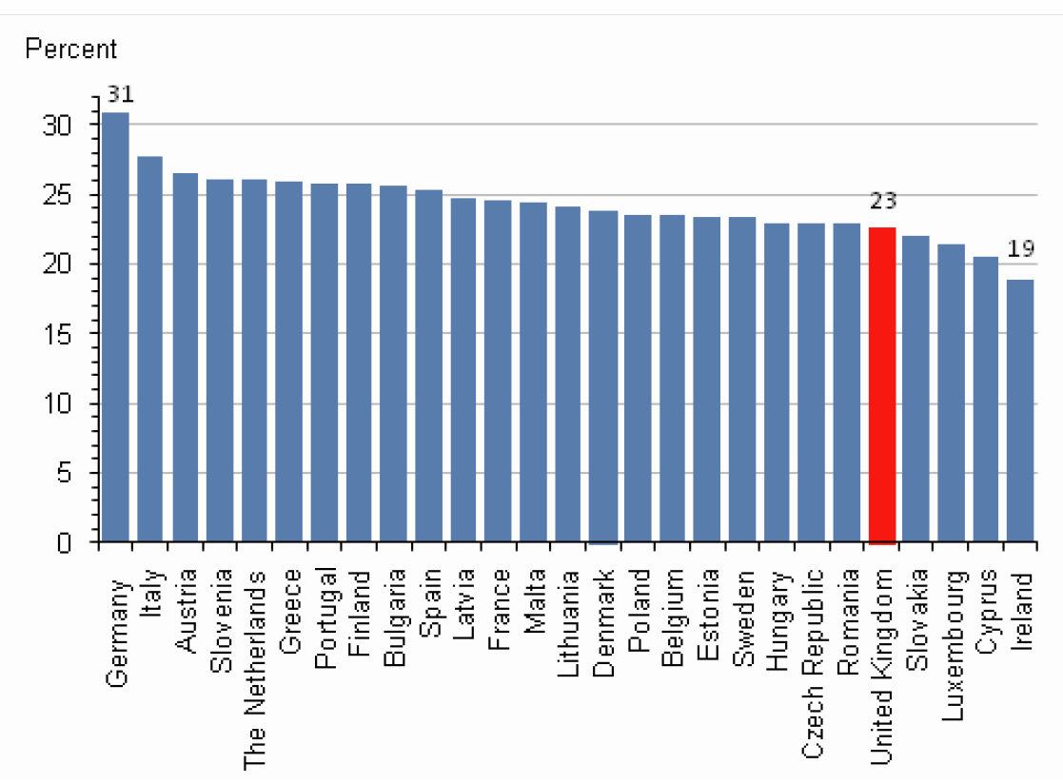
Percentage population over 65 in the EU: 2035

Slide 31
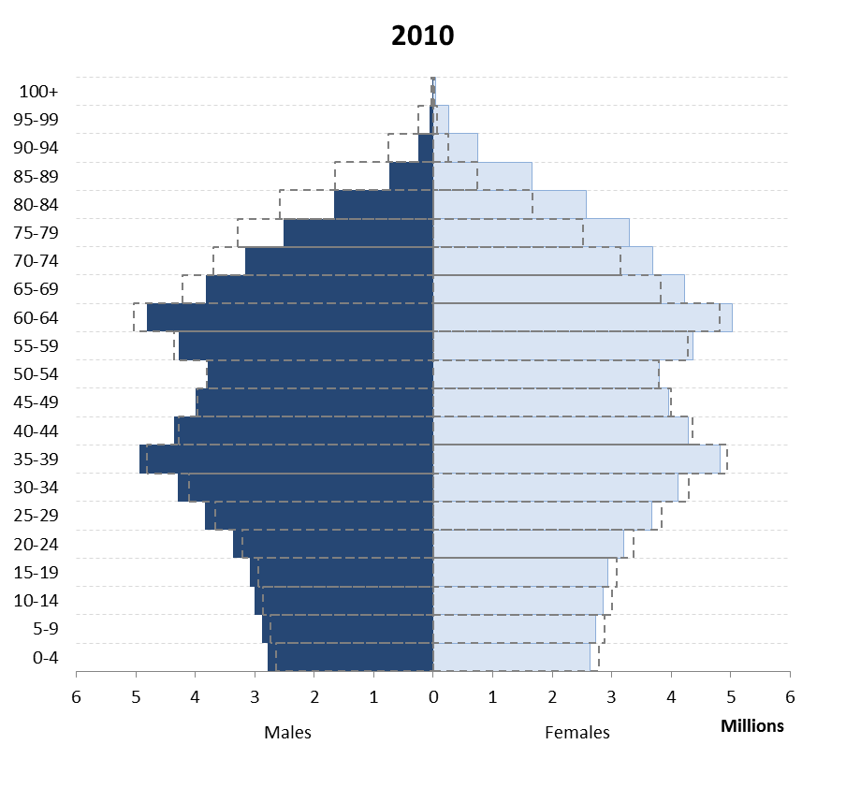
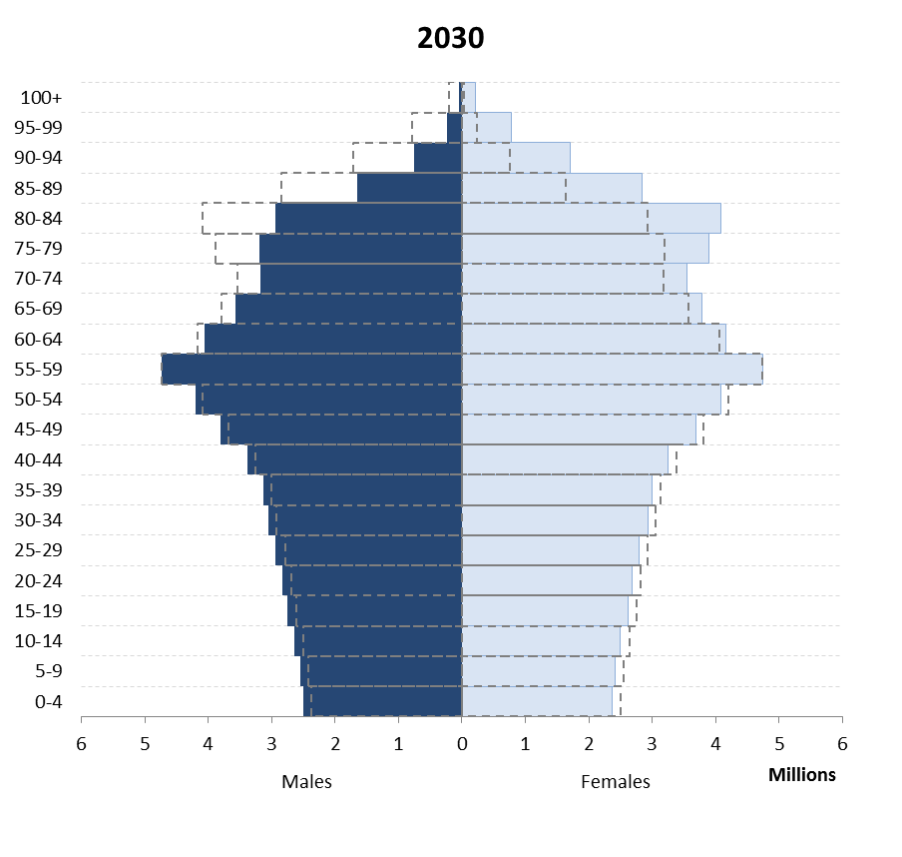
Japan

Slide 32
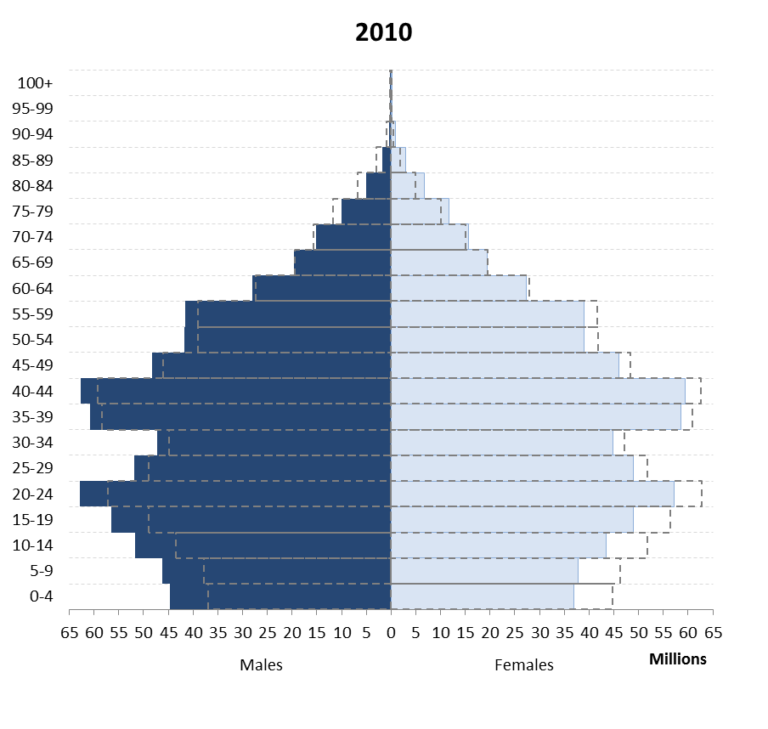

China

Slide 33

China 2

Slide 34


India

Slide 35

India 2

Slide 36


Bangladesh

Slide 37


Brazil

Slide 38


Nigeria

Slide 39


Ethiopia

Slide 40


South Africa

Slide 41
Projected population structure with and without the AIDS epidemic, Botswana, 2020
80
Projected population
structure in 2020
75
70
Males
Females
Deficits due to AIDS
65
60
55
Age in years
50
45
40
35
30
25
20
15
10
5
0
Population (thousands)
Source: US Census Bureau, World Population Profile 2000

Slide 42


Russia

Slide 43


Iran

Slide 44


Iran 2

Slide 45


Syria

Slide 46


Afghanistan

Slide 47


Zimbabwe

Slide 48


UK including effect of WWI (Census data)

Slide 49


UK demographic transition and effect of WW2, wealth and contraception

Slide 50

Migration into and out of London by age (ONS 2014).
Of 8.4 million population, 197,000 moved into London, 252,000 moved out in 2013.
In- young adults for work.
Out- families and children, retiring, university/college.
This keeps London forever young, exporting age.

Slide 51

Net flow between other cities and London 2009-2012 (GO-Science)
Two-thirds of graduates move to London.
Movement of young people from north and West to London, and outflow to South-East and South-West

Slide 52

London v England, 2017 (ONS 2012 data)

Slide 53

London v England, 2037 (ONS 2012 data)

Slide 54


Inner (L) v outer London (2001 Census data)

Slide 55


Wandsworth (L), City of London

Slide 56


Not just London- many cities and some student towns. Oxford (L) Nottingham

Slide 57


UK international migrant populations not random (Jones et al)

Slide 58


The other side: Rother (L) and Chichester

Slide 59

Northumberland and Newcastle 2012 (ONS)

Slide 60

Northumberland and Newcastle 2037

Slide 61

North Norfolk, East Devon, 2012

Slide 62

North Norfolk, East Devon, 2037

Slide 63


Population aged 85 or over, 1992 and 2015 (ONS)

Slide 64

Population 85 and over, 2033.

Slide 65

Age support ratio 2015: persons of working age / state pension (ONS)

Slide 66


Age support ratio (working/pensioner), 1993-2033 (ONS)

Slide 67

Improving health at the extremes of life- two of the great challenges for our generation.
One in three UK babies born in 2015 will live to 100.
The opportunities, economics and stability of the world they will live in will be profoundly affected by current demographic shifts.
Health drives demography-which affects health.
How and where will we care for them in their old age?

