Slide 1

Euler’s Exponentials
Raymond Flood
Gresham Professor of Geometry

Slide 2
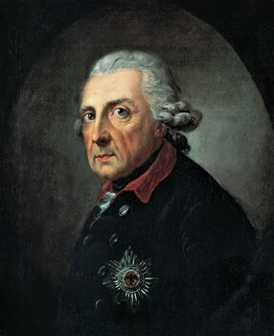
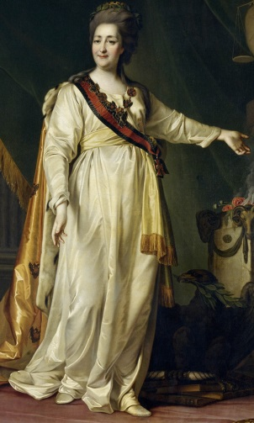
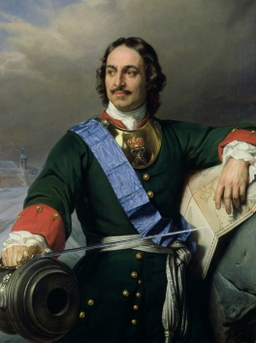
Euler’s Timeline
Born
1707
Died
1783
1727
1741
1766
Basel
St. Petersburg
Berlin
St. Petersburg
Peter the Great of Russia
Frederick the Great of Prussia
Catherine the Great of Russia

Slide 3
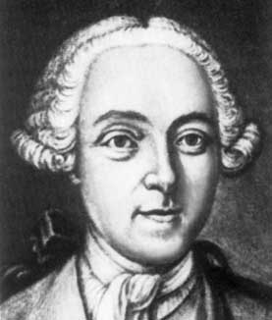
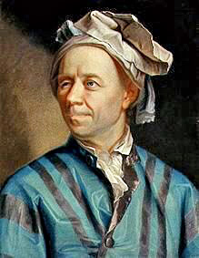
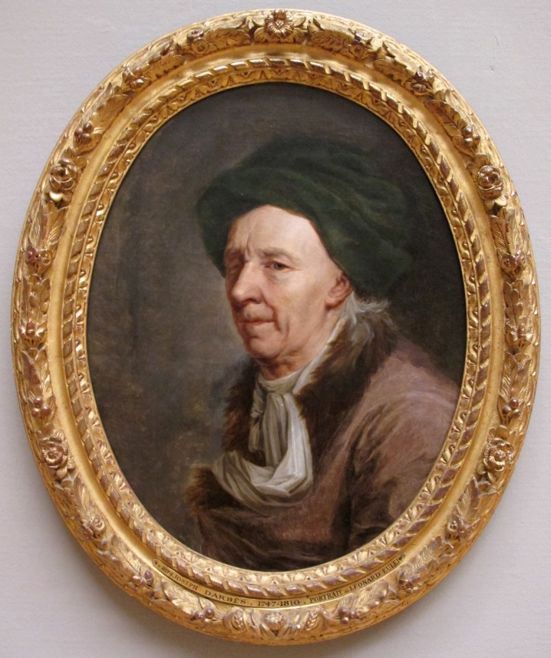
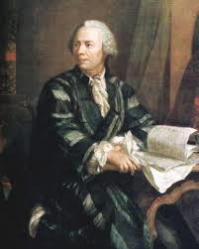
1737 mezzotint by Sokolov
Two portraits by Handmann.
Top pastel painting 1753, Below oil painting 1756
Reference: Florence Fasanelli, "Images of Euler", in Leonhard Euler: Life, Work, and Legacy, Robert E. Bradley and C. Edward Sandifer (eds.), Elsevier, 2007.
1778 oil painting
Joseph Friedrich August Darbes

Slide 4

Quantity
Over 800 books and papers
228 of his papers were published after he died
Publication of his collected works began in 1911 and to date 76 volumes have been published
Three volumes of his correspondence have been published and several more are in preparation
http://eulerarchive.maa.org/

Slide 5
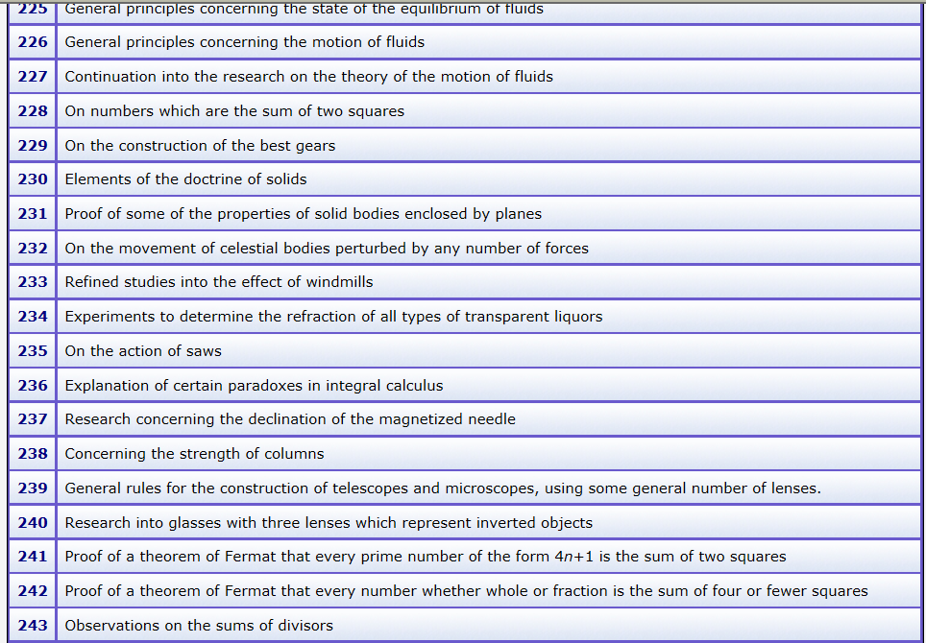
Range

Slide 6

Significance
Notation
e for the exponential number, f for a function and i for √−1.
Infinite series
  Euler’s constant
(1 + ¹/₂ + ¹/₃ + ¹/₄ + ¹/₅ + . . . + ¹/_{n}) – log_{e} n
  Basel problem
1 + ¹/₄ + ¹/₉ + ¹/₁₆ + ¹/₂₅ + . . . = π²/6
4th powers π⁴/90
6th powers π⁶/945, and up to the 26th powers!

Slide 7
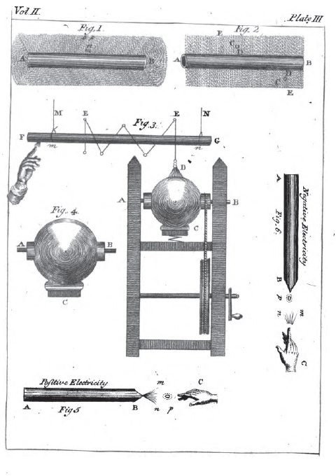
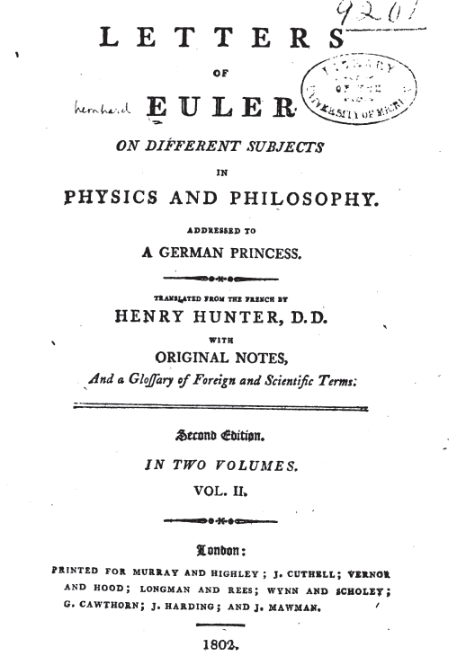
Letters to a German princess

Slide 8
The number e = 2.7182818284590452…
Invest £1
Interest rate 100%
Interest applied each | Sum at end of the year
Year | £2.00000
Half-year | £2.25000
Quarter | £2.44141
Month | £2.61304
Week | £2.69260
Day | £2.71457
Hour | £2.71813
Minute | £2.71828
Second | £2.71828

Slide 9
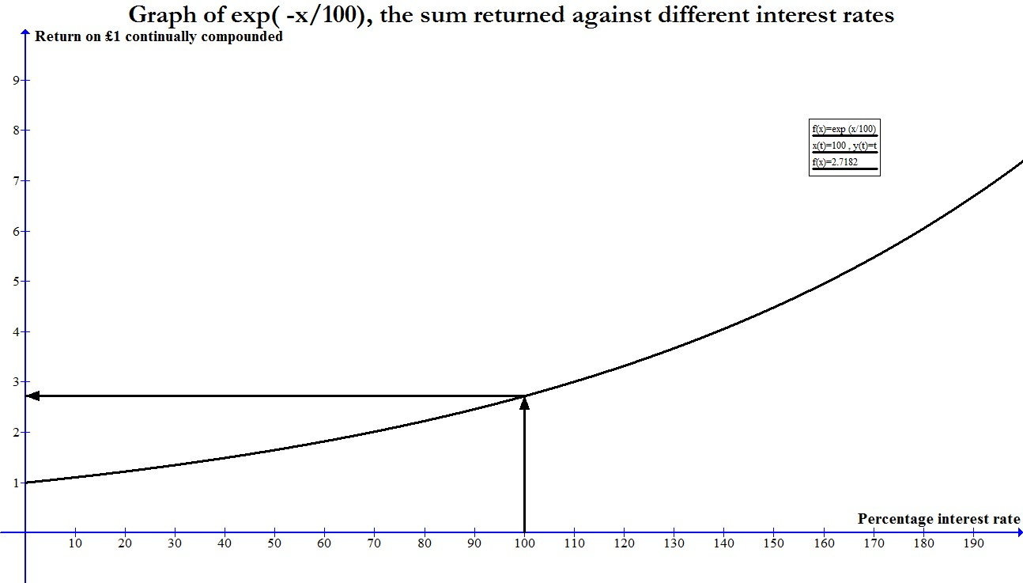
Exponential growth
e

Slide 10
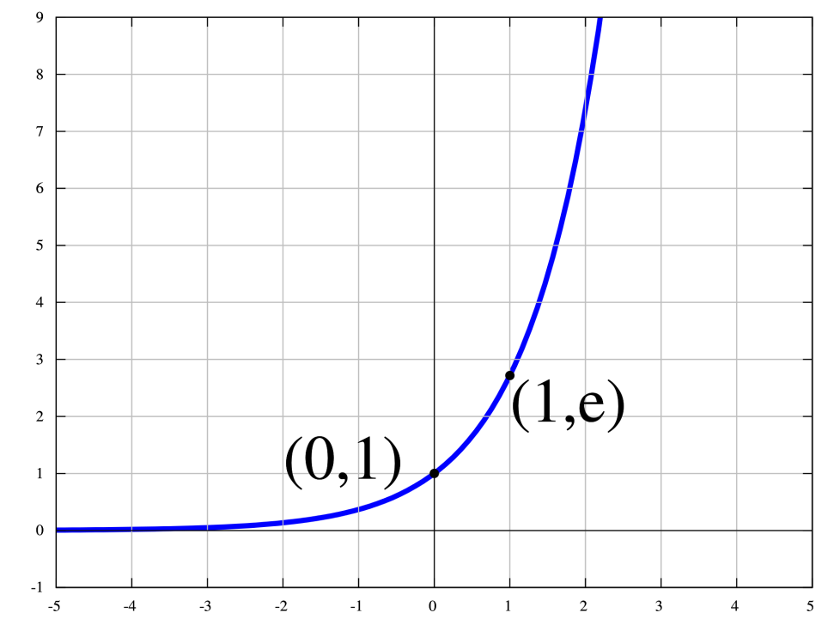
Exponential function
The exponential function e^{x}
The slope of this curve above any point x is also e^{x}

Slide 11
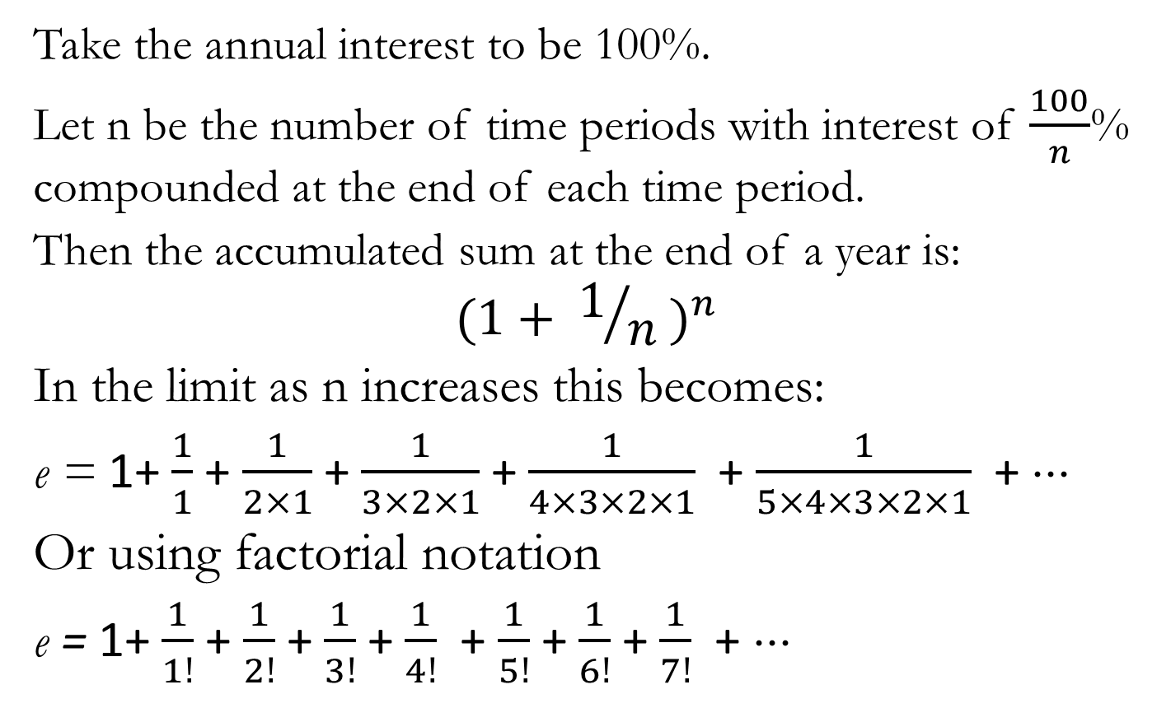
A series expression for e
Take the annual interest to be 100%.
Let n be the number of time periods with interest of $\frac{100}{n}$% compounded at the end of each time period.
Then the accumulated sum at the end of a year is:
$${(1+ 1/n )}^{n}$$
In the limit as n increases this becomes:
e = 1+ $\frac{1}{1}$ + $\frac{1}{2×1}$ + $\frac{1}{3×2×1}$ + $\frac{1}{4×3×2×1}$+ $\frac{1}{5×4×3×2×1}$+ ⋅⋅⋅
Or using factorial notation
e = 1+ $\frac{1}{1!}$ + $\frac{1}{2!}$ + $\frac{1}{3!}$ + $\frac{1}{4!}$+ $\frac{1}{5!}$+ $\frac{1}{6!}$+ $\frac{1}{7!}$+ ⋅⋅⋅

Slide 12


$e^{x}$ as an infinite series
$e^{1}$ = 1+ $\frac{1}{1!}$ + $\frac{1}{2!}$ + $\frac{1}{3!}$ + $\frac{1}{4!}$+ $\frac{1}{5!}$+ $\frac{1}{6!}$+ $\frac{1}{7!}$+ ⋅⋅⋅
$e^{x}$ = 1+ $\frac{x}{1!}$ + $\frac{x^{2}}{2!}$ + $\frac{x^{3}}{3!}$ + $\frac{x^{4}}{4!}$+ $\frac{x^{5}}{5!}$+ $\frac{x^{6}}{6!}$+ $\frac{x^{7}}{7!}$+ ⋅⋅⋅
is the limit of ${(1+ x/n )}^{n}$

Slide 13
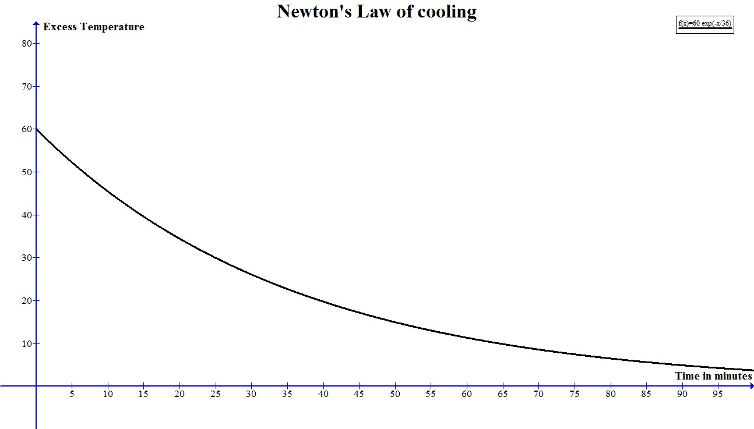
Exponential Decay

Slide 14
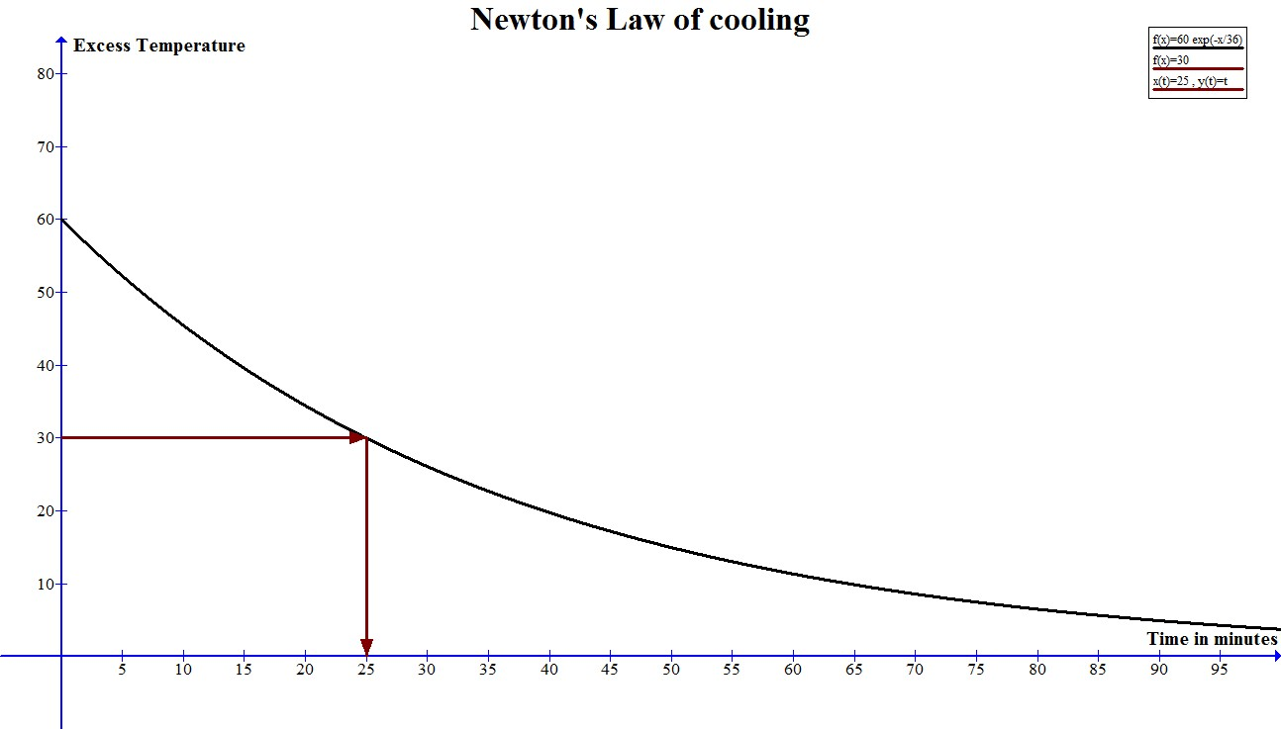
Exponential decay: half-life the time for the excess temp to halve from any value is always the same

Slide 15
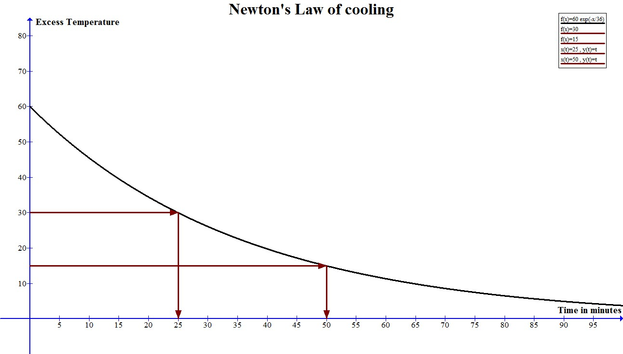
Exponential decay: half-life the time for the excess temp to halve from any value is always the same

Slide 16
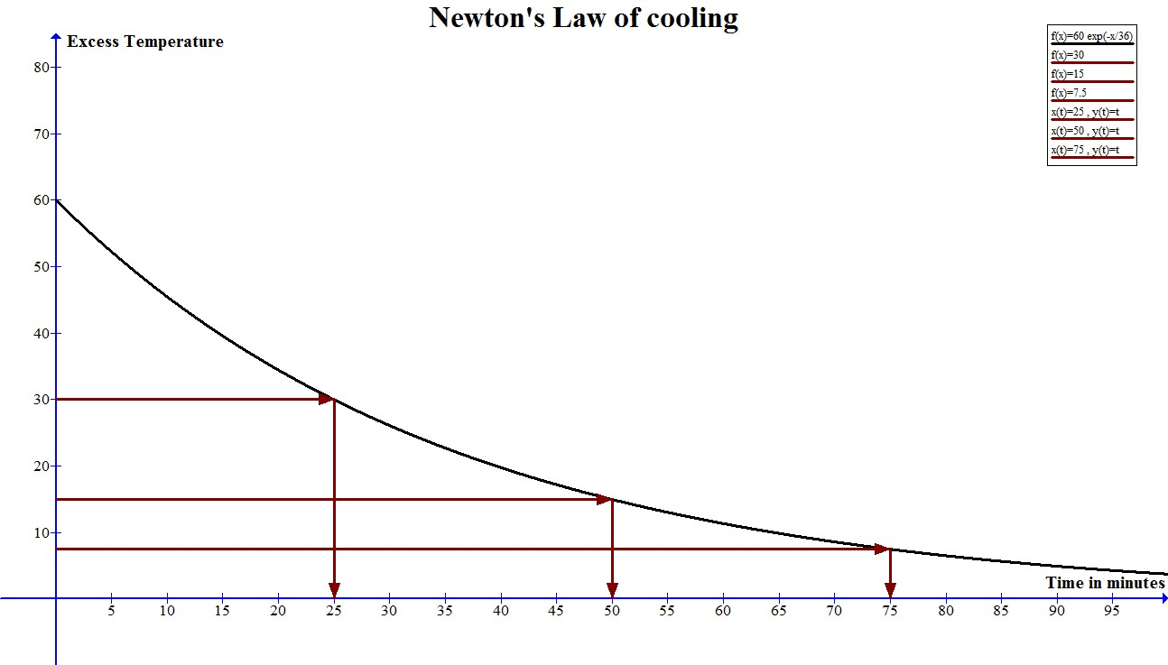
Exponential decay: half-life the time for the excess temp to halve from any value is always the same

Slide 17
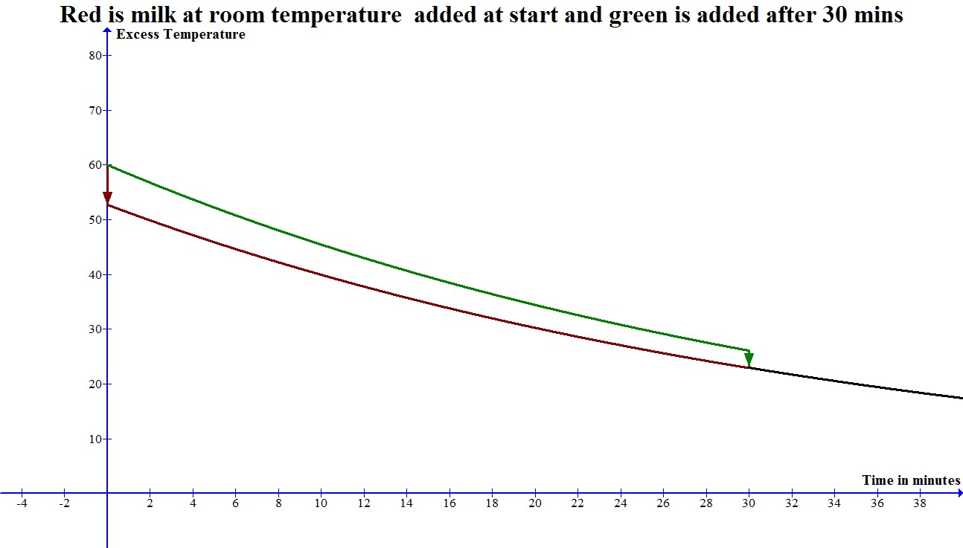
If milk is at room temperature

Slide 18
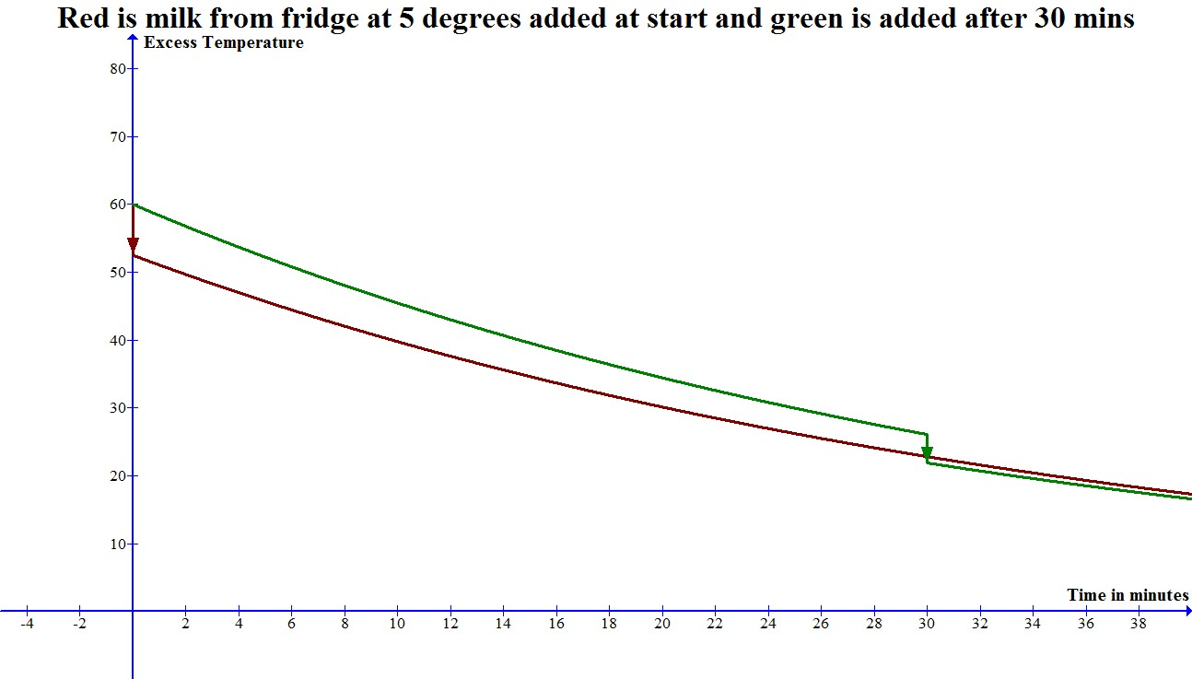
If milk is from the fridge

Slide 19
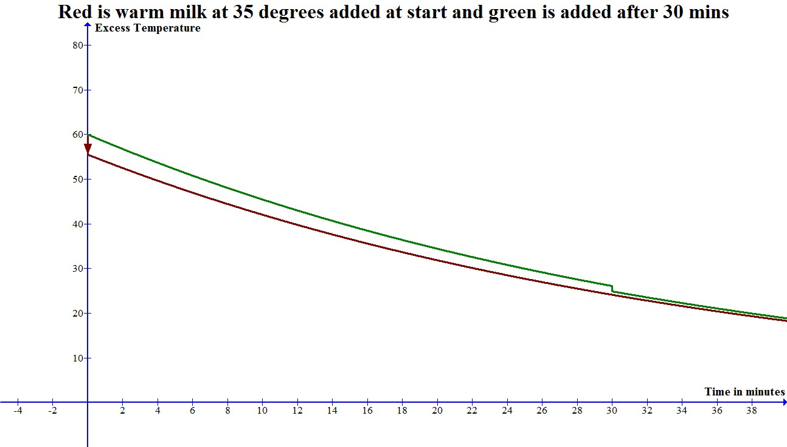
If the milk is warm

Slide 20
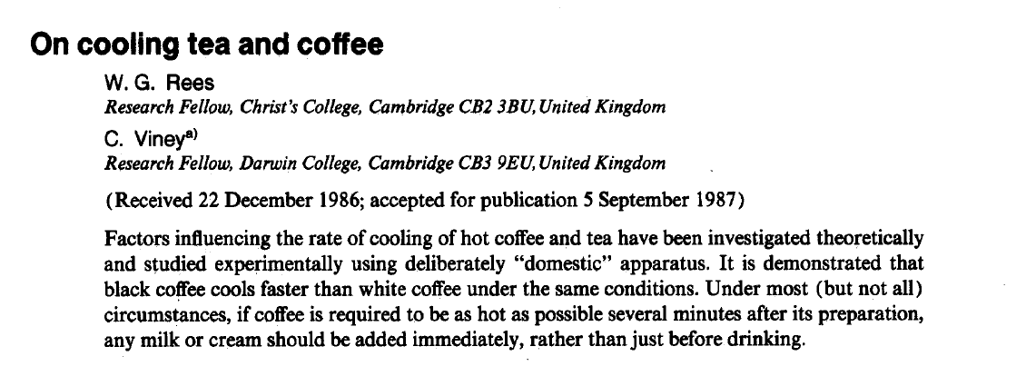
Black coffee and white coffee cool at different rates!

Slide 21
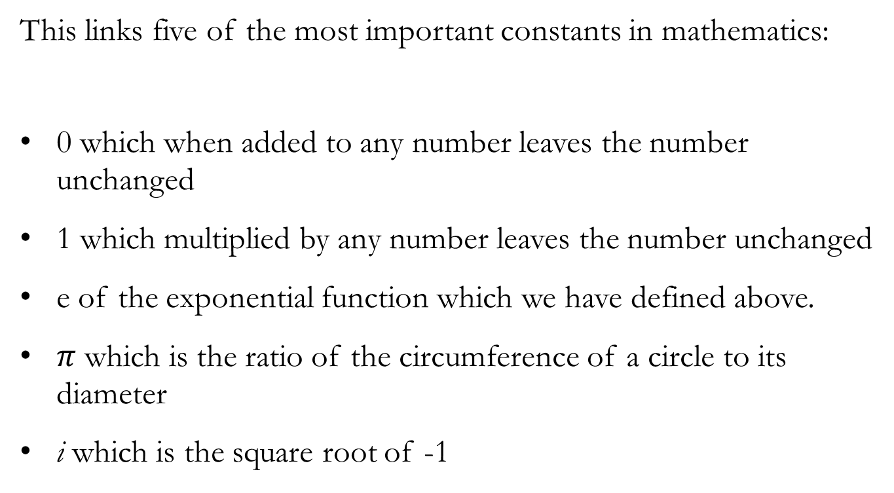

$e^{iπ}$ + 1 = 0
This links five of the most important constants in mathematics:
0 which when added to any number leaves the number unchanged
1 which multiplied by any number leaves the number unchanged
e of the exponential function which we have defined above.
$π$ which is the ratio of the circumference of a circle to its diameter
i which is the square root of -1

Slide 22
Euler on complex numbers
Of such numbers we may truly assert that they are neither nothing, nor greater than nothing, nor less than nothing, which necessarily constitutes them imaginary or impossible.

Slide 23
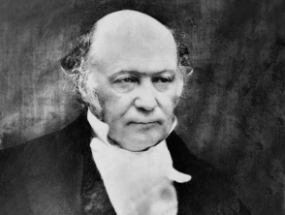
Complex Numbers
William Rowan Hamilton 1805 - 1865
We define a complex number as a pair (a, b) of real numbers.

Slide 24
Complex Numbers
William Rowan Hamilton 1805 - 1865
We define a complex number as a pair (a, b) of real numbers.
They are added as follows: (a, b) + (c, d) = (a + c, b + d);
(1, 2) + (3, 4) = (4, 6)

Slide 25
Complex Numbers
William Rowan Hamilton 1805 - 1865
We define a complex number as a pair (a, b) of real numbers.
They are added as follows: (a, b) + (c, d) = (a + c, b + d);
They are multiplied as follows: (a, b) x (c, d) = (ac - bd, ad + bc);
(1, 2) × (3, 4) = (3 – 8, 4 + 6) = (-5, 10)

Slide 26
Complex Numbers
William Rowan Hamilton 1805 - 1865
We define a complex number as a pair (a, b) of real numbers.
They are added as follows: (a, b) + (c, d) = (a + c, b + d);
They are multiplied as follows: (a, b) x (c, d) = (ac - bd, ad + bc);
The pair (a, 0) then corresponds to the real number a
the pair (0, 1) corresponds to the imaginary number i

Slide 27
Complex Numbers
William Rowan Hamilton 1805 - 1865
We define a complex number as a pair (a, b) of real numbers.
They are added as follows: (a, b) + (c, d) = (a + c, b + d);
They are multiplied as follows: (a, b) x (c, d) = (ac - bd, ad + bc);
The pair (a, 0) then corresponds to the real number a
the pair (0, 1) corresponds to the imaginary number i
Then (0, 1) x (0, 1) = (-1, 0),
which corresponds to the relation
i x i = - 1.

Slide 28
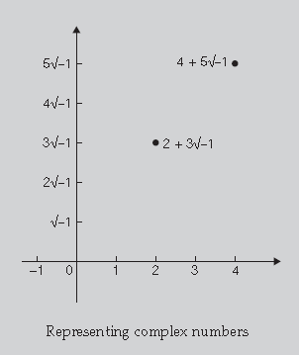
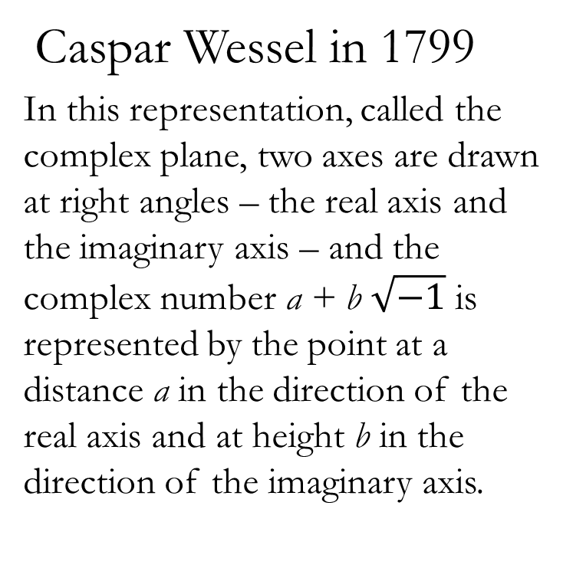
Representing Complex numbers geometrically
Caspar Wessel in 1799
In this representation, called the complex plane, two axes are drawn at right angles – the real axis and the imaginary axis – and the complex number a + b $\sqrt{−1}$ is represented by the point at a distance a in the direction of the real axis and at height b in the direction of the imaginary axis.

Slide 29
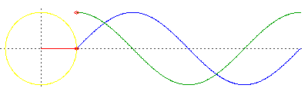
This animation depicts points moving along the graphs of the sine function (in blue) and the cosine function (in green) corresponding to a point moving around the unit circle
Source: http://www2.seminolestate.edu/lvosbury/AnimationsForTrigonometry.htm

Slide 30
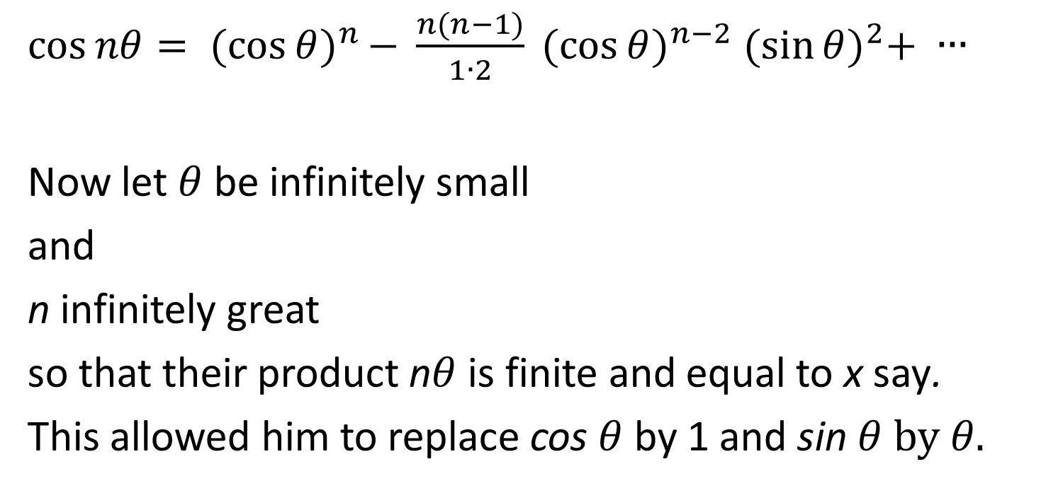
Expression for the cosine of a multiple of an angle in terms of the cosine and sine of the angle
$\cos{nθ= {(\cos{θ)}}^{n }− \frac{n(n−1)}{1∙2}} {(\cos{θ)}}^{n−2} {(\sin{θ)}}^{2}+ ∙∙∙$
Now let $θ$ be infinitely small
and
n infinitely great
so that their product n$θ$ is finite and equal to x say.
This allowed him to replace cos $θ$ by 1 and sin $θ by θ.$

Slide 31
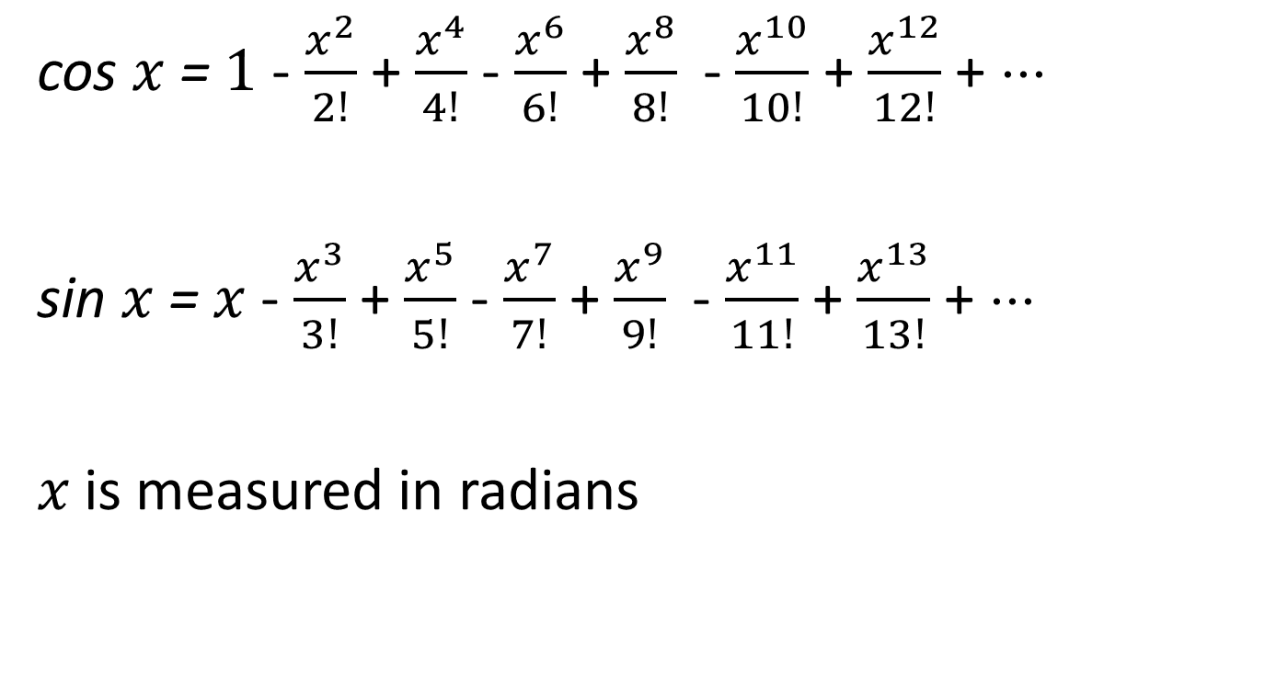
Series expansions for sin and cos
cos $x$ =$1$ - $\frac{x^{2}}{2!}$ + $\frac{x^{4}}{4!}$ - $\frac{x^{6}}{6!}$ +$\frac{x^{8}}{8!}$- $\frac{x^{10}}{10!}$ + $\frac{x^{12}}{12!}$ + ⋅⋅⋅
sin $x$ =$x$ - $\frac{x^{3}}{3!}$ + $\frac{x^{5}}{5!}$ - $\frac{x^{7}}{7!}$ +$\frac{x^{9}}{9!}$- $\frac{x^{11}}{11!}$ + $\frac{x^{13}}{13!}$ + ⋅⋅⋅
𝑥 is measured in radians

Slide 32

$e^{ix}$ = cos $x$ + $i$ sin $x$

Slide 33

$e^{ix}$ = cos $x$ + $i$ sin $x$
cos $x$ =$1$ - $\frac{x^{2}}{2!}$ + $\frac{x^{4}}{4!}$ - $\frac{x^{6}}{6!}$ +$\frac{x^{8}}{8!}$- $\frac{x^{10}}{10!}$ + $\frac{x^{12}}{12!}$ + ⋅⋅⋅
$i$sin $x$ =$ix$ - $i \frac{x^{3}}{3!}$ + $i \frac{x^{5}}{5!}$ - $i \frac{x^{7}}{7!}$ +$i\frac{x^{9}}{9!}$- $i \frac{x^{11}}{11!}$ + $i \frac{x^{13}}{13!}$ + ⋅⋅⋅

Slide 34
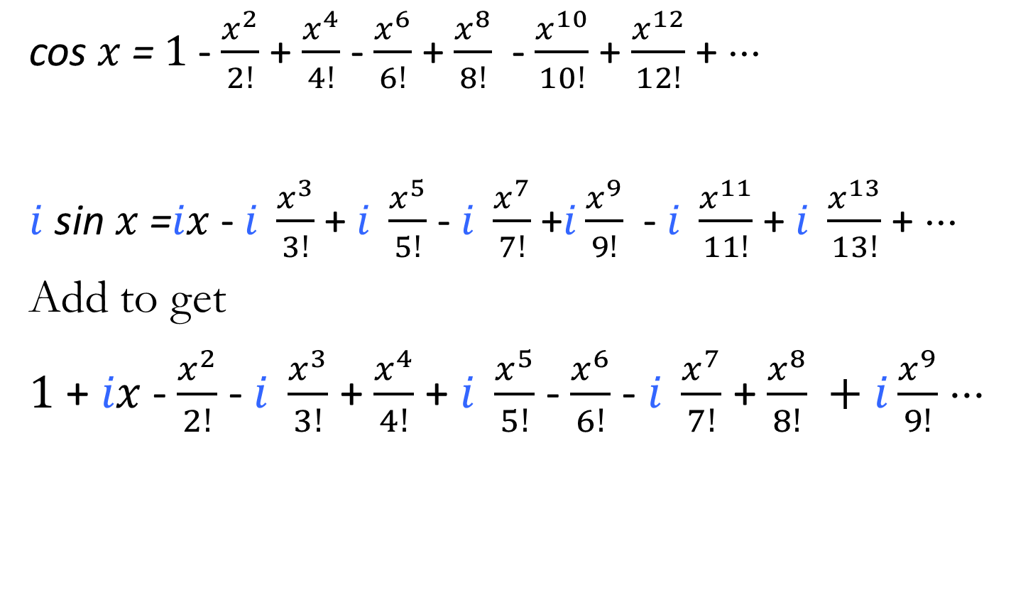
$e^{ix}$ = cos $x$ + $i$ sin $x$
cos $x$ =$1$ - $\frac{x^{2}}{2!}$ + $\frac{x^{4}}{4!}$ - $\frac{x^{6}}{6!}$ +$\frac{x^{8}}{8!}$- $\frac{x^{10}}{10!}$ + $\frac{x^{12}}{12!}$ + ⋅⋅⋅
$i$sin $x$ =$ix$ - $i \frac{x^{3}}{3!}$ + $i \frac{x^{5}}{5!}$ - $i \frac{x^{7}}{7!}$ +$i\frac{x^{9}}{9!}$- $i \frac{x^{11}}{11!}$ + $i \frac{x^{13}}{13!}$ + ⋅⋅⋅
Add to get
$1$ + $ix$- $\frac{x^{2}}{2!}$ - $i \frac{x^{3}}{3!}$ + $\frac{x^{4}}{4!}$ + $i \frac{x^{5}}{5!}$ - $\frac{x^{6}}{6!}$ - $i \frac{x^{7}}{7!}$ +$\frac{x^{8}}{8!} +i\frac{x^{9}}{9!}$ ⋅⋅⋅

Slide 35
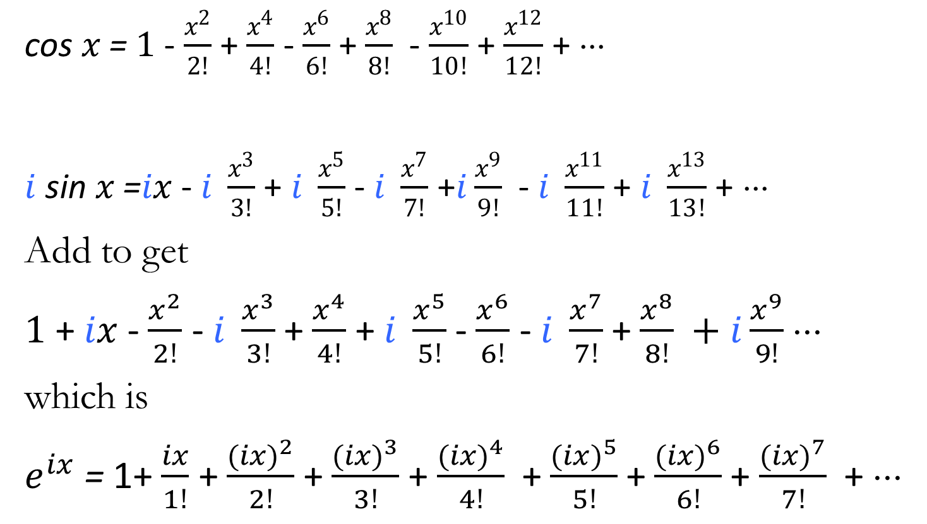
$e^{ix}$ = cos $x$ + $i$ sin $x$
cos $x$ =$1$ - $\frac{x^{2}}{2!}$ + $\frac{x^{4}}{4!}$ - $\frac{x^{6}}{6!}$ +$\frac{x^{8}}{8!}$- $\frac{x^{10}}{10!}$ + $\frac{x^{12}}{12!}$ + ⋅⋅⋅
$i$sin $x$ =$ix$ - $i \frac{x^{3}}{3!}$ + $i \frac{x^{5}}{5!}$ - $i \frac{x^{7}}{7!}$ +$i\frac{x^{9}}{9!}$- $i \frac{x^{11}}{11!}$ + $i \frac{x^{13}}{13!}$ + ⋅⋅⋅
Add to get
$1$ + $ix$- $\frac{x^{2}}{2!}$ - $i \frac{x^{3}}{3!}$ + $\frac{x^{4}}{4!}$ + $i \frac{x^{5}}{5!}$ - $\frac{x^{6}}{6!}$ - $i \frac{x^{7}}{7!}$ +$\frac{x^{8}}{8!} +i\frac{x^{9}}{9!}$ ⋅⋅⋅
which is
$e^{ix}$ = 1+ $\frac{ix}{1!}$ + $\frac{{(ix)}^{2}}{2!}$ + $\frac{{(ix)}^{3}}{3!}$ + $\frac{{(ix)}^{4}}{4!}$+ $\frac{{(ix)}^{5}}{5!}$+ $\frac{{(ix)}^{6}}{6!}$+ $\frac{{(ix)}^{7}}{7!}$+ ⋅⋅⋅

Slide 36

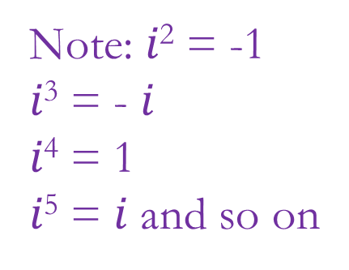
$e^{ix}$ = cos $x$ + $i$ sin $x$
Add to get
$1$ + $ix$- $\frac{x^{2}}{2!}$ - $i \frac{x^{3}}{3!}$ + $\frac{x^{4}}{4!}$ + $i \frac{x^{5}}{5!}$ - $\frac{x^{6}}{6!}$ - $i \frac{x^{7}}{7!}$ +$\frac{x^{8}}{8!} +i\frac{x^{9}}{9!}$ ⋅⋅⋅
which is
$e^{ix}$ = 1+ $\frac{ix}{1!}$ + $\frac{{(ix)}^{2}}{2!}$ + $\frac{{(ix)}^{3}}{3!}$ + $\frac{{(ix)}^{4}}{4!}$+ $\frac{{(ix)}^{5}}{5!}$+ $\frac{{(ix)}^{6}}{6!}$+ $\frac{{(ix)}^{7}}{7!}$+ ⋅⋅⋅
Note: $i$² = -1
$i$³ = - $i$
$i$⁴ = 1
$i$⁵ = $i$ and so on

Slide 37
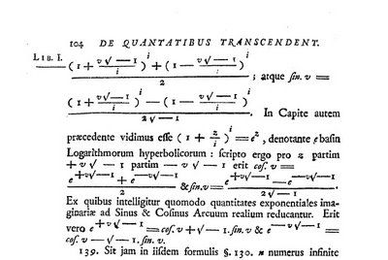
Euler’s formula in Introductio, 1748
From which it can be worked out in what way the exponentials of imaginary quantities can be reduced to the sines and cosines of real arcs

Slide 38

$e^{ix}$ = cos $x$ + $i$ sin $x$
Set $x$ equal to π
$e^{i\text{π}}$ = cos π+ $i$ sin π
and use cos π = -1 and sin π = 0
giving
$e^{iπ}$ = -1
or
$e^{iπ}$ + 1 = 0

Slide 39

$e^{ix}$ = cos $x$ + $i$ sin $x$
Set $x$ equal to π/2 and use cos π/2 = 0 and sin π/2 = 1
Then raise both sides to the power of i.
$i^{i }= \frac{1}{\sqrt{e^{π}}}$

Slide 40
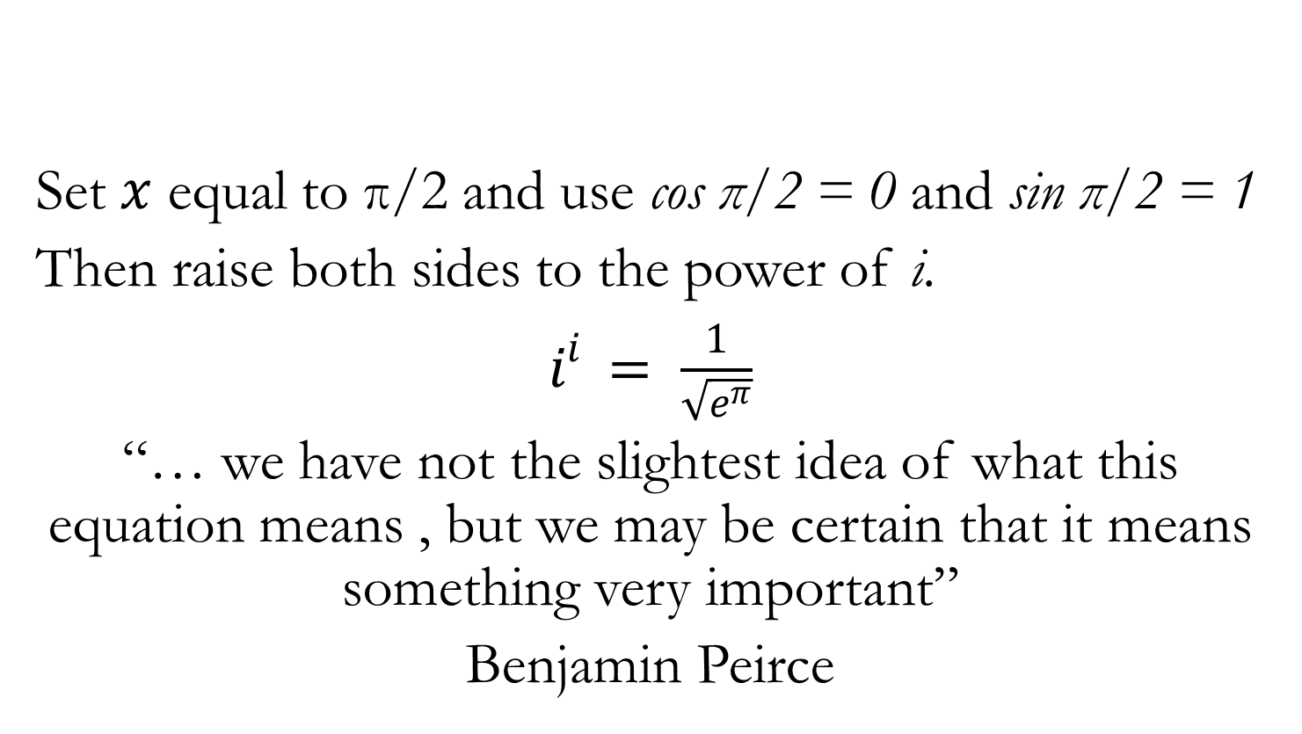
$e^{ix}$ = cos $x$ + $i$ sin $x$
Set $x$ equal to π/2 and use cos π/2 = 0 and sin π/2 = 1
Then raise both sides to the power of i.
$i^{i }= \frac{1}{\sqrt{e^{π}}}$
“… we have not the slightest idea of what this equation means , but we may be certain that it means something very important”
Benjamin Peirce

Slide 41
Some Euler characteristics
Manipulation of symbolic expressions
Treating the infinite
Strategy
Genius

Slide 42
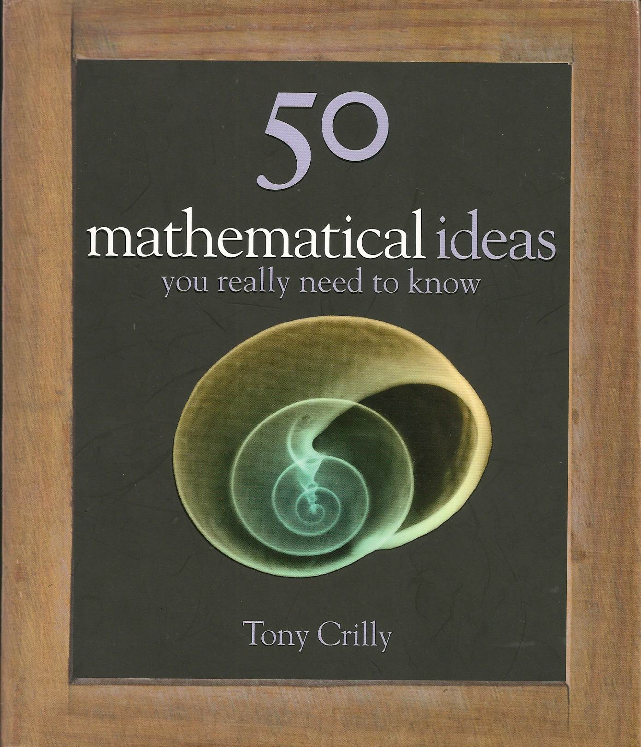

Read Euler, read Euler, he is the master of us all

Slide 43
1 pm on Tuesdays
Museum of London
Fermat’s Theorems: Tuesday 16 September 2014
Newton’s Laws: Tuesday 21 October 2014
Euler’s Exponentials: Tuesday 18 November 2014
Fourier’s Series: Tuesday 20 January 2015
Möbius and his Band: Tuesday 17 February 2015
Cantor’s Infinities: Tuesday 17 March 2015

