Slide 1
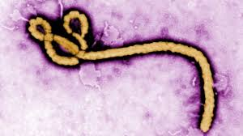
Ebola: the outbreak in West Africa.
Christopher Whitty
Gresham College
December 2014

Slide 2
Dedicated to the local, UK and international staff battling the Ebola epidemic in Sierra Leone.
So far over 100 healthcare workers have died in Sierra Leone, and over 600 have caught Ebola and over 340 died in the wider region.

Slide 3
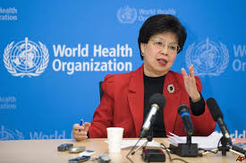
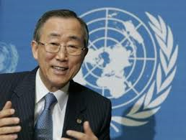
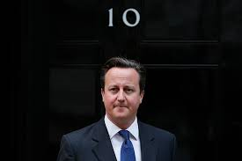
“A public health emergency of international concern” (WHO).
“The largest, most complex and most severe we've ever seen“ Margaret Chan, WHO
“The biggest health problem facing our world in a generation” David Cameron
“ [Ebola] has gone beyond health issues... It has gone to the areas of affecting social and economic situations, it may even affect political stability.” Ban Ki Moon, UN

Slide 4
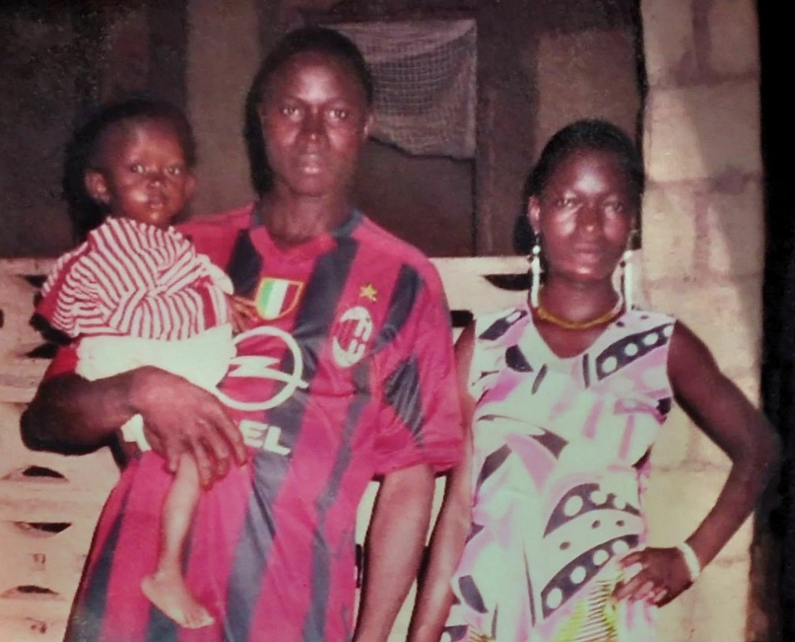
It started with one child, one year ago.
In December 2013 Emile Ouamouno, aged 2, caught Ebola in Guinea. He passed it to his family.
As of December 2014 there have been 17,942 reported cases of Ebola, with 6388 reported deaths (WHO). The numbers are still increasing.
This talk will address why this happened, and what we can do about it.

Slide 5
Ebola first recognised from an outbreak in 1976 in Zaire (now DRC).
In Yambuku Mission Hospital, a rural remote setting, a teacher presented with fever. He was the index case.
318 cases of a haemorrhagic fever occurred- mortality over 90%.
The outbreak was investigated by a group of Zairian, Belgian and US doctors.
They identified a new filovirus, and named it Ebola after a local river.

Slide 6


Ebola also entered popular culture as a plague of our times. This has not always been helpful.

Slide 7
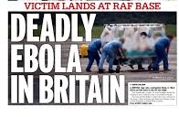
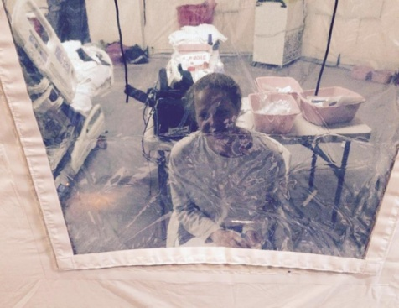
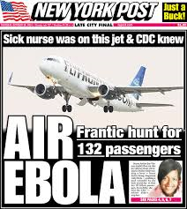
Ebola is a tragedy for families and health services, but much of the economic damage is due to panic.
Ebola is a disease of panic.
“The Ebola epidemic continues to cripple the economies of Liberia, Sierra Leone, and Guinea.” (World Bank).
Cf SARS- around $40 bn wiped off the world economy- less than 1000 people died.
Cf around 100,000 smoking-related deaths in the UK.

Slide 8
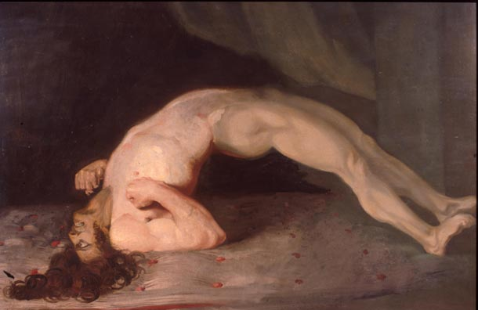
An unpleasant and dangerous disease
High mortality, shock, diarrhoea, may be haemorrhage.
Cf Rabies- almost 100% fatal, terrible death, around 25,000 deaths. Tetanus, around 60,000 deaths (2010).
Cf malaria. Most children will get it several times a year.
Probably more people will die of non-Ebola conditions than of Ebola due to the Ebola outbreak.
Tetanus. Sir Charles Bell

Slide 9
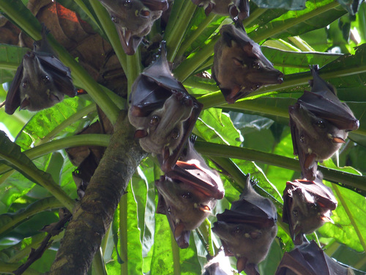
The natural reservoir is probably fruit bats.
Most ‘new’ diseases are ones that jump a species barrier.
Recent examples: HIV, nvCJD, SARS.
Generally start off more virulent but less transmissible than their normal host.
Ebola very dangerous to many non-human primates.
Ebola not especially dangerous to fruit bats.

Slide 10
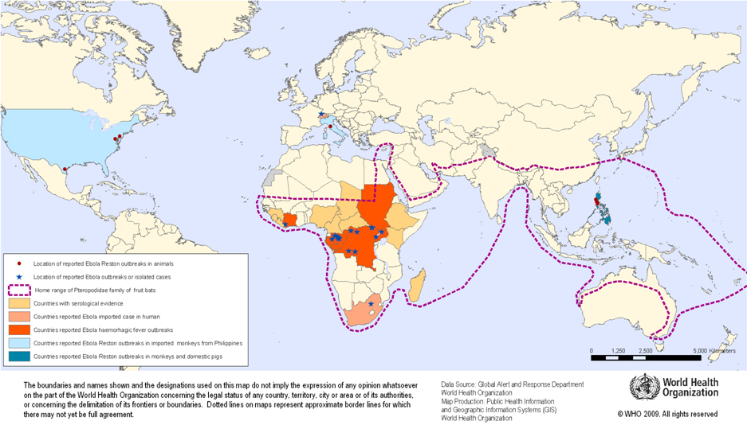
Home range of Pteropodidae fruit bat family

Slide 11
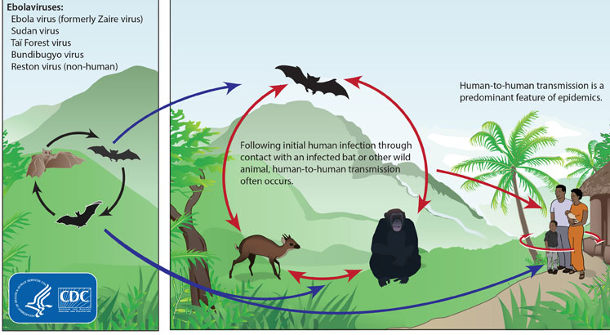
Five Ebola’s identified so far, 4 affecting humans. Plus Marburg.

Slide 12
Virulence and transmissibility of infections. Influenza cf Ebola.
Low virulence, high transmissibility. ‘Mexican pig ‘flu’ (H1N1) 2009/10. Infected 540,000 in UK killed 138 (Donaldson et al) so 26/100,000 Up to 200,000 deaths. | High virulence, high transmissibility. ‘Spanish influenza’ (H1N1) outbreak 1918-20. Infected around 500m, killed 50-100 million (3-5% of global population).
Low transmissibility, low virulence. Irrelevant. | High virulence, relatively low transmissibility. Avian influenza (H5N1). 638 cases, around 60% mortality. Ebola towards this part of the quadrant.

Slide 13
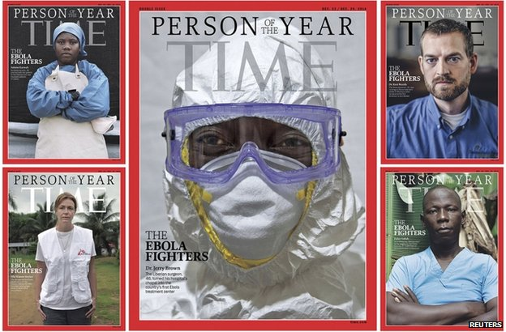
Ebola is virulent in humans.
It is also very difficult to catch
(unless you are a healthcare worker).
Around 70% mortality at present.
In practice you can only catch it from direct contact with:
-infected people with symptoms
-their bodily fluids eg blood, diarrhoea, vomit.

Slide 14
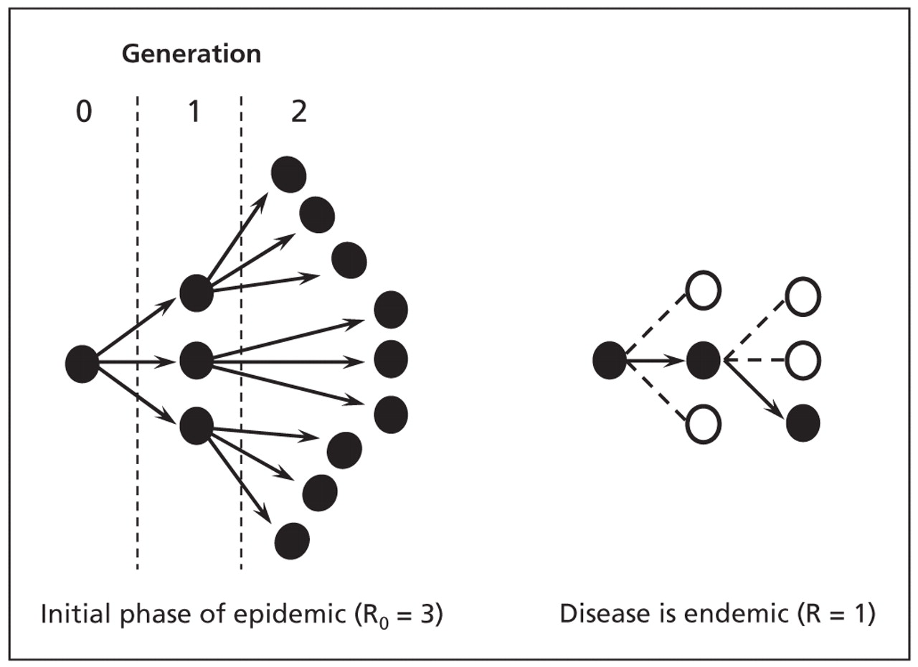
The mathematics of transmission- Ro
If greater than 1 increasing.
If=1 stable.
If less than 1 decreasing. Elimination possible.

Slide 15
Three major routes of transmission once in the human population:
In hospital, or from healthcare workers.
During burials, or near death.
In the community between symptoms starting and isolation.

Slide 16
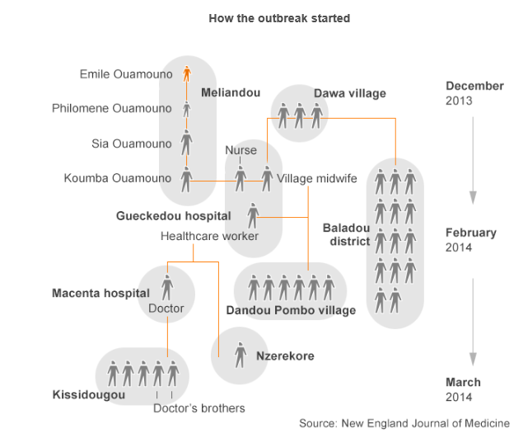

Slide 18
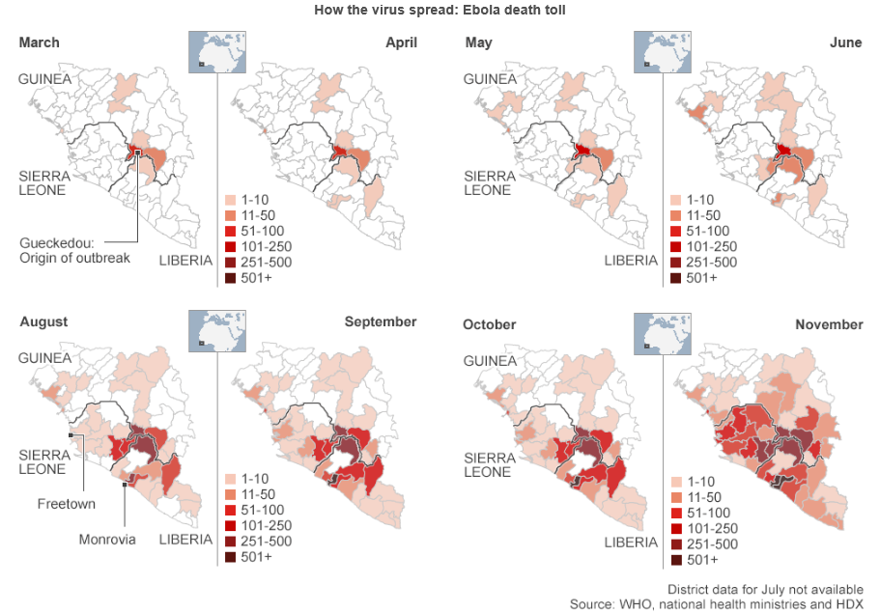
A serious gap- April to August 2014
(adapted from BBC, data from Ministries and WHO).

Slide 19
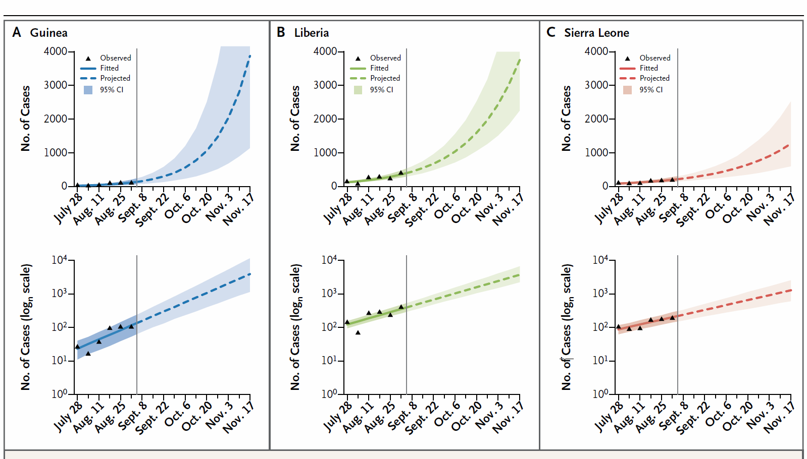
Ebola Virus Disease in West Africa: The First 9 Months of the Epidemic and Forward Projections. WHO Ebola Response Team. WHO- NEJM Aug

Slide 20
Current interventions.
Reduce transmission in hospital and other healthcare settings.
Reduce transmission around death and safe burial.
Reduce transmission in the community by shortening the time between first symptoms and isolation.
Increase social distancing.

Slide 21
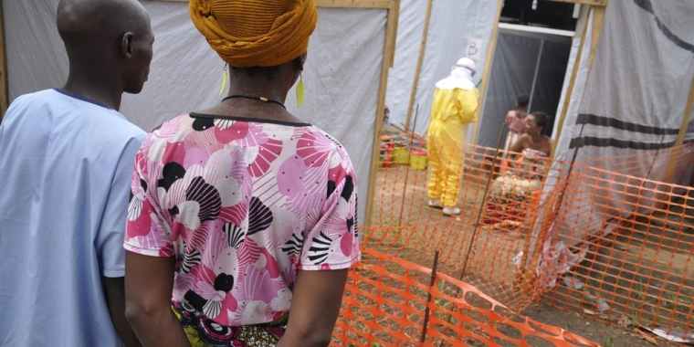
Reducing transmission in hospitals.
We know how to do it.
Requires good hospital design, excellent training and obsessive execution.
Easy to get wrong with potentially fatal results- USA, Spain.
MSF hospital

Slide 22
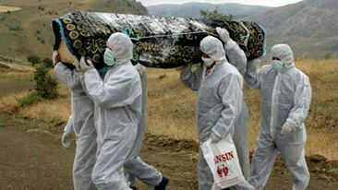
Reducing transmission for funerals and other peri-death rituals.
Local burials involve washing and touching the body.
We know how to do medically safe burials.
The challenge is doing it in a socially acceptable way.
Funeral rites central to all societies.
The period just before death also important.
‘High charisma’ individuals.
The role of anthropology.
Dr Umar Khan
(Sierra Leone Telegraph)

Slide 23
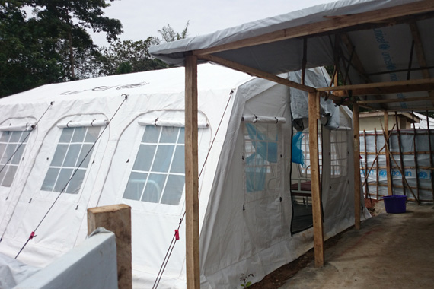
Shortening the interval between first symptoms and isolation.
Ebola first symptoms are very non-specific.
Similar to early malaria, pneumonia, influenza, typhoid, meningitis.
By the time it is obviously Ebola- highly infectious.
Community care centres.
Reduce barriers- distance, stigma, cost etc.

Slide 24
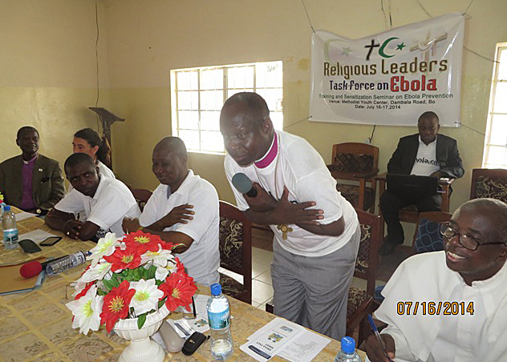
Increasing social distancing- primary prevention.
Ebola is very difficult to catch in the community- the key is to make it even more so.
Comparisons- syphilis in 1500s in UK, HIV, TB, diarrhoeal diseases.
Key is rational acceptable and achievable social interventions.

Slide 25
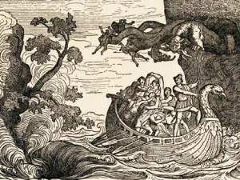
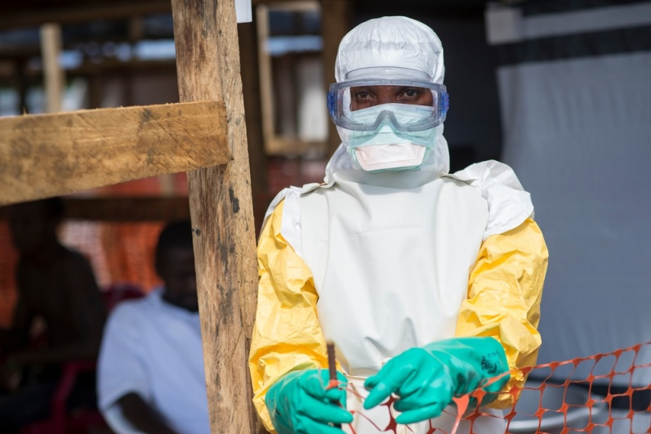
Between a rock and hard place.
Massive epidemiological advantage to rapid reaction.
This depends on healthcare workers (HCWs).
The initial incidence of Ebola in HCWs may be 8-10% per person per year. Over 70% died.
Photo Sylvain Cherkaoui/Cosmos for MSF

Slide 26
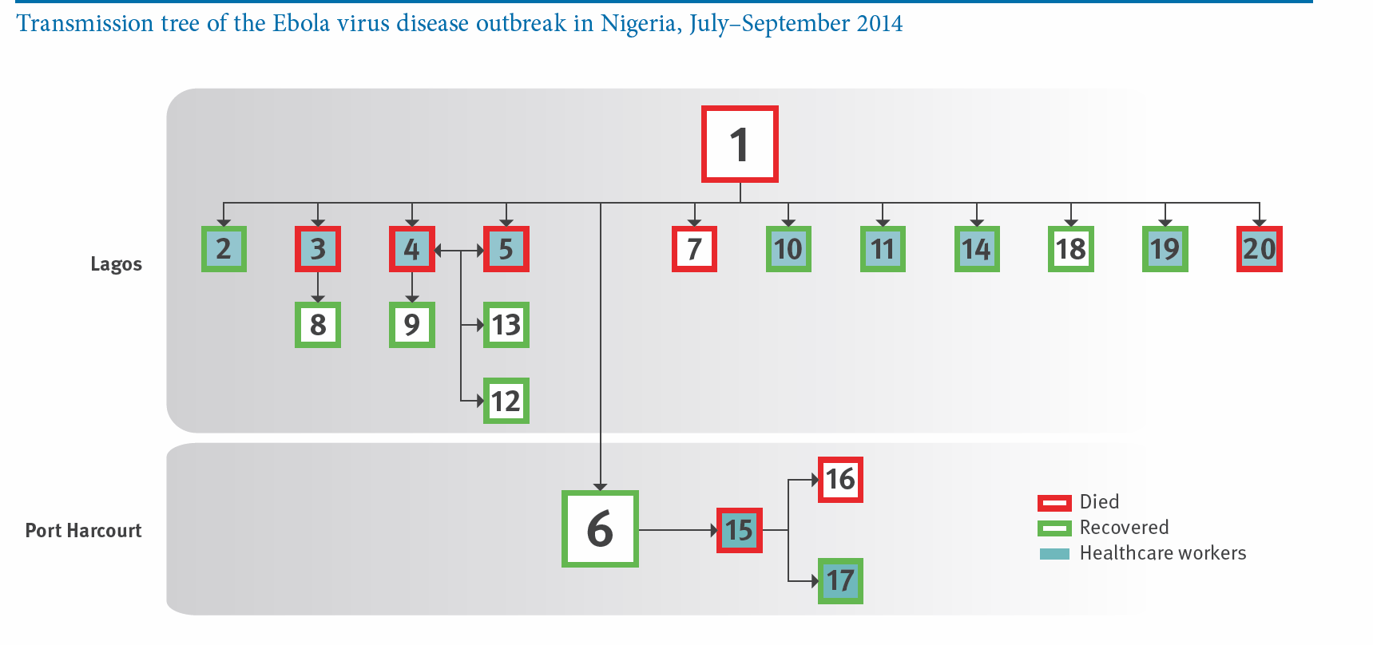
Transmission dynamics and control of Ebola virus disease outbreak in Nigeria, July-Sept 2014
F O Fasina. Eurosurveillance

Slide 27
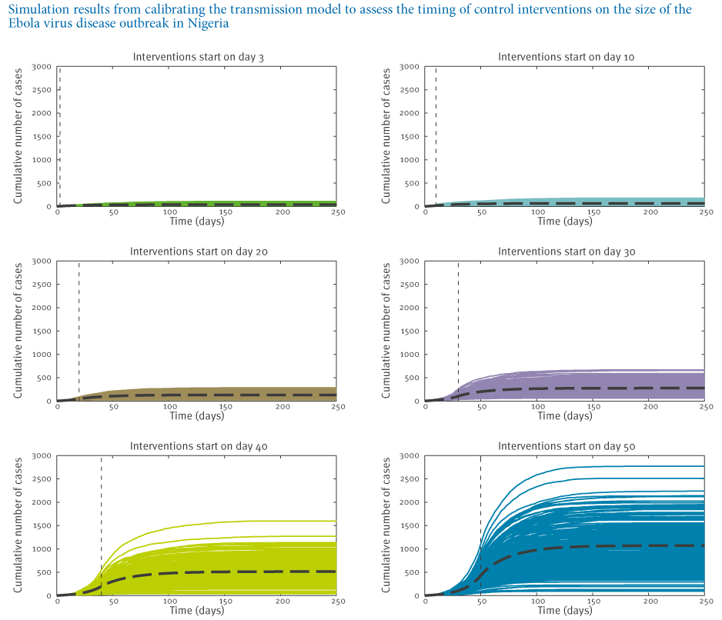

Slide 28
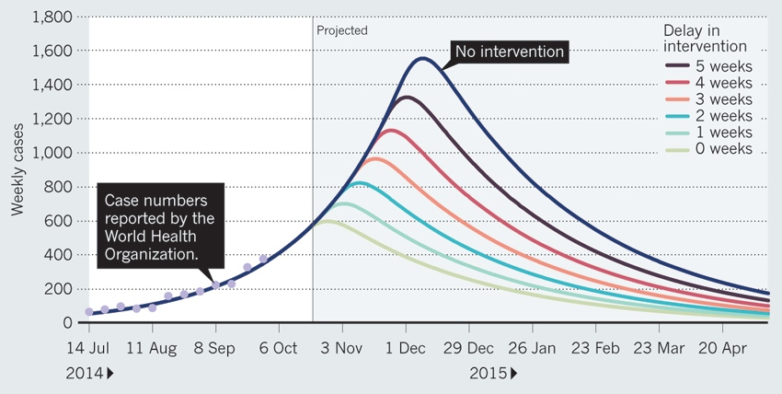
Modelling the impact of delay in intervention by week in Sierra Leone.
(Whitty et al Nature, analysis by Fergurson et al)

Slide 29
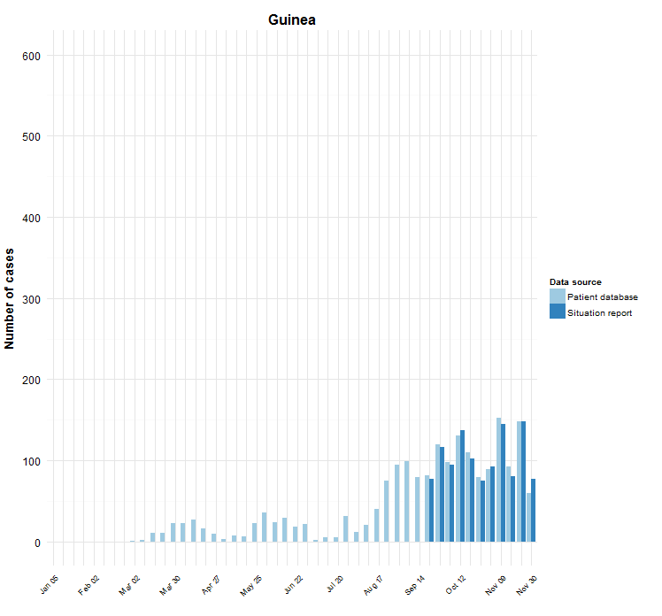
Guinea (WHO)

Slide 30
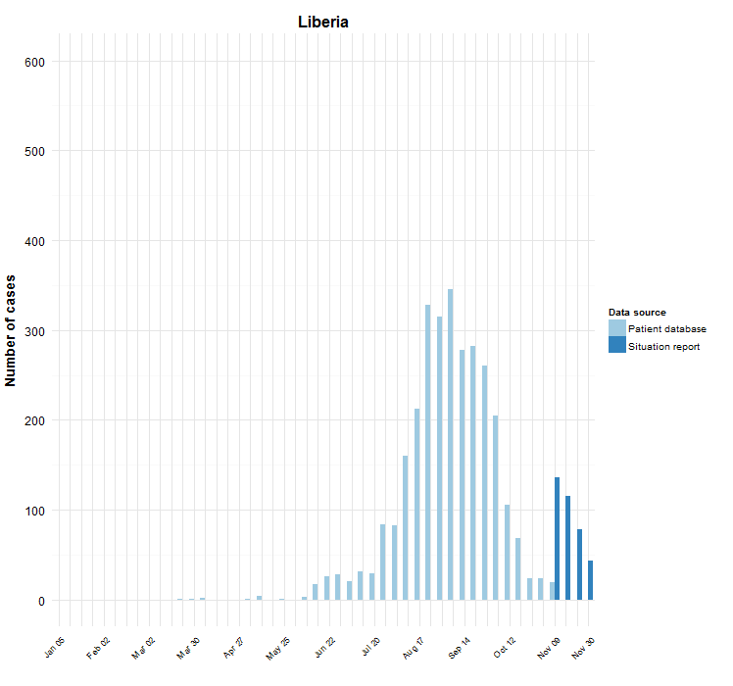
Liberia (WHO)

Slide 31
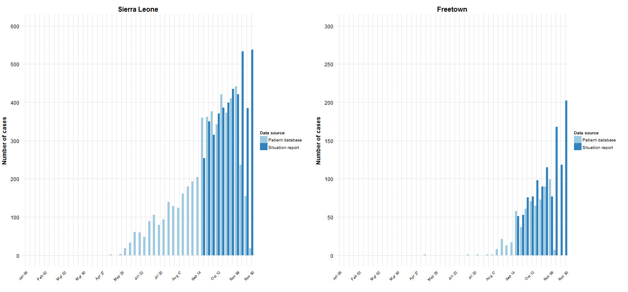
Sierra Leone (WHO)

Slide 32
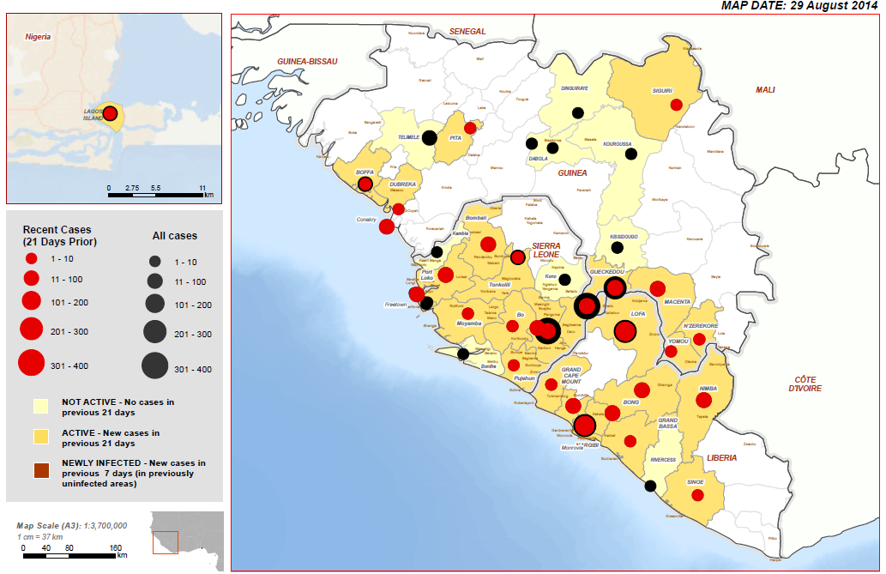
Ebola distribution end Aug (WHO).

Slide 33
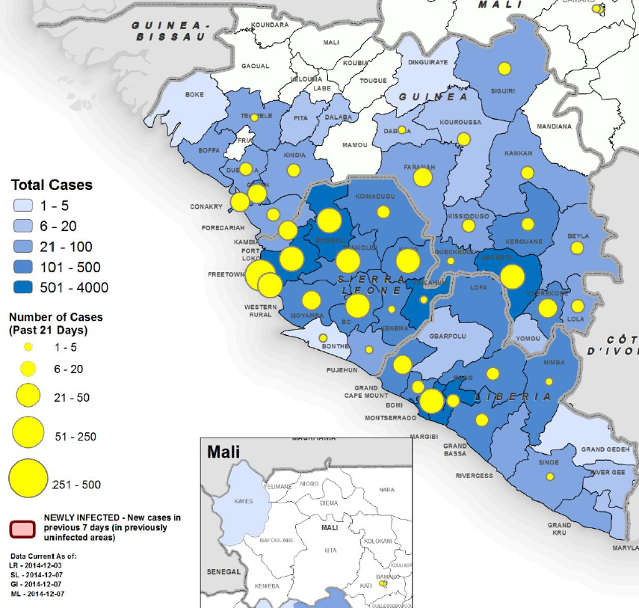
Ebola distribution end Nov 2014 (WHO)

Slide 34
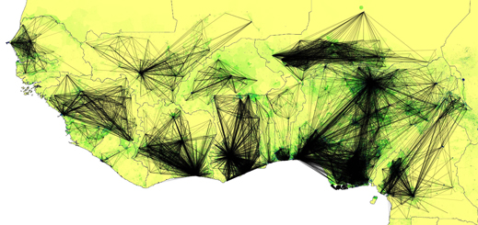
What are the chances of it spreading in Africa?
The chances of importing cases to other parts of West Africa high.
Already Nigeria, Mali, Senegal.
So far all outbreaks have been contained.
Imported case to multiple secondary cases- but once identified the third generation stopped.
If it get to relatively ungoverned spaces- could be a serious problem.
West Africa travel (data Orange/Flowminder)

Slide 35
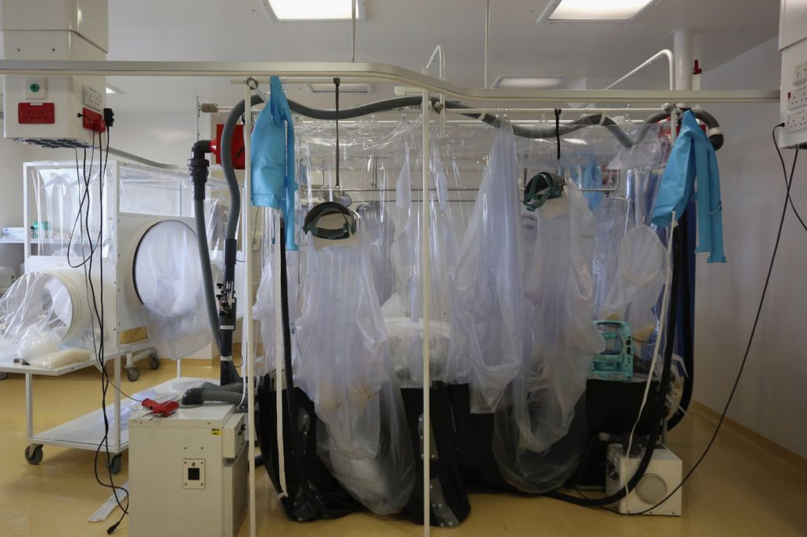
And the UK?
Chief Medical Officer thinks we may see a ‘handful’ of imported cases.
There is the potential for secondary cases, including in healthcare workers before the first case identified as Ebola.
There could be a small 3rd but very unlikely to be a 4th generation.
The chance of a significant propagated epidemic currently effectively zero.

Slide 36
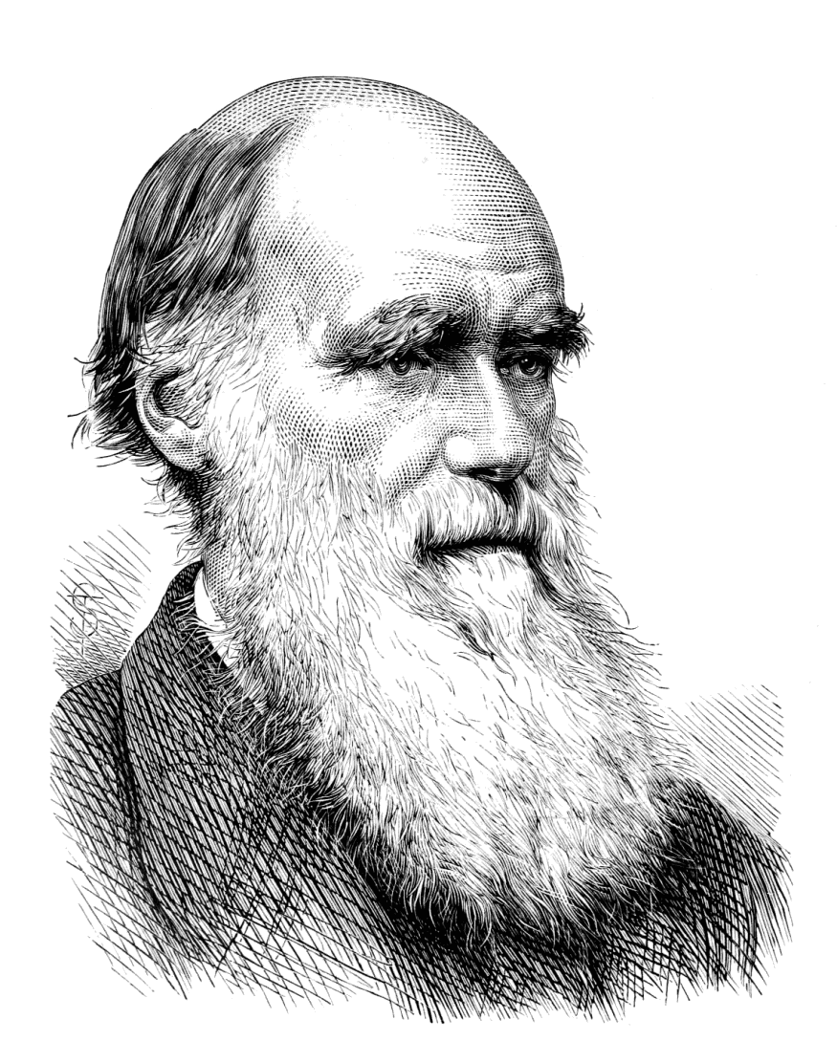
Could it mutate to become more infectious?
If it was left uninterrupted that would be the most likely evolutionary outcome.
Infections also often attenuate (become less virulent) as they passage through a new host species.
Very unlikely to be fast.
Exceptionally unlikely to change main mode of transmission- eg become a major airborne pathogen.

Slide 37
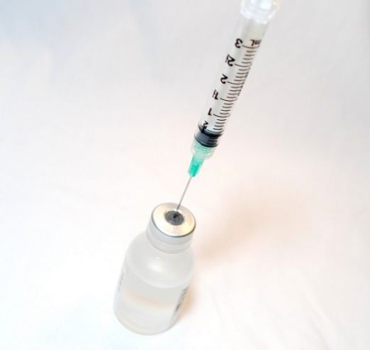
Ebola vaccines
Currently (Dec 2014) 3 in early clinical trials (Phase 1- safety and immunogenicity).
Two are chimp adenovirus (GSK, J&J). Likely to need a prime then a later boost (MVA).
One a VSV vaccine (Newlink/Merck), probably one shot. Currently on pause.
Effective in non-human primates.
Attempt to fast track all three.
Even if all goes well unlikely to be deployable at population scale before end 2015.

Slide 38
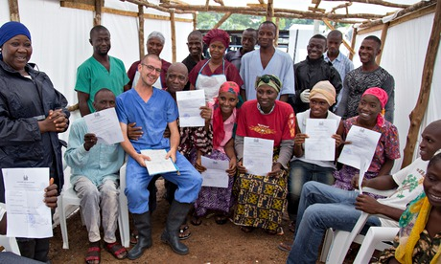
Potential new diagnostics and treatments for Ebola
Better fluid management.
Blood or plasma from recovered patients.
Antibody (eg Zmapp).
Anti-viral drugs such as favipiravir, brincidofivir, toremifine and interferons.
Many others, not all equally sensible.
New, safer or more rapid tests being developed.

Slide 39
What are the scenarios for the next 6 months?
Spirals out of control. Wait for a vaccine.
Complete interruption of transmission.
Intermediate outcome:
-we control in most places
-some hotspots remain
-mini-outbreaks
-grind out a victory by many small steps.
Eradication impossible- animal reservoir. But we must eliminate this outbreak.

Slide 40
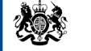
Multiple groups from the UK have acted, largely in concert, to address this major global threat.
NGOs- including MSF, Save the Children.
Academic- Kings College London, London School of Hygiene & Tropical Medicine, Oxford University.
NHS
Wellcome Trust, MRC.
Many individual doctors, nurses and public servants who have volunteered.
Department for International Development.
Department of Health.
Army, Navy, MOD.
Public Health England.
Cabinet Office.
FCO.

Slide 41
Ebola remains a clear and present danger.
Between March and July 2014 the world reacted too slowly.
Now there is an impressive global effort, with the UK playing a major role.
At present it looks as if the worst is over in Liberia.
In Sierra Leone we have yet convincingly to see a peak. I am confident it will come.
Eliminating this outbreak will take time, and may need a vaccine. Likely to continue at least through most of 2015.
Ebola outbreaks will occur again- but we will have new tools and better knowledge.
If we do this right we are currently experiencing the worst Ebola outbreak in history- future as well as past.

