Slide 1
Long Finance & UCL
Autumn Conference 2012
“Measures Beyond Money”

Slide 2
Welcome
Professor Malcolm Grant
President and Provost,
University College London

Slide 3
Introduction
Professor Michael Mainelli
Chairman, Z/Yen Group
Principal Advisor, Long Finance

Slide 4
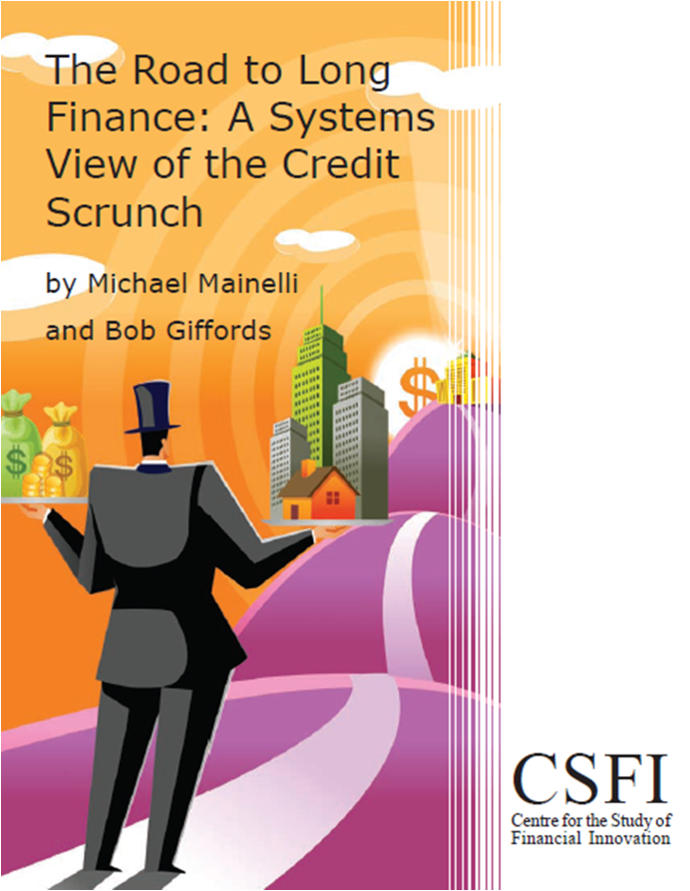
About Long Finance
‘When would we know our financial system is working?’
Objectives:
Expand Frontiers
Change Systems
Deliver Services
Build Communities
Programmes:
London Accord
Financial Centre Futures
Meta-Commerce
Eternal Coin

Slide 5
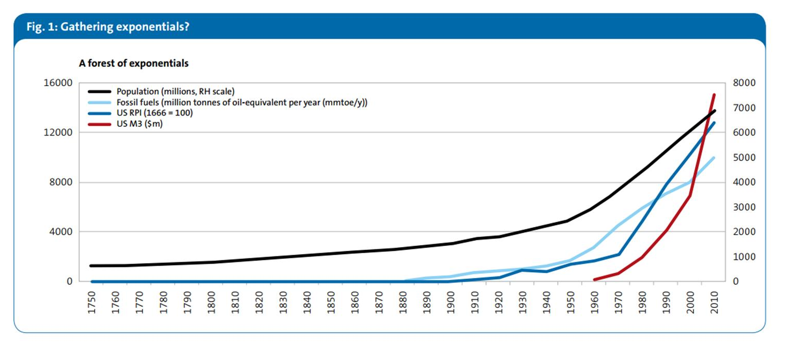
Dangerous Exponentials
“The biggest shortcoming of the human race is our inability to understand the exponential function.”
Professor Al Bartlett, University of Colorado
[source: Dr Tim Morgan, Dangerous Exponentials, Tullett Prebon (June 2010)]

Slide 6
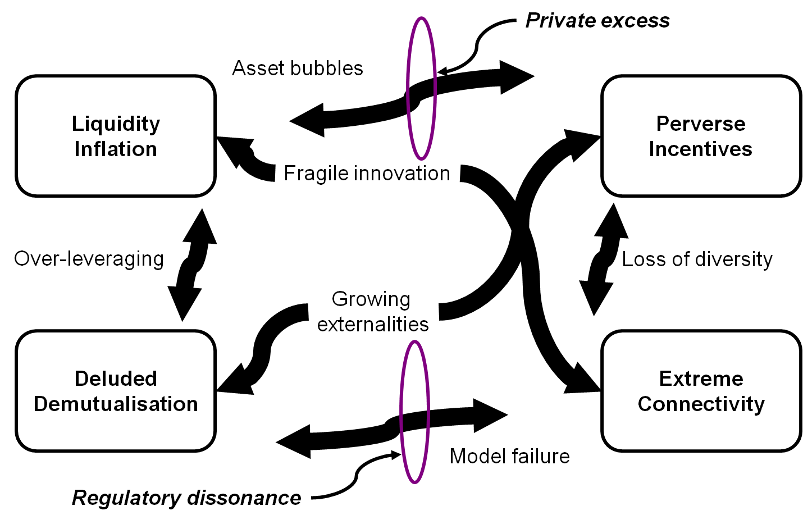
Value?
Systemic Scrunch

Slide 7
GDP
Robert F. Kennedy, 1968
"Yet the gross national product does not allow for the health of our children, the quality of their education, or the joy of their play. It does not include the beauty of our poetry or the strength of our marriages; the intelligence of our public debate or the integrity of our public officials. It measures neither our wit nor our courage; neither our wisdom nor our learning; neither our compassion nor our devotion to our country; it measures everything, in short, except that which makes life worthwhile."

Slide 8
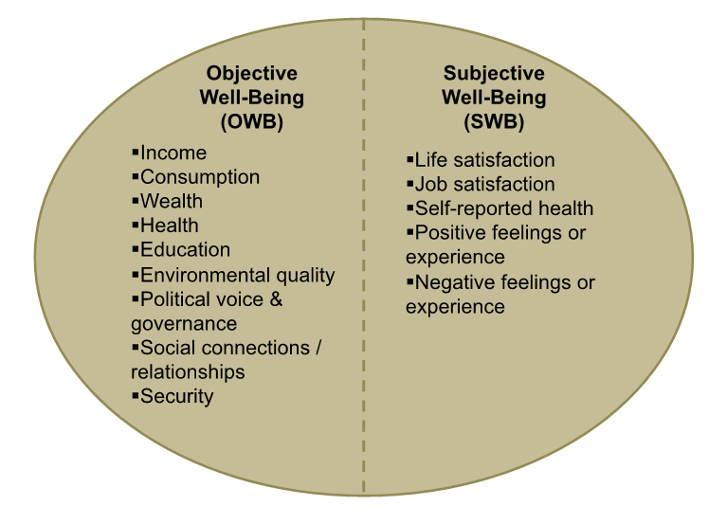
Objective & Subjective
[source: adapted from Stiglitz E., Sen A., Fitoussi J.P. et al, “Report by the Commission on the Measurement of Economic Performance and Social Progress” (2009)]

Slide 9
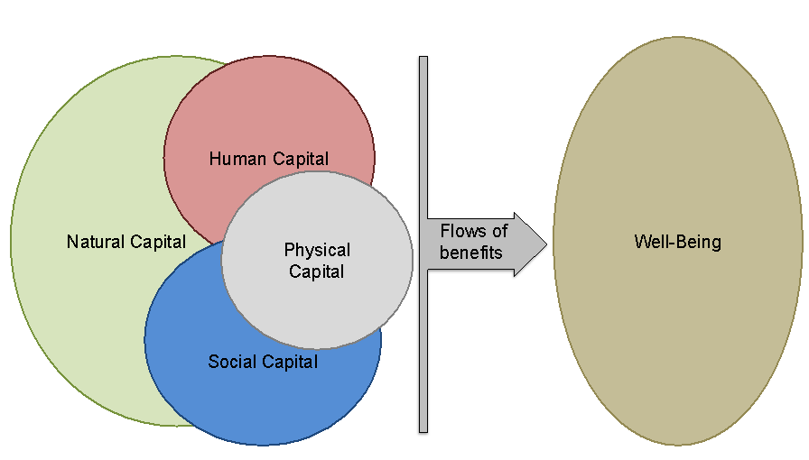
Capital Stock Model & Well-Being

Slide 10
Rio +20
Article 111 of the zero draft for Rio +20
111. We also recognize the limitations of GDP as a measure of well-being. We agree to further develop and strengthen indicators complementing GDP that integrate economic, social and environmental dimensions in a balanced manner. We request the Secretary-General to establish a process in consultation with the UN system and other relevant organizations.

Slide 11
Agenda
14:30 – 14:35 Welcome
14:35 – 14:40 Introduction
14:45 – 15:15 Keynote: “Energy & Emergy – Measuring Well-Being Among Nations” – Denis White, Oregon State University
15:15 – 16:00 Panel: “Beyond GDP: Measures of Growth and Well- Being”
16:00 – 16:20 Break
16:20 – 16:40 Presentation: “Green Growth: the What, Why and How” – Professor Paul Ekins, UCL Energy Institute
16:40 – 17:25 Panel: “Green Growth: The Grand Policy Challenge and the Role of Science”
17:25 – 17:30 Close
17:30 – 18:30 Reception

Slide 12
Keynote Address
“Energy & Emergy – Measuring Well-Being Among Nations”
Denis White,
Oregon State University

Slide 13
Energy & Emergy – Measuring Well-Being Among Nations
Denis White
whitede@onid.orst.edu
Long Finance Conference
14 November 2012
With credits to Dan Campbell and Mark Brown

Slide 14
Two kinds of value
Value is based on what something contains, “donor-based”
2. Value is based on how much something is desired, “receiver-based”
Production
Value
Consumption

Slide 15
Simple economic model
$
$
Wages
Production
Consumption
Purchases
$
$

Slide 16
Value is transferred back
Labor
$
$
Wages
Production
Consumption
Purchases
$
$
Goods

Slide 17
The environment supplies value
Nonrenewable
energy
sources
Labor
$
$
Wages
Production
Consumption
Renewable
energy
sources
Purchases
$
$
Goods

Slide 18
An alternative value system
All action is accompanied by the transformation of available energy
The available energy used in the past to create a good or service is a measure of what was required to produce that good or service
But available energy of different kinds has different ability to do work when used in a network

Slide 19
What is emergy?
Emergy is the available energy of one kind previously used both directly and indirectly to make another form of energy, product or service
Emergy can be thought of as energy memory
Most studies use solar energy as the starting point. The units of emergy are then solar emjoules.

Slide 20
What is the basis for emergy?
Based on the laws of physics and thermodynamics
Derived from energy systems principles
All goods, services and information (either environmental, economic or cultural) are put into a common unit of measure

Slide 21
Energy quality
Sunlight = Wind = Fuels = Electricity
Calories of one form of energy are not necessarily equal to calories of another form in their ability to cause work
Energy quality is related to
  Concentration
  Flexibility
  Ease of transportation
  Convertibility

Slide 22
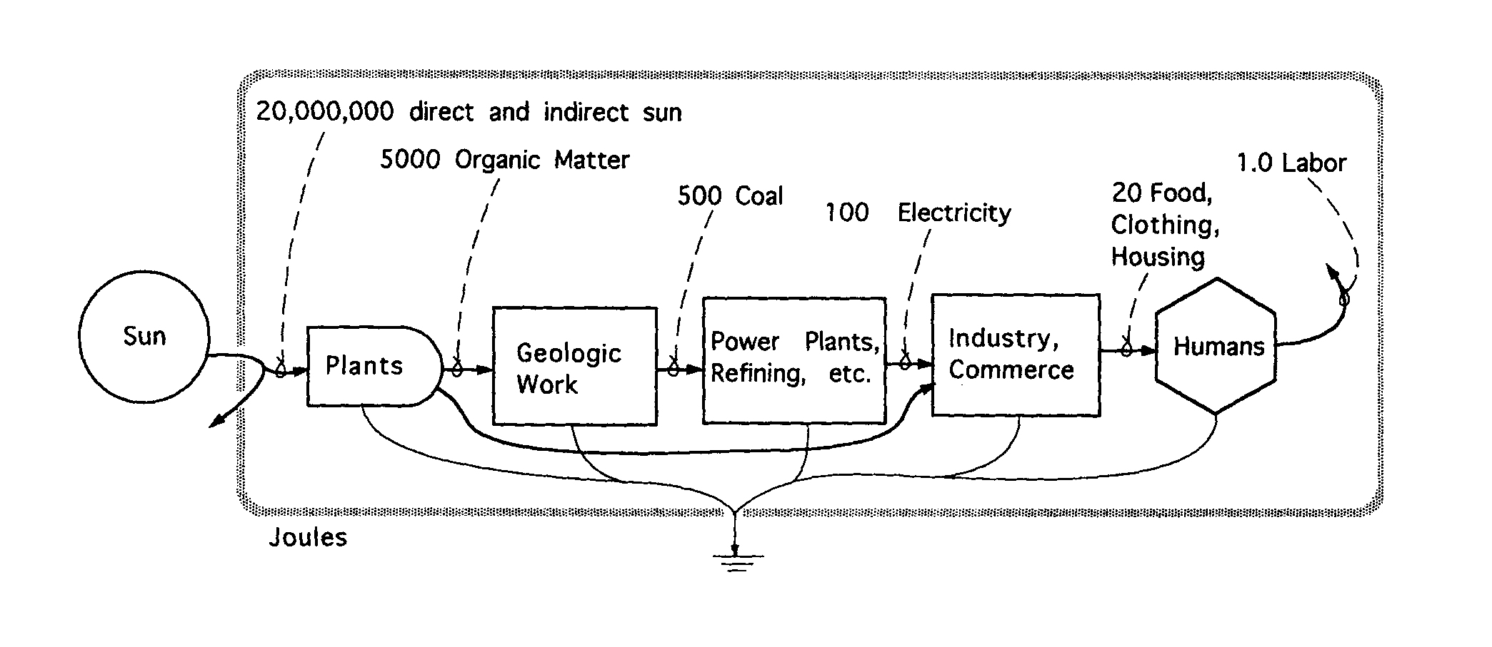
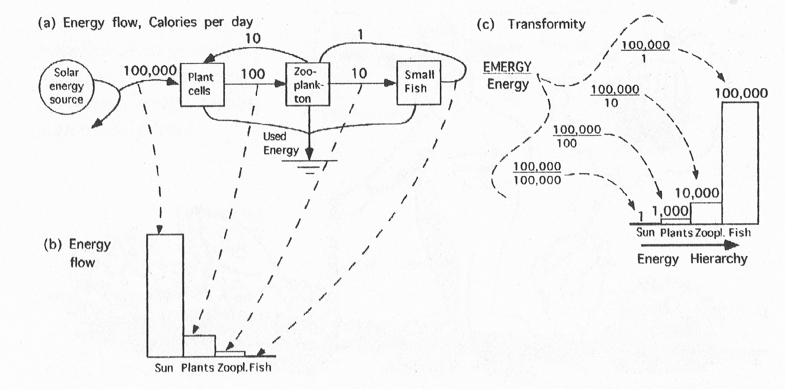
Hierarchy of energy transformations
A contemporary energy chain to provision humans

Slide 23
Transformities
The energy along any pathway can be quantified
The ratio of total emergy coming into the system to the energy leaving any component is a useful number known as the emergy per unit ratio
If the unit is available energy, the ratio is called a transformity

Slide 24
Transformities (typical)
Sources, goods, and services | Solar Emcalories per calorie
Sunlight energy | 1
Wind energy | 1,500
Organic matter, wood, soil | 4,400
Potential of elevated rainwater | 10,000
Chemical energy of rainwater | 18,000
Mechanical energy | 20,000
Large river energy | 40,000
Fossil fuels | 50,000
Foods | 100,000
Electric power | 170,000
Protein foods | 1,000,000
Human services | 100,000,000
Information | 1 x 10¹¹
Species formation | 1 x 10¹⁵

Slide 25
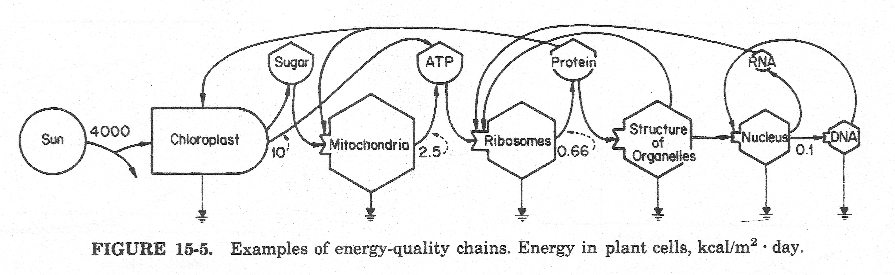
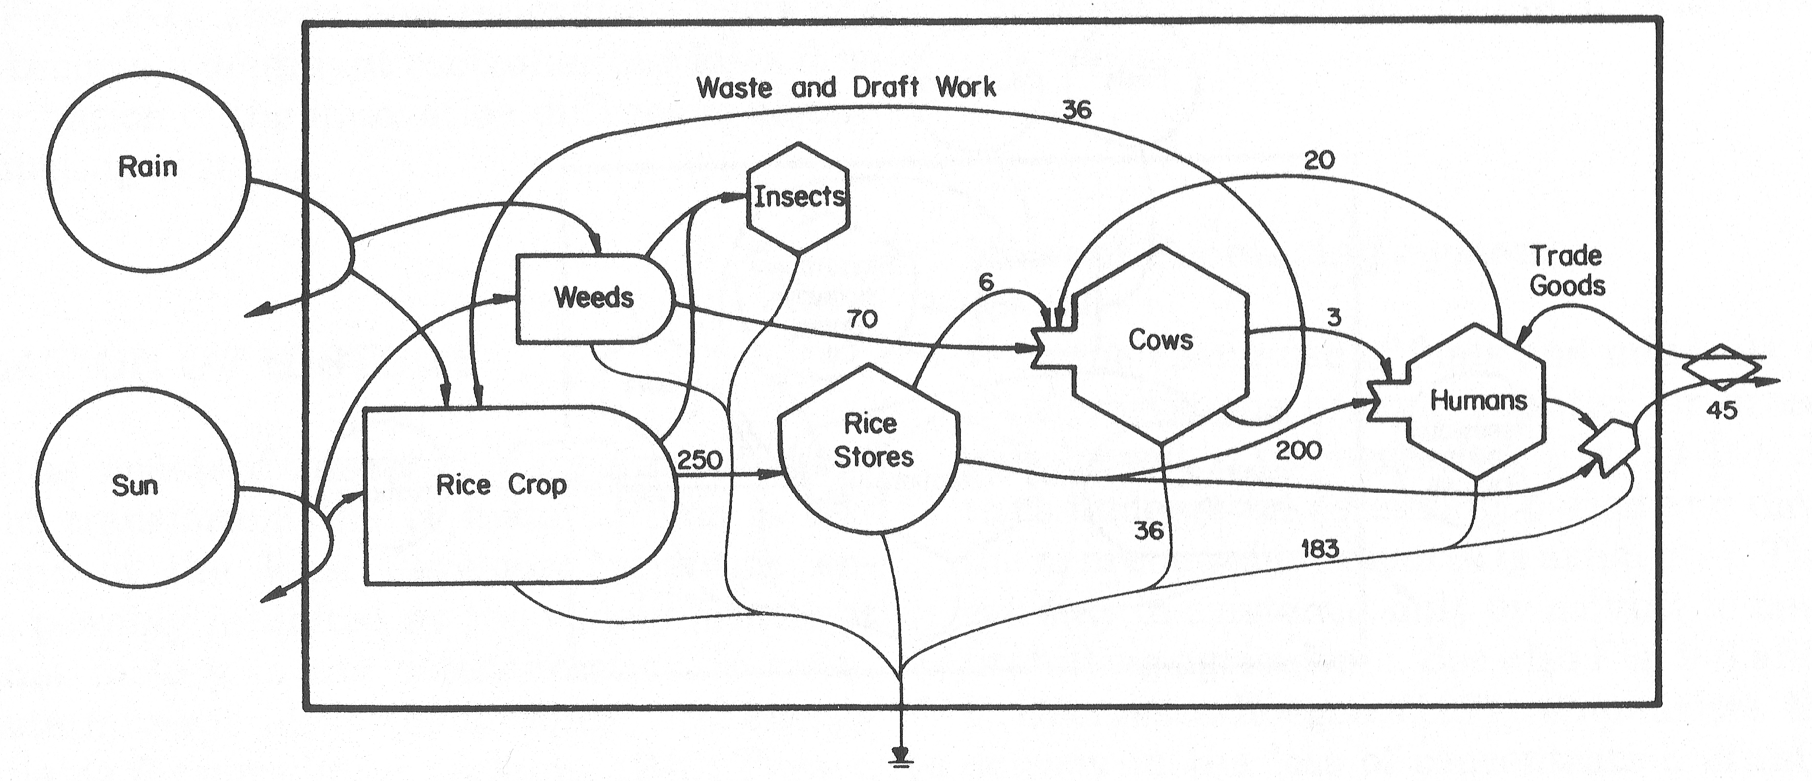
Emergy applications
Energy
network
in plant
cells
Emergy
network
in Indian
agriculture
with
sacred cow

Slide 26
Market price, standard of living
When environmental resources are abundant, little work is required to obtain them, costs are small and prices are low
Net contributions to the economy are greatest then, there are abundant resources and standard of living is high
When resources are scarce, costs are higher, supply is low and prices are higher
Then real wealth is scarce and standard of living is low

Slide 27
Market price, real wealth
Thus, market prices are inverse to the real wealth contributions of the environment
Note also that money is paid only to people for their work, not to the environment
Market prices also do not value impacts on the environment, which become liabilities on a balance sheet

Slide 28
Balance sheet
Description | Data | Unit | Emergy/Unit sej/unit | Emergy x 10²⁰ sej
Assets
Forest biomass | 1.04x10¹⁹ | Joules | 28,200 | 2,933
Coal | 1.42x10²¹ | Joules | 39,200 | 556,640
Knowledge of People | 1,816,000 | Individuals | Various | 4,498
Buildings | 4.45x10⁹ | $ | 1.08x10¹² | 481
Accumulated Depreciation | 18x10⁹ | $ | 1.08x10¹² | (194)
Total Assets |  |  |  | 564,358
Liabilities
Extraction Damage | 1.25x10¹⁹ | Joules | Average, 1.0x10⁵ | 17,400
Bonds Outstanding | 3.956x10⁹ | $ | 1.08x10¹² | 43
Public and private equity
Built Capital | 22.5x10⁹ | $ | 1.08x10¹² | 244
Natural Capital | 1.43x10²¹ | Various | Various | 542,173
Human Capital | 1,816,000 | Individuals | Various | 4,498
Total Liabilities + Equity |  |  |  | 564,358

Slide 29
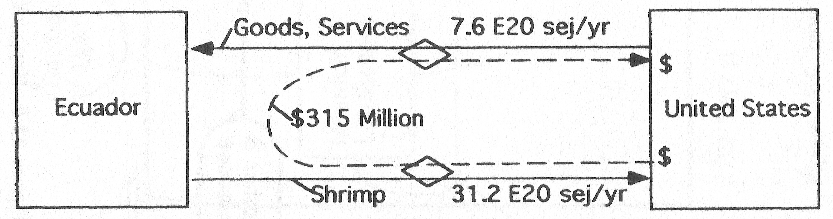
International trade
Emergy analysis can reveal imbalances in international trade
Assume all income from shrimp production in Ecuador was spent on goods and services from the US (1991 data)
Ecuador exported 31.2/7.6=~4.1 times more emergy than it received from the US

Slide 30
Emprint of emergy
3x2 matrix with columns for renewable and nonrenewable emergy and rows for local, imported, and exported emergy
Based on the emergy budget for a fixed time (one year) for a well defined system (a nation, or group of nations for example)
Snapshot of system inflows and outflows that shows the relative sustainability and self-sufficiency of a system at any given point in time

Slide 31
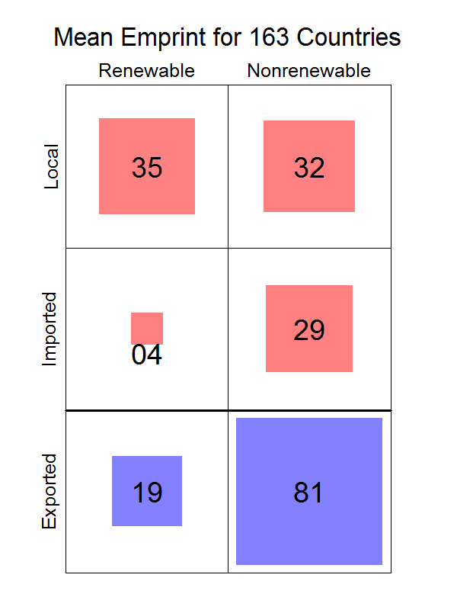
Emprint of all
Countries

Slide 32
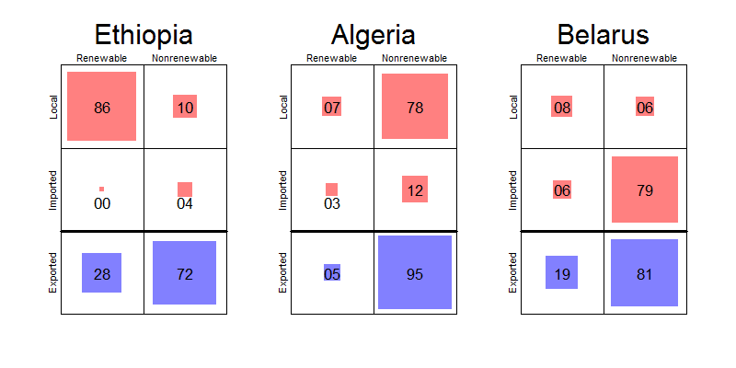
Emprints of countries at extremes

Slide 33
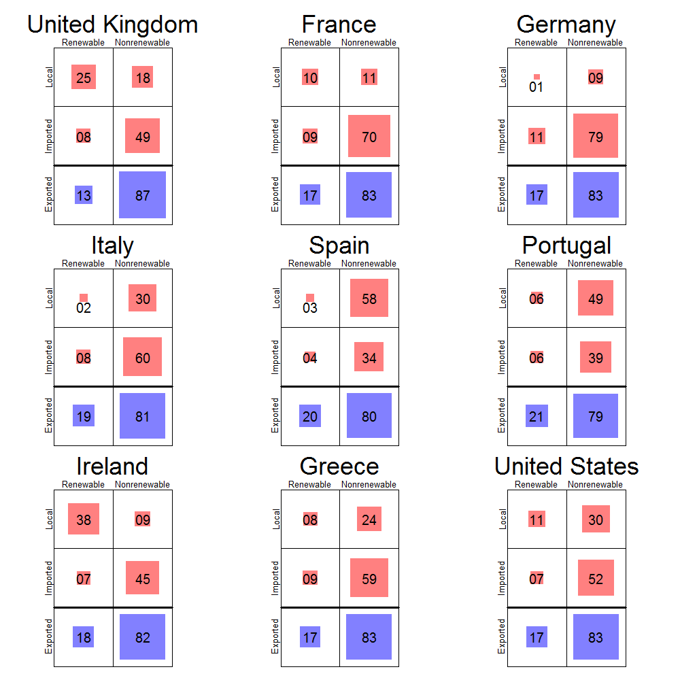
Emprints of selected
EU countries plus
US

Slide 34
Self-sufficiency,
Sustainability
Sustainability is the sum of the local and imported renewable emergy (first column, first two rows)
Self-sufficiency is the sum of the local renewable and nonrenewable emergy (top row of emprint)

Slide 35
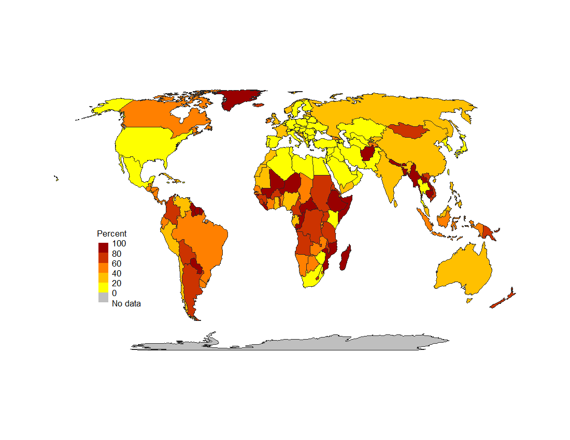
Sustainability index

Slide 36
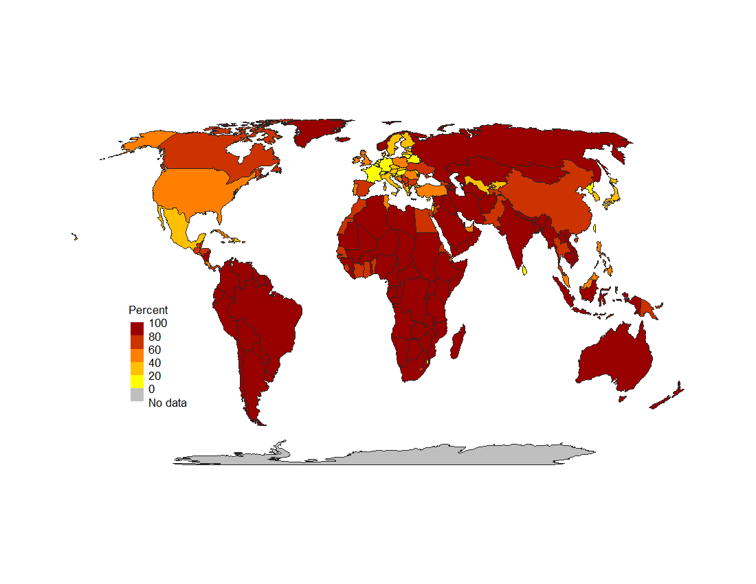
Self-sufficiency index

Slide 37
Sustainable, Self-sufficient
Most Sustainable | % |  | Least Sustainable | %
Guinea-Bissau | 97.9 |  | Kuwait | 2.0
Central African Republic | 95.7 |  | Luxembourg | 3.6
French Guiana | 92.8 |  | Armenia | 4.3
Somalia | 92.5 |  | Qatar | 4.9
Mozambique | 91.1 |  | United Arab Emirates | 5.5
Laos | 91.0 |  | Saudi Arabia | 5.6
Bhutan | 88.3 |  | Jordan | 5.9
Congo DRC | 87.9 |  | Zimbabwe | 7.1
Ethiopia | 86.7 |  | Syria | 7.3
Nepal | 86.6 |  | Ukraine | 7.3
Most Self-sufficient | % |  | Least Self-sufficient | %
Central African Republic | 99.4 |  | Switzerland | 3.9
Congo DRC | 99.3 |  | Taiwan | 4.8
Chad | 98.8 |  | Lebanon | 5.8
Guinea-Bissau | 98.6 |  | Germany | 9.9
Gabon | 98.4 |  | Israel | 10.6
Congo | 97.8 |  | Netherlands | 13.1
Zambia | 97.7 |  | France | 13.4
Madagascar | 97.0 |  | Sri Lanka | 14.1
Angola | 96.8 |  | Belarus | 14.5
Zimbabwe | 96.5 |  | Slovenia | 15.5

Slide 38
Comparison with other indices
Human Development Index (HDI), UNDP, 2000
Happy Planet Index (HPI), New Economics Foundation, 2005
Environmental Performance Index (EPI), Yale & Columbia Universities, 2000
Ecological Footprint (EF), Global Footprint Network, 2001

Slide 39
Correlations of ranks
 | HDI | HPI | EPI | EF | Sustain-ability | Self-sufficiency
HDI | 1
HPI | 0.06 | 1
EPI | 0.45 | 0.03 | 1
EF | 0.71 | -0.09 | 0.36 | 1
Sustainability | -0.32 | -0.02 | -0.01 | -0.38 | 1
Self-sufficiency | -0.43 | -0.12 | -0.25 | -0.38 | 0.36 | 1

Slide 40
Conclusions
Real wealth is the value in human goods and services, and non-human environmental goods and services
Energy is contained in every good, service, and environmental process
Energy has different quality depending upon the source and position in a chain of energy transformations
Emergy is the most comprehensive and scientifically correct method for valuation

Slide 41
Panel Discussion 1
“Beyond GDP: Measures of Growth and Well-Being”
Balazs Magyar, Bank Sarasin
Professor Stephen Smith, University College London
Denis White, Oregon State University
Professor Michael Mainelli (Chair)

Slide 42
Break
Please come back
to your seats by 16:20

Slide 43
Presentation
“Green Growth:
the What, Why and How”
Professor Paul Ekins,
UCL Energy Institute

Slide 44

GREEN GROWTH: THE WHAT, WHY AND HOW
A presentation to the Long Finance Autumn Conference 2012: ‘Measures Beyond Money’
Paul Ekins
Professor of Resources and Environmental Policy
UCL Institute for Sustainable Resources
University College London
University College London November 14th, 2012

Slide 45
Green Economy: definition and characteristics
A Green Economy is more easily characterised than defined. It:
Has very low levels of carbon and other emissions to the atmosphere, and does not pollute the land, freshwater or seas.
Has very high levels of resource productivity, which means that it delivers high levels of human value, measured in money or other terms, for low throughput of energy and material resources.
Results in aggregate human activity remaining within local and planetary environmental limits, such that it does not damage human health, deplete renewable resources, or cause climate change or ecosystem degradation, because it takes due account of the values and human benefits which a stable climate, high environmental quality and resilient ecosystems provide.
Intersects with two important high-level public policy agendas – those on environmental sustainability and ‘GDP and Beyond’.
May or may not experience economic (GDP) growth

Slide 46
Where does economic growth come from?
Applied knowledge and innovation
    Turning non-resources into resources (e.g. fossil fuels)
    Finding better ways of doing things
Investment in knowledge and innovation is at an all-time high globally
There is no shortage of renewable energy if we knew how to harness it (cost-)effectively
There is no shortage of materials if we knew how to manipulate and use them
It is not clear how policy makers could ‘stop’ economic growth even if we wanted to
BUT economic growth must be consistent with environmental sustainability (and currently is not so)

Slide 47
How big can the economy get?
what kind of growth?
    Physical growth (growth in the amount of matter/energy mobilised by the economy: indefinite growth of this kind is impossible in a finite physical system subject to the laws of thermodynamics
    Economic (GDP) growth: growth in money flows/incomes/value added/expenditure: there is no theoretical limit on this kind of growth
    Growth in human welfare:
        Dependent on sustaining environmental functions
        Complex relationship to economic growth (although hard to argue that, ceteris paribus, more money is not better than less)
        Dependent on many other factors
    ‘Green growth’: increases in GDP that either keep the economy within the safe operating space or move it back towards this space [optional: while also increasing human well-being]
    ‘Green growth’ requires decoupling of GDP growth from resource use and environmental impact

Slide 48
Why green growth (1)?
The current human population is in excess of 6 billion. Barring catastrophe it will rise to 9 billion by 2050
The vast majority of the relatively poor want to live like rich consumers in Europe, North America and other currently rich countries, while the relatively rich in those countries want to get still richer
Large populations in relatively poor countries now have the human and technical capacity to get richer
There will be a considerable increase in resource consumption, energy use, greenhouse gas emissions and destruction/degradation of ecosystems
Science (IPCC, MEA) is suggesting that environmental degradation is already beyond safe limits

Slide 49
Why green growth (2)?
  Brown growth is unsustainable, i.e. it will not/cannot continue
  Thailand floods: “GDP declined 9% in the three months through December [2011] from a year earlier.” (Bloomberg Finance)
  “Sustained heat, above 38ºC – never before endured in 130 years of record keeping” caused fires in Russia which destroyed over a quarter of Russia’s crops, took 1% off GDP ($15 bn), destroyed 50 villages (with a rebuilding cost of $400m - £1 billion) and took 15,000 lives. (BBC, Daily Telegraph, Bloomberg, Aug.2010)
“The worst drought in the US in at least half a century has destroyed one-sixth of the country’s expected corn crop in a month threatening a surge in global food price inflation.” (Financial Times, 10/8/12)
This is with less that 1ºC average global warming. What about 6ºC ?
Prof Sir John Beddington, CSA, 2009: ‘The perfect storm’ of crises in food, water and energy by 2030

Slide 50
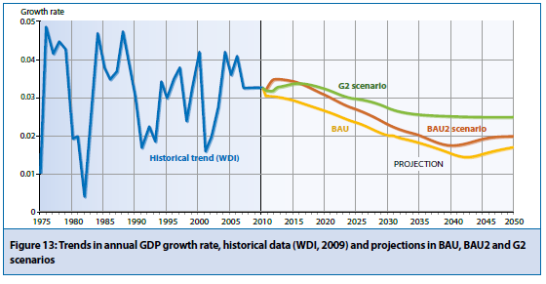
Projections from the 2011 UNEP Green Economy Report

Slide 51
An unprecedented policy challenge
The Stern Review Policy Prescription for climate change
Carbon pricing: carbon taxes; emission trading
Technology policy: low-carbon energy sources; high-efficiency end-use appliances/buildings; incentivisation of a huge investment programme
Remove other barriers and promote behaviour change: take-up of new technologies and high-efficiency end-use options; low-energy (carbon) behaviours
The basic insights from the Stern Review need to be applied to the use of other environmental resources (water, materials, biodiversity [space])
In a market economy, pricing is the key to resource efficiency, investment and behaviour change
Policy is required to bring about a step-change in eco-innovation

Slide 52
Policy approaches for green growth
Resource efficiency/productivity
Circular economy (reduce, re-use, recycle)
Waste hierarchy
Extended producer responsibility
Industrial symbiosis
Instruments (market-based, regulation, voluntary agreements, information, R&D/innovation):
  Resource and environmental taxation
  Recycling and efficiency targets
  Take-back/deposit requirements
  Consumer information/labelling

Slide 53
The benefits of increased resource productivity
Negative cost opportunities for resource efficiency in the UK economy of £23 billion (Oakdene Hollins 2011)
Innovation and investment: new technology, economic activity, exports
Increased resource security (reduced vulnerability): food, water, energy, rare materials
Environmental improvement: reduced GHG emissions, waste to landfill, extraction of virgin materials

Slide 54
Thank You
www.ucl.ac.uk/sustainable-resources

Slide 55
Panel Discussion 2
“Green Growth: The Grand Policy Challenge and the Role of Science”
Professor Paul Ekins, UCL Energy Institute
Dr Steven Fries, DECC
Chris Goodall, Carbon Commentary
Andrew Simms, the new economics foundation
Professor Michael Mainelli (Chair)

Slide 56
Closing Remarks
Professor Michael Mainelli
Chairman, Z/Yen Group
Principal Advisor, Long Finance

Slide 57




Long Finance Programmes
Founded 2005
Focus on finance & ESG issues
Over 50 contributing organisations
Over 300 reports free to access on the website
Long Finance’s ‘sustainable finance’ programme
London Accord
Financial Centre Futures
Meta-Commerce
Eternal Coin

Slide 58


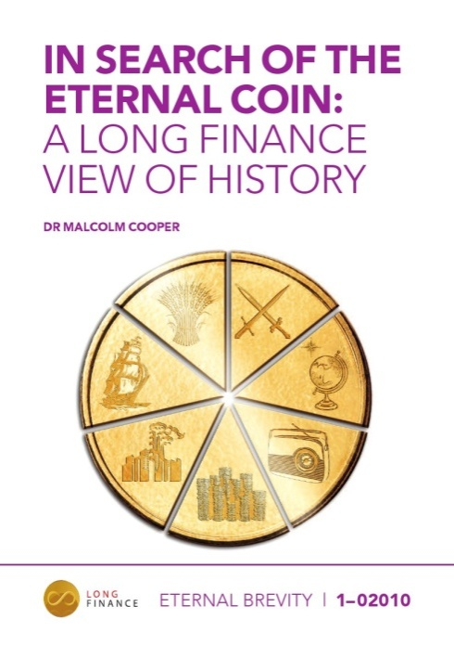
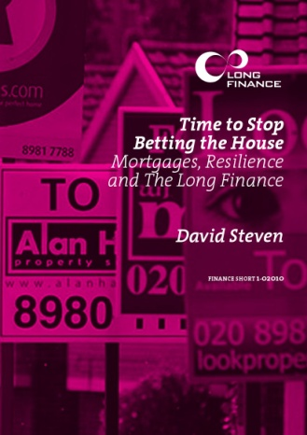

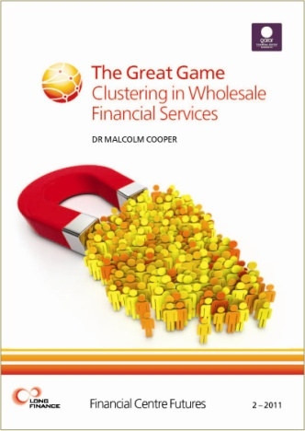

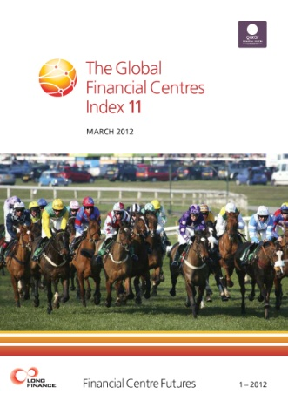

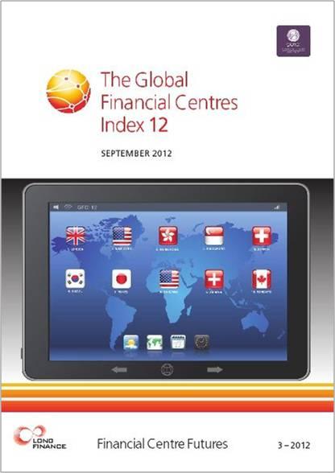
Long Finance Publications

Slide 59
Outlook 2013
Events
  The Role of Government Finance – 4 December 2012
  Confidence in Corporate Reporting – 6 December 2012
  The Currency of Management - What Managing Money Teaches Us About People – 13 December 2012
  Long Finance Spring Conference – 13 March 2012
  What Makes a Good Professional – 23 April 2013
  www.longfinance.net/events.html
Publications
  Impact of the Euro Crisis on Emerging Markets – January 2013
  GFCI 13 – March 2013
  www.longfinance.net/publications.html
Long Finance Online Community - hear first about the latest news and events
  www.longfinance.net/online-community.html

Slide 60




Thanks To Our Sponsors

