Slide 1
Medics at War
The First World War: Disease the only victor
Professor Francis E. G. Cox
Department of Disease Control
London School of Hygiene and Tropical Medicine

Slide 2
Diseases and their mode of transmission
Mode of transmission | Causative agent | Disease
Water-borne | Bacterium | Cholera
 | Bacterium | Typhoid
 | Virus | Poliomyelitis
Contact | Bacterium | Tuberculosis
 | Bacteria | Venereal diseases
 | Virus | Influenza
Insect (Louse) | Bacterium | Typhus
Insect (Mosquito) | Protozoan | Malaria

Slide 3
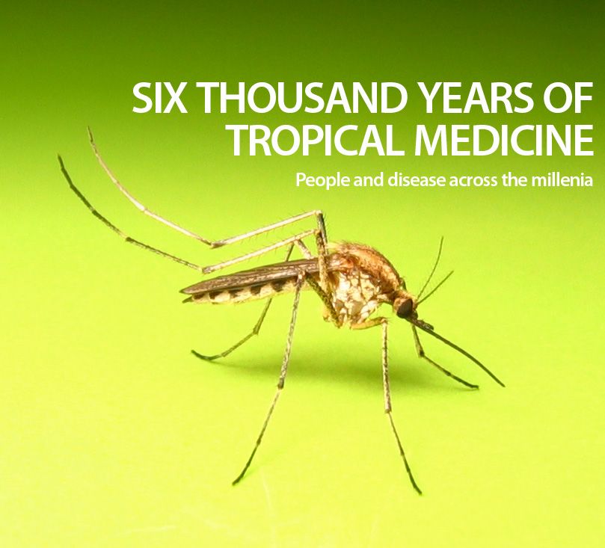
Six thousand years of knowledge of infectious diseases

Slide 4
Concepts of Disease
6000 BC-14C AD
Wrath of gods, punishment for sin etc.
14C AD-19C AD
Miasmic theory of disease
19C-21C
Germ theory of disease

Slide 5
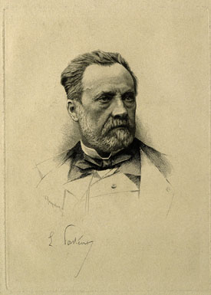
Louis Pasteur
(Courtesy Wellcome Trust Library)
1867
Louis Pasteur demonstrated the existence of microbes and showed that microbes can cause disease.

Slide 6
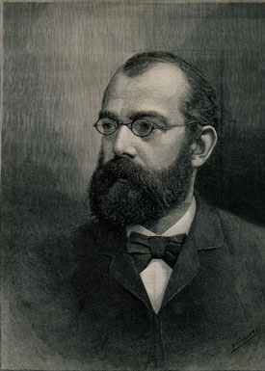
The Germ theory
(Courtesy Wellcome Trust Library)
1876
Robert Koch demonstrated that specific organisms cause specific diseases.

Slide 7
Rudyard Kipling
My Son Jack, 1915, London Methuen
“If any question why we died
Tell them because our fathers lied”.

Slide 8
Donald Rumsfeld
(2002)
There are known knowns: these are things we know that we know.
There are known unknowns that is to say that there are things we know we don’t know.
But there are things we do not know we don’t know.

Slide 9
Commentary on Rumsfeld
“…a brilliant distillation of a complex matter.”
Mark Steyn, Canadian writer and political commentator.
“…Impeccable stylistically, logically and rhetorically…”
Geoffrey Pullum, author of The Cambridge Grammar of the English Language.

Slide 10
Winners of past wars
“The winners of past wars were not always the armies with the best generals and weapons , but were often merely those bearing the nastiest germs to transmit to their enemies.”
Jared Diamond in Guns, Germs and Steel

Slide 11
American Civil War 1861-1865

Slide 12
Peninsular Wars 1808-1815

Slide 13
Crimean War 1853-1856
British deaths

Slide 14
Boer Wars 1880-1881, 1899-1902
British deaths

Slide 15
Russo-Japanese War 1904-1905

Slide 16
Disease as a weapon of war
1346 Kaffa (now Theodosia), Crimea. Plague victims catapulted over walls of city.
15C. Many unauthenticated records.
1710 Tallinn. Russians left plague victims behind enemy lines.
1763 North America. British commander Sir Jeffrey Amherst gave Native Indians gifts of smallpox infested blankets.
1763 Repeated at Fort Pitt.
1785 La Calle. Tunisian forces given smallpox-infested clothing.

Slide 17
Siege of Kaffa 1346
Whereupon the Tartars, worn out by this pestilential
disease, and falling on all sides as if thunderstruck, and seeing that they were perishing hopelessly, ordered the corpses to be placed upon their engines and thrown into the city of Kaffa. Accordingly were the bodies of the dead hurled over the walls, so that the Christians were not able to hide or protect themselves from this danger, although they carried away as many dead as possible and threw them into the sea. But soon the whole air became infected, and the water poisoned, and such a pestilence grew up that scarcely one out of a thousand was able to escape. Gabriele de Mussi (Mussis) 1348.

Slide 18
Infectious diseases common in Europe in 1914
Bacterial
Cholera
Typhoid
Typhus
Tuberculosis
Venereal diseases
Whooping cough
Viral
Influenza
Measles
Mumps
Poliomyelitis
Smallpox

Slide 19
Sir William Osler
(Royal College of Physicians London)
Sir William Osler argued that ‘the army marched on its brain’ and persuaded senior army officers to have troops vaccinated against typhoid.

Slide 20
Vaccines against infectious diseases common in Europe in 1914
Bacterial
Typhoid (1896)
Tetanus (1890)
Typhus
Tuberculosis
Venereal diseases
Whooping cough
Cholera (1897)
Viral
Influenza
Measles
Mumps
Poliomyelitis
Smallpox (1796)

Slide 21
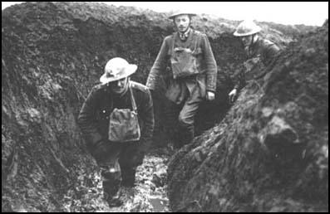
First World War Trench
(Spartacus Educational)

Slide 22
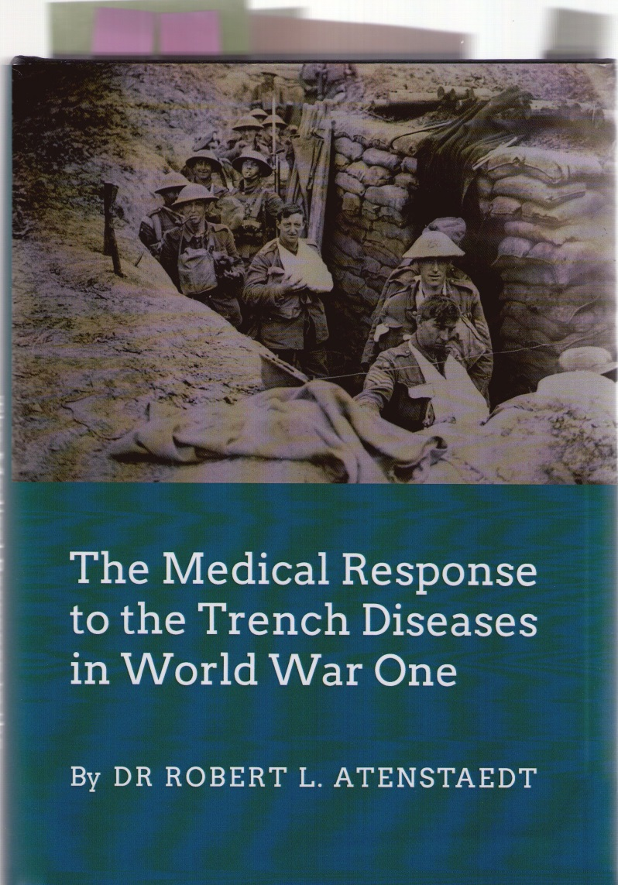
Trench diseases
Distinguished from known illnesses.
Specific and novel.
Trench fever 1916
Trench foot 1915
Trench mouth 1915
Trench nephritis 1915

Slide 23
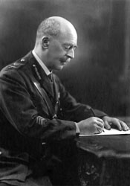
Sir William Leishman
(Courtesy Wellcome Trust Library)
Colonel Sir William Leishman successfully argued for a louse-transmitted microbial cause for trench fever.

Slide 24
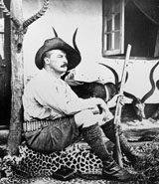
Major General Sir David Bruce
(Courtesy Wellcome Trust Library)
Sir David Bruce, a distinguished bacteriologist and parasitologist, suggested that ‘…had this disease (trench fever) and its mode of transmission been recognised earlier the war might have been considerably shorter’.

Slide 25
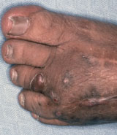
Fungal infection of foot
(Courtesy Wellcome Trust Library)

Slide 26
Military deaths Entente and Central 1914-1918

Slide 27
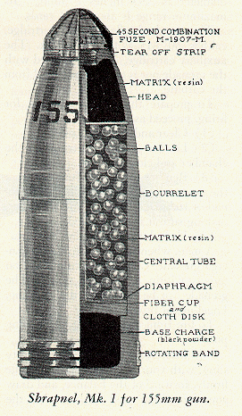
WW1 Shrapnel shell
A single shrapnel shell was
the equivalent of 400-800
bullets and could cover an
arc of up to 1500-3000 yards

Slide 28
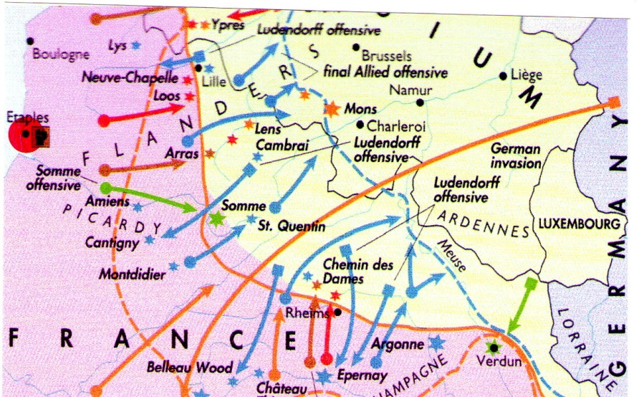
Western Front 1914-1915
(The Times Complete History of the World)

Slide 29
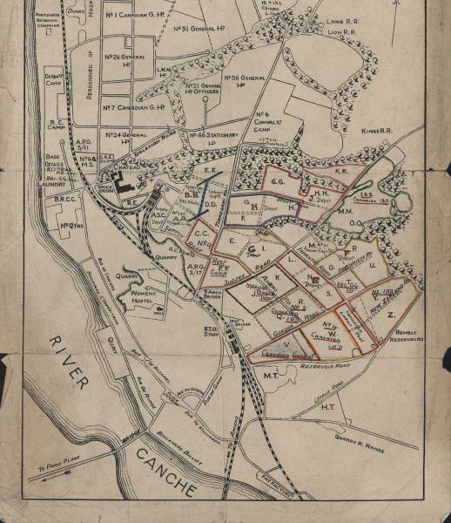
Étaples
Étaples is an old fishing port at the mouth of the River Canache in Pas de Calais, Picardy.
Over one million troops passed through the camp which housed 100,000 at any one time.

Slide 30
Military deaths Entente and Central adjusted for influenza

Slide 31
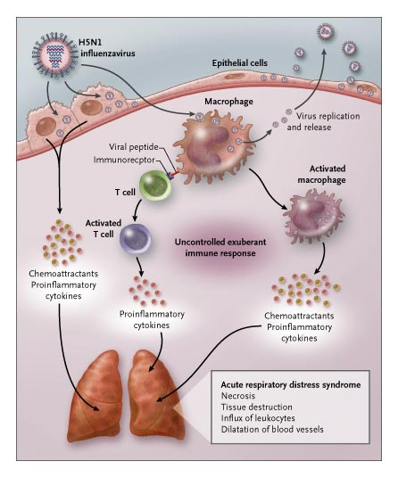
Cytokine storm

Slide 32
Haiti cholera epidemic 2010

Slide 33
Envoi
“When will they ever learn?
When will they ever learn”
From Where have all the flowers gone?
Pete Seeger and Joe Hickerson, Colombia Records

