Slide 1
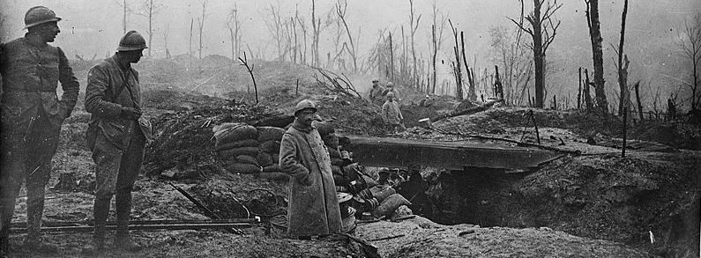
Christopher Clark
How Europe Went to War in 1914

Slide 2
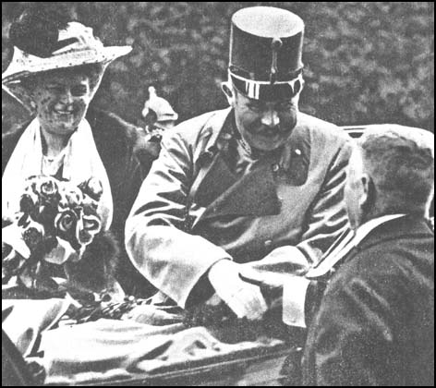
Archduke Franz Ferdinand and Sophie Chotek, Duchess of Hohenberg

Slide 3
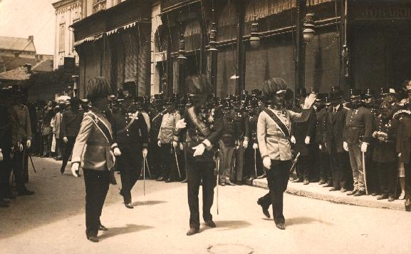
Last images before the assassination

Slide 4
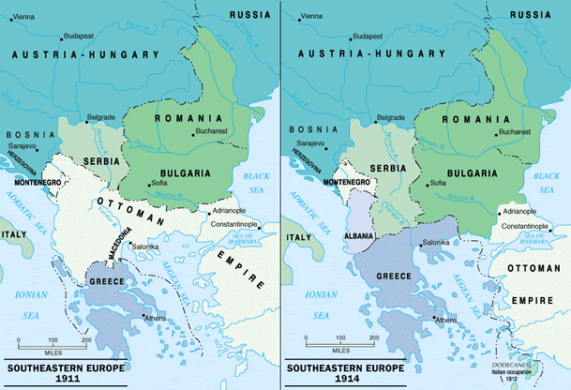

Slide 5
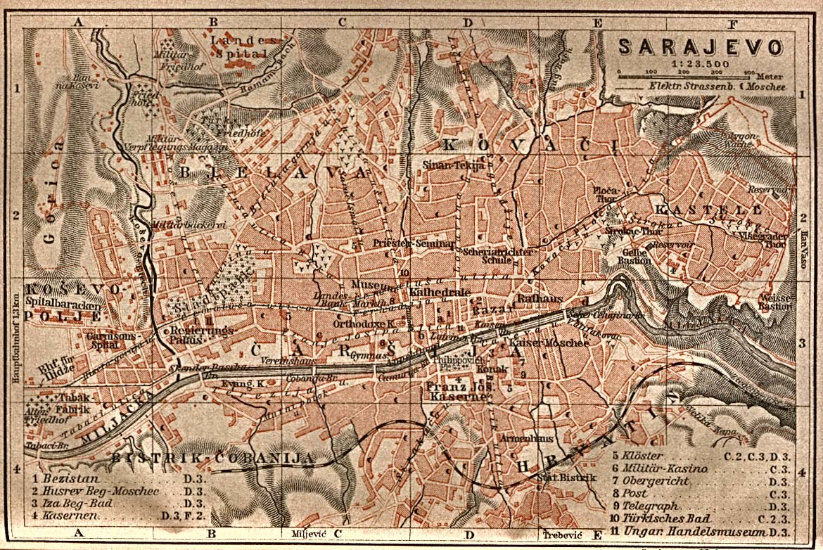

Slide 6
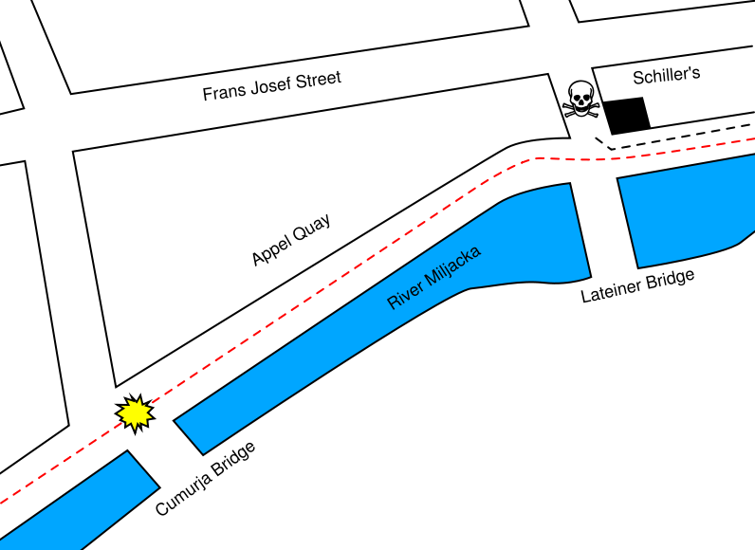
Notes:
Map of the assassination, 2

Slide 7
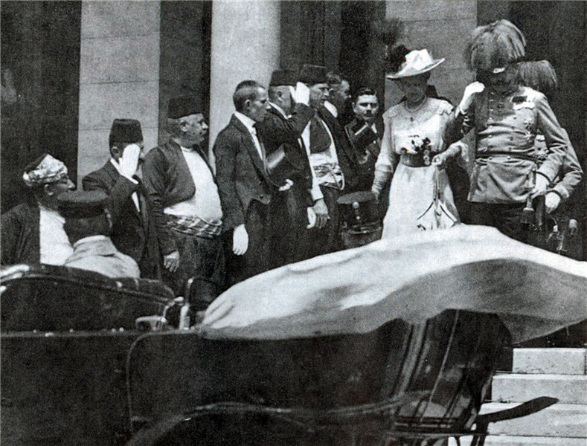
Sarajevo City Hall, 28 June 1914

Slide 8
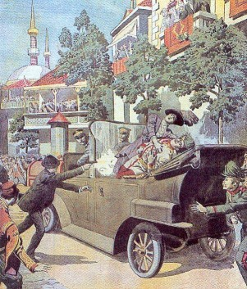
The assassination: an artist’s impression

Slide 9
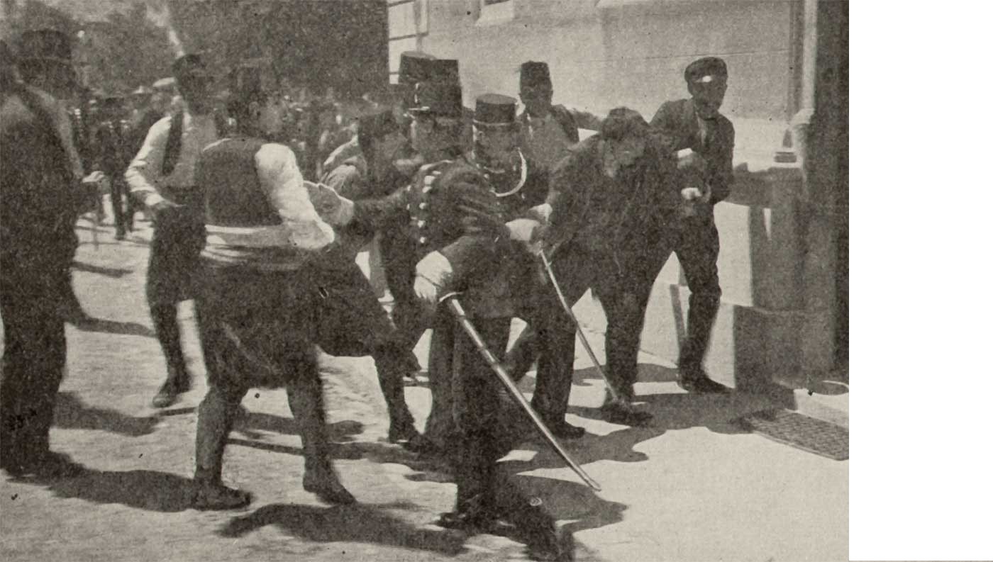

Slide 10
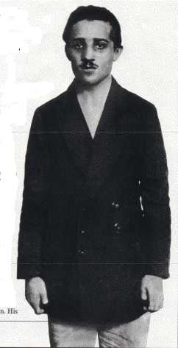
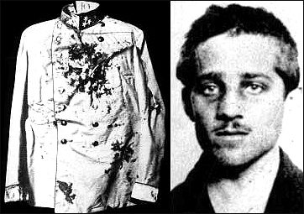
Gavrilo Princip

Slide 11
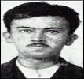

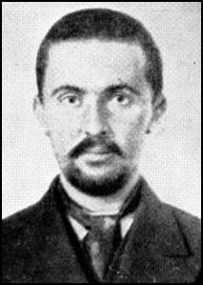
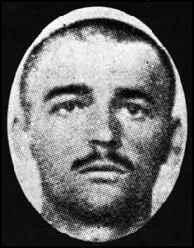
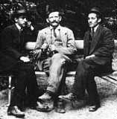
Four of the conspirators: Čubrilović, Čabrinović, Ilić, Grabez

Slide 12
How Europe Went to War in 1914

