Slide 1
Long Finance - Gresham College Symposium
Saving Havens
Offshore, Onshore or Mid-Shore Financial Centres

Slide 2
Welcome
“Offshore, Onshore, Mid-Shore”
Professor Michael Mainelli
Executive Chairman, Z/Yen Group

Slide 3
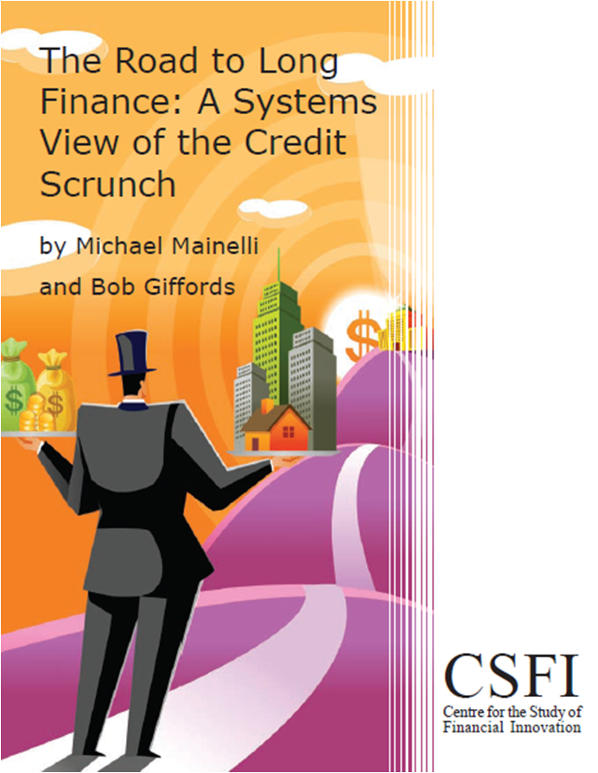
About Long Finance
‘When would we know our financial system is working?’
Objectives:
Expand Frontiers
Change Systems
Deliver Services
Build Communities
Programmes:
London Accord
Financial Centre Futures
Meta-Commerce
Eternal Coin

Slide 4
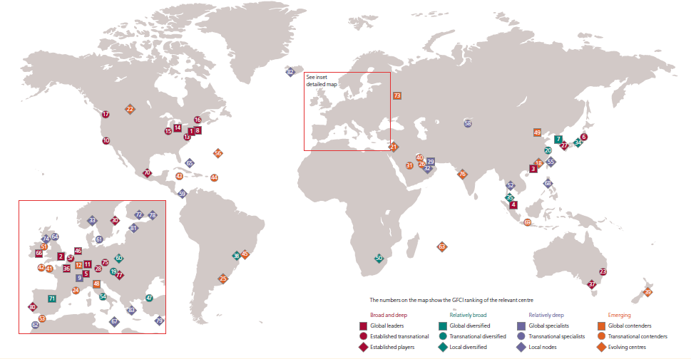
The GFCI World

Slide 5
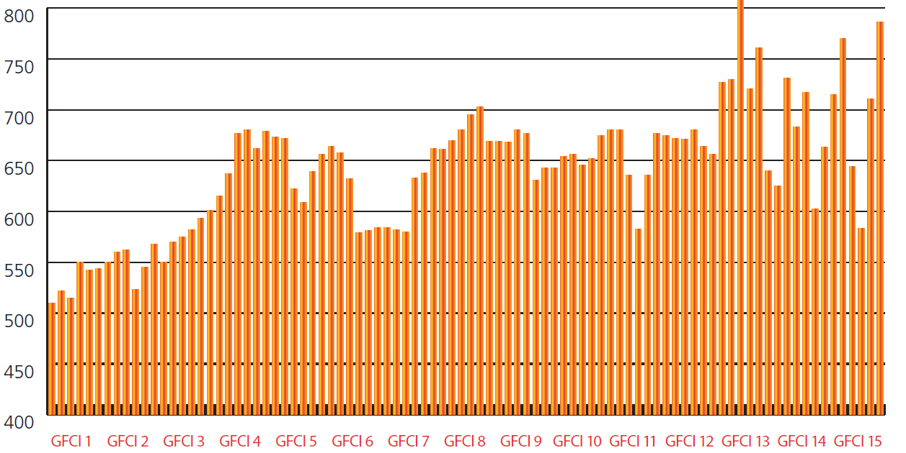
Headline Findings (1)
Greater volatility and uncertainty

Slide 6
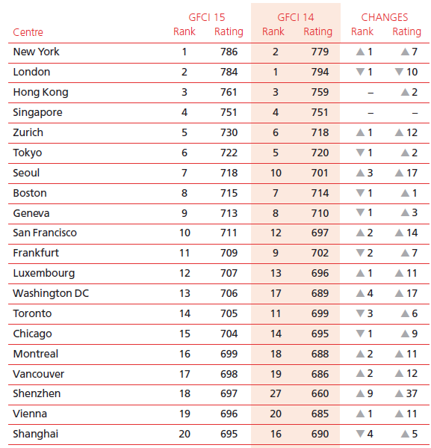
Top Twenty GFCI 15 Centres

Slide 7
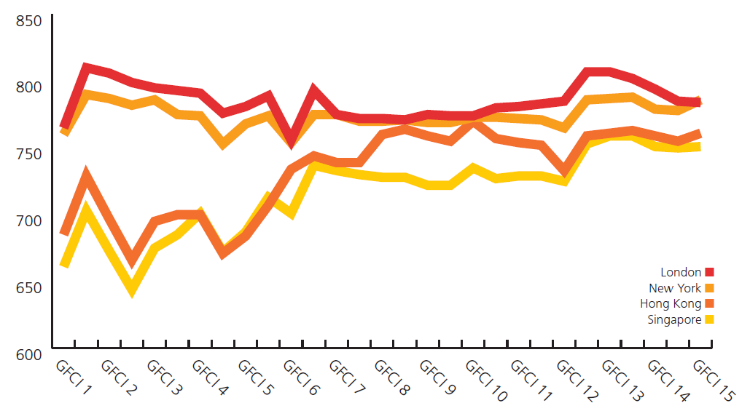
Headline Findings (2)
New York is now in first place
Hong Kong and Singapore continue to gain on New York and London
New York / London Trend Line
Hong Kong / Singapore Trend Line
Notes:
New York, London, Hong Kong and Singapore remain the top four global financial centres. New York is now the leading centre, although its lead over London is statistically insignificant - two points on a scale of 1,000. London’s reputation has suffered due to uncertainty over European Union membership, uncertainty over Scotland, regulatory creep and conservatism as well as expense, regulatory failures on Payment Protection Insurance or RBS's Global Restructuring Group or rate swap scandals or the London Whale, perceived ‘insider’ markets in LIBOR and foreign exchange, uncertainty over taxation, and the UK appearing unwelcoming to foreign workers and visitors. London exhibited the biggest fall in the top 50 centres. Whilst financial services employment is increasing in London, there is some evidence that jobs growth is in regulatory and compliance, including IT compliance jobs. There may be a looming tussle among the top four centres for renminbi (RMB) business at the traditional end of foreign exchange, or alternative currencies at the innovative end.
The ‘big four’ global financial centres are being chased. It is easy to focus on New York, London, Hong Kong and Singapore but others are catching up to the leaders. Three years ago (in GFCI 9) the difference between first and tenth was 117 points. The top ten centres are now within 75 points of each other.

Slide 8
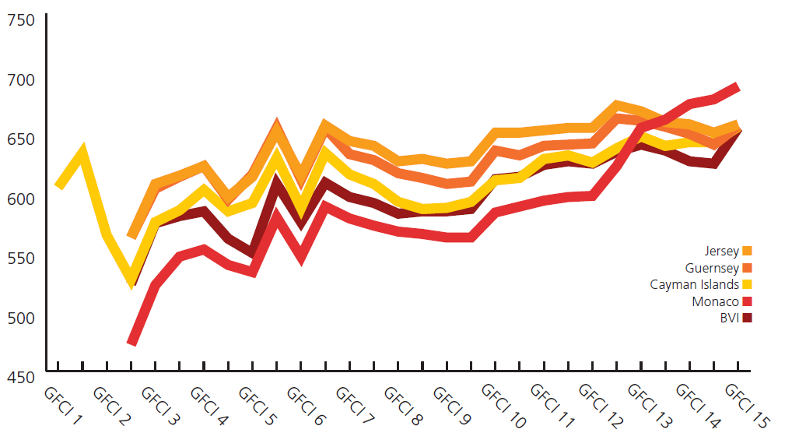
Headline Findings (6)
Offshore centres struggle with reputation and regulation. All except Gibraltar and the British Virgin Islands decline in the ranks.

Slide 9
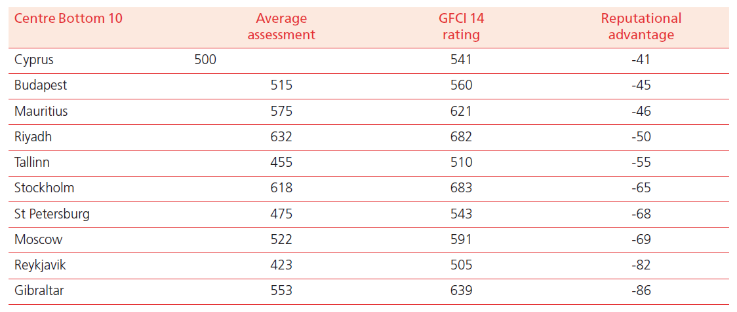
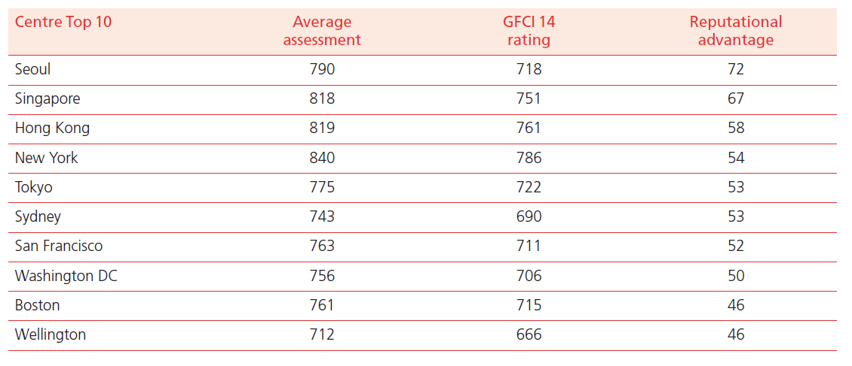
Reputational “Disadvantage”

Slide 10

IFC Characteristics
Strong in Wealth Management
Strong in Professional Services
Weak in Government & Regulatory
Weak in Insurance
Saving Havens?
Mid-Shore?

Slide 11
Agenda
14:00 to 14:30 Welcoming Address – “Offshore, Onshore, Mid-Shore”
14:30 to 15:00 First Address – “Why A ‘Competitive’ Tax System Is A Bad Tax System”, Nicholas Shaxson
15:00 to 15:30 Second Address – “The Future For International Financial Centres”, Richard Hay
15:30 to 16:00 Discussion – Nicholas Shaxson, Richard Hay
16:00 to 16:15 Break
16:15 to 17:15 Panel – “How Fares Fair Offshore?”, Mark Field MP, Jakob Schaad, Stuart Trought
17:15 to 17:30 Closing Remarks
17:30 to 18:30 Reception sponsored by Z/Yen Group

Slide 12
Panel Discussion
“Tax and Financial Centres”
Richard Hay, Partner, Stikeman Elliott
Nicholas Shaxson, Author, Treasure Islands: Tax Havens And The Men Who Stole The World
Professor Michael Mainelli (Chair)

Slide 13

Break
Please come back
to your seats by 16:15

Slide 14
Panel Discussion
“How Fares Fair Offshore”
Mark Field MP, City & Westminster
Jakob Schaad, Head of Financial Markets International, Deputy CEO of the Swiss Bankers Association
Stuart Trought, President, States of Alderney
Professor Michael Mainelli (Chair)

Slide 15

Closing Remarks

Slide 16
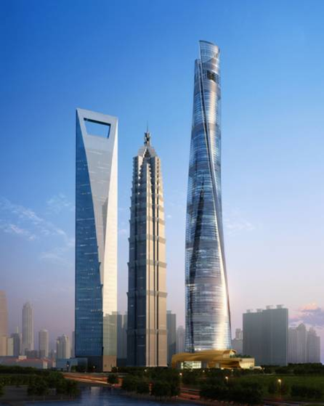
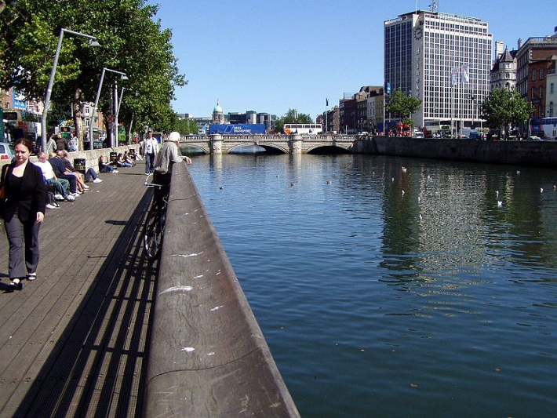
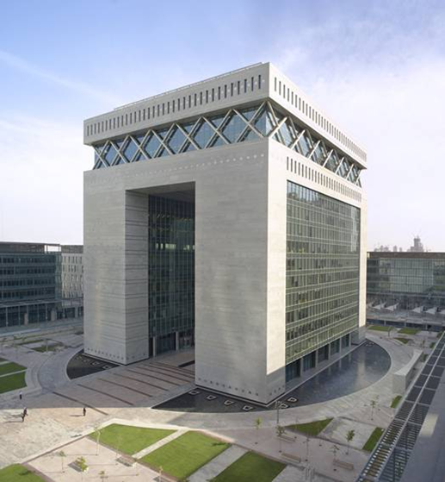

Thoughts for IFCs
Secrecy ✗
Tax evasion ✗
Simplification – conduits – Mid-Shore √
  tax simplicity – fighting back
  simple rule zones
  long-term “store and release” zones
Wealth protection - long finance – savin’ havens √
  signalling stability and rules of change
  ‘selling’ regulation
  regulatory standards, e.g. ISO
Working together √
  standards
  training and education
  corporates, professional services, IFCs ...

Slide 17




Long Finance Programmes
Founded 2005
Focus on finance & ESG issues
New thematic strand on finance & cities since launch of Financing Tomorrow’s Cities in 2013
60 contributing organisations
Over 420 reports free to access on the website
Long Finance’s ‘sustainable finance’ programme
London Accord
Financial Centre Futures
Meta-Commerce
Eternal Coin

Slide 18
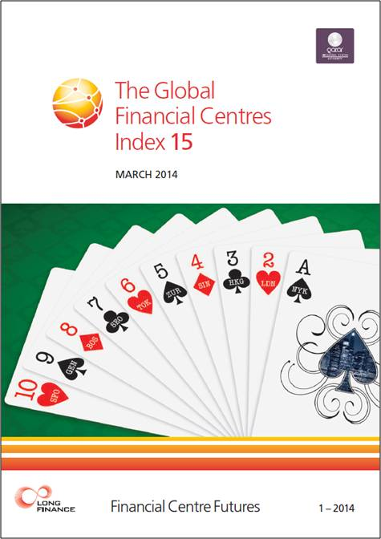
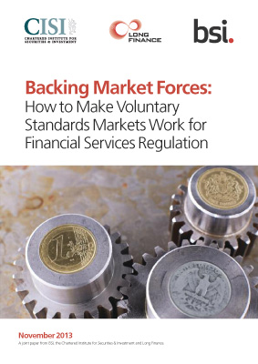
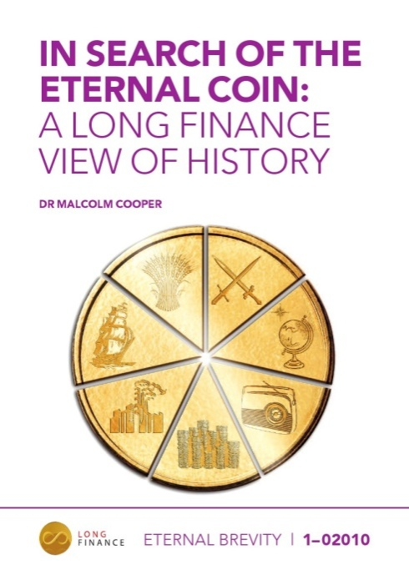
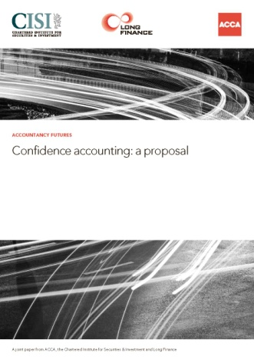
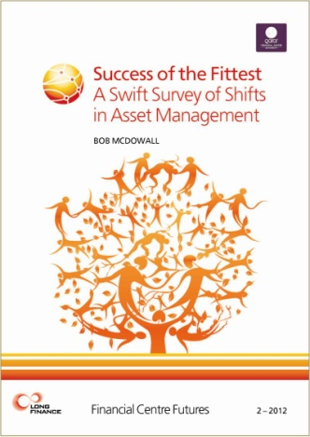

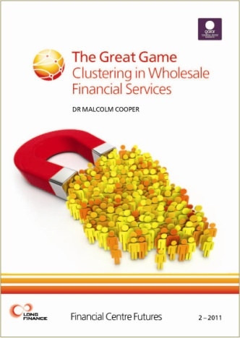
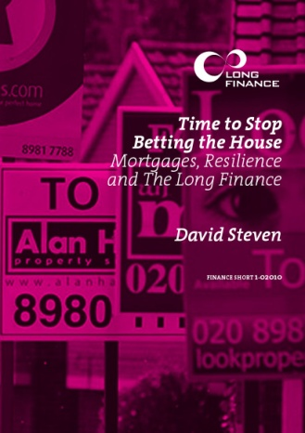
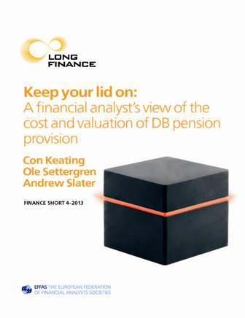
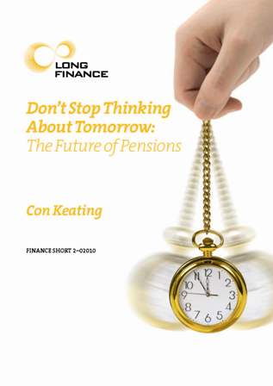
Long Finance Publications

Slide 19
Outlook 2014
Publications
  Financing Tomorrow Cities: A Meta-Analysis - June/July 2014
  GFCI 16 – September 2014
  www.longfinance.net/publications.html
The Pamphleteers Blog
http://www.longfinance.net/news/long-finance-blogs/the-pamphleteers.html
Events
http://www.longfinance.net/events/forthcoming-events.html
Long Finance Online Community - hear first about the latest news and events
  www.longfinance.net/online-community.html

Slide 20
Symposium Exam Question
*symposium n., 1. A conference or meeting for the discussion of some subject, esp, an academic topic or social problem. 2. A drinking party with intellectual conversation, music, etc.

