Slide 1
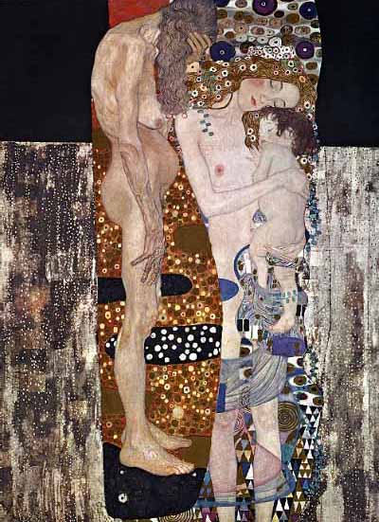
Health and the Seven Ages of Man:
Serious ill health in the very old and the very young.
Christopher Whitty
Gresham College 2014

Slide 2
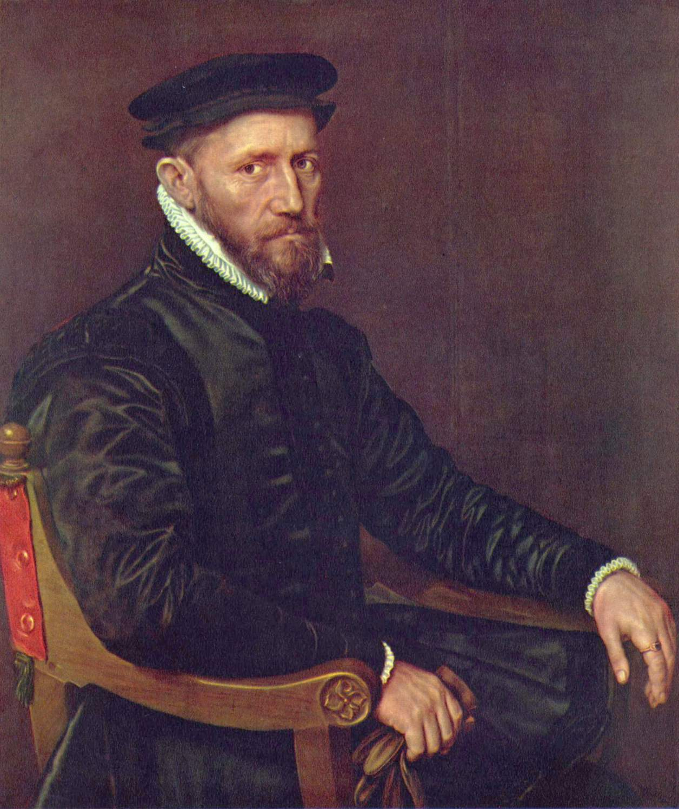
Until our generation death was a common visitor to any age, in any economic class.
Sir Thomas Gresham 60(ish)
Shakespeare 52
Queen Anne 49
Pitt the Younger 47
Prince Albert 42
Mozart 35
Prince Arthur 15, Henry VIII 55, Edward VI 15.

Slide 3
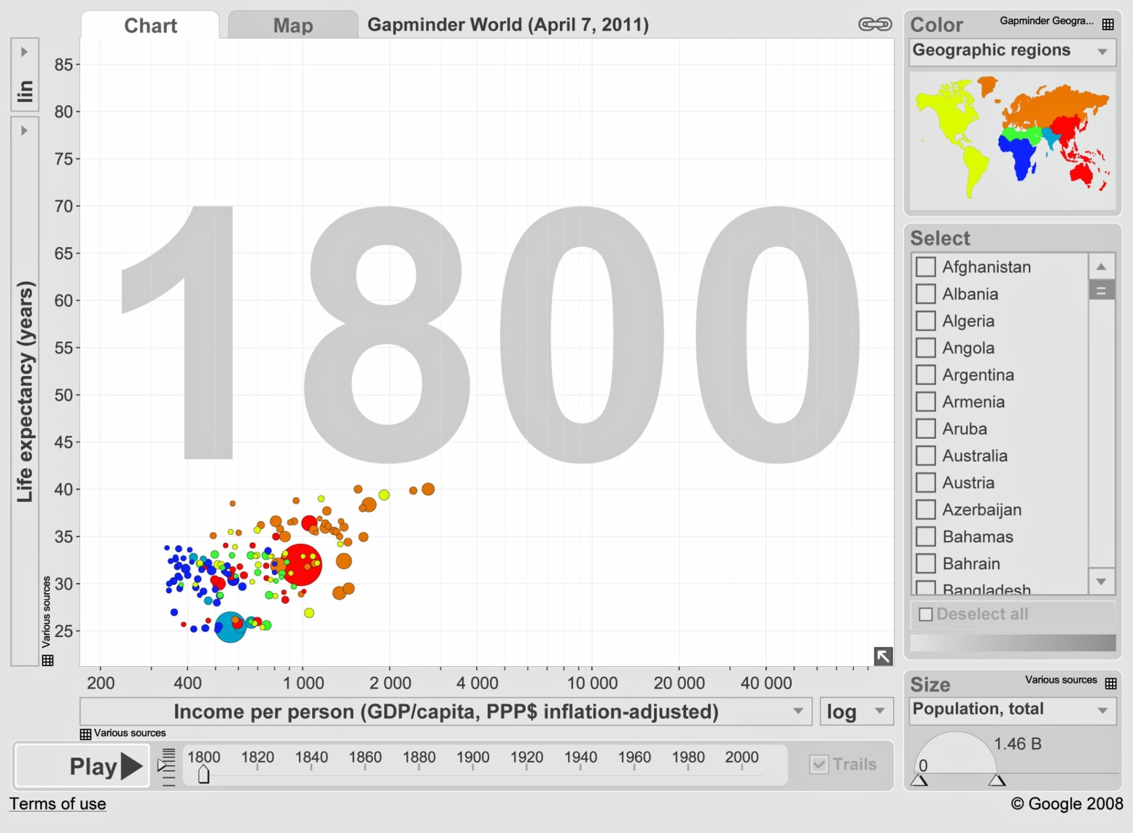
Data from Gapminder, Hans Rosling

Slide 4
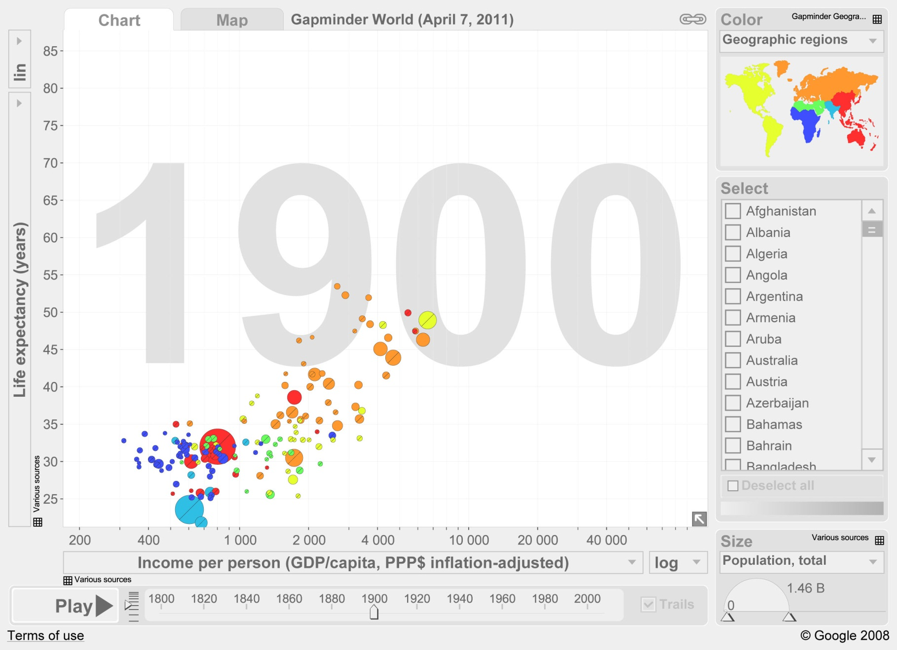

Slide 5
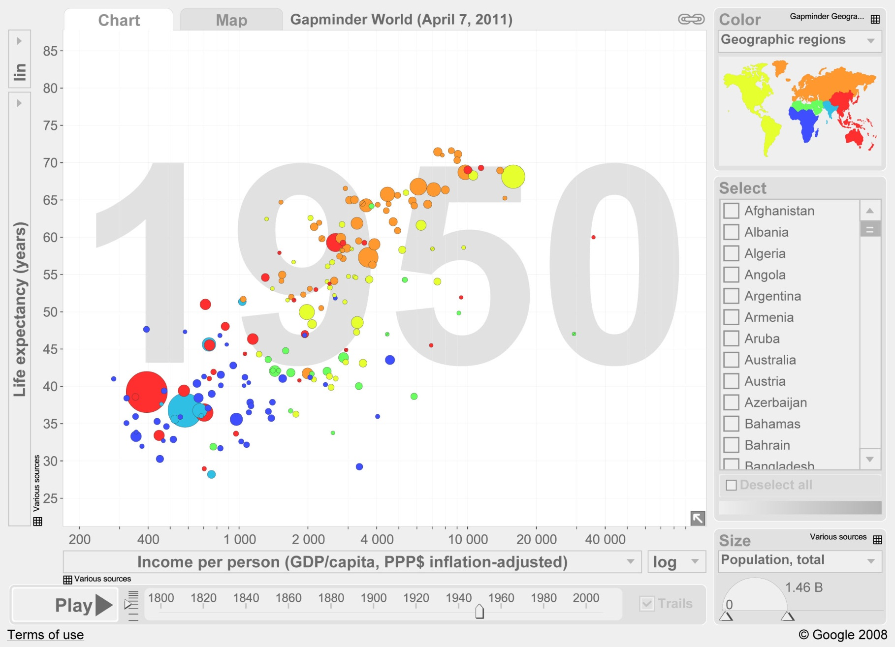

Slide 7

Globally the hourglass of mortality and serious ill-health is being squeezed in the middle
Young adult deaths, then childhood deaths became rare by historical standards in the industrialised world.
In developing world childhood deaths are now falling fast.
Serious ill health and mortality is increasingly concentrated in the first 28 days of life, and in the elderly.

Slide 8
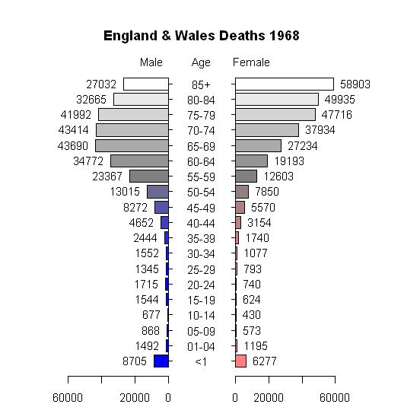
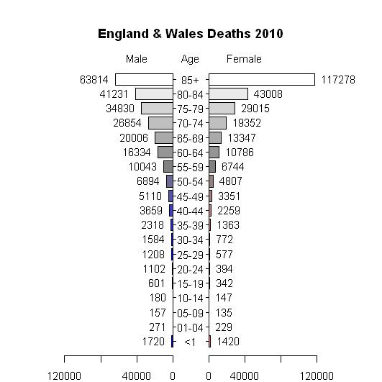
Mortality by age, England and Wales 1968-10
(McCulloch A, Significance)

Slide 9
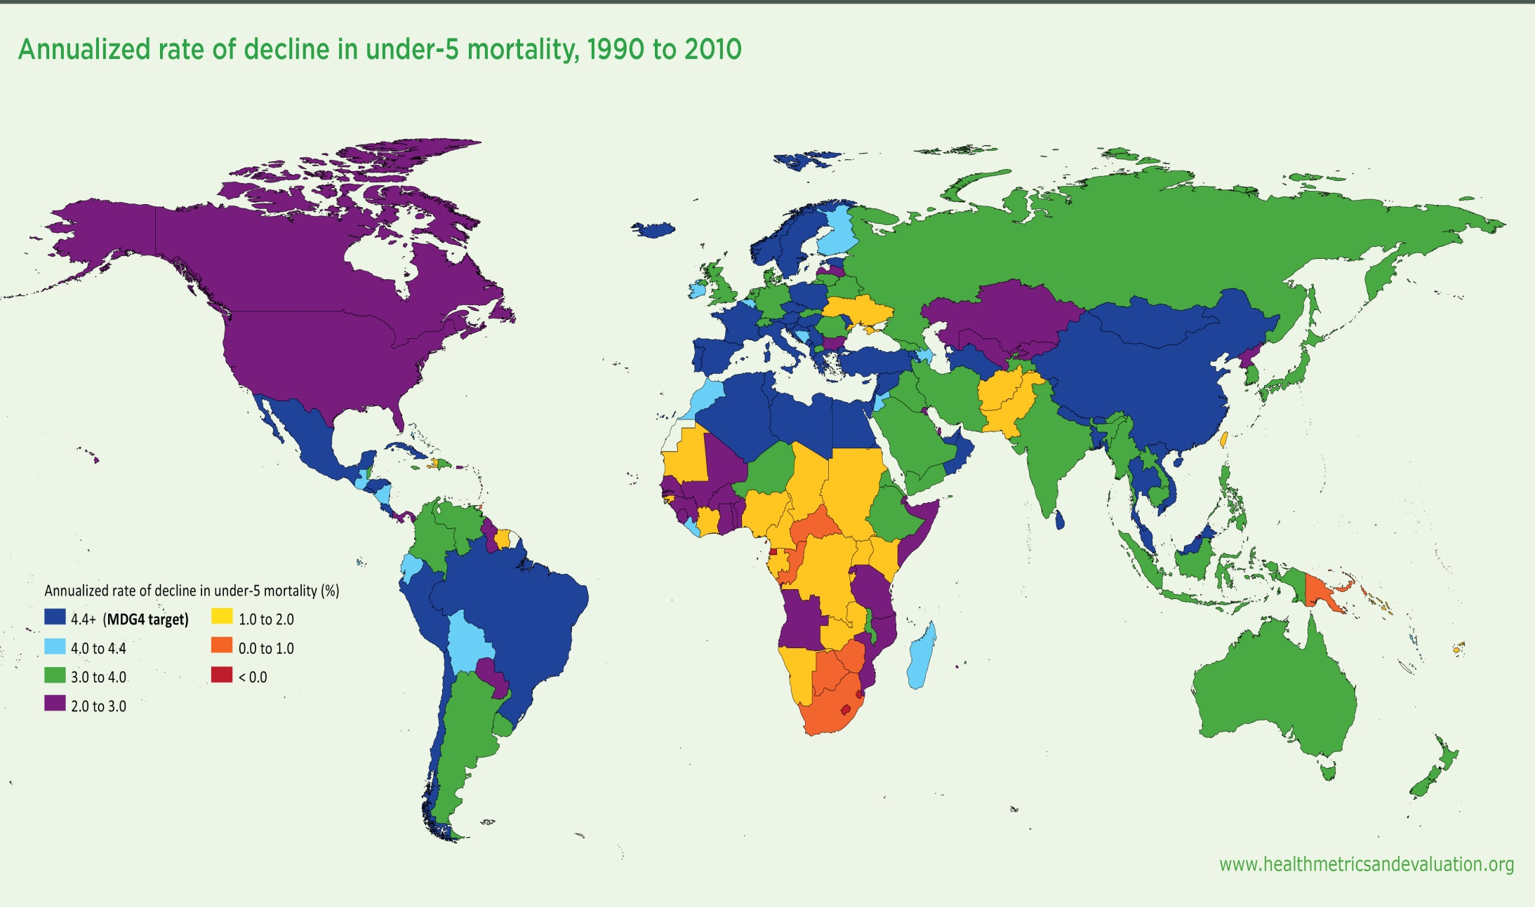
Steady decline in under-5 mortality virtually everywhere (Institute for Health Metrics)

Slide 10
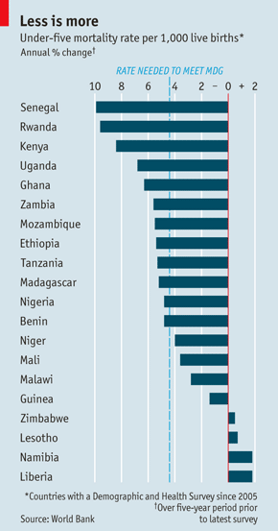
“Africa is experiencing some of the biggest falls in child mortality ever seen, anywhere.”
(Economist 2012)
In Africa, Asia and Latin America incidence of many major infectious diseases falling fast over the last decade.
Economic growth, but also a bold vision, great generosity, and well targeted science.
Can we say the same of our vision for the health of the old?

Slide 11
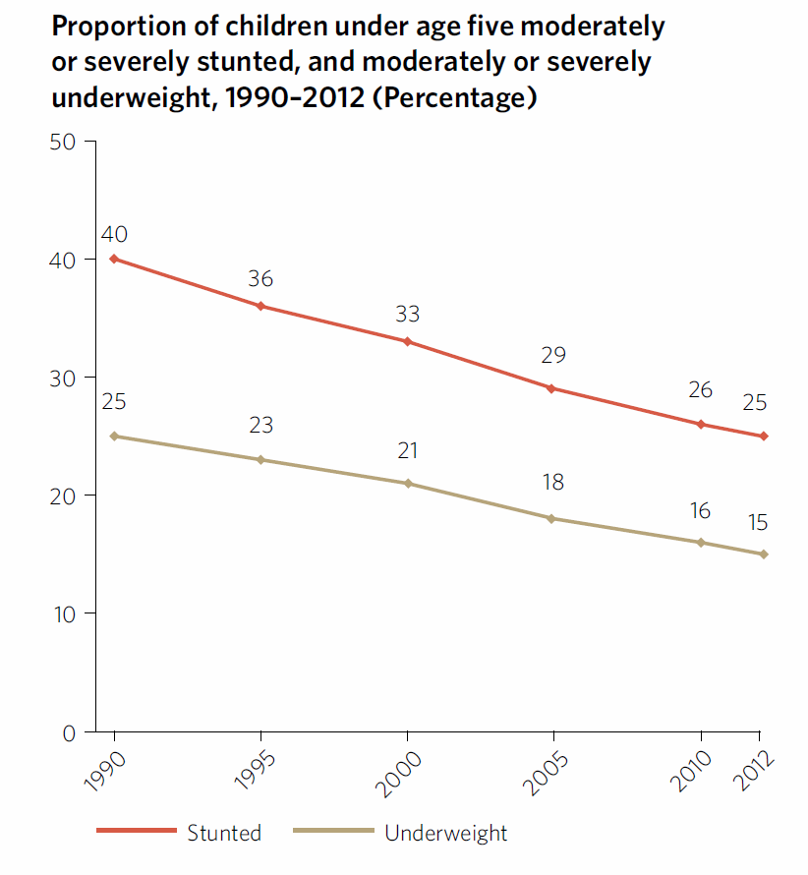
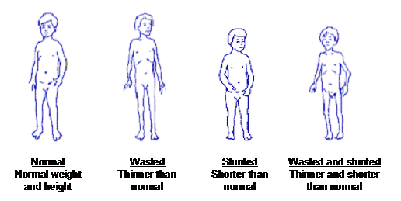
General economic development and reductions in malnutrition (UN).
Strong correlation between malnutrition and mortality.
Includes protein-energy malnutrition and specific deficiencies such as Vitamin A.

Slide 12
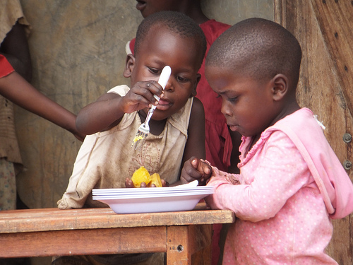
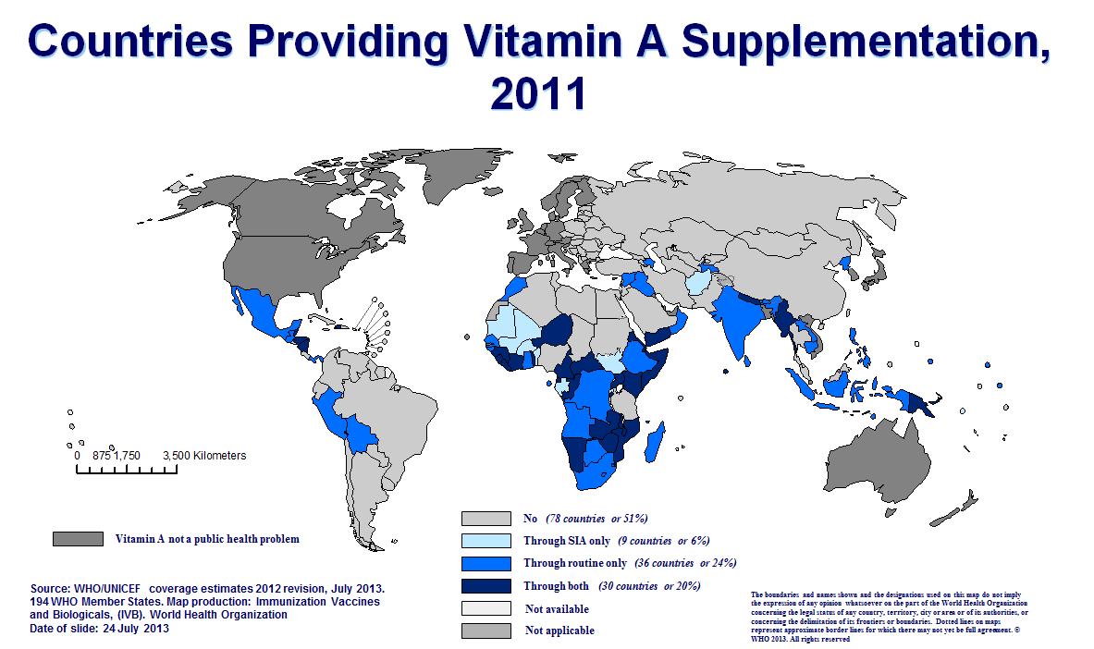
Multiple small interventions are essential (WHO data)
For Vitamin A, examples include:
Better balanced diets.
Breeding in higher Vitamin A- eg orange-fleshed sweet potato
Supplementing foods
Emergency high-dose Vitamin A during epidemics.

Slide 13
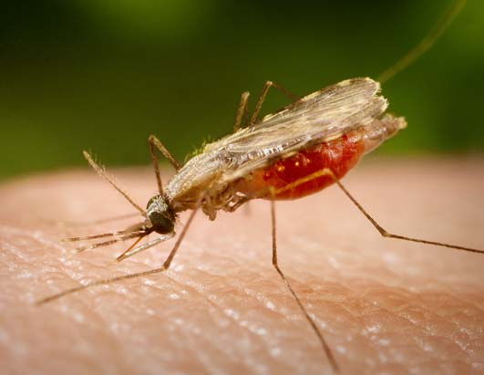
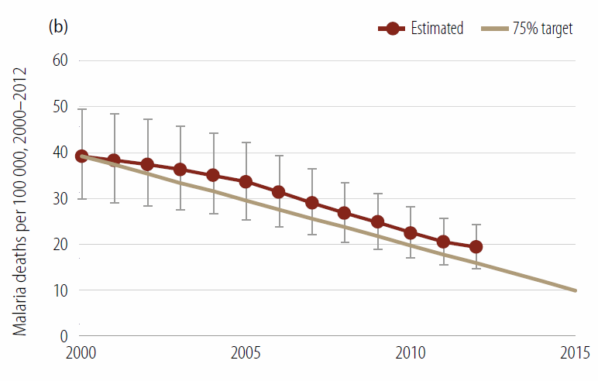
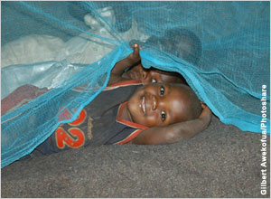
Reduction in many serious insect-transmitted diseases, especially malaria in Africa.
(WHO World Malaria Report 2013- reduction in under 5 child deaths from malaria).

Slide 14
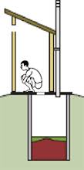
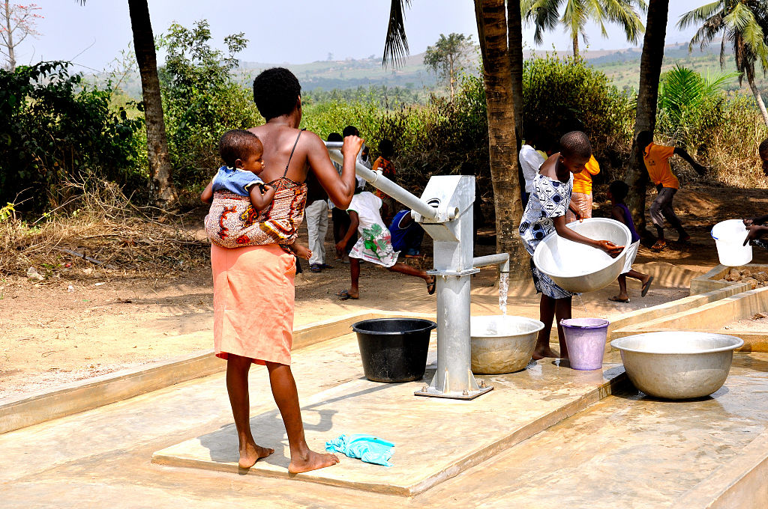
Water and sanitation

Slide 15
Vaccine preventable deaths- huge strides forward, still room for significant progress.
Children who die from diseases preventable by vaccines recommended by WHO: 1.5M.
Haemophilus influenzae: 199 000
Pertussis (whooping cough): 195 000
Measles: 118 000
Neonatal tetanus: 59 000
Tetanus (non-neonatal): 2 000
Pneumococcal disease: 476 000
Rotavirus: 453 000
Nearly 17% of deaths in children under five are vaccine preventable (WHO).

Slide 16
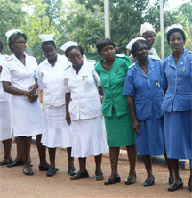
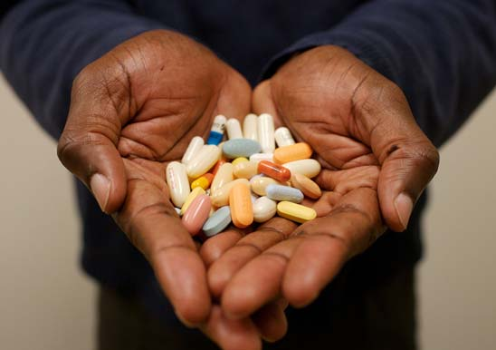
Better curative services
More and better trained healthcare workers.
New drugs for neglected diseases.
Better diagnostics tests.
Mechanisms such as the Global Fund to make treatments affordable.

Slide 17
“Results [in Niger]… show that about 59,000 lives were saved in children younger than 5 years in 2009, attributable to
-the introduction of insecticide-treated bednets (25%);
-improvements in nutritional status (19%);
-vitamin A supplementation (9%);
-treatment of diarrhoea with oral rehydration salts and zinc, careseeking for fever, malaria, or childhood pneumonia (22%);
-and vaccinations (11%).”
Amouzou et al, Lancet Sept 2012.

Slide 18
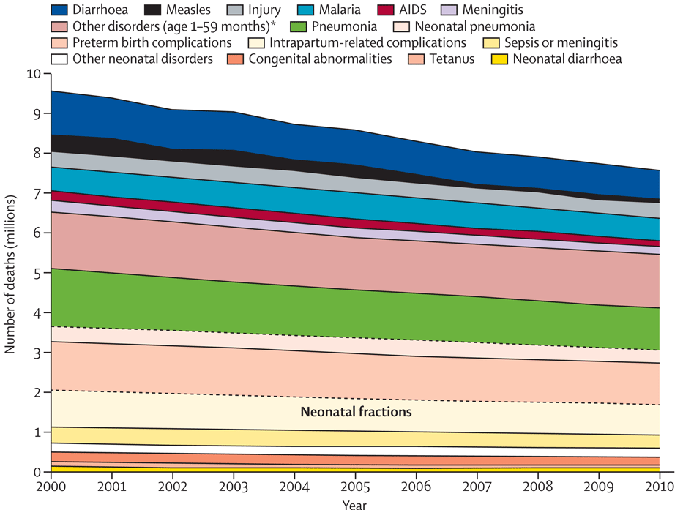
Trends in childhood deaths (Liu/CHERG 2012)

Slide 19
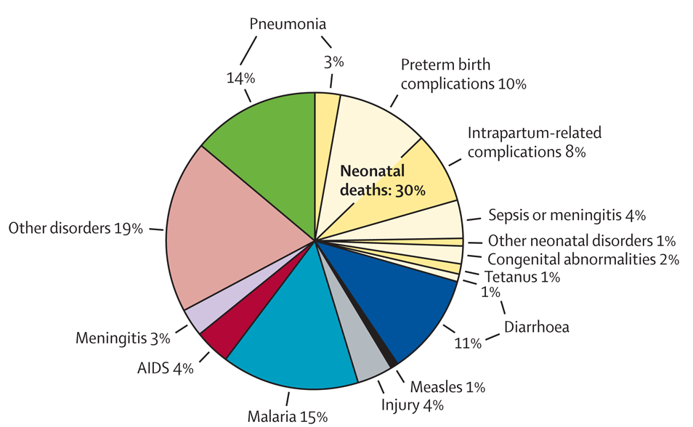
Causes of childhood deaths, Africa 2010 (Liu et al 2012)

Slide 20
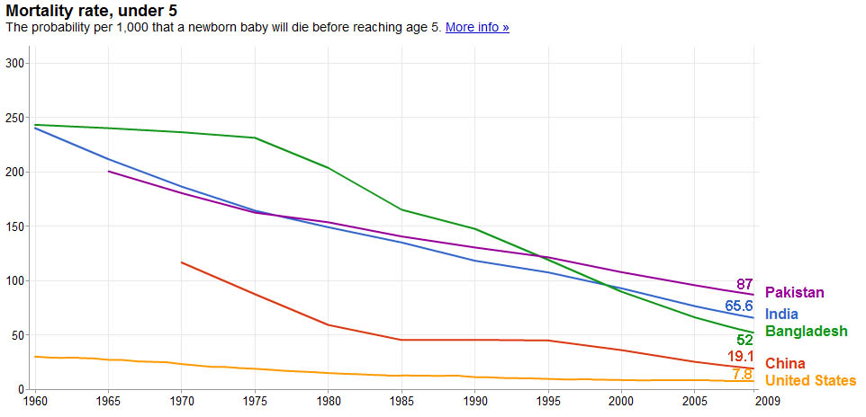
Child mortality rate Asia
(under 5 rate/1000)

Slide 21
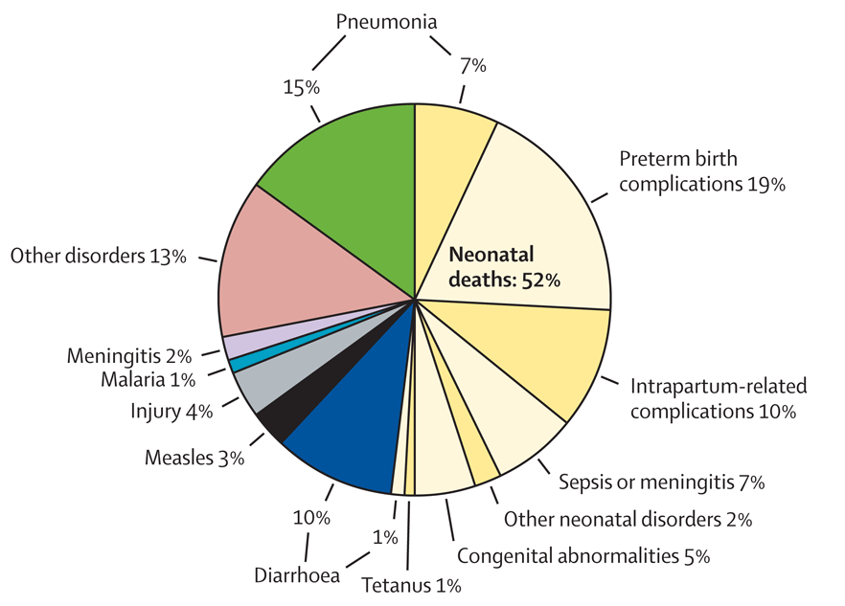
The proportion of deaths in the first 28 days increasing. Childhood deaths South Asia (Liu/CHERG 2012)

Slide 22
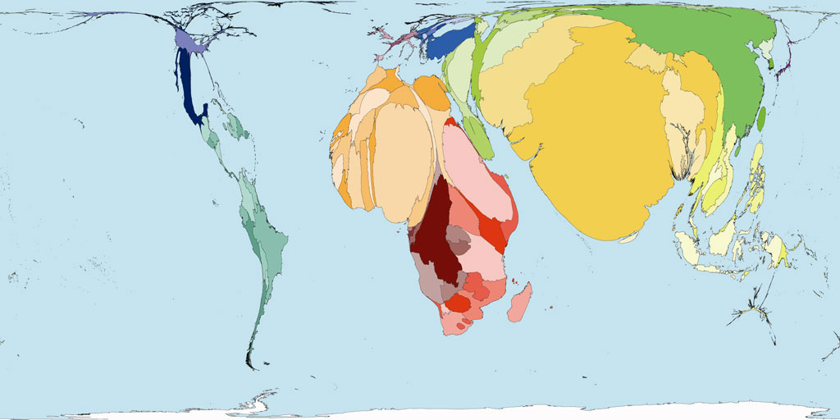
Global burden of neonatal deaths

Slide 23
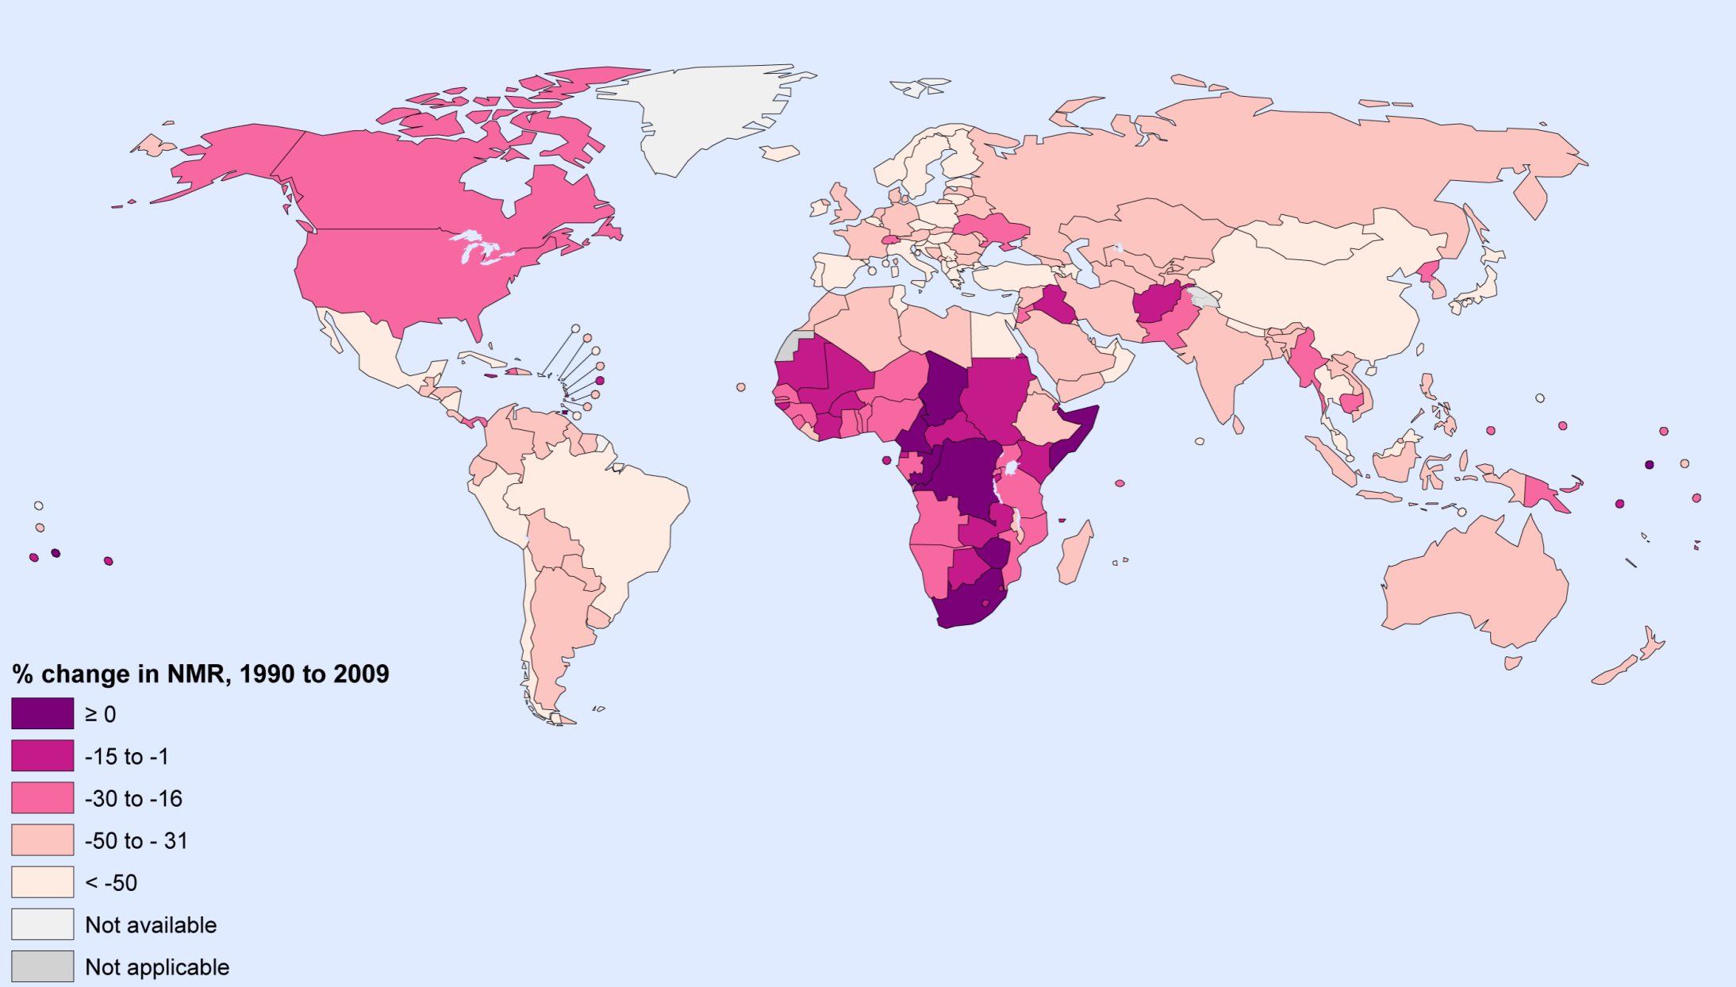
Change in neonatal mortality rate 1990-2009 (CHERG, PLOS 2011)

Slide 24
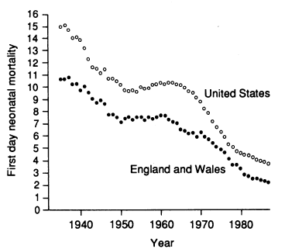
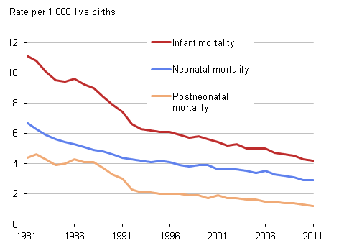
Reduction in neonatal mortality- England and Wales

Slide 25
Mortality by age, England and Wales 1968-10

Slide 26
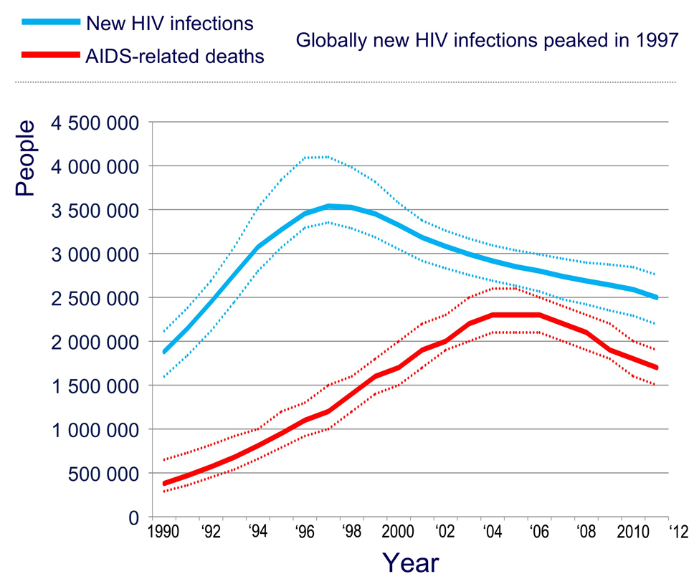
HIV the one new infection killing young adults globally- now on a slow, steady retreat (WHO)

Slide 27
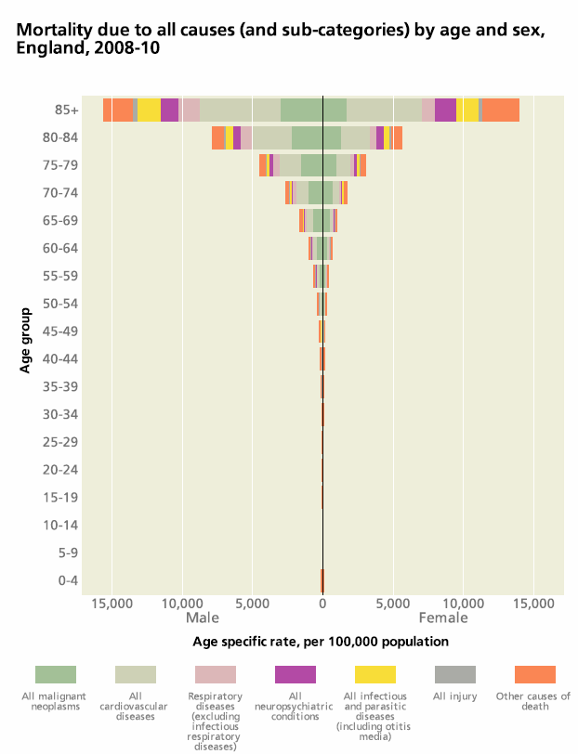
CMO report data
Move 1- from multiple cause poverty-related deaths to single conditions, usually infections, especially in children.
Move 2- from preventable or treatable infections to single manageable chronic diseases (eg cardiovascular disease) or several diseases with a single risk factor (eg smoking), middle and older age.
Move 3- to multiple conditions with multiple risk factors. The poor, the elderly.

Slide 28
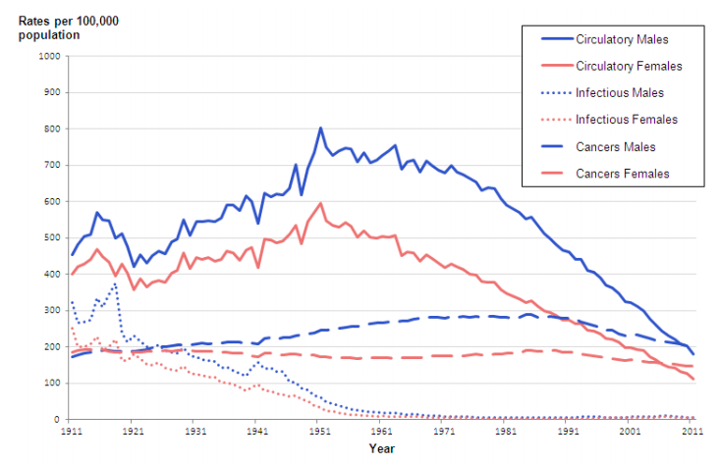
Age-standardised mortality rates England and Wales- circulatory, cancer, infection. (ONS 2014)

Slide 29
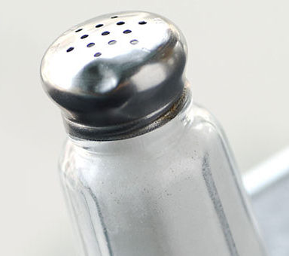

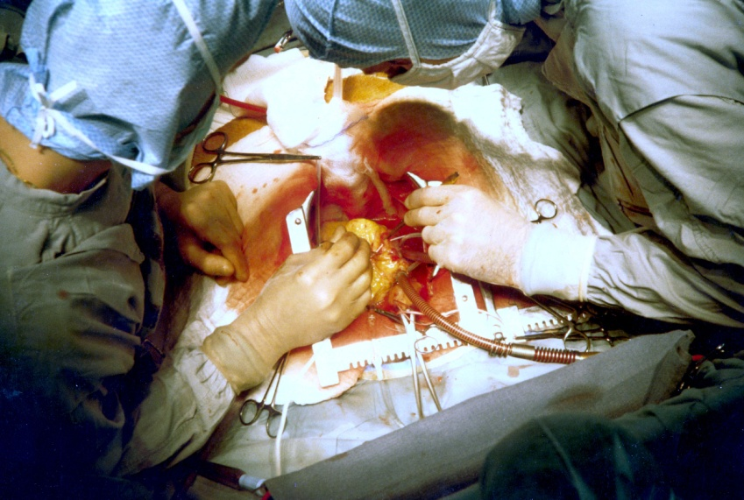
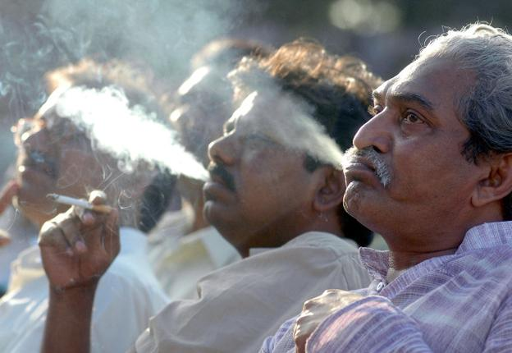
Multiple causes for the fall in cardiovascular diseases

Slide 30
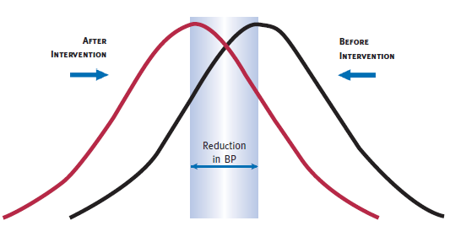
Prevention and cure- circulatory diseases (heart attacks, strokes)
Primary prevention- reduced smoking, reduced salt.
Secondary prevention- treatment of hypertension.
Tertiary prevention- post angina drugs, surgery.

Slide 31
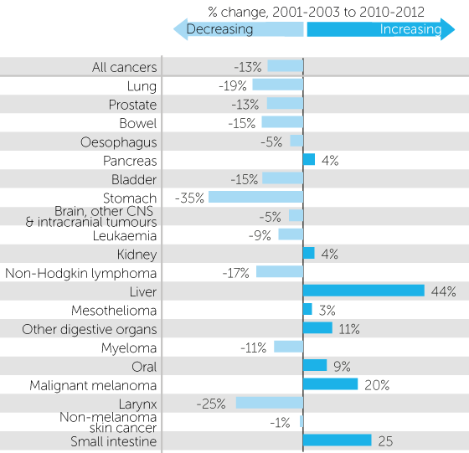
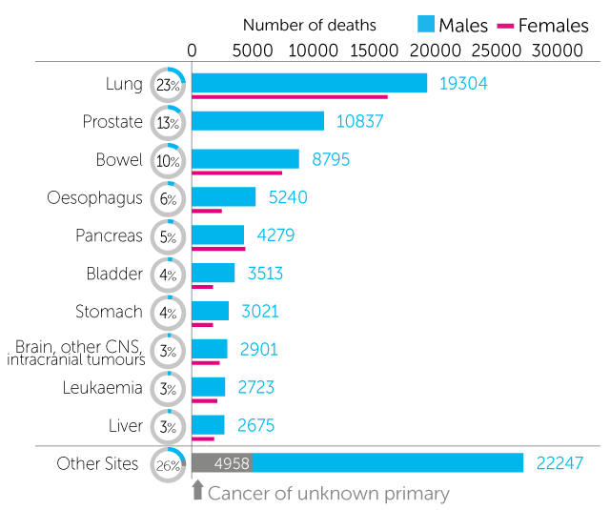
Cancers UK- male mortality and change on a decade ago (Cancer Research UK 2014)

Slide 32
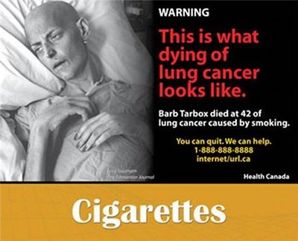

Reductions in cancer mortality have many drivers.
Lung cancer- reduction in smoking.
Stomach cancer- reduced H. pylori incidence and treatment, fresh foods.
Hodgkin's lymphoma- better treatment (and reclassification).
Cervical cancer- vaccination in due course, screening now.

Slide 33

The average age of mortality will continue to rise. Very good- but it has consequences.
The likelihood people will have only one condition will decrease.
Economic and practical implications for health services are profound.
Demography and dependency ratios will shift irreversibly.
Social and policy implications from housing stock to transport are significant.

Slide 34
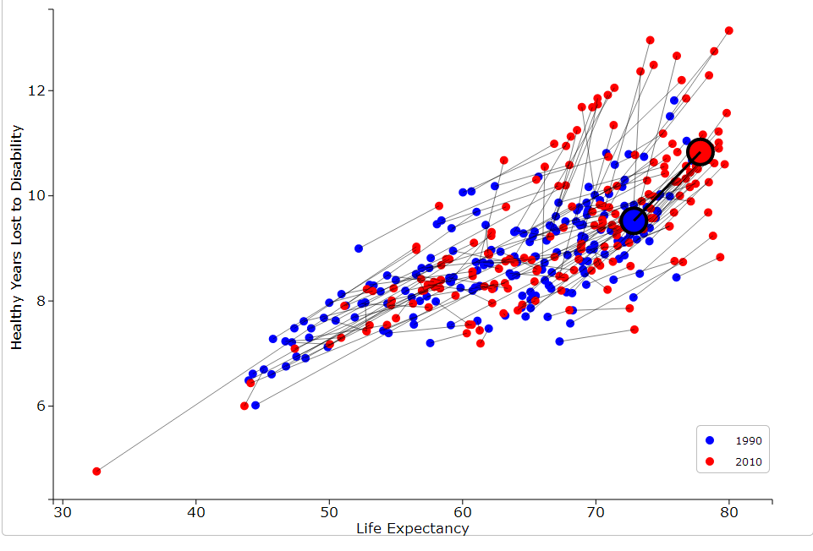
As life expectancy increases so does disability: all countries, UK highlighted. (GBD 2013)

Slide 35
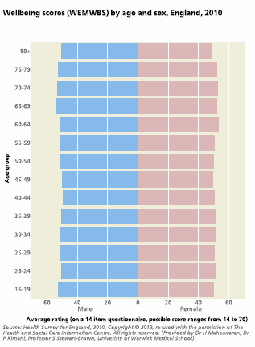
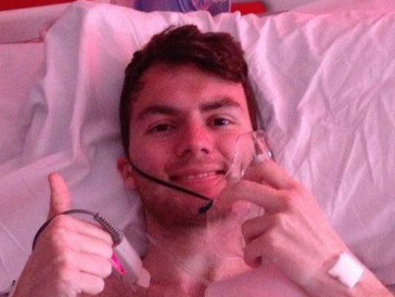
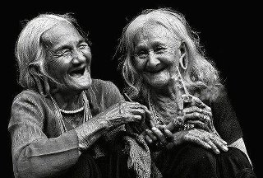
Disability and wellbeing are not the same.
Whilst there is a trend between disability and wellbeing, it is not obvious by age, or inevitable at any age.
Stephen Sutton, 19; Interact Project, Antol et al.

Slide 36
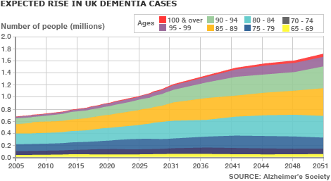
Dementia- one of many disabling conditions of the elderly which will increase inexorably.
Median age of cases is rising- but the number of cases rising faster.
Dementia advances very disappointing compared to infection, CVD and cancers.

Slide 37
Is our level of ambition and strategic focus right for the very young?
Our generation has seen remarkable drops in child mortality.
More needs doing but if we have determination the tools, money and science are there.
It will be irreversible unless we give up.
Neonatal mortality reduction has lagged, and needs significant further work.

Slide 38
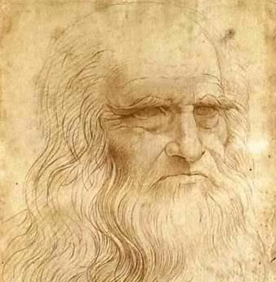
Is our level of ambition and strategic focus right for the very old?
The increase in average age of mortality in the developed word is also remarkable, welcome and irreversible.
The increase in the proportion of the sick who are elderly will continue for the rest of our generation.
Are we as single-minded in our determination scientifically, in policy and operationally to reduce disability in the elderly?

Slide 39
The scientific challenges are not trivial- but are not insuperable.
Research often deliberately excludes the elderly. Considered too complicated or high risk.
Seldom considers interaction of multiple conditions- we are wedded to disease-based rather than disability-based science.
Economic implications often not seen as sufficient for public (DALY, ‘healthy workforce’) or private (years to recoup investment) prioritisation.
Fatalism at the lack of progress on elderly health; outrage at the lack of progress on child health.

Slide 40
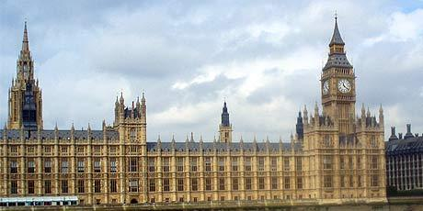
There are difficult ethical questions. Society, not doctors or scientists, must answer them.
There may be a trade-off between reducing neonatal mortality, and increasing disability.
There probably will be a trade-off between maximising age of death, and maximising disability-free years lived.
What is our primary goal?

Slide 41
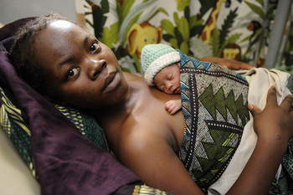
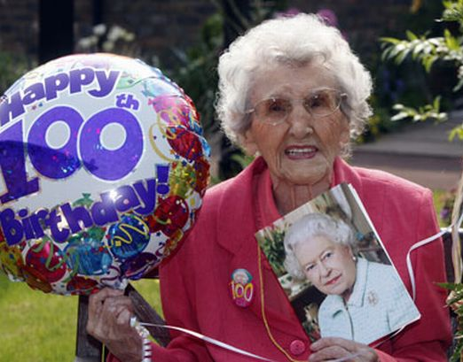
Improving health at the extremes of life- two of the great challenges for our generation.

