Slide 1
Should We Trust Computers?
Martyn Thomas CBE FREng
Livery Company Professor of Information Technology
Notes:
Good evening. It is an honour and a privilege to have been appointed as the first Livery Company Professor of Information Technology at Gresham College thank WCIT and Academic Board of Gresham
software engineer, private sector strong links universities and Government Praxis, - software for, banks, education, industry, commerce. Partner Deloitte Consulting. Expert witness Europe + Australia. My work has taken me behind the scenes in a variety of different organisations, ranging from retailers and banks to air traffic control, the police and the Ministry of Defence. I have seen a lot of software projects, from a lot of different companies: I have serious concerns that we are already taking unreasonable risks and that these risks are growing. Two main reasons.
first IT has changed the ways in which we work, play, shop and communicate to a far greater extent than is generally recognised.
one example, GPS satellites is used across the whole of society; eg the navigation for the safe docking of oil tankers, the positioning of the supports for the new Forth Bridge, the control of automatic machinery on farms and the time stamping of high-frequency trades on international stockmarkets.
Yet the GPS signal can be jammed with a transmitter costing a few pounds and spoofed with a simulator that costs little more.
second example: the way that personal data is being harvested, combined and analysed at vast scale, and used to target individuals with everything from legitimate advertising through to financial and romance frauds that have driven people to despair and to suicide.
We have not been asked whether we are happy that our web-browsing history is used to decide what prices to charge when we shop online, or what results we get from a search engine, or whether we are interviewed for a job.
My other main reason for concern is the poor quality of the software at the heart of all this technology, and I shall return to this point later in this talk.
I hope to use the next three years at Gresham College to discuss these and many other issues with you and to explore the best way forward. Everyone in the hall this evening is a computer user, through your phone, your contactless payment card, your car, your television and much more. So whether you are directly involved in designing computer systems or not, you have a stake in how information technology is used today and how it will develop over the next decade and beyond.

Slide 2
Join the discussions …
Visit and discuss at http:www.cyberliving.uk
Use hashtag #cyberliving on Twitter
… and please keep your comments positive and relevant!
Notes:
The power of computing and the inventiveness of engineers and entrepreneurs have brought about radical changes to the way we all live. Even for those of us in the computing industry, it has been difficult to foresee the consequences of each new technology. It was inevitable that regulation and legislation would fail to keep up with the challenges of cybersecurity, big data analytics, robotics and autonomous vehicles. The pace of change is not slowing – indeed it seems to be accelerating – so I think we should see whether we, the citizens of cyberspace, can influence the design of our future world.
Gresham College is ideally placed to convene and host discussions about how we want to use information technology in future. We have four centuries of tradition in holding public lectures and discussions, and very close links with the City of London, which is now so dependent on computing.We can hold our discussions both here and also in cyberspace. We have set up a website, http://www.cyberliving.uk to host discussions and if you use the hashtag #cyberliving on Twitter I will try to incorporate those tweets into our discussions. This means that those of you watching the recording of this talk on the internet can also join in the questions and discussions. Please do join it, and please let’s keep any arguments polite and constructive. This is new ground for Gresham College, so let’s see how well we can make it work.
I hope you will help me tonight and throughout this series of lectures, as we explore and discuss some of the difficult issues that already exist and some of the difficult decisions that will have to be taken in the next few years and beyond. In the near term, we shall see new data protection legislation across Europe, and new UK laws about surveillance, intelligence and hacking, after Edward Snowden’s revelations about the activities of the US National Security Agency and the UK’s GCHQ. We shall see the installation of 53 million smart gas and electricity meters across the UK, with new tariffs and, later perhaps, the ability for electricity suppliers to control our fridges and freezers, heating, air conditioning and the chargers for our electric vehicles, so that they can be turned off if demand gets too high. We may soon see driverless cars and lorries on our streets and motorways, perhaps with far-reaching consequences. Further ahead, there will be decisions to be made about whether we need controls over artificial intelligence and (perhaps surprisingly soon) artificial life.

Slide 3
This is where it all started
Notes:
But first I want to examine the state of computing today, and whether we are already putting too much trust in computer systems and in the people who develop them.
Information technology pervades our lives. If I could clap my hands and switch off all computers, the lights would go out, trains would stop, taps would run dry, food would not be delivered to shops, cars and aircraft would crash, telephones would be dead, hospitals would cease to function, no money would be available from banks, most shops would be unable to accept payment (and those that could would soon run out of goods to sell). There would be riots in cities within hours and the emergency services would be helpless. In short, the disruption would be enormous and very many people would die.
This is not an exaggeration. We are completely dependent on the modern electronic computer and software – technologies that are only two months older than I am myself.
The first modern computer was invented and built in Manchester University by F C (Freddie) Williams, Tom Kilburn and Geoff Toothill and ran its first successful program on June 21 1948.
Computing has transformed the world in the last 67 years. We have millions of different devices and applications.
Computer hardware – the physical components that store the information, carry out the processing and communicate with us and with other computers – all of that has become extraordinarily small, fast, efficient and cheap.

Slide 4
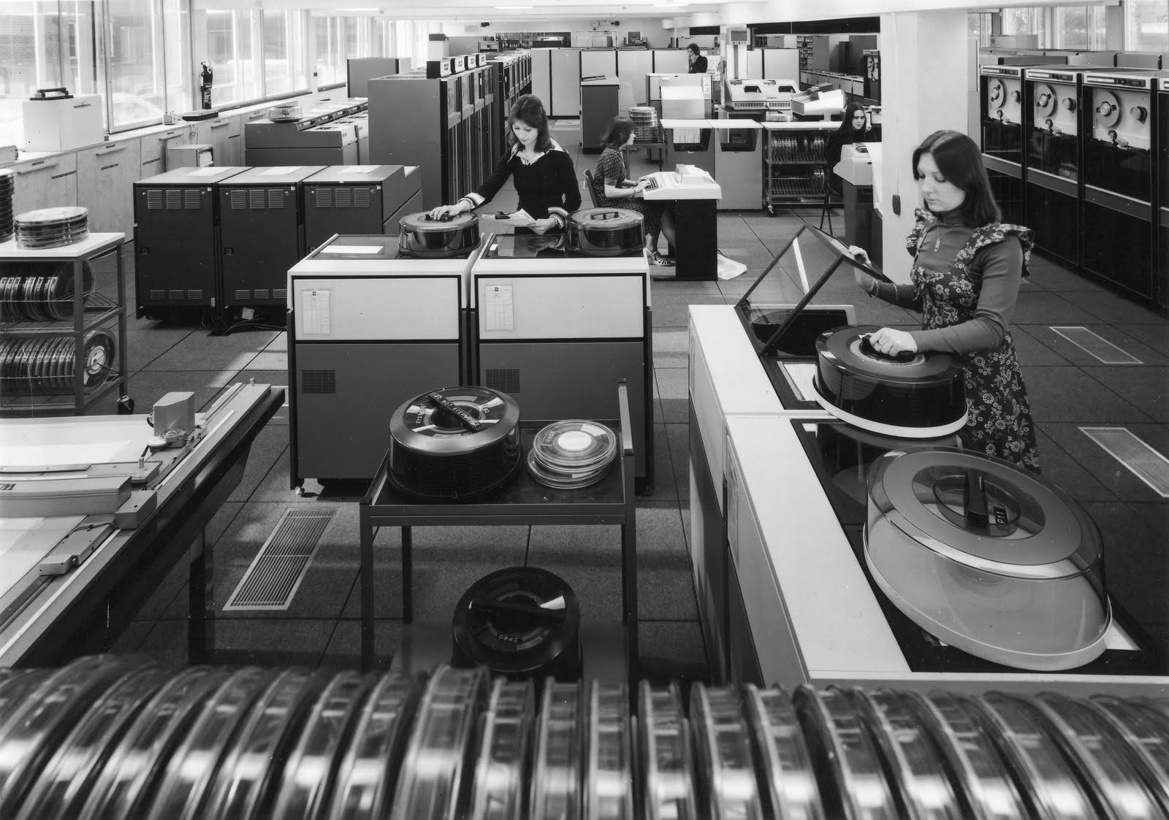
Notes:
I started my own computing career in 1969, just 21 years after that first computer was built.
UCL had one large computer – an IBM 360/65 that was said to have cost over £2m (which would be more than £30m in today’s money).
The disks in the picture held less than 250 Mb and cost $250 million.
It had 128K of main memory and executed instructions at the (then) amazing rate of 2 million per second. It provided all the computing services for many hundreds of students and staff.
Today you have hugely more power and memory in your mobile phone.
Computer processors have doubled in power or halved in price every two years since the mid 1960s, and disks and memory have followed much the same path. It is these hardware advances that have made computers affordable in the enormous range of different applications, and led to computers coming out of the large, air-conditioned computer rooms of the 1960s and appearing in departments, then on desks, and now inside telephones, cars, toys and light-bulbs.
In the whole of human history, no other invention has changed so many lives, so quickly.

Slide 5
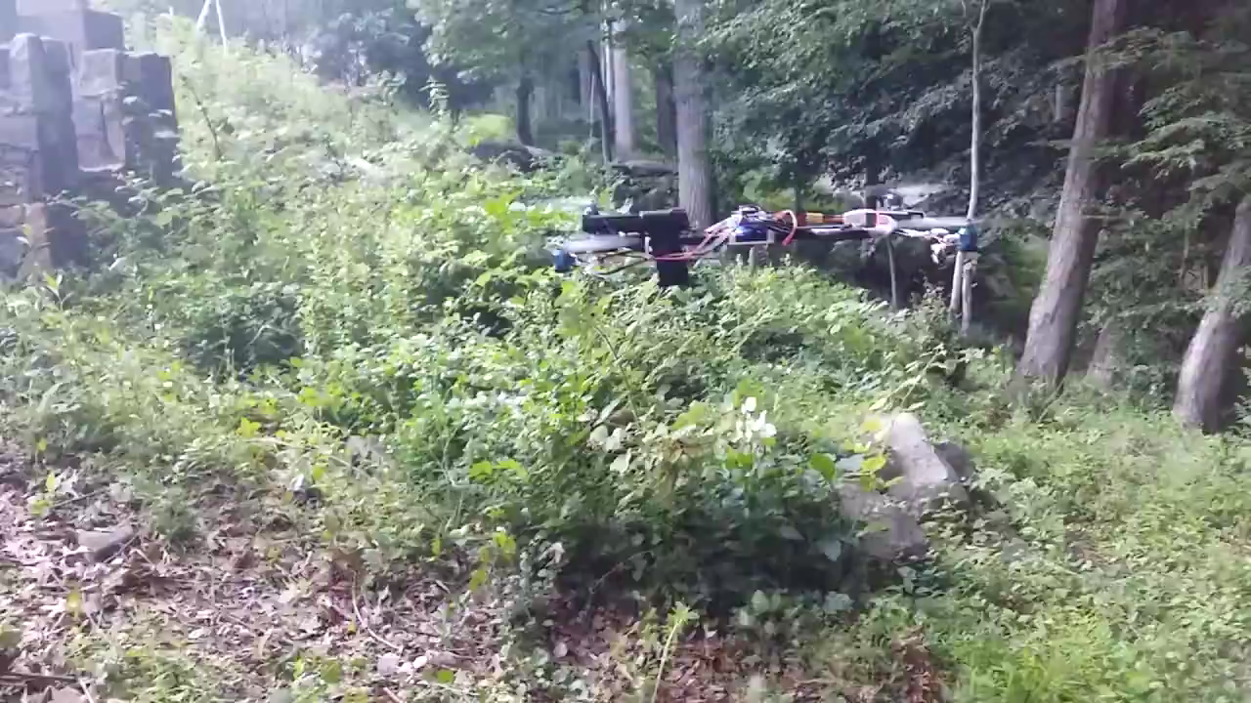
An armed drone
Notes:
Yet we are only at the beginning of the revolutionary changes that computers will bring to society. We are on the verge of the “internet of things”, where almost everything could contain intelligence and be network connected.
Autonomous and remote controlled air vehicles with high resolution cameras and satellite navigation have already moved from military applications into toyshops – and at least one of them has been modified to fire a handgun.

Slide 6
Software is almost everywhere
Every 60 seconds in cyberspace
200 million emails
2m Google searches
40,000 Facebook posts
75 hours of YouTube videos uploaded
280,000 tweets
$80,000 Amazon sales
100,000 Snapchat photos
2m Facebook Likes
570 new websites
150,000 instagram photos
10,000 searches on LinkedIn
20m photos viewed on Tumblr
1.5 million people using Skype
Notes:
It is the dramatic improvements in computer hardware that have driven the economics of this new industrial revolution.
But the technology that has created most of the huge and complex diversity of uses is software: computer programs. Software provides the variety and flexibility; software contains the complexity of all the different things we want to do.
Software is almost everywhere! And there will be lots more software written, because we are still only at the beginning of this information age.
Because modern life depends so heavily on software, it seems prudent to consider how dependable that software is today, and how we should feel about proposals for new computer systems that could cause serious harm if they go wrong. How confident should we be that the software on which we already depend is adequately reliable, safe and secure? And how confident should we be that other new and critical systems can be built at reasonable cost and with reasonable success?
After four decades of work in the software industry, I am increasingly nervous and so are many of my colleagues because, despite the tremendous achievements of the computing industry, all this progress is dependent on a software industry that is still very immature – still a long way from becoming a mature engineering profession, even though it is 45 years since the phrase “software engineering” first came into common use.
Most computer programmers do not have qualifications in computer science or familiarity with the rigorous management disciplines that are fundamental to every engineering profession. The software industry is brilliantly creative and agile and brings new ideas to market with extraordinary speed. But there is a big difference between a product that works well most of the time and one that is truly dependable. When the product needs to be shown to be particularly safe or secure, speed and agility should take second place to those critical properties, but building safe and secure computer systems is difficult and can be expensive, and too few programmers know how to show that a system is adequately safe or secure. As we shall see later, testing alone can never be enough.
Designing and building trustworthy systems is an engineering task that requires methods and tools with strong scientific foundations, supported by processes that manage complexity, that prevent careless and unsafe ways of working, that control and manage change, and that deliver sufficient evidence that the resulting product is dependable. Without strong engineering methods, it is highly probable that the development will suffer major overruns in costs and time, or that it will fail to do the job it was supposed to deliver, or that the resulting software will contain very many defects that leave its users and others in society exposed to cybercrime.
I would like to explain just how faulty much software is today, and remind you of some of the things that have gone wrong.

Slide 7
Software is almost everywhere
-but software contains a lot of defects
Many studies have analysed the number of defects in software
This is usually reported as a rate per thousand lines of program source (Thousand Lines of Code or KLoC)
Different studies have different definitions of “defect” and different ways of counting lines
But they all show that we have a problem …
Notes:
Almost all software contains a lot of faults.
Software quality is generally poor. Academic studies have shown defect rates between 10 and 30 defects in every 1000 lines of program source.
In the USA, Steve McConnell has studied software defects for many years. His book Code Complete says that the industry average is about 15 - 50 faults per 1000 lines of delivered code. Of course, some companies do better than this; one example is Microsoft, which stopped work to retrain its programmers over a decade ago and invested in many, world class development tools. But if you are delivering software that contains 50 million lines (which is said to be the size of Microsoft Windows) then even one fault in each thousand lines would mean that you are selling software that contains 50,000 faults.
The American author, trainer and consultant Capers Jones has published substantial data on delivered product fault levels. In his sample, the most quality-conscious companies delivered systems with an average of about 1 fault per thousand lines, whereas other companies in his sample were delivering over 7 faults per thousand lines. (Different authors use different definitions of what constitutes a fault or how to count lines of software so the figures from different authors are not wholly comparable. The key message from everyone who has studied defect rates is that software contains a large number of faults). 2nd Edition. Redmond, Wa.: Microsoft Press, 2004
Jones, C. Software Assessments, Benchmarks, and Best Practices. Reading, MA: Addison Wesley, 2000

Slide 8
Software defect rates in the software for a military aircraft
Notes:
One detailed analysis of defence software, a paper called Software Static Code Analysis Lessons Learned was published in Crosstalk, the journal of defence software engineering, by Andy German, a software engineer in QinetiQ who worked on military aircraft systems at the UK Ministry of Defence at Boscombe Down.
He analysed a range of software systems that had been developed for an American military aircraft. The systems included:
Automatic flight control.
Engine control.
Fuel and centre-of-gravity management.
Warning systems.
Anti-icing systems.
Flight management.
Weapons management.
Air data units.
Radio altimeters.
Anti-skid brakes.
These systems varied in size from 3,000 lines of code to 300,000 lines of code and were written in several different languages. He reported that he found the following level of “anomalies”.
The developers were following the then current standard for civilian aircraft software DO-178A, because the aircraft had to be certified to fly in civil airspace.
Again, I do not want to focus on the definition of an “anomaly” or how lines of code are defined (when a single line in a program listing could contain several program statements or none); I am simply illustrating that every detailed study finds that there are a lot of defects in most software.

Slide 9
What were the defects?
Erroneous signal de-activation.
Data not sent or lost
Inadequate defensive programming with respected to untrusted input data
Warnings not sent
Display of misleading data
Stale values inconsistently treated
Undefined array, local data and output parameters

Slide 10
… and many more
- Incorrect data message formats
-Ambiguous variable process update
-Incorrect initialisation of variables
-Inadequate RAM test
-Indefinite timeouts after test failure
-RAM corruption
-Timing issues - system runs backwards
-Process does not disengage when required
-Switches not operated when required
-System does not close down after failure
-Safety check not conducted within a suitable time frame
-Use of exception handling and continuous resets
-Invalid aircraft transition states used
-Incorrect aircraft direction data
-Incorrect Magic numbers used
-Reliance on a single bit to prevent erroneous operation

Slide 11
Watts Humphrey’s experiment
There are many more security defects than these functional defects
Notes:
Another study, this time by Watts Humphrey, of the Software Engineering Institute at Carnegie-Mellon University, analysed the fault density of more than 8000 programs written by 810 industrial software developers. This was the result:
A “KLOC” is 1000 Lines Of Code. These figures show that even the best 1% of these programmers were introducing a fault in every 100 lines of program that they wrote. The average programmer was introducing a fault in every 9 lines.
Different researchers and authors may describe faults as “flaws”, “errors”, “defects”, “anomalies” or “bugs” but they will almost always mean functional faults, that cause the software to crash or to give the wrong results. A functional error may be a simple typing mistake, such as omitting a minus sign in a mathematical formula, or testing that value A is greater than value B [A>B], when they should have written a test that value A is less than value B [A<B] .
Or it may be a design error that means that the program sometimes attempts to divide by zero, or runs out of the available memory. http://resources.sei.cmu.edu/asset_files/SpecialReport/2009_003_001_15035.pdf page 132

Slide 12
Software: big and getting bigger!
Simple smartphone app 10,000
Heart pacemaker 80,000
Photoshop version 1 120,000
Space Shuttle 400,000
Microsoft Windows 3.1 (1993) 4,300,000
Photoshop CS6 (2012) 4,500,000
Firefox web browser 9,700,000
Boeing 787 Flight Software 14,000,000
MS Office 2013 45,000,000
Facebook 62,000,000
Mac OSX 86,000,000
Software in a typical car 100,000,000
Notes:
When software contains millions of lines, we need fault densities to be far, far lower than 10 faults per thousand lines or even 1 fault per thousand lines. Otherwise we can be sure that there will be very many faults and very many security vulnerabilities in the product.

Slide 13
How does software fail?
It can fail in many ways. One is by attempting to divide by zero, causing an “integer overflow”.
Consider the expression:
  result = 1 / (a – b);
If the values of a and b are the same, a-b is zero and the expression divides by zero.
How many tests would you need to run to discover this defect?
Notes:
consider a program that contains two integer variables, a and b. [A variable is a named place in the computer’s memory that contains some data—in this case a whole number or integer]. Suppose that the program calculates the result of the expression 1/(a-b). You might run and pass a million tests with a million different numbers placed in a and b but then, the first time the number in a is the same as the number in b, a-b will be zero and the attempt to divide by zero could cause the program to fail. The million successful tests have given you no evidence that the system could not fail.
Of course, a large program will contain many hundreds of variables and thousands of calculations any of which could fail. If you run a million different tests without any failures, you will have tested a negligibly small fraction of the possible combinations, and learnt nothing of value about the probability that your program will fail in the future.
So when you hear someone say “it wasn’t tested enough”, ask them “how much testing would have been enough?”.

Slide 14
Another way to fail …
type Alert is (Warning, Caution, Advisory);
function RingBell (Event : Alert) return Boolean
-- return True for Event = Warning or Event = Caution,
-- return False for Event = Advisory
is
Result : Boolean;
begin
if Event = Warning then
Result := True;
elsif Event = Advisory then
Result := False;
end if;
return Result;
end RingBell;
-- Caution returns uninitialised (usually TRUE, as required).
Notes:
This is an example of the uninitialised variable

Slide 15
Uninitialised variables
The value that the software uses is whatever happens to be left in the computer memory.
That may change every time the program is run or (perhaps worse still) …
  The program may work until something else is changed, such as a bug fix, upgrade or new data.
  Some years ago, UK airspace was closed for a few hours because an increase in the number of routes caused air-traffic control systems to fail.
    The error had remained undetected for more than 5 years

Slide 16
Better quality software
We have seen that software is big and that programmers make a lot of mistakes.
Most software is just tested. That provides very weak evidence of quality.
To show that there are no defects such as uninitialised variables and overflows, we need to analyse the software.
Fortunately, we can prove that there are no such defects, if we choose the right programming languages and tools: formal methods.

Slide 17
Formal Methods
Using the power of mathematics and computer-based tools to analyse software and find defects – or prove that there are none.
Can be used on major projects (iFACTS)
Can be cost-effective (Tokeneer)
Increasingly used by industry leading companies
I shall give explanations and examples in a future talk
Notes:
Computer scientists and software engineers know that it is possible to design and develop software so that it is almost completely free of faults. You can even prove mathematically that the system will never crash as a result of a software fault (which provides strong assurance for the absence of many whole classes of security fault). A few companies work this way and, as I will show in a later talk, it doesn’t have to make the software more expensive; better can also be cheaper.
Many software developers scorn the use of mathematically rigorous development methods, claiming that they can only be used on trivially small problems but they are wrong; it is perfectly practical to use rigorous software engineering methods on big projects. Examples where these formal methods have been used include the signalling for the Paris Metro, developed by Siemens, and the air traffic management system (iFACTS) that Altran recently developed for the UK’s National Air Traffic Services, NATS.
The iFACTS system is about 250,000 lines of code, written in a programming language called SPARK. To show that the software cannot generate any exceptional conditions that could lead to a run-time failure, Altran needed to carry out more than 152,000 individual proofs of verification conditions. The SPARK tools were able to prove 98.76% of these verification conditions automatically, and the remainder with help from the software engineers.
To prove the whole system of 250,000 lines takes 3 hours on a 16-core desktop computer with 32Gb RAM (in other words, a small computer costing only £2,000), and the SPARK prover can save and reuse successful proofs, with the result that re-proving the system after a change can be done in 15 minutes. [These figures come from a paper written by the software engineer Rod Chapman who developed and supported the SPARK software tools. The paper is available online and the SPARK tools can be downloaded and used free, as I will explain in a future lecture]

Slide 18
Functional defects and cybersecurity
It’s bad when a system fails, but may be acceptable if it’s not very frequent
It’s worse when a defect can be used maliciously: for example, the StageFright attack on Android smartphones …
  Perhaps 950 million phones, tablets etc at risk
I shall talk about cybersecurity and how cyberattacks work, on 3 May 2016.

Slide 19
Notes:
Of course, software faults can be much more complex than a simple zero-divide. But even a zero-divide can be very damaging. In July 2015, a zero-divide error was reported in the Android software that is used by most smartphones other than the iPhone. Sending someone a multimedia text message containing a special MKV video file will cause the phone to crash. This was estimated to affect 90% of Android phones. (A further fault in the Android video software means that a criminal can install their own software on your phone just by sending you a message. All they need is your phone number – and you do not even need to click on the message).

Slide 20
Notes:
Anyone who wants to understand the details of Stagefright can now see how it works – and maybe try it out on old phones and tablets.
How many networked and unpatched Android devices exist in the world? Probably millions, and some of them may be in critical applications – because that’s what programmers do …

Slide 21
Bad software causes great damage
Major economic loss: the Slammer worm, Code Red worm and Melissa computer virus each caused over $1B damage.
Therac 25 Radiotherapy machine massively overdosed 6 patients.
Hundreds of thousands of pacemakers and other medical devices have been recalled because of software errors.
No-one knows how many deaths have been caused by software failures
Security vulnerabilities make the problems far worse
Notes:
Security exploitsare not new. We have had computer viruses and worms for decades and some of them have caused huge damage and costs.
The 1999 Melissa virus is estimated to have caused damage exceeding $1B. It propagated as a Microsoft Word document containing a malicious macro which sent a copy of the same dangerous document to all your contacts.
Why did Microsoft think it was a good idea to design Word so that a file that appeared to be a text document would be capable of reading your contacts list and sending emails? Or, at the very least, why didn’t they write the software so that it had to tell the user what it was about to do, and ask for permission?
Software faults have also led to fatalities. One that has been analysed thoroughly by Professor Nancy Leveson is the Therac-25 radiotherapy system that massively overdosed six people.
So there have always been serious consequences from inadequate software development, but recent developments have increased the threat dramatically. The early safety problems were the chance outcomes of accidental errors (and some incompetence) and the viruses and worms were motivated mainly by vandalism or curiosity. More recently, organised criminal groups have recognised that it is safer and potentially much more profitable to commit crimes online and from overseas than to commit crimes in person. So the data that enables identity theft and fraud or blackmail have become a major target, as we have seen recently with the attack on the US Office of Personnel Management (that stole the intimate and very sensitive records from security interviews for millions of US personnel whose role required security clearance) and the attack on the infidelity website Ashley Madison.
http://sunnyday.mit.edu/papers/therac.pdf

Slide 22
Reported software problems in cars
2005 Toyota Camry L4 uncommanded acceleration claims
  see Michael Barr’s expert report in the Bookout v Toyota lawsuit. http://www.safetyresearch.net/Library/BarrSlides_FINAL_SCRUBBED.pdf
  Barr inspected the electronic throttle control system code. He stated that he found buffer overflow, invalid pointer dereferencing, stack overflow, undetected task death, unsafe casting, race conditions and >80,000 violations of MISRA-C coding standards.
In Nov 2013, Honda recalled 344,000 Odyssey vans for a software bug that could cause sudden braking.
http://www.autonews.com/article/20131102/OEM11/131109934/honda-to-recall-344000-minivans-in-u.s.-due-to-braking-glitch
Notes:
An increased focus of security concern and academic research has been cyber-physical systems; these are computer systems where faults or cyber attacks can cause serious problems to physical systems such as oil refineries or vehicles. The threats that exist here from faulty engineering are legion and I do not want to go into any detail today, but the recent demonstration that a Chrysler car could be disabled or controlled remotely over a mobile communications network has led to the recall of 1.4 million cars and emphasises the urgent need for far better engineering certification before driverless cars are licensed for use on public roads.
http://www.wired.com/2015/07/hackers-remotely-kill-jeep-highway/
http://gizmodo.com/chrysler-recalls-1-4-million-cars-for-being-easily-hack-1719980321

Slide 24
http://www.theguardian.com/business/2015/feb/09/most-cars-vulnerable-hacking-privacy-intrusions-senate-report

Slide 27
Notes:
Any networked system may be vulnerable
And some that are not networked – like the Iranian uranium centrifuges that Stuxnet attacked.

Slide 28
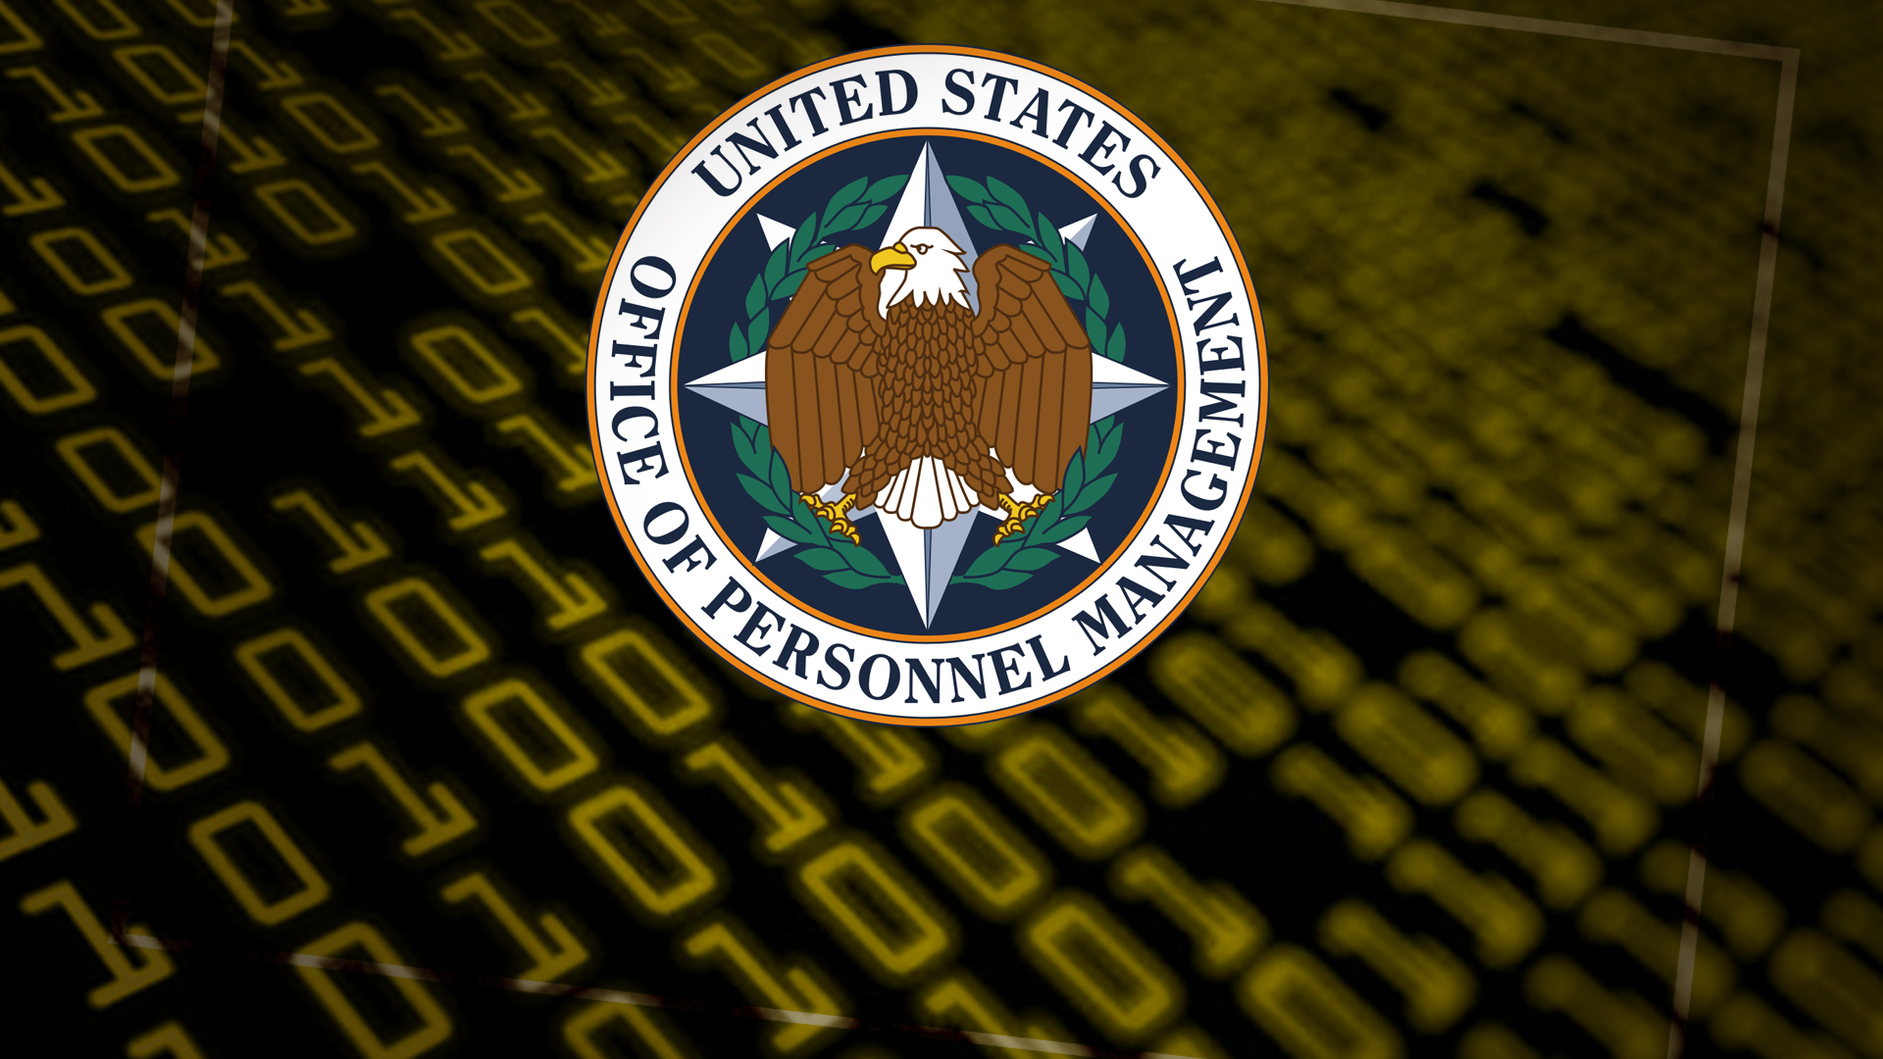
Notes:
the attack on the US Office of Personnel Management (that stole the intimate and very sensitive records from security interviews for millions of US personnel whose role required security clearance)

Slide 29
Notes:
With the current state of software – if the data is on-line, it will get stolen. If it isn’t online, it will still probably get stolen.
If it’s important data, it should be encrypted with a strong algorithm and a strong key.

Slide 31
Notes:
Medical records command an attractive price. But medical records contain details that can destroy careers or marriages or lead to suicides or murders.
I shall explain on 14 June why the promise that records have been anonymised and are therefore safe is almost always untrue.

Slide 33
Notes:
Then there’s financial fraud.

Slide 34
Should we trust computers?
Developing dependable software for important systems is an engineering problem, but the software industry is still a long way from becoming an engineering profession.
AS a result, most important computer systems contain an unknown number of defects and probably many of these can be exploited by criminals, vandals or worse.
There are many practical improvements that can be made: but how do we change the culture of an industry?
Notes:
The final consequence of the immaturity of the software industry that I want to highlight today is that software projects often overrun in time and cost. Software developers are either very poor at estimating or managing their projects, or they lie to their customers (or quite often, in my experience, both). Billions of pounds have been wasted on failed software projects in the UK, in industry (and also in Government as a search of the reports from the National Audit Office and the Public Accounts Committee will confirm). I shall look at some of the reasons for this and some of the solutions in my lecture next February.
As I said in opening, Information Technology has changed the world in less than 70 years. The world in 2015 is startlingly different from the world in 1948 and much of the difference has been brought about through computers and software.
But the pace of change shows no signs of slowing down and there are decisions to be made.

Slide 35
Topics for the future
12 January: A very brief history of computing
9 February: How can software be so hard?
5 April: Computers, people and the real world
3 May: Cybersecurity
14 June: Big data: The broken promise of anonymisation
Please continue the discussions on line.
Notes:
Can we tolerate the way that companies and Governments collect and analyse our personal data, so that they know more about us than we know ourselves?
What is the right balance between protecting the privacy of sensitive medical histories of patients and the benefits that could flow from using the records for research?
What should we do about the growing problems of cybersecurity?
What is the right balance between privacy for individuals and the need to detect crime and catch criminals?
Are the fears that have been expressed about artificial intelligence outstripping human intelligence justified?
These are really questions about the sort of future we want for ourselves and our children, and I believe the decisions are too important to be left entirely to companies in their competition for profits. I would like to see discussions and debates, informed by a good understanding of the nature, current capabilities and future potential of information technology, so that we can influence industry and Government towards the sort of future we would prefer. I hope that together we can use these lectures and Gresham College to have some of these discussions.
My planned lectures for the rest of this academic year have been published in your programme booklet and on the Gresham College website. I have already mapped out possible lectures for the following year but I welcome your views on the topics you most want to hear about and to discuss.
Thank you for coming today. I hope you will come to future talks and I look forward to our discussions.

