Slide 1


2016-7 Lecture Series:
Where are we after the Storm? The UK Economy in the Aftermath of Financial Crisis:
The External Position
Professor Jagjit S. Chadha
Mercers’ School Memorial Professor of Commerce
© Jagjit S. Chadha 2016-7

Slide 2
The Mercantilist Heritage
“First, as to this that no gold or silver comes into England, but that which is in England is carried beyond the sea, I maintain that it is because the land spends too much in merchandise, as in grocery, mercery and peltry, or wines, red, white and sweet, and also in exchanges made to the Court of Rome in divers ways. Wherefore the remedy seems to me to be that each merchant bringing merchandise into England take out of the commodities of the land as much as his merchandise aforesaid shall amount to ; and that none carry gold or
silver beyond the sea, as it is ordained by statute. . . . And so meseems that the money that is in England will remain, and great quantity of money and bullion will come from the parts beyond the sea.”
Richard Leicester, 1381

Slide 3
The Balance of Payments
A country’s international transactions are recorded in the balance of
payments accounts
Three main components (types of transactions):
Current account
  Exports (+) and imports (-) of goods and services, and international income receipts
Financial account
  Net sales of assets to foreigners (+) and net
  purchases of assets from foreigners (-)
Capital account
  Transfers of wealth (small)

Slide 4
The Balance of Payments
UK Balance of Payment, 2016, £ mn
Current account -84504 Trade Balance -37026 Income Balance -23129 Net Unilateral Transactions -24349 | Financial account +108695 Net sales of assets to foreigners (+) and net purchases of assets from foreigners (-) Capital Account -1953 Net errors and omissions +22238
-84504 | -84504
BoP = CurrA + FA + CapA = 0
The financial account finances the current account deficit: to pay for a current account deficit a country must reduce its foreign assets or increase its foreign liabilities (or both).

Slide 5
Current Account and Trade in Good and Services Balances
1946 - 2016
Steep fall in the primary income balance

Slide 6
Current account and its components (% of GDP)
1946 - 2016
From 2011 to 2013 while the trade balance remains constant, the primary balance considerably deteriorates, which causes the current account balance to diverge from the trade balance
Primary income includes investment income and compensation of employees.
Secondary income includes redistribution of income through current transfers (there is no corresponding return of an item of economic there is no corresponding return of an item of economic
value).

Slide 7
Economic Growth and the Current Account
Correlation coefficient of -0.42

Slide 8




Closed economy
Y as output
C as consumption (private + public)
I as Gross Capital Formation (private + public)
$$Y=C+I$$
$$⇒$$
$$S=I$$
$$Y=C+S$$
S=I is an accounting equality which is always true.
However Gross Capital Formation includes FBCF (investment) + change in inventories (hence it may not mean that all savings are productively invested).

Slide 9






Closed economy with an explicit government sector
$$Y=C^{P}+I+G$$
$$S^{P}+T−G=I$$
Y as output
C as private consumption
I as Gross Capital Formation (private + public)
G as government consumption
T as Taxes
$$⇒$$
$$Y=C^{P}+S^{P}+T$$
$$S^{P}+S^{G}=I$$
$$S=I$$
S=I is an accounting equality which is always true as an accounting identity.

Slide 10





Open economy
Y as output
C as consumption (private + public)
I as Gross Capital Formation (private + public)
X as exports
M as imports
$Y=C+I$ + X - M
$$⇒$$
$$S−I=X −M$$
$$Y=C+S$$
$$S−I=CA$$
If domestic savings exceed domestic investment then a country runs a current account surplus: It lends to the rest of the rest of the world.
If domestic investment exceed domestic savings then a country runs a current account deficit: It borrows from the rest of the rest of the world.
In other words, the current account balance reflects a country’s need for net foreign financing.

Slide 11





Open economy with an explicit public sector
Y as output
C as private consumption
I as private Gross Capital Formation
G as government spending
T as Taxes
X as exports
M as imports
$$Y=C^{P}+I+G+X−M$$
$$S^{P}+T−G=I+X−M$$
$$⇒$$
$$Y=C^{P}+S^{P}+T$$
$$S^{P}−I=CA+(G−T)$$
A current account surplus tends to reflect a government budget surplus and/or an excess of national savings
A current account deficit tends to reflect a government budget deficit and/or an excess of national investment

Slide 12
Saving and Investment in a closed economy
Interest rate
I
S
i
Investment,
Savings

Slide 13


Saving and Investment in a small open economy
Interest rate
I
S
$$i^{D}$$
$$i^{w}$$
Investment,
Savings
S-I = CA deficit
The shortage of domestic savings is met by the arrival of foreign capital

Slide 14







Saving and Investment in a small open economy
Domestic
Foreign
Interest rate
I
S
Interest rate
I
$$S^{1}$$
$$S^{2}$$
$$i^{D}$$
$$i^{w1}$$
$$i^{w2}$$
$$i^{F1}$$
$$i^{F2}$$
I,S, domestic
I,S, foreign
S-I = CA deficit
CA surplus
A surge of savings in the rest of the world reduces the world interest rate and generates a larger current account deficit

Slide 15
The Feldstein – Horioka puzzle
Investment is determined by world interest rate and marginal productivity of capital
With decreasing marginal returns to capital, an increase in domestic savings will be invested abroad
Domestic investment should be uncorrelated with domestic savings
Feldstein and Horioka (1980) found the following results for a panel of OECD countries 1960-74 (OLS regression):
            I /Y = 0.04 + 0.89S/Y
Domestic savings and domestic investment highly correlated across countries
It means that even for OECD countries capital mobility is not very high

Slide 16
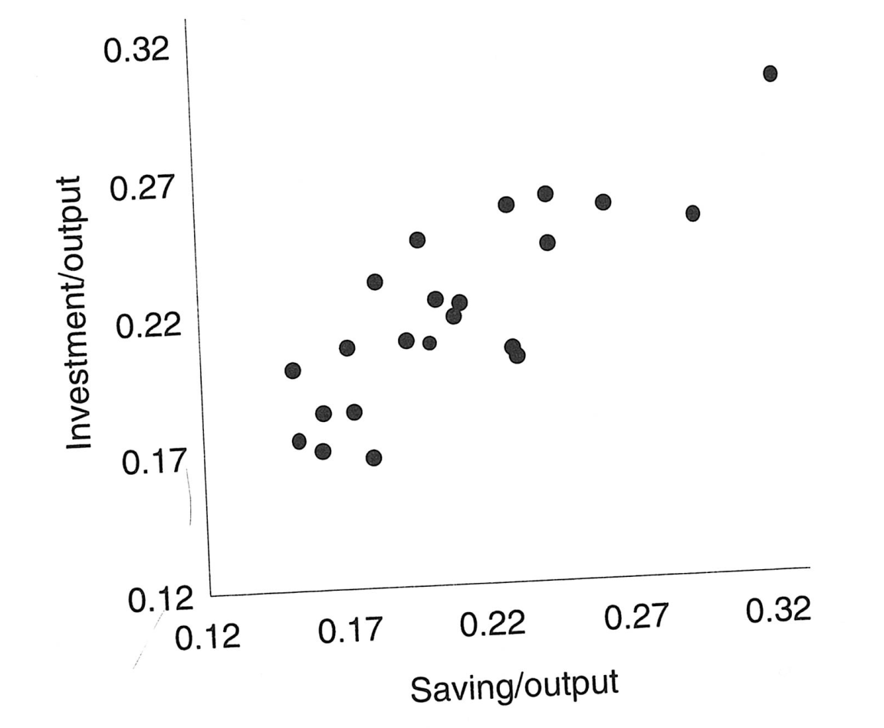
Industrial-country saving and investment rates, 1982-91
            I /Y = 0.09 + 0.62 x S/Y
Rogoff and Obstfeld (1996)

Slide 17

The International Investment Position (IIP)
The accumulation of flows from the financial account balance (which is the result of the current account balance) results in a stock position : The International Investment Position
A country International Investment Position reflects a country’s net foreign wealth
$$∆IIP=CA+valuation changes$$
The Net International Investment Position represents the difference between the financial inflows resulting from the UK assets minus the financial outflows resulting from the UK liabilities.

Slide 18
The International Investment Position (IIP)
Changes in earnings from the stock of assets or payments for the stock of liabilities can be affected by the following:
A change in volumes
A change in the valuation
    A change in the market price
    A change in the exchange rate of the currency the asset/liability is denominated in

Slide 19
Breakdown of the income balance
Income Balance=
    Net Investment Income
      Net Foreign Direct Investment (FDI)
      Net Portfolio Investment
      Net Other Investment (notably loans and currency and deposits)
      Reserves assets
    Net International Compensation to Employees

Slide 20
Decomposition of the NIIP
Assets
Liabilities
Source: ONS Balance of Payments time series dataset (PNBP) & NIESR

Slide 21
The IIP across time
Net IIP
24%
Assets
PI = Portfolio Investment
OI = Other Investment
FDI = Foreign Direct Investment
FD = Financial Derivatives
-11%
-7%
Liabilities
Reserves
Source: ONS Balance of Payments time series dataset (PNBP) & NIESR

Slide 22
Returns on Assets vs Returns on Liabilities
Source: NIESR

Slide 23
Financial flows from foreign assets and liabilities
$$Flow=Rate of returns ×Stock of Assets/Liabilities$$
Table 1: Financial flows from foreign assets and liabilities (% of GDP)
Year | Returns on Liabilities | Stock of Foreign Liabilities | Returns on Assets | Stock of Foreign Liabilities | Outflow | Inflow | Net flow
2016 | 0. 32% | 548% | 1.41% | 572% | -1.8% | 8.1% | 6.3%
2006 | 4.17% | 448% | 3.85% | 437% | -18.7% | 16.8% | -1.9%
1996 | 4.99% | 197% | 5.54% | 189% | -9.8% | 10.5% | 0.7%
Source: NIESR

Slide 24
The Real Effective Exchange Rate and the NIPP
% GDP
2010 = 100
Corr = -0.16
REER (rhs)
NIIP (lhs)
One of the main drivers of the NIIP is the Sterling Exchange Rate:
Assets denominated in foreign currencies increase when the pound depreciates

Slide 25
The International Investment Position (IIP)
Source: ONS Balance of Payments time series dataset (PNBP) & NIESR
The difference between the accumulation of the current account balance and the NIIP is due to valuation changes.
In the long run the NIIP tends to follow the trend of the current account balance accumulation, but in the short run it is highly dependent on valuation shocks.

Slide 26
The Salter-Swan Diagram
Exchange
Rate
Internal Balance
Unemployment
Inflation
Domestic Absorption/
Expenditure

Slide 27
The Salter-Swan Diagram
Exchange
Rate
External Balance
CA deficit
CA surplus
Domestic Absorption/
Expenditure

Slide 28
The Salter-Swan Diagram
Exchange
Rate
External Balance
Internal Balance
Unemployment/
CA deficit
Unemployment/
CA surplus
Inflation /
CA deficit
Inflation /
CA surplus
Domestic Absorption/
Expenditure

Slide 29
Real growth and the current account-to-GDP ratio
Real Exchange
Rate
External Balance
Internal Balance
Unemployment/
CA deficit
A
Depreciation of the Pound
The Brexit jump in the exchange rate might shift the UK from point A to point B
Unemployment/
CA surplus
Inflation /
CA deficit
B
Inflation /
CA surplus
Domestic Absorption/
Expenditure

Slide 30
Real growth and the current account-to-GDP ratio
Real Exchange
Rate
External Balance
Internal Balance
However, decoupling from Europe might also have an impact on the fundamentals of the UK economy, which could shift the external and internal balance curves. The outcome could be much the same.
A
B
Domestic Absorption/
Expenditure

Slide 31
Is reliance on foreign capital a risk ?
The counterpart of a current account deficit is a need for foreign financing. But is relying on foreign financing a critical situation ?
Example of the Suez crisis and the intervention of the IMF
However, investors deciding to suddenly stop lending to the UK also implies
that foreigners would not want to sell their goods and services to the UK anymore.
The composition of capital inflows matters:
In 2014 81% of net UK capital flows were foreign direct investment: FDI are usually long term investment and less volatile and vulnerable to panic behaviour.

Slide 32
Concluding Remarks
Does domestic absorption “cause” the current account? Or does foreign capital “cause” the current account?
Surpluses store up income from net foreign assets in the future
Deficits store up payments to net foreign liabilities in the future
The current account position is determined by domestic savings and investment schedules relative to those in the rest of the world
The exchange rate can jump to ensure that the net internal investment position is financially sustainable

