Slide 1
Gresham Lectures 2016-17
Divinity Lecture 5
Is Humanity naturally Good?
Richard Dawkins’s Selfish Gene
Alister McGrath
Gresham Professor of Divinity

Slide 2
William Hazlitt
“Man is the only animal that laughs and weeps; for he is the only animal that is struck with the difference between what things are and what they ought to be.”

Slide 3
J. R. R. Tolkien
I will not walk with your progressive ages,
Erect and sapient. Before them gapes
the dark abyss to which their progress tends

Slide 4
E. O. Wilson
“We are drowning in information, while starving for wisdom. The world henceforth will be run by synthesizers, people able to put together the right information at the right time, think critically about it, and make important choices wisely.”

Slide 5

The Three Day Week

Slide 6
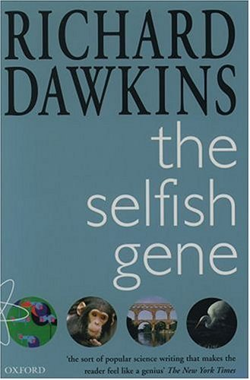
The Selfish Gene (1976)

Slide 7
Frans de Waal
‘The Selfish Gene taught us that since evolution helps those who help themselves, selfishness should be looked at as a driving force for change rather than a flaw that drags us down.’

Slide 8
Richard Dawkins
‘We have the power to defy the selfish genes of our birth … We have the power to turn against our creators. We, alone on earth, can rebel against the tyranny of the selfish replicators.’
‘Let us understand what our own selfish genes are up to, because we may then at least have the chance to upset their designs’

Slide 9
Thomas H. Huxley
‘Evolution may teach us how the good and the evil tendencies of man may have come about; but, in itself, it is incompetent to furnish any better reason why what we call good is preferable to what we call evil than we had before.’

Slide 10
Charles Darwin
‘The inevitable result is an ever-recurrent Struggle for Existence. It has truly been said that all nature is at war; the strongest ultimately prevail, the weakest fail. … The severe and often-recurrent struggle for existence will determine that those variations, however slight, which are favourable shall be preserved or selected, and those which are unfavourable shall be destroyed.’

Slide 11
Marjorie Suchocki
‘A tendency toward aggression is built into human nature . . . we are by nature an aggressive species with a history of physical and psychic violence . . . . The capacity for violence is built into our species through aggressive instincts related to survival. When that violence is unnecessary and avoidable, it is sin.’

Slide 12
[End]

