Slide 1


2016-7 Lecture Series:
Where are we after the Storm? The UK Economy in the Aftermath of Financial Crisis:
Capitalism and Inequality
Professor Jagjit S. Chadha
Mercers’ School Memorial Professor of Commerce
© Jagjit S. Chadha 2016-7

Slide 2
Tony Atkinson, Inequality - What can be done?
"The concept of equality of opportunity is an attractive one. However, does it mean that inequality of outcome is irrelevant? In my view, the answer to this question is "no". Inequality of outcome is still important, even for those who start from the concern for a `level playing field'. To see why, we need to start by noting that different between the two concepts. Inequality of opportunity is essentially an ex ante concept - everyone should have an equal starting point - whereas much redistribution activity is concerned with ex post outcomes. Those who think inequality of outcome is irrelevant regard concern for ex post outcomes as illegitimate and believe that, once a level playing filed for the race for life has been established, we should not enquire into the outcomes. I believe this is wrong..."

Slide 3
Issues
Output clearing via natural interest rate
Share of income accruing to wage earners falling?
Dynamic questions for politic-economic settlement
Consequence of globalisation
Has equalisation of global incomes increased domestic inequality?

Slide 4
R. H. Tawney, Equality
`Democracy is unstable as a political system as long as it remains a political system and nothing more, instead of being, as it should be, not only a form of government but a type of society, and a manner of life which is in harmony with that type. To make it a type of society requires an advance along two lines. It involves, in the first place, the resolute elimination of all forms of special privilege which favour some groups and depress other, whether their source be differences of environment, of education, or of pecuniary income. It involves, in the second place, the conversion of economic power, now often an irresponsible tyrant, into a servant of society, working within clearly defined limits and accountable for its actions to a public authority.'

Slide 5
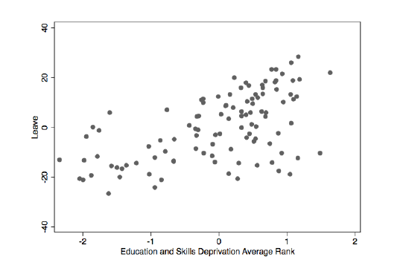
Role in Explaining Vote Share

Slide 6
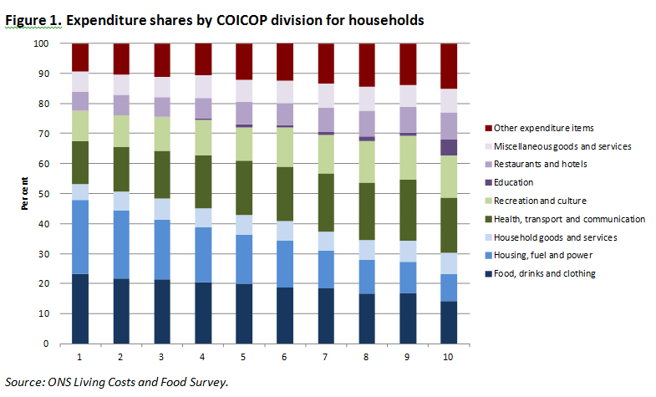
Impact of Inflation on Households

Slide 7
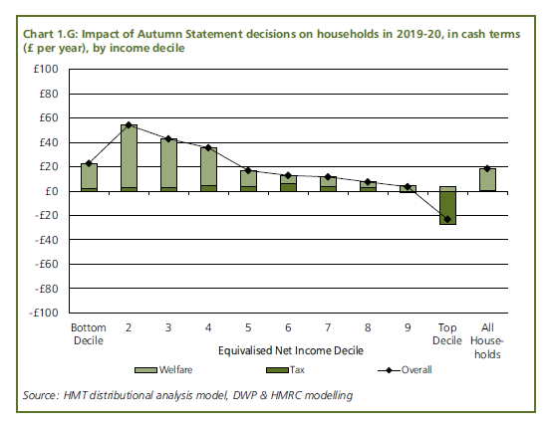
Consideration of Policy Consequences

Slide 8
Individual and Aggregate Variance
Assume utility falls in consumption variance – for a given level of consumption
Utility = mean (representative agent consumption) – variance (representative agent consumption)
Suppose representative agent = H(1)+H(2)
Utility = mean (consumption(H1+H2)) – variance (consumption (H1+H2))
variance (consumption (H1+H2)) = variance of (H1 consumption) + variance of house + 2 covariation (H1 + H2)
➔ Individual variance may rise i.e. individual utility may fall even though aggregate utility may not change much if household consumption is negatively correlated

Slide 9
Intra-temporal Risk Sharing
Risk Sharing
Income
Household 1
Household 2
Time

Slide 10
Example of negative correlations

Slide 11
Piketty: 1

Slide 12
Piketty: 2

Slide 13
Capital Share in National Income
The first fundamental law is simply an accounting identity that arises from the use of a standard growth model in which output is a function of three factors of production (capital, labour and land) and total factor productivity.
The share in national income accruing to each factor of production is determined by the return to each factor of production: the real interest rate for capital, wages for labour and rent for land multiplied by the quantity of each factor employed.
So that if the return on capital is 5% and the capital stock is 6 times the level of income, then the capital share in output will be 30%. Indeed there has been some downward trend in the labour share of income in the past couple of decades and this observation may provide some support for the view that the capital share may be set to climb.
But it does seem to me that globalisation of the labour force has done much to reduce the labour share or, put more optimistically, equalise global wages.

Slide 14
R(eal rates) and G(rowth rates)
Because the rate of return on capital has been historically higher than the growth rate of income, the second `law' implies that the capital share in income will rise inexorably if the capital stock grows.
This prediction is best explained by a simple example. If the return on capital stays at 5% but growth falls to zero, and the capital stock grows in line with a positive level of savings, let us suppose 10%, then the capital stock after a century will account for 80% of income.
Now if capital is owned by a small elite, then clearly the fraction of income, and by association its permanent equivalent, wealth, will be increasingly concentrated in fewer hands.
But under most standard theory, if growth falls to zero so will the savings rate as there is only a need to save in order to match any depreciation in the capital stock and the ultimate dominance by capital seems rather unlikely.

Slide 15
A More Positive Outlook
How should we tax capital or inheritance?
Education as ex ante redistribution or ex post redistribution
What about the distribution at the middle?
From 1990 to 2010, the fraction of people living below the poverty line of $1.25 per day in developing countries, fell from 43% to 21%. This fall has taken nearly 1bn people out of extreme poverty and the numbers are forecast to fall below 10% by the end of this decade
Measure wealth better
Not the same people year after year – note well!

Slide 16
Measuring Inequality
100%
Gini = A/(A+B)
➔0 under equality
➔1 under perfect inequality
20:80➔at least 0.6
Share of Total Income
A
Inequality
B
0
0
Cumulative Share from Low to High
100%

Slide 17
Inequality rose in the 1980s

Slide 18
Top Income Shares fell over much of the 20th Century but doubled since 1980

Slide 19
Wealth Shares have downward trend and fall in households below 60% median since 1992

Slide 20
Some trend increase in top decile earnings

Slide 21
Inequality
Income shares to labour and capital depend on returns and share of factor in production
Inequality irrelevance proposition is history
Macro models need heterogeneity
Aggregate performance masks considerable heterogeneity
The post crisis change in inequality is different at the national and international level

