Slide 1
The Future of the Port of London
Katherine Riggs
Director of the Thames Vision
Port of London Authority

Slide 2
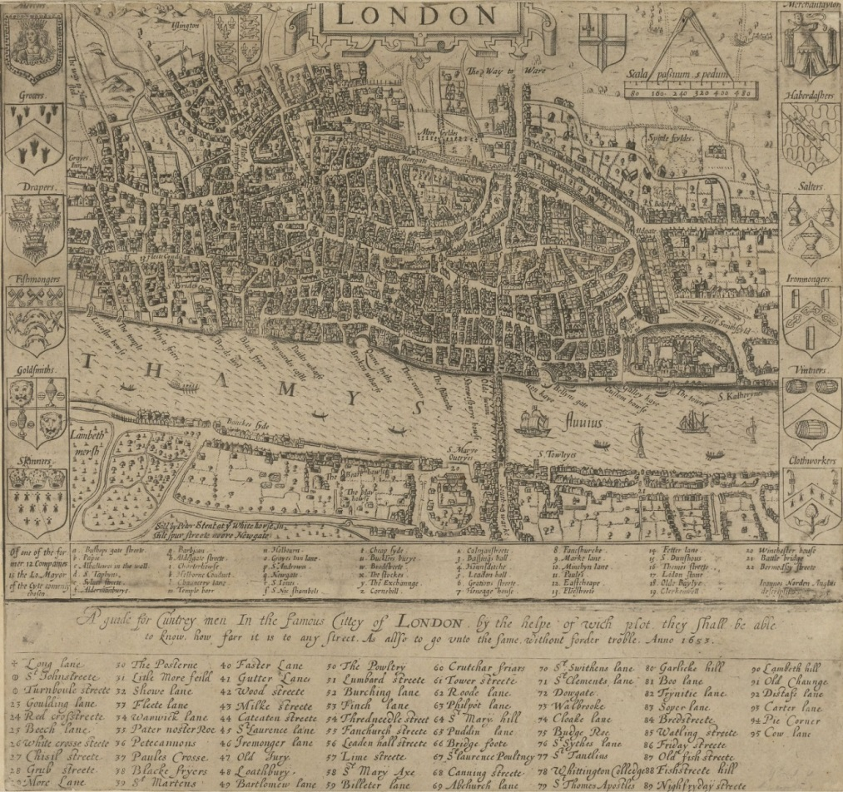
The Port of London in the past

Slide 3
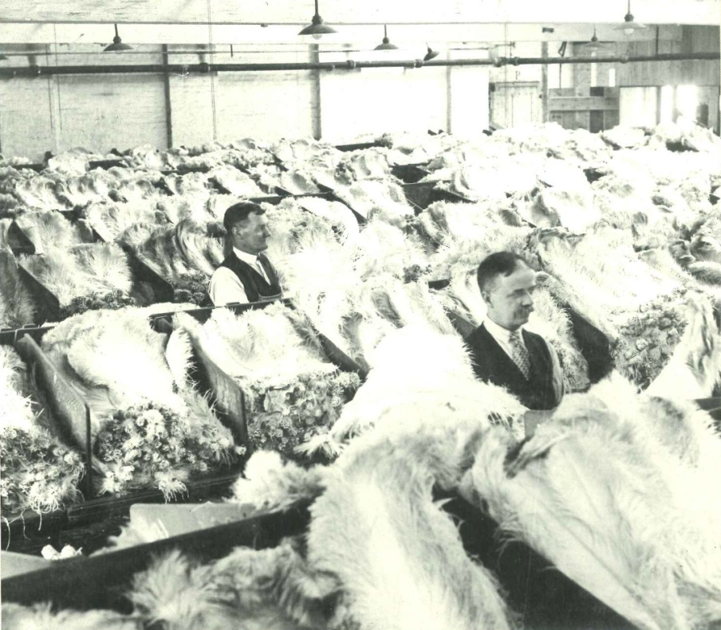
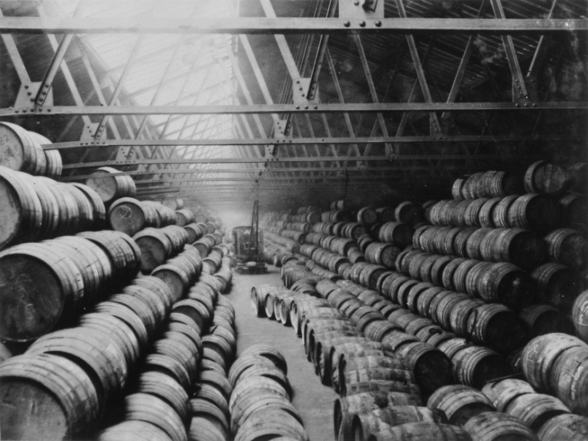
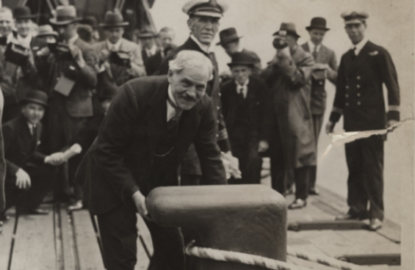
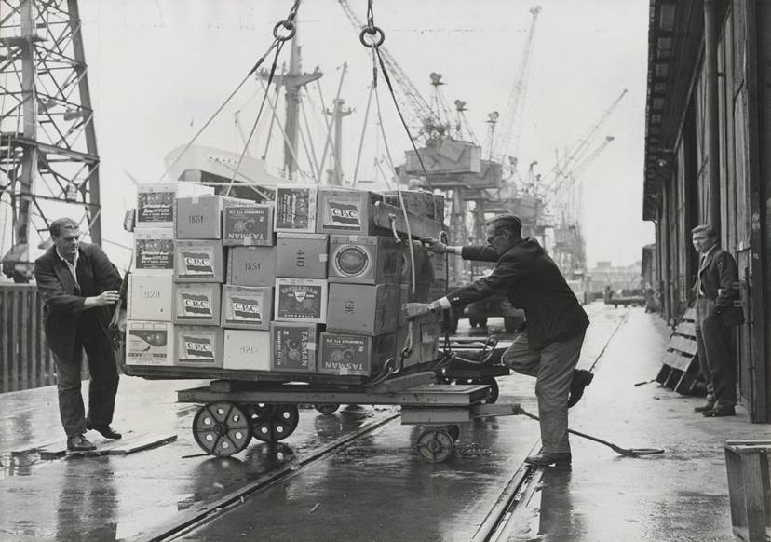

The Port of London in the past

Slide 4
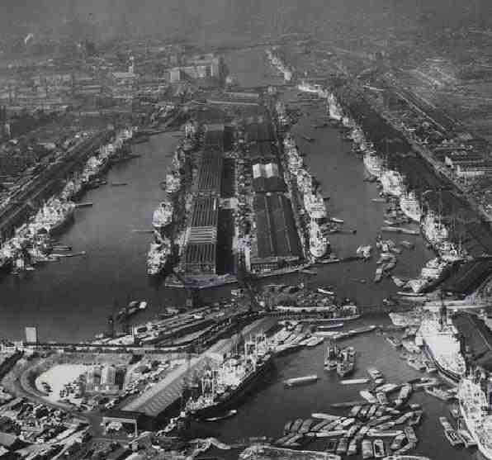
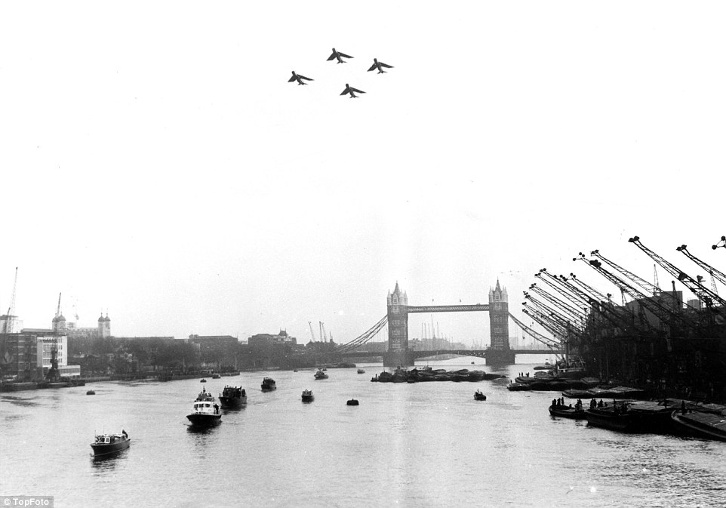
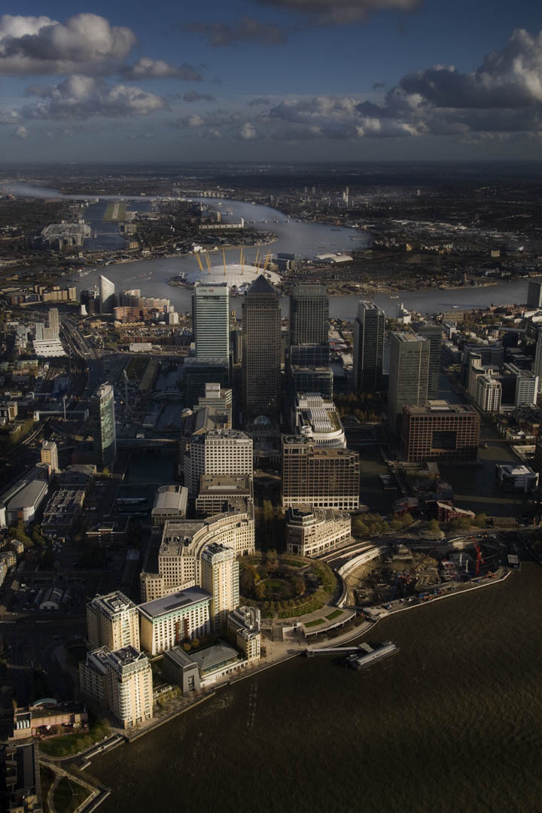
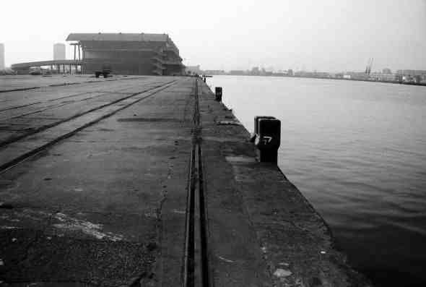
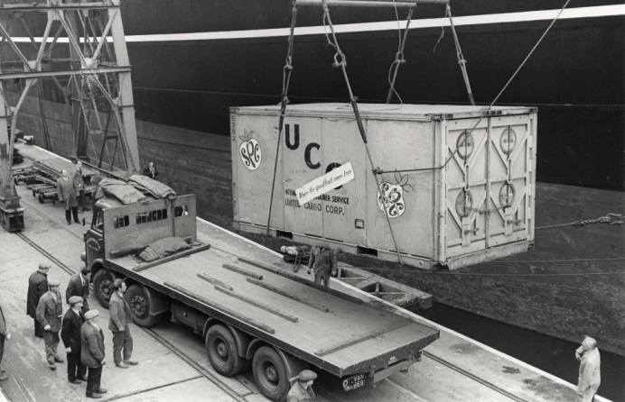
The Port of London in the past

Slide 5
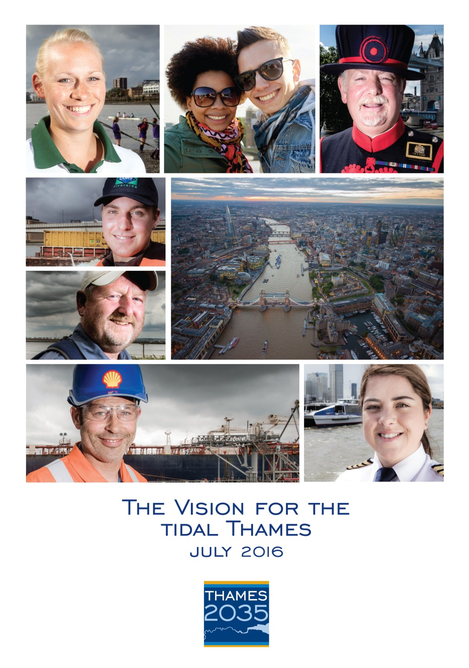
The Port of London in the future

Slide 6
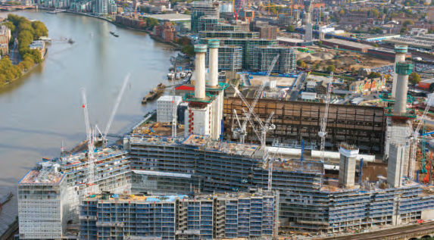
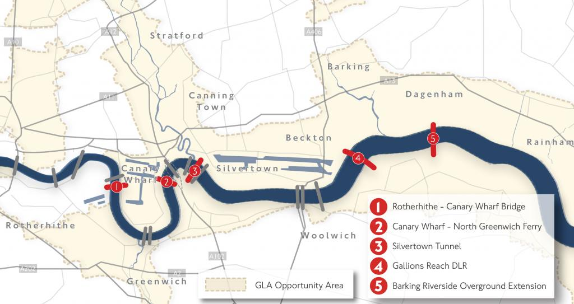
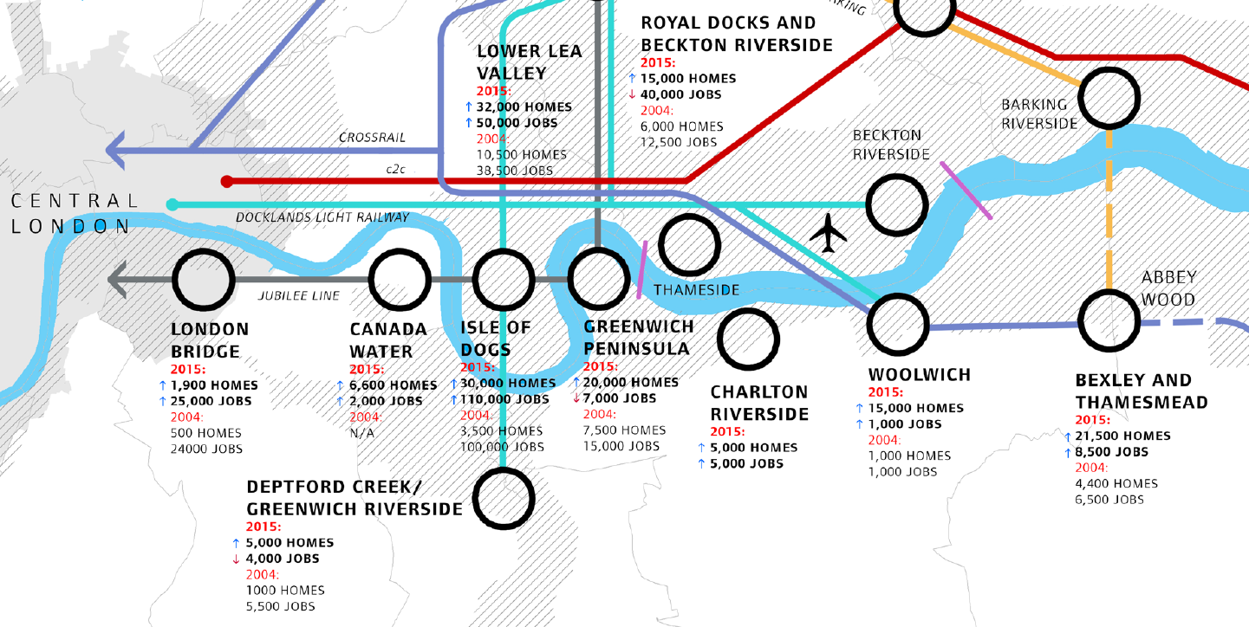
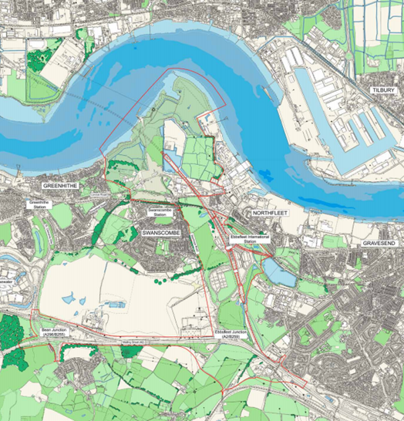
Growth of London

Slide 7
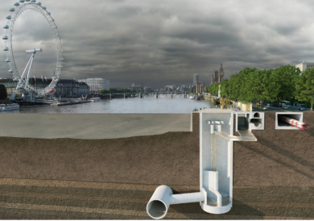
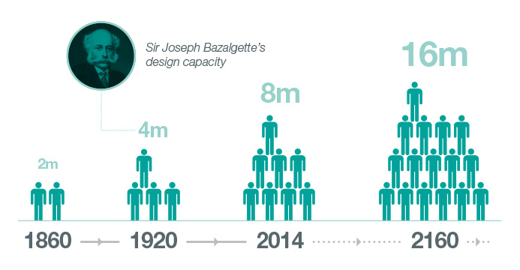
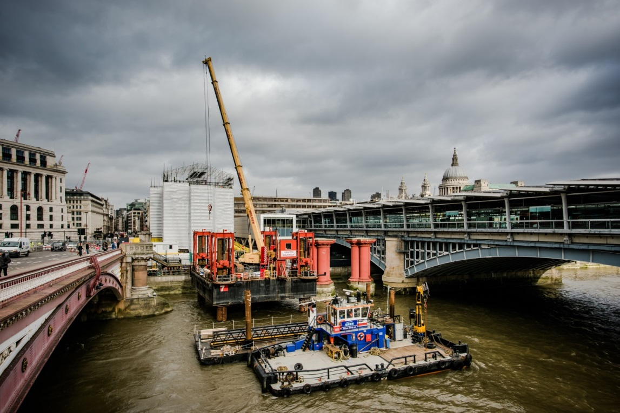
Thames Tideway Tunnel
Above: Tideway’s ‘The Situation Now’ diagram

Slide 8
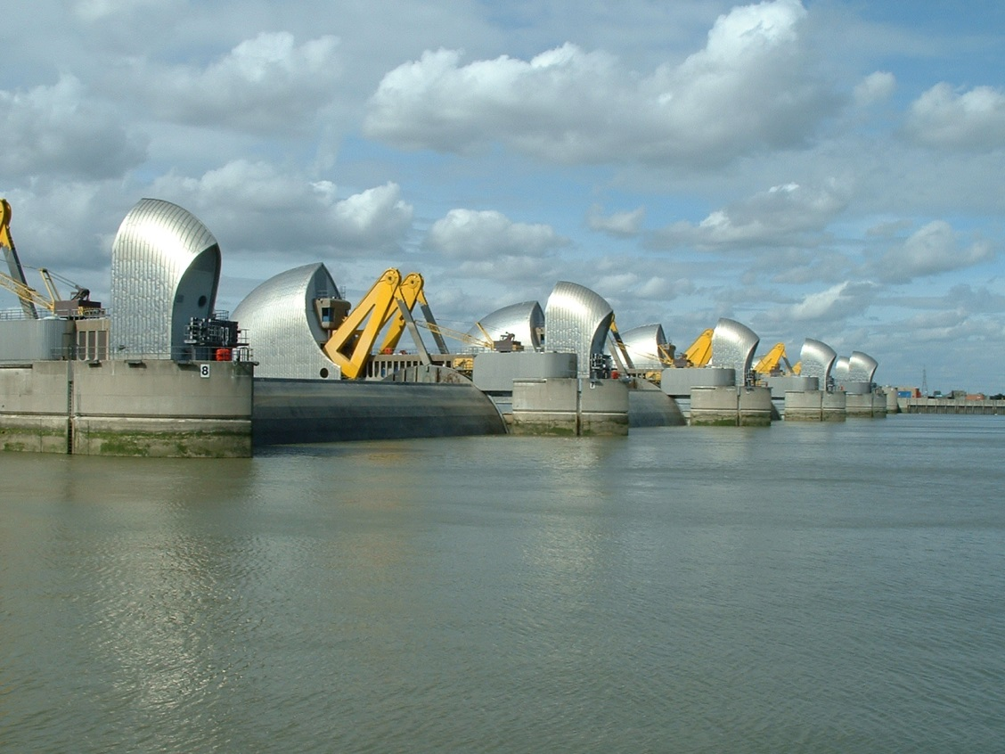
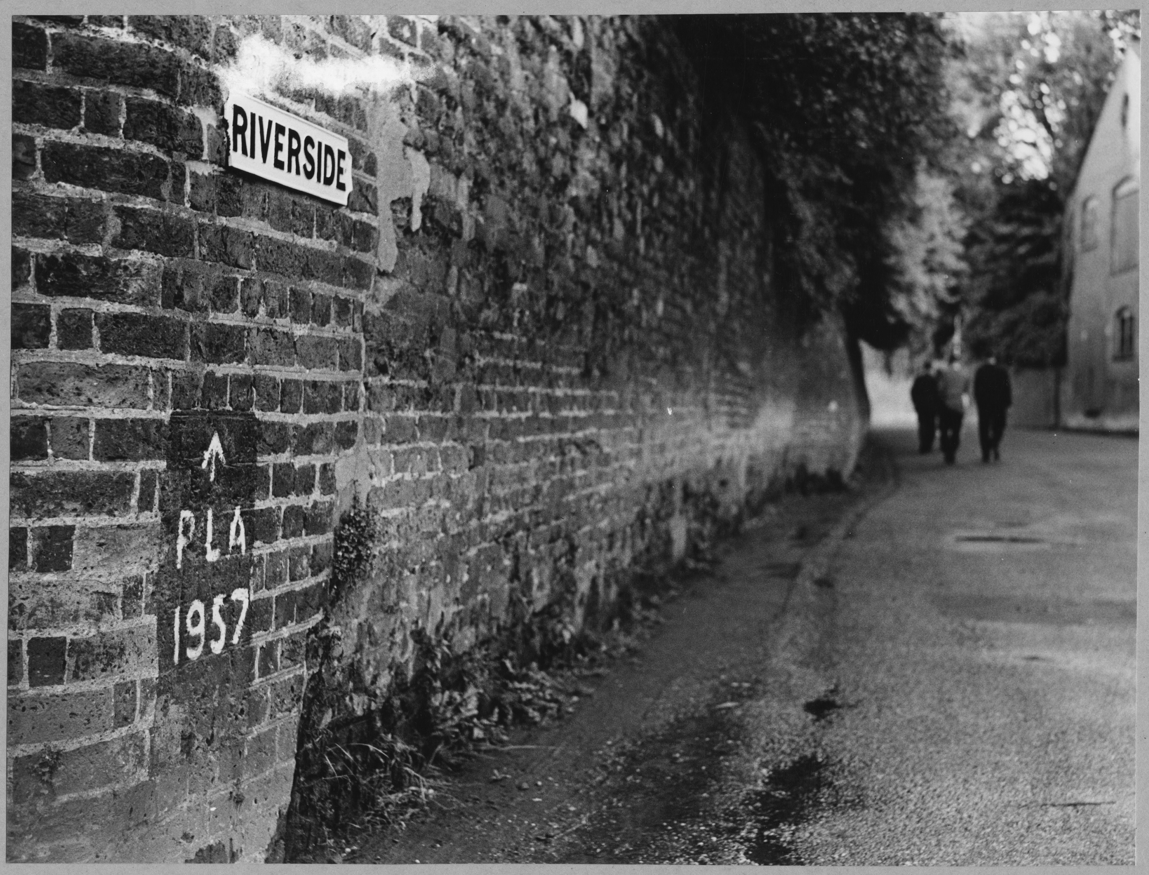
Climate change

Slide 9
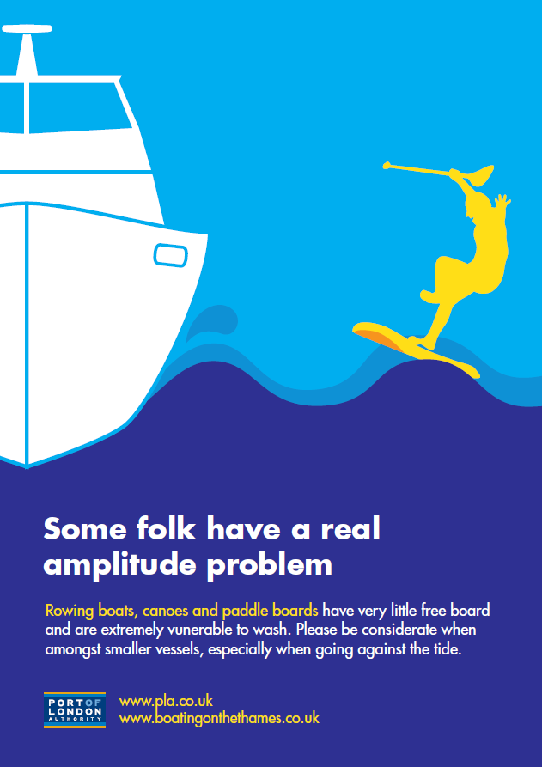

Safety

Slide 10
Thames Vision, July 2016
port trade: More trade, more jobs
  - The biggest ever Port of London (up to 80 million tonnes)
Inland Freight: More goods off roads onto the river - Double underlying freight
Passenger Transport: More passenger journeys - Up to 20 million
Sport and Recreation: More participants
Environment and Heritage: Cleanest Thames since Industrial Revolution
Community & Culture: More people coming to enjoy the Thames and its banks

Slide 11
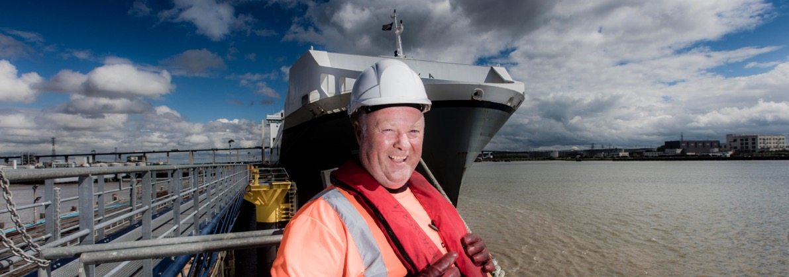
Port of London – More Trade, more jobs
The busiest ever Port of London, handling 60 – 80 million tonnes of cargo each year, on the doorstep of Europe’s biggest metropolitan consumer market.

Slide 12
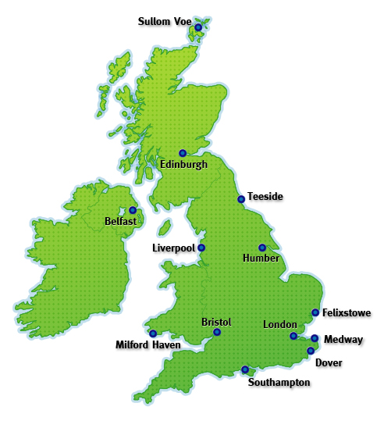
Top Ten UK Ports
No. Port Tonnage (mt)
1. Grimsby &
Immingham 59.1
2. London 45.4
3. Milford Haven 37.8
4. Southampton 37.7
5. Tees & Hartlepool 35.8
6. Liverpool 31.3
7. Dover 27.3
8. Forth 27.1
9. Felixstowe 26.7
10.Belfast 16.7
Source: DfT 2015 Port Statistics

Slide 13
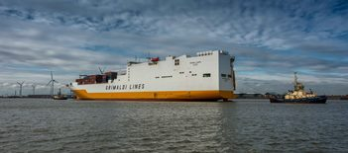
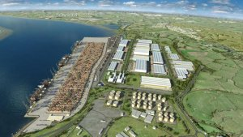
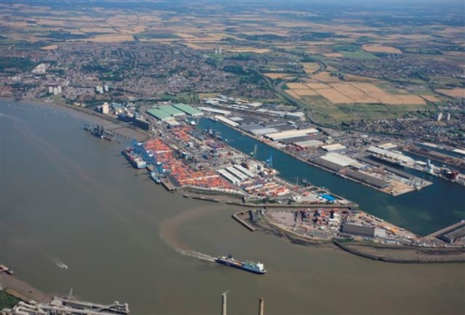
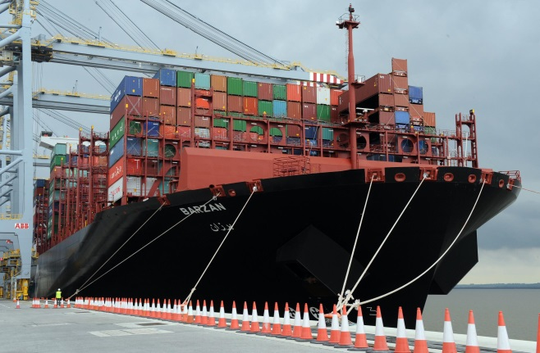
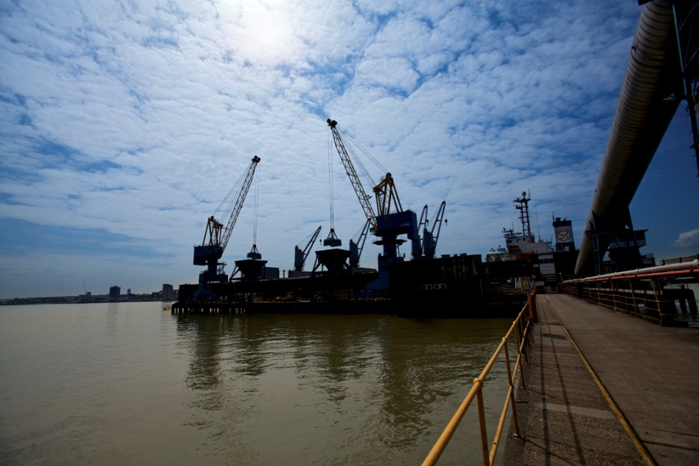
Port of London – More Trade, more jobs

Slide 14
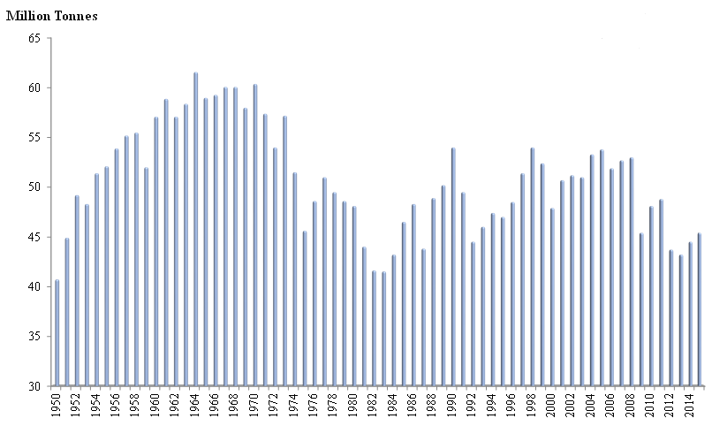
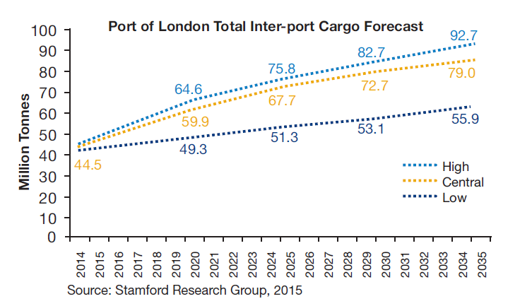
Port of London – More trade, more jobs
1964: 61.3 mt
2015: 45.4 mt

Slide 15
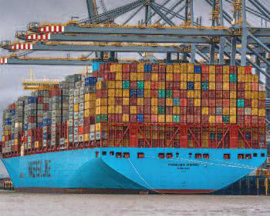
Port of London – More trade, more jobs
Sustain private sector investment
Improve navigational access to the port
Improve rail and road access to port operations/terminals, including:
  Lower Thames crossing downstream of Tilbury, by 2025
  At least three further Thames crossings to the east of Tower Bridge, that allow continuation of river trade, the first by 2022
  Widening of A13, by the end of 2018
  Closure of level crossings affecting operational terminals, by 2020
Deliver efficient, effective and sustainable PLA harbour and pilotage services to support growth

Slide 16
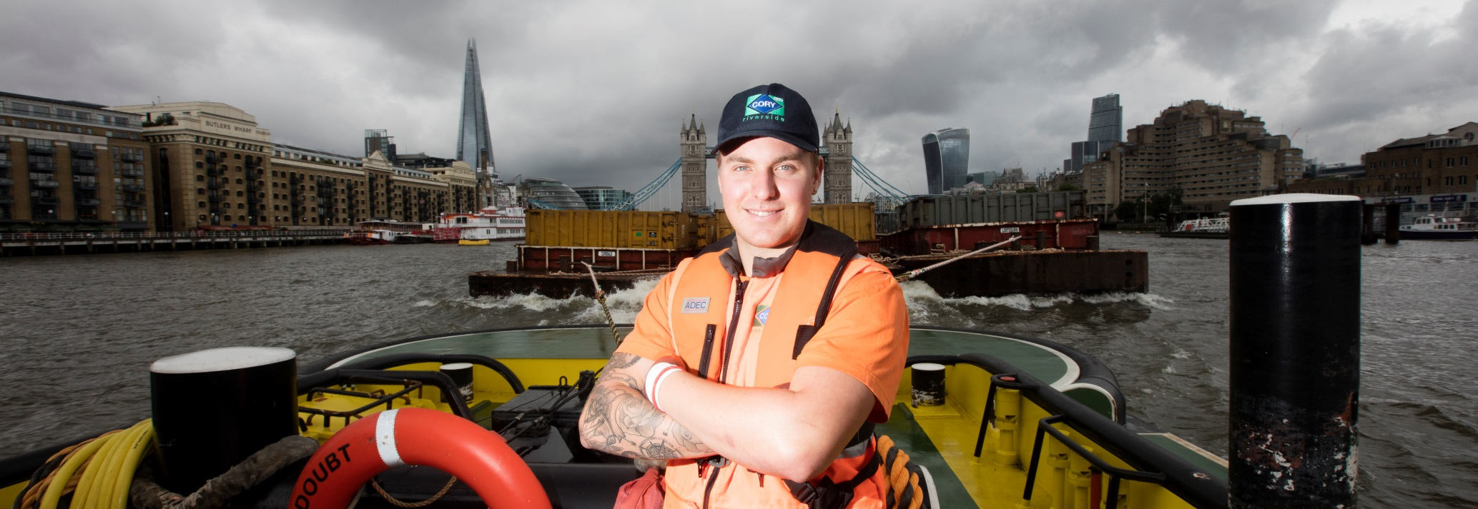
Inland freight - More goods off roads onto the river
More goods and materials routinely moved between wharves on the river – every year over 4 million tonnes carried by water – taking over 400,000 lorry trips off the region’s roads.

Slide 17
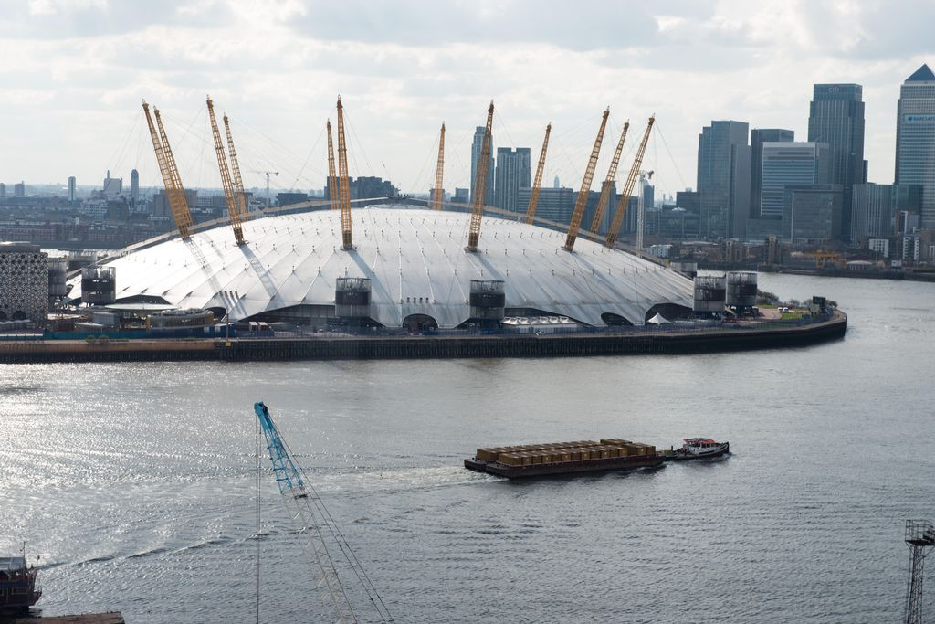
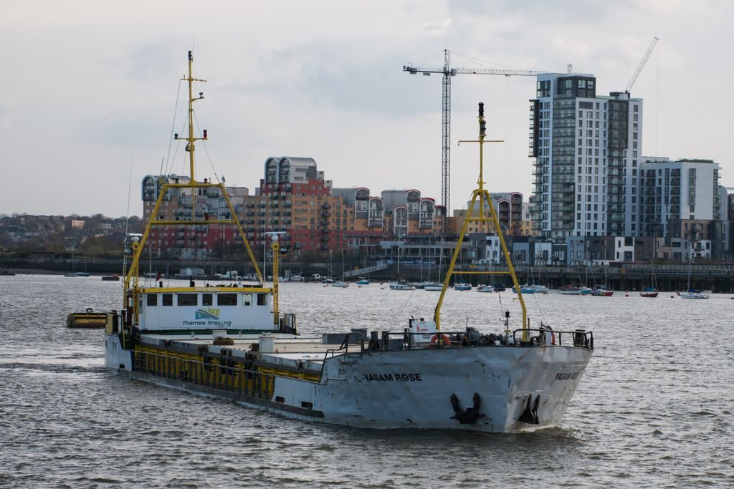
Inland freight - More goods off roads onto the river
UK’s busiest inland waterway, with a record level of 5.5 million tonnes carried by river in 2014
Marine dredged aggregates provide 50% of all of London’s aggregates supply
Every 1,000 tonne barge on the river takes up to 100 lorry movements off the roads

Slide 18
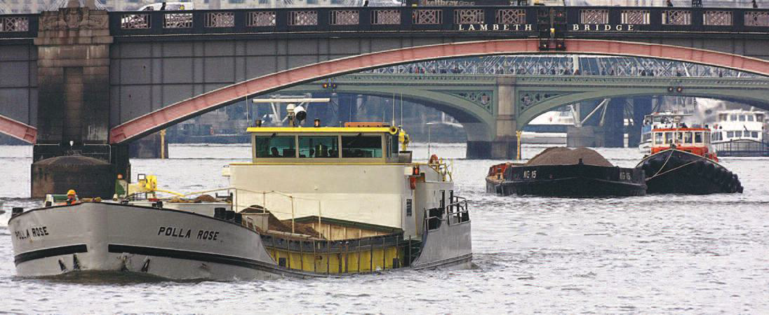
Inland freight - More goods off roads onto the river
Double underlying intra-port freight carried by water (i.e. excluding infrastructure projects) to over 4 million tonnes
Champion the Thames as a default choice for moving spoil and materials from infrastructure projects close to the river
Maintain or reactivate viable cargo handling facilities, with at least five facilities brought into operation by 2025
Extend the River Concordat to promote freight movements by water
Develop the Thames Skills Academy to provide the skills needed on the Thames

Slide 19
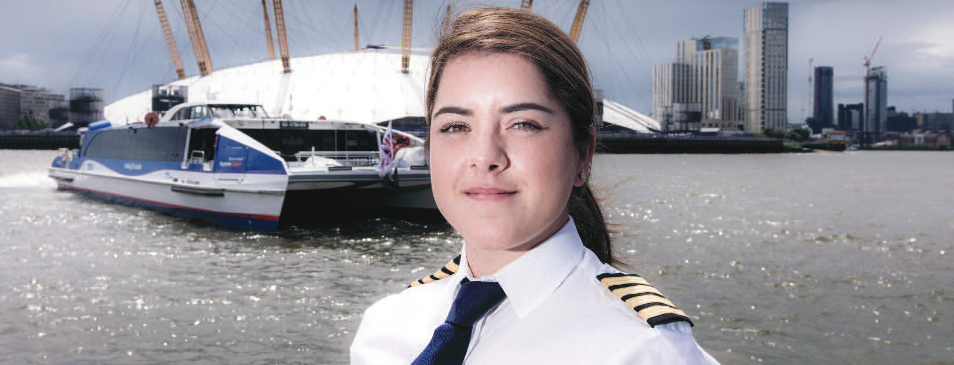
Passenger transport – More journeys
Double the number of people travelling by river – reaching 20 million commuter and tourist trips every year.

Slide 20
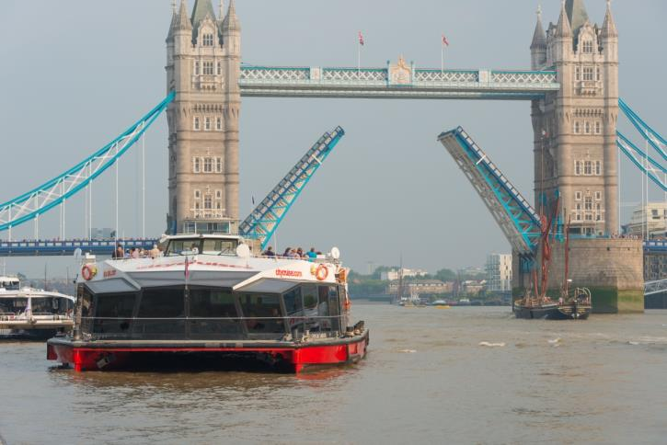
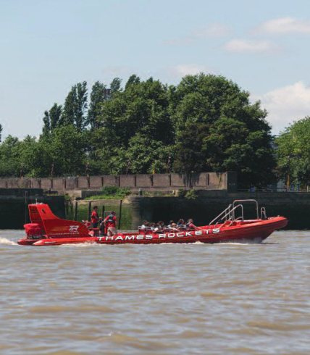
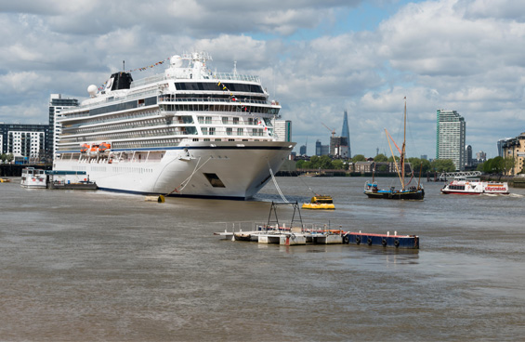
Passenger transport – More journeys
In 2015 there were 10.3 million passenger journeys, continuing growth in passenger travel of more than 150% over the last decade
23.4 million visitor trips to attractions beside the Thames, of which 4.7 million have a direct maritime connection
Some £68 million investment in passenger and cruise related services is planned over the next five years

Slide 21
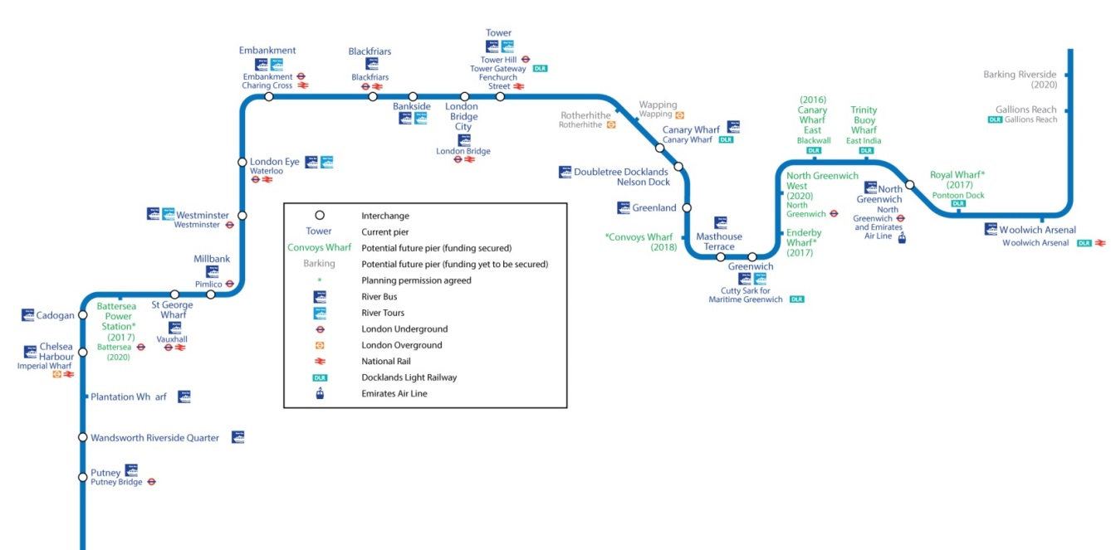
Passenger transport – More journeys
Make more efficient use of piers and river space
Innovate to achieve more passenger journeys at current low peak times
Develop and implement a long-term pier strategy
Convene a consultative forum to address issues of wash
Secure the infrastructure required
for growth

Slide 22
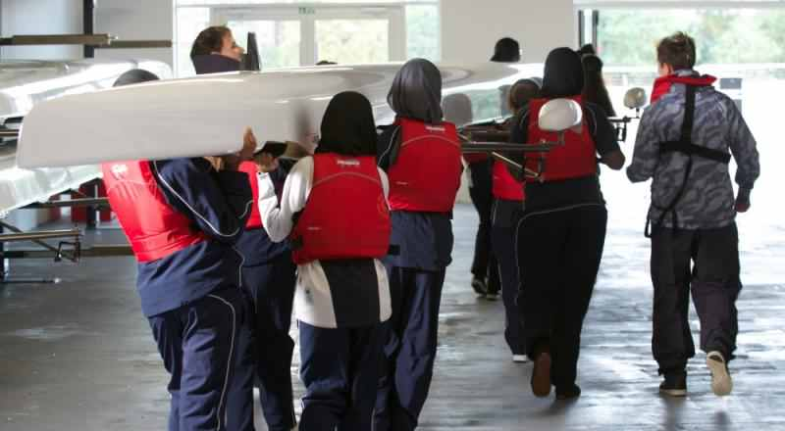
Sport & recreation – More participants
Greater participation in sport and recreation on and alongside the water.

Slide 23
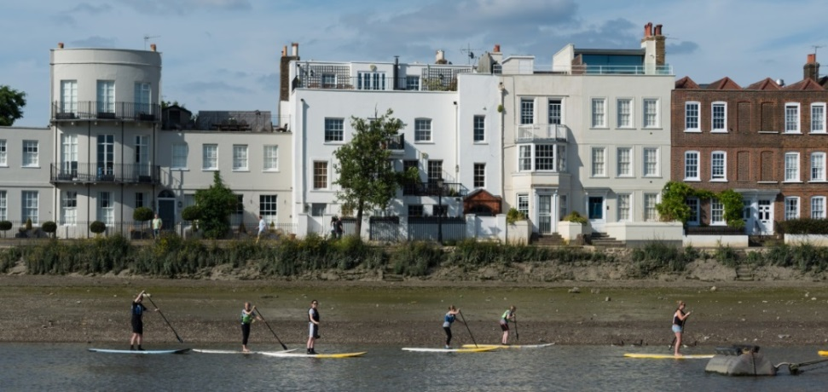
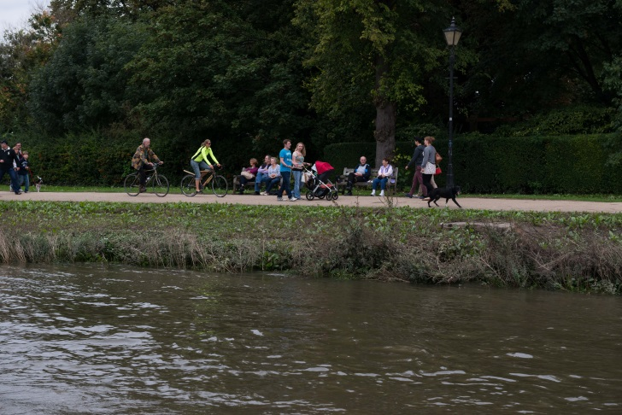
Sport & recreation – More participants
More than 100 sport and recreation clubs along the Thames
Thames plays host to more than 80 major sporting events
At least 10 million walkers or cyclists on the Thames towpath each year
Estimated value of people participating in sport and recreation is £132 million a year in terms of health and wellbeing benefits

Slide 24
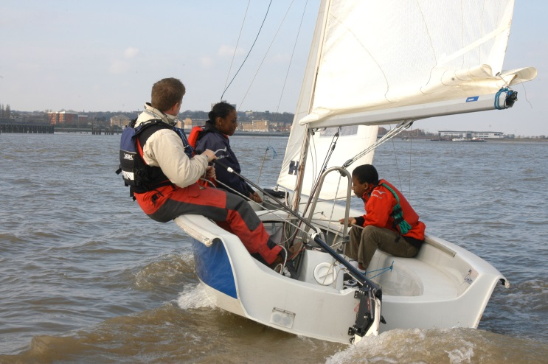
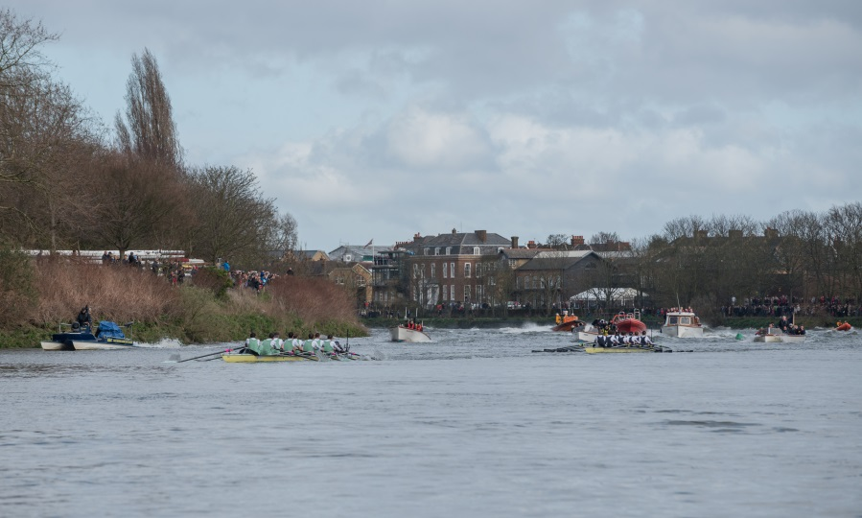
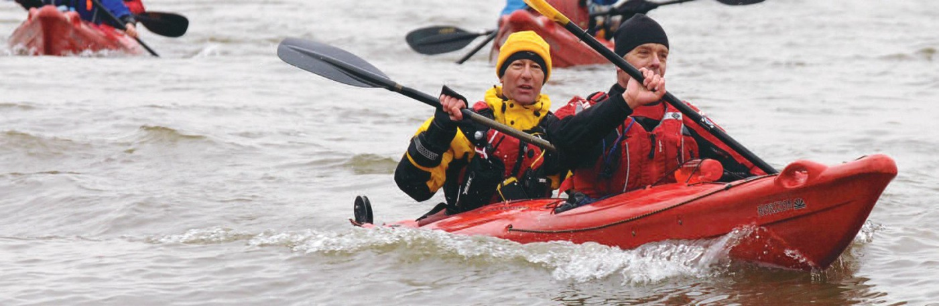
Sport & recreation – More participants
Ascertain current levels of sport participation and work towards increasing participation on and alongside the Thames
Extend sport opportunity zones on the Thames
Realise new visitor moorings and publicise the availability of all visitor moorings effectively
Join up the Thames Path from source to sea

Slide 25
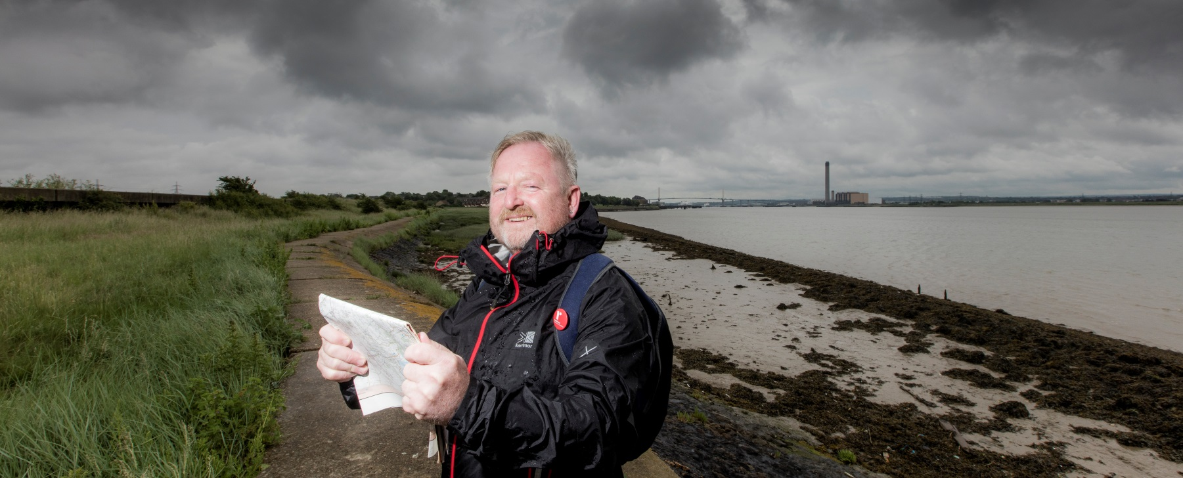
Environment & heritage – Improved tidal Thames environment
The river the cleanest since the Industrial Revolution, with improved habitats and awareness of heritage.

Slide 26
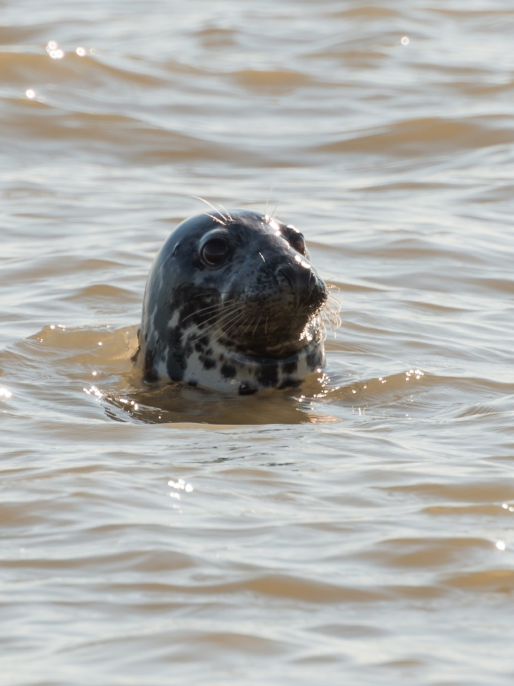
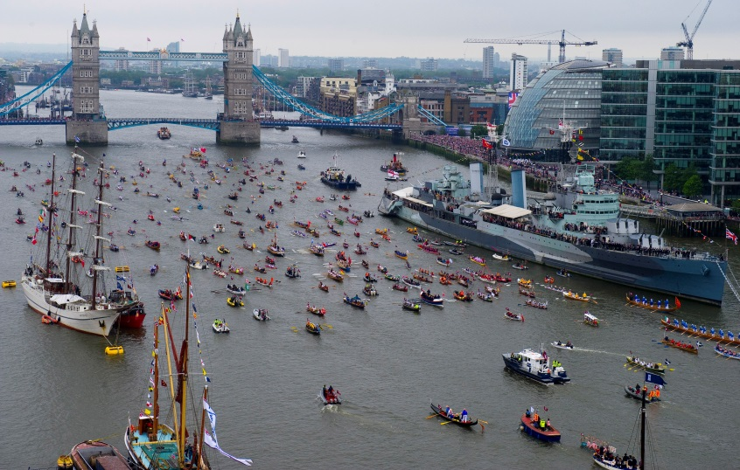
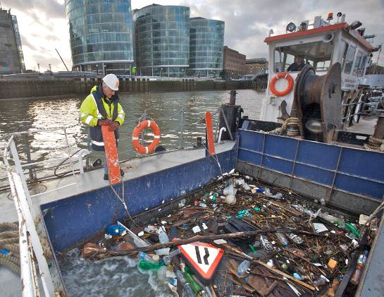
Environment & heritage – Improved tidal Thames environment
Home to nine Sites of Special Scientific Interest (SSSIs)
Over 900 seals and visits from 300,000 overwintering birds every year
Up to 300 tonnes of rubbish is recovered from the Thames each year.

Slide 27

Environment & heritage – Improved tidal Thames environment
Build and bring into operation the Thames Tideway Tunnel, by 2021
Improve water quality by a range of measures including reduced litter in the river
Improve biodiversity of sites recognised for their wildlife interest, and the connections between them
Identify and improve access to, and appreciation of, the historic environment along the Thames
Encourage uptake of new and green technologies to reduce the port’s environmental impact

Slide 28

Community & culture - More people coming to enjoy the Thames and its banks
A riverside which is a magnet for ramblers, historians, artists and others, whether living nearby, on the river or travelling from further afield.

Slide 29



Community & culture - More people coming to enjoy the Thames and its banks
There are four UNESCO World Heritage Sites on the banks of one river: Kew Gardens, Westminster Abbey and the Palace of Westminster, Tower of London and Maritime Greenwich
4.7 million people visit the Thames or maritime related attractions annually
At least 23 million people visit the attractions located by the Thames

Slide 30


Community & culture - More people coming to enjoy the Thames and its banks
Enhance access to information about the Thames
Educate local school children about the Thames
Create new appropriate residential moorings accommodating suitable vessels
Explore development of a Thames brand for culture, heritage and quality of life

Slide 31







































Stakeholders
Terminal Operators
Developers / Landowners
Local Authorities
Arts and Community Groups
River Operators
Houseboat Residents
London Port Health Authority
Custodians of Heritage Sites
Moorings and Marinas
New End Users
Schools
Recreational Clubs
River Concordat
River Works Licensees
The Hubbub Foundation
Public

Slide 32

Conclusion
“The benefit will not [just] be for the London of today and tomorrow, but we shall have laid the foundations of an enduring prosperity that will extend far into and enrich the future”.
PLA’s first Chairman, Hudson Kearley, 1909

