Slide 1
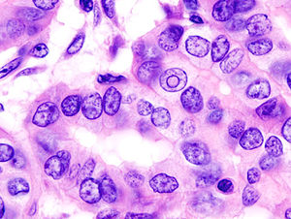

Cancer treatment
Gresham College 2016
Christopher Whitty

Slide 2
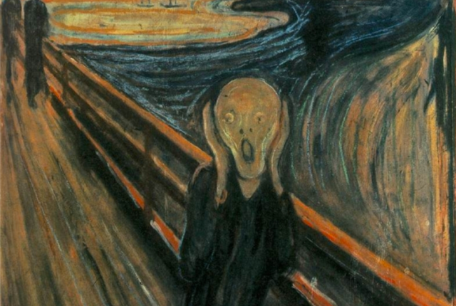
‘You have cancer’.
Edvard Munch

Slide 3
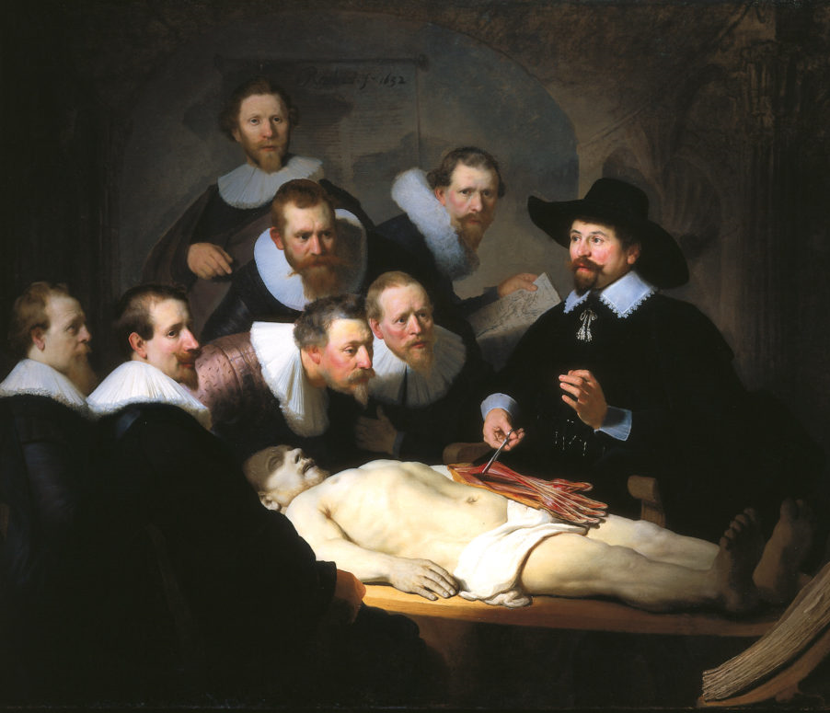
Cancer: misunderstood in Sir Thomas Gresham’s lifetime, almost unmentionable until quite recently.
Descriptions of cancer go back millennia.
Around time of this College started it was thought contagious by experts such as Dr. Tulp.
The Scottish surgeon John Hunter (d 1793): If the tumour has not invaded nearby tissue and “moveable,” “There is no impropriety in removing it.”
Rembrandt. The Anatomy lesson of Dr. Nicolaes Tulp. 1632.

Slide 4
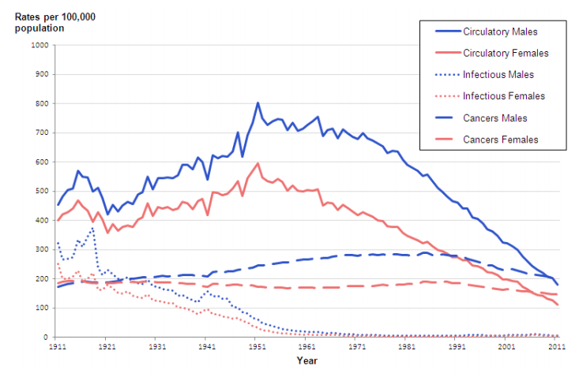
Age-standardised mortality rates England and Wales (ONS 2014)

Slide 5
This talk will consider:
Trends in cancer survival.
Diagnosis.
Surgery.
Radiotherapy.
Chemotherapy.
Hormone therapy.
Immunotherapy.
Policy problems and the future.

Slide 6
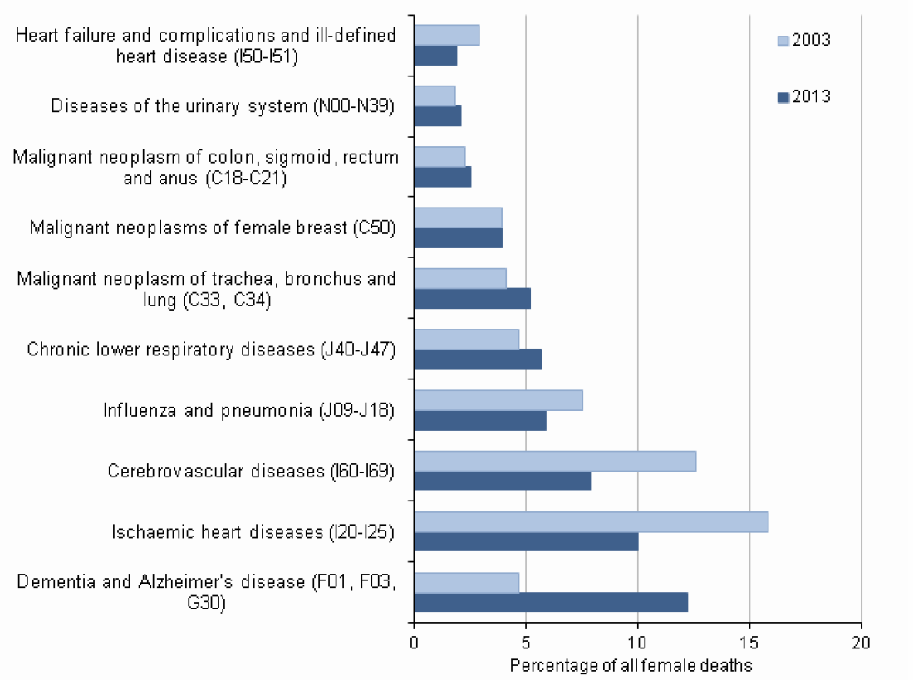

Ten leading causes of death in females, 2003-2013, England & Wales (ONS)

Slide 7
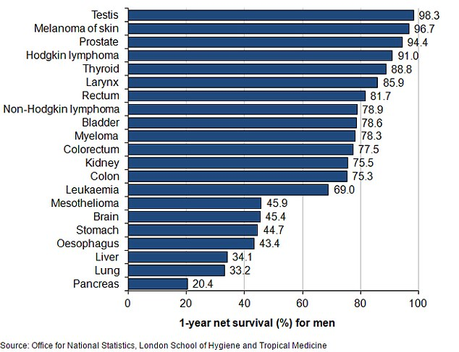
Current 1 year survival.

Slide 8
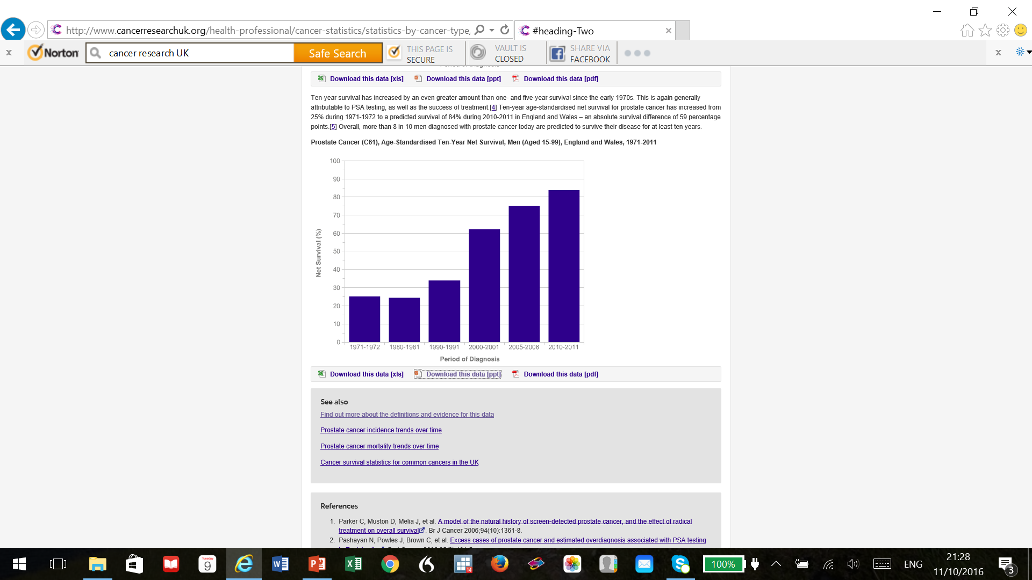
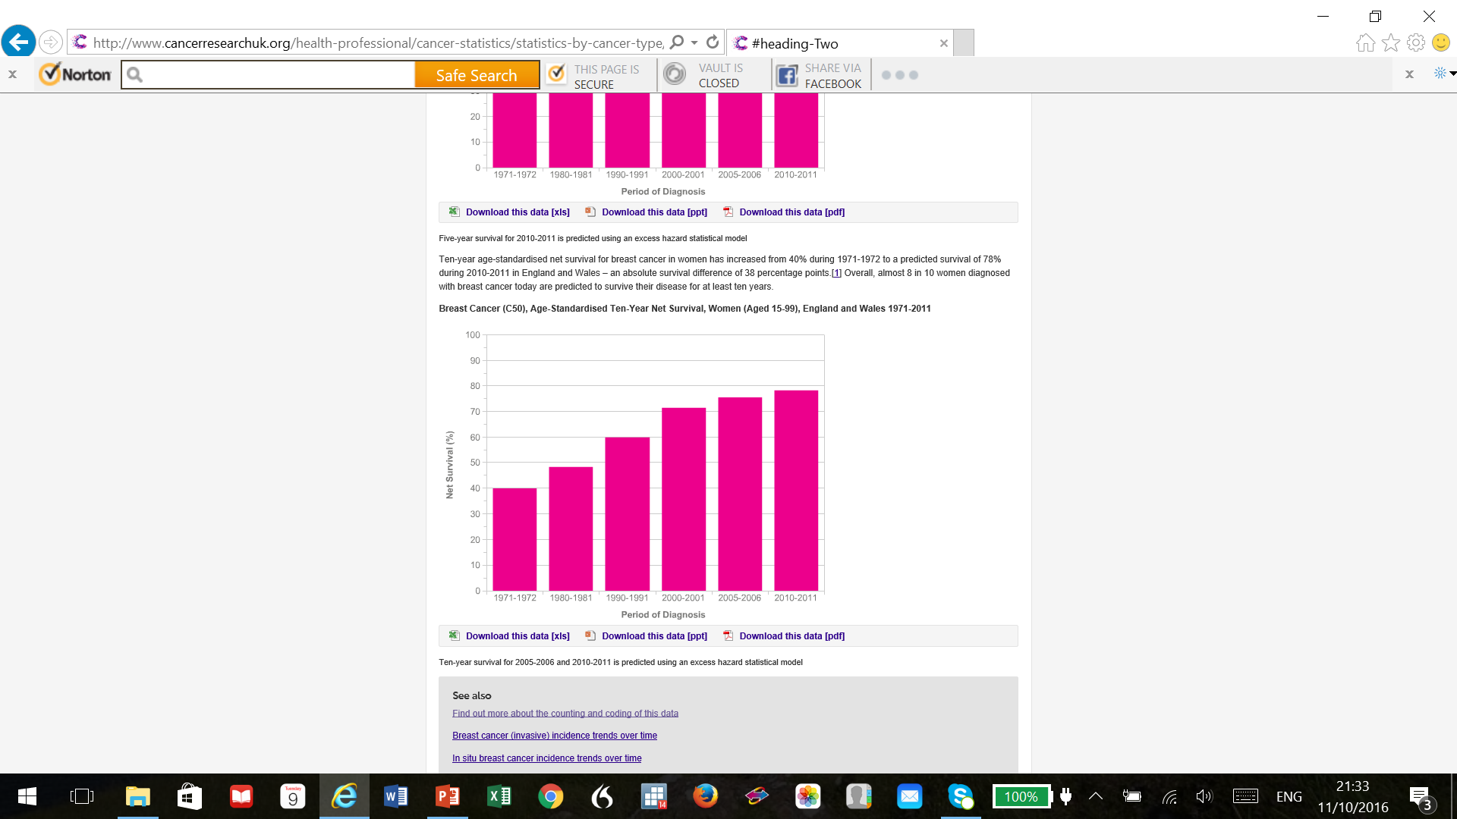
10 year cancer survival, prostate (L) breast (R)

Slide 9
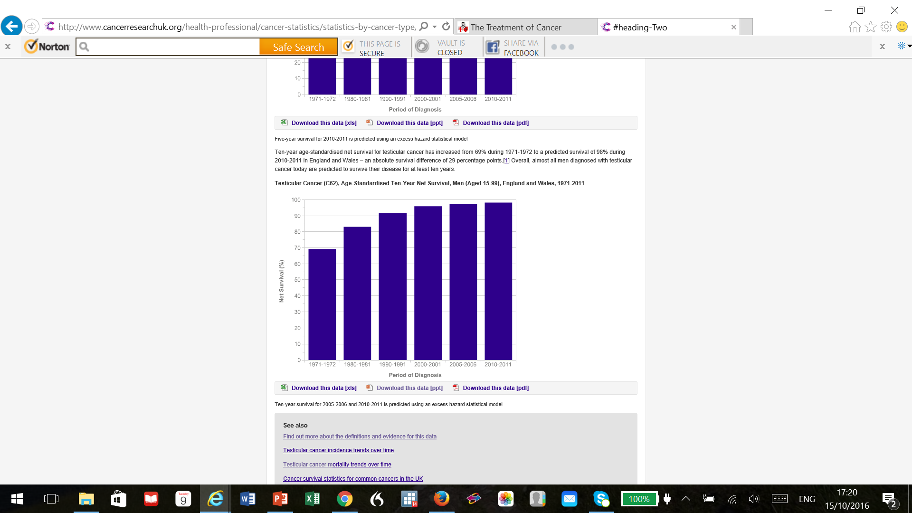
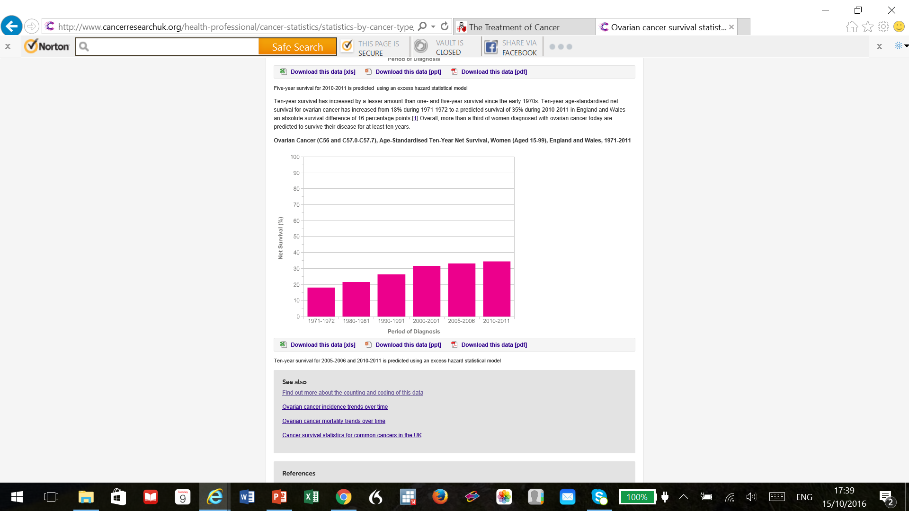
10 year survival: testicular cancer (L, 98%), ovarian cancer (R, 35%; 70% at 1 year). (CRCUK)

Slide 10
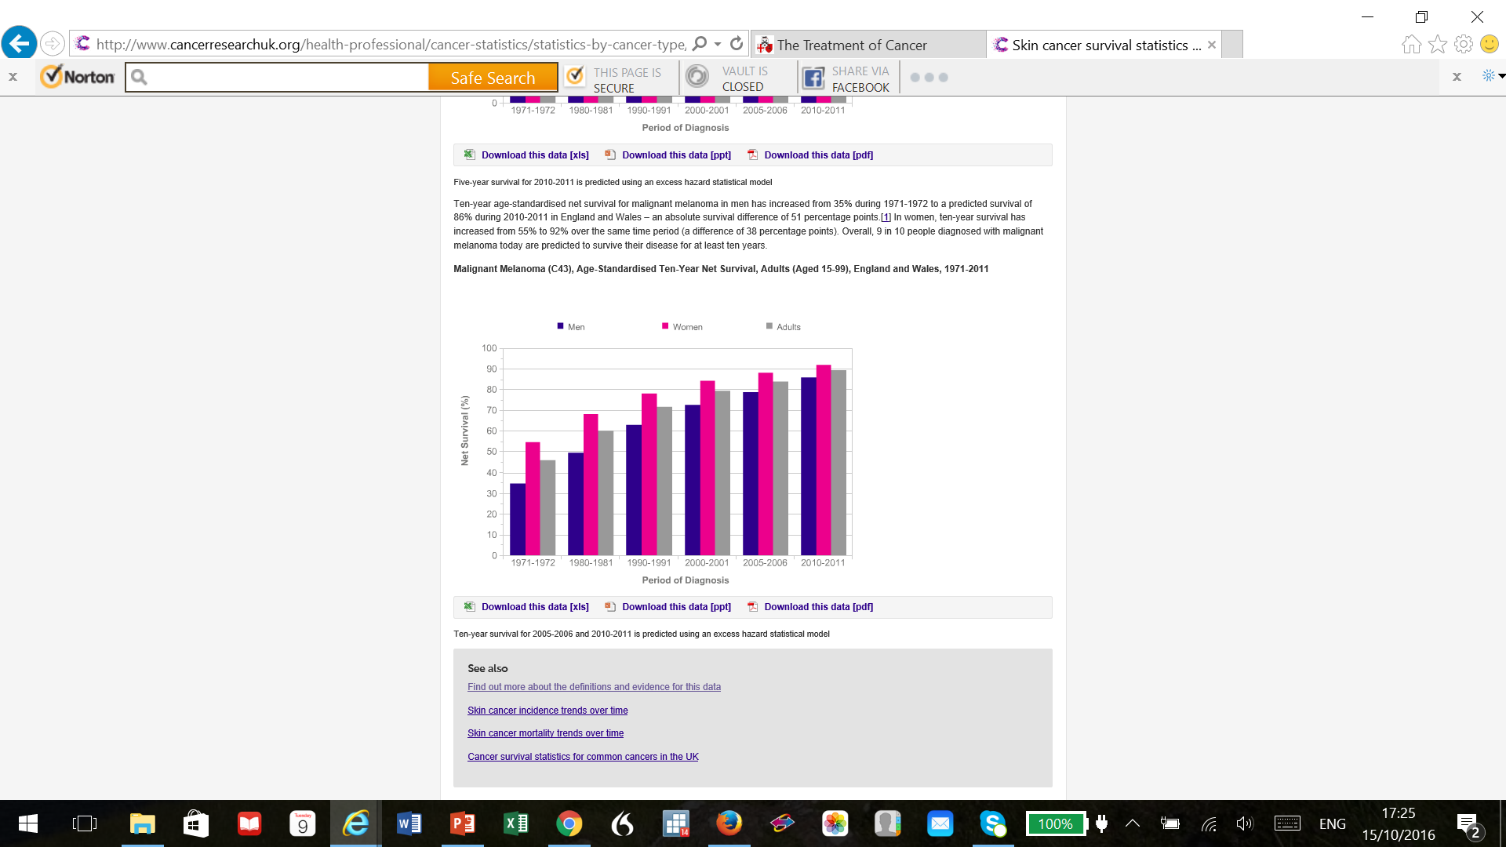
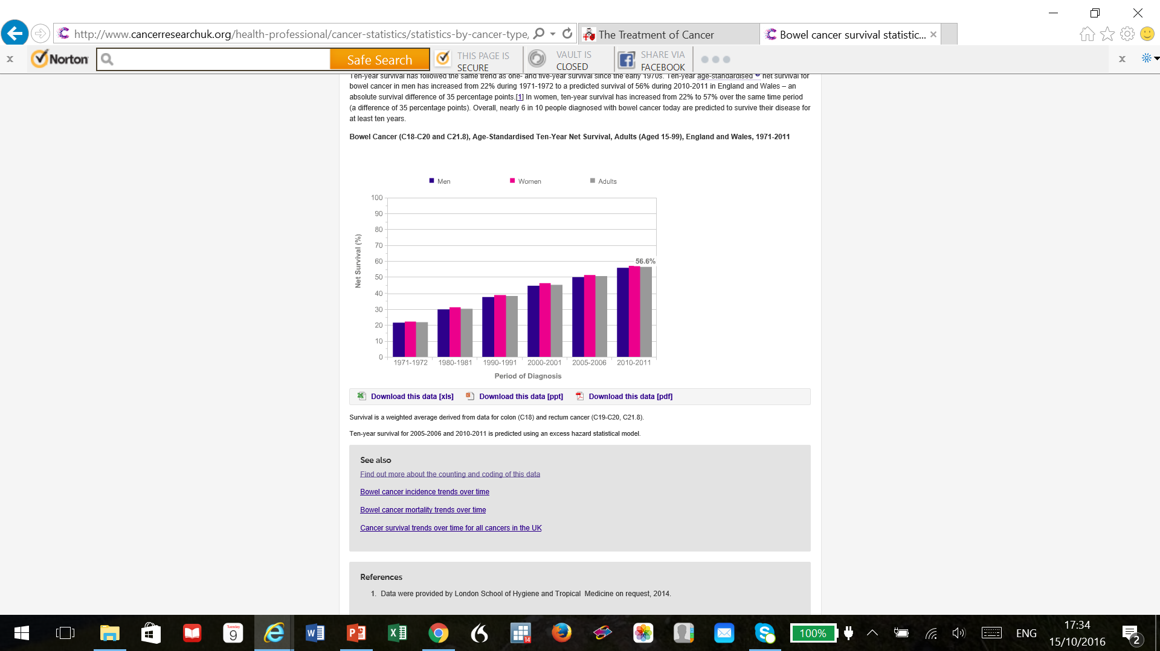
10 year survival: bowel cancer (L, 57%), melanoma (R, 90%) (CRUK)

Slide 11
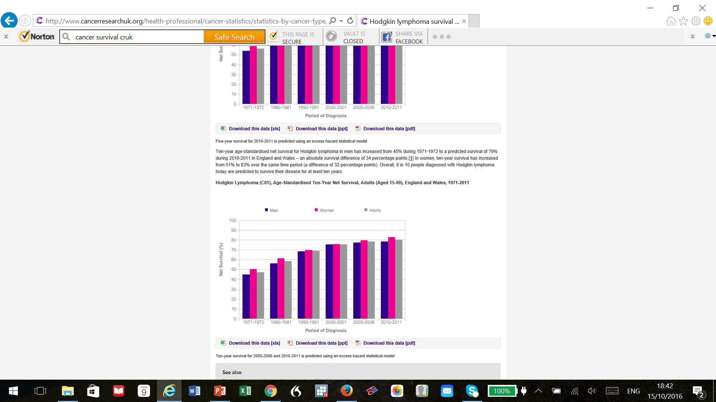
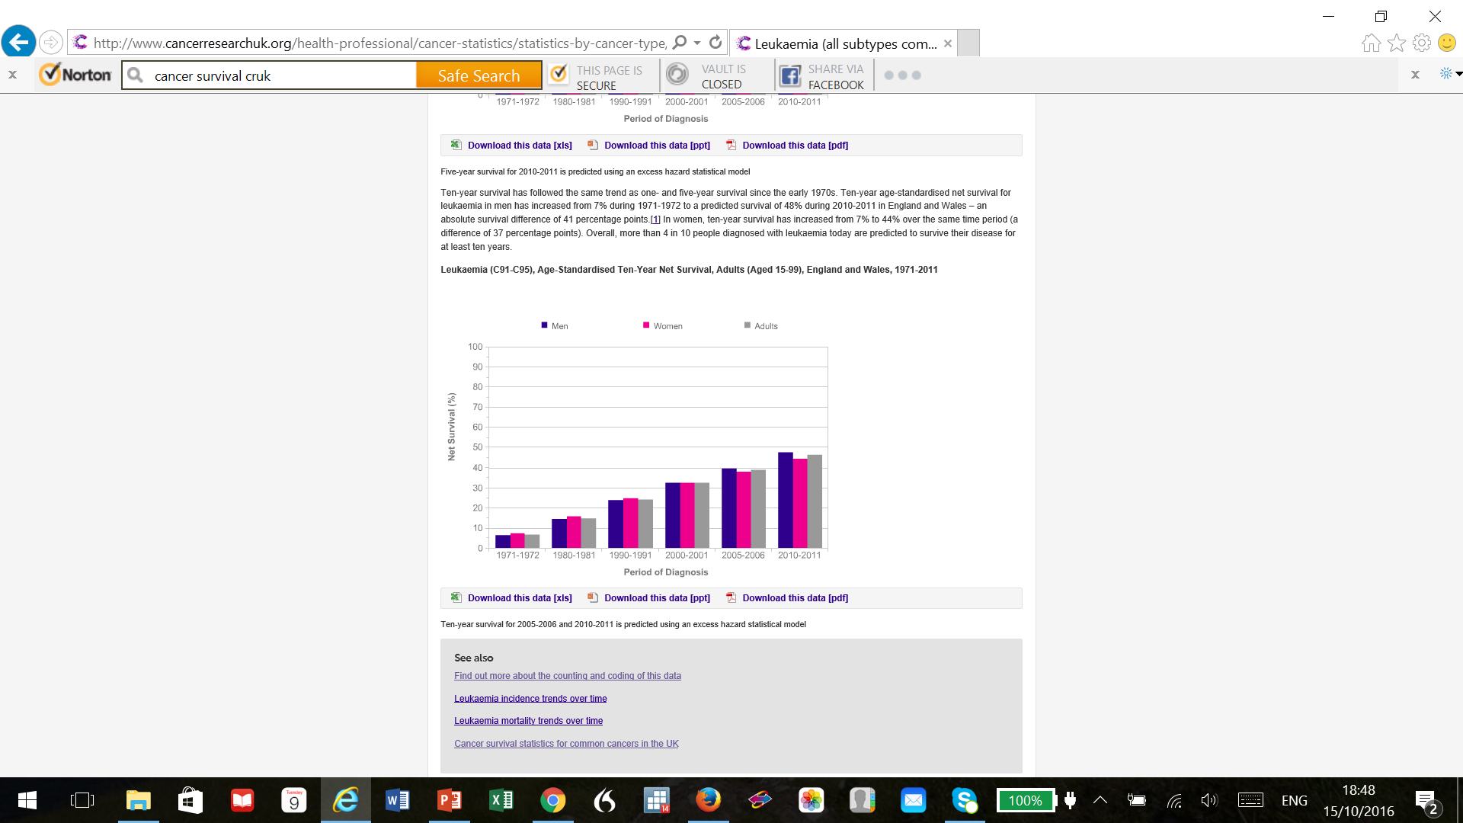
10 year survival: Hodgkin lymphoma (L 80%), leukaemia (R 46%). (CRCUK)

Slide 12
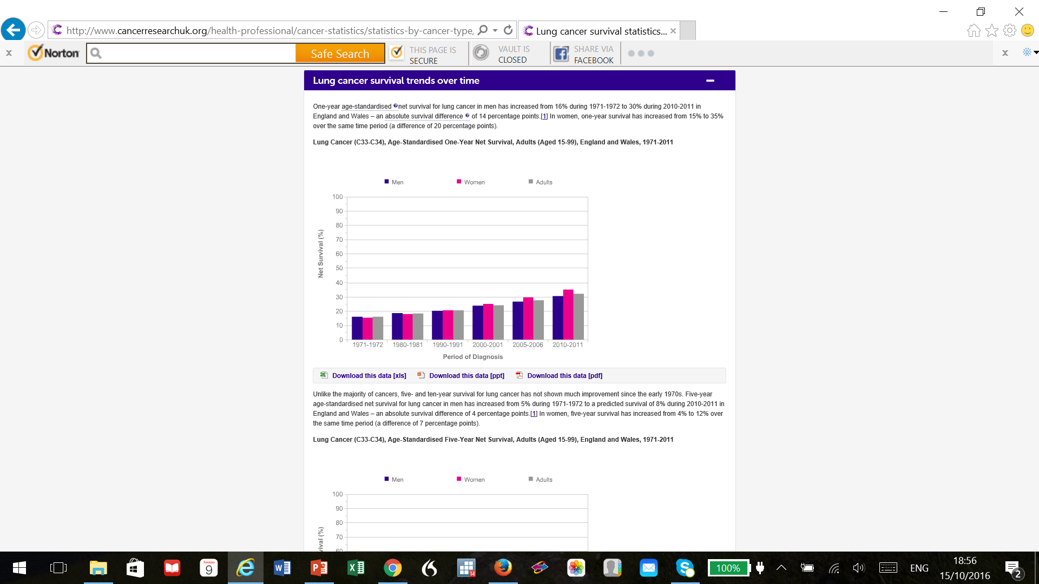
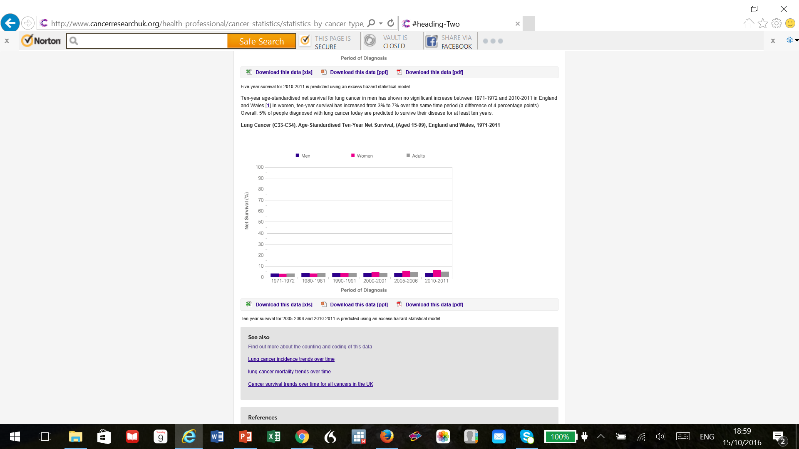
Lung cancer, 1 year (L, 32%) and 10 year (5%) survival. Almost 90% preventable. CRUK

Slide 13
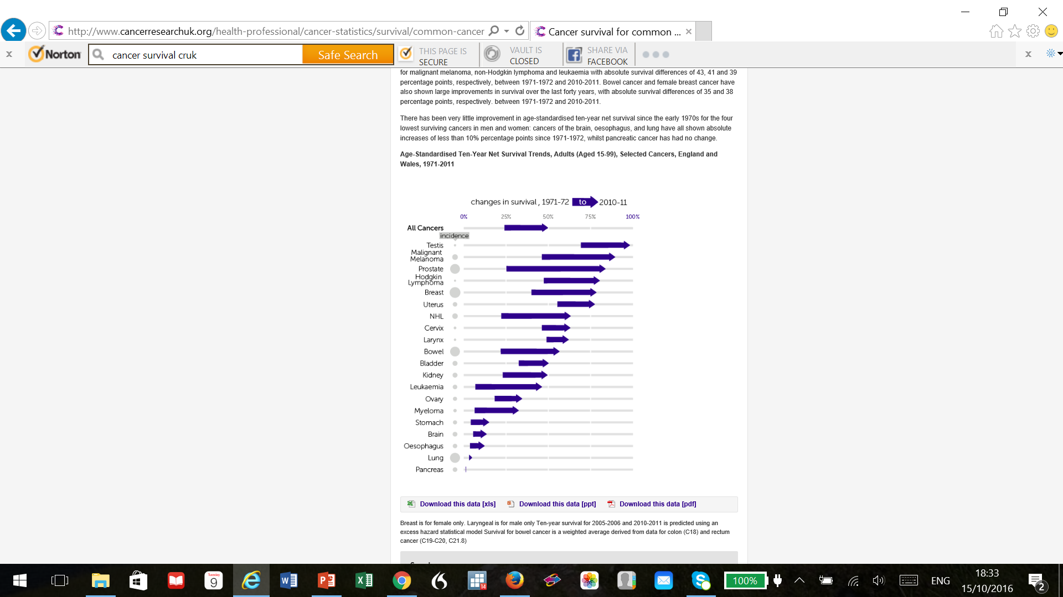
Changes in 10 year survival 1971 to 2011 (CRUK)

Slide 14
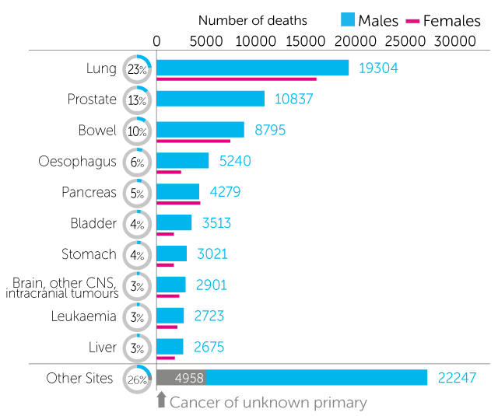
Cancers: UK mortality
(CRUK 2014: males)
Overall mortality a combination of incidence (how common) and survival.
The key difficulty in cancer is removing, killing or controlling the cancer whilst minimising damage to the person whose cancer it is.

Slide 15
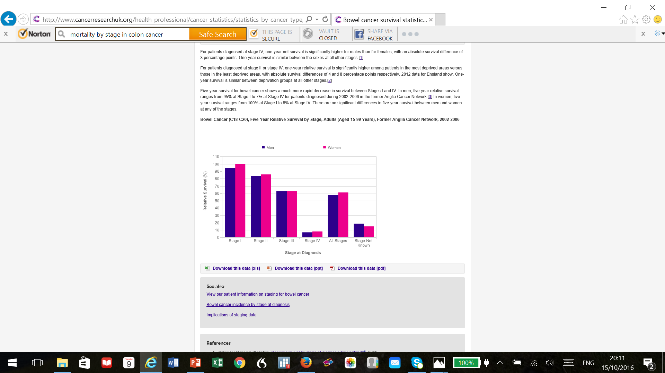
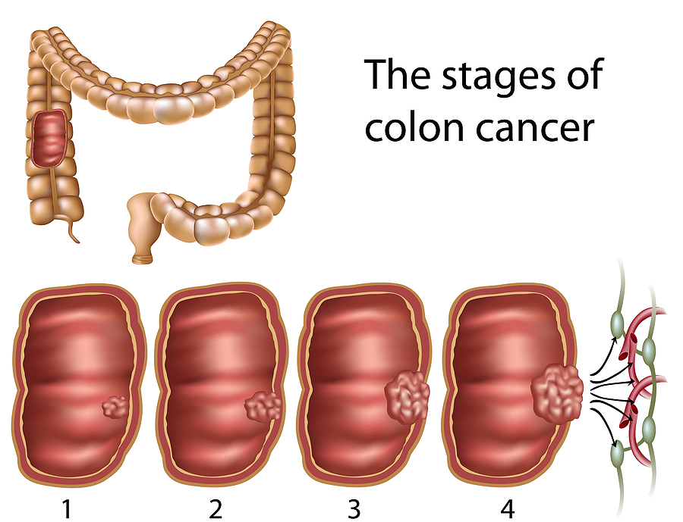
Early diagnosis is key to good outcome in most treatable cancers.
Anglia Cancer Network, 2002-2006 and CRUK. 5 year relative survival.
The Colorectal Institute.

Slide 16
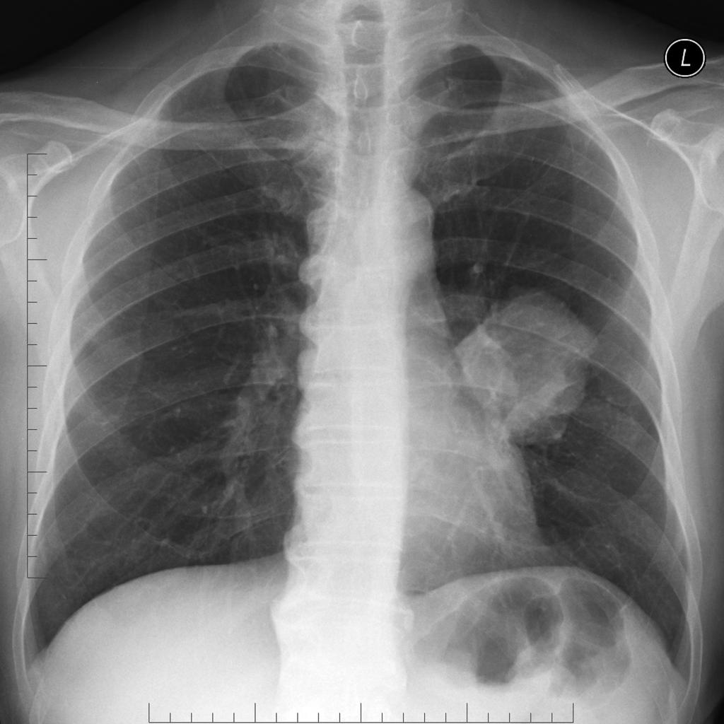
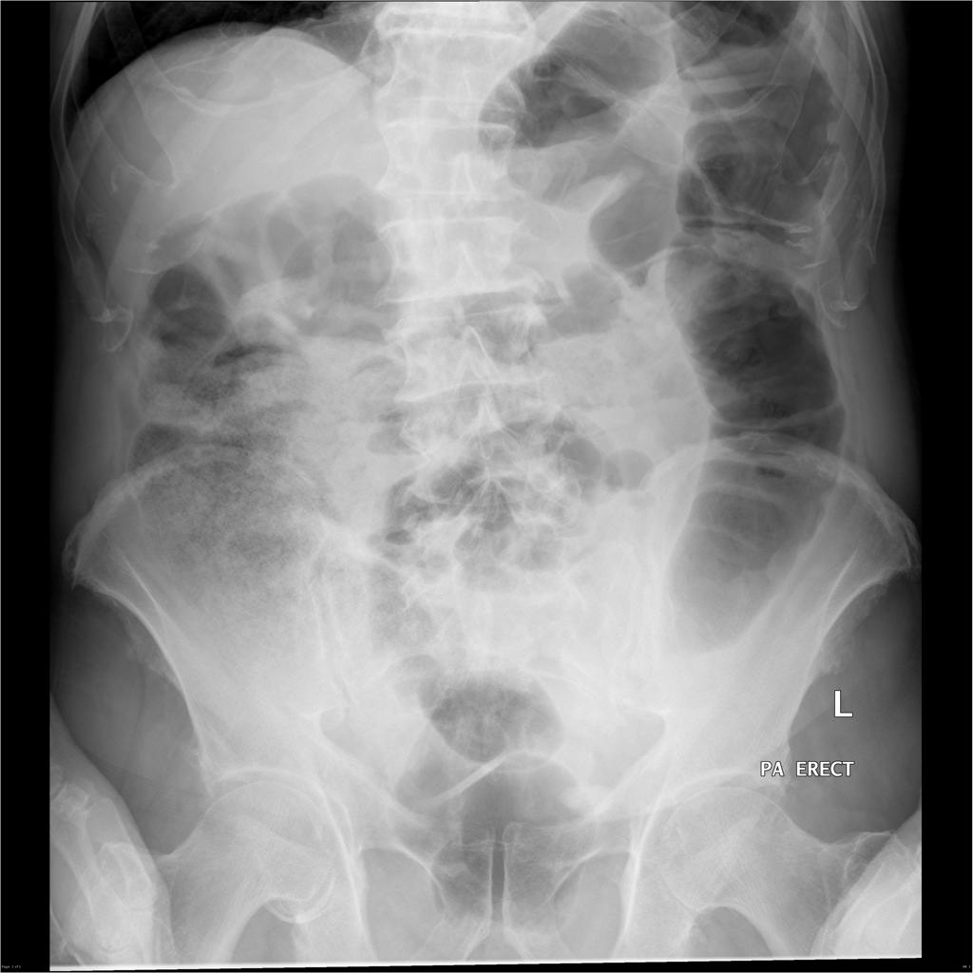
X-rays revolutionised diagnosis and treatment of cancer.
Courtesy Prof Frank Gaillard, Radiopaedia.org

Slide 17
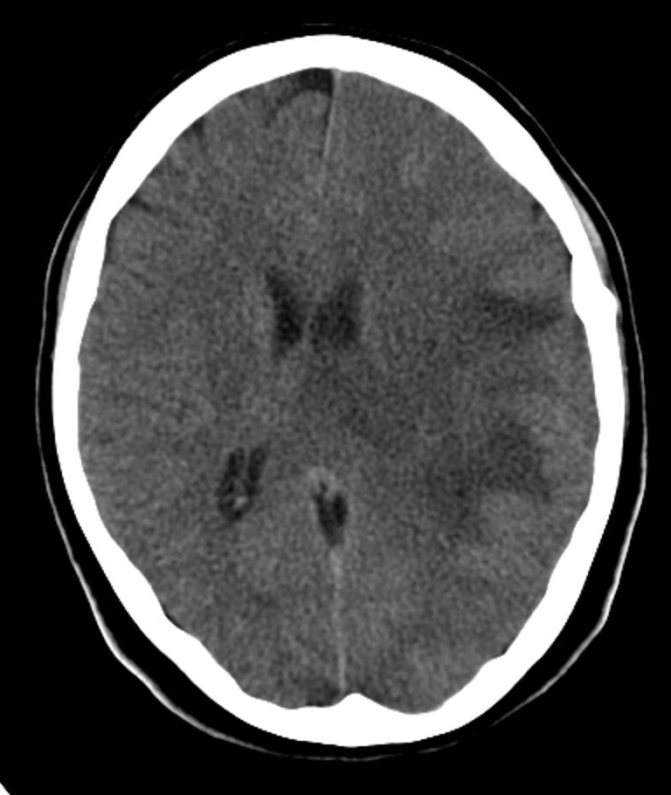
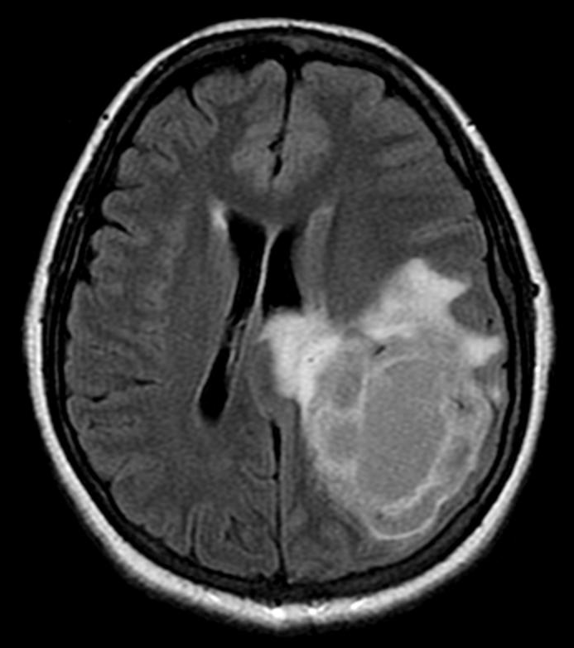
CT, then MRI have allowed successively earlier and more precise diagnosis.
Courtesy of Dr Hani Al Salam, Radiopaedia.org. CT L, MRI R of same tumour in a man (neuroectodermal tumour).

Slide 18
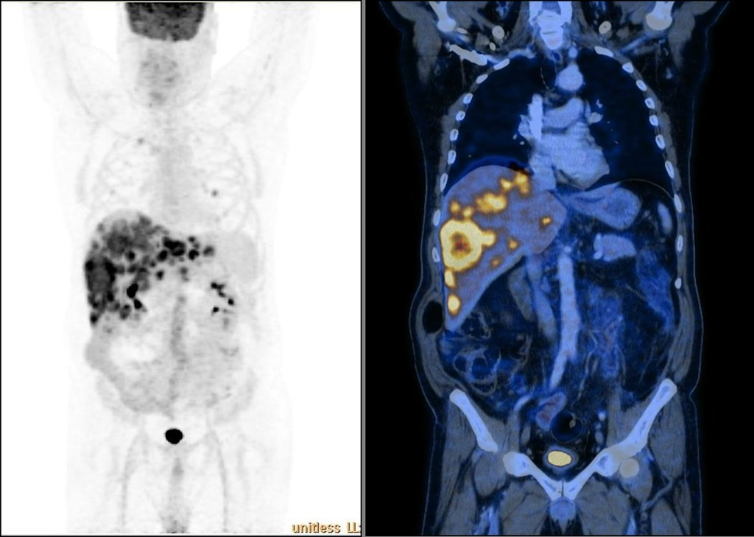
Nuclear medicine.
Courtesy of Dr Dalia Ibrahim, Radiopaedia.org. FDG avid uptake, colon cancer in a man.

Slide 19
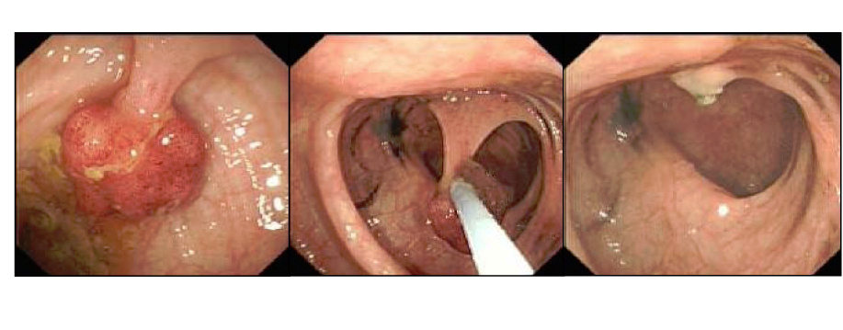
Endoscopy allows vision, biopsy, treatment.
Colonoscopy (colon), gastroscopy (stomach), bronchoscopy (lung), cystoscopy (bladder).
Gilo1969 Wikimedia commons

Slide 20
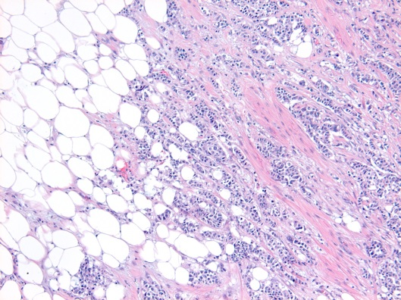
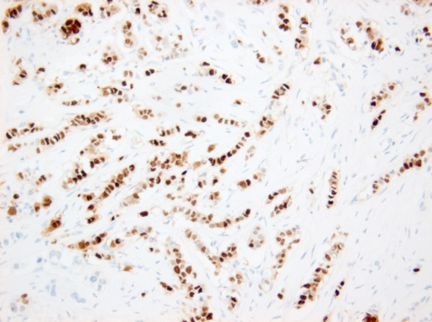
Better histological diagnosis.
H&E histology,
breast cancer.
IHC ER+.
Hormone receptors
Dr Ala Enno Consultant Histopathologist, Liverpool Hospital. Cancer Council Australia

Slide 21
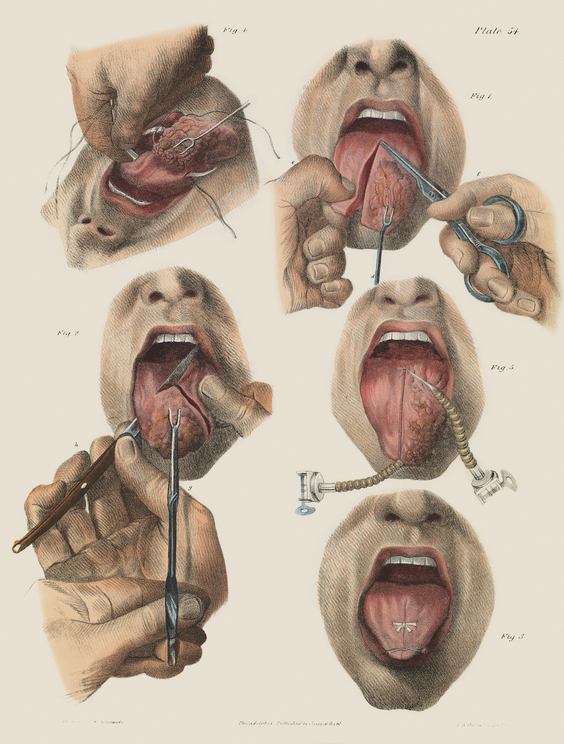
Surgery.
The earliest treatment for cancers- solid tumours which could be seen or felt.
Cut the cancer out- still highly effective.
Key enabling sciences:
Anaesthesia.
Antisepsis.
Pancoast, 1846. Surgery for cancer of the tongue.

Slide 22
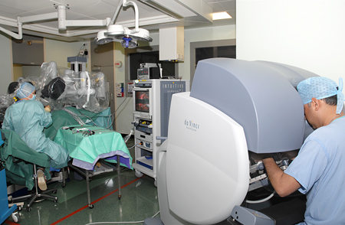
Surgery is steadily getting better.
Concentration of expertise.
Best combination of surgery, radiotherapy and chemotherapy.
Endoscopic and ‘keyhole’ methods.
Robot-assisted surgery.
Either decrease cancer recurrence, or reduce unnecessary surgical damage, or both.
CRUK: robot-assisted prostate surgery

Slide 23
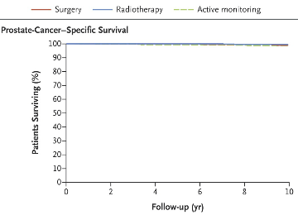
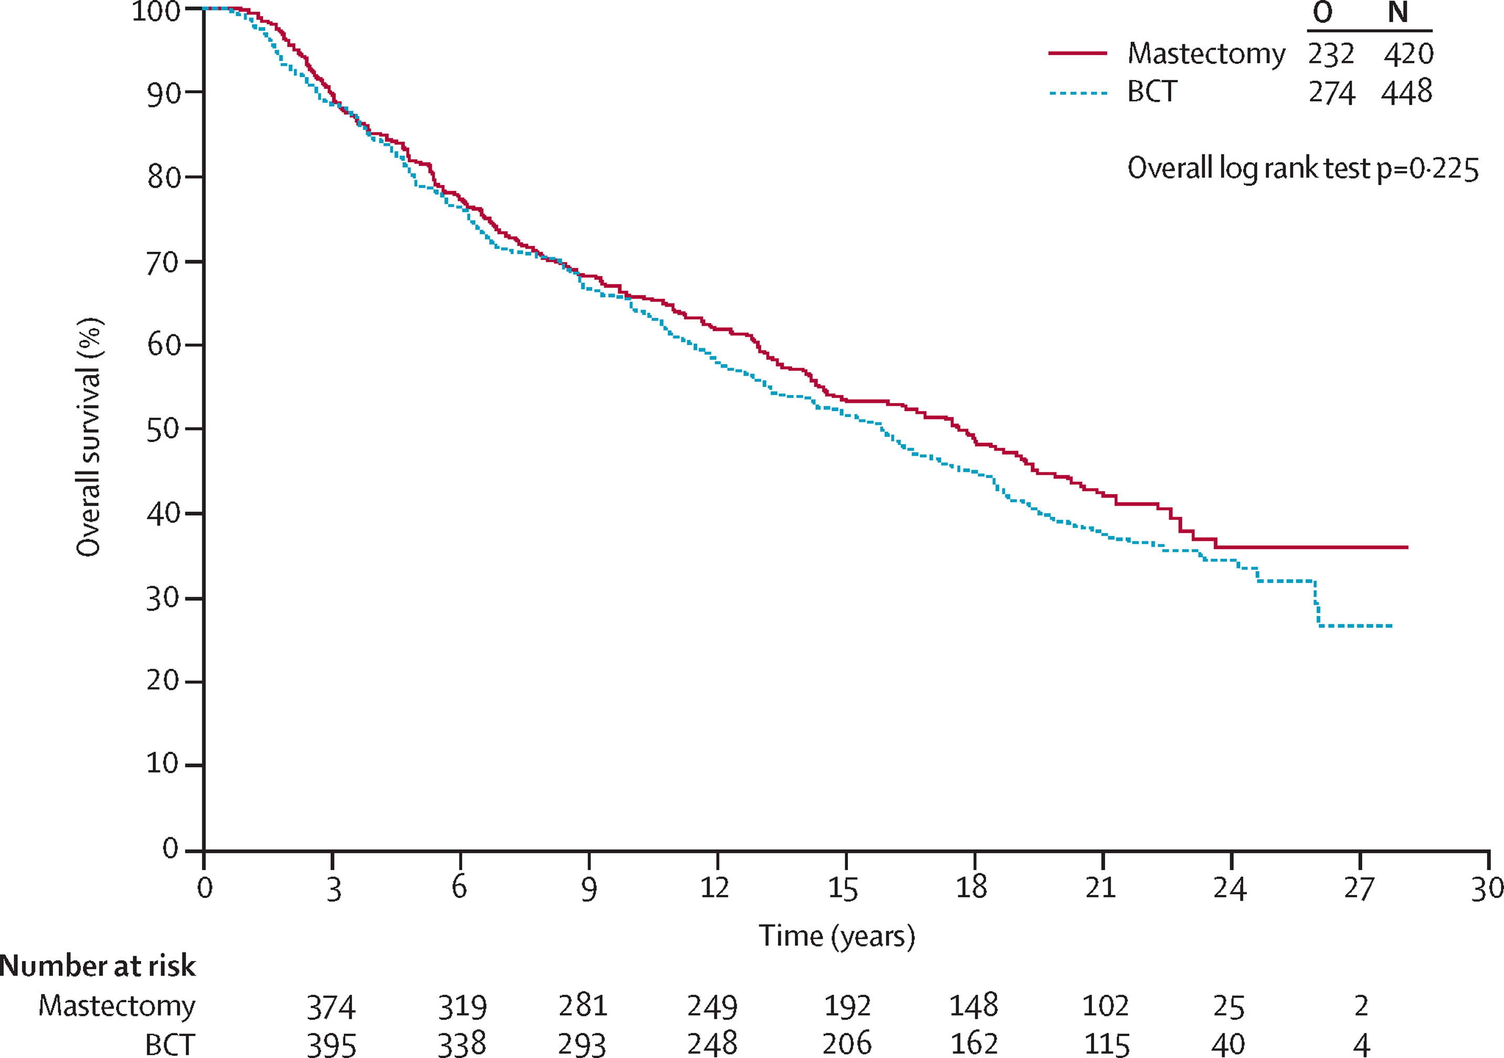
Less surgery is often as good as more.
Mastectomy v breast-conserving surgery for breast cancer over 27 years.
Litiere et al Lancet 2012.
Prostatectomy v radiotherapy v active watching, prostate cancer over 10 years. Hamdy et al NEJM 2016.

Slide 24
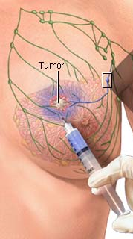
An example of apparently simple advances.
Sentinel node sampling in breast cancer, melanoma.
Radioactive tracer and dye injected into the tumour.
Nodes sampled and examined to assess need for further operation.
Recently further refined for breast: RD-100i OSNA test for cytokeratin‑19 (CK19) gene (NICE).
45 minutes so can be done during the operation.
Aboutcancer.com. ADAM.

Slide 25
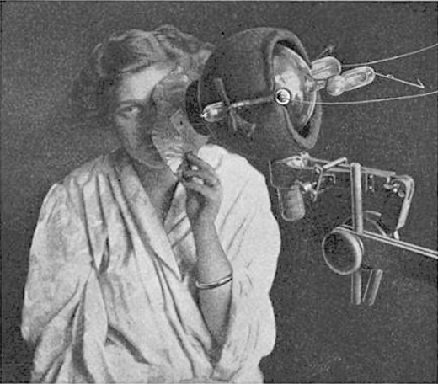
The second form of treatment developed was radiotherapy. Engineering steadily improved it.
First used in 1896. Initially a single massive dose of X-rays.
1920s fractionated (many dose) radiotherapy as effective, fewer side effects.
By 1950s much more powerful linear accelerators.
Stronger X-rays (gamma rays) penetrate further, damage skin less.
Beam became more focussed so less collateral damage.
Radiotherapy 1915

Slide 26
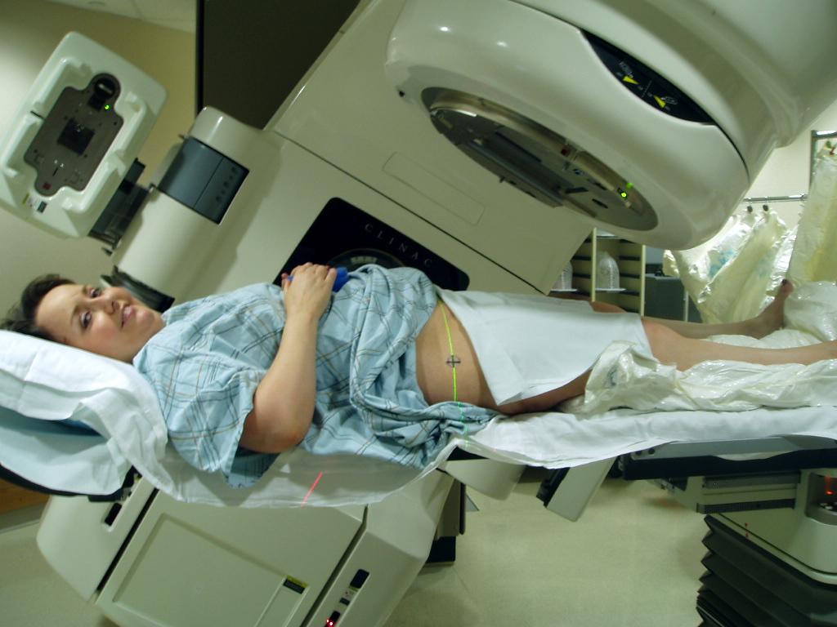
Uses of radiotherapy now.
Stand-alone cancer treatment.
To shrink cancers before surgery.
To reduce the risk of a cancer coming back after surgery.
With chemotherapy.
To control symptoms and improve quality of life.
Dina Wakulchik WikiCommons

Slide 27
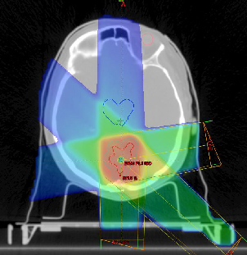
The basic principles of radiotherapy.
Radiation damages DNA (via free radicals).
Cancer cells more sensitive, less able to repair DNA.
Normal tissues less likely to die, more likely to recover.
Btbuddies.org

Slide 28
Radiosensitivity and distribution.
Radiosensitivity varies.
Bigger tumours less radiosensitive.
Lymphomas, leukaemia, germ-cell tumours very radiosensitive.
Some radioresistant: renal, melanoma.
Radiosensitizing drugs such as Cisplatin, Nimorazole, Cetuximab.
Distribution matters.
Some cancers (leukaemias for example) widely distributed.
Widespread metastases.

Slide 29
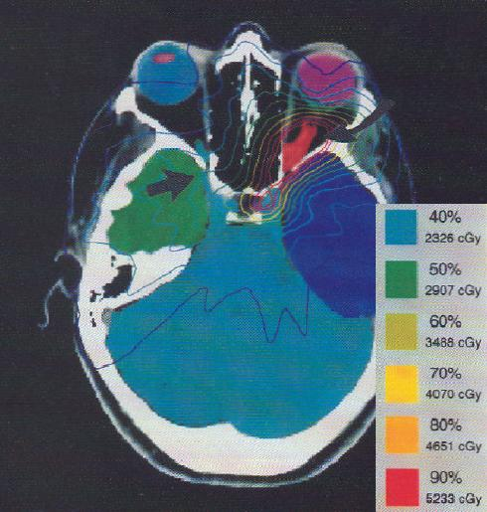
Radiation treatment planning.
Now largely done by computer.
Usually based on CT scans.
Aims to get the optimal dose to the affected area, minimise it elsewhere.

Slide 30
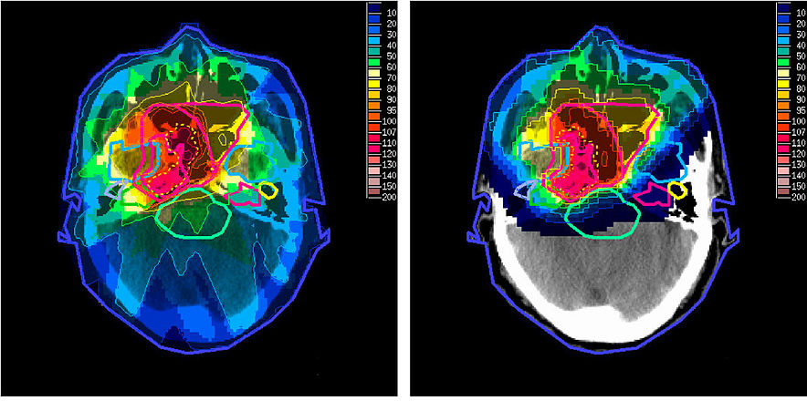
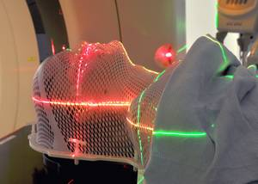
Steadily increasing accuracy.
Some technologies relatively simple, like moulds (masks) to ensure exact position.
Others technologically advanced such as:
Proton beam therapy (R)
Intensity modulated radiotherapy (L)
Volumetric modulated arc radiotherapy (VMAT)
Stereotactic body ablative radiotherapy (SABR)
Taheri-Kadkhoda WikimediaCommons, Poole NHS

Slide 31
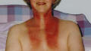
How about the side effects?
May be limited to temporary fatigue and local skin redness.
Usually predictable and limited to the area being treated.
So for example:
-nausea rare except for abdominal, brain or middle ear.
-dry mouth problematic in head and neck cancer.
-infertility after treatment for pelvic cancers.
PWT, cancer diary 14 days after radiotherapy.

Slide 32
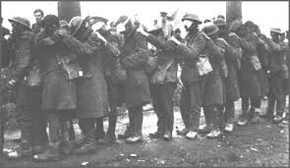

Chemotherapy- from many routes.
Nitrogen mustards from mustard gas (1940s). Cyclophosphamide, chlorambucil.
Antifolates, after discovery of folate in pregnancy in India 1930s. Methotrexate.
Alkaloids looking for anti-diabetic drugs. Vincristine, vinblastine. From plants.
Cisplatin. An accident of the effects of electrical fields in bacteria.
Madagascar periwinkle

Slide 33
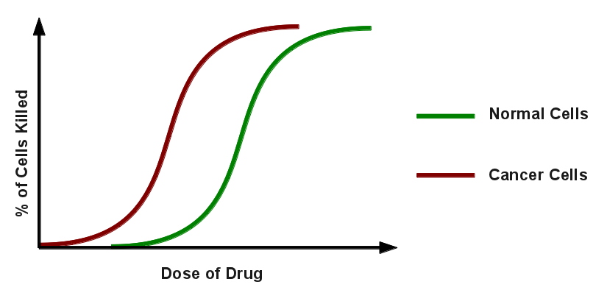
Cytotoxic chemotherapy mechanisms.
The basic mechanisms of chemotherapy simple.
Kill any cell that is dividing- cancer cells more sensitive and slower to recover.
Good effect depends on the cancer. Rapidly dividing = more effective.

Slide 34
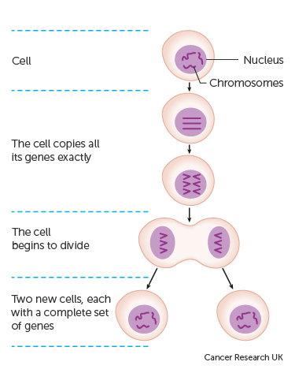
Many mechanisms of chemotherapy.
Alkylating agents like cyclophosphamide damage DNA.
Antimetabolites like methotrexate interfere with synthesis of DNA, RNA.
Antitumour antibiotics like doxorubicin attack enzymes which assist in DNA replication.
Mitotic inhibitors like vinblastine stop cancer cells making copies of themselves eg via microtubule system.

Slide 35
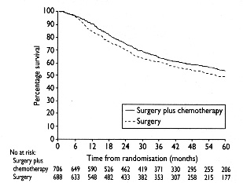
Combinations.
Different chemotherapy agents used in combination.
To get the best balance between effect and toxicity.
Reduce impact of resistance.
Chemo in combination with surgery and radiotherapy.
Stewart L et al 1995 BMJ. Lung cancer meta-analysis.

Slide 36
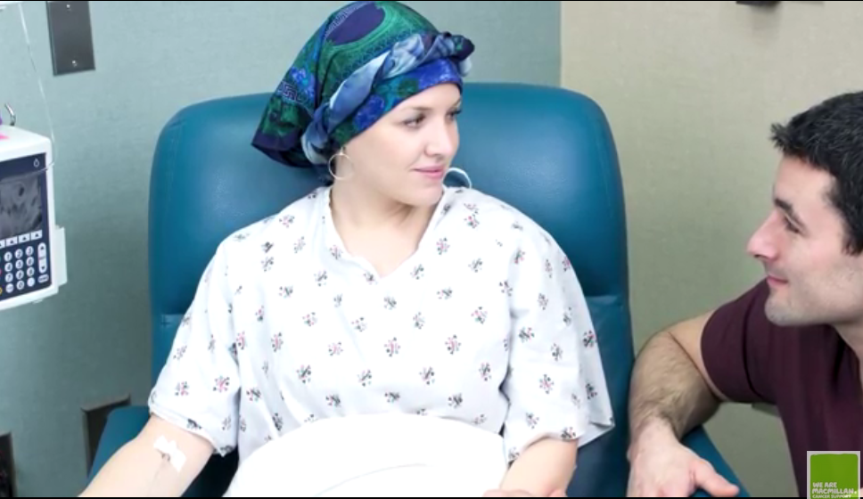
Side effects.
Biggest impact on cells that are rapidly dividing: gut, hair follicles, mouth, skin, bone marrow.
Nausea, vomiting swallowing.
Hair loss.
Immune system.
Macmillan Cancer Support

Slide 37
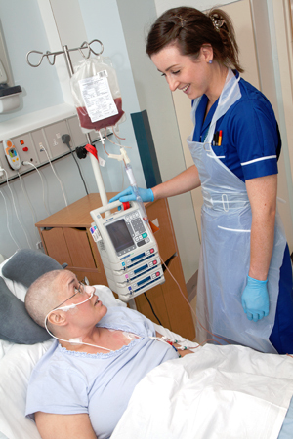
Stem cell and bone marrow transplants.
Some leukaemias, lymphomas and myeloma will be widespread in bone marrow.
Therefore need total body irradiation or chemotherapy.
This will kill cancer but also healthy bone marrow cells.
Need stem cells or bone marrow transplant.
CRUK

Slide 38
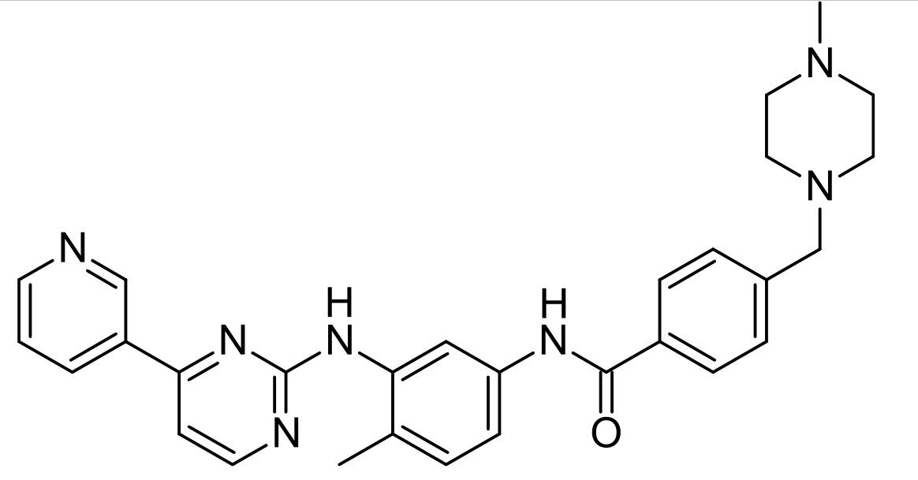
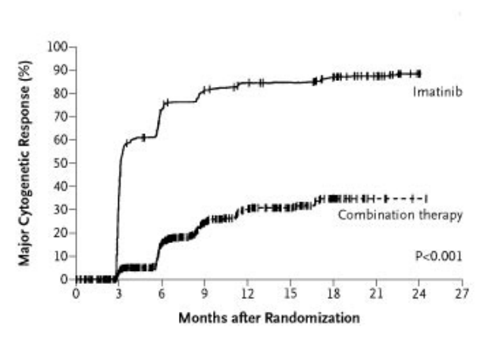
Targeted treatments: small molecules.
Small molecules target processes in the cancer cell.
A leading example is the tyrosine-kinase inhibitor imatinib (Gleevec).
Philadelphia-chromosome positive CML leukaemia.
Inhibits (blocks) bcr-abl protein.
Overall survival now 85%.
May require lifelong treatment.
Cost has been a major issue.
O’Brien S et al 2003 NEJM

Slide 39
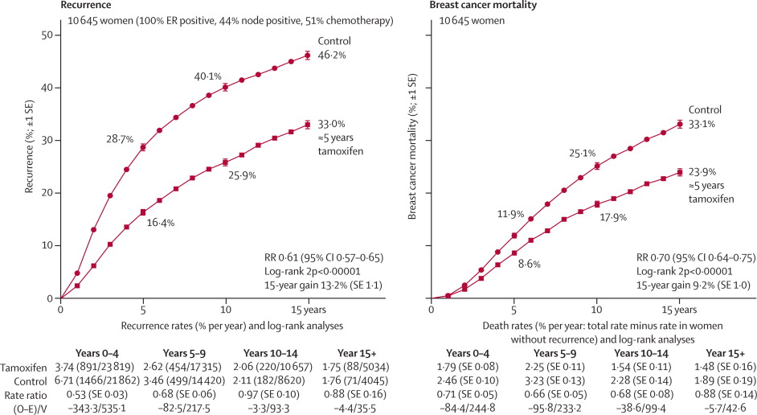
Hormonal treatments in breast, prostate, ovarian cancer.
Tamoxifen: anti-oestrogen developed as an (unsuccessful) morning after contraceptive.
5 years tamoxifen reduces recurrence and mortality in oestrogen receptor + (ER+) women.
10 years better than 5 (15 probably no better than 10).
Aromatase inhibitors better still (reduce by around 30%) in postmenopausal women.
Tamoxifen 5 years recurrence
EBCTCG, Lancet

Slide 40
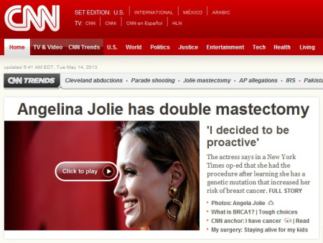

Genetic targeting.
Some very high-risk individuals for prophylactic treatment, eg BRCA1.
Already some genetic markers guide treatment.
Genetic makeup of cancers is likely to be increasingly important in personalised medicine.
100,000 Genomes Project an example of new science.

Slide 41



‘Breakthrough’ an easy headline but seldom realistic science.

Slide 42

Immunotherapy
The immune system fights infection- it also attacks cancerous cells.
By definition, cancer is in cells which have evaded this.
If the immune system can be allowed, or trained, to identify cancer cells it will kill them.
Antibodies have many uses.
The most rapidly growing field in cancer treatment.

Slide 43

Antibody treatment to block receptors- already used.
HER2+ (human epidermal growth factor receptor 2). Overexpressed in 20-30% of breast cancers.
HER2 promotes cell growth.
Trastuzumab (Herceptin) monoclonal antibody blocks the receptor.
Trastuzumab reduces progression and improves survival in HER2+ breast cancer and some other cancers.
Resistance a problem.
Pharmacodia

Slide 44

Antibodies to deliver radiotherapy or chemotherapy.
Still relatively speculative.
Antibodies which recognise and lock onto cancer cell receptors.
Carry drugs or radiotherapy.
CRUK

Slide 45

Immune-checkpoint blockade.
Immune checkpoints protect healthy cells- and cancer cells.
Blocking them takes the brakes off.
Encouraging results for PD-1 monoclonal antibody to T cell receptors.
Can have substantial effects in some cases and severe side effects in others.
Might allow cancer vaccines to work?
Pembrolizumab in melanoma. BBC

Slide 46

New drugs- cost.
Many new drugs currently target cancer as rescue therapy.
Often extend life by months.
Most are very expensive.
For an individual and their family these months are often priceless.
System-wide it will pose serious problems in health systems with fixed budgets like the NHS.
Howard et al. J. Econ. Persp. 2015, adapted by Fortune. US data.

Slide 47

Early diagnosis.
Much more important than new drugs which prolong life by a few months is early diagnosis.
With early diagnosis chances of a quick, relatively simple cure massively increased.
Addressing barriers to diagnosis essential.

Slide 48

Screening: risk v benefit. Example breast.
Benefit of breast screening catching early cancers.
Risks: overdiagnosis, over-treatment.
False negative.
The worry of procedure.
In current breast cancer screening benefits thought greater than risks in those aged over 47 (NICE).
In England breast cancer detected in 7.9 per 1000 women screened.
Exact numbers not easy.
National Cancer Institute.

Slide 49

Screening: example prostate.
Current prostate cancer screening is with PSA blood test.
Systematic review of 341,342 men in trials found relative risk 1 (no difference).
Screening not worthwhile.
Ilic et al 2013 Cochrane

Slide 50

Palliative care.
Most cancers are now cured or put into long term remission.
Even these may have significant symptoms.
Some cancers are incurable, all can have good palliative care.
Minimising symptoms, maximising quality of life and dignity.
Milwaukee VA Palliative Care Program

Slide 51

How does the UK compare with the EU?
Neither the best nor (despite headlines) the worst.
Depends by cancer type, and comparisons difficult.
Debates tend to be around availability of latest drugs.
The real prize is early diagnosis.
Gatta et al, Lancet Oncology 2014. Childhood cancers 2007.

Slide 52


The remarkable improvements over the last 3 decades made up of multiple small steps.
Breast cancer an example:
Better diagnosis.
Screening.
Surgical advances.
Better radiotherapy.
Chemotherapy advances.
Hormonal treatment.
Antibody treatment.
10 year survival for breast cancer.

Slide 53

Treatments for most cancers more effective and less harmful than popularly imagined.
Have steadily improved over last 40 years.
Will steadily improve in the next 40 years.
Many cancers will become largely curable or chronic diseases like diabetes.
Cancer treatment will never be easy.
Prevention is way better than cure.
Changes in 10 year survival 1971-2011

