Slide 1



Shaping Modern Mathematics:
Modelling the World
Raymond Flood
Gresham Professor of Geometry
This lecture will soon be available on the Gresham College website,
where it will join our online archive of almost 1,500 lectures.
www.gresham.ac.uk

Slide 2
OVERVIEW
Applied mathematics or mathematical physics or mixt or mixed mathematics
Joseph Fourier
George Stokes
William Thompson (later Lord Kelvin)
Peter Guthrie Tait
James Clerk Maxwell
Two case studies
  Thomson on tide prediction
  Maxwell’s work on electricity and magnetism

Slide 3
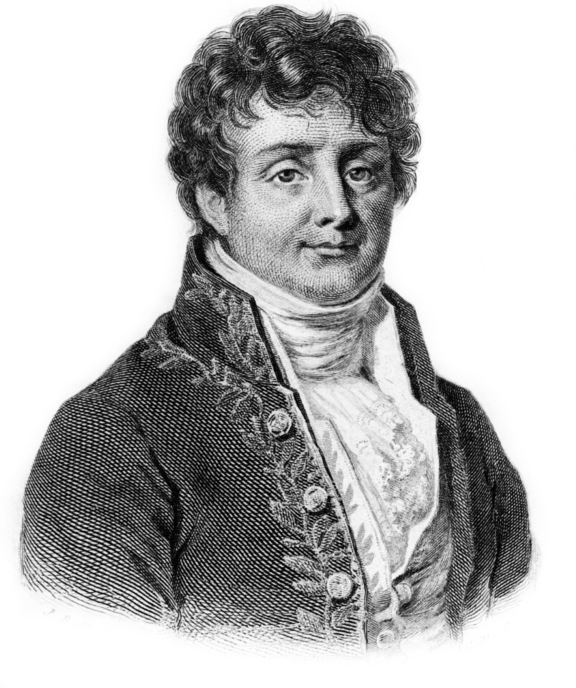
Joseph Fourier (1768–1830)

Slide 4
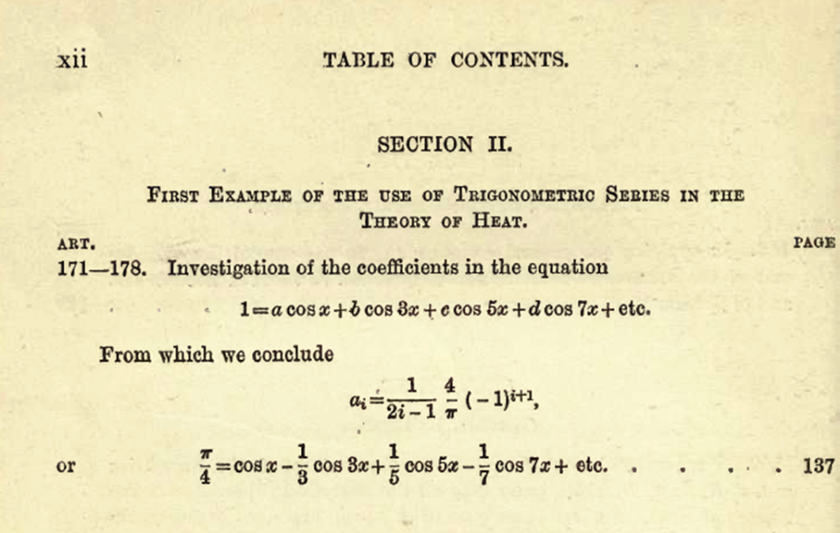

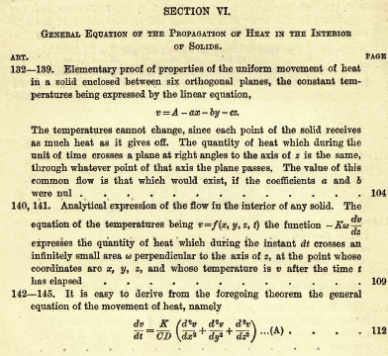

Slide 5
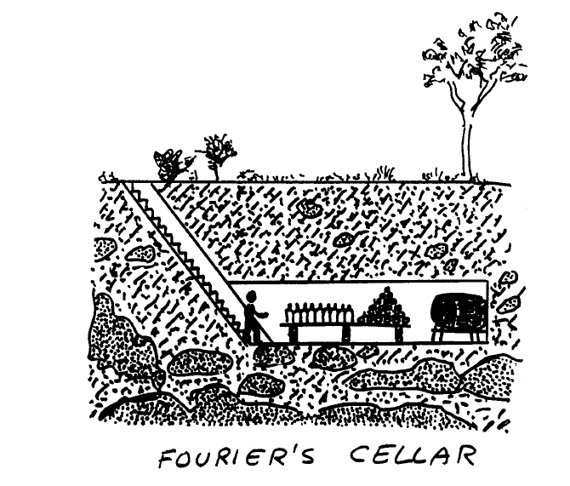
One dimensional partial differential equation of heat diffusion
u(x , t) is the temperature at depth x at time t.
The left hand side is the change of temperature over time at depth x.
The right hand side is the flow of heat into the point at depth x.
K is a constant depending on the soil.
Drawing by Enrico Bomberieri

Slide 6
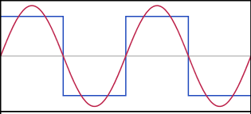
Approximating a square waveform by a Fourier series
cos u

Slide 7
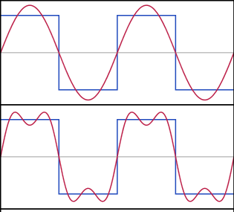

Approximating a square waveform by a Fourier series

Slide 8
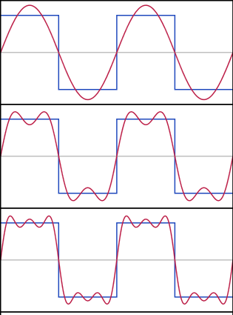

Approximating a square waveform by a Fourier series

Slide 9
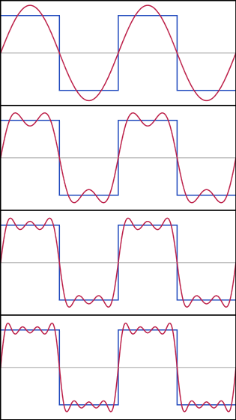
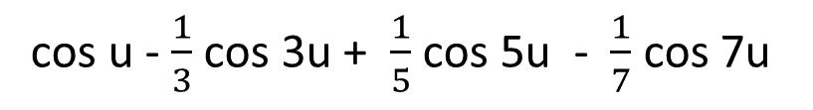
Approximating a square waveform by a Fourier series

Slide 10
One dimensional partial differential equation of heat diffusion
Linearity
If u₁ and u₂ are solutions then so is α u₁ + β u₂ for any constants α and β.
He then represented the temperature distribution as a Fourier series
The temperature variation at the surface can also be written as a Fourier series.
Drawing by Enrico Bomberieri

Slide 11
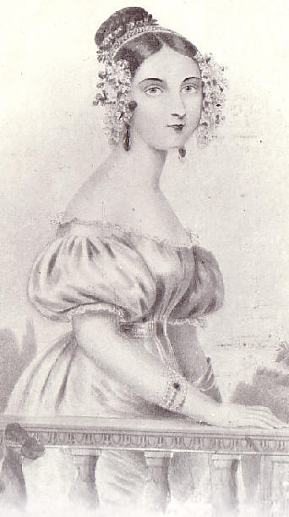
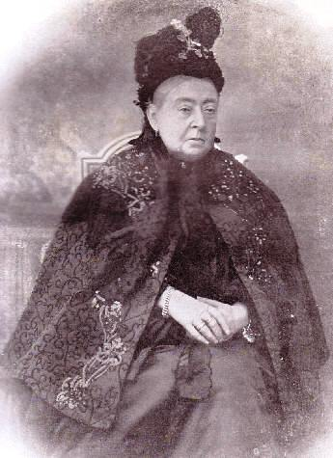
Queen Victoria
Queen Victoria in 1837
- the start of her reign
Queen Victoria in 1901
- the end of her reign

Slide 12
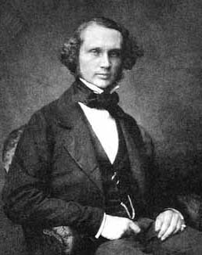
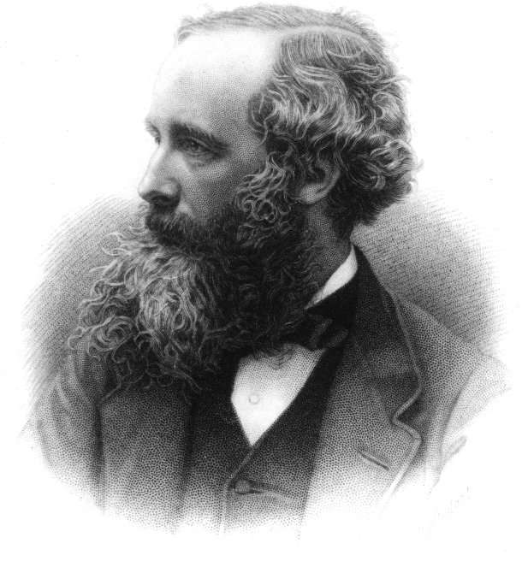
George Gabriel Stokes
(1819–1903)
William Thomson
Lord Kelvin
(1824–1907)
James Clerk Maxwell
(1831–1879)
Peter Guthrie Tait
(1831–1901)

Slide 13
Navier–Stokes Equation
A Clay Millennium Prize problem
Waves follow our boat as we meander across the lake, and turbulent air currents follow our flight in a modern jet. Mathematicians and physicists believe that an explanation for and the prediction of both the breeze and the turbulence can be found through an understanding of solutions to the Navier-Stokes equations. Although these equations were written down in the 19th Century, our understanding of them remains minimal. The challenge is to make substantial progress toward a mathematical theory which will unlock the secrets hidden in the Navier-Stokes equations.

Slide 14
Thomson and Tait
William Thomson, Lord Kelvin
(1824–1907)
Peter Guthrie Tait
(1831–1901)

Slide 15
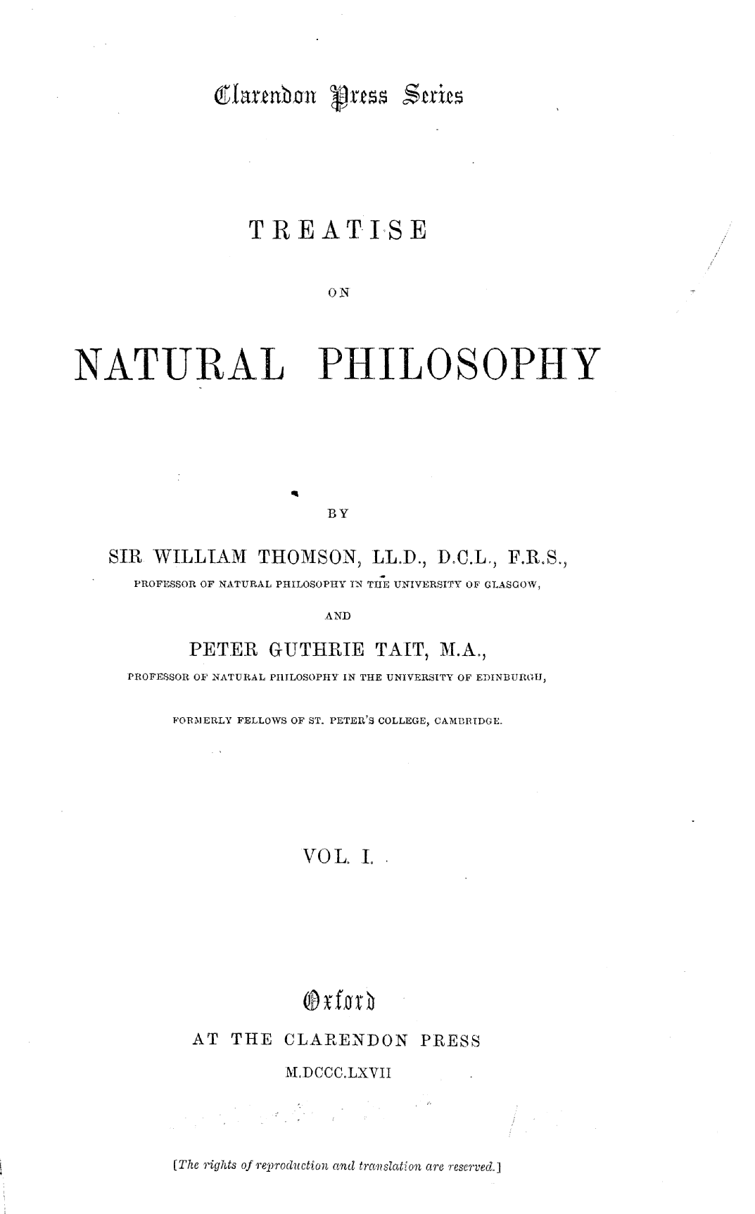
The work of “two northern wizards”

Slide 16
Tait to Thomson in June 1864
I am getting quite sick of the great Book. . . if you send only scraps and these at rare intervals, what can I do? You have not given me even a hint as to what you want done in our present chapter about statics of liquids and gases!

Slide 17
Thomson and Tait’s motivation for the Treatise of Natural Philosophy
To provide appropriate textbooks to back up their lectures.
To provide a balance between experimental demonstration and mathematical deduction.
To base their natural philosophy on the principle of conversation of energy and extremum principles.

Slide 18
James Clerk Maxwell’s comments in his review of volume 1 of the second edition in Nature, 1879 published shortly before his death.
The two northern wizards were the first who, with-out compunction or dread, uttered in their mother tongue the true and proper names of those dynamical concepts which the magicians of old were wont to invoke only by the aid of muttered symbols and inarticulate equations. And now the feeblest among us can repeat the words of power and take part in dynamical discussions which but a few years ago we should have left for our betters.

Slide 19
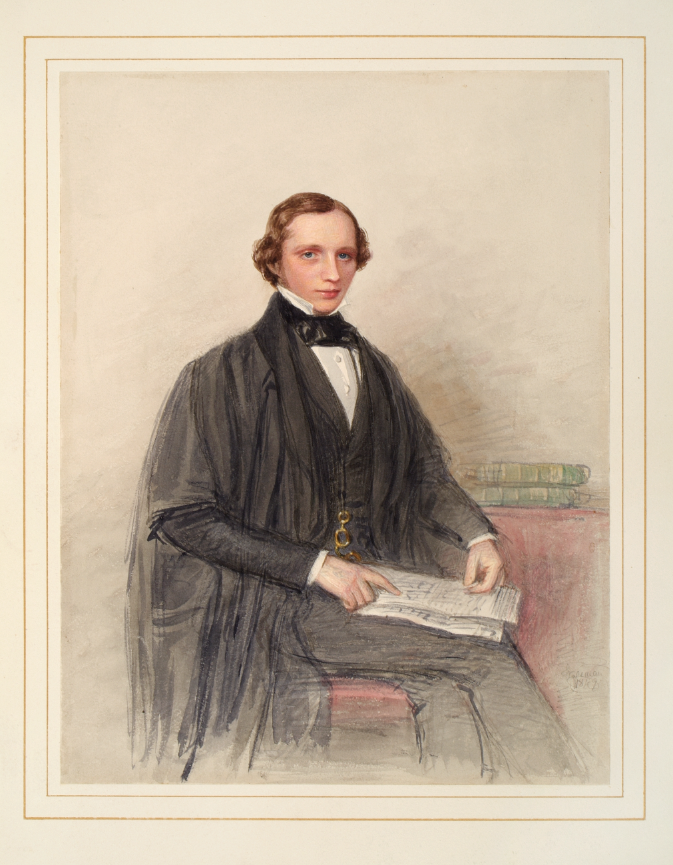
William Thomson (1824 – 1907), soon after graduating at Cambridge in 1845. He became Lord Kelvin in 1892.

Slide 20
Tide Prediction
Describing the tide
Calculating the tide theoretically
Calculating the tide practically

Slide 21
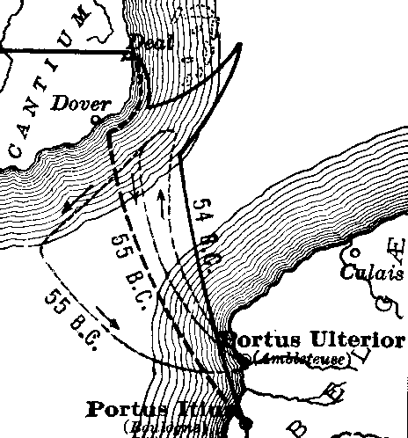
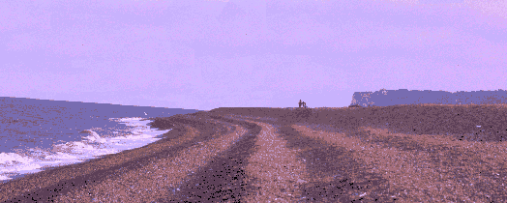
Julius Caesar’s 55BC invasion of Britain
That night happened to be the night of a full moon, when the Atlantic has the highest tides, and we did not know this. So the longships, which had been pulled up on the beach, were swamped, while the supply ships, moored to anchors, were tossed about by the storm … Many of the ships were broken up …
From Gallic War IV, 29
Map of Caesar’s crossings over the English Channel
Deal Beach in Kent where Caesar probably landed in 55BC

Slide 22
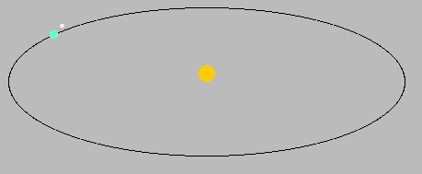
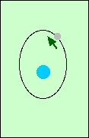
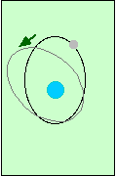
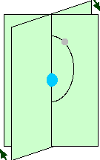
Astronomical frequencies
Length of the year
Length of the day
The rate of precession of the
axis of the moon’s orbit
The rate of precession of the
plane of the moon’s orbit
The lunar month

Slide 23
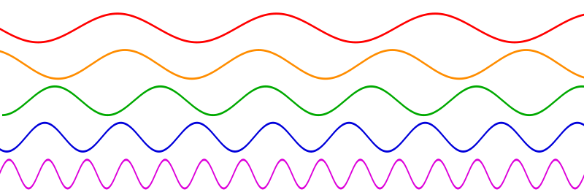
Sine waves with different frequencies

Slide 24
Height of the tide at a given place is of the form
A₀ + A₁cos(v₁t) + B₁sin(v₁t) + A₂cos(v₂t) + B₂sin(v₂t) + ... another 120 similar terms
The Frequencies v_{1,}v_{2,} etc. are all known – they are combinations of the astronomical frequencies.
We do not know the coefficients A₀ ,A₁ ,A₂ , B₁ , B₂ ,…- these numbers depend on the place.

Slide 25
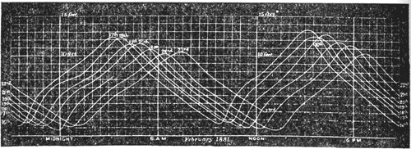
Weekly record of the tide in the River Clyde, at the entrance to the Queen’s Dock, Glasgow
How to find the coefficients A₀ ,A₁ ,A₂ , B₁ , B₂ ,…?

Slide 26
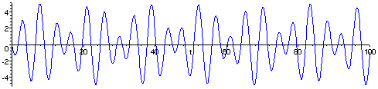
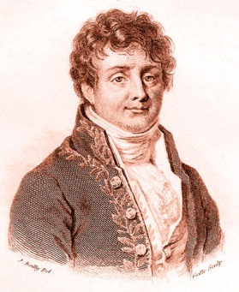
The French Connection - Fourier Analysis
Asin(t) + Bsin(2^{1/2}t)
In this curve we know that it is made up of from sin t and sin(2^{1/2}t). We do not know how much there is of each of these
two trigonometric waves i.e. we do not know the coefficients A and B
Joseph Fourier 1768 - 1830

Slide 27
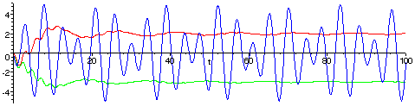
The French Connection - Fourier Analysis
Asin(t) + Bsin(2^{1/2}t)
Multiple by sin(t) to get Asin(t)sin(t) + Bsin(2^{1/2}t) sin(t) Now calculate twice the long term average which gives A because the long term average of Bsin(2^{1/2}t) sin(t) is 0.
Similarly to find B multiple by sin(2^{1/2}t) and calculate twice the long term average.
Joseph Fourier 1768 - 1830

Slide 28
The method followed in the sample problem can be extended to the complete calculation. Given the tidal record H(t) over a sufficiently long time interval
A₀ is the average value of H(t) over the interval.
A₁ is twice the average value of H(t)cos(v₁t) over the interval.
B₁ is twice the average value of H(t)sin(v₁t) over the interval.
A₂ is twice the average value of H(t)cos(v₂t) over the interval.
etc.

Slide 29
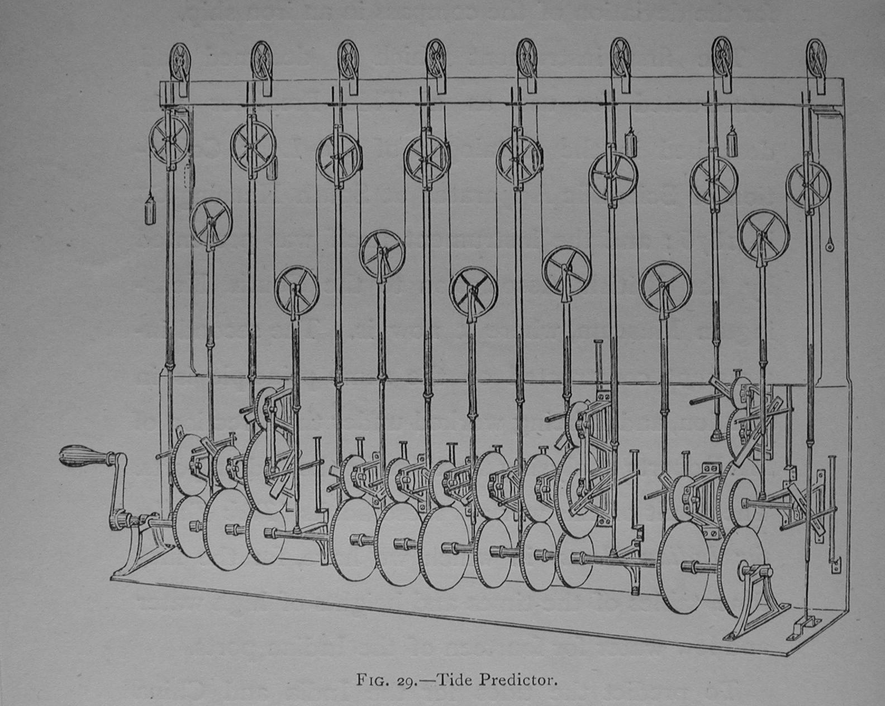
The tide predictor.
www.ams.org/featurecolumn/archive/tidesIII2.html

Slide 30
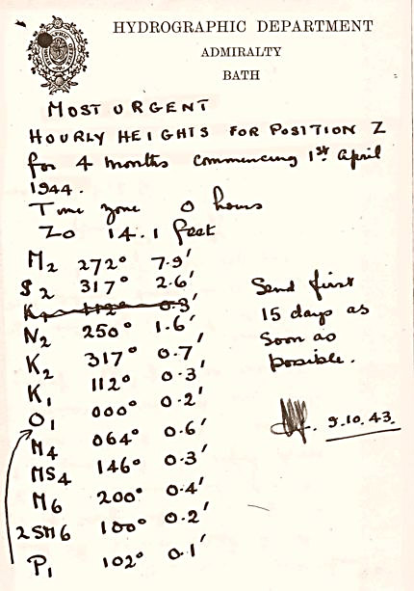
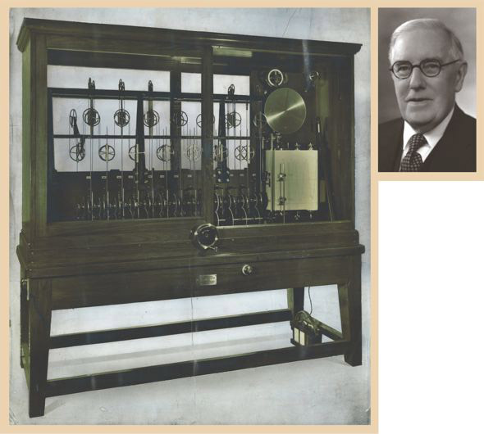
A “most urgent” October 1943 note to Arthur Doodson from William Farquharson, the Admiralty’s superintendent of tides, listing 11 pairs of tidal harmonic constants for a location, code-named “Position Z,” for which he was to prepare hourly tide predictions for April through July 1944. Doodson was not told that the predictions were for the Normandy coast, but he guessed as much.
Kelvin’s tide machine, the mechanical calculator built for William Thomson (later Lord Kelvin) in 1872 but shown here as overhauled in 1942 to handle 26 tidal constituents. It was one of the two machines used by Arthur Doodson (above) at the Liverpool Tidal Institute to predict tides for the Normandy invasion

Slide 31
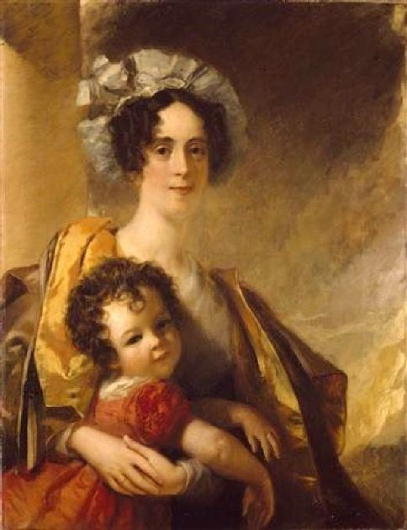
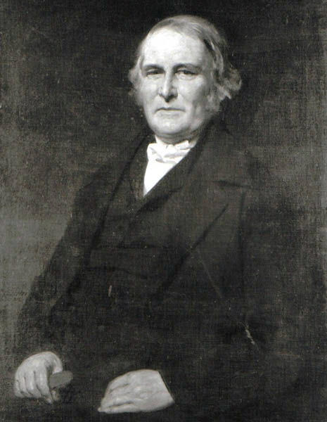
James with his mother, Frances, in about 1834
James’ father, John,
in about 1850

Slide 32
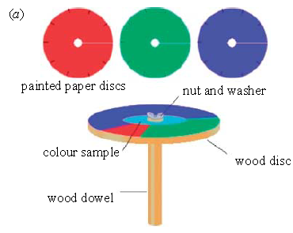
Colour Vision

Slide 33
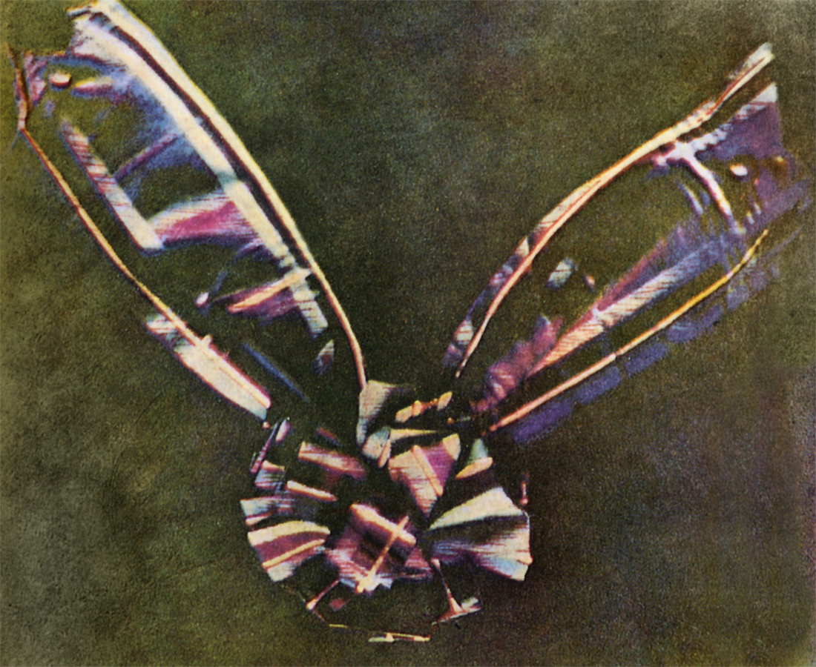
Tartan Ribbon – first colour photograph

Slide 34
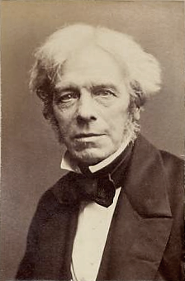
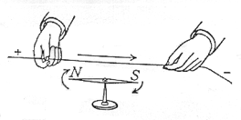
Oersted’s experiment
Electromagnetism
Michael Faraday
1791 - 1867

Slide 35
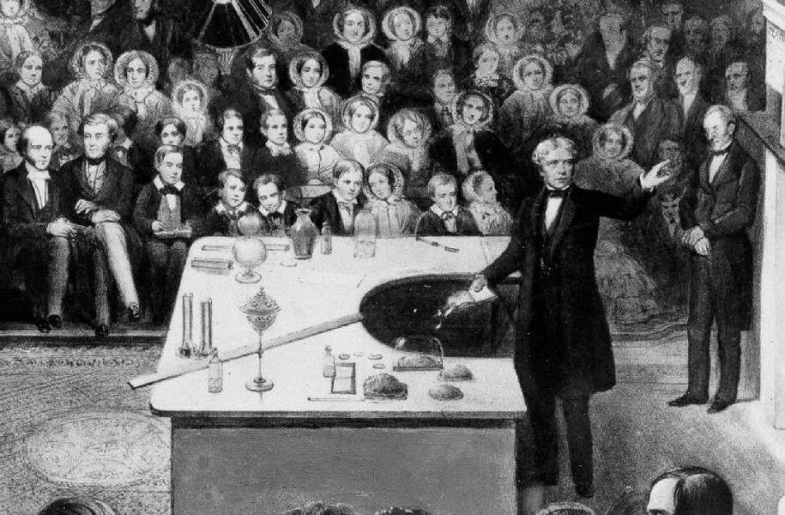
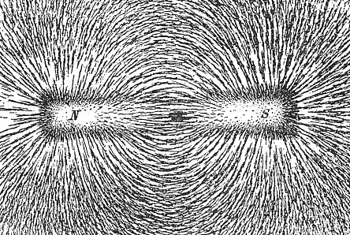
Faraday delivering a Christmas Lecture
at the Royal institution in 1856
Iron filings scattered on
paper over a magnet show
the lines of force

Slide 36
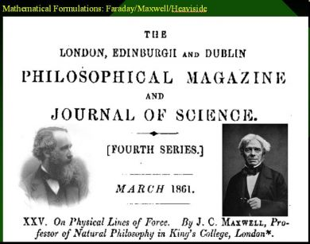
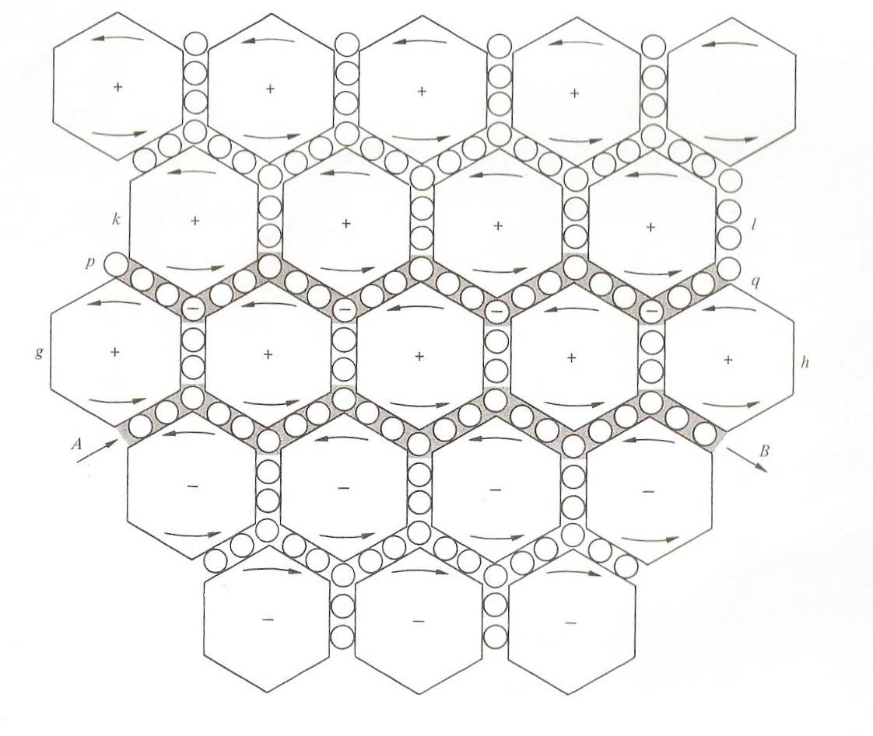
Model of molecular vortices and electric particles

Slide 37
Light
we can scarcely avoid the inference that light consists in the transverse undulations of the same medium which is the cause of electric and magnetic phenomena

Slide 38
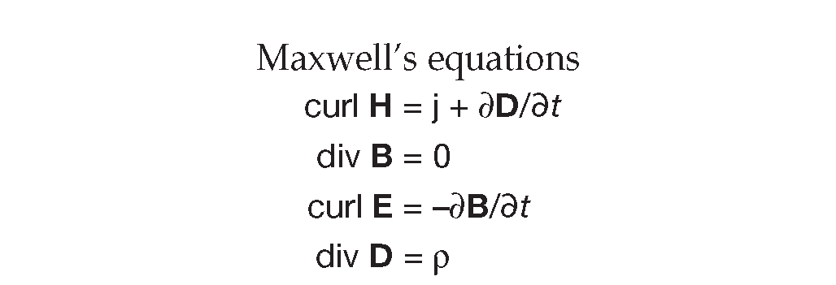
Light
we can scarcely avoid the inference that light consists in the transverse undulations of the same medium which is the cause of electric and magnetic phenomena

Slide 39
Einstein on Maxwell
Since Maxwell’s time, physical reality has been thought of as represented by continuous fields, and not capable of any mechanical interpretation. This change in the conception of reality is the most profound and the most fruitful that physics has experienced since the time of Newton

Slide 40
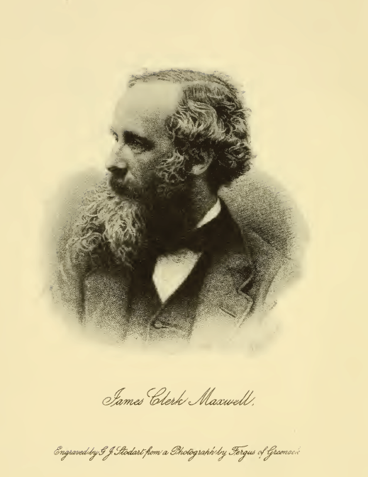
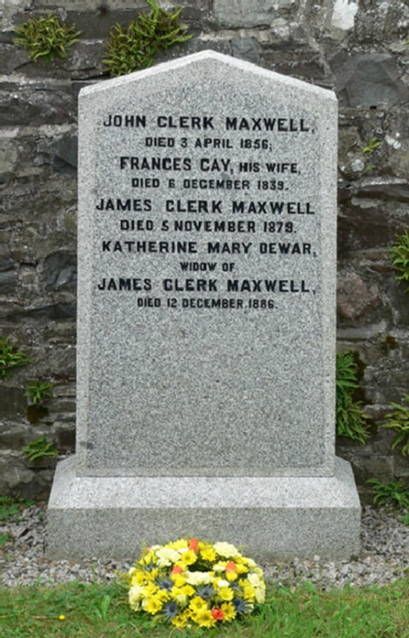
James Clerk Maxwell
1831 - 1879
James Clerk Maxwell buried with his parents and wife in Parton Churchyard near Glenlair

Slide 41
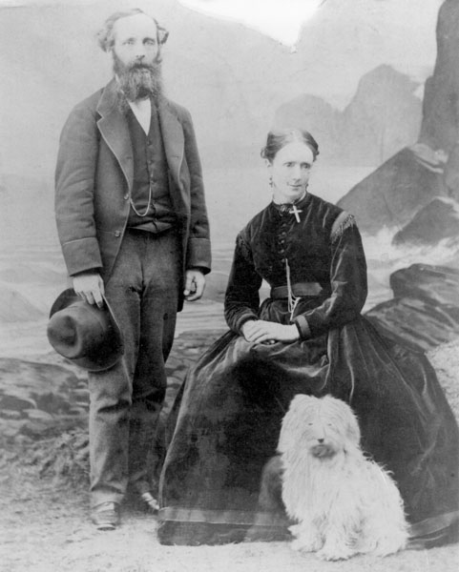
Maxwell, Katherine and Toby in 1869

