Slide 1

Globalisation and inequality
Year 2, Lecture 1
Douglas McWilliams
Mercers School Memorial Professor of Commerce
Gresham College
Centre for economics and business research ltd
Unit 1, 4 Bath Street, London EC1V 9DX
t: 020 7324 2850 f: 020 7324 2855 e: advice@cebr.com w: www.cebr.com

Slide 2
Objective
To disentangle the relationship between globalisation and inequality;
To understand the forces driving changes in inequality
To consider the impact of globalisation on world poverty

Slide 3
Overview
The background to the debate
Inequality within countries
Inequality between countries
The process of economic development
Technology v globalisation
The role of industrial organisation
Football – the example of soccer salaries
What has happened to poverty
Conclusions

Slide 4
Implications of global shift
Intense international trade competition – the new economies are not just competitive but ‘supercompetitive’ because they have an entirely new cost basis
Rising real prices of natural resources – food, energy, fuel, materials
Slower growth in the Western world and faster growth in the emerging economies
Lower interest rates as a result of savings glut (see currencies and interest rate section later)
More volatile international economy

Slide 11
OECD data on trends in income inequality

Slide 12
Possible causes of the recent trend towards increasing inequality
OECD Topics
Globalisation (but which aspect?)
Skill biased technical change (SBTC)
Labour market changes
Product market and regulatory changes
Household specific issues – eg increasing single parent households
Others
Changed relationship between owners and managers
Emergence of a ‘winner takes all’ star system

Slide 13
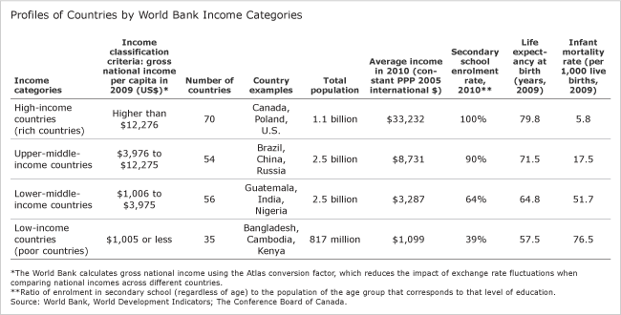
Definitions of different income groups for countries

Slide 14
What has happened to income inequality between countries?
Source: World Bank

Slide 15
Source: James H Chan-Lee and Helen Sutch Profits and Rates of Return OECD

Slide 16
Time series of profits share – UK 1920 to 1980
Source: James H Chan-Lee and Helen Sutch Profits and Rates of Return OECD

Slide 17
Source: US Department of Commerce Bureau of Economic Analysis

Slide 18
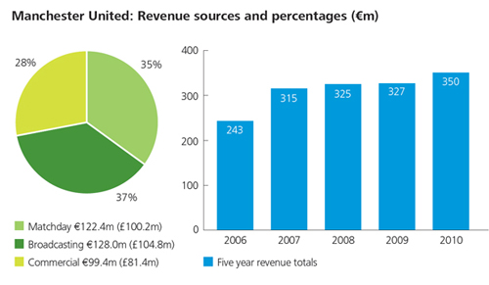
Manchester United revenues 2006-10

Slide 19
How Manchester United’s revenues have changed

Slide 20
How Manchester United’s revenues have changed in 2010 £

Slide 21
How Premier League footballers’ weekly salaries have changed

Slide 22
In 1971 a top footballer was paid just over 4 times what a player in the lower leagues earned (who earned less than average earnings!)

Slide 23
In 2012 an average Premier League footballer earns nearly 50 times what a player in the lower leagues gets

Slide 24
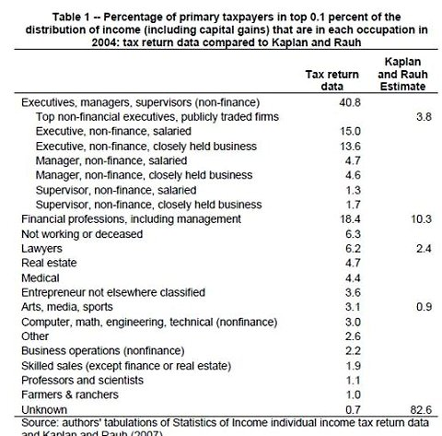

Slide 25
According to Brookings, the millennium anti-poverty goal may already have been achieved
Source: ‘Poverty in Numbers: The Changing State of Global Poverty from 2005 to 2015’
Laurence Chandy and Geoffrey Gertz, The Brookings Institution, January 2011

Slide 26
According to Brookings, by 2015 the number of poor will have fallen from 1.4 billion people in 2005 to fewer than 600 million
Source: ‘Poverty in Numbers: The Changing State of Global Poverty from 2005 to 2015’
Laurence Chandy and Geoffrey Gertz, The Brookings Institution, January 2011

Slide 27
Conclusions
In recent years, income inequality in most countries has risen
But the effects of this have been offset by a fall in income inequality between countries
Globalisation is one of the causes but others include information technology and the impact of shareholders trying to incentivise better performance from managers
In the early 1970s, top footballers earned 4 times the earnings of lower league footballers while stars earned twice the top league average, today top footballers earn 50 times the earnings from lower leagues while stars earn 10 times the top league average. This has been driven by TV technology and globalisation
But while all this has been going on at the top end, poverty has been reduced dramatically. The number of people in poverty by 2015 is set to be down by three quarters from the number in 1990.
The main cause of the fall in poverty has been globalisation and economic growth, not aid

Slide 28
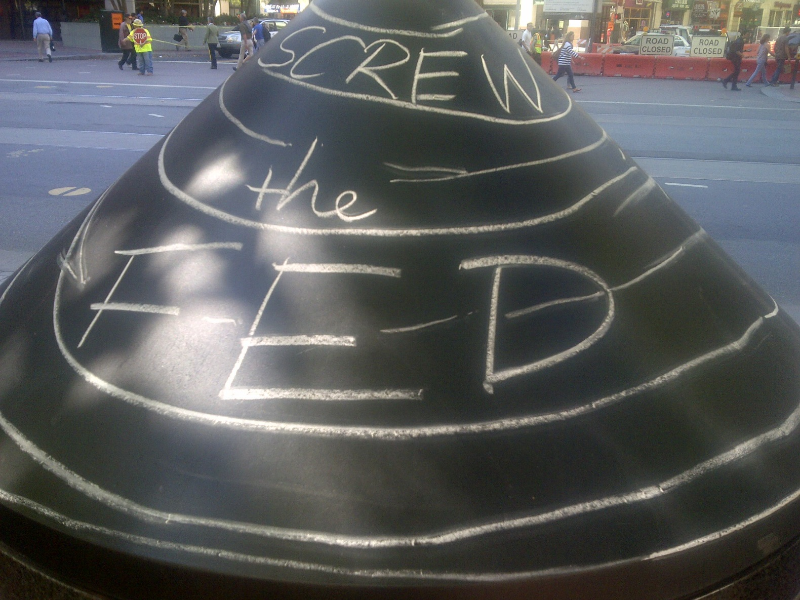
The sophisticated economic policy of the San Francisco Occupy movement

Slide 29
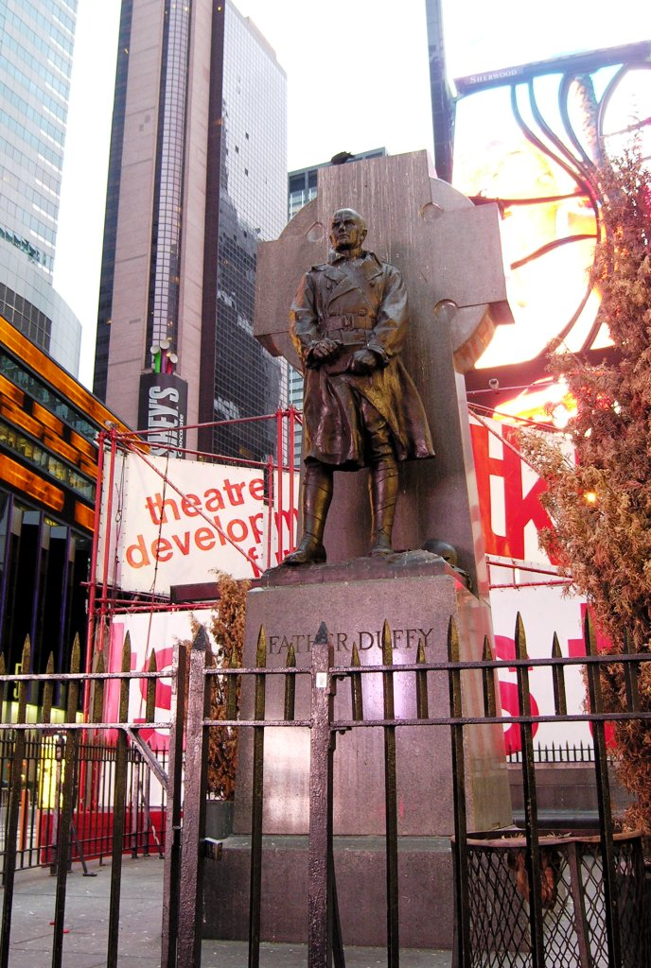

Slide 30
Globalisation and inequality
Douglas McWilliams, Mercers’ School Memorial Professor of Commerce at Gresham College and Chief Executive of Cebr

