Slide 1
The Novel and Morality:
Samuel Johnson’s Rasselas
By
Professor Belinda Jack
Gresham Professor of Rhetoric

Slide 2
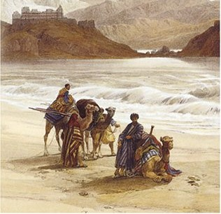

Slide 3
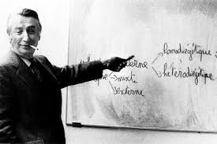

Slide 4
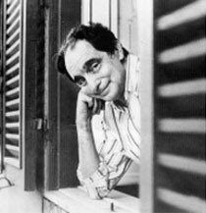

Slide 5
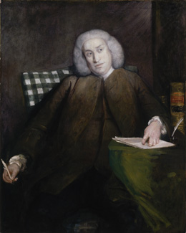
Sir Joshua Reynolds, c.1856

Slide 6
Hides from himself his state, and shuns to know,
That life protracted is protracted woe

Slide 7


Slide 8
Ye who listen with credulity to the whispers of fancy, and persue with eagerness the phantoms of hope; who expect that age will perform the phantoms of hope; who expect that age will perform the promises of youth, and that the deficiencies of the present day will be supplied by the morrow; attend to the history of Rasselas prince of Abissinia.

Slide 9
You Sir... are the first who has complained of misery in the happy valley... Look round and tell me which of your wants is without supply: if you want nothing, how are you unhappy?’ An insight then comes to Rasselas: ‘That I want nothing, said the prince, or that I know not what I want, is the cause of my complaint....’. And some lines later he comes to this conclusion: ‘You have given me something to desire; I shall long to see the miseries of the world, since the sight of them is necessary to happiness.

Slide 10
By the moral fitness of things, I mean the Fitness, which arises from, and is founded in the Nature and the Relation of Things; taking it for granted, that there is an essential Difference betwixt Good and Evil, or Fitness and Unfitness, arising from the Nature and the Relation of Things, antecedent to, and independent of any divine or human Determination concerning them. (Chubb, The Previous Question with Regard to Religion (1725), p.7)

Slide 11
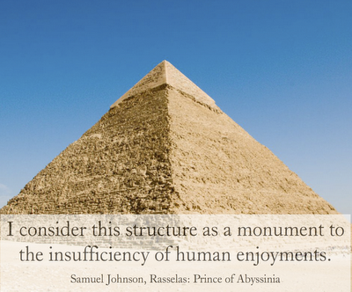

Slide 12
‘Keep this thought always prevalent, that you are only one atom of the mass of humanity, and have neither such virtue or vice, as that you should be singled out for supernatural favours or afflictions.’

Slide 13
‘[Rasselas]... went away, convinced of the emptiness of rhetorical sound, and the inefficacy of polished periods and studied sentences.’

Slide 14
‘Dear Princess’, said Rasselas, ‘you fall into the common errors of exaggeratory declamation, by producing, in a familiar disquisition, examples of national calamities.’

Slide 15
Like a cloistress she will veiled walk,
And water once a day her chamber round
With eye-offending brine, which she would keep fresh
And lasting in her sad remembrance. 1.1.27-31]

Slide 17
Future Rhetoric Lectures
The Novel as Political History: Stendahl
25 November 6pm
The Novel and Idealism:
George Sand
27 January 6pm
The Novel &Psychology: Edith Wharton
24 February 6pm
Poetry & Remembrance: Thomas Gray’s Elegy
14 April 6pm
Poetry & Immortality:
John Keats
12 May 6pm

