Slide 1
Through the Looking-Glass:
A Theory of Performance
Professor David Owen Norris
University of Southampton

Slide 2
A Note:
In the spelling of such words as Baptize, Recognise, Realize and Surprise, I follow the orthography of Dr Johnson’s Dictionary, which uses S or Z according to the word’s derivation from Latin or Old French.

Slide 3
Surprise or Satisfy

Slide 4
Don’t Disgust….
‘….our disgust, or weariness of attention, will be found in proportion to the beauties of the author so abused. And just thus it fares with an injudicious performance of a fine musical composition’.
Charles Avison 1752

Slide 5
or Disappoint
‘As it is safer to aim at pleasing than surprising, especially in the musical art, I flatter myself I shall be in less hazard of disappointing …’
Charles Avison

Slide 7
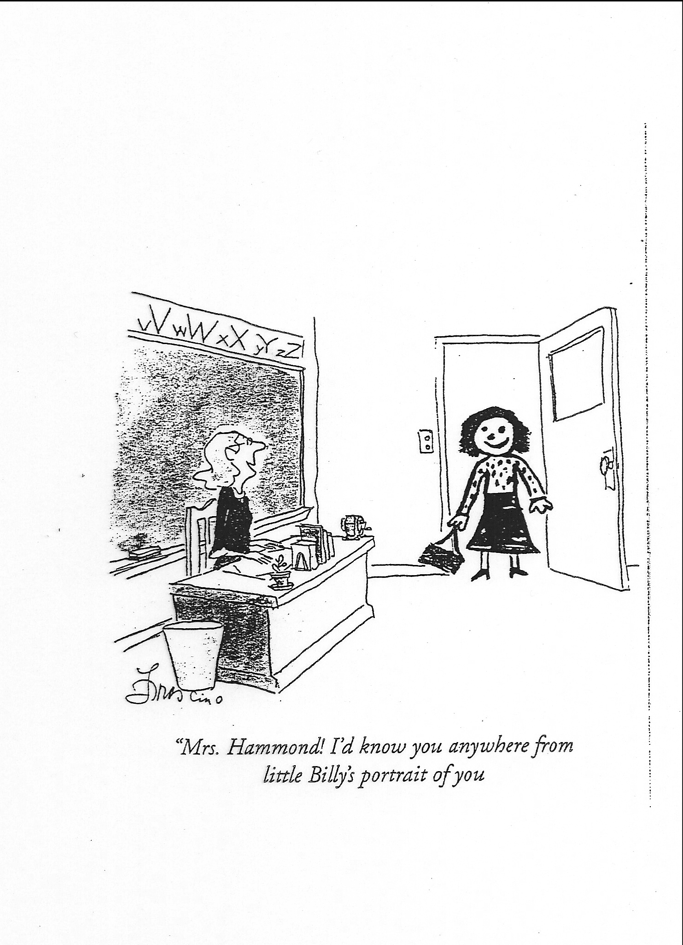

Slide 9
New Old-Music
Goblins from Four Country Pieces (1923) by Roger Quilter (1877-1953)

Slide 10
New Old-Music
Goblins from Four Country Pieces (1923) by Roger Quilter (1877-1953)
Nice to know Goblins are rural.

Slide 11
New Old-Music
Goblins from Four Country Pieces (1923) by Roger Quilter (1877-1953)
Nice to know Goblins are rural.
Roger Quilter is one of the world’s great song composers. His piano music is less well known.

Slide 12
New Old-Music
Goblins from Four Country Pieces (1923) by Roger Quilter (1877-1953)
Nice to know Goblins are rural.
Roger Quilter is one of the world’s great song composers. His piano music is less well known.
I recorded this on my own Bösendorfer piano – Quilter Complete Piano Music (EMR CD02)

Slide 13
New New-Music
‘The sound of God breathing’.

Slide 14
New New-Music
‘The sound of God breathing’.
The opening of an oratorio entitled PrayerBook.

Slide 15
New New-Music
‘The sound of God breathing’.
The opening of an oratorio entitled PrayerBook.
I wrote it (EMR CD 0012)

Slide 16
Old New-Music
A version of Purcell’s famous song Music for a while.

Slide 17
Old New-Music
A version of Purcell’s famous song Music for a while.
I arranged this for my BBC Radio 4 Playlist strand.

Slide 18
Old New-Music
A version of Purcell’s famous song Music for a while.
I arranged this for my BBC Radio 4 Playlist strand.
I think this approach to music is neglected.

Slide 20
Musical Prisms
What it MEANT
What it MEANS
What it COULD MEAN

Slide 21
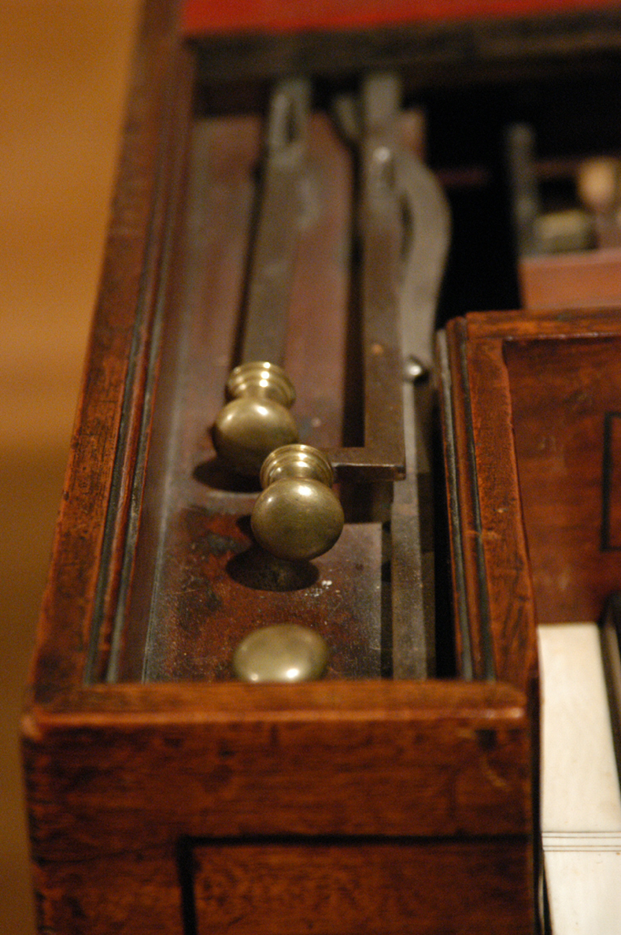

Slide 22
Performance as Jurisprudence
The slow movement of the Concerto in A by Philip Hayes (Avie CDAV0014)

Slide 23
Performance as Jurisprudence
The slow movement of the Concerto in A by Philip Hayes (Avie CDAV0014)
It is the World’s First Piano Concerto, published in London in 1769.

Slide 24
Performance as Jurisprudence
The slow movement of the Concerto in A by Philip Hayes (Avie CDAV0014)
It is the World’s First Piano Concerto, published in London in 1769.
Hayes went on to become both Professor of Music at Oxford (in succession to his father, William) and the Fattest Man in England.

Slide 25
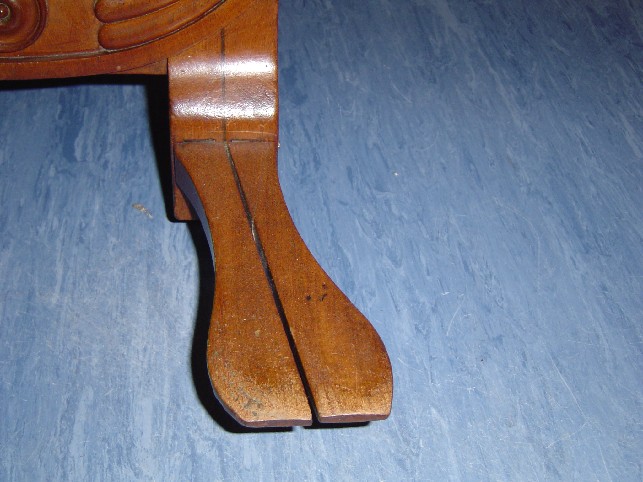

Slide 26
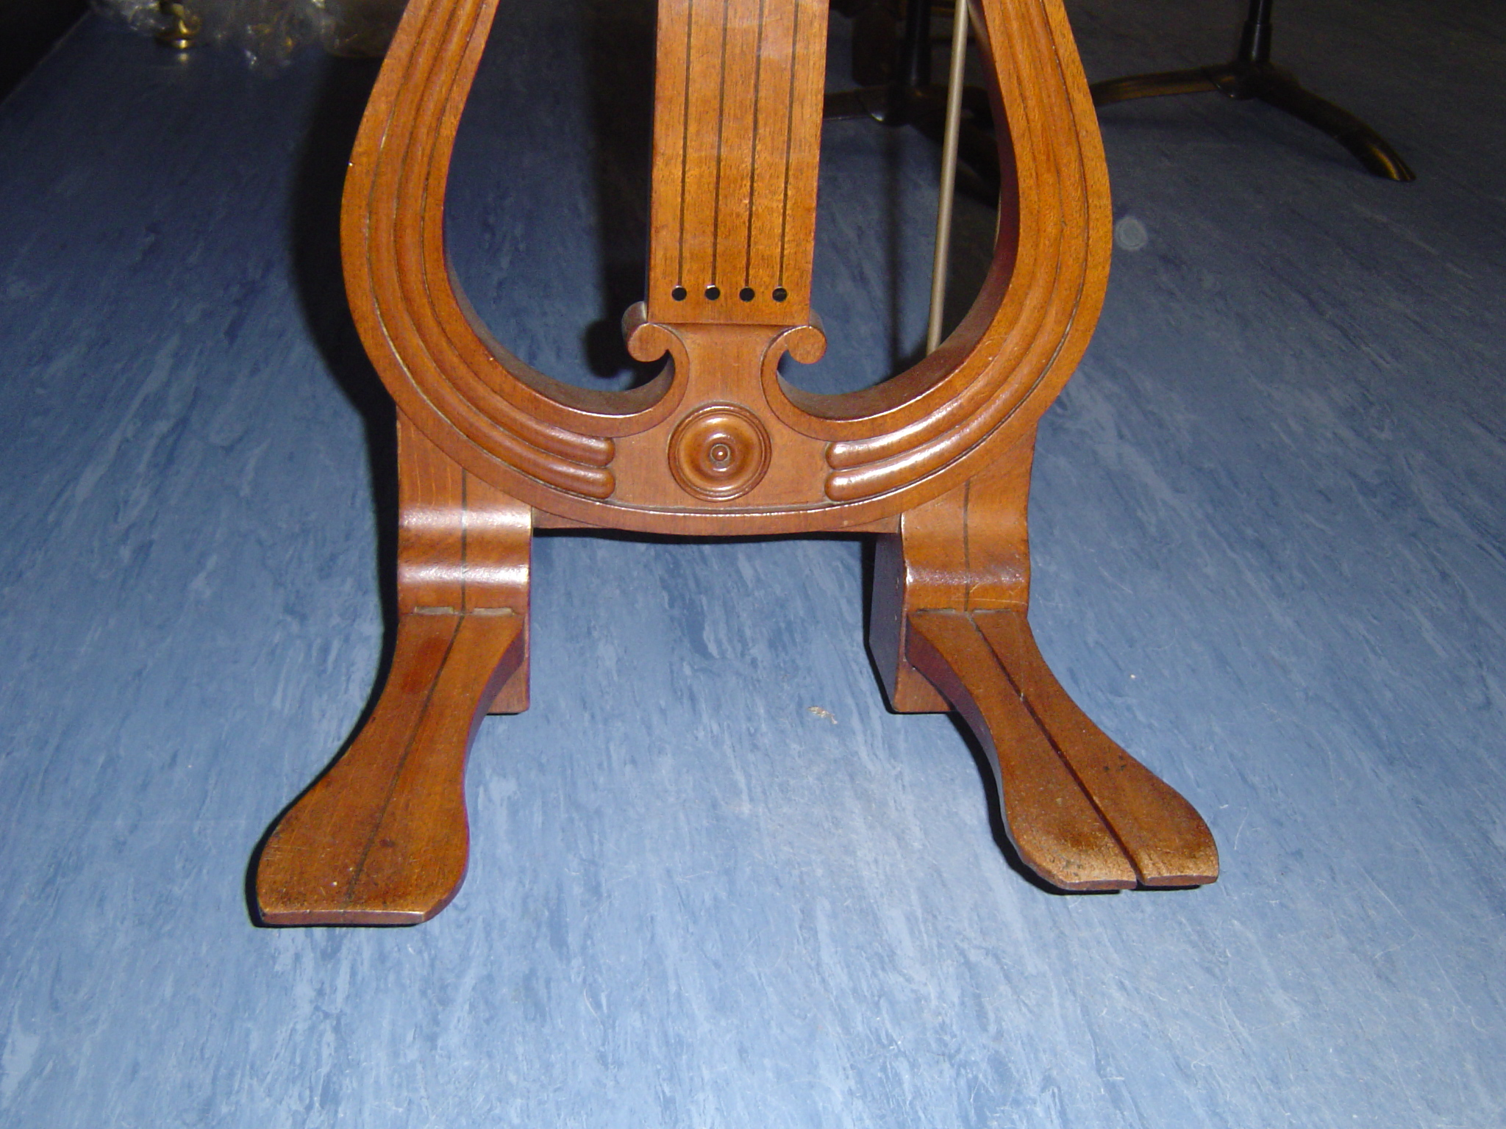

Slide 27
Performance as Research
The fourth Song without Words from Mendelssohn’s Fourth Book.

Slide 28
Performance as Research
The fourth Song without Words from Mendelssohn’s Fourth Book.
This performance demonstrates my belief that sf implies an accent, not of force, but of placing.

Slide 29
Performance as Research
The fourth Song without Words from Mendelssohn’s Fourth Book.
This performance demonstrates my belief that sf implies an accent, not of force, but of placing,
And that the abbreviations dim (get quieter) and cres (get louder) imply also a slowing-down.

Slide 30
Performance as Research
This performance demonstrates my belief that sf implies an accent, not of force, but of placing,
And that the abbreviations dim (get quieter) and cres (get louder) imply also a slowing-down,
While the ‘hairpin’ signs that technically mean the same thing imply a speeding-up.

Slide 31
I recorded it on Gustav Holst’s piano, in the Drawing-Room of his Birthplace in Cheltenham.

Slide 32
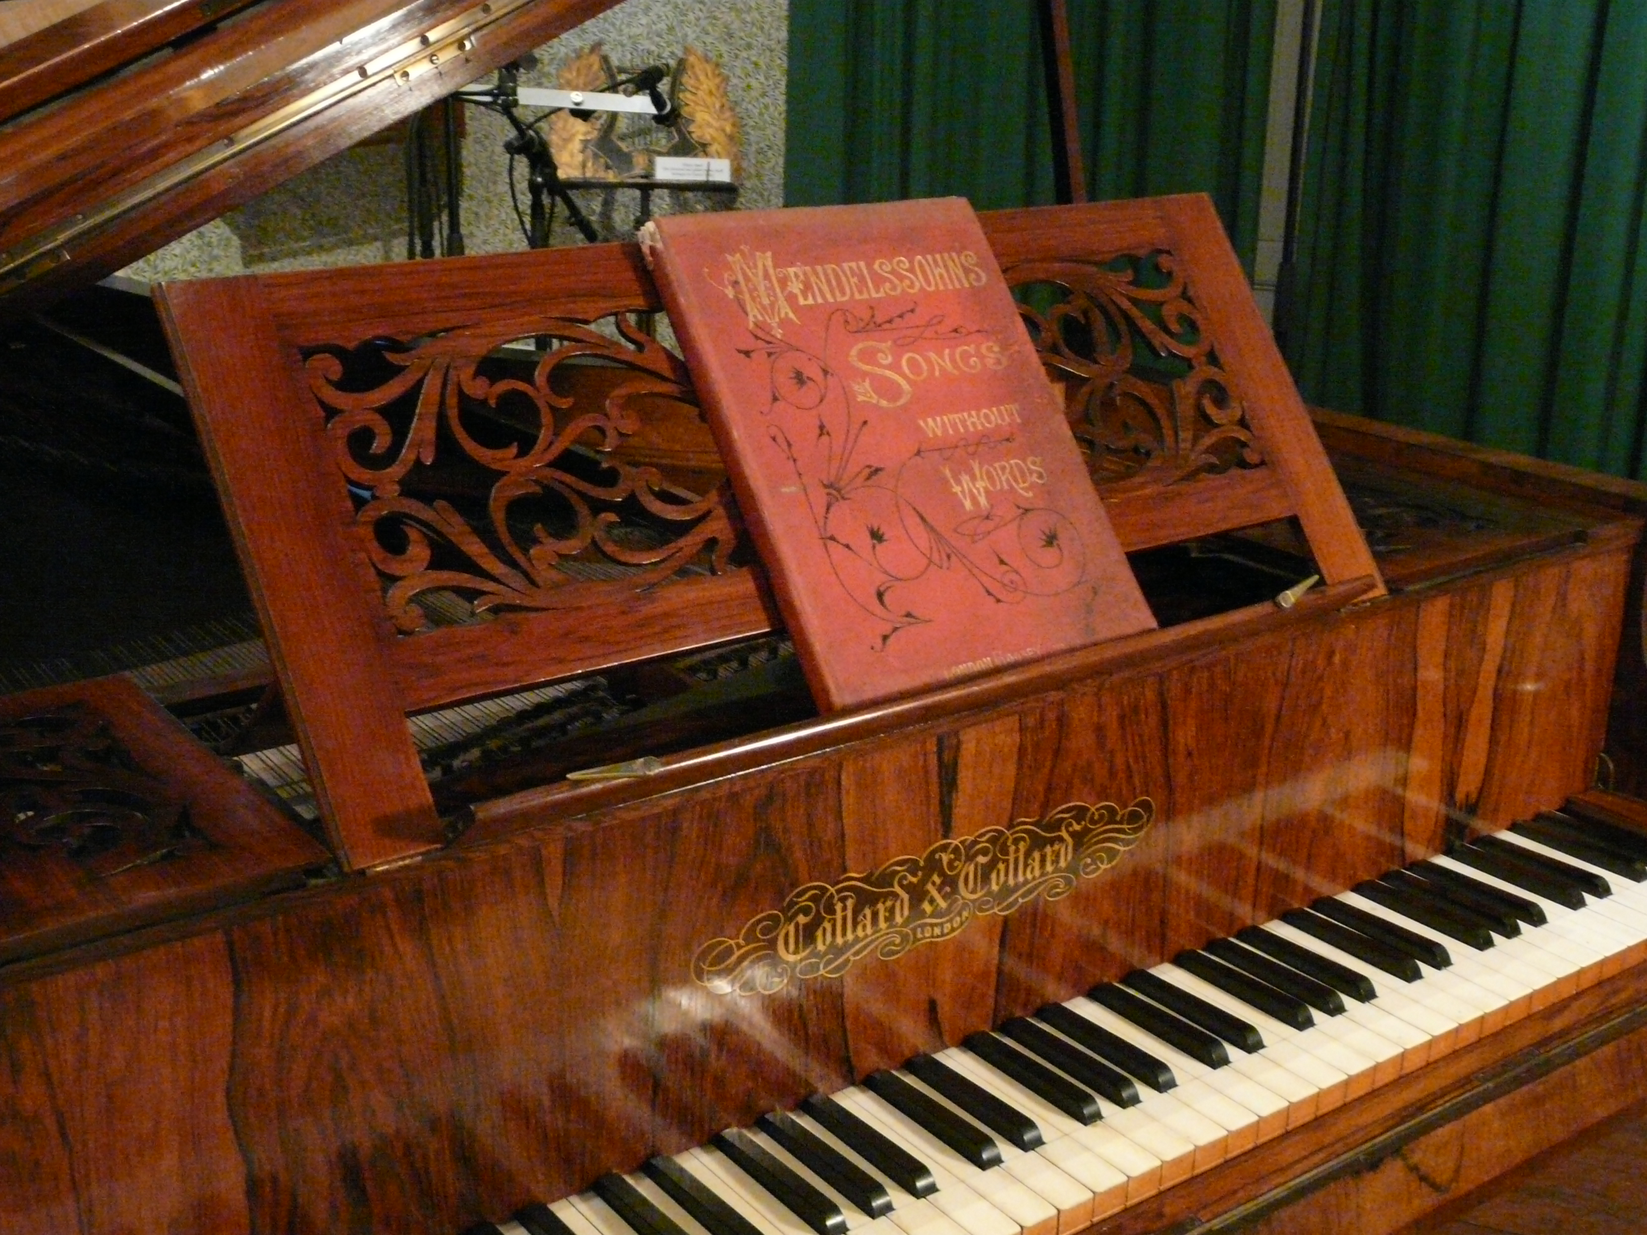

Slide 34
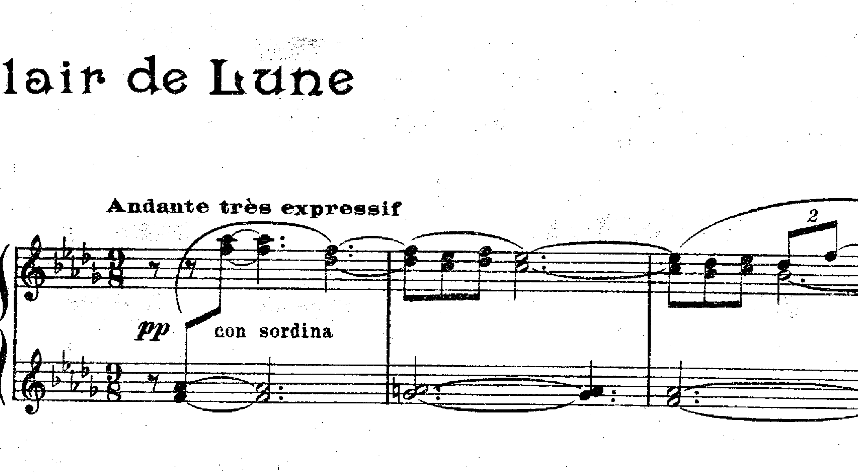
Debussy: Clair de lune

Slide 36
Recognition can operate at a number of purely musical levels, even for those with no prior musical knowledge.
We can recognise – instinctively – the acoustic imperative of this long dominant in the bass, which demands resolution ...

Slide 37
... to the tonic.
(Take note of this melody, so very English in its prosody, and of its perky accompaniment.)

Slide 38
We can recognise the achievements of virtuosity as ends in themselves, independent of their musical meaning –

Slide 39
Just as the discipline of counterpoint carries a recognisable authority all its own.

Slide 40
Now Sullivan does a wonderful thing:
This new lyrical melody is, we realize at last, simply that very English melody, transformed.
What is Recapitulation, so integral to musical form, but an opportunity for Recognition?

Slide 41
Through this gradual process of recognition,
ullivan achieves imultaneous
urprise &
atisfaction.
S

Slide 43
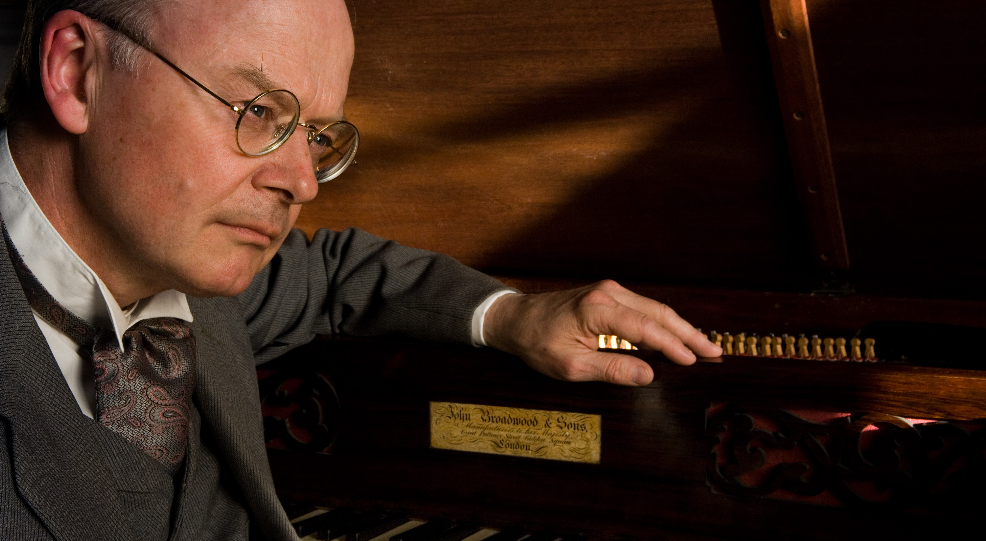
This is Elgar’s Broadwood.

Slide 44
I’m playing Elgar’s own arrangement of The Angel’s Farewell from The Dream of Gerontius.

Slide 45
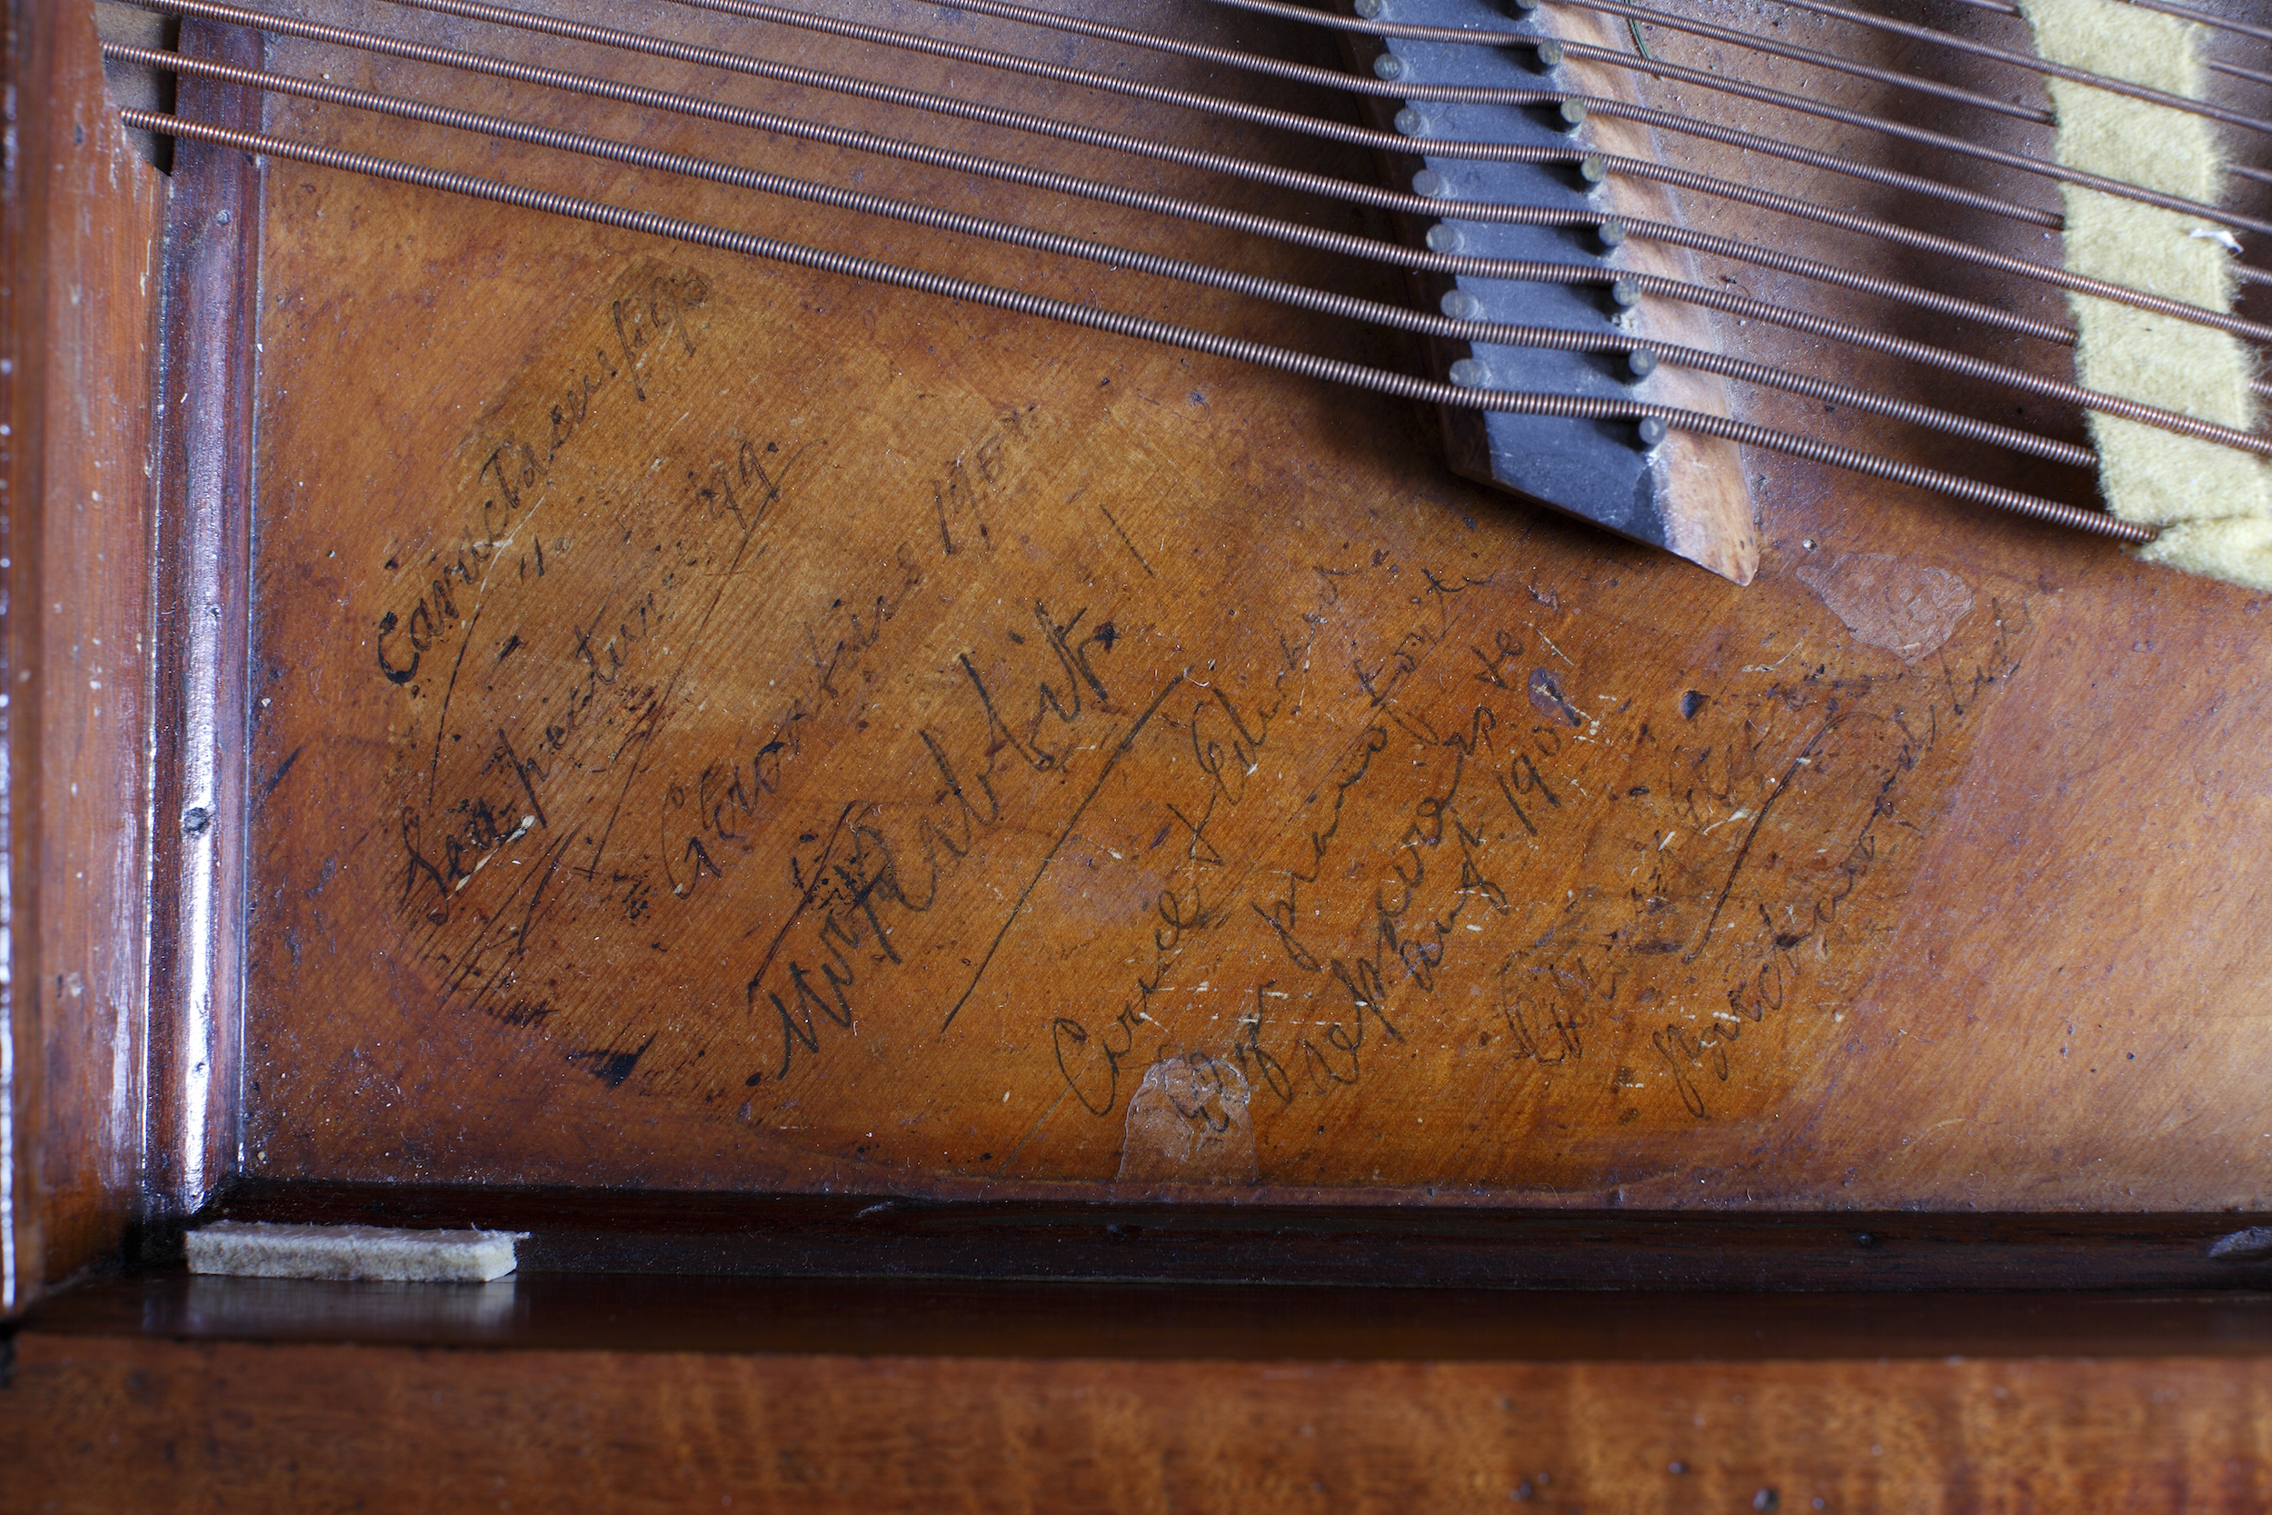
He composed the piece at this piano, writing the title on the soundboard: third one down.

Slide 46
I play this piano very often,
and sometimes, improvising on Elgar’s themes,
I’ve sensed his spirit within me.

Slide 47
I once performed the Angel’s Farewell to the patients at Broadmoor Hospital –
men sedated out of all emotion,
their faces a blank.

Slide 48
And yet, when I told them that
Elgar had worked in a mental hospital,
their attention sharpened.

Slide 49
I explained that the piece represented
an angel saying goodbye
to a soul in heaven,
and they became thoughtful:
death, alas, they know all too well.

Slide 50
They received the piece in a deep silence – they sat,
and eventually left,
in a most unaccustomed state
of quiet attention.

Slide 51
Just last weekend,
I heard the Angel’s Farewell as part of another profoundly moving occasion. Elgar’s sister, Dot, became the Prioress of a convent in Stroud.
The St Cecilia Singers of Gloucester have made a programme that tells her story, and they performed it in her own convent church.

Slide 52
Elgar sketched a piece ‘For Dot’s Nuns’, which was never completed.
I was asked to turn the sketch into a performable piece.

Slide 53
So last Saturday night,
as part of Dot’s own story,
we heard the first performance of
For Dot’s Nuns
on the very organ at which, a hundred years ago, Sir Edward Elgar found those wonderful harmonies.

Slide 54
We who listened,
like the men of Broadmoor,
were drawn into the Looking-Glass –
and those complementary images blended and made us whole.

Slide 55
Music is not an Artefact, but an Activity that creates Society.
David Owen Norris, Gresham Lecture 1993

Slide 56
All the performing strategies we have surveyed today are effective,
but the most important is
The Looking-Glass

Slide 57
Just as a Looking-Glass is more than a passing reflection in a shop window,
so too a Performance must be
more than the notes,
more than the sounds,
more even than the performer’s reputation.

Slide 58
A Performance must be
an all-consuming Occasion
where the audience becomes the performer, and together they share
the artistic reward,
the inner spiritual completeness.

Slide 59
Musical Prisms
What it MEANT
What it MEANS
What it COULD MEAN
WHAT IT MEANS TO
ME !!!

Slide 60
So does Satisfaction prevail over Surprise
in the end?

Slide 61
No,
for the performer knows that,
in Looking-Glass Land,
to raise his right hand,
he must …

