Slide 1
What women can do to stay healthy
THE MILLION WOMEN STUDY
Valerie Beral
University of Oxford

Slide 2
Questions:
What are the effects on health of major lifestyle factors that are potentially modifiable?
Are the effects persistent?
How do the effects of different factors compare?
Factors I will discuss:
The pill, HRT, adiposity, physical activity, alcohol, diet, smoking.

Slide 3
Age-specific incidence of important conditions in women (rate/1000/year)
Heart disease
Hip fracture
Breast cancer
Venous thrombosis

Slide 4
Age-specific incidence of important conditions in women (rate/1000/year)
Heart disease
Hip fracture
Breast cancer
Venous thrombosis

Slide 5
Age-specific incidence of important conditions in women (rate/1000/year)
Heart disease
Hip fracture
Breast cancer
Venous thrombosis

Slide 6
Age-specific incidence of important conditions in women (rate/1000/year)
Heart disease
HRT
Hip fracture
Breast cancer
Venous thrombosis

Slide 7
Disease rates vary by age; and lifestyle factors and behaviours vary by age

Slide 8
THE PILL
First licensed in ~1960
600 million women have used it
120 million are currently using it
In western countries today:
- women in their 60s, 80% ever-users (for 7 years)
- women in their 90s, 30% ever-users (for 5 years)

Slide 9
THE PILL
1960 and 1970s – adverse vascular effects
1961 – first report of venous thrombosis (VTE)
1962 – 26 cases of VTE reported to FDA
1962 – first report of stroke
1964 – first report of coronary heart disease
2-4 fold increase in venous thromboembolism, stroke and heart disease
All vascular effects are reversible

Slide 10

1980s and 1990s – emphasis on cancer
1980s - over 30 studies published results on breast cancer and the pill, with conflicting findings
1992 - Collaborative Group on Hormonal Factors in Breast Cancer set up in Oxford to bring together worldwide data; first results published in 1996

Slide 11
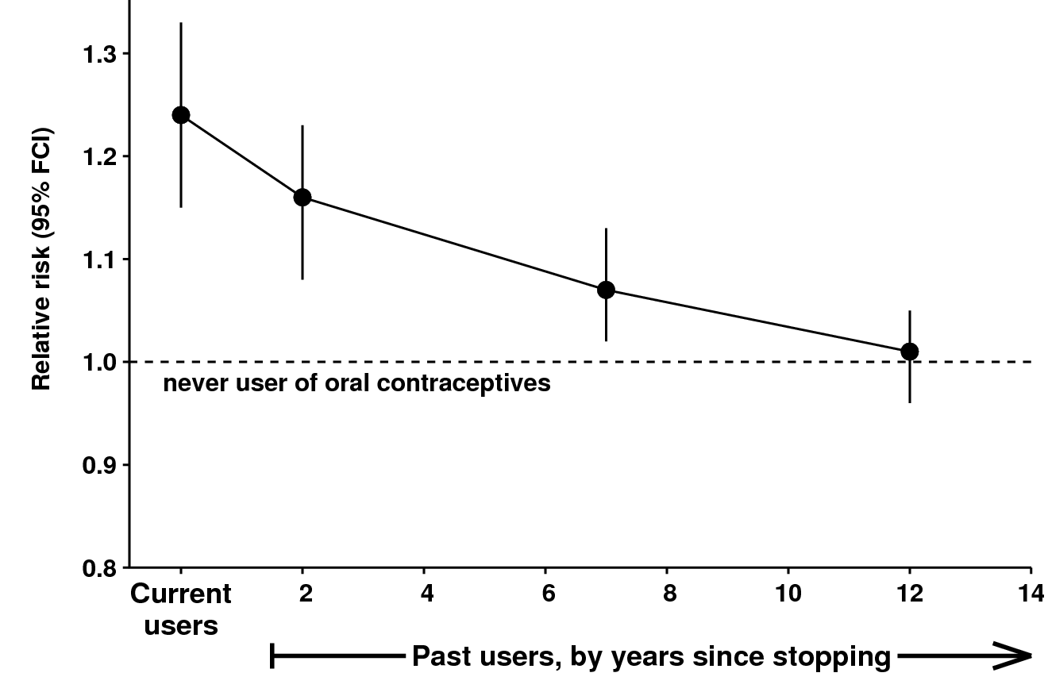
Oral contraceptives and breast cancer incidence
Collaborative Group on Hormonal Factors in Breast Cancer (Lancet, 1996)
Excess breast cancer risk is reversible

Slide 12
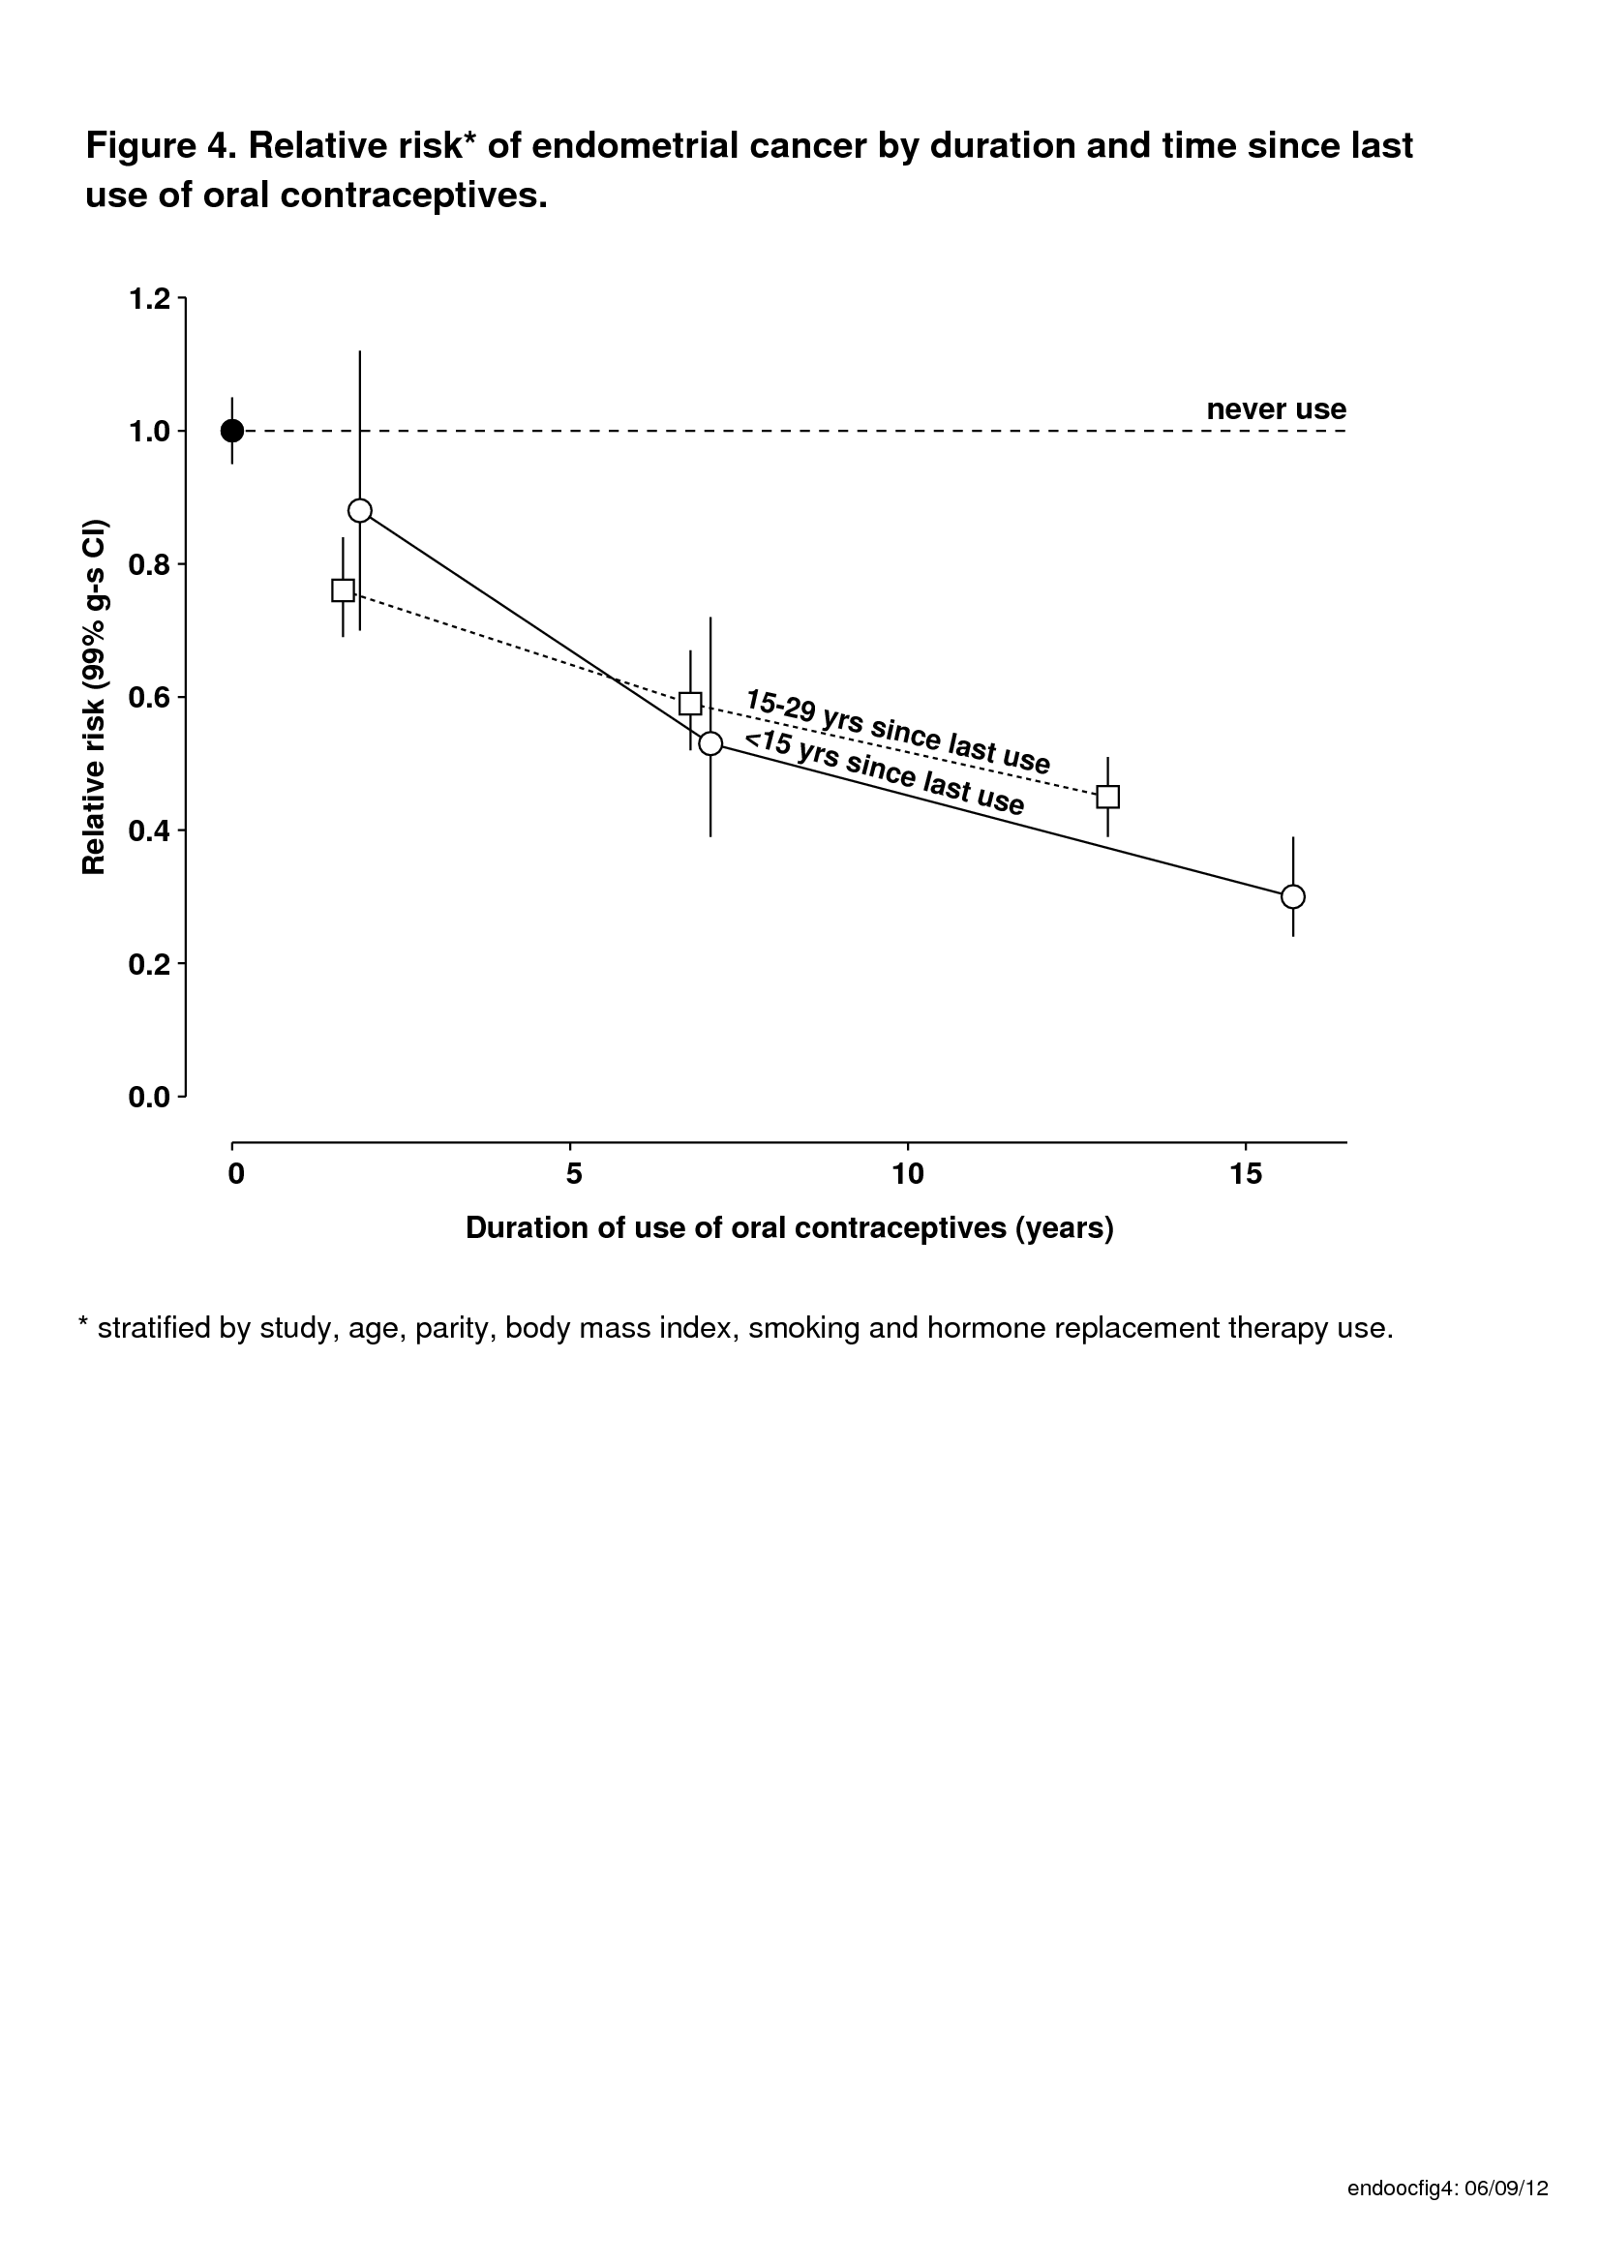
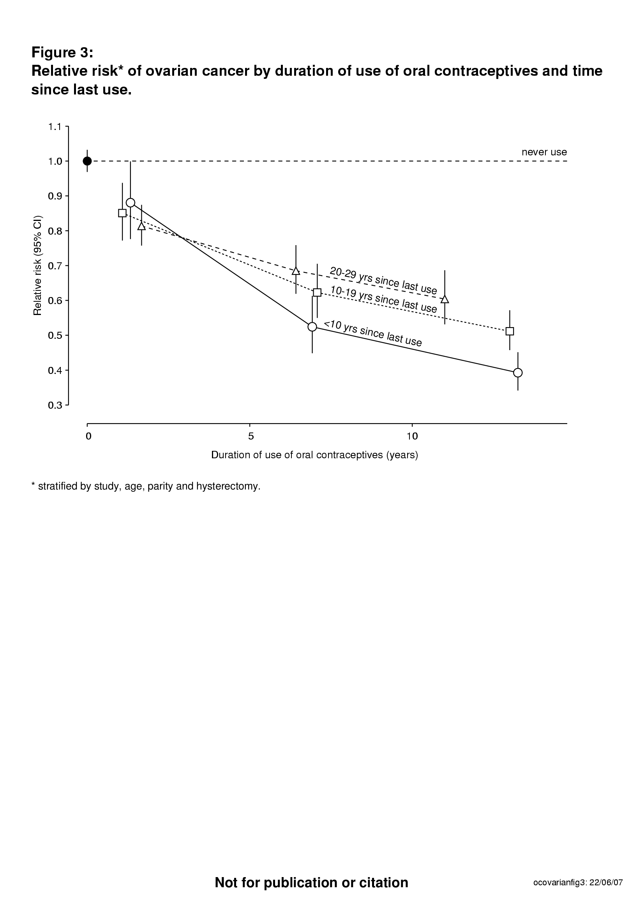
PERSISTENT reduction in ovarian and endometrial cancer risk – greater the longer the pill was used
Ovarian cancer
Endometrial cancer

Slide 13
THE PILL
50 years of research has taught us that:
While the pill is being used, there is an increase in the incidence of vascular diseases and breast cancer; all these effects are reversible
Because most serious illnesses are rare in women’s 20s and 30s (except perhaps venous thrombosis) the numbers who have adverse pill-associated illnesses is small
In the long term there is a persistent decrease in cancer of the ovary and womb
In the long term women who have taken the pill have net REDUCTION in cancer incidence

Slide 14
What about hormone therapies for the menopause (HRT)?
Heart disease
Hip fracture
Breast cancer
Venous thrombosis

Slide 15

THE MILLION WOMEN STUDY
1.3 million women recruited in 1996-2001, from NHS Breast Screening Units
- to obtain reliable evidence about breast cancer and women’s health in general
- 1 in 4 UK women aged 50-64 at the time of recruitment
- average age 56 at recruitment, now 70
www.millionwomenstudy.org

Slide 16
THE MILLION WOMEN STUDY
HRT and cancer incidence
Lancet, 2007

Slide 17
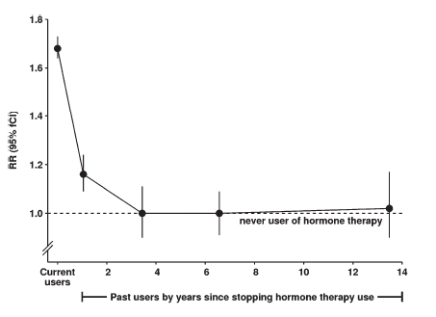
THE MILLION WOMEN STUDY
HRT-associated breast cancer risk is rapidly reversible

Slide 18
Coronary heart disease: results from randomized trials*
little or no increase or difference by type of HRT
*MHRA Public Assessment Report, 2007 (www.mhra.gov.uk)

Slide 19
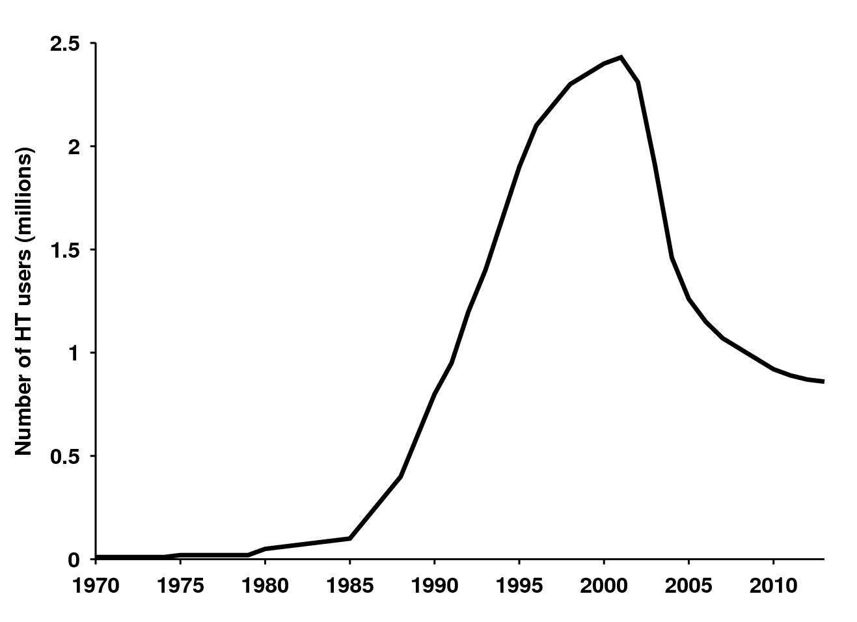
Estimated number of HRT users in the UK

Slide 20
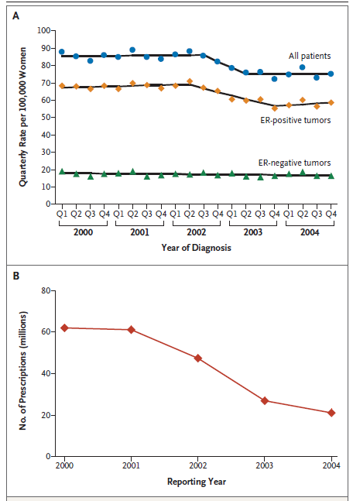
Drop in HRT use has been followed by a fall in breast cancer incidence in a dozen countries
Ravdin, NEJM, 2007

Slide 21
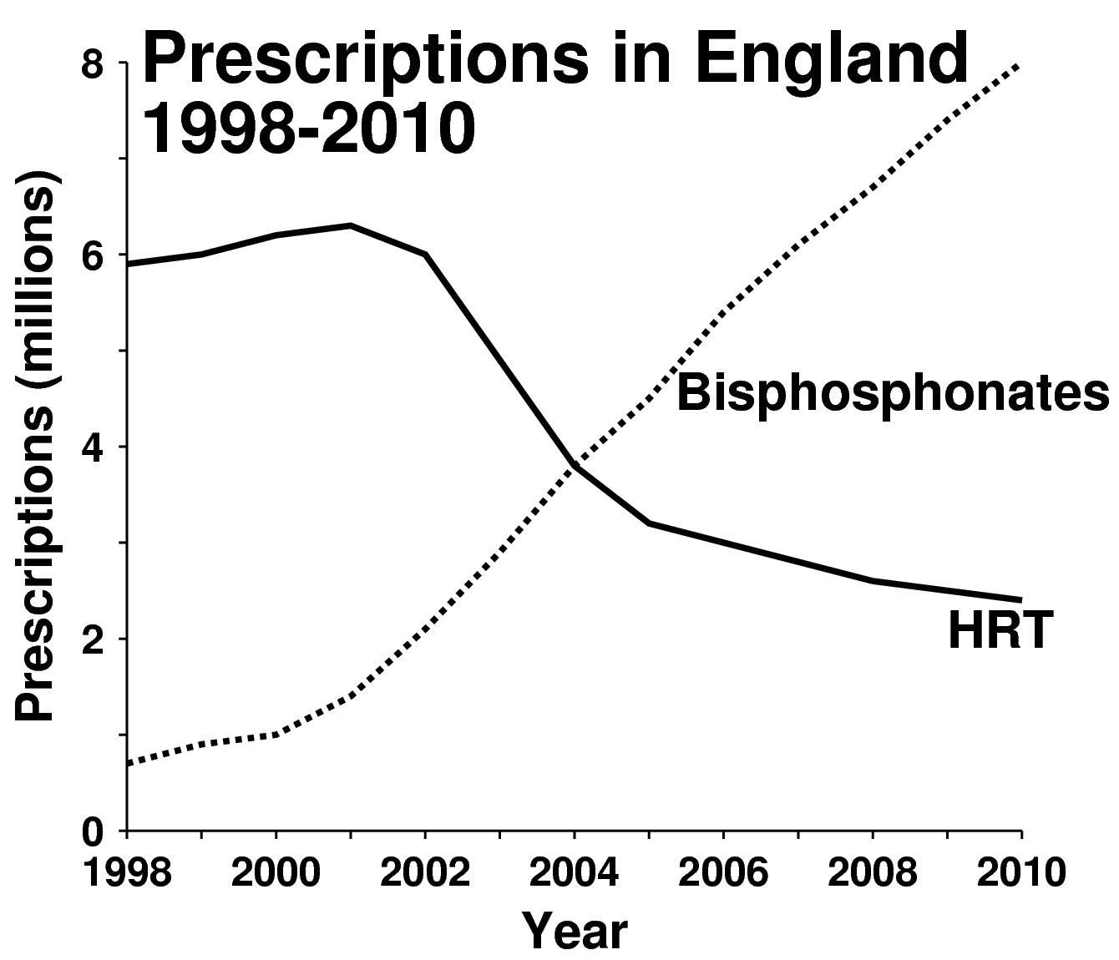

Slide 22
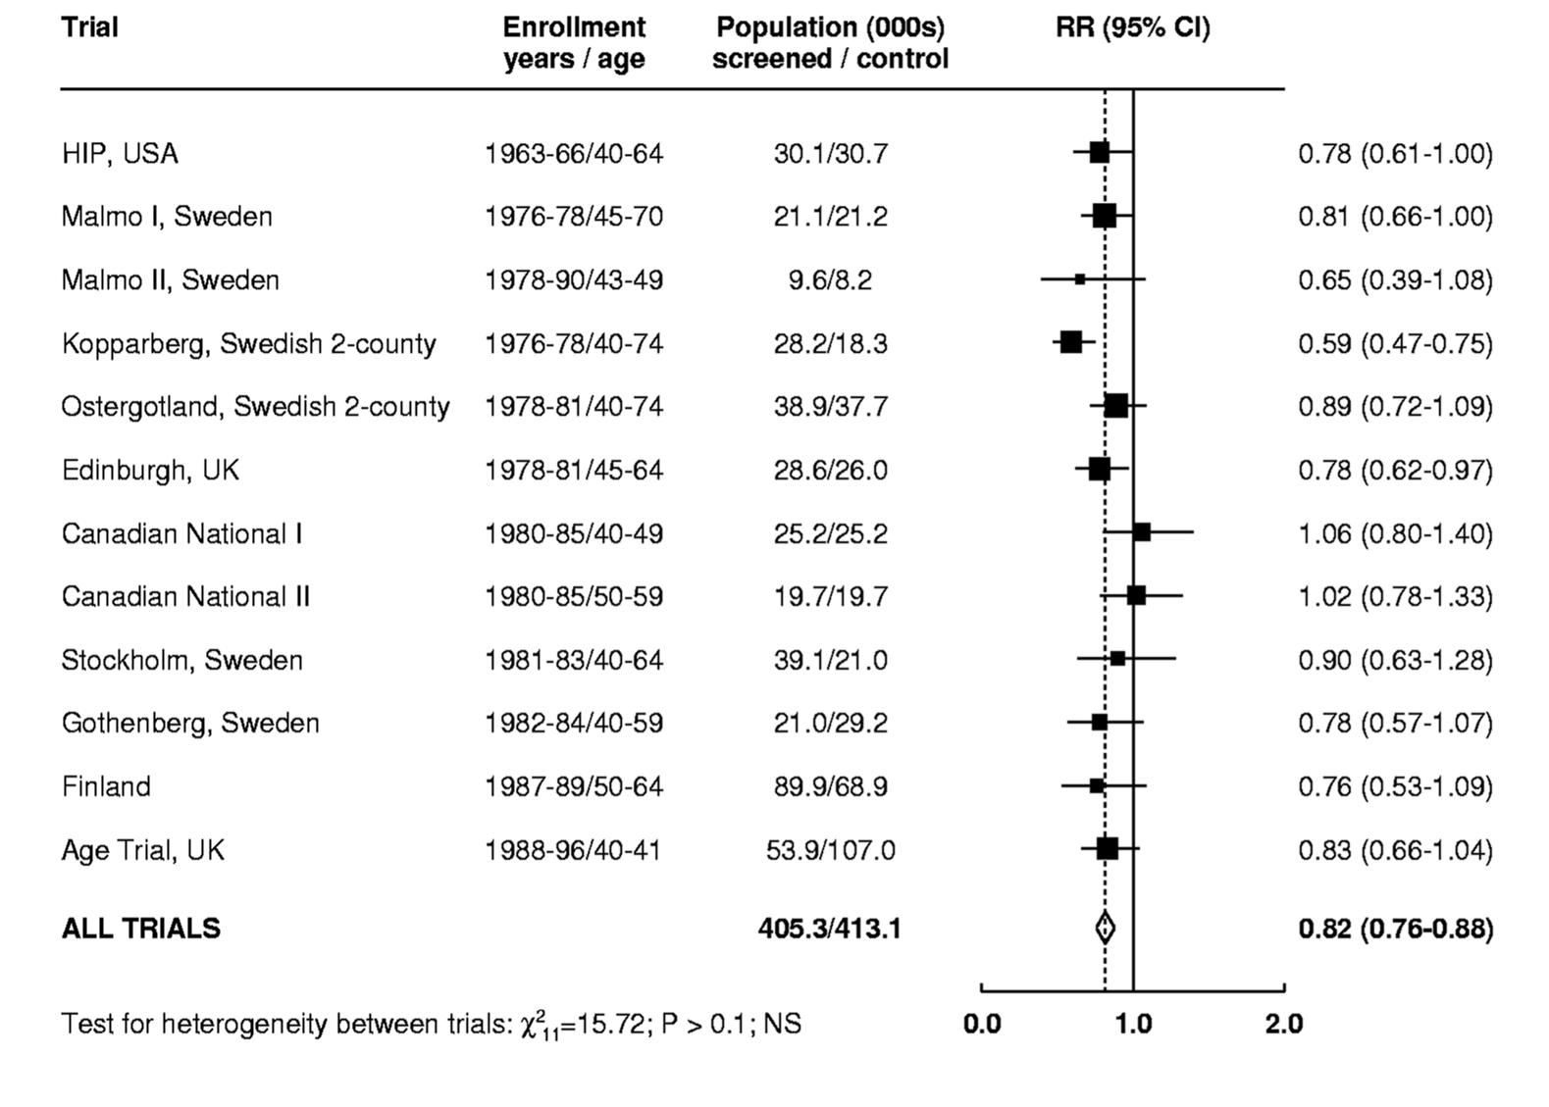
SCREENING: effective at ages 50-70 and prevents ~1400 breast cancer deaths in England every year

Slide 23
OBESITY

Slide 24
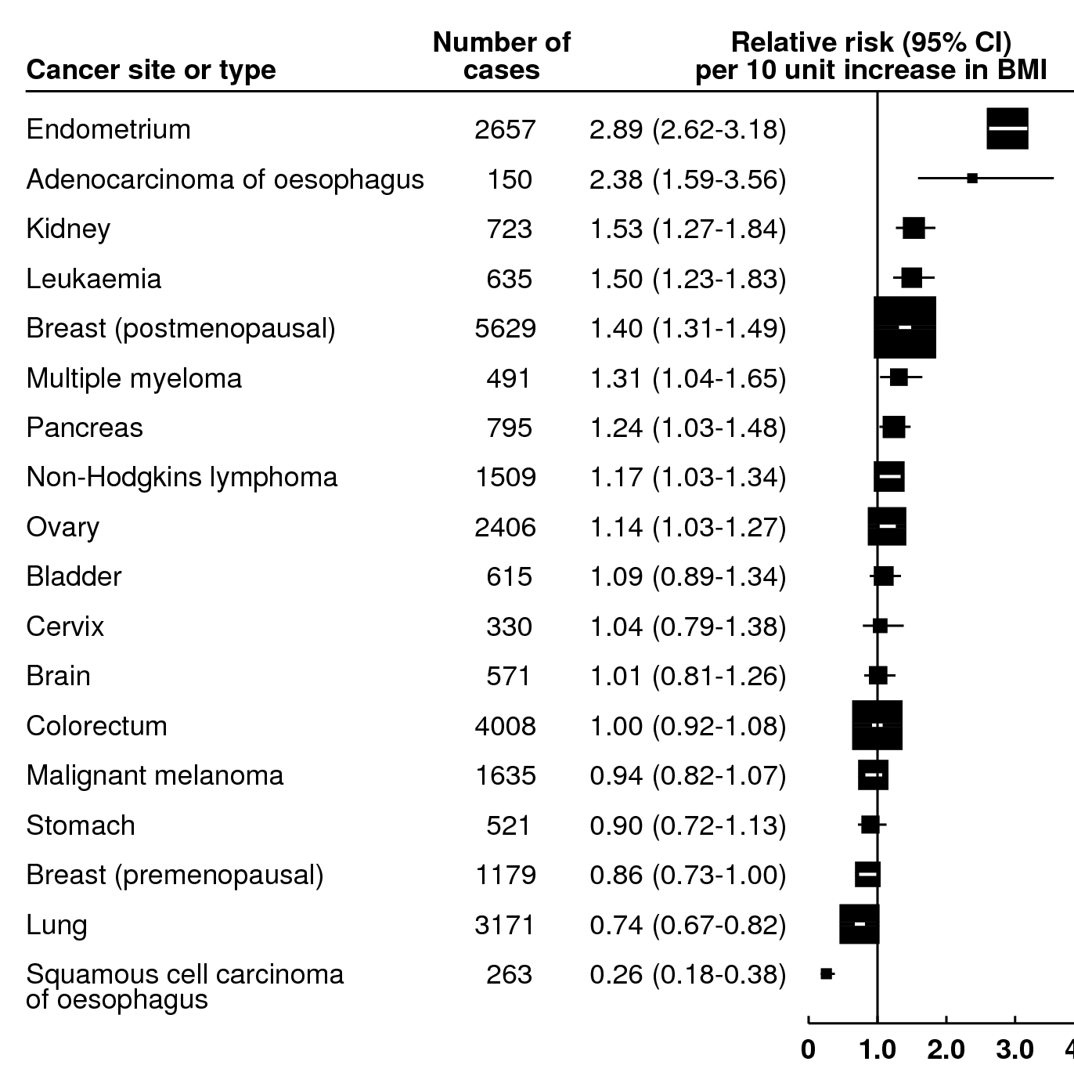
OBESITY is associated with an increased risk for 9 out of the 18 most common cancers
Reeves et al, BMJ 2007

Slide 25
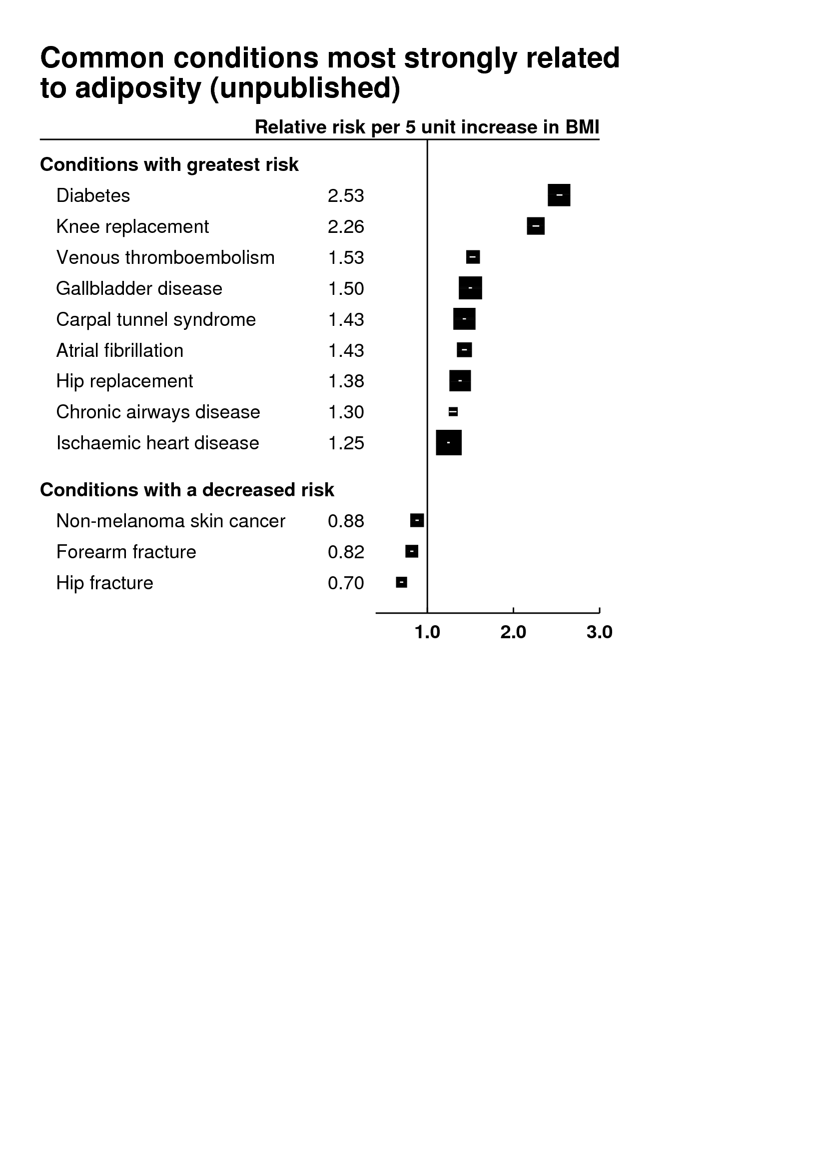
THE MILLION WOMEN STUDY
OBESITY is associated with an increased risk for 21 out of the 25 most common non-cancer conditions
Reeves et al, 2014

Slide 26
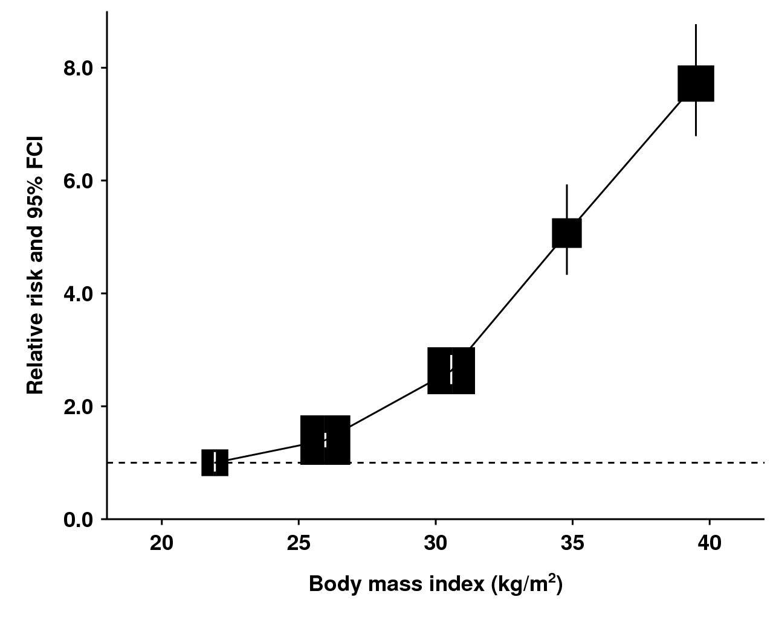
THE MILLION WOMEN STUDY
Body mass index and endometrial cancer risk in postmenopausal women

Slide 27
THE MILLION WOMEN STUDY
Little to suggest persistent effect of obesity and endometrial cancer risk
Lean at age 10, obese at age 60
Plump at age 10, lean at age 60

Slide 28
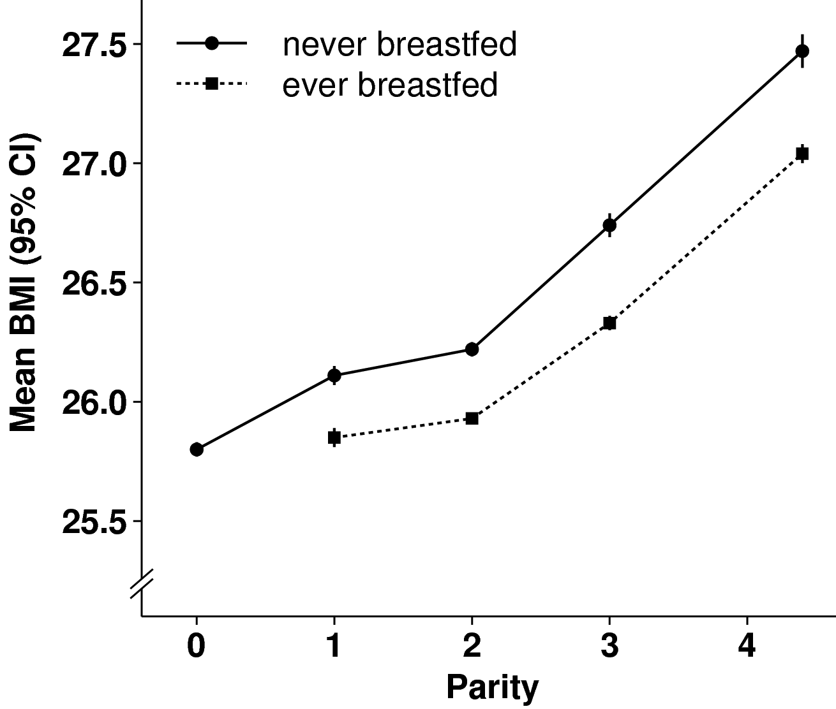
THE MILLION WOMEN STUDY
Persistent effect of childbearing on body mass index in postmenopausal women

Slide 29
PHYSICAL ACTIVITY

Slide 30
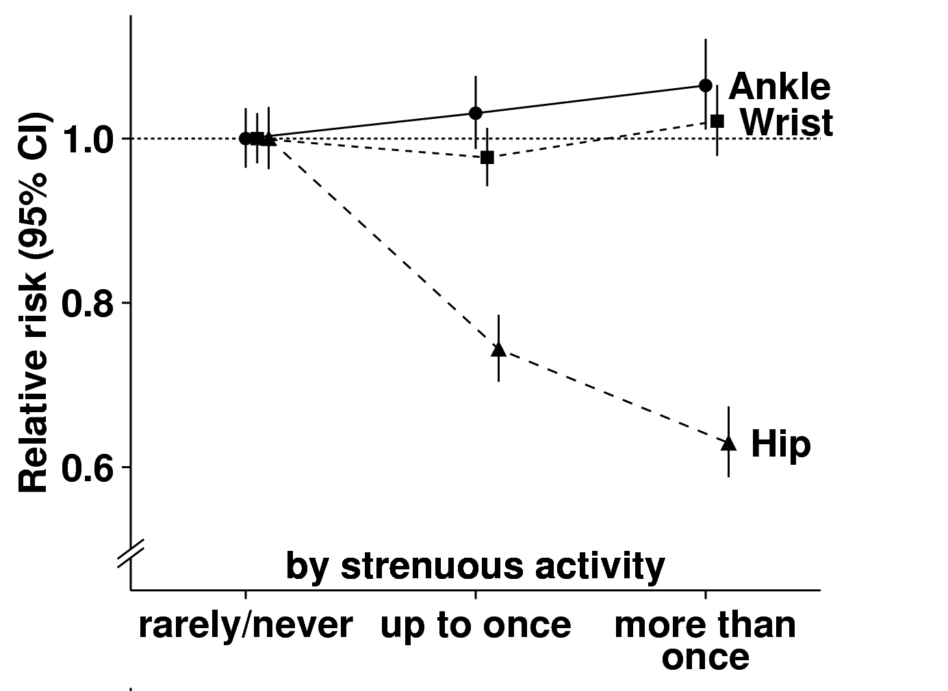
THE MILLION WOMEN STUDY
PHYSICAL ACTIVITY and fracture risk
Armstrong et al, 2013

Slide 31
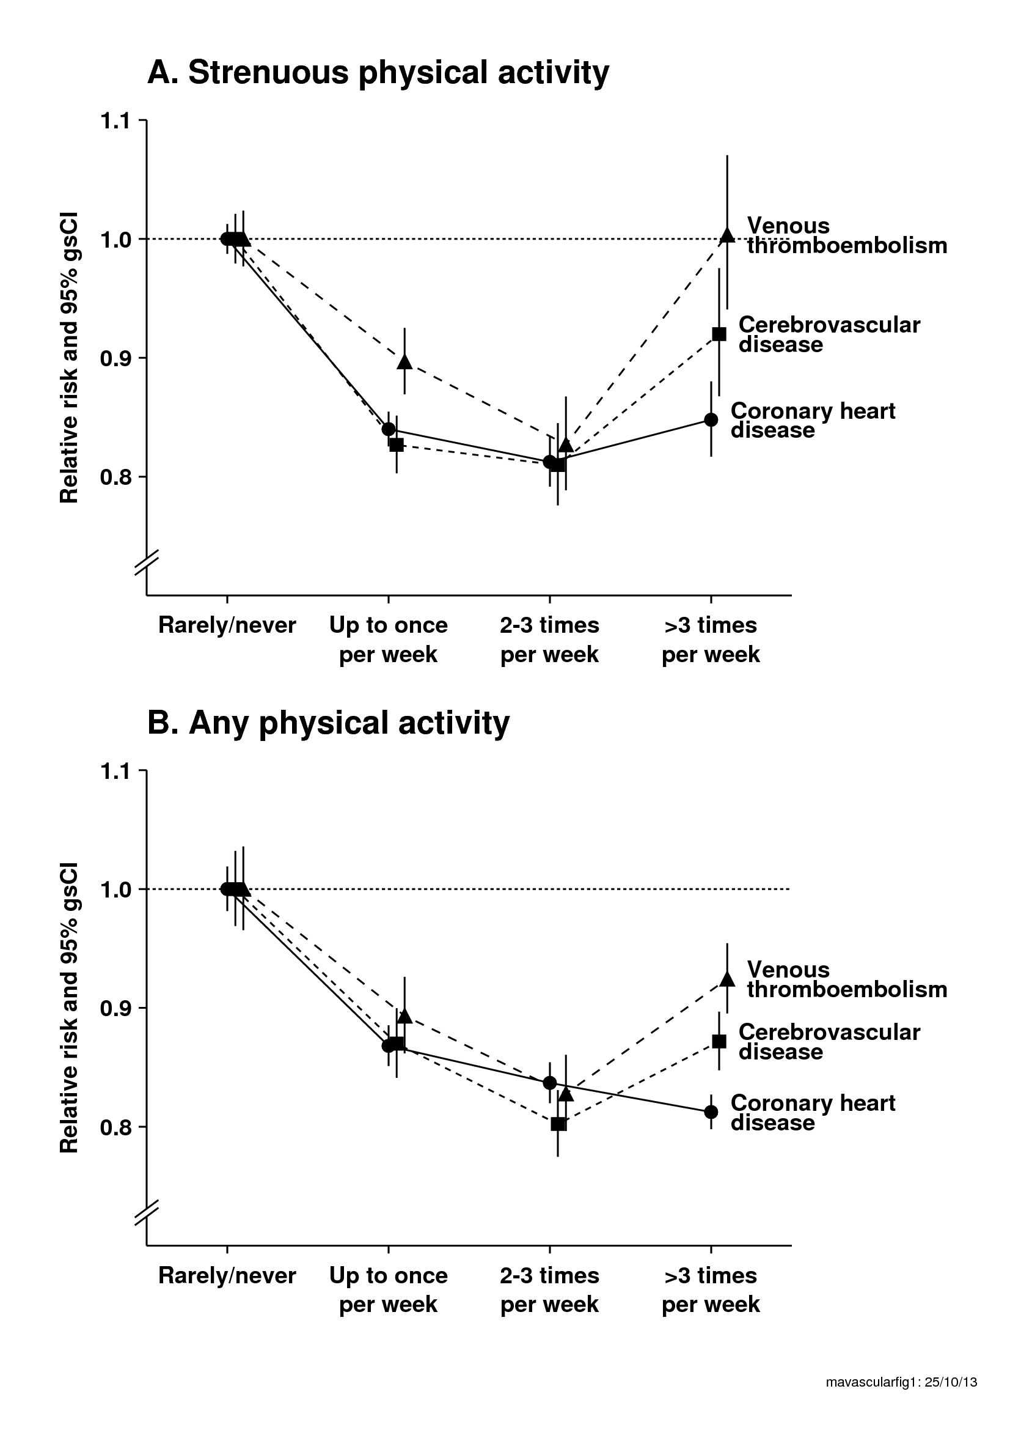
THE MILLION WOMEN STUDY
PHYSICAL ACTIVITY and vascular disease risk

Slide 32
ALCOHOL and DIET

Slide 33
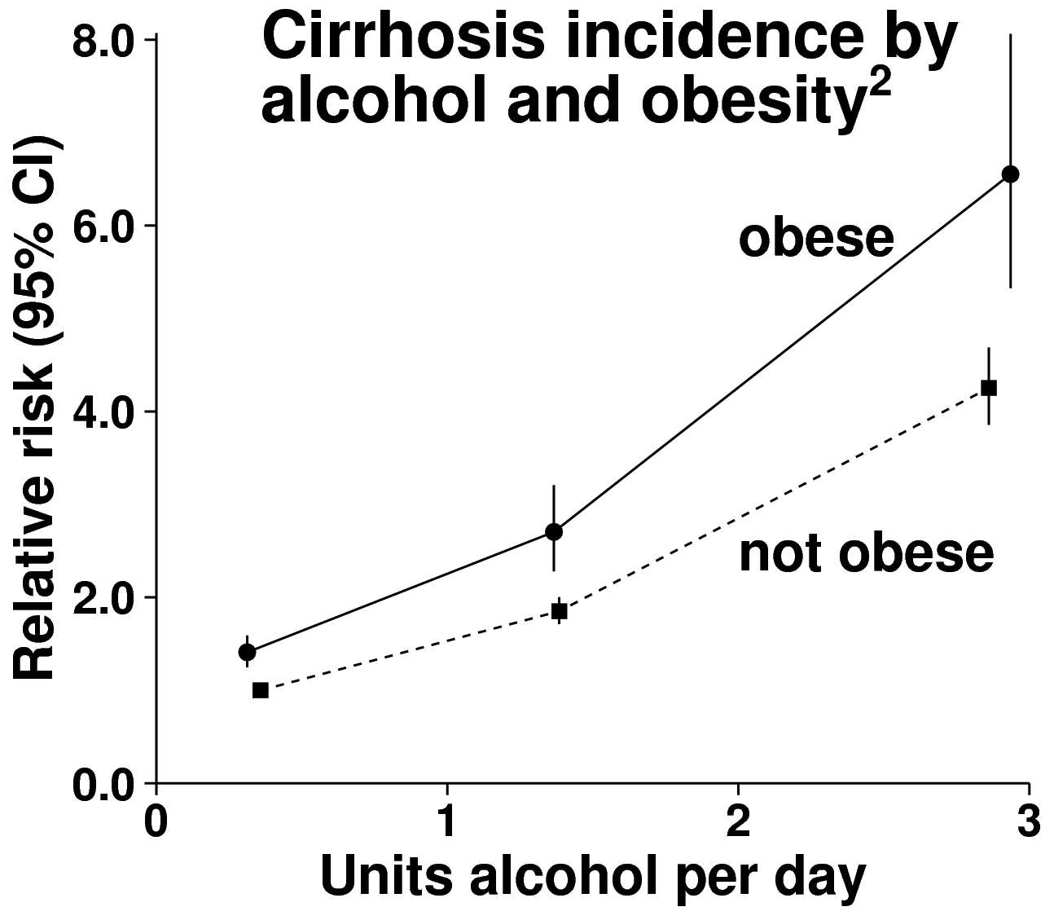
THE MILLION WOMEN STUDY
CIRRHOSIS:
ALCOHOL & OBESITY
Liu et al, 2010

Slide 34
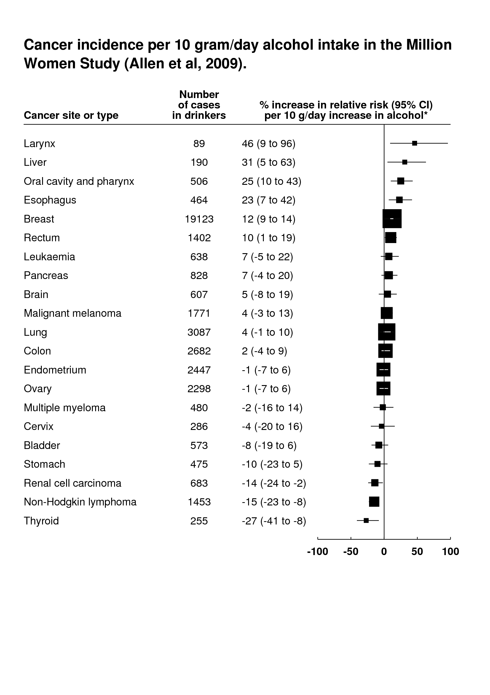
ALCOHOL and cancer incidence
Allen et al, JNCI, 2009

Slide 35
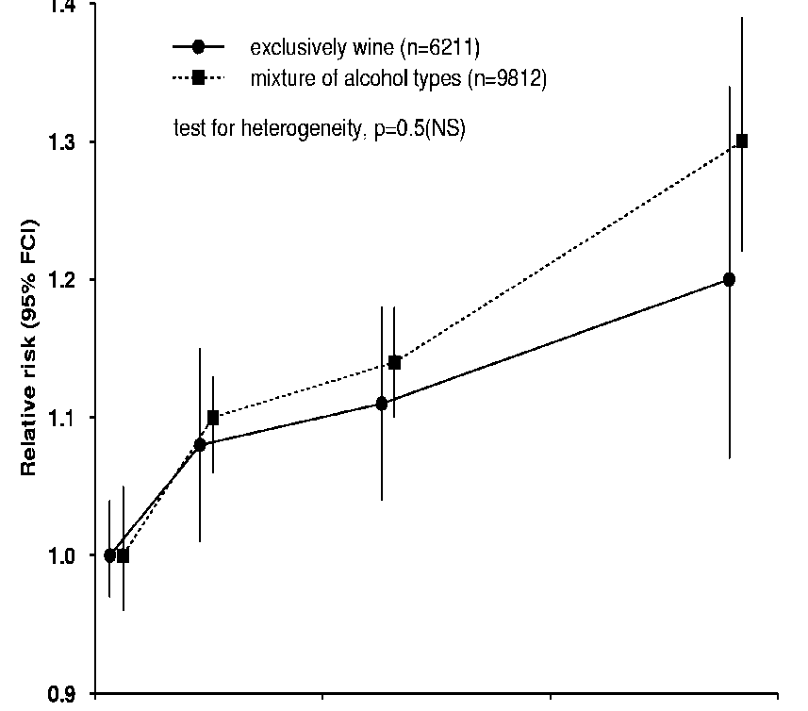
THE MILLION WOMEN STUDY
Type of alcohol and breast cancer risk
1 2 3
units alcohol per day

Slide 36

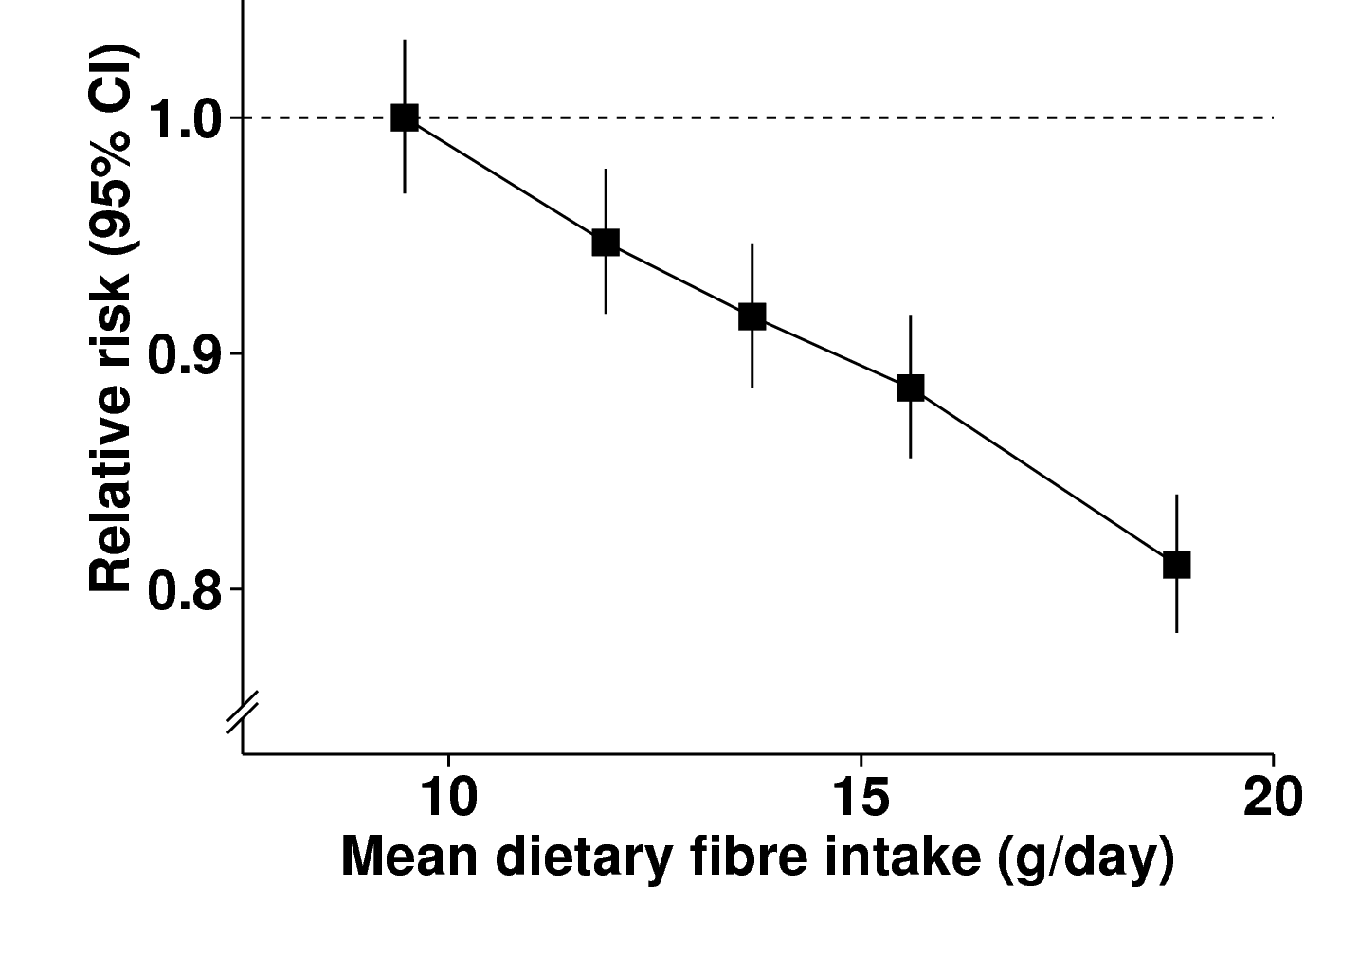

THE MILLION WOMEN STUDY
FIBRE INTAKE & diverticular disease
Crowe et al

Slide 37
SMOKING

Slide 38
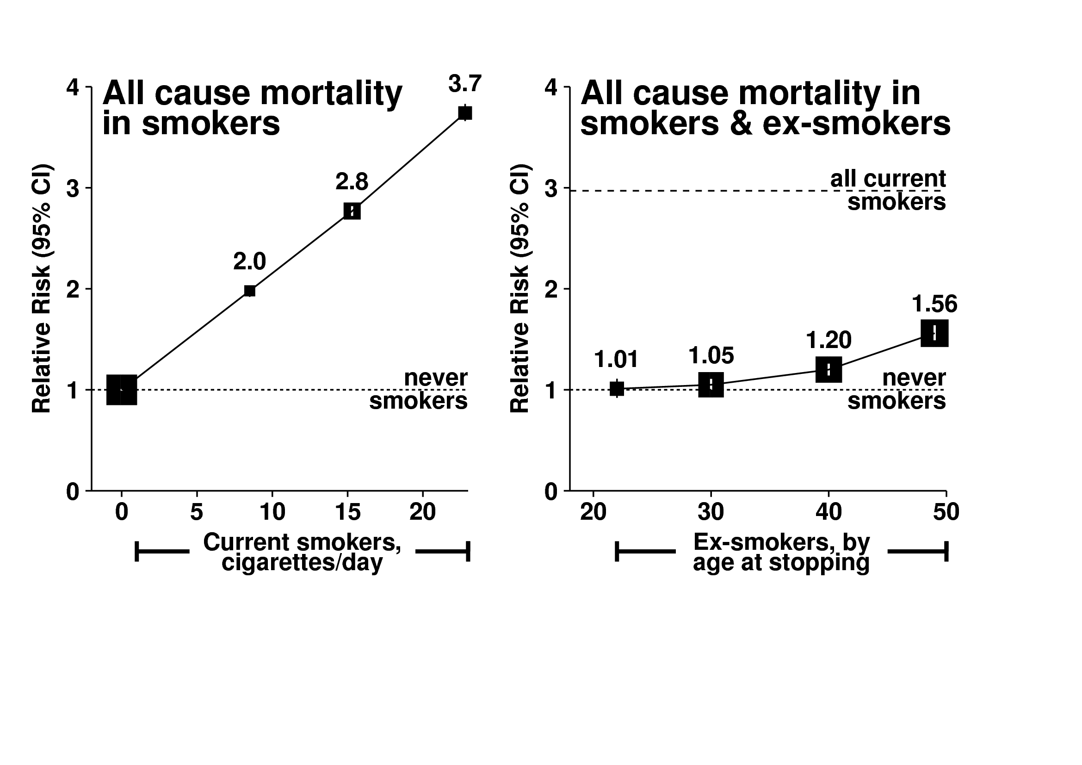
THE MILLION WOMEN STUDY
All cause mortality in smokers
Pirie, Peto, et al, 2013

Slide 39
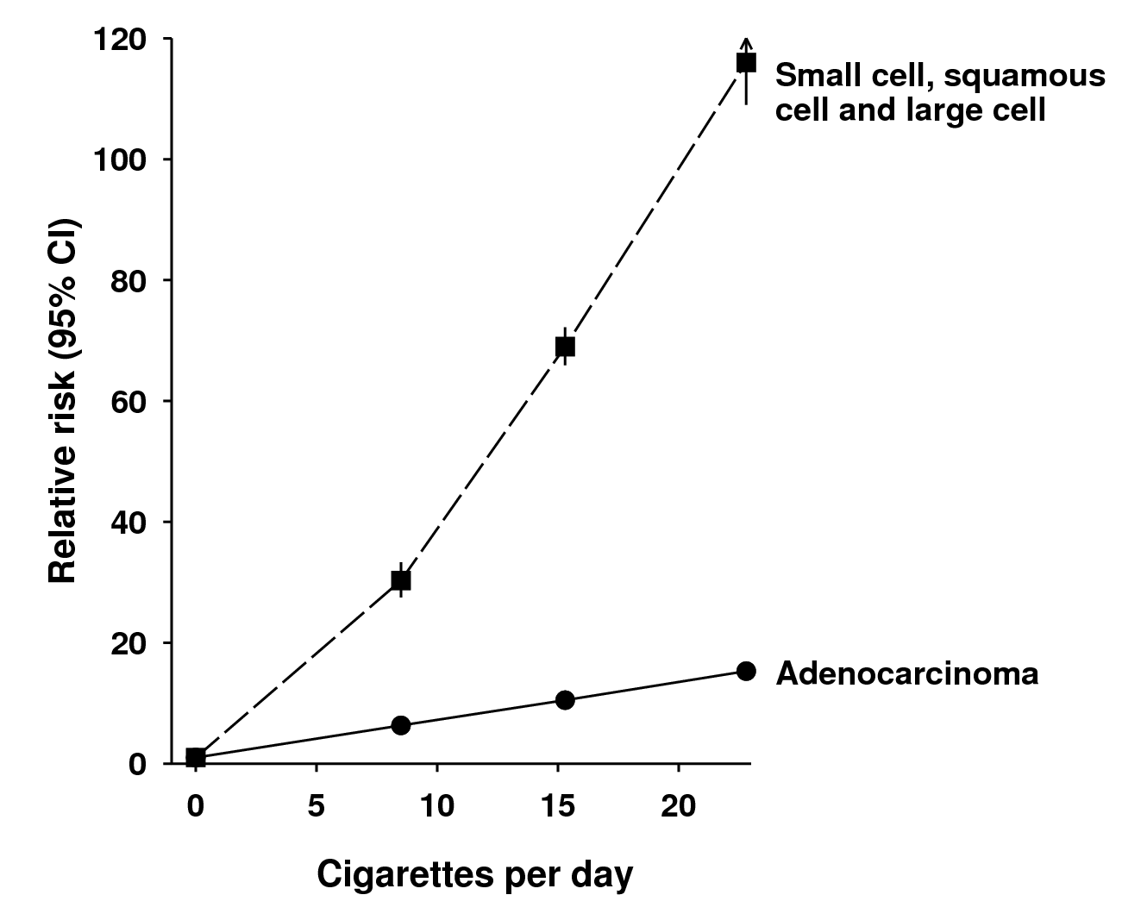
THE MILLION WOMEN STUDY
Lung cancer histology in smokers
Pirie, Peto, et al

Slide 40
THE MILLION WOMEN STUDY
All cause mortality in ex-smokers
Pirie, Peto, et al, 2013

Slide 41
What will definitely improve health:
Don’t smoke; give up if you do
Keep your weight down
Go for cancer screening (breast, cervix, bowel)
Exercise, but possibly not excessively
Drink as little alcohol as possible (until old age)
Eat fruit and vegetables
Take the pill, but stop before ~age 40 years
Take menopausal hormones as little as possible
MANY EFFECTS ARE REVERSIBLE so it is rarely too late to benefit from a change
Benefits from each can be small,
BUT TOGETHER CAN BE LARGE

Slide 42
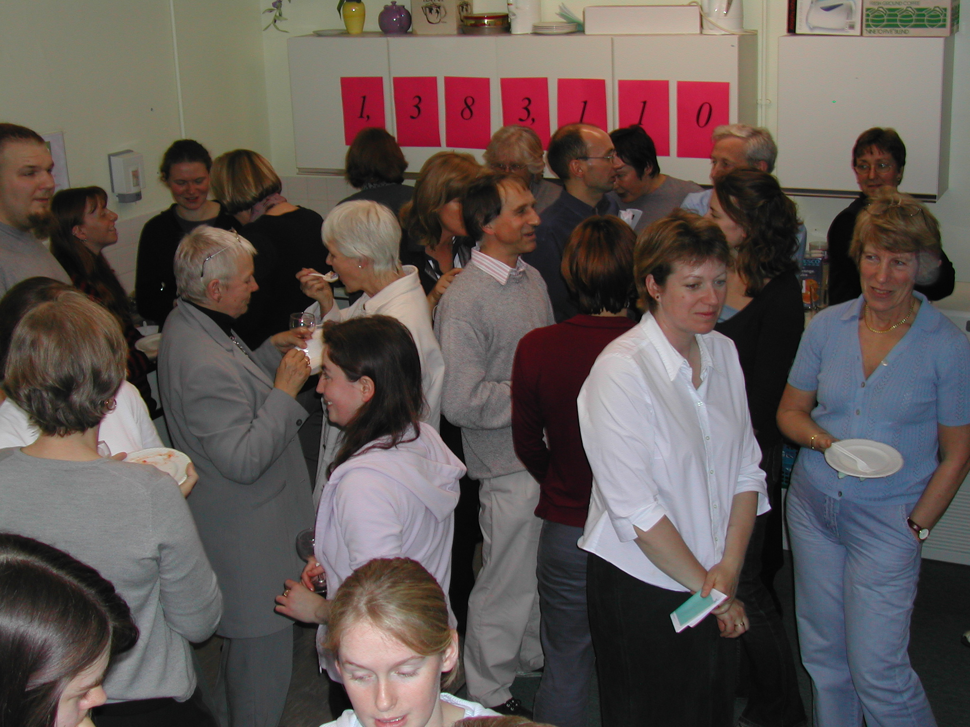
THANK YOU

