Slide 1
God's Good Order and the Artist's Patterns
Professor Ben Quash, King’s College London
Gresham College, 14th March 2013

Slide 2
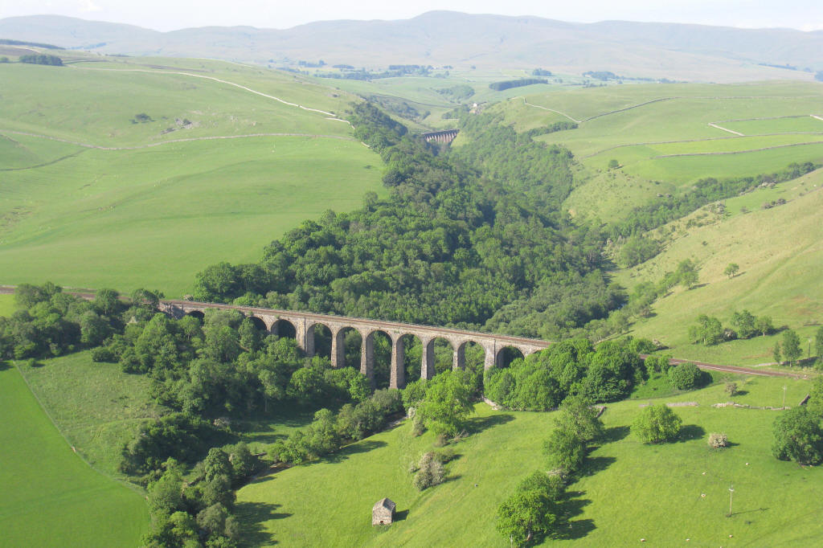
Smardale Viaduct, Carlisle to Settle Railway

Slide 3
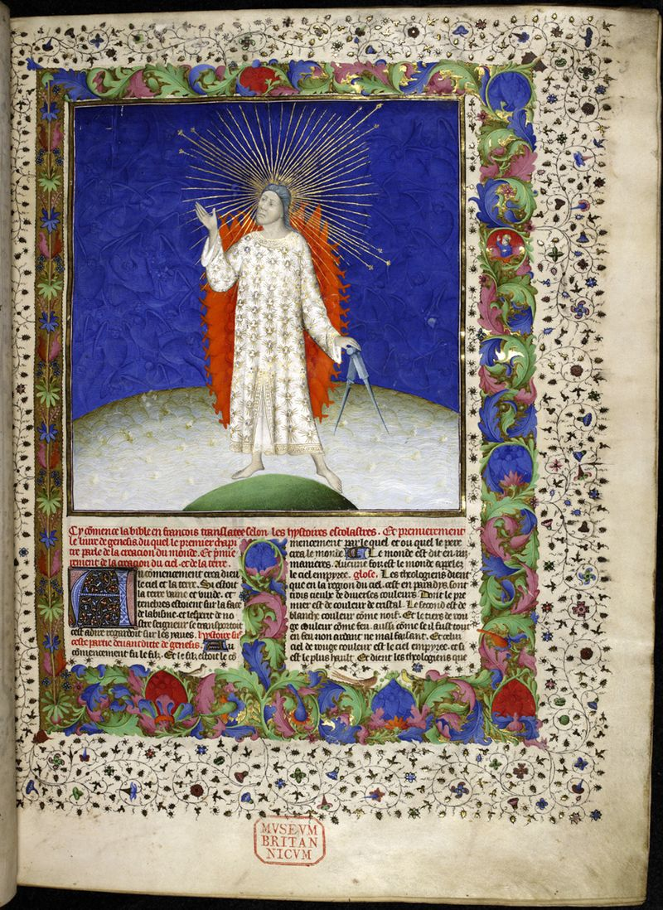
God the Creator,
Bible historiale,
Royal 19 D. iii, vol. 1, f. 3. French, 1411.
British Library,

Slide 4
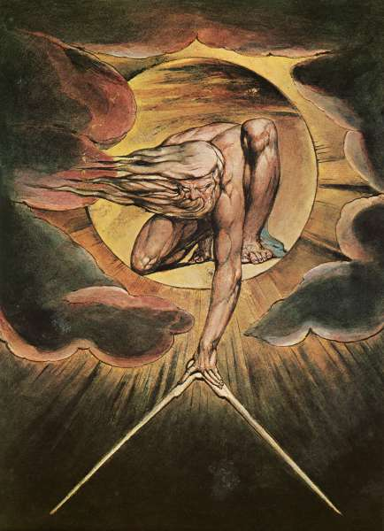
William Blake,
The Ancient of Days. Frontispiece,
Europe, a Prophecy, 1794.

Slide 5
Beauty . . . is the great creating cause which bestirs the world and holds all things in existence by the longing inside them to have beauty . . . it is . . . the Cause toward which all things move, since it is the longing for beauty which brings them into existence. . . . The Beautiful is . . . the same as the Good, for everything looks to the Beautiful and the Good as the cause of being, and there is nothing in the world without a share of the beautiful and the good . . . This – the One, the Good, the Beautiful – is in its uniqueness the cause of the multitudes of the good and the beautiful.

Slide 6
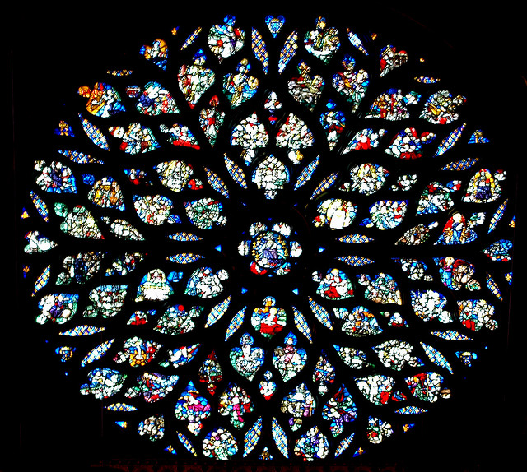
Rose window, La Sainte Chapelle, Paris. C.1490

Slide 7
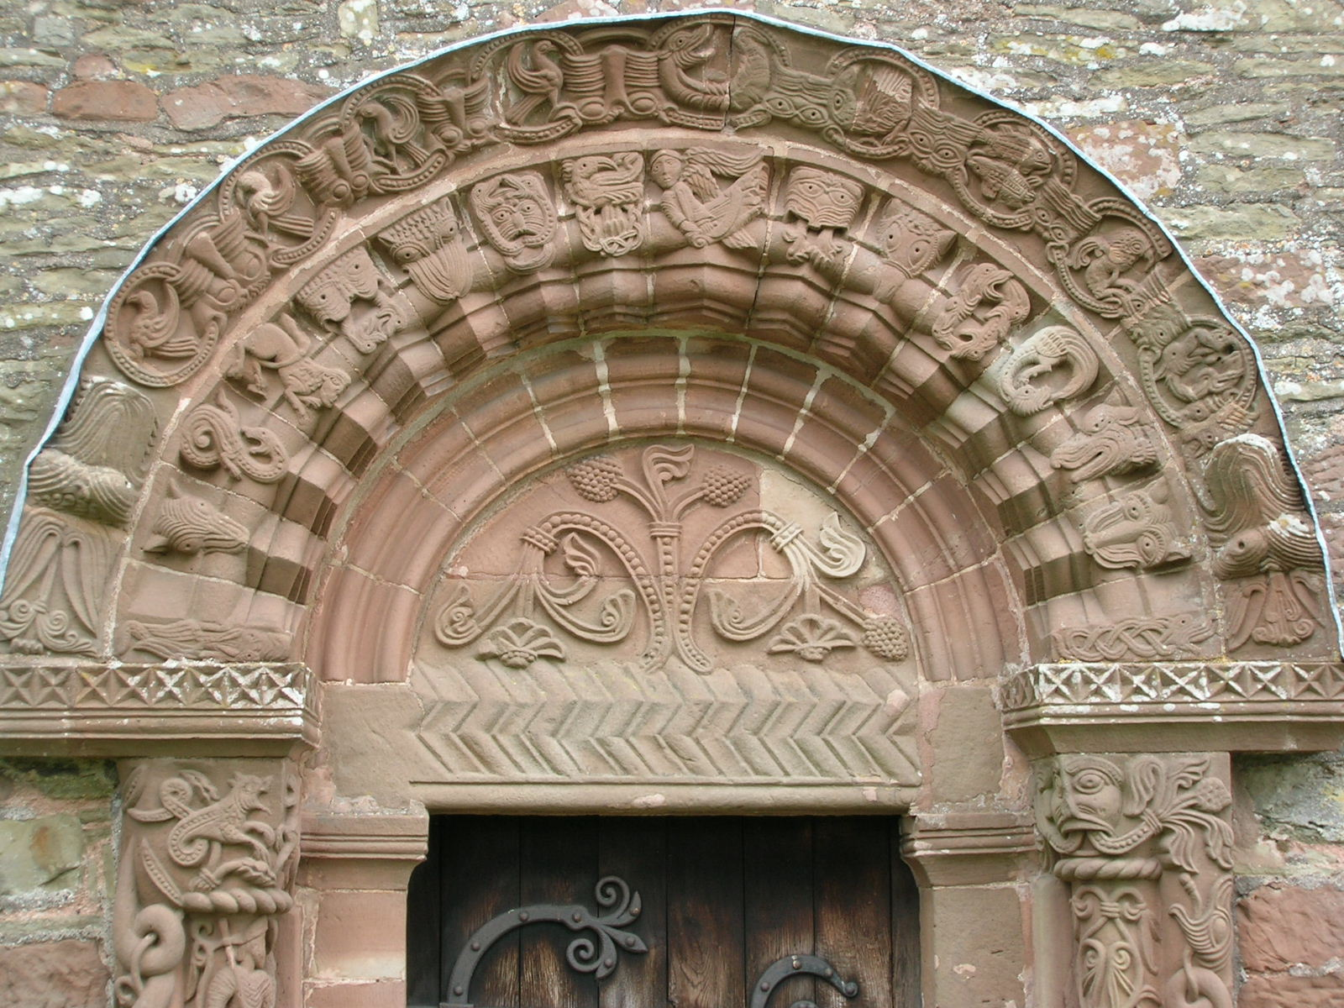
South Door, Kilpeck Church, Herefordshire. 12th C. Red sandstone.

Slide 8
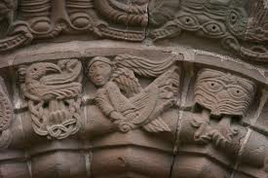

Slide 9
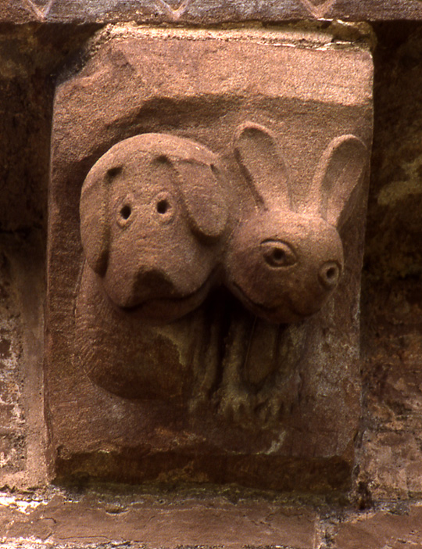

Slide 10
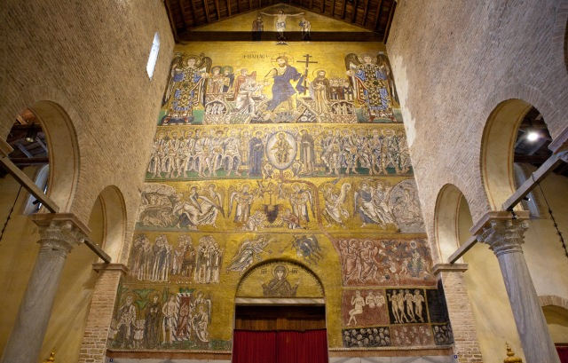
Last Judgement, Cathedral of Santa Maria Assunta, Torcello Island, Venice. 11th/12th C.

Slide 11
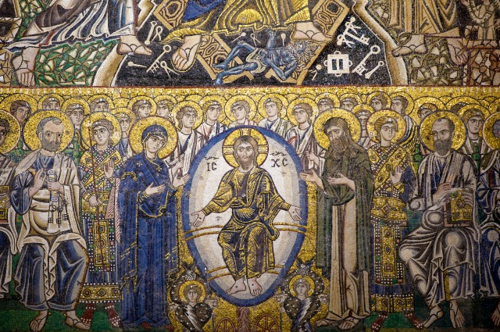
Last Judgement , Deësis detail, Cathedral of Santa Maria Assunta, Torcello Island, Venice. 11th/12th C.

Slide 12
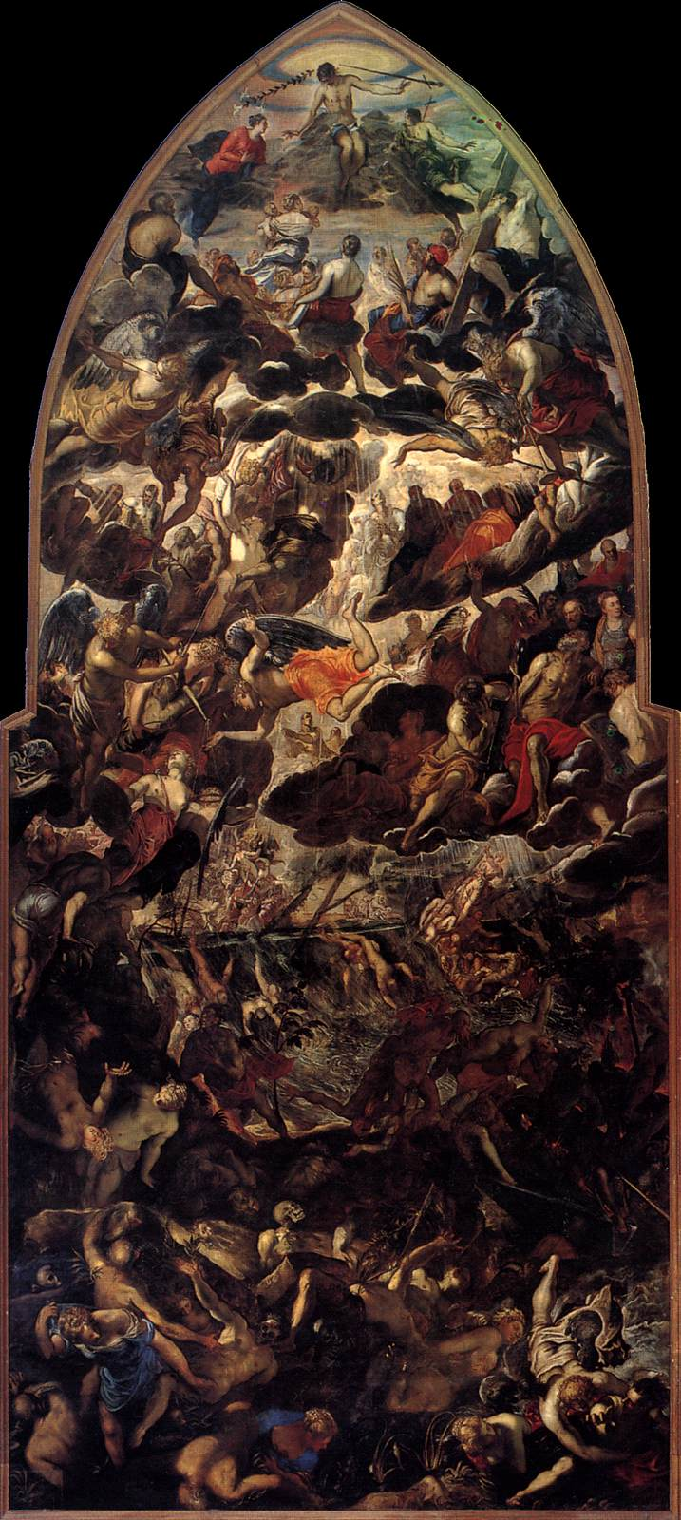
Tintoretto, Last Judgement 1560-62 (Madonna dell’Orto, Venice)

Slide 13
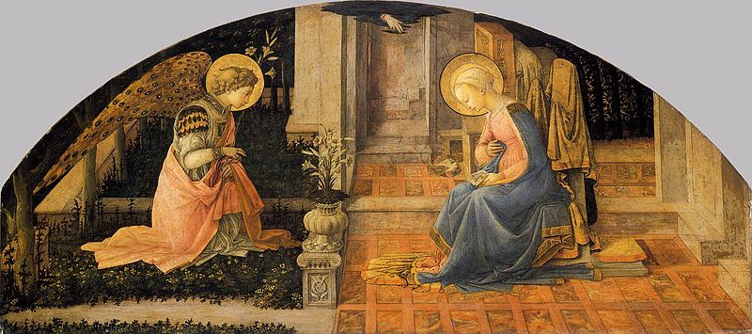
Fra Filippo Lippi, The Annunciation (1449)
National Gallery, London

Slide 14
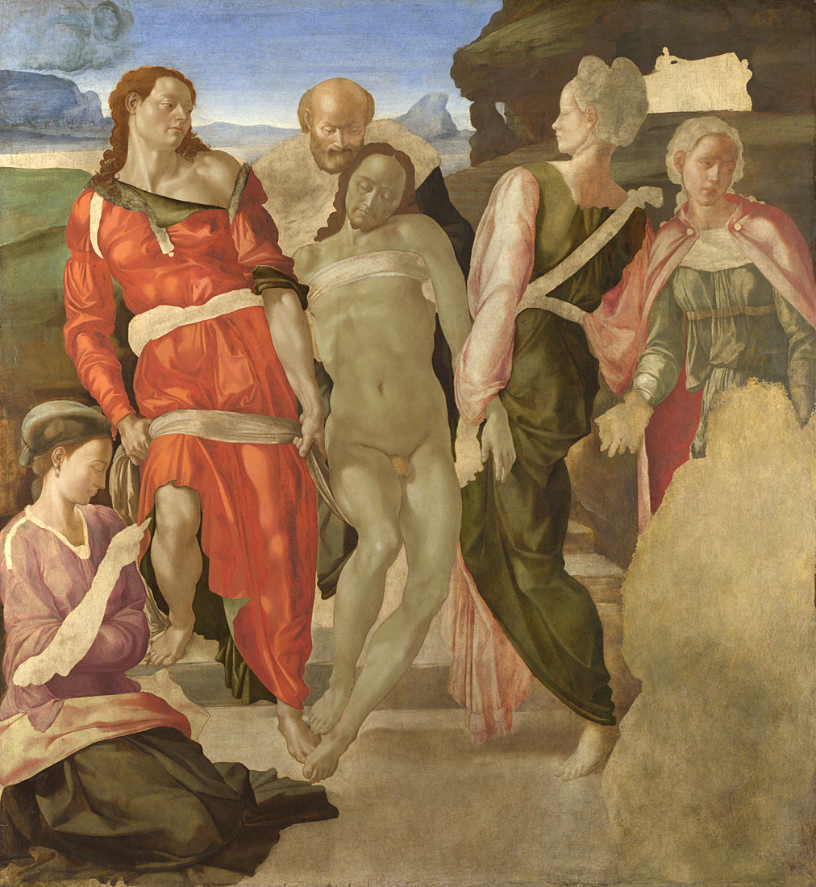
Michelangelo,
The Entombment. 1500-01.
Image courtesy of the National Gallery Picture Library.

Slide 15
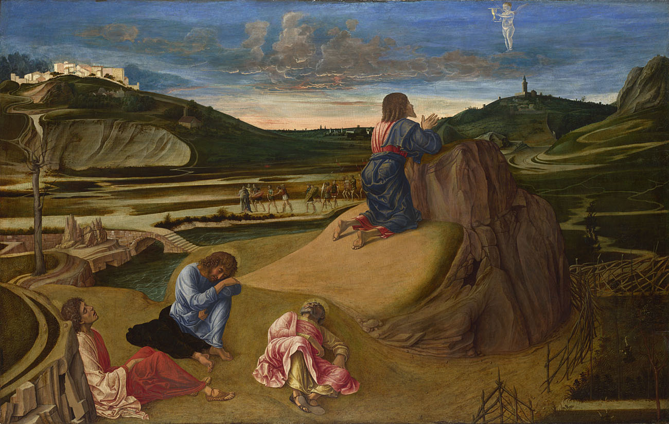
Giovanni Bellini, Agony in the Garden, c.1465. Image courtesy of the National Gallery Picture Library.

Slide 16
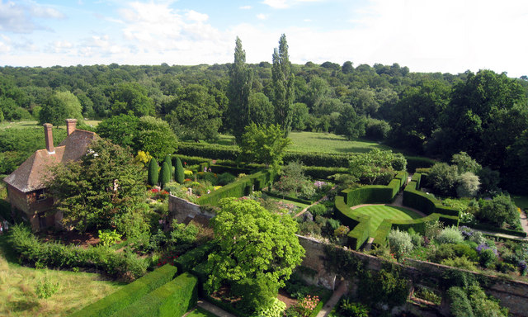

Slide 17
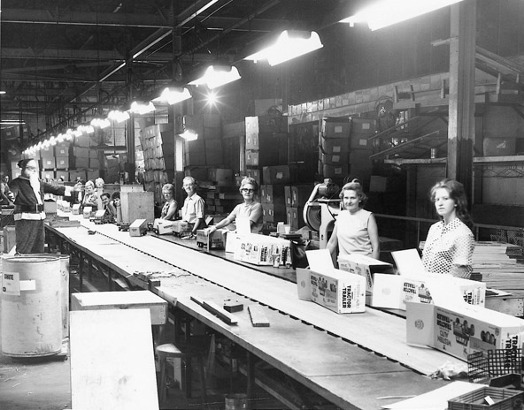

Slide 18
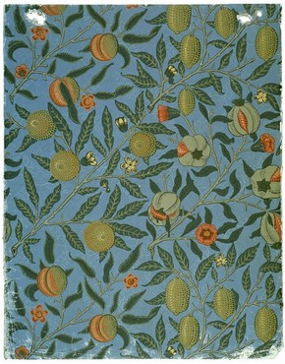
William Morris,
'Fruit' (or 'Pomegranate') wallpaper, 1866. Victoria & Albert Museum

Slide 19
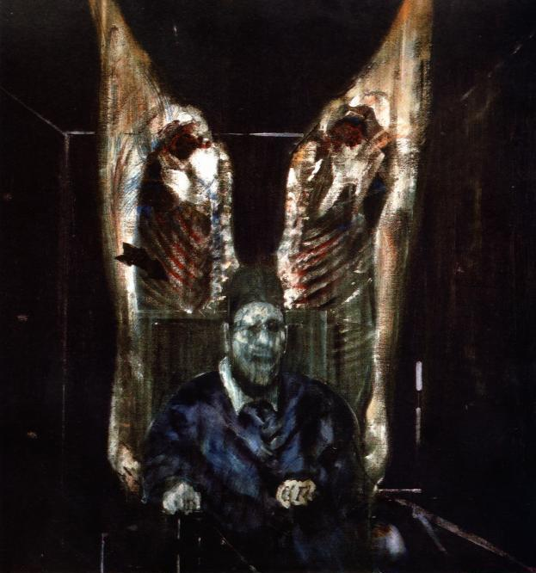
Francis Bacon, Figure with meat 1954. Oil on canvas, 129.9 × 121.9 cm, The Art Institute of Chicago, Harriott A Fox Fund

Slide 20
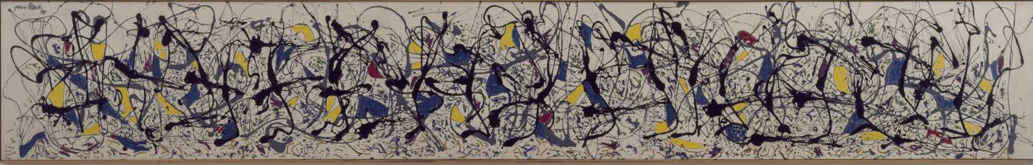
Jackson Pollock, Summertime, Number 9A, 1948. Tate Modern, London.

Slide 21
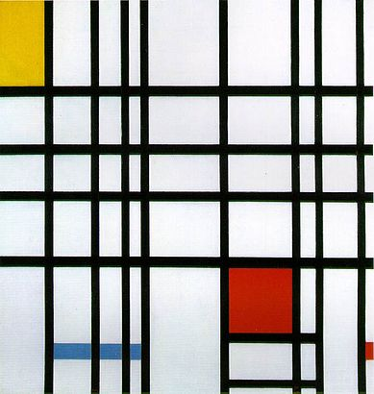
Piet Mondrian, Composition with Yellow, Blue, and Red, 1937–42.
Tate, London.

Slide 22
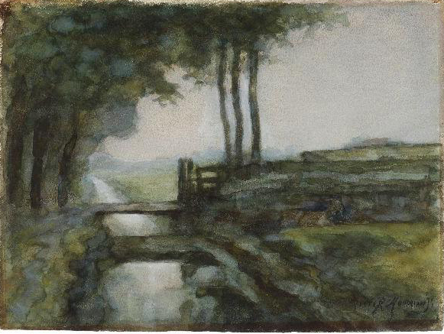
Piet Mondrian, Irrigation Ditch, Bridge and Goat, 1894-5, Gemeentemuseum, the Hague.

Slide 23
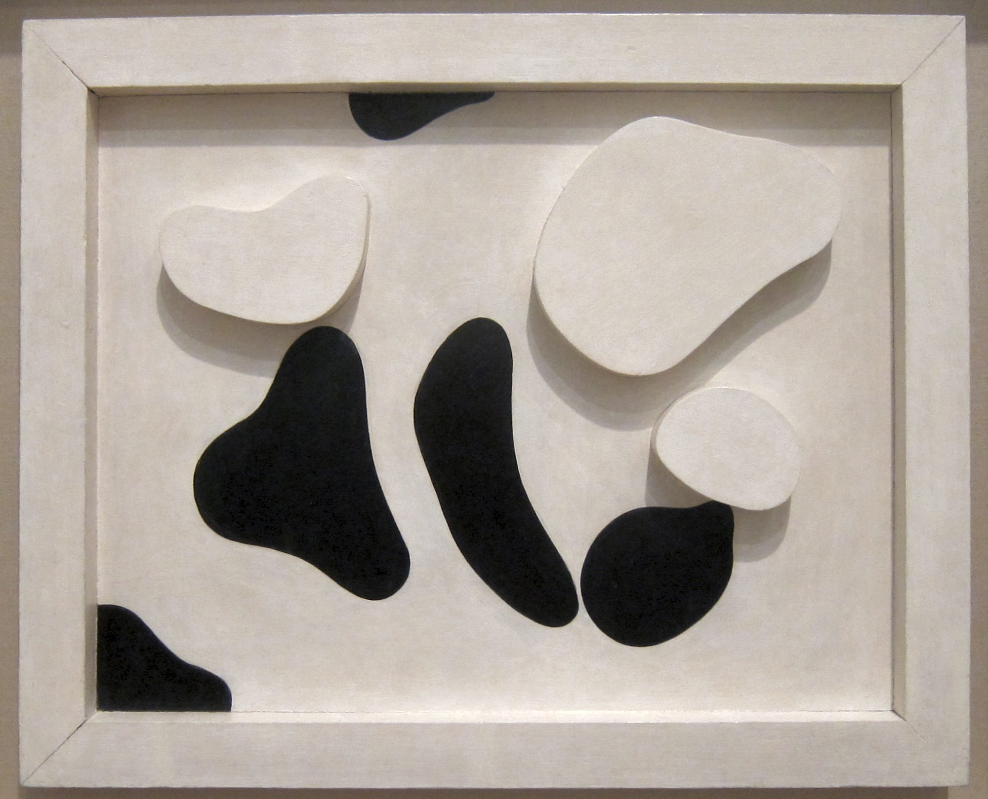
Constellation According to the Laws of Chance, aluminium sculpture by Jean Arp (Hans Arp), c. 1930, Tate Modern

Slide 24
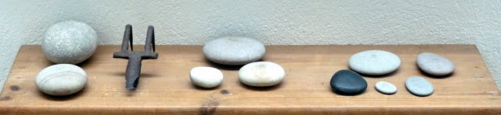
Pebbles at Kettle’s Yard, Cambridge

Slide 25
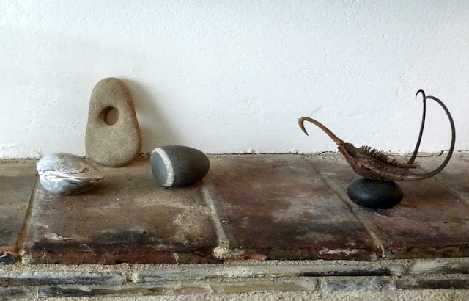
Pebbles at Kettle’s Yard, Cambridge

Slide 26
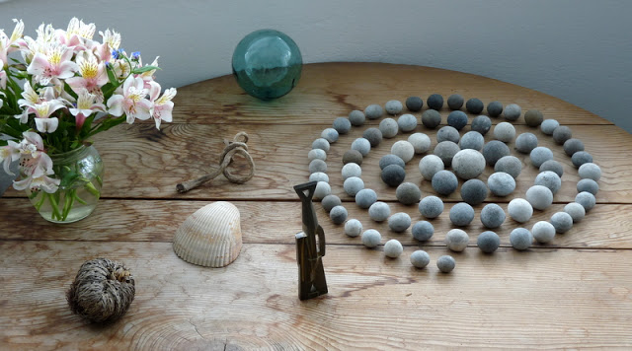
Pebbles at Kettle’s Yard, Cambridge

Slide 27
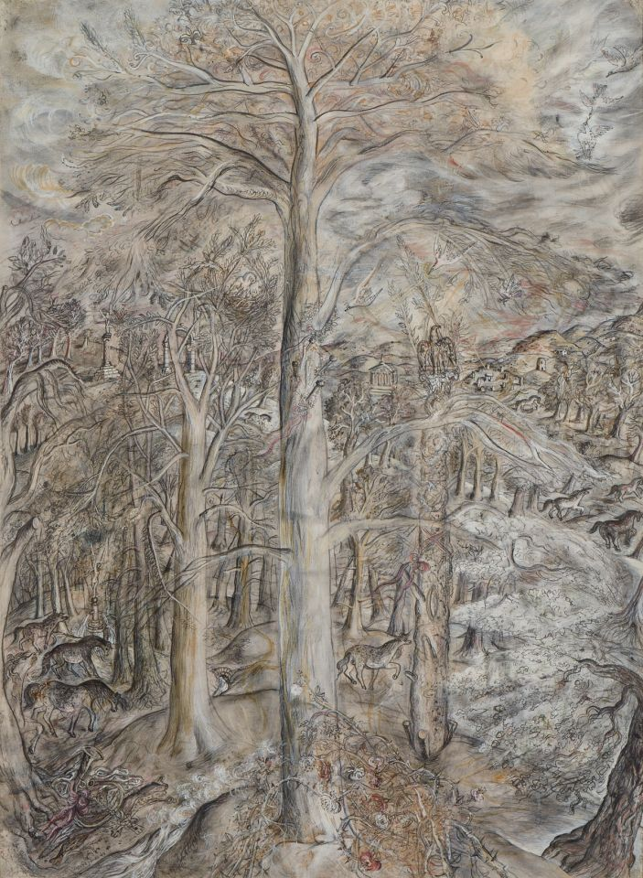
David Jones,
Vexilla Regis, 1948. Kettle’s Yard, Cambridge.

Slide 28
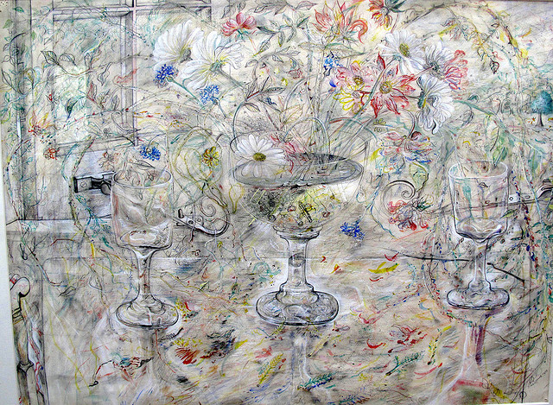
Flora in Calix Light, David Jones,1950, Watercolour and graphite on paper: Kettle's Yard House Gallery, Cambridge

Slide 29
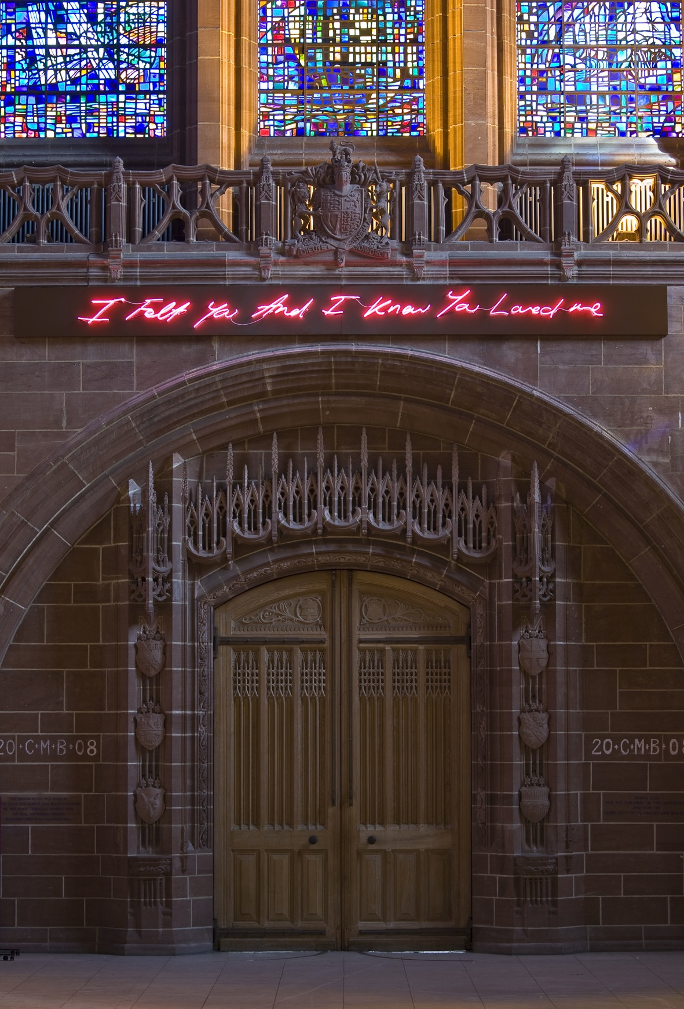
Tracey Emin (1963-), For You 2008 (Liverpool Cathedral, UK)

Slide 30
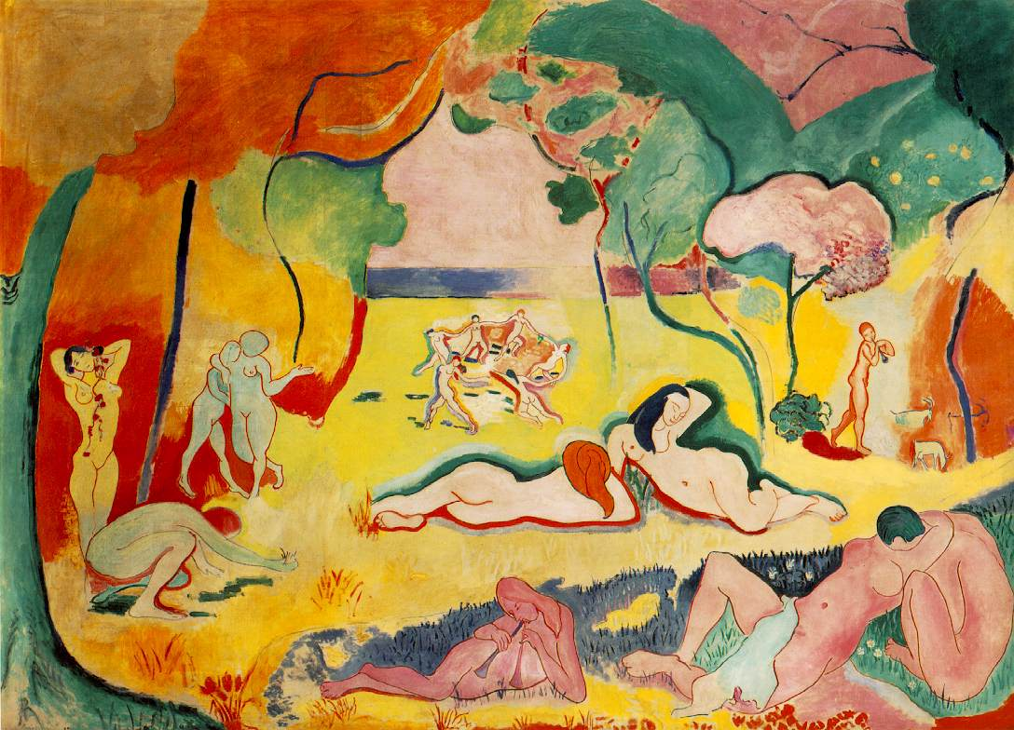
Henri Matisse, The Joy of Life 1905-6 oil on canvas 175 x 241 cm (Barnes Foundation, Pennsylvania).

