Slide 1
Escalation of Commitment
Who rides a tiger can never dismount.

Slide 2
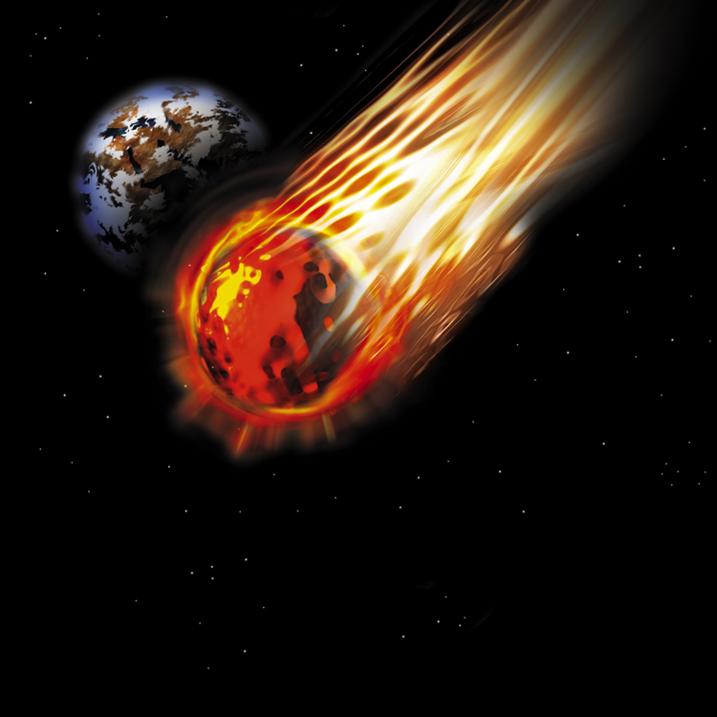
Is Your Project Becoming a “Black Hole”?

Slide 3
OVERVIEW
What is escalation?
What drives it?
What can individuals and organizations do to protect themselves against becoming embroiled in an escalatory spiral?

Slide 4
Escalation defined
persistence with an important line of activity beyond an economically defensible point.
Known more colloquially as “throwing good money after bad”.

Slide 5
Applies to…
any investment decision from being on “hold” on telephone to a multi-billion pound project.

Slide 6
BUSINESS EXAMPLES
Chicago sewer system “money down the drain”
Chinook Mark 3 helicopters
NHS electronic patient record system
2012 London Olympics
Amsterdam underground railway
Edinburgh tram system
Brandenburg airport
HS2?

Slide 7
ESCALATORY SPIRAL
Resources are invested.
Feedback begins to suggest important expectations may not be met.
There is an opportunity to persist or quit.
Consequences of persistence and quitting are unknown.

Slide 8
MAIN ESCALTION DRIVERS
Psychological
Social
Economic
Organizational
The simple passage of time

Slide 9
MAIN PSYCHOLOGICAL DRIVERS
Reluctance to incur waste
Risk-seeking behaviour
Ego
Confirmation traps

Slide 10
PSYCHOLOGICAL DRIVERS
Choose
As human beings we hate waste
You have two identical meals in the fridge.
One cost £8.99; the other was bought on special offer for £4.99.
Both have reached “use by” dates.
Which one do you eat?

Slide 11
ARE YOU RISK-SEEKING?
After a day at the races you have lost £95.
You have £5 left. Do you bet on the favourite at 3 to 1, or on a “long shot” at 20 to 1?

Slide 12

Choose between
accepting a definite loss of £10, 000, or
a 50% chance of losing £20, 000, or nothing at all?

Slide 13
PROSPECT THEORY
Predicts risk seeking behaviour occurs when decisions are expressed (framed) as a choice between losses.
A sure loss is less attractive than a much bigger loss uncertain loss.

Slide 14
IMPLICATIONS OF PROSPECT THEORY
Quitting means incurring a sure loss.
Persistence offers possibility of avoiding that loss altogether but at the risk of subsequently incurring an even bigger loss.

Slide 15

MONEY SUNK AND LOST
Sunk costs
investments made in anticipation of a return.
Should be ignored when deciding how to allocate resources in future because cannot influence outcomes.
Cost of a licence is irrelevant in deciding whether to continue drilling for oil.
BUT – sunk costs can exert a powerful hold on decision makers.

Slide 16
PSYCHOLOGICAL DRIVERS
Ego defensiveness
Underscored by
We find it almost impossible to believe that we could be wrong.
Confirmation traps – pay too much attention to what we want to hear;
Attribution traps – blame failure of others or on factors beyond our control.
Result: we may genuinely believe things are not too bad; success is just round the corner.

Slide 17
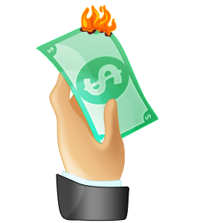
SOCIAL DRIVERS
The dollar auction ….

Slide 18
MORE SOCIAL DRIVERS
Desire to look good before an audience.
Perceived need to be consistent, fulfil promises, finish what we started.
Reputation and commercial credibility.

Slide 19
ECONOMIC DRIVERS
Exiting costs restrict freedom of action.
They include redundancy payments; contract penalties, leasehold obligations, costs of ripping up partly completed works etc…
Technical and economic “side-bets”

Slide 20
ORGANIZATIONAL DRIVERS
Pressure from vested interests
Internal politics and ‘non-decisions’
Administrative infra-structure created round project
Project becomes identified with values and purposes of the organization
Easier not to “rock the boat”

Slide 21
“Drifting idly towards eternity”
Escalating Indecision

Slide 22
ESCALATING INDECISION
Escalation can also result from the simple passage of time.

Slide 23
Side-bets
Incidental investments that eventually make it too expensive to change direction.

Slide 24

Time is …..?

Slide 25
Decision-makers may assume that the passage of time is somehow bringing them closer to their goal.

Slide 26
But the passage of time is not without cost.

Slide 27
Waiting begets waiting….

Slide 28

CURBING ESCALATION
Stop!!!!!
Think!!!!
What might you be getting into?

Slide 29
The Tao
Only by avoiding the beginning of things, can we escape their inevitable ends.

Slide 30
Consider opportunity costs
The true cost of anything is what we could have had instead.

Slide 31
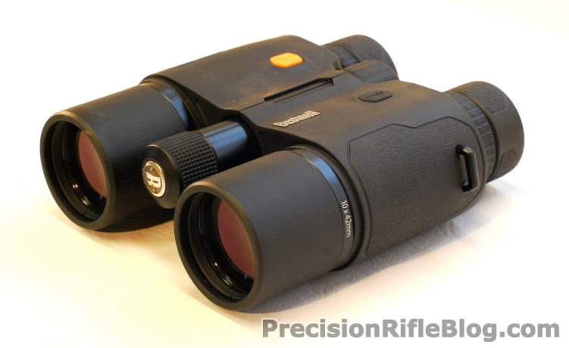
Be vigilant
Define expectations
Monitor progress against expectations
Set limits (including budgets, mental or financial)
Stick to those limits
Active decisions

Slide 32
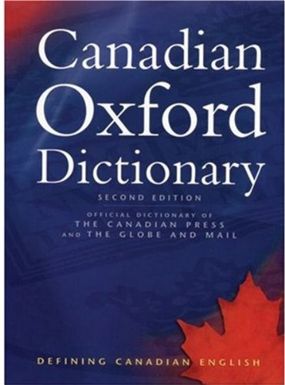
Think the unthinkable …
Is there a “dictionary”?

Slide 33
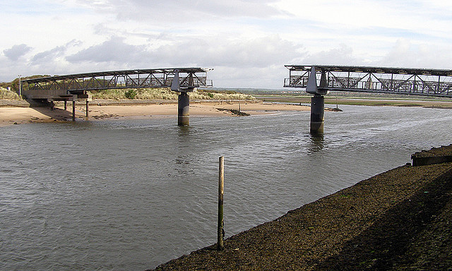

Slide 34
Critical distinction
Not what has been done
But what remains to be done

Slide 35
THINK
How probable is success?
What am I not hearing?
What benefits will this bring?
What could persistence end up costing?

Slide 36

Don’t Institute a “Death March”

Slide 37
Real options thinking
An option buys the right but not the obligation to take an action in the future.
For example, to acquire land and licence but postpone drilling until oil reaches a certain price – known as delayed entry option.

Slide 38

Real options theory …
Buy an escape from uncertainty instead of guessing
Price of option fixed
Potential gains unlimited

Slide 39
Options can exacerbate escalation
Not always clear when safe to exercise
Can be more costly than living with uncertainty
Uncertainty always lurks

Slide 40

Even so, before exiting …
THINK: What options would be destroyed?

Slide 41

A nice problem
If an opportunity offering a better return becomes available, we should switch even though it means abandoning a successful line of activity.
But maybe only for a very big gain.
But how big is big enough?

Slide 42
Finally …
Nothing is certain, perhaps not even uncertainty itself.
Thank-you for listening.
Good luck!

