Slide 1
The Run-away Universe
Joseph Silk (IAP/JHU/Oxford)
Gresham Lecture, 1 March 2017

Slide 2
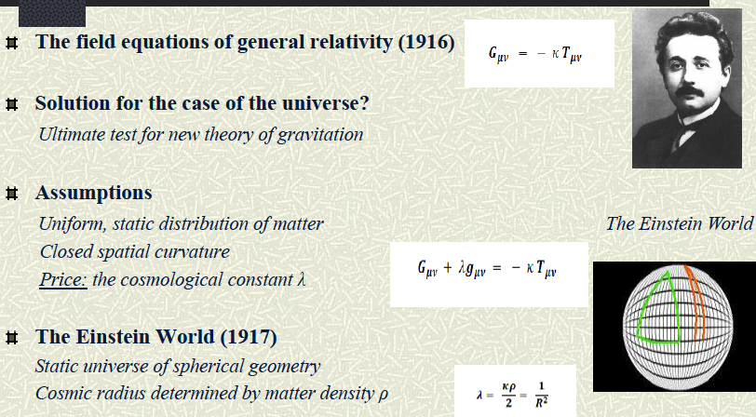
1917: Einstein’s first attempt at cosmology

Slide 3
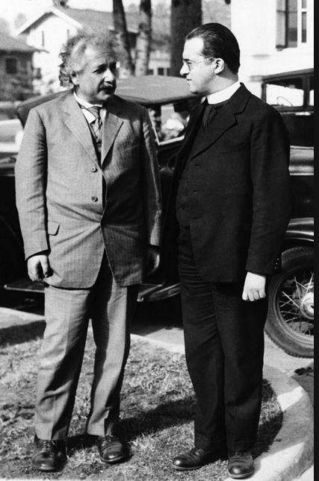
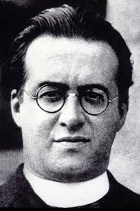
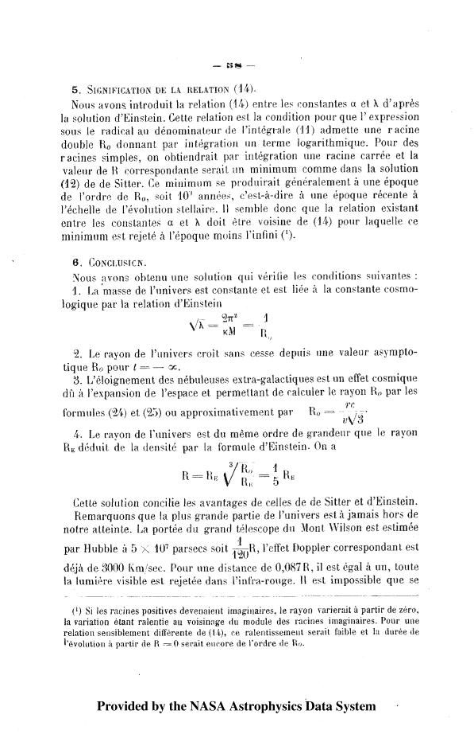
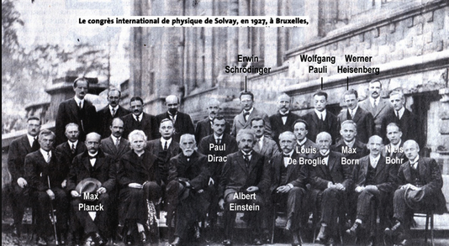
The radius of space began at zero; the first stages of the expansion consisted of a rapid expansion
Lemaître 1927 Ann. Soc. Scient. de Bruxelles
Notes:
Let us begin with Lemaître’s paper of 1927 (translated 1931) : « A homogeneous Universe of constant mass and growing radius accounting for the radial velocity of extragalactic nebulae » (Monthly Notices of the Royal Astronomical Society, 91, 1930-1931)
« 6. Conclusion.
We have found a solution such that:
1. The mass of the universe is a constant…
2. The radius of the universe increases without limits from an asymptotic value R₀ for t = −∞…
3. The recession velocities of extragalactic nebulæ are a cosmical effect of the expansion of the universe. »

Slide 4
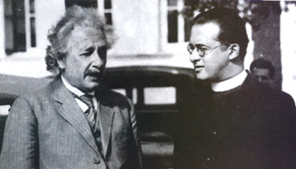
Solvay Conference 1927
Einstein: Your calculations are correct, but your physics is atrocious…This is too much… suggesting… a creation.
Lemaître: The hypothesis of the primeval atom is the antithesis of a supernatural creation.
Notes:
«J’ai rencontré Einstein pour la première fois, il y a vingt-neuf ans. Il était venu à Bruxelles assister au congrès Solvay de 1927. En se promenant dans les allées du parc Léopold, il me parla d’un article, peu remarqué, que j’avais écrit l’année précédente sur l’expansion de l’univers et qu’un ami lui avait fait lire. Après quelques remarques techniques favorables, il conclut en disant que du point de vue physique cela lui paraissait tout à fait abominable.»
10 ans auparavant, introduction de la constante cosmologique… pour sauver le caractère statique de l’univers
<<inspirée par le dogme chrétien de la création, et injustifiée sur le plan de la physique>>

Slide 5
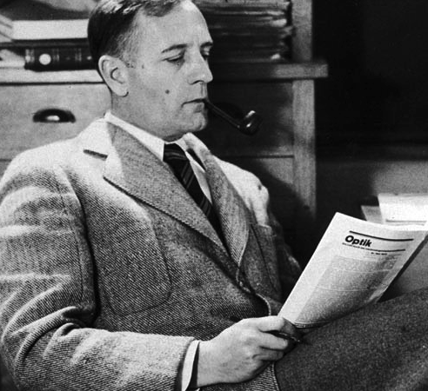
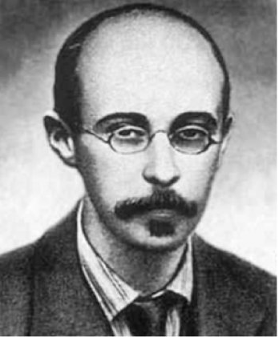
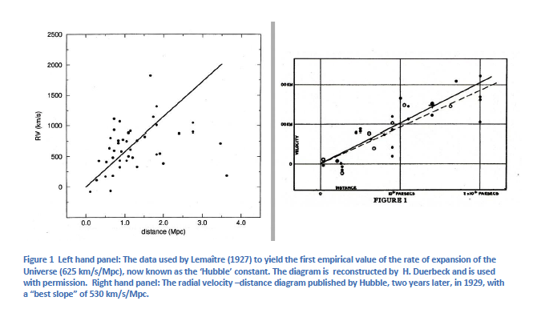
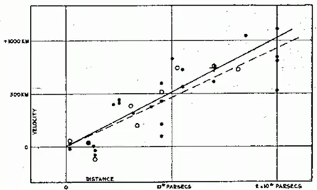
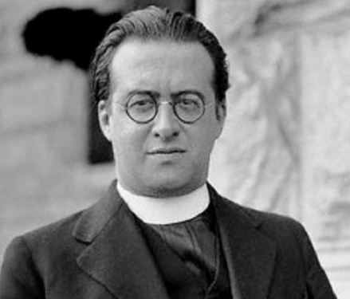
1929: Hubble obtained
slope H=530 km/sec/Mpc
Alexander Friedmann: 1924
prediction of expansion
1927: Georges Lemaitre predicted expansion, obtained H=625 km/secMpc but published in French
velocity
distance

Slide 6
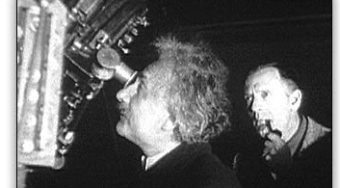
Einstein saw the evidence…
Einstein and Hubble at Mount Wilson in 1931

Slide 7
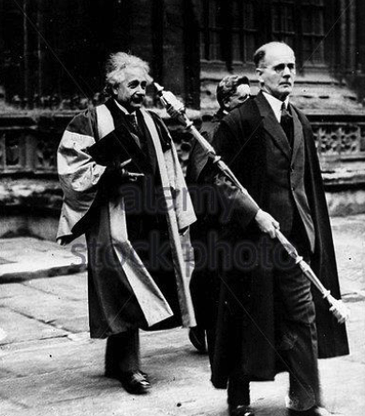
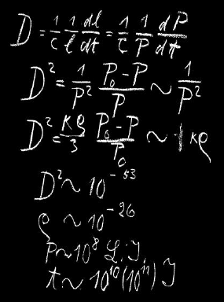
Einstein still didn’t get it quite right
Einstein’s Oxford blackboard from 1931

Slide 8
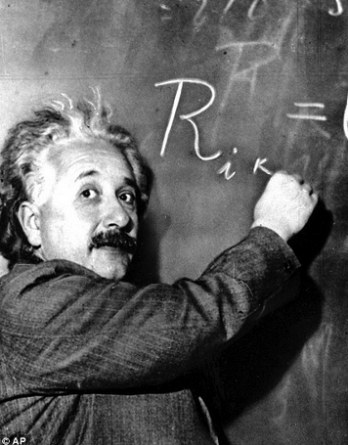
Einstein made several errors in his first dynamical model of cosmology
density was wrong
age of the universe was wrong
size of the universe was wrong
He got away with it by publishing
in an unrefereed journal in 1931!
But the band wagon rolled on

Slide 9
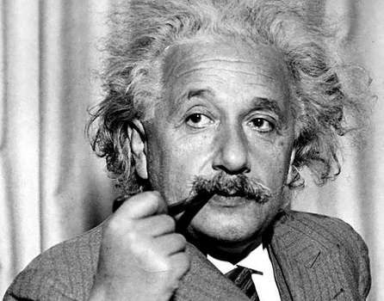
Einstein: 1933, on Lemaitre
This is the most
beautiful and
satisfactory
explanation of
reation I have
ever listened to.

Slide 10
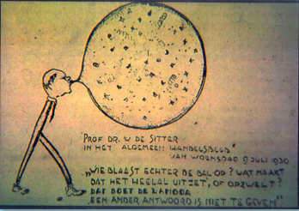

Slide 11
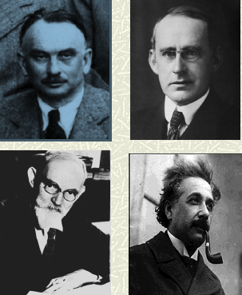
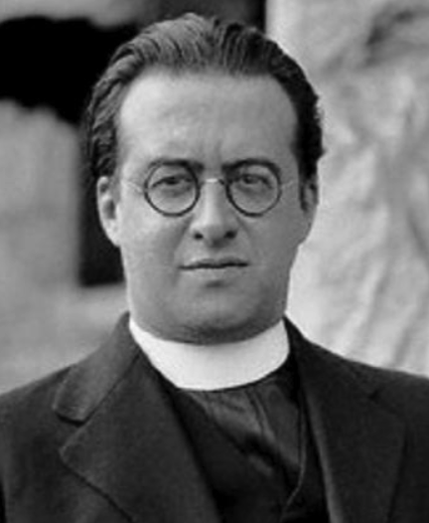
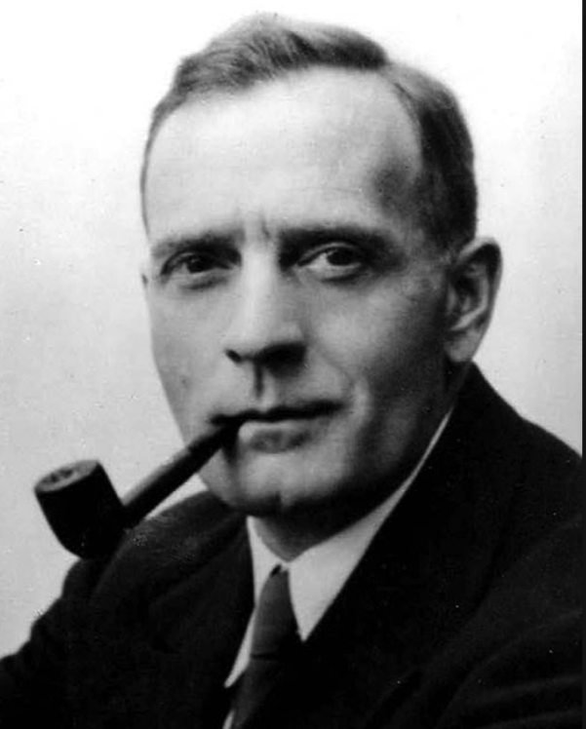
The big bang gang
1931: a magical year
Willem de Sitter
Albert Einstein
Arthur Eddington
Edwin Hubble
Georges Lemaitre

Slide 12
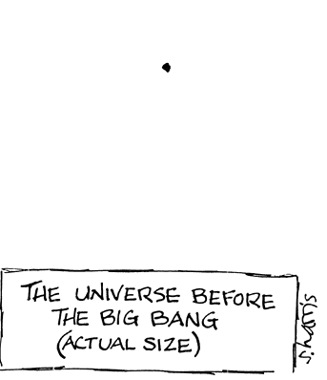
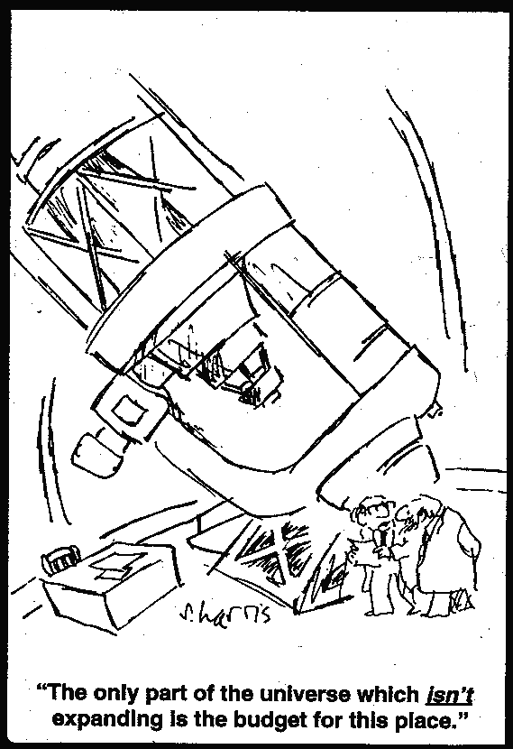
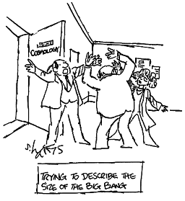

Slide 13
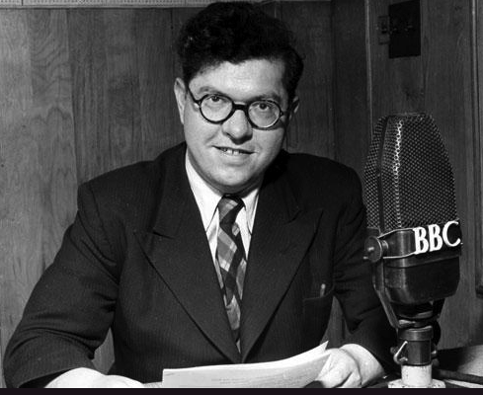
Origin of the Big Bang
The evolution of the world can be compared to a display of fireworks that has just ended: some few red wisps, ashes and smoke. Standing on a well-chilled cinder, we see the slow fading of the suns, and we try to recall the vanished brilliance of the origin of the worlds.
Georges Lemaitre 1931
Fred Hoyle on the Big Bang:
it's an irrational process, and
can't be described in scientific terms
Fred Hoyle 1951

Slide 14

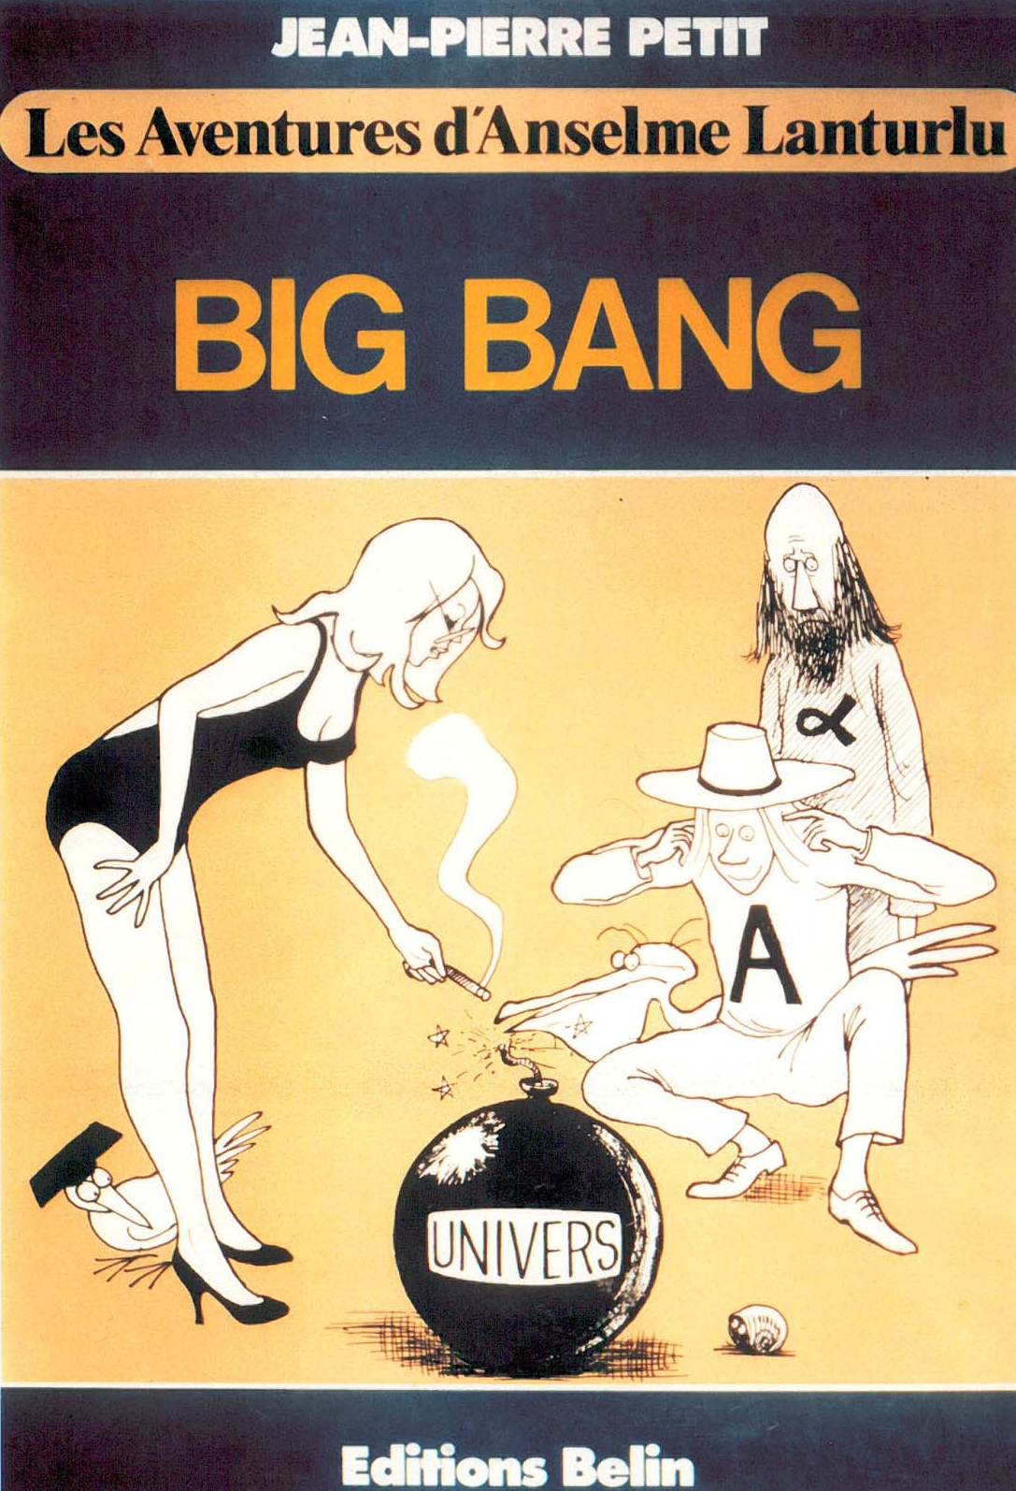
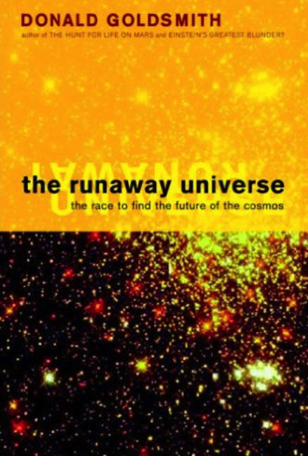
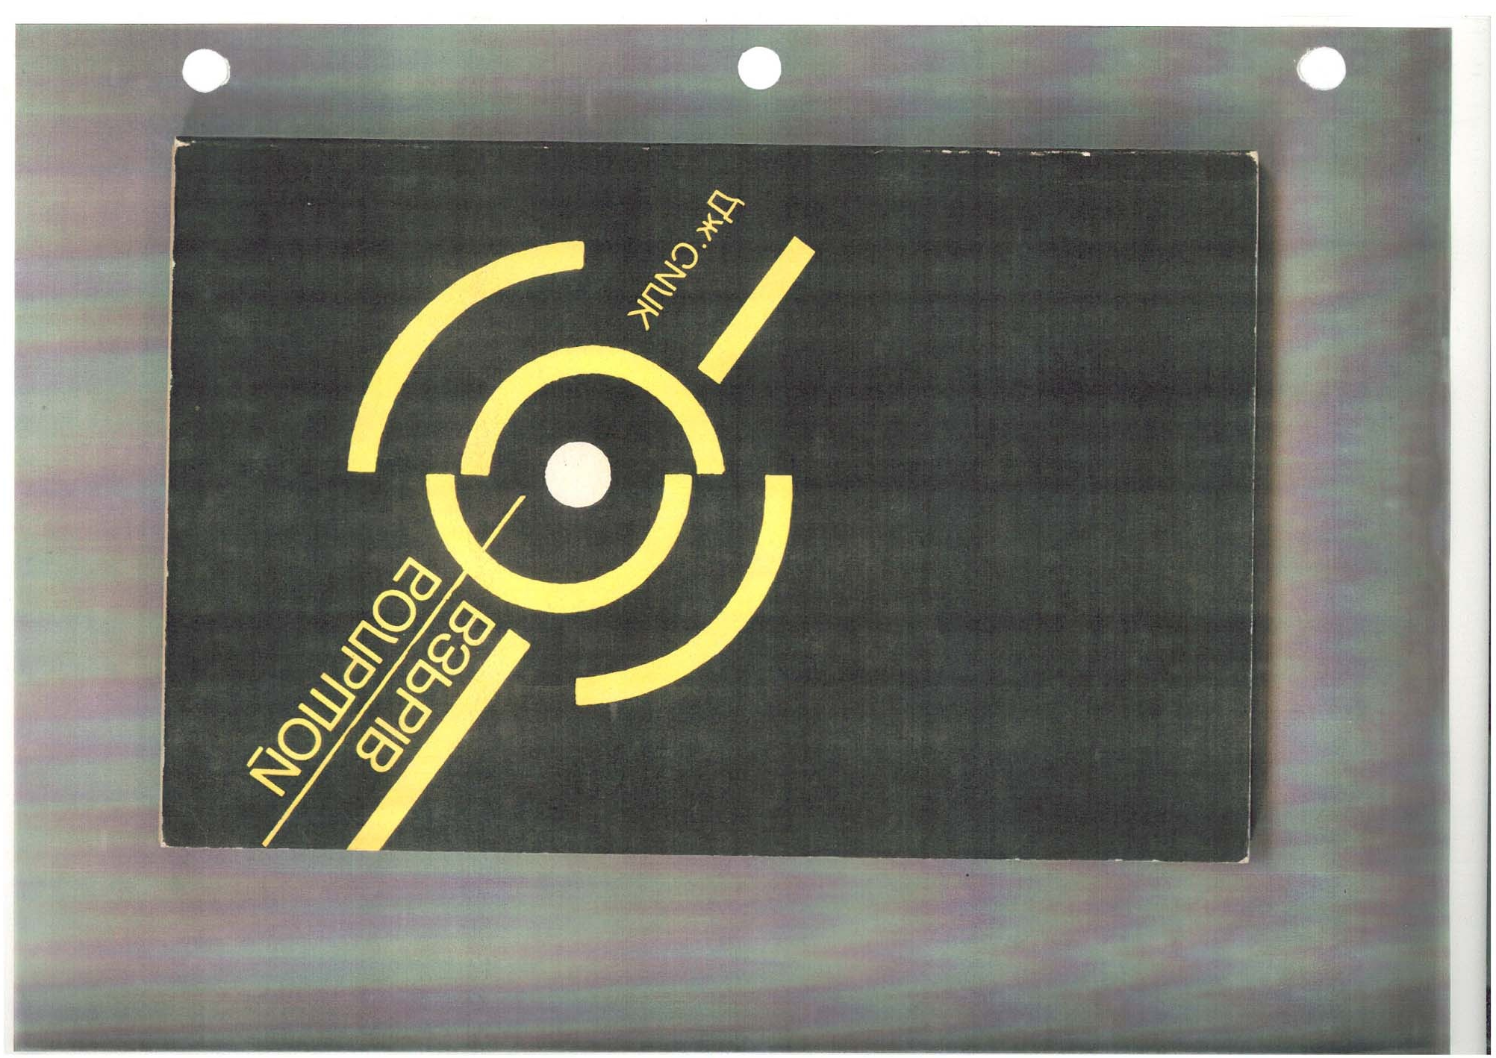
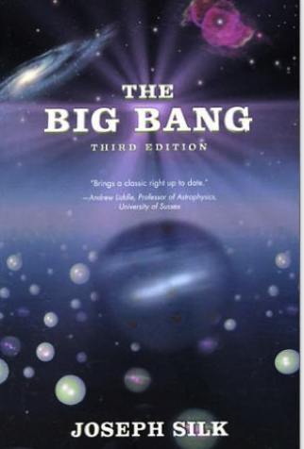
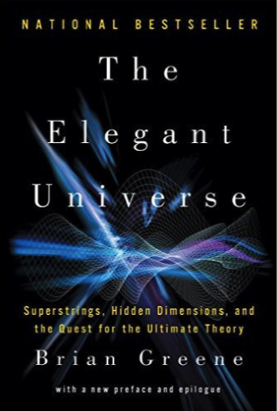
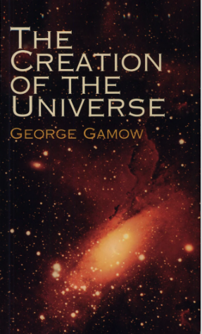

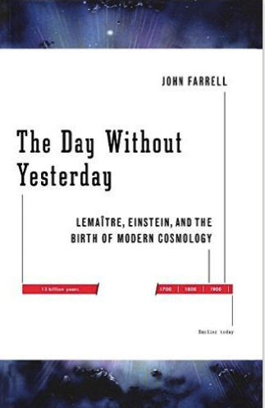
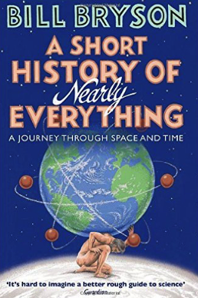

Slide 15
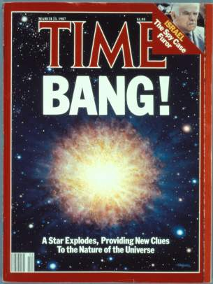
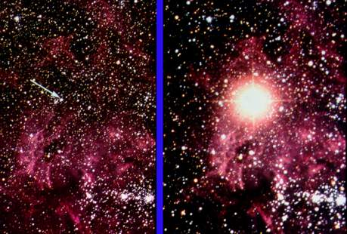
February 24 1987
about 160000 light years away
Before
After
Supernovae of Type 1a are perfect bombs

Slide 16
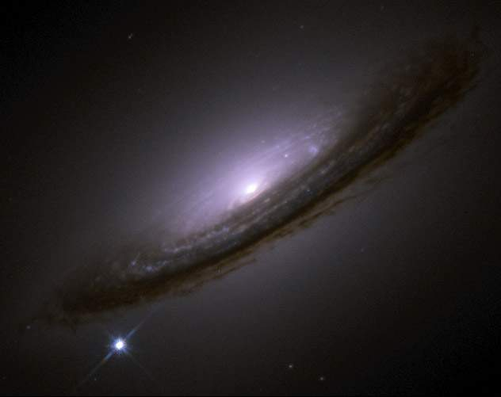
Supernovae in remote galaxies…
Distant type Ia supernovae are too faint!

Slide 17
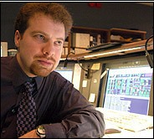
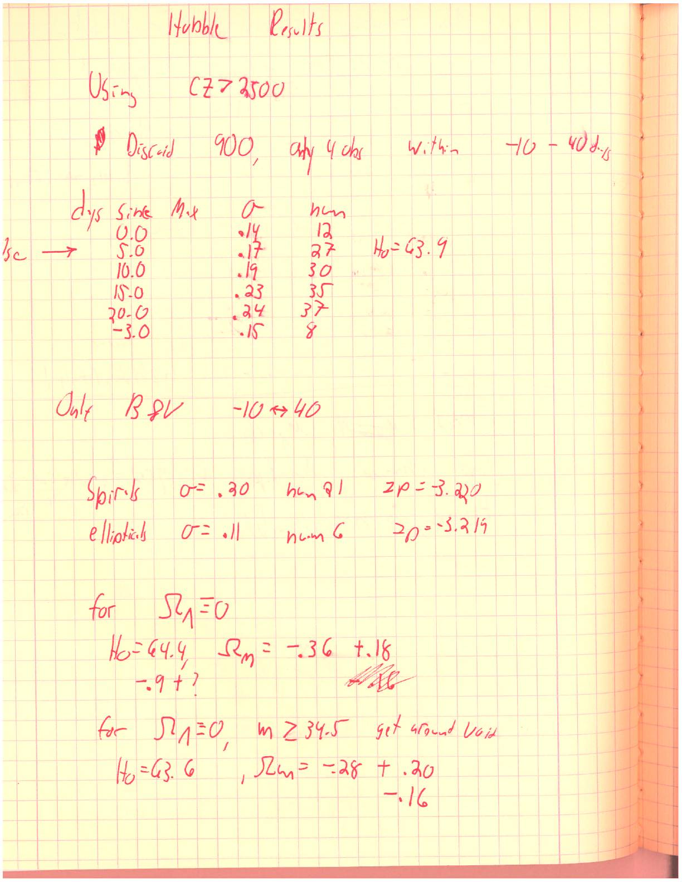
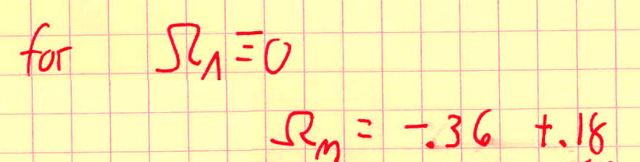
EUREKA moment
Adam Riess was leading our efforts in the fall of 1997 to increase our sample of 4 objects to 15.
Adam Riess lab book, Fall 1997:
found the total sum of mass to be negative - which meant acceleration

Slide 18
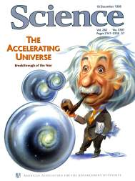
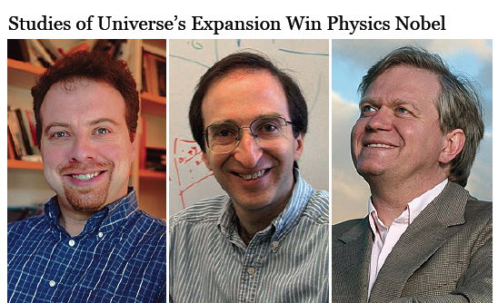
DARK ENERGY accelerates
measure dark matter minus dark energy
Adam Riess
Saul Perlmutter
Brian Schmidt

Slide 19
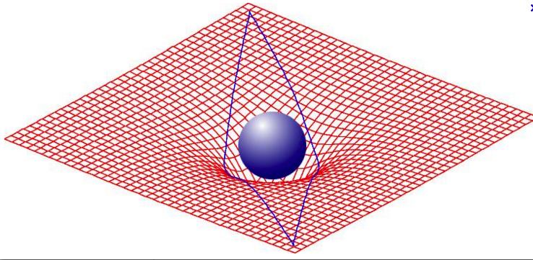
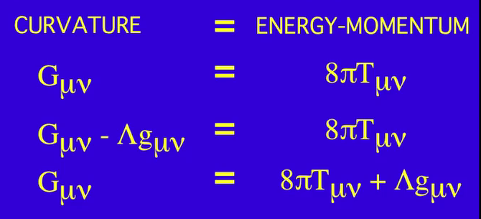
matter curves space and space directs matter
we measure dark matter minus dark energy

Slide 20
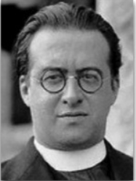
Who invented dark energy?
“The theory of relativity suggests that, when we identify gravitational mass and energy, we have to introduce a constant. Everything happens as though the energy in vacuo would be different from zero. In order that motion relative to vacuum may not be detected, we must associate a pressure to the density of energy of vacuum. This is essentially the meaning of the
cosmological constant Λ which corresponds
to a negative density of vacuum.”
Georges Lemaitre 1933

Slide 21
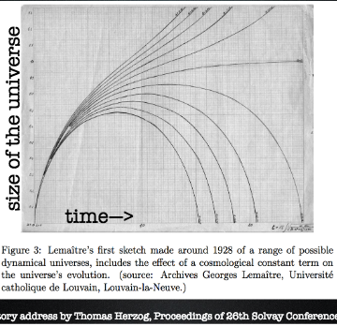
Log(distance)
Lemaitre’s expanding
universe models (1928)
?
Hubble
Lemaitre
80 years progress
redshift
21
Betoule + 2014
Notes:
21

Slide 22
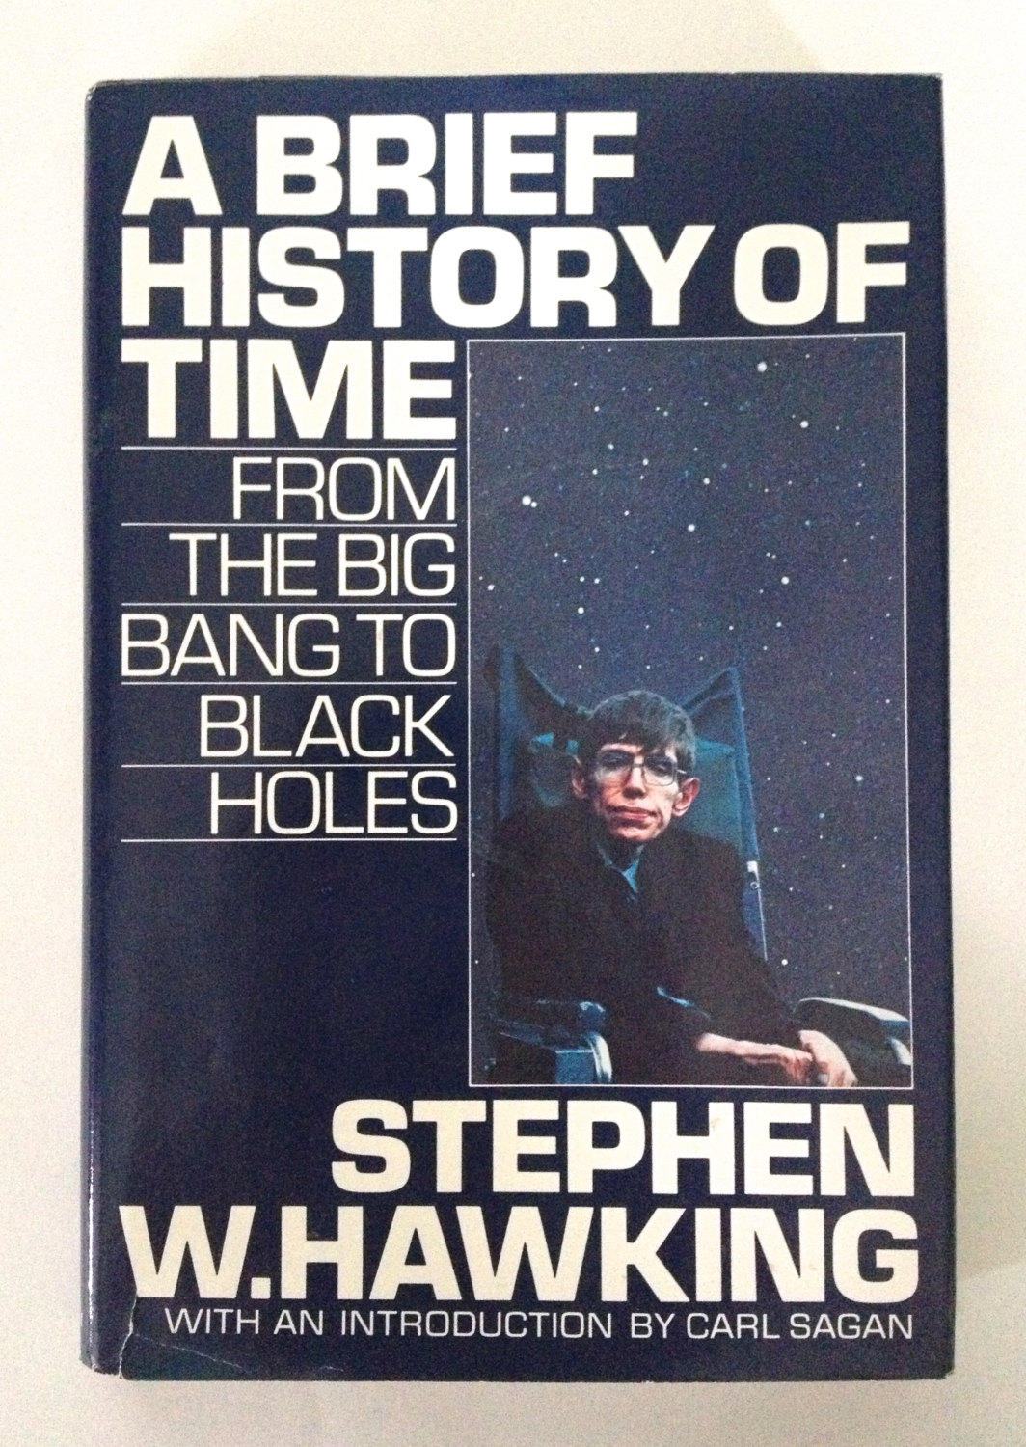
Was there something or was there nothing?
It is said that there’s no such thing as a free lunch. But the universe is the ultimate free lunch.
What is it that breathes fire into the
equations and makes a universe for
them to describe?... Why does the
universe go to all the bother of existing?
The universe would be completely self-contained and not affected by anything outside itself. It would neither be created nor destroyed. It would just BE.
A physics beginning!
Stephen Hawking 1988

Slide 23
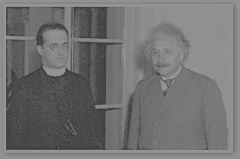
A physical beginning of the universe
« the radius of the space grows with time… it is
unavoidable that precedently it was smaller and
smaller. A naught value of the radius induces a
physical beginning (..and..) does not
deserve anymore the title of creation out of nothing »
Georges Lemaitre 1963
Notes:
With the zero value of the radius of the universe, you have no more concurrence between a physical extrapolation to the preworld and a supernatural suspension of the extrapolation : you just get a natural stopping point.

Slide 24
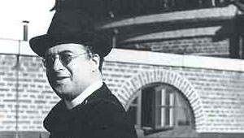

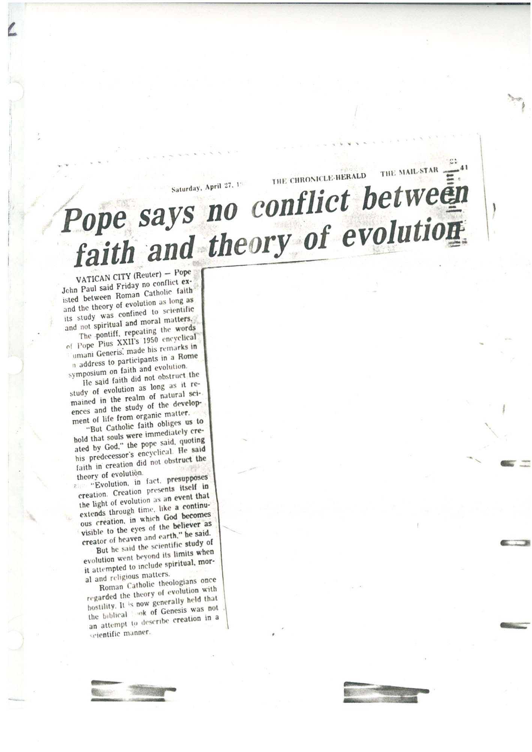
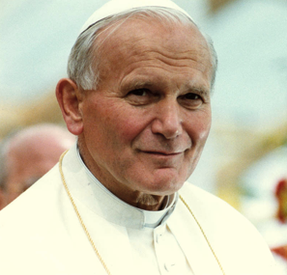
Science and religion
Everyone who believes in a supreme being
believes also that God is essentially hidden
and may be glad to see how present physics
provides a veil hiding the creation.
Georges Lemaitre
1931
1996
Pope Francis 2014
Pope John Paul 1996
The theories of evolution and the Big Bang are real and God is not “a magician with a magic wand”

Slide 25
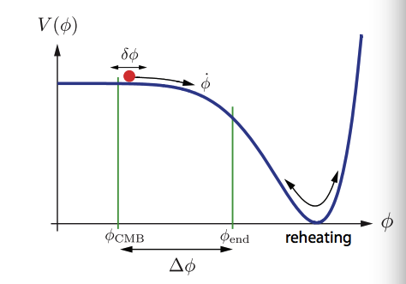




INFLATION
Slow roll
p=-ρ
a(t)~ e^{H”t}

Slide 26





1980s inflation made 3 predictions:
Alan Guth
flatness of space
2. size of the universe
Andrei Linde
primordial density fluctuations
Just 6 numbers
2017: Why we trust inflation
Universal spatial fluctuations
Phase coherence……acausality
2-point correlation function, polarization
Near scale-invariance n_{s} = 0.9667+/- 0.004
Gaussianity of fluctuations f_{NL} δΤ/Τ< 0.01%
Gravity wave background T/S < 0.08

Slide 27
The very early universe

Slide 28

observe
75%
4%
21%
predict
The worst prediction in physics!

Slide 29


Because multiverses can explain
anything, the answer is likely to
be there is none
George Ellis 2015

Slide 30
The authors of this new cosmology are primarily concerned about the great difficulty which must face all systems that contemplate a changing universe, namely, how can we conceive it to have begun? They are not content to leave this question unanswered until further knowledge comes; all problems must be solved now. Nor, for some reason, are they content to suppose that at some period in the distant past something happened that does not continually happen now. It seems to them better to suppose that there was no beginning and will be no ending to the material Universe, and therefore, tacitly assuming that the universe must conform to their tastes, they declare that this must have been the case. But if we must really answer all questions immediately, is their solution in fact more intellectually satisfying than that of a special creation?
Herbert Dingle, Presidential address, RAS: 1951
referring to steady state cosmology

Slide 31
We may need to wait for a new Einstein
to settle the problem of quantum gravity
….and the multiverse

Slide 32


the future of the universe
today
Our horizon in 140 billion years

Slide 33


Lifetime is
a trillion years

Slide 34







THE FUTURE FOR DARK ENERGY
E-ELT
PLANCK
EUCLID
JWST
DES
KECK ARRAY

