Slide 1

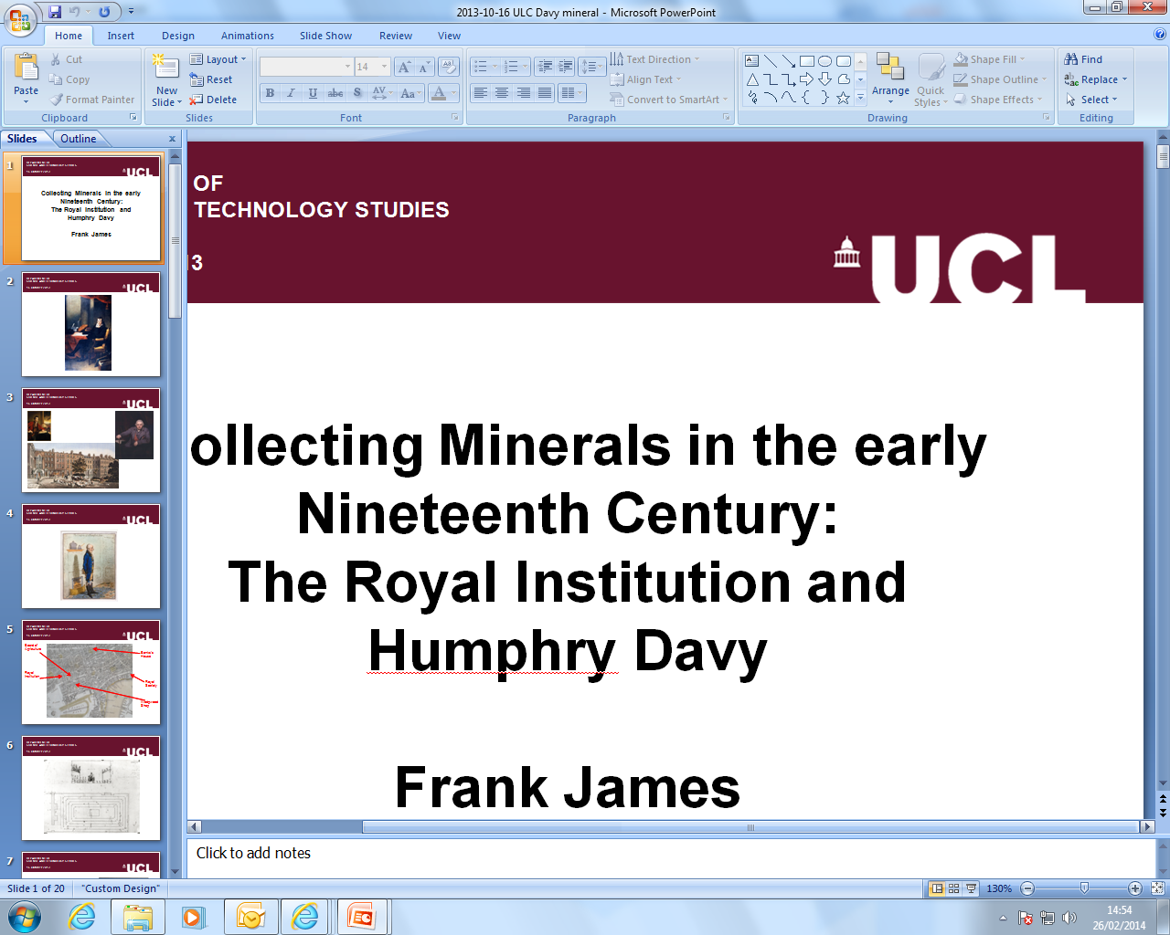
Safety Underground: Mining and the Miners' Lamp
Frank James
Gresham College
1 June 2015

Slide 2
An instance for Bacons spirit to behold – Davys magic lantern – The Miners Davy &c Every philosopher must view it as a mark of subjection set by Science in the strongest holds of nature
Michael Faraday at the City Philosophical Society, 16 July 1817
Gresham College
1 June 2015

Slide 3
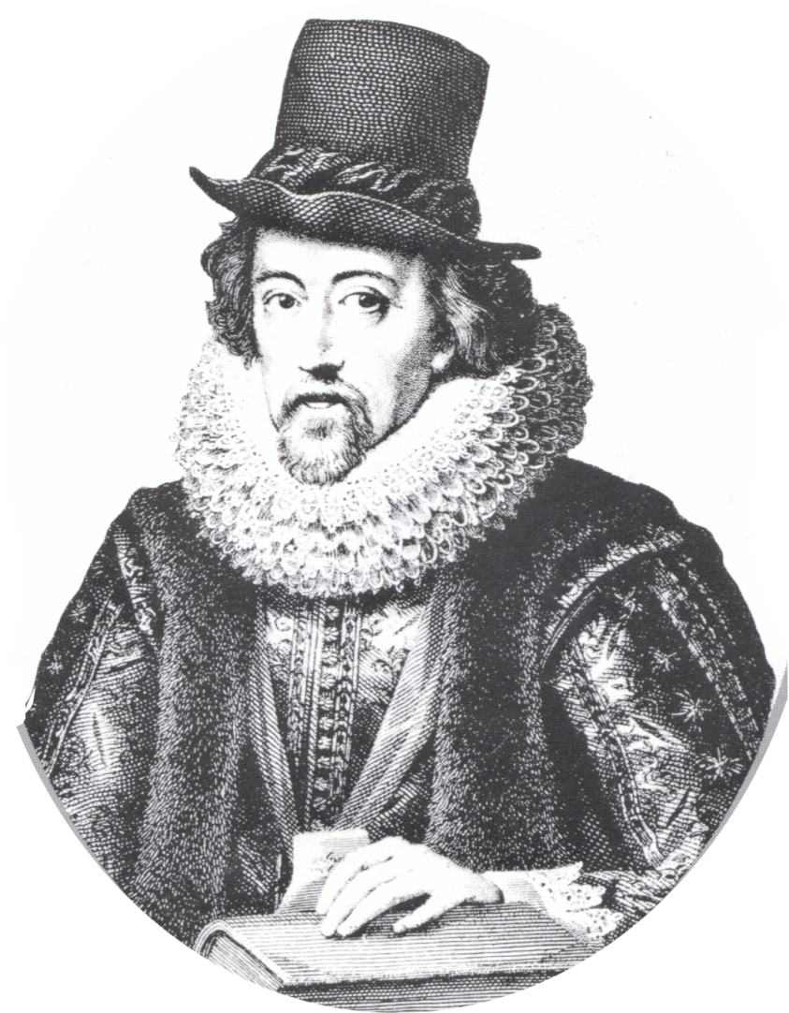
knowledge itself is power
Francis Bacon, Meditationes Sacrae, London, 1597, p.13
Gresham College
1 June 2015

Slide 4
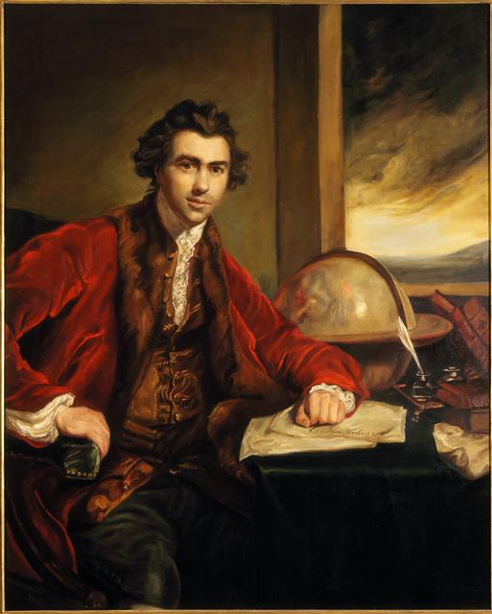
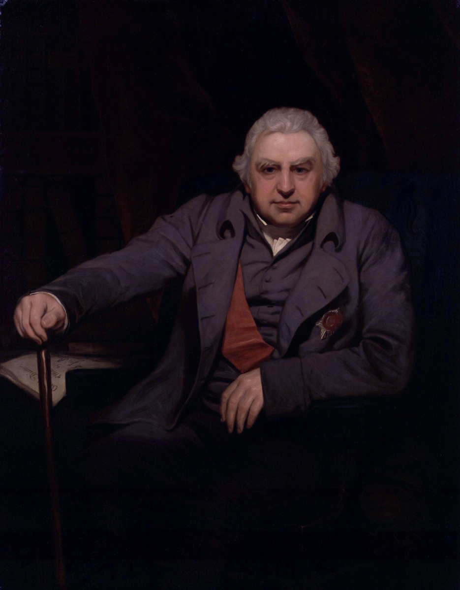
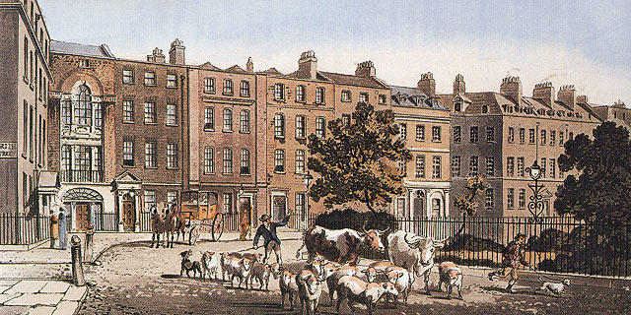
Gresham College
1 June 2015

Slide 5
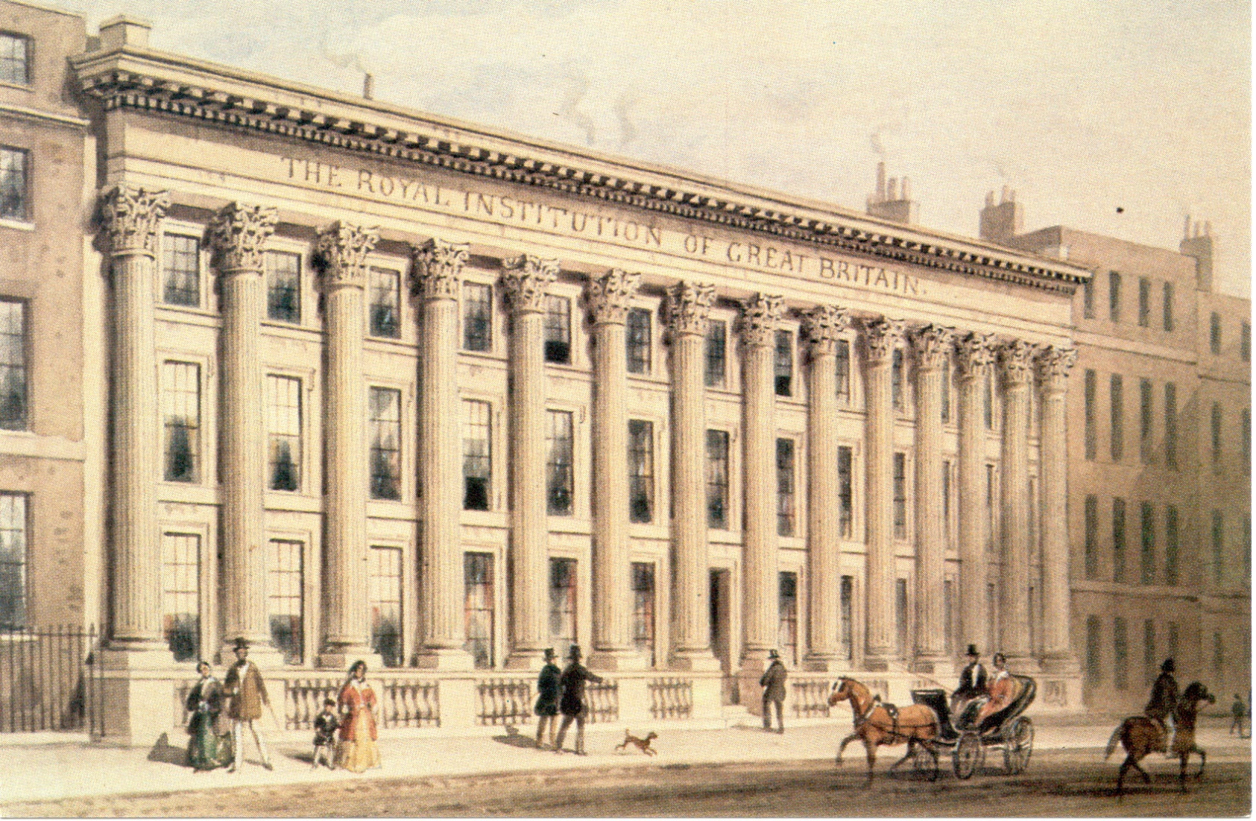
Gresham College
1 June 2015

Slide 6
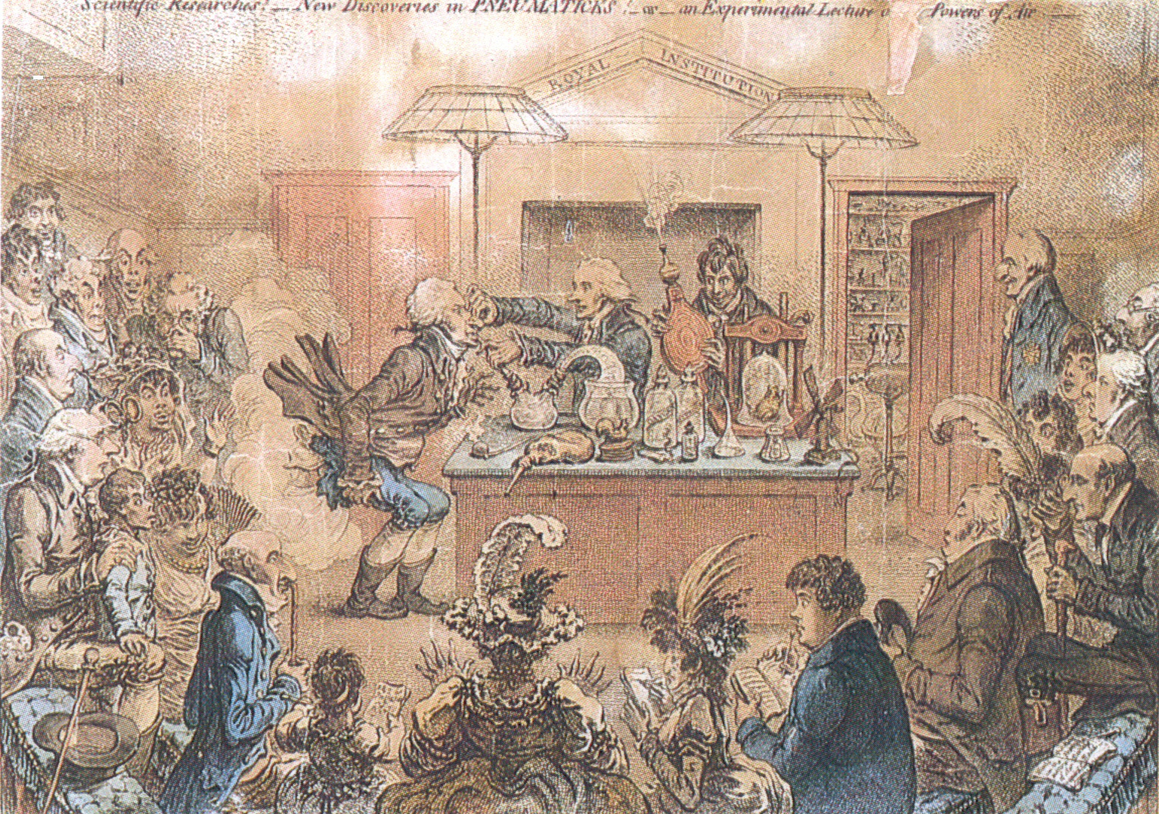
Gresham College
1 June 2015

Slide 7
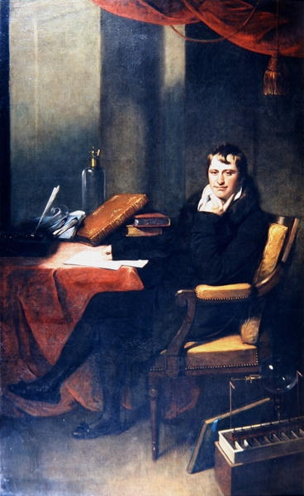
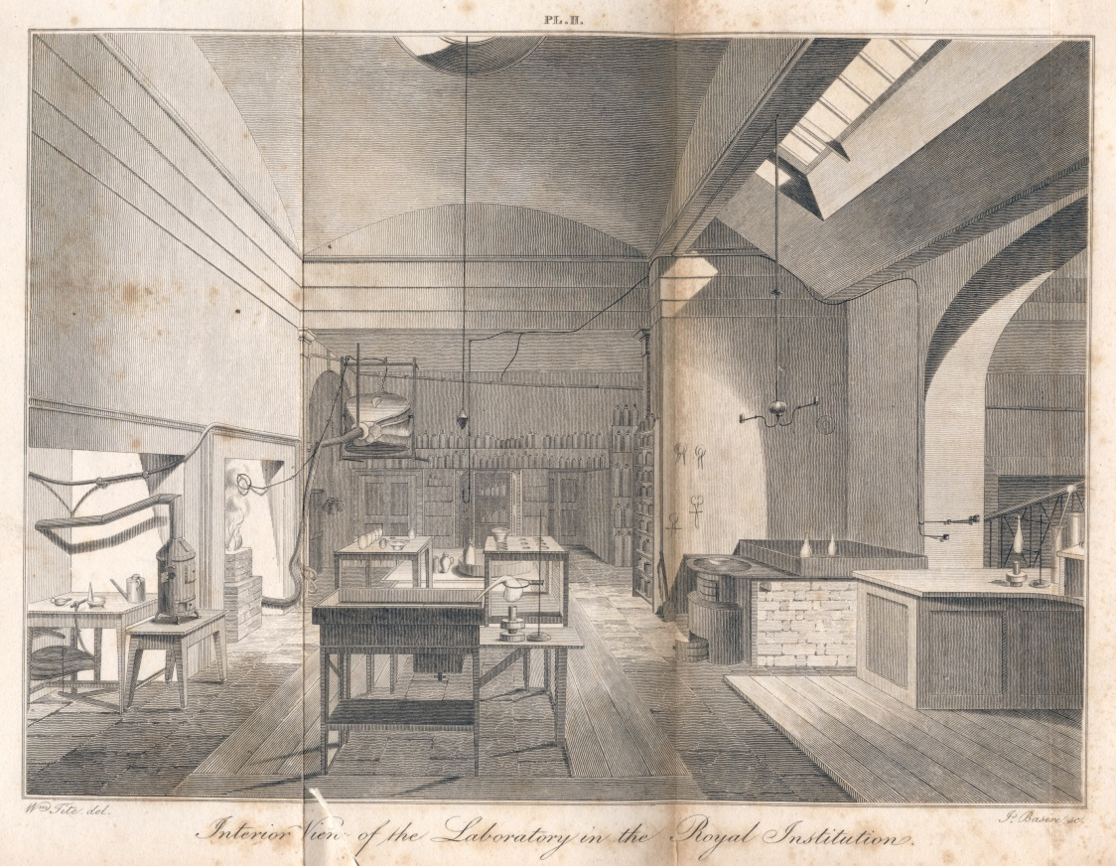
Gresham College
1 June 2015

Slide 8
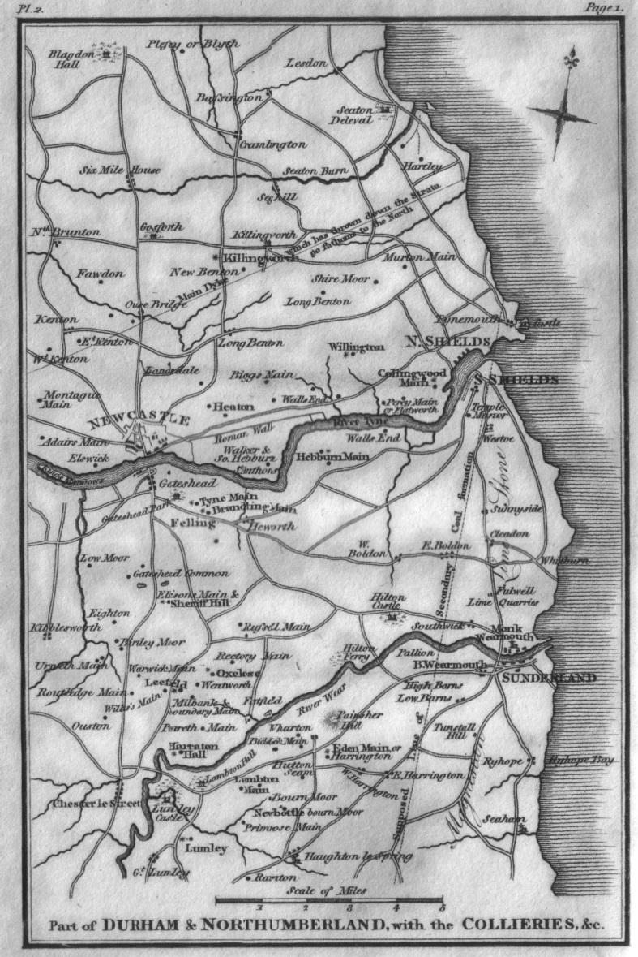
Gresham College
1 June 2015

Slide 9
Gresham College
1 June 2015

Slide 10
Average Annual Fatalities in the North East Coal Field
Gresham College
1 June 2015

Slide 11
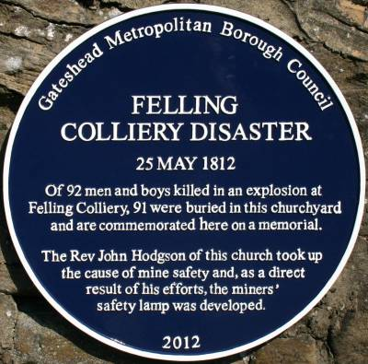
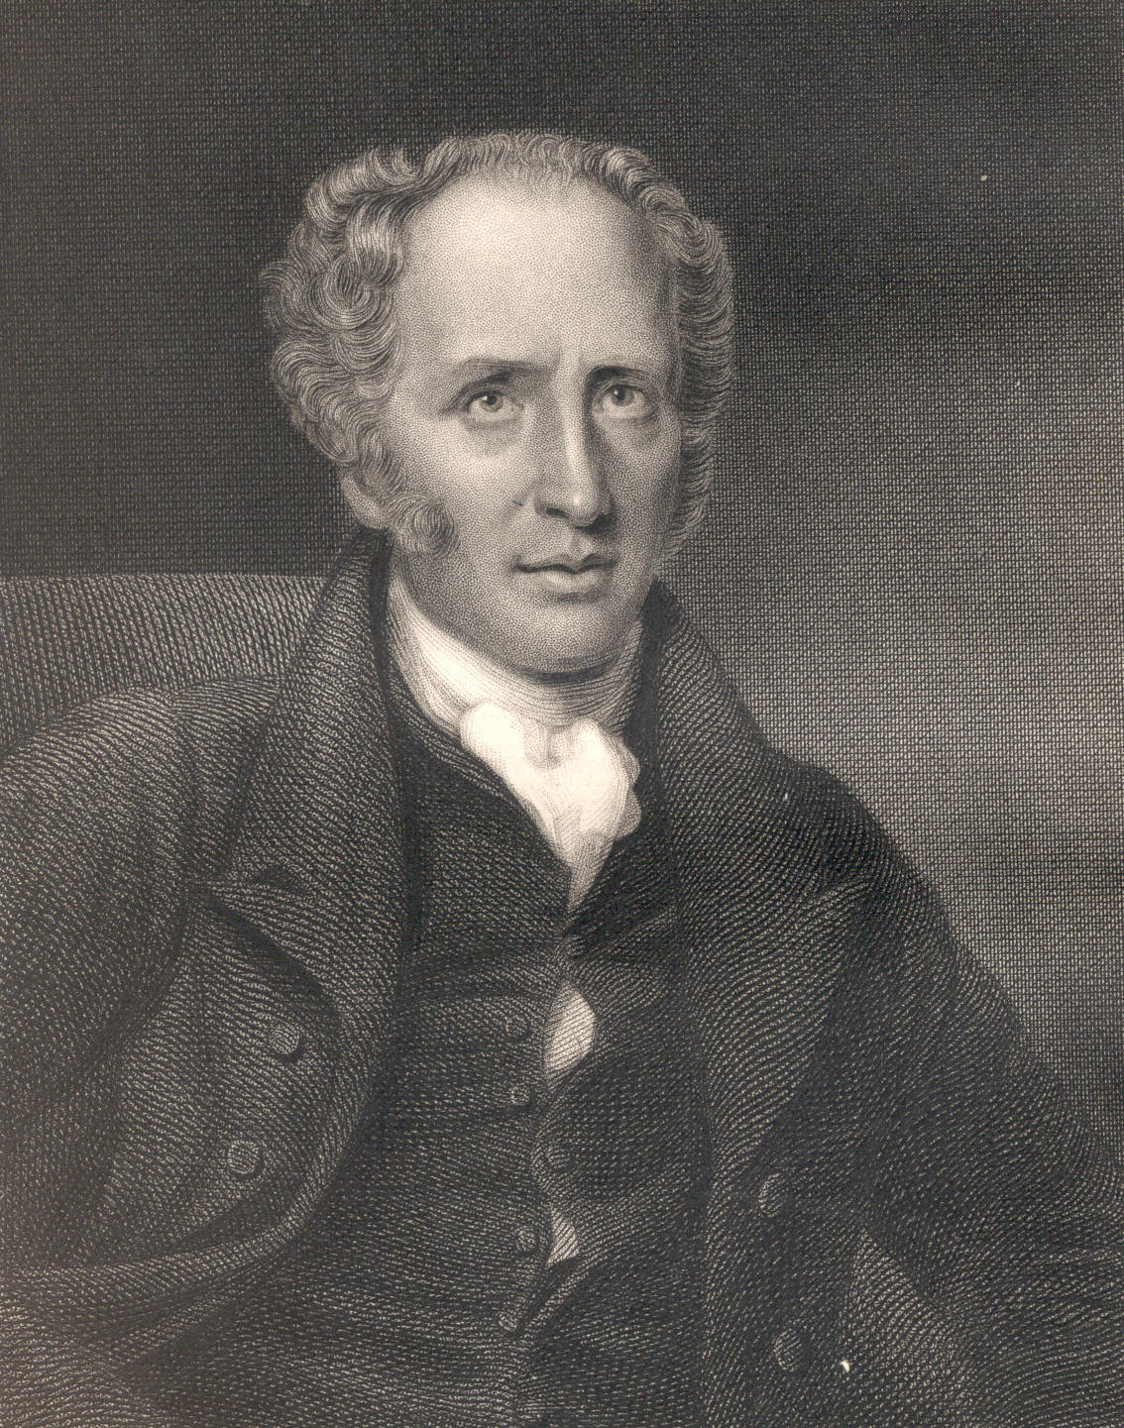
Gresham College
1 June 2015

Slide 12
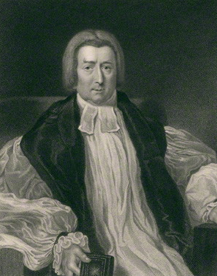
Gresham College
1 June 2015

Slide 13
it is to scientific men only that we must look up for assistance in providing a cheap and effectual remedy
The first report of a Society for Preventing Accidents in Coal Mines, Newcastle, 1814, p.23.
Gresham College
1 June 2015

Slide 14
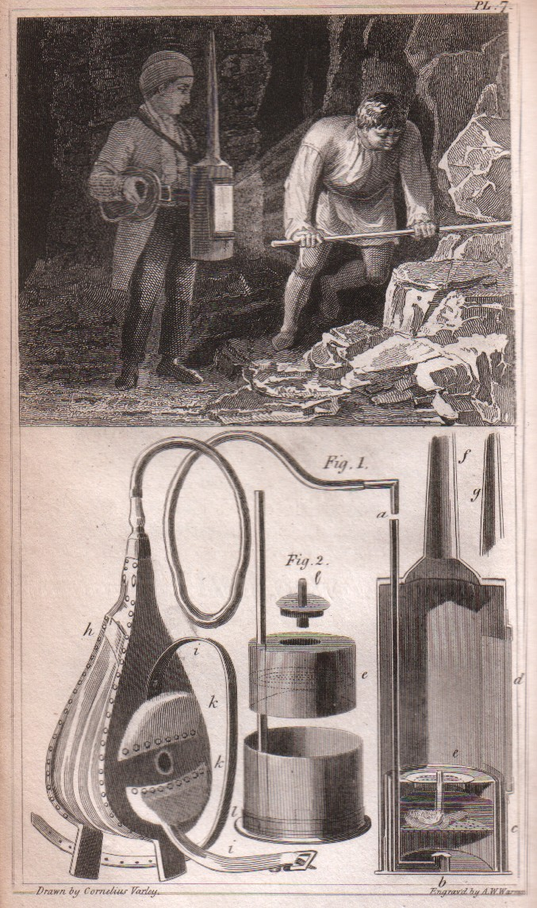
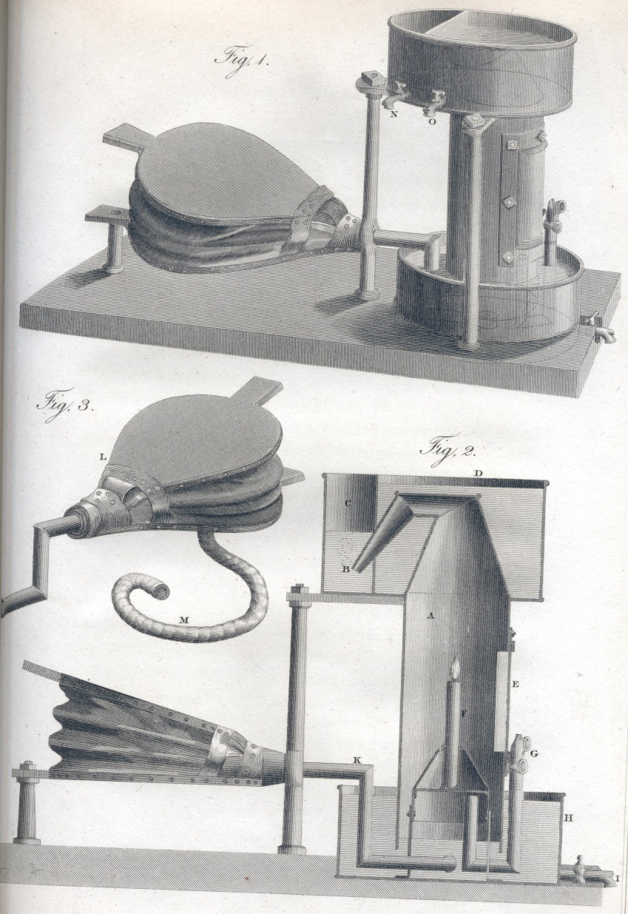
Gresham College
1 June 2015

Slide 15
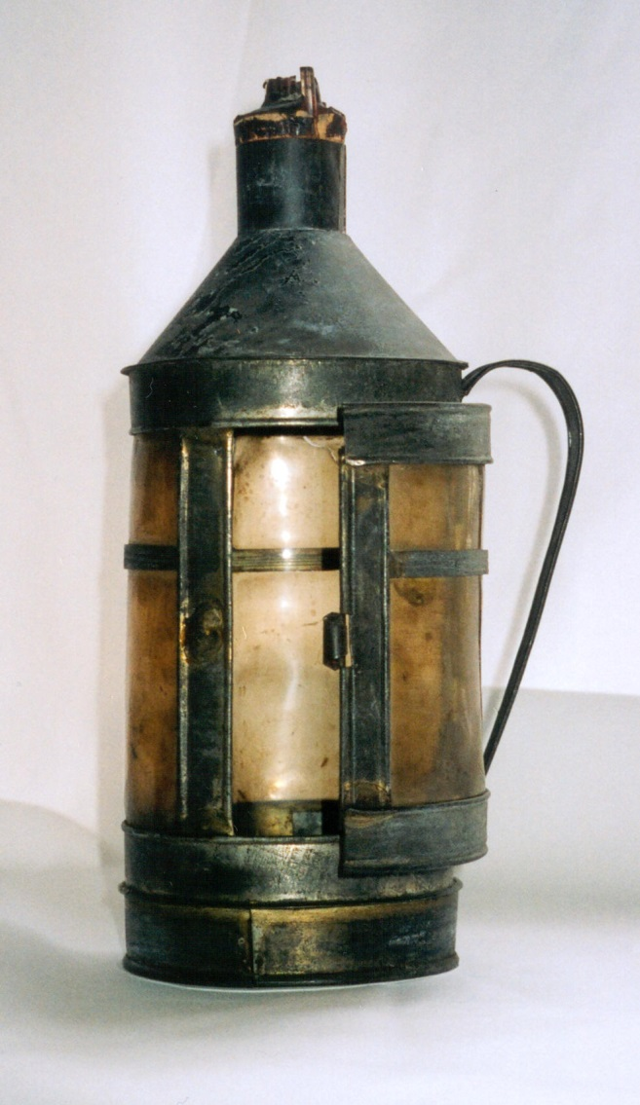
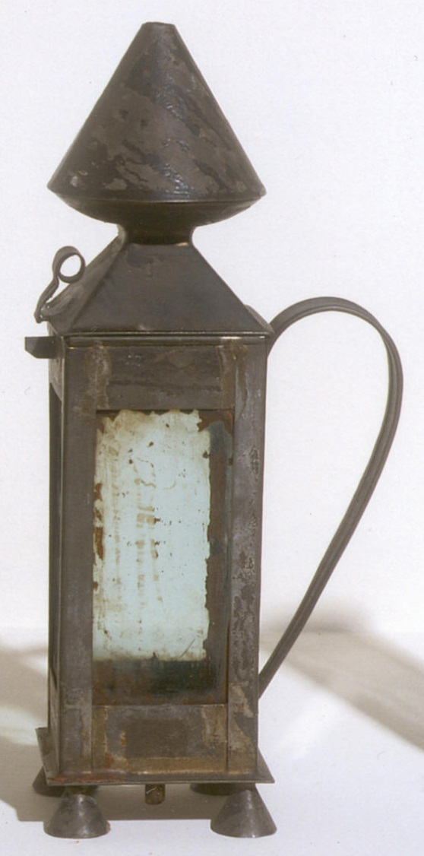
Gresham College
1 June 2015

Slide 16
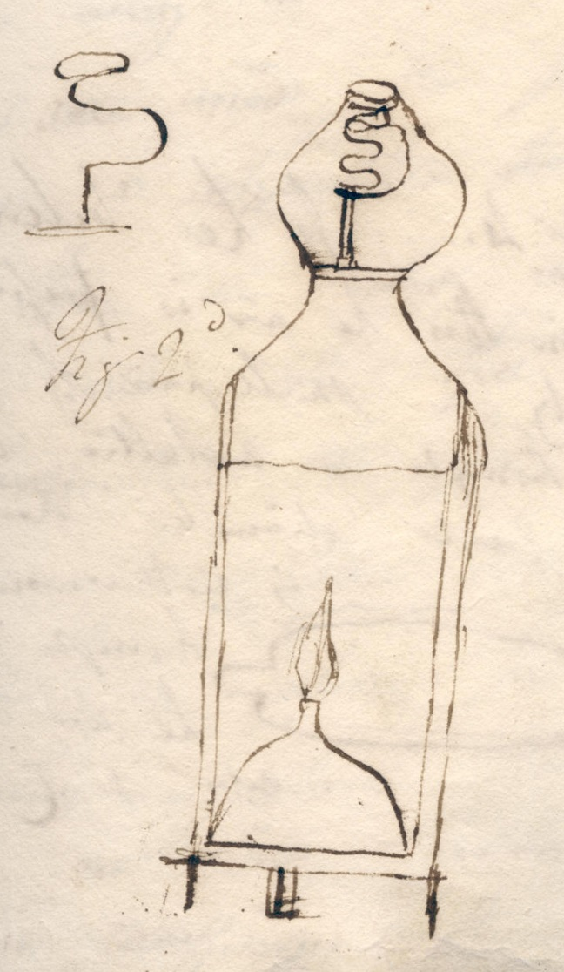
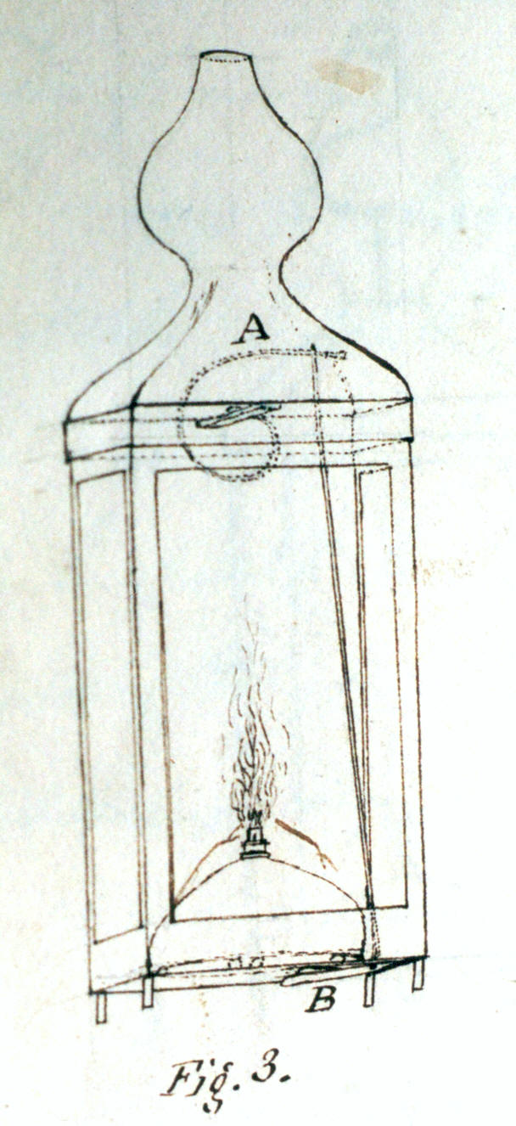
Gresham College
1 June 2015

Slide 17
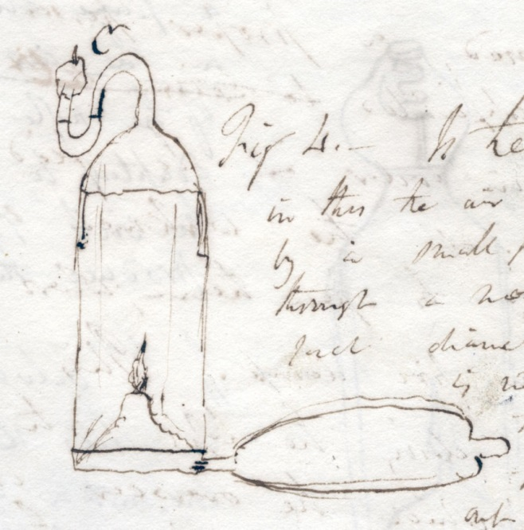
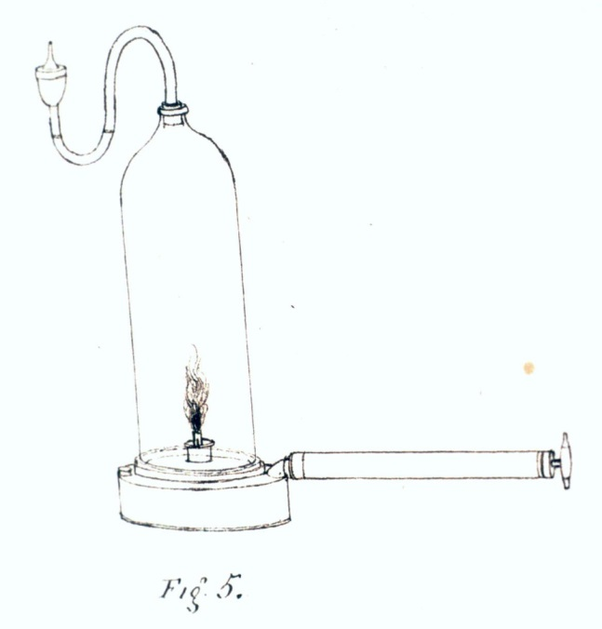

Gresham College
1 June 2015

Slide 18
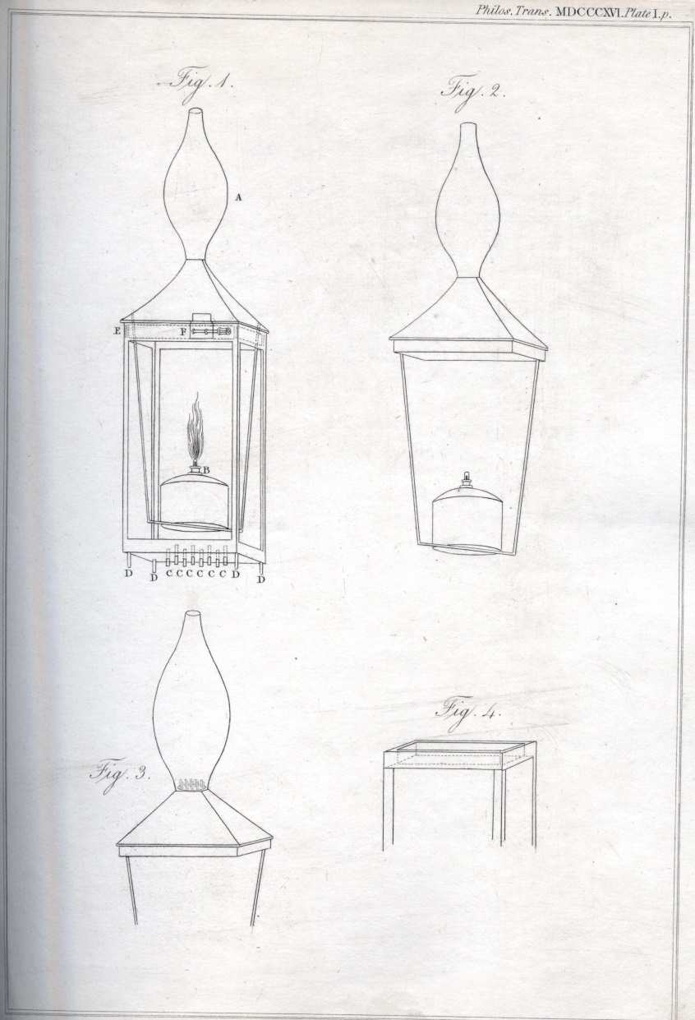
Gresham College
1 June 2015

Slide 19
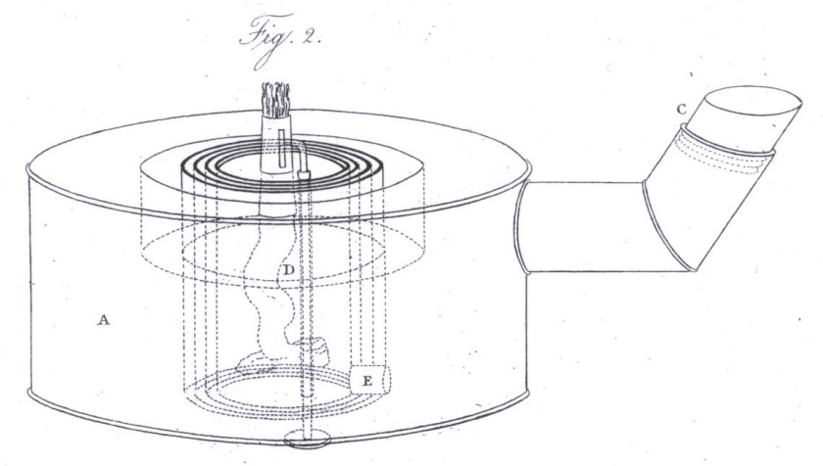
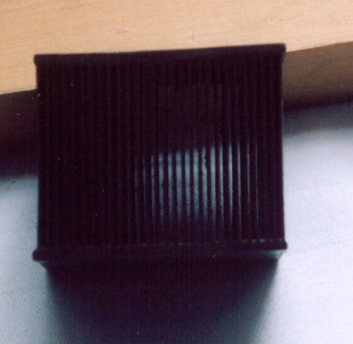
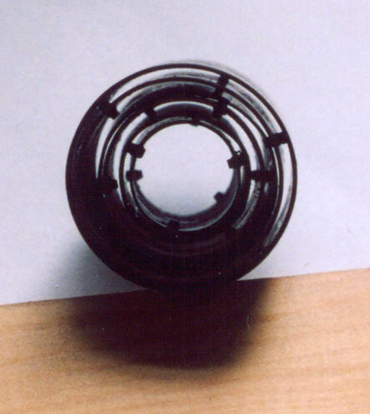
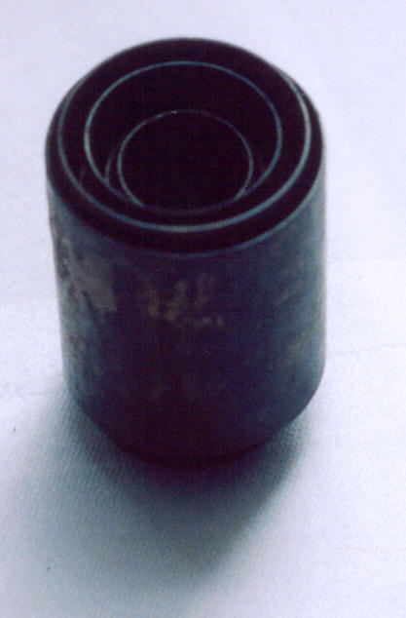
Gresham College
1 June 2015

Slide 20
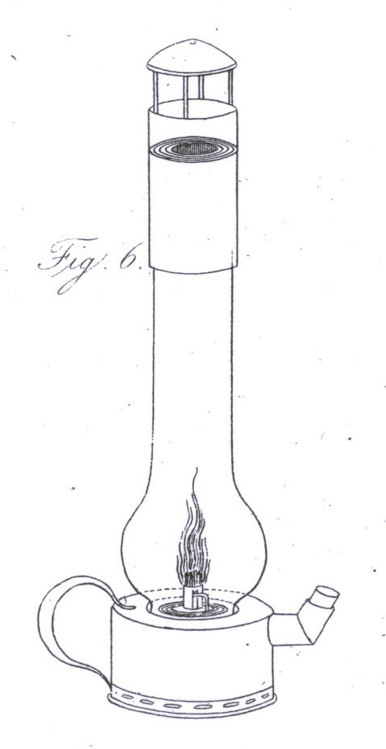
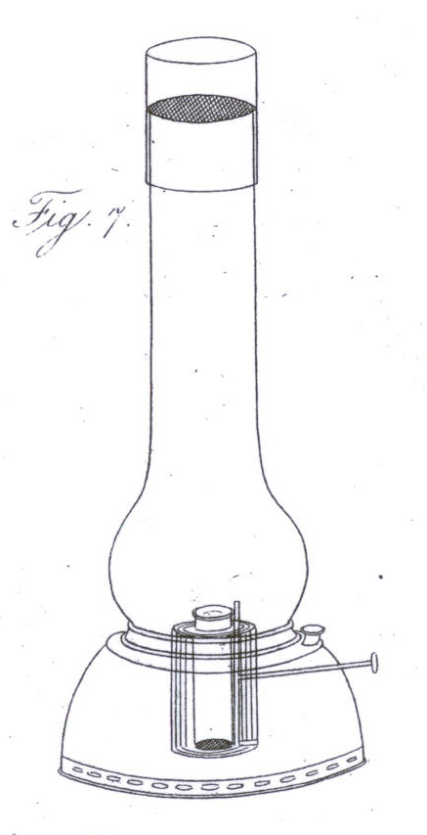
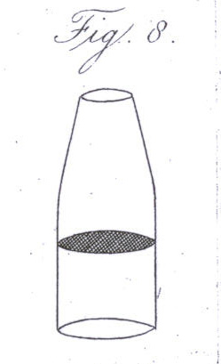
Gresham College
1 June 2015

Slide 21
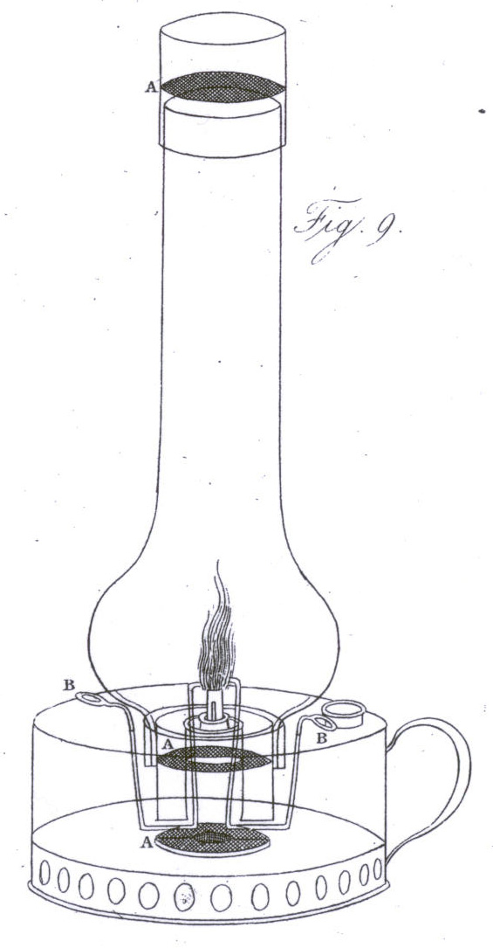
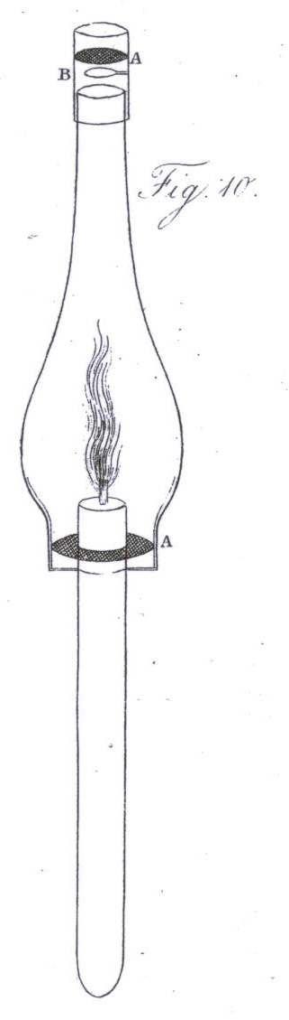
Gresham College
1 June 2015

Slide 22
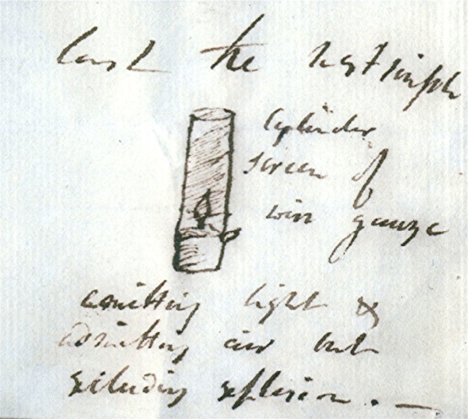

When a candle or lamp is enclosed in a wire gauze cylinder & introduced into an explosive mixture the flame of the wick is extinguished but the mixed gas burns steadily within the wire gauze vessel. … I can confine this destructive element flame like a bird in a cage.
Humphry Davy to John Hodgson, 29 December 1815
Gresham College
1 June 2015

Slide 23
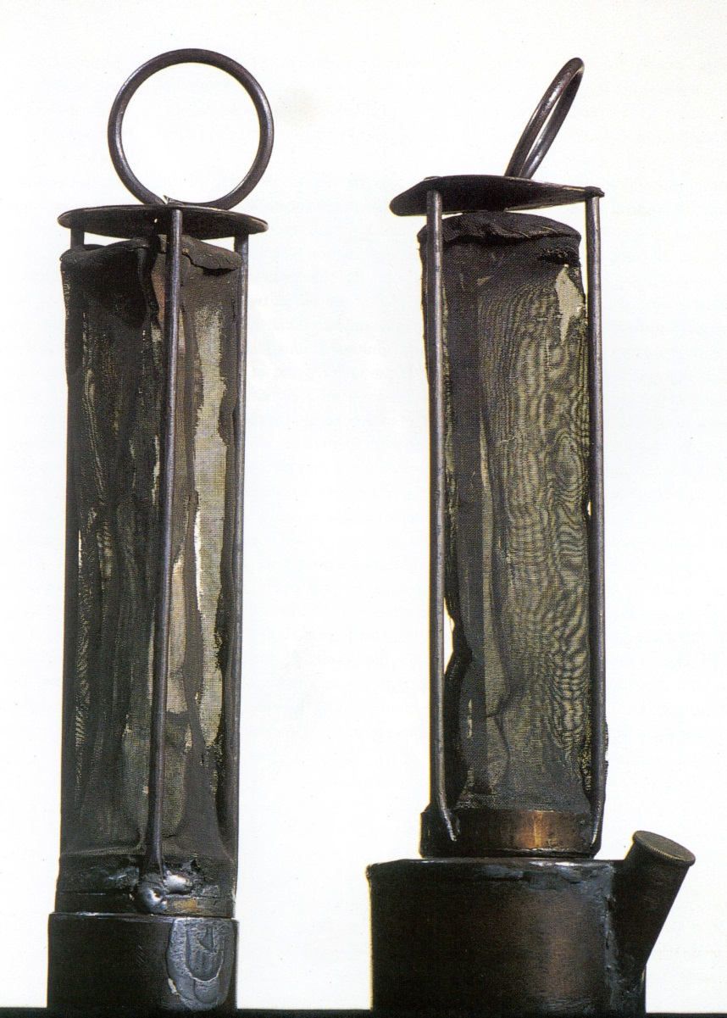
Gresham College
1 June 2015

Slide 24
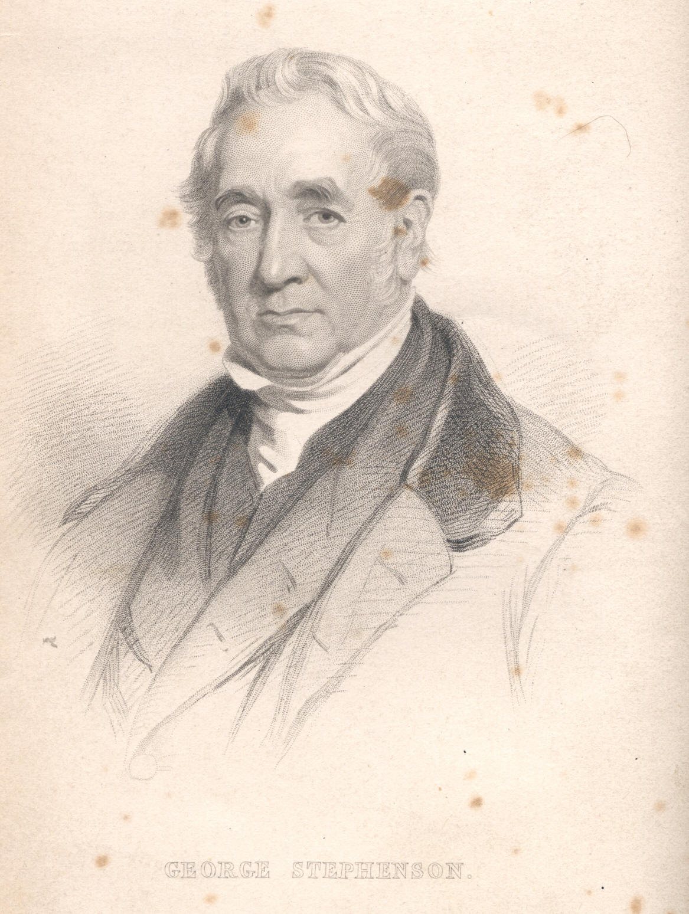
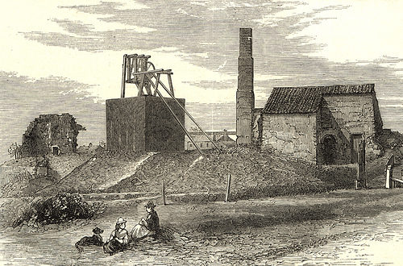
Gresham College
1 June 2015

Slide 25
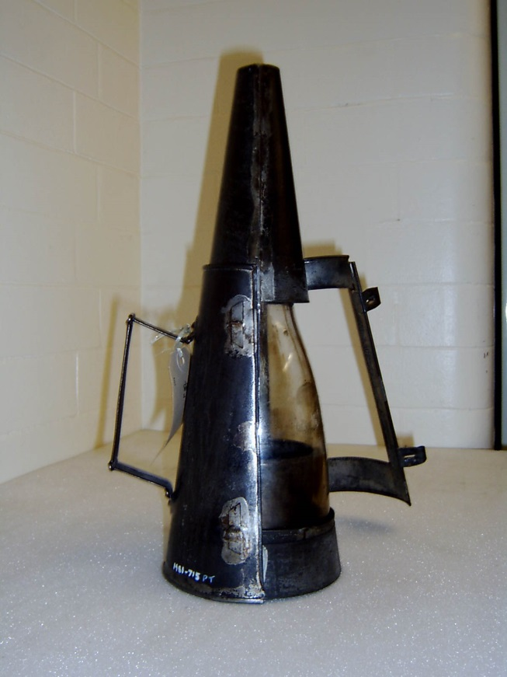
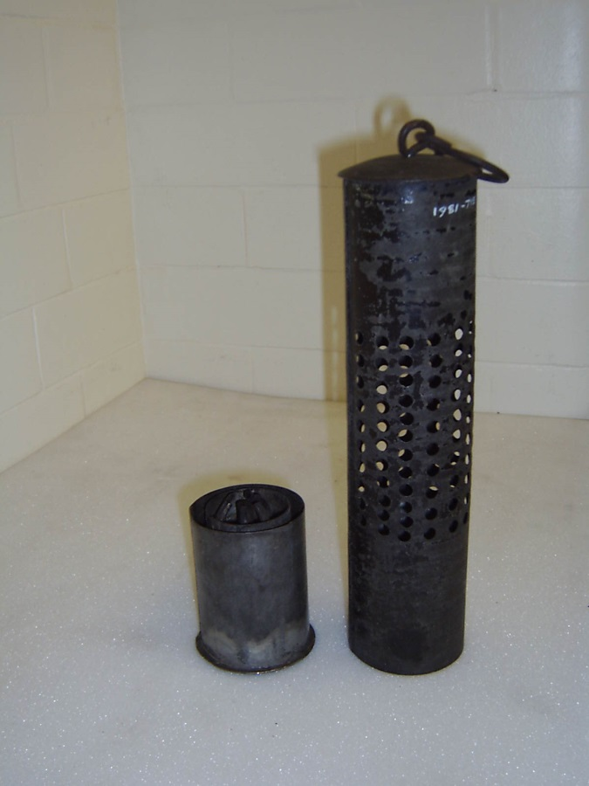
Gresham College
1 June 2015

Slide 26
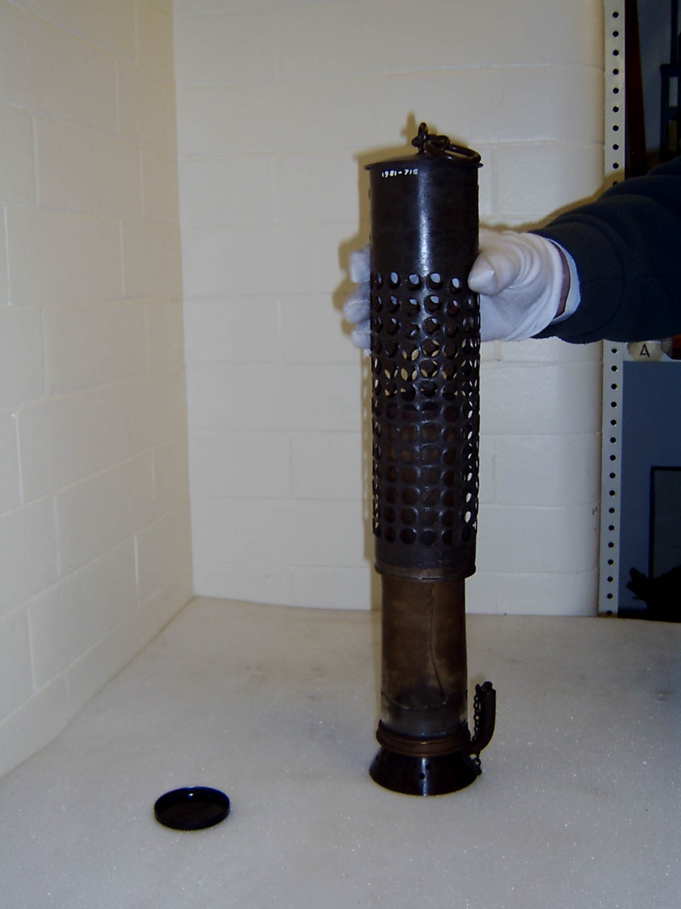
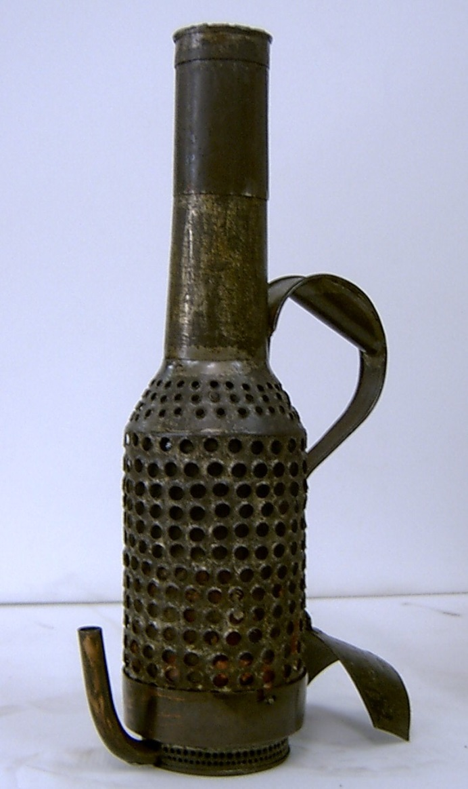
Gresham College
1 June 2015

Slide 27
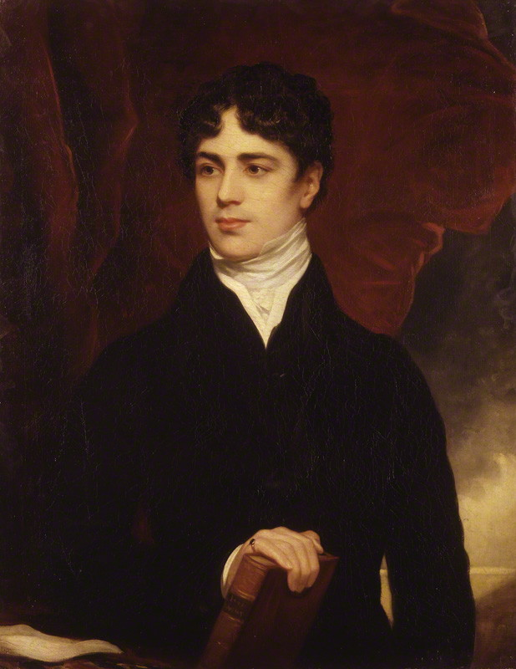
Gresham College
1 June 2015

Slide 28
I hope you will not blame me for not taking any notice of the attacks of my enemies in the North. I have no desire to go out of my way to crush gnats that buzz at a distance, and do not bite me, or to quarrel with persons who shoot arrows at the moon.
Humphry Davy to John Lambton, 29 October 1816
to know my enemies on this occasion, not from any feeling of fear, but because I would not connect the names of honourable men with those other persons whose conduct with respect to my exertions in their cause, will I think awake public indignation
Humphry Davy to James Losh, 11 November 1817
Gresham College
1 June 2015

Slide 29
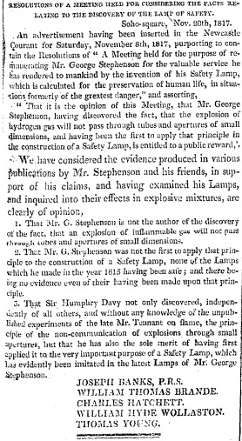
Morning Chronicle, 22 November 1817
Gresham College
1 June 2015

Slide 30
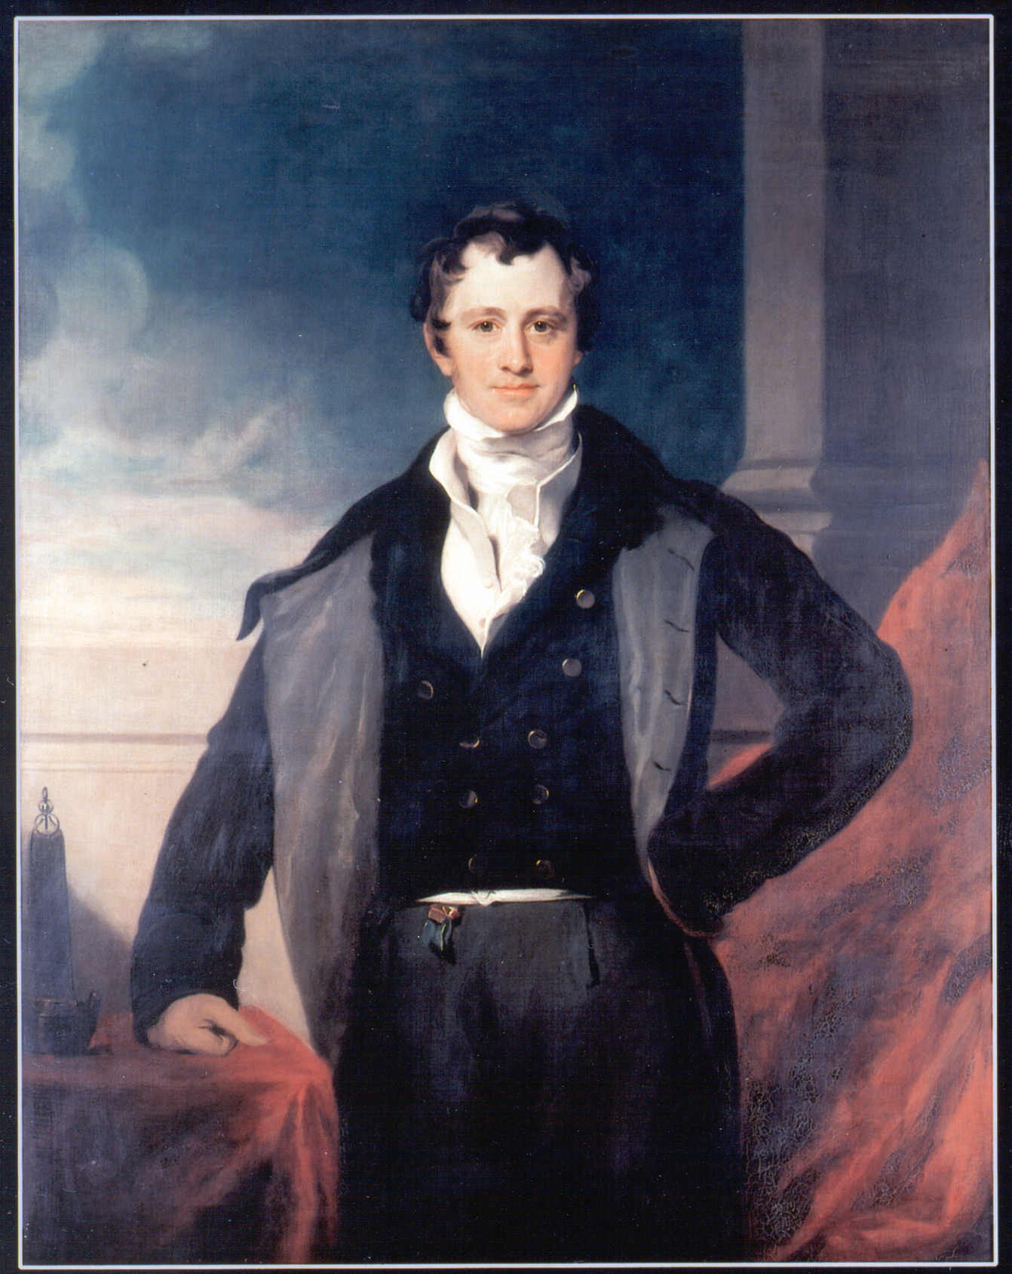
Gresham College
1 June 2015

Slide 31
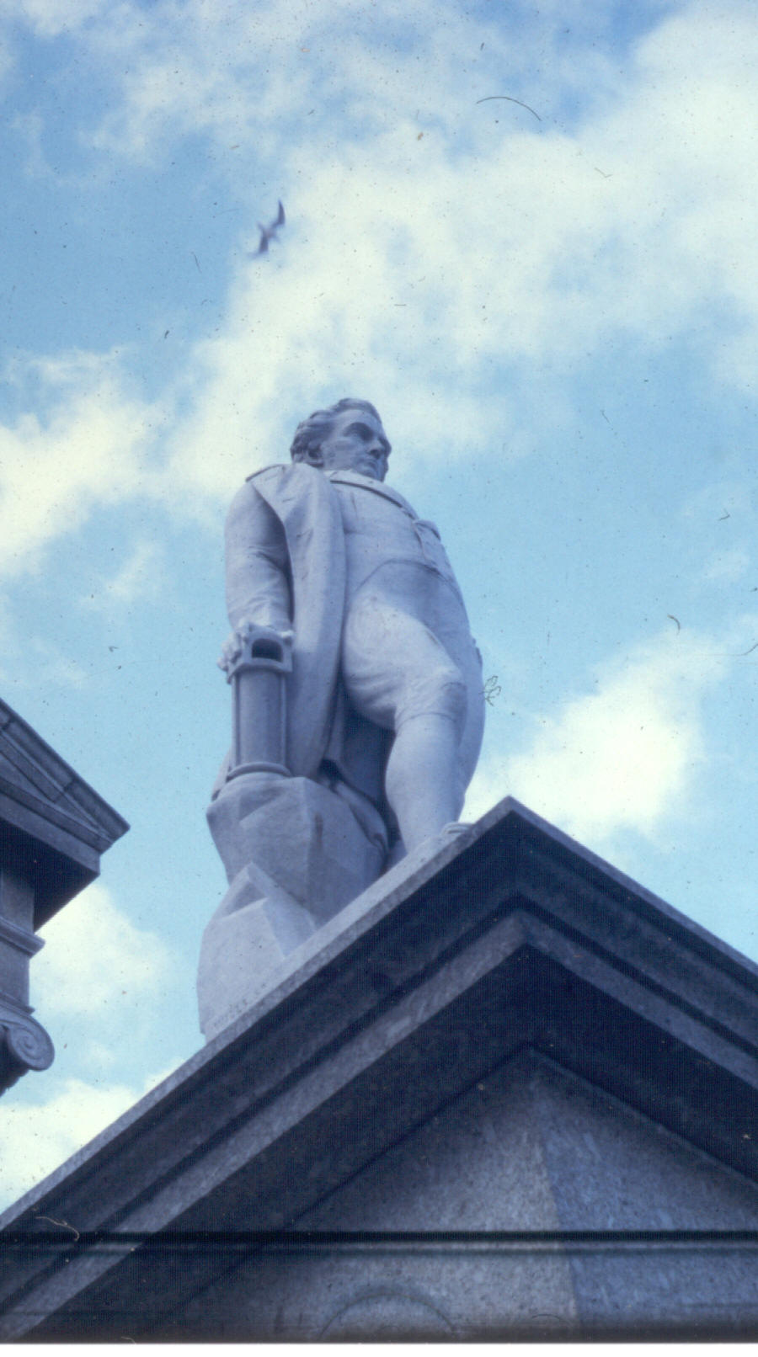
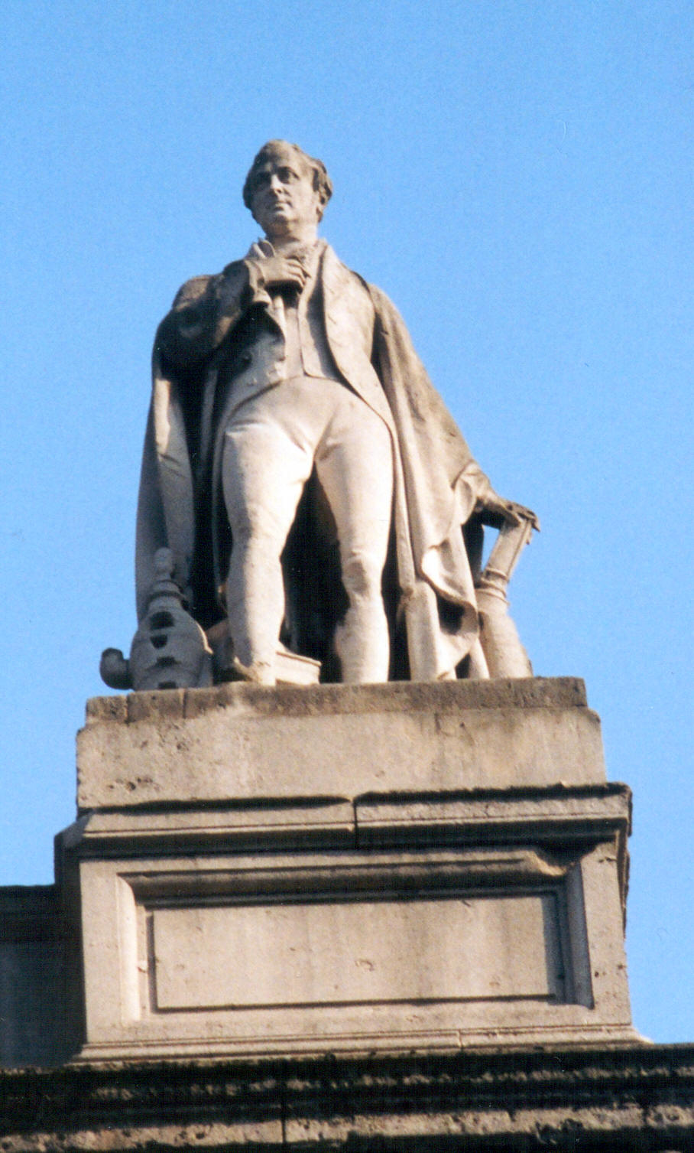
Gresham College
1 June 2015

Slide 32
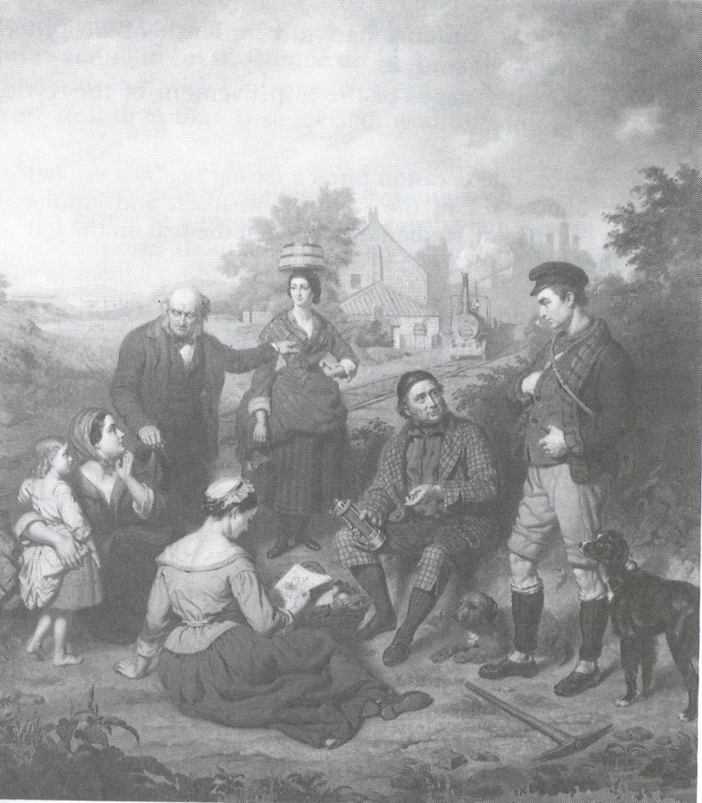
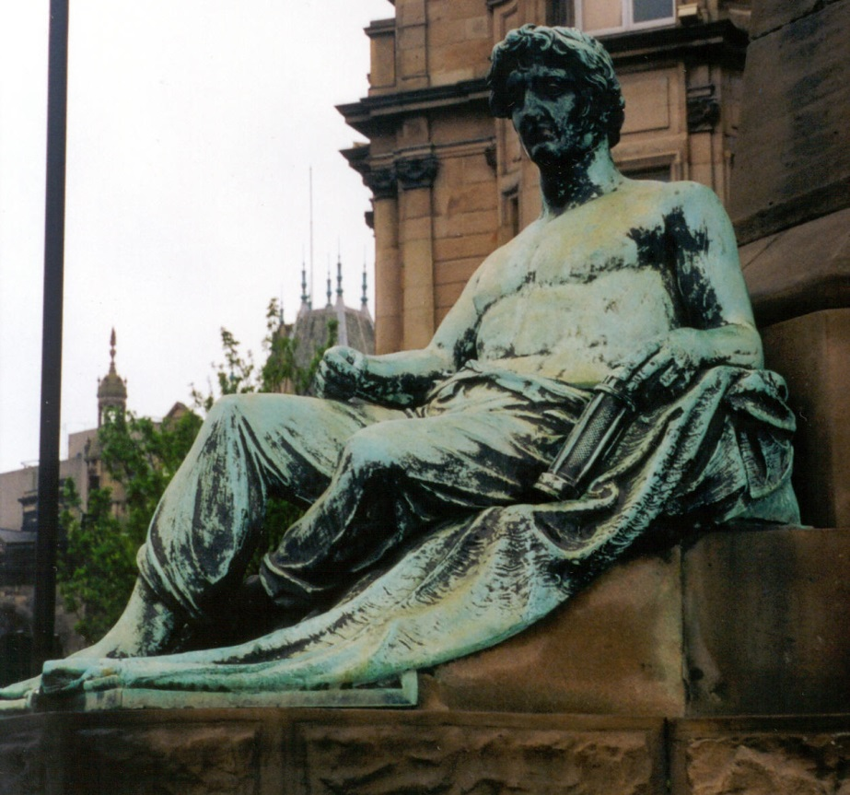
Gresham College
1 June 2015

Slide 33
Average Annual Fatalities in the North East Coal Field
per Million Tons of Coal Produced
Gresham College
1 June 2015

Slide 34
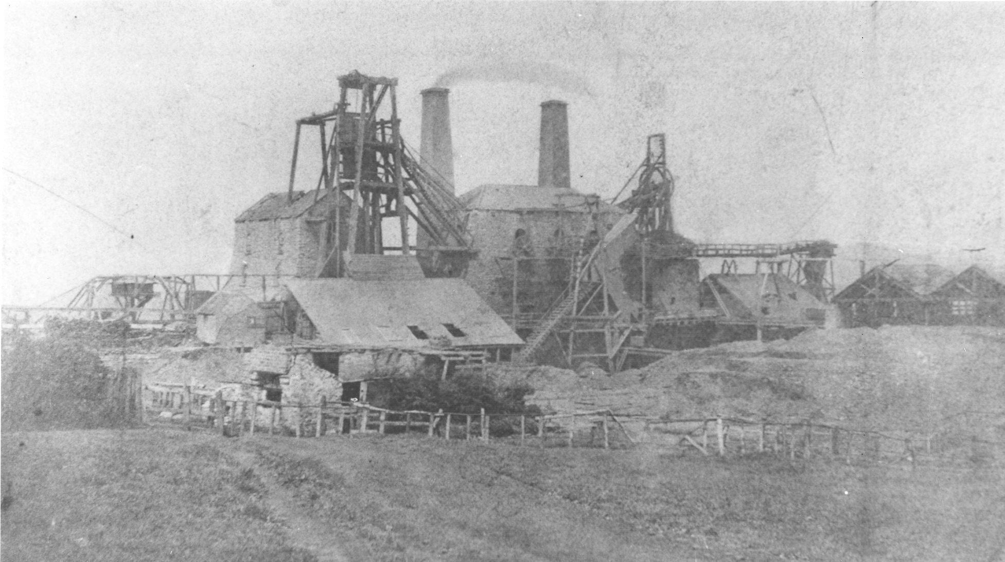
Gresham College
1 June 2015

Slide 35
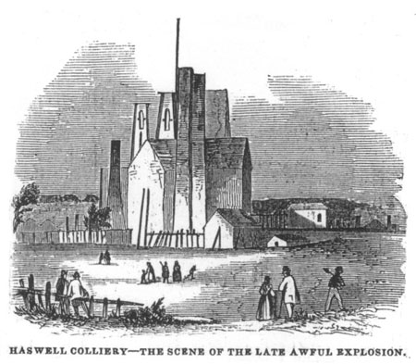
Gresham College
1 June 2015

Slide 36
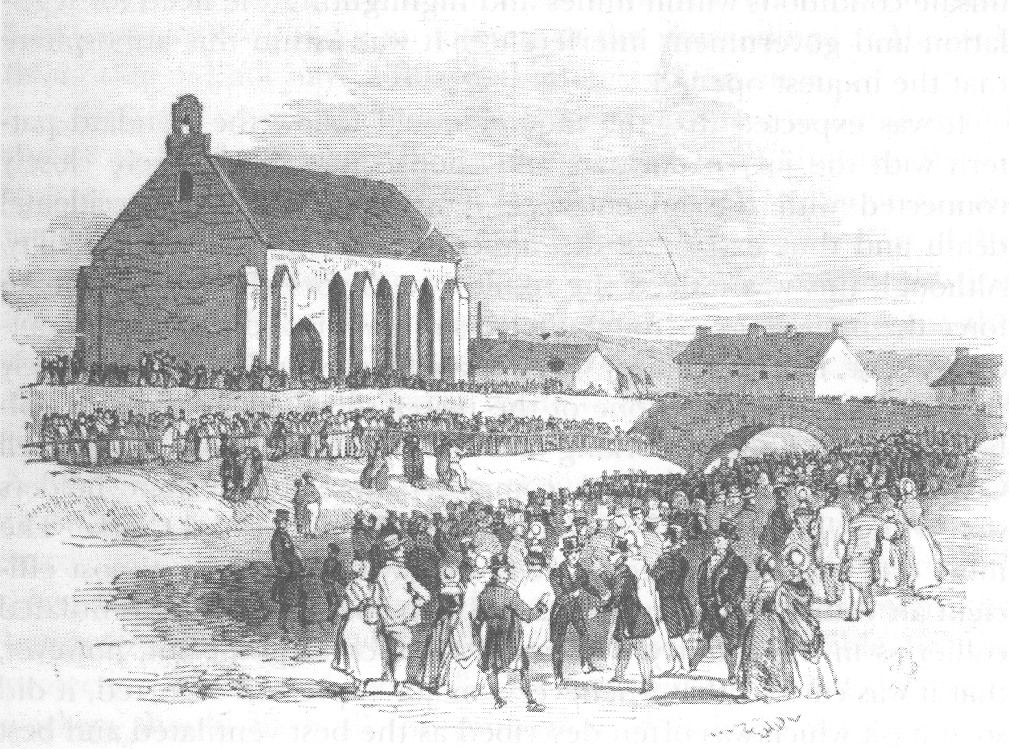
Gresham College
1 June 2015

Slide 37
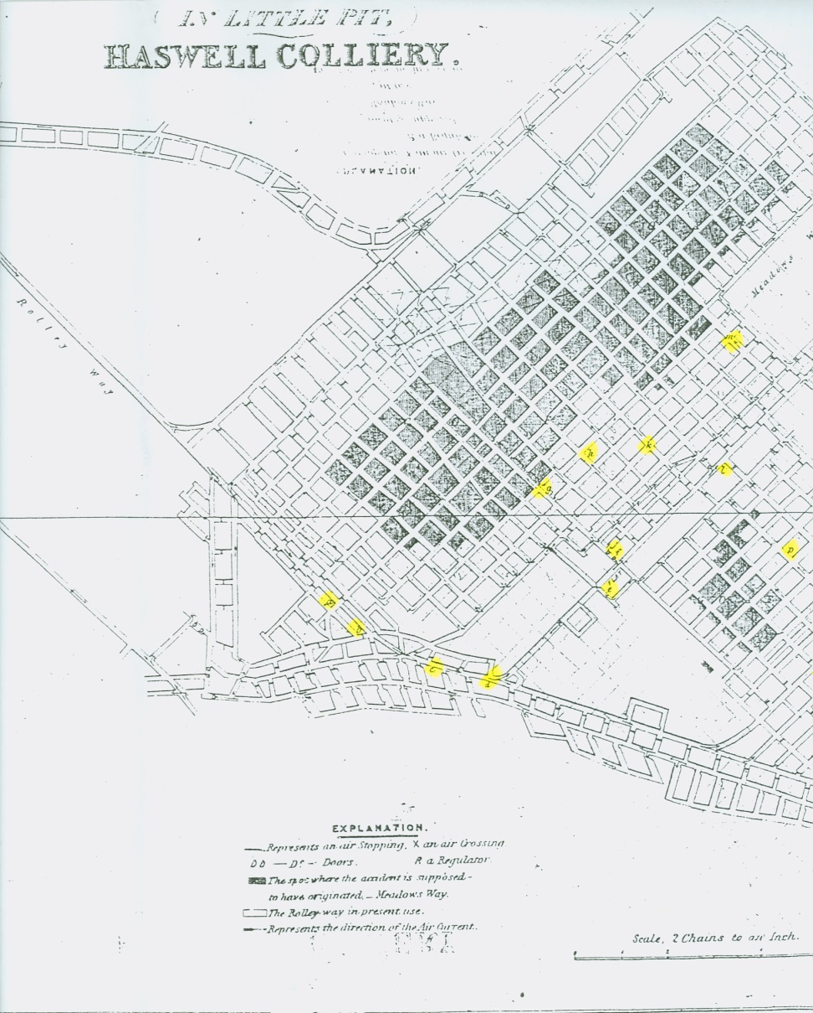
Gresham College
1 June 2015

Slide 38


Gresham College
1 June 2015

Slide 39


Gresham College
1 June 2015

Slide 40


Gresham College
1 June 2015

Slide 41
Gresham College
1 June 2015

Slide 42
Gresham College
1 June 2015

