Slide 1
GRESHAM 1 APRIL 2015 SREBRENICA 1
Geoffrey Nice
Nevenka Tromp

Slide 2
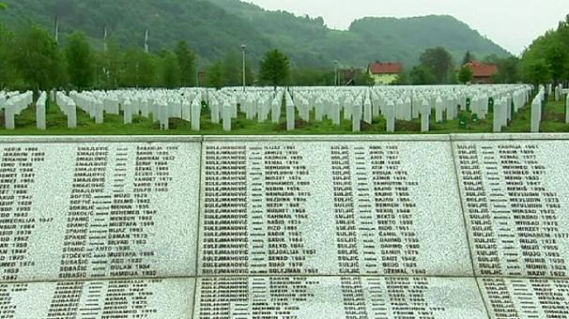
SREBRENICA - GRAVES

Slide 3
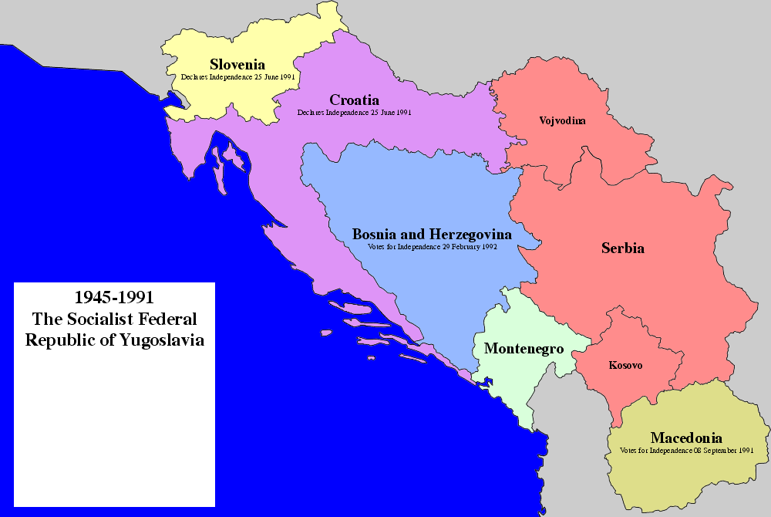
Transitional Justice
The UN has adopted the following definition of the term:
The notion of transitional justice comprises...the full range of processes and mechanisms associated with a society’s attempts to come to terms with a legacy of large-scale past abuses, in order to ensure accountability, serve justice, and achieve reconciliation.”
United Nations Security Council, The Rule of Law and Transitional Justice in Conflict and Post- Conflict Societies: Report of Secretary General, S/2004/616 (23 August 2004), 4.
Notes:
3

Slide 4
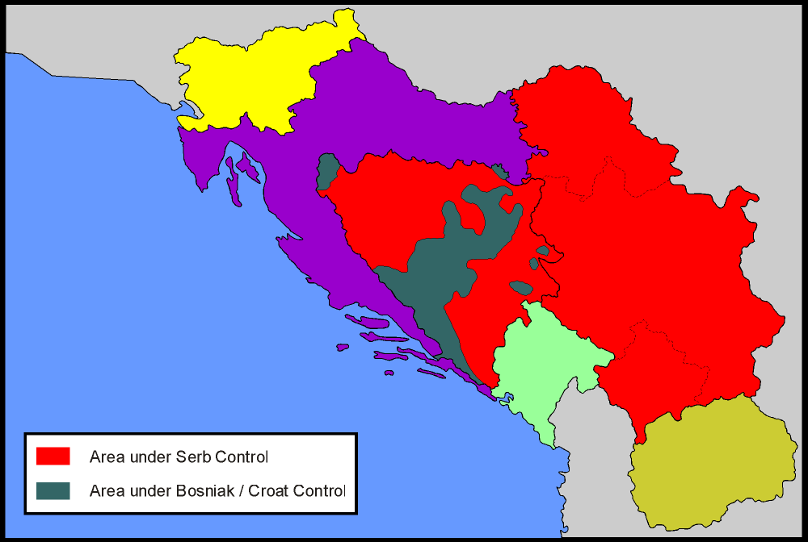
Srebrenica
Map showing approximate location of front lines in Bosnia in June 1995
Notes:
4

Slide 5
ICTY INTERACTIVE MAP
http://www.icty.org/sections/TheCases/InteractiveMap

Slide 6
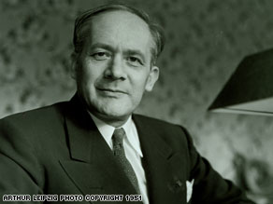
Rapheael Lemkin 1900 -1959

Slide 7
Lemkin’s approach to the new crime
……different actions aiming at the destruction of essential foundations of the life of national groups, with the aim of annihilating the groups themselves…… disintegration of the political and social institutions, of culture, language, national feelings, religion, and the economic existence of national groups, and the destruction of the personal security, liberty, health, dignity, and even the lives of the individuals belonging to such groups.

Slide 8
Winston Churchill, 1941 speech
"The aggressor ... retaliates by the most frightful cruelties. As his Armies advance, whole districts are being exterminated. Scores of thousands - literally scores of thousands - of executions in cold blood are being perpetrated by the German Police-troops upon the Russian patriots who defend their native soil. Since the Mongol invasions of Europe in the Sixteenth Century, there has never been methodical, merciless butchery on such a scale, or approaching such a scale.
And this is but the beginning. Famine and pestilence have yet to follow in the bloody ruts of Hitler's tanks.
We are in the presence of a crime without a name. "

Slide 9
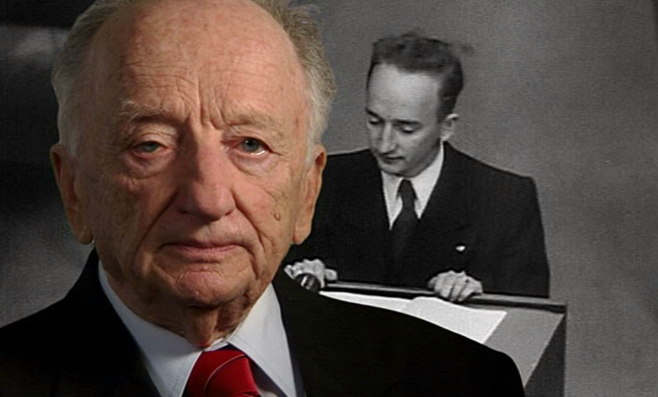
BEN FERENCZ

Slide 10
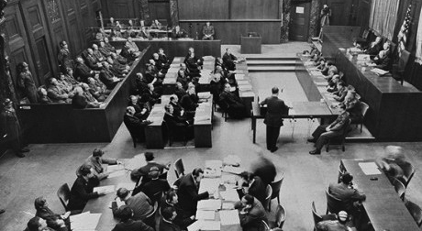
Ben Ferencz opening Einsatzgruppen Trial

Slide 11
Ben Ferencz opening speech at eth Einsatzgruppen trial
https://www.youtube.com/watch?v=3E5QWY6hQUY
Time counter 2.00 to 2.25 and
Time counter 4.00 to 4.25

Slide 12
BEN FERENCZ PROPOSAL
Any person responsible for the illegal use of armed force in violation of the United Nations Charter, which unavoidably and inevitably results in the death of large numbers of civilians, should be subject to punishment for crimes against humanity.

Slide 13
BEN FERENCZ PROPOSAL
“The precise character of ‘other inhumane acts’ as crimes against humanity was left to interpretation by courts and judges. The door was deliberately left open to possible inclusion of other unforeseeable major inhumanities that might otherwise have escaped judicial scrutiny. Nuremberg correctly condemned aggression as ‘the supreme international crime’ because it included all the other crimes. Even if the appellation ‘aggression’ is not used, the consequences of the illegal use of armed force may be equally reprehensible and should not be allowed to escape criminalization because of nomenclature.”

Slide 14
ICC STATUTE _ AGGRESSION
Article 8 bis: For the purpose of this Statute, “crime of aggression” means the planning, preparation, initiation or execution, by a person in a position effectively to exercise control over or to direct the political or military action of a State, of an act of aggression which, by its character, gravity and scale, constitutes a manifest violation of the Charter of the United Nations…………….

Slide 15
ICC STATUTE GENOCIDE
For the purpose of this Statute, "genocide" means any of the following acts committed with intent to destroy, in whole or in part, a national, ethnical, racial or religious group, as such:
(a) Killing members of the group;
(b) Causing serious bodily or mental harm to members of the group;
(c) Deliberately inflicting on the group conditions of life calculated to bring about its physical destruction in whole or in part;
(d) Imposing measures intended to prevent births within the group;
(e) Forcibly transferring children of the group to another group.

Slide 16
ICC STATUTE CRIMES AGAINST HUMANITY
For the purpose of this Statute, "crime against humanity" means any of the following acts when committed as part of a widespread or systematic attack directed against any civilian population, with knowledge of the attack:
(a) Murder;
(b) Extermination;
(c) Enslavement;
(d) Deportation or forcible transfer of population; (e) Imprisonment or other

Slide 17
ICC STATUTE MENTAL ELEMENT
Unless otherwise provided, a person shall be criminally responsible and liable for punishment for a crime within the jurisdiction of the Court only if the material elements are committed with intent and knowledge.
For the purposes of this article, a person has intent where:
  (a) In relation to conduct, that person means to engage in the conduct;
  (b) In relation to a consequence, that person means to cause that consequence or is aware that it will occur in the ordinary course of events.
For the purposes of this article, "knowledge" means awareness that a circumstance exists or a consequence will occur in the ordinary course of events. "Know" and "knowingly" shall be construed accordingly.

Slide 18
ICTY STATUTE INDIVIDUAL REPSONSIBILITY
Article 6 Personal jurisdiction
The International Tribunal shall have jurisdiction over natural persons pursuant to the provisions of the present Statute.
Article 7
Individual criminal responsibility
A person who planned, instigated, ordered, committed or otherwise aided and abetted in the planning, preparation or execution of a crime referred to in articles 2 to 5 of the present Statute, shall be individually responsible for the crime.

Slide 19
MLADIC CLIP, Entering Srebrenica
https://www.youtube.com/watch?v=QfInjlNoT4Q
1.50 – 2.09

Slide 20
MLADIC CLIP, Fontana Hotel 12 July 1995
https://www.youtube.com/watch?v=urpbonh7kj8
4.39-5.15

Slide 21
Nevenka Tromp
Political Scientist
Lecturer of University of Amsterdam, 1992- Present
UN ICTY, 2000-2012 – Researcher in Leadership Research Team at the OTP

Slide 22
Gregory H. Stenton Classificationm
1. CLASSIFICATION:
2. SYMBOLIZATION:
3. DEHUMANIZATION:
4. ORGANIZATION:
5. POLARIZATION:
6. PREPARATION:
7. EXTERMINATION :
8. DENIAL

Slide 23
Ethnic Majority Map of the 1991Population: Bosnia and Herzegovina
Source: The 1991 Population Census for Bosnia and Herzegovina. (Tabeau (ed.), 2009)

Slide 24
Ethnic Majority Map of the Actual Population: 1997, Bosnia and Herzegovina
Source: The 1991 Population Census for Bosnia and Herzegovina and the OSCE Voters Register 1997/98. (Tabeau (ed.), 2009).

Slide 25
VARIANT A and B DOCUMENT, December 1991
“Instructions for the Organisation and Activity of the Organs of the Serb People in Bosnia and Herzegovina in Extraordinary Circumstances.”
The Instructions laid out two variants:
Variant A dealt with municipalities where Bosnian Serbs comprised a majority of the population;
Variant B addressed municipalities where the Serb population was a minority.

Slide 26
Statement by Miroslav Deronjić, Exhibit P600, ERN ET0344-7914-0344-7918,
I meant, first of all, that these volunteers such as the Arkan's -- the Arkan guards and others would come to the territory before the outbreak of a conflict where inter-ethnic relations had already been disrupted, and we know that by referring to materials known as Variant A and B. The arrival of volunteers would create a certain climate in these areas primarily due to the killings of innocent people, widespread looting, robbing of private property, mainly from people of Muslim faith, resulting in the intimidation of the Muslim community and their fleeing from the area

Slide 27
Statement by Miroslav Deronjić
. Those were the complex events that took place in those regions. With the arrival of the army - and we are talking about the JNA since this took place before the 15th of May - created an impression, a false impression maybe, that the JNA would make efforts to prevent these developments. But then from a series of facts, we could see that the Yugoslav People's Army sided with the Serbs, and its activities in those areas contributed to the deepening of inter-ethnic tensions, the fleeing of Muslims from these areas, and as far as I know, in Bratunac municipality and in neighbouring municipalities the JNA took part even in the offensive actions undertaken by Serbs in that territory.

Slide 28
‘Decision on Strategic Objectives of the Serbian People in Bosnia and Herzegovina’, (12 May 1992)
The strategic objectives or priorities of the Serbian people in Bosnia and Herzegovina are to:
1. Establish State borders separating the Serbian people from the other two ethnic communities;
2. Set up a corridor between Semberija and Krajina;
3. Establish a corridor in the Drina river valley, that is, eliminate the Drina as a border separating Serbian states.
4. Establish a border on the Una and Neretva rivers;
5. Divide the city of Sarajevo into Serbian and Muslim parts and establish effective State authorities in both parts.
6. Ensure access to the sea for Republika Srpska.

Slide 29
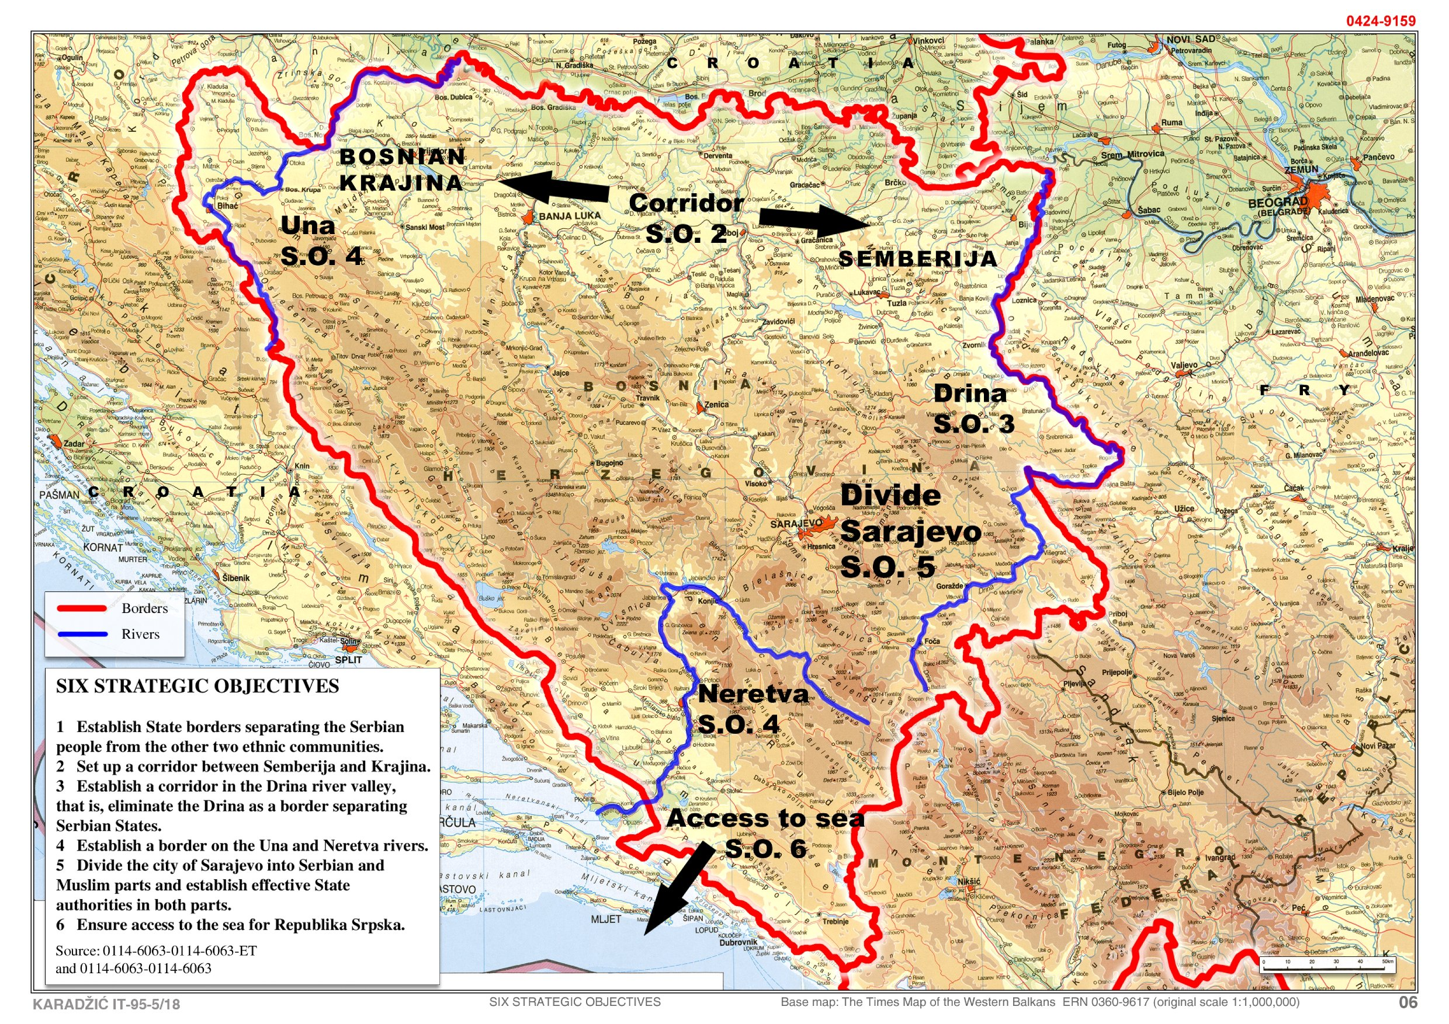

Slide 30
Ethnic Majority Map of the 1991 Population: MILOSEVIC Indictment Area
Source: The 1991 Census for Bosnia and Herzegovina. (Extracted from the Map for Bosnia and Herzegovina
Notes:
30

Slide 31
819 UN RESOLUTION, 17 April 1993
http://daccess-dds-ny.un.org/doc/UNDOC/GEN/N93/221/90/IMG/N9322190.pdf?OpenElement
Alex: cannot download to copiable format – can you? No problem if not

Slide 32
DIRECTIVE, Radovan Karadžić, March 1995
“Complete the physical separation of Srebrenica from Žepa as soon as possible, preventing even communication between individuals in the two enclaves. By planned and well-thought out combat operations, create an unbearable situation of total insecurity with no hope of further survival or life for the inhabitants of Srebrenica”

Slide 33
DIPLOMATIC CABLES, FRY
A report of 25 July from New York and Washington covered the UN SC discussion on Žepa. The author referred to the critical statement on Žepa by the Contact Group, concluding that it was just a routine statement aimed at satisfying the Muslims by demonstrating that the UN SC took the situation seriously. In reality, the author said, nobody was going to make any fuss about Žepa. Indeed, Žepa fell on 25 July, followed by ethnic cleansing of the area.

Slide 34
SDC Records, 14 August 1995
Momo remembers well my conversation with Mladić on the occasion of attack on Žepa and Srebrenica. On that occasion I said: “Ratko, you are now measuring the military price of that success. The military price is six persons killed, 20 wounded, one vehicle destroyed, etc. It is inexpensive. However, the political price could be million times higher because there might be a concern for the interests of 12 million people!”

Slide 35
SCORPION VIDEO
Execution of the Srebrenica and Žepa men went on weeks after.
Godinjske Bare, some 150 km from Srebrenica

Slide 36
VLADISLAV JOVANOVIć’s letter to UN, 27 November 1995
Immediately before the takeover of Srebrenica by the Army of Republika Srpska, disorder and conflicts within the Bosnian Muslims Army in that enclave erupted. In the clashes that ensued, those units, which wanted to continue fighting, were mercilessly killing those who wanted to surrender and were in favour of cease-fire.
Since the units of the Army of Republika Srpska did not have access to those areas at the time, it was only after the fall of the enclave that the bodies of Muslim fighters and civilians, who died as a result of the infighting, were discovered. This situation was abused by the Bosnian Muslim government to further its propaganda campaign of the alleged mass killings and disappearances of Muslims in the area.

Slide 37
Slobodan Milošević at the SDC meeting, 6 December 1995
Then, being in a lost negotiating position, we accomplished through difficult negotiations the same thing that was offered in the best negotiation position a year and half ago – 49% : 51%.
And, Republika Srpska has been created in the area where no Serbian country had ever existed before! It is a historic achievement; it is two times bigger than Montenegro and one and a half time bigger then Slovenia - extending on 25,000 square kilometres with a million of inhabitants which makes 40 inhabitants per a square kilometre. ....
A great victory has been simply won and result of it is that Republika Srpska has been created, occupying half of the territory of Bosnia and Herzegovina!
Please, you can make a comparison; you had several official maps, not to mention the unofficial maps. The Muslims, knowing how bad their position was, said at the beginning of the Dayton negotiations that Republika Srpska should not have been given more than 30% of the territory.

Slide 38
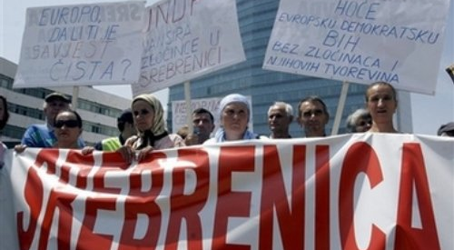
Mothers of Srebrenica

Slide 39
ICJ RULING _ DISSENTING OPINION JUDGE AL-KHASAWNEH
Thirdly, the Court has refused to infer genocidal intent from the consistent pattern of conduct in Bosnia and Herzegovina. In its reasoning, the Court relies heavily on several arguments, each of which is inadequate for the purpose, and contradictory to the consistent jurisprudence of the international criminal tribunals.

Slide 40
ICJ RULING _ DISSENTING OPINION JUDGE AL-KHASAWNEH
The Court essentially ignores the facts and substitutes its own assessment of how the Bosnian Serbs could have hypothetically best achieved their macabre Strategic Goals. The Applicant is not asking the Court to evaluate whether the Bosnian Serbs were efficient in achieving their objectives. The Applicant is asking the Court to look at the pattern of conduct and draw the logically necessary inferences.
If the only objective was to move the Muslim population, and the Court is willing to assume that the Bosnian Serbs did only that which is strictly necessary in order to achieve this objective, then what to make of the mass murder?

Slide 41
OBSERVATIONS OF MEMBER OF THE SERB LEGAL TEAM AT THE ICJ
Confronted with the suggestion that the Serbian team at ICJ had not told the truth; he replied: ‘It’s normal. Every country will do everything possible to protect the state. Bosnia wanted a lot of money for damages.’ When told that one day the truth will come out he said:
‘But that’s the future. Now it’s important to protect the state.’
Marlise Simons – International Herald tribune 9 April 2007

